Slide 1

Samwel Kagwi
12 - March - 2023

Slide 2


Background
Microsoft intends to open a movie studio. Based on provided datasets, we explore what types of films are currently doing the best at the box office.
With the analysis data, we then get some insights about movies that will help in decision making, to determine what films to create.

Slide 3
Data Exploration
The data we used in this analysis was sourced from 3 datasets:
Box Office Mojo
IMDB
The Numbers

Slide 4
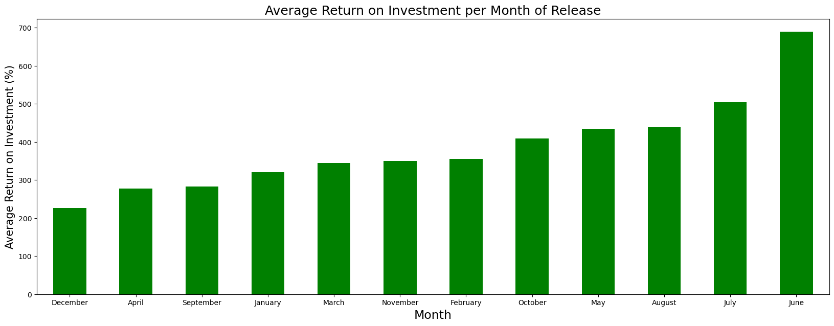
Return on Investment
Movies released in June had the highest return on investment.

Slide 5
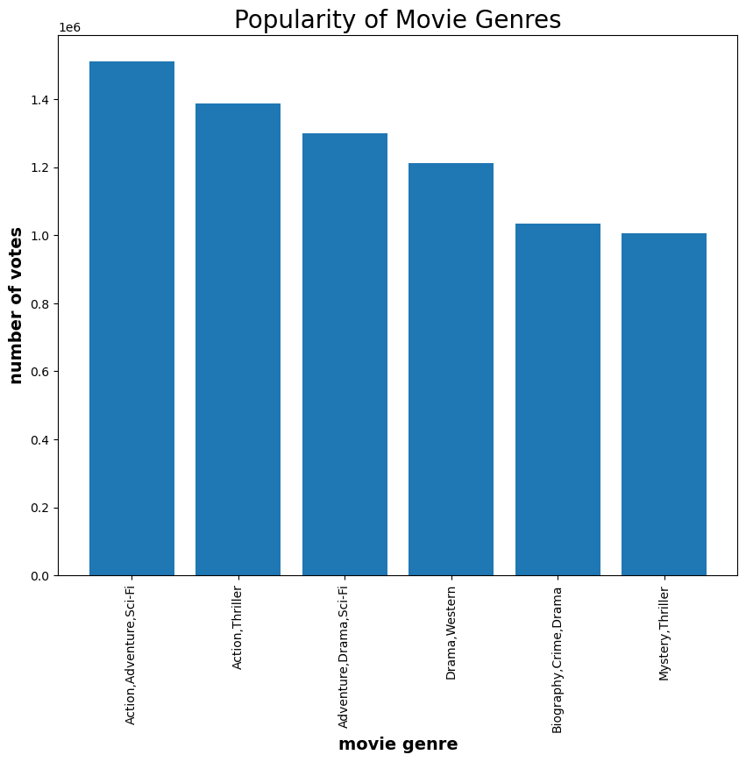
Popularity of Movie Genres
Movies with a combination of Action, Adventure and Sci-Fi genres are the most popular movies.

Slide 6
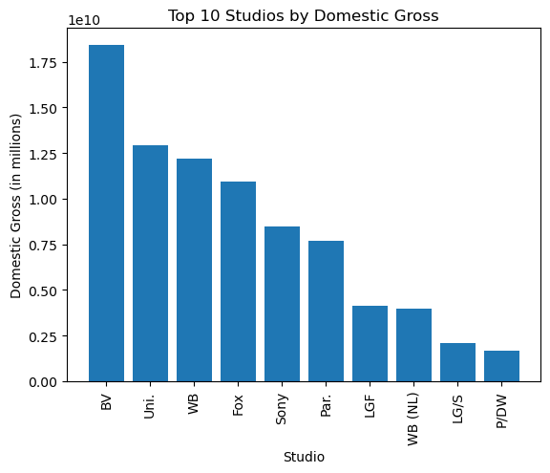
Top Studios by Gross Revenues
BV Studios had the highest revenues generated by movies produced.

Slide 7
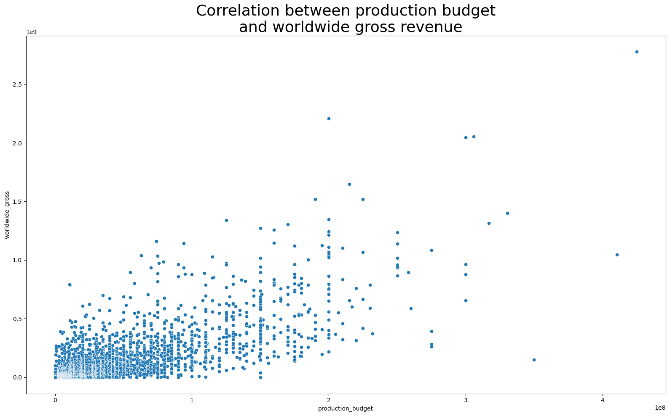
Relationship between Production Budget and Gross Revenue
A higher production budget results in higher worldwide gross revenue.

Slide 8
Recommendations
Movies with a combination of Action, Adventure and Sci-Fi genres were the most popular. Microsoft should consider producing a movie with this combination of genres.
Microsoft should release movies in June, to generate the highest return on investment.
BV Studios had the highest revenues generated by movies produced. Microsoft Studios should consider partnering with them.

Slide 9

THANK YOU
Samwel Kagwi
GitHub: https://github.com/S-Kagwi/dsc-phase-1-project-v2-4.git

