Slide 1
Decision Science: Policy Design and Clinical Decision-Making Through Health Economics
Satoshi Koiso
Medical Practice Evaluation Center
Massachusetts General Hospital
April 2025 Boston Japanese Researchers Forum

Slide 2
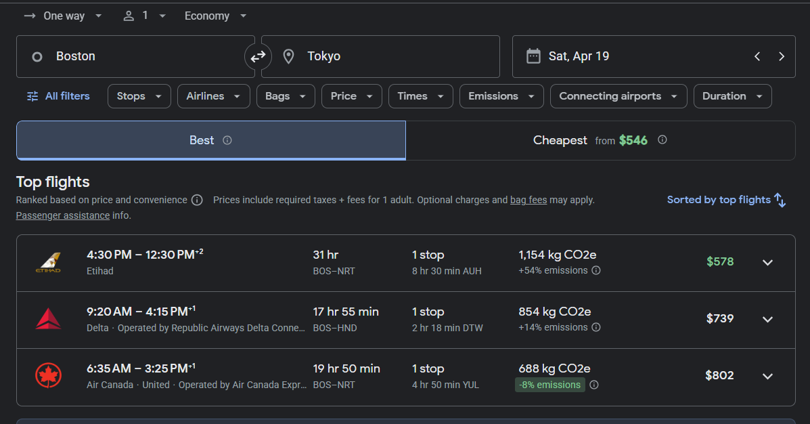
Preface
If you were to fly to Japan today, which flight would you choose?
Notes:
Google Flightで
おススメの便が３つ

Slide 3
Preface
What do you consider when choosing a flight?
Duration
Environmental impact
Departure time
Arrival time
Layover time
Cost
Brand
Destination
Notes:
色々と考慮できる要素があると思いますが、

Slide 4
What do we consider when making decisions?
We often consider benefits, downsides, and uncertainty unconsciously.
There is, in fact, an academic field that analyzes decision-making scientifically by explicitly accounting for these elements.
Expected benefits
convenience, comfort, in-flight services, etc.
Expected downsides
cost, travel time, number of layovers, etc.
Degree of uncertainty
delays, missed connections, cancellations, etc.
Notes:
無意識のうちに期待される
私自身こういった分野が存在することを現在の職場で働き始めてから、初めて知りました。

Slide 5
Purpose of This Talk
Introduce the basic concepts and framework of Decision Science.
Demonstrate how effects, costs, and uncertainty are incorporated into scientific decision analysis using concrete examples.
Provide participants with a perspective for structuring decisions in their own research and professional practice, leading to new insights and ideas.
Notes:
私個人の研究の話はあまりしない。

Slide 6
Agenda
1. What is Decision Science, and how do we analyze decisions?
2. Experiencing Decision Science in practice
3. Use cases of Decision Science
Notes:
１で定義や分析の流れ
２でもう少し具体的に実際に体験して
３は現実にどこで使われるか
ちなみに、

Slide 7
Agenda
1. What is Decision Science, and how do we analyze decisions?
2. Experiencing Decision Science in practice
3. Use cases of Decision Science

Slide 8
What Is Decision Science?
①Definition
②Practice
③Use cases
An interdisciplinary approach that integrates effects, costs, and uncertainty to support optimal decision-making.
Integrates methods from economics, statistics, psychology, and behavioral science.
Aims to identify optimal choices under limited resources and uncertainty.
Widely applied in healthcare, public policy, and business.
Enhances transparency and supports consensus-building in decision processes.

Slide 9
Analytical Process
①Definition
②Practice
③Use cases
I introduce an example using eight core steps.
(note: in practice, steps may not be strictly sequential)
Define the problem and objectives
1
Define outcomes
2
Select simulation model
3
Design simulation model
4
Select model inputs
5
Simulate multiple decision options
6
Sensitivity and scenario analyses
7
Evaluate results
8
Notes:
例は医療多め

Slide 10
Step① Defining the Problem and Objectives
①Definition
②Practice
③Use cases
Explicitly identify the value to be optimized when benefits and downsides are in tension.
Define the problem and objectives
Decision problems arise when trade-offs exist among options.
If one option clearly dominates in both benefits and downsides, analysis is unnecessary.
Clarify the objective
Maximize benefits?
Minimize downsides?
Maximize benefits relative to downsides?
1
Define outcomes
2
Select simulation model
3
Design simulation model
4
Select model inputs
5
Simulate multiple decision options
6
Sensitivity and scenario analyses
7
Evaluate results
8

Slide 11
Step① Defining the Problem and Objectives
①Definition
②Practice
③Use cases
Explicitly identify the value to be optimized when benefits and downsides are in tension.
Define the problem and objectives
Decision problems arise when trade-offs exist among options.
New drug (high efficacy, high cost) vs. existing drug (lower efficacy, lower cost)
Early cancer surgery (curative potential, high invasiveness) vs. watchful waiting
Additional pediatric vaccination (prevention, side effects) vs. no vaccination
Clarify the objective
Maximize benefits? - Extend life expectancy; improve quality of life (QoL)
Minimize downsides? - Reduce the number of infections; contain costs
Maximize benefits relative to downsides? - Achieve the greatest gain in life expectancy per dollar spent
1
Define outcomes
2
Select simulation model
3
Design simulation model
4
Select model inputs
5
Simulate multiple decision options
6
Sensitivity and scenario analyses
7
Evaluate results
8
Notes:
意思決定にかかわる問題と目的を設定します
意思決定にかかわる問題とは、複数の選択肢
意思決定した後にどうなりたいのか、目的

Slide 12
Step② Defining Outcomes
①Definition
②Practice
③Use cases
Define benefits (effects) and downsides (costs) according to the decision objective.
Define the problem and objectives
Quantifying effects
Binary outcomes: alive/dead, cured/not cured
Continuous outcomes: survival years, quality of life (QoL), satisfaction
Multidimensional outcomes: incorporating both quality and quantity
Quantifying costs
Perspective matters:
Decision-maker (e.g., provider, insurer)
Affected individuals (patients, families)
Society as a whole
Types of costs:
Direct: medical care, medications, transportation
Indirect: productivity loss, caregiving burden
Intangible: time, psychological burden, opportunity cost
1
Define outcomes
2
Select simulation model
3
Design simulation model
4
Select model inputs
5
Simulate multiple decision options
6
Sensitivity and scenario analyses
7
Evaluate results
8

Slide 13
Step② Defining Outcomes
①Definition
②Practice
③Use cases
In health economics, QALYs (Quality-Adjusted Life Years)—defined as QoL × survival years—are commonly used.
Define the problem and objectives
Multidimensional outcome measure: considering both “quality” and “quantity”
Quality (“utility”) = QoL
Measured on a scale from 0 = death to 1 = perfect health.
Not based on objective symptom severity, but on the individual’s subjective perception.
Utility is measured through questionnaires or experimental methods.
Quantity = survival years
Quality × Quantity = QALYs (Quality-Adjusted Life Years)
A numerical representation of how long and how well a person lives
1
Define outcomes
2
Select simulation model
3
Design simulation model
4
Select model inputs
5
Simulate multiple decision options
6
1
QoL
1×1yr＋0.8×2yrs＋0.5×2yrs
＝1＋1.6＋1
＝3.6QALYs
Sensitivity and scenario analyses
7
Evaluate results
8
Survival years
5

Slide 14
Step② Defining Outcomes
①Definition
②Practice
③Use cases
Define benefits (effects) and costs based on the decision objective. In health economics, effects are often measured using QALYs (QoL × survival years).
Define the problem and objectives
Outcome measures that consider both “quality” and “quantity”
Quality (“utility”) = QoL
Measured on a scale from 0 = death to 1 = perfect health.
Not based on objective symptom severity, but on the individual’s subjective perception.
Utility is measured through questionnaires or experimental methods.
Quantity = survival years
Quality × Quantity = QALYs (Quality-Adjusted Life Years)
A numerical representation of how long and how well a person lives
1
Define outcomes
2
Select simulation model
3
Design simulation model
4
Select model inputs
5
Simulate multiple decision options
6
1
QoL
1×1yr＋0.8×2yrs＋0.5×2yrs
＝1＋1.6＋1
＝3.6QALYs
Sensitivity and scenario analyses
7
Evaluate results
8
Survival years
5
Notes:
医療経済ではQALYs(質調整生存年)を効果としてよく使用

Slide 15
Step③ Selecting a Simulation Model
①Definition
②Practice
③Use cases
Choose the model that best fits the decision problem.
Define the problem and objectives
Model
Outline
Characteristics
1
Decision Tree Analysis(*)
Visualizes choices and outcomes as branches.
Limited ability to model time-varying events
Low
Define outcomes
2
Select simulation model
Markov model
Represents disease progression and state transitions over time.
Suitable for long-term processes; population level
3
Design simulation model
Complexity
4
Microsimulation
Predicts outcomes accounting for individual characteristics.
Individual level
Select model inputs
5
Simulate multiple decision options
Discrete Event
Simulation
Simulates the timing of individual events.
Focuses on process flows; individual level
6
Sensitivity and scenario analyses
7
Agent-based model
Simulates interactions among individuals following rules.
Individual level
Evaluate results
8
High
*:Different from machine-learning methods that identify predictors influencing the outcome variable.
Notes:
少し唐突に感じられるかもしれませんが、分析においてはシミュレーションモデルを作成することが頻繁にあります。
というのも、問題に直面している状況というのは、
複数の選択肢の全部を実際にやって確かめることができないから悩んでいる状況なので、

Slide 16
Step④ Designing the Simulation Model
①Definition
②Practice
③Use cases
Structure the overall problem you are facing.
Define the problem and objectives
Structure the problem:
Decision timing
Causal relationships
Temporal relationships
Results depend heavily on model design
Different decision-makers may conceptualize the same problem differently.
Align implicit knowledge between decision-makers and modelers.
1
Define outcomes
2
Select simulation model
3
Design simulation model
4
Select model inputs
5
Simulate multiple decision options
6
Sensitivity and scenario analyses
7
Evaluate results
8

Slide 17
Step③ Selecting a Simulation Model (Example)
①Definition
②Practice
③Use cases
In decision tree analysis:■ represents a decision;● represents a chance event;▲ represents an outcome.
Define the problem and objectives
Example: Diagnosis and Treatment of Severe Malaria
1
: Decision
: Chance event
: Outcomes
Define outcomes
2
Success
Recovery
Select simulation model
True positive→Treat
3
Failure
Test
Death
Design simulation model
4
Arrival
at hospital
Empirical
treatment
Success
Select model inputs
Recovery
5
Failure
Simulate multiple decision options
Death
6
False negative
No or unrelated treatment
Sensitivity and scenario analyses
Death
7
No or unrelated treatment
Evaluate results
Death
8

Slide 18
Step④ Designing the Simulation Model (Example)
①Definition
②Practice
③Use cases
The structure of a model may differ depending on the decision-maker.
Define the problem and objectives
Example: Diagnosis and Treatment of Severe Malaria
1
Define outcomes
2
Select simulation model
3
Design simulation model
4
Select model inputs
5
Simulate multiple decision options
6
Sensitivity and scenario analyses
7
“empirical treatment” could instead be “second diagnostic test”, depending on how the decision-maker frames the problem.
Evaluate results
8

Slide 19
Step③ Selecting a Simulation Model (Example)
①Definition
②Practice
③Use cases
In a Markov model, the modeled population transitions between health states over time according to state-specific transition probabilities.
Define the problem and objectives
Example: Syphilis disease progression (Lee et al. 2023)
1
: Progression
: With testing & treatment
Define outcomes
2
Early
neurosyphilis
Late
neurosyphilis
Select simulation model
3
Start
Design simulation model
4
Primary
Secondary
Early latent
Late latent
Untreated
tertiary
Select model inputs
5
Recovery
(w/o sequelae)
Recovery
(w sequelae)
Simulate multiple decision options
6
Sensitivity and scenario analyses
7
Death
Evaluate results
8
Lee K et al. Estimation of the Lifetime Quality-Adjusted Life Years (QALYs) Lost Due to Syphilis Acquired in the United States in 2018. CID. 2023;76(3):e810-e819. doi:10.1093/cid/ciac427
Notes:
梅毒は経過が長い病気。

Slide 20
Step④ Designing the Simulation Model (Example)
①Definition
②Practice
③Use cases
The structure of a model may differ depending on the decision-maker.
Define the problem and objectives
Example: Syphilis disease progression (Lee et al. 2023)
1
Define outcomes
2
Select simulation model
3
Design simulation model
4
Select model inputs
5
Simulate multiple decision options
6
Sensitivity and scenario analyses
7
These could potentially be combined
Evaluate results
8
Lee K et al. Estimation of the Lifetime Quality-Adjusted Life Years (QALYs) Lost Due to Syphilis Acquired in the United States in 2018. CID. 2023;76(3):e810-e819. doi:10.1093/cid/ciac427

Slide 21
Step⑤ Selecting Model Inputs
①Definition
②Practice
③Use cases
Identify numerical values for structured relationships and outcome measures from existing evidence.
Define the problem and objectives
Seek high-quality evidence, though not always be available
Uncertainty remains even with high-quality evidence.
e.g., 95% confidence intervals, interquartile ranges
Methods to address uncertainty are discussed later.
1
Hierarchy of evidence in evidence-based medicine
(Burns et al. 2011)
Define outcomes
2
RCT
Meta-analyses/
systematic reviews
Select simulation model
3
Design simulation model
4
Non-randomized comparative studies
Select model inputs
Cohort and case–control studies
5
Case reports
Simulate multiple decision options
6
Expert opinion / animal studies
Sensitivity and scenario analyses
7
Evaluate results
8
Burns PB et al. The levels of evidence and their role in evidence-based medicine. Plast Reconstr Surg. 2011;128(1):305-310. doi:10.1097/PRS.0b013e318219c171
Notes:
RCT：介入や治療の因果効果を最も信頼性高く評価するための実験的手法

Slide 22
Step⑤ Selecting Model Inputs (Example)
①Definition
②Practice
③Use cases
Identify numerical values for structured relationships and outcome measures from existing evidence.
Define the problem and objectives
Example: Syphilis disease progression (Lee et al. 2023)
1
Parameter | Value | [Confidence Interval]
Duration of primary stage (months) | 0.7 | [0.25-1.96]
Duration of secondary stage (months) | 3.6 | [2.16-5.99]
Monthly probability of recovery from neurosyphilis after treatment | 0.18 | [0.12–0.28]
Monthly probability of treatment failure | 0.05 | [0–0.1]
Utility decrement during primary stage | -.006 | [-.004– -.01]
…
etc
Define outcomes
2
Select simulation model
3
Design simulation model
4
Select model inputs
5
Simulate multiple decision options
6
Sensitivity and scenario analyses
7
Evaluate results
8
Lee K et al. Estimation of the Lifetime Quality-Adjusted Life Years (QALYs) Lost Due to Syphilis Acquired in the United States in 2018. CID. 2023;76(3):e810-e819. doi:10.1093/cid/ciac427

Slide 23
Step⑥ Simulating Multiple Decision Options
①Definition
②Practice
③Use cases
Simulate each decision option within the model.
Define the problem and objectives
Example: Syphilis disease progression (Lee et al. 2023)
1
Without testing or treatment
Define outcomes
2
Select simulation model
3
Design simulation model
4
Select model inputs
5
With testing and treatment
Simulate multiple decision options
6
Sensitivity and scenario analyses
7
Evaluate results
8
Lee K et al. Estimation of the Lifetime Quality-Adjusted Life Years (QALYs) Lost Due to Syphilis Acquired in the United States in 2018. CID. 2023;76(3):e810-e819. doi:10.1093/cid/ciac427

Slide 24
Step⑦ Sensitivity and Scenario Analyses
①Definition
②Practice
③Use cases
Accounting for multiple sources of uncertainty.
Define the problem and objectives
How do we handle uncertainty?
Stochastic uncertainty: Results are unknown until simulated.
Increase the number of simulated individuals or runs.
Model (structural) uncertainty: The correc.t model structure is unknown
Test multiple plausible model structures.
Parameter uncertainty: Input values are uncertain.
Vary parameters over plausible ranges and re-run the model.
1
Define outcomes
2
Select simulation model
3
Design simulation model
4
Select model inputs
5
Simulate multiple decision options
6
Sensitivity and scenario analyses
7
Evaluate results
8
Notes:
確率的不確実性：コイントスで実際にコインを投げないと表が出るか裏が出るかわからない
モデルの不確実性：マラリア患者で、偽陰性が出た場合に試験的治療をするのか、２回目の検査をするのか
パラメータの不確実性：各パラメータの値は一義的には決まらない。信頼区間

Slide 25
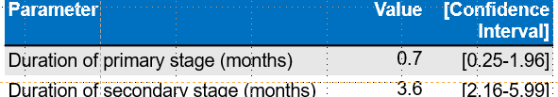
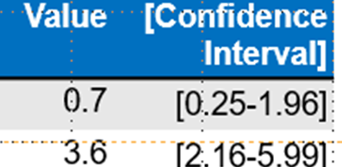
Step⑦ Sensitivity and Scenario Analyses (Example)
①Definition
②Practice
③Use cases
To address parameter uncertainty, two common approaches are used.
Define the problem and objectives
Approaches to handling parameter uncertainty
1
Define outcomes
2
Select simulation model
3
Design simulation model
4
Select model inputs
Test plausible boundary values
Sample from
probability distributions
5
Simulate multiple decision options
Prob.
6
Sensitivity and scenario analyses
7
0.25
0.7
1.96
Month
Evaluate results
8
Produces a range of outcomes
Generates an outcome
distribution across iterations

Slide 26
Step⑧ Evaluating Results
①Definition
②Practice
③Use cases
Evaluate the trade-offs between effects and costs across multiple decision options. In health economics, cost-effectiveness analysis is commonly used.
Define the problem and objectives
Methods for evaluating cost–effect trade-offs (WHO. 2003)
Cost-minimization analysis
Compare costs across options and select the least costly. Requires that outcomes be equivalent across options.
Cost-benefit analysis
Compare the difference between monetized benefits and costs. Select the option with the largest net benefit. Less commonly used due to the difficulty of monetizing health outcomes.
Cot-effectiveness analysis
Compare options based on the incremental cost per incremental unit of effect.
1
Define outcomes
2
Select simulation model
3
Design simulation model
4
Select model inputs
5
Simulate multiple decision options
6
Sensitivity and scenario analyses
7
Evaluate results
8
WHO. Introduction to Drug Utilization Research. 2003

Slide 27
Step⑧ Evaluating Results
①Definition
②Practice
③Use cases
In cost-effectiveness analysis, the preferred option is the one with the lowest incremental cost per additional unit of effect (ICER).
Define the problem and objectives
A lower increase in cost per increase in effect is preferable.
Incremental Cost-Effectiveness Ratio (ICER)
= the slope between two options when plotting costs and effects of the options
In Japan, an ICER of ≤ ¥5 million per QALY is often considered cost-effective.
1
Define outcomes
2
Select simulation model
3
OptionB
CostB ー CostA
Design simulation model
CostB
4
EffectB ー EffectA
Cost
OptionA
Select model inputs
CostA
5
Simulate multiple decision options
6
EffectA
EffectB
Sensitivity and scenario analyses
Effect (QALYs)
7
Evaluate results
8

Slide 28
Summary So Far
①Definition
②Practice
③Use cases
When multiple decision options exist, construct a structured model to represent the decision problem.
Simulate outcomes while accounting for uncertainty in key structural factors such as costs and effects.
Use the resulting cost–effect trade-offs to identify the option that best aligns with the decision objective.

Slide 29
Agenda
1. What is Decision Science, and how do we analyze decisions?
2. Experiencing Decision Science in practice
3. Use cases of Decision Science

Slide 30
Choosing a Flight Seat Class
①Definition
②Practice
③Use cases
Assume we select Delta for the previously discussed flight to Tokyo.

Slide 31
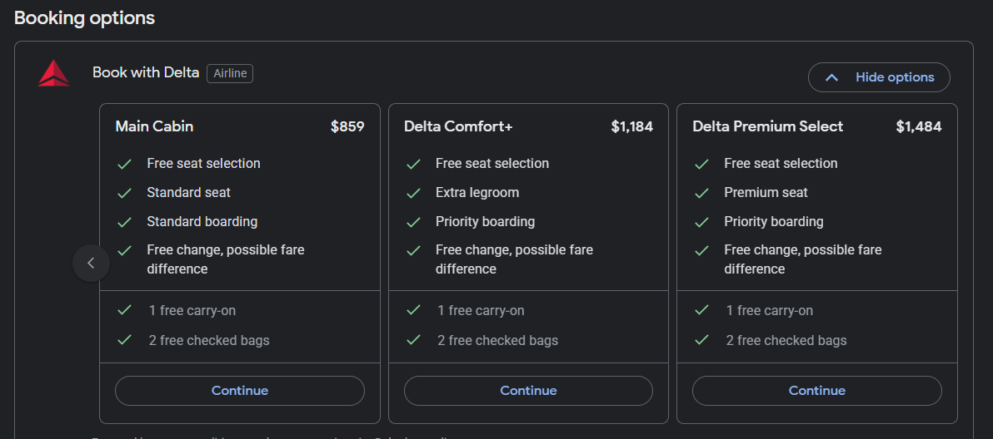
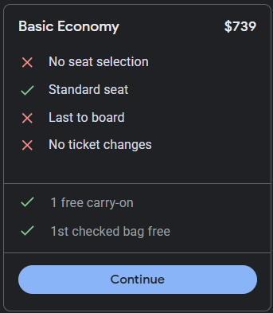
Choosing a Flight Seat Class
①Definition
②Practice
③Use cases
Selecting one option from three seat classes.

Slide 32
Choosing a Flight Seat Class
①Definition
②Practice
③Use cases
Assign simple labels for convenience.
Economy $750
Business $1200
First class $1500

Slide 33
Choosing a Flight Seat Class — Objective and Outcomes
①Definition
②Practice
③Use cases
Decision problem and objective
For an 18-hour Boston–Tokyo flight, choose the seat class—Economy, Business, or First—that provides the greatest comfort relative to cost.
Although Economy is usually chosen, any class is affordable within the budget for this scenario.
Outcomes
Effect: Comfort × Time → Quality-Adjusted Hours (QAH)
Comfort is defined on a scale from 0 = flight canceled to 1 = extremely comfortable (a premium travel experience)
Cost: Airfare
Willingness to pay
Willing to pay up to $120 per QAH(i.e., per hour of an “extremely comfortable” travel experience)
Notes:
QAHという指標は実在しない。今回限りの発明

Slide 34
Choosing a Flight Seat Class — Structuring the Decision Problem
①Definition
②Practice
③Use cases
: Decision
: Chance event
: Outcomes
Cost ($)
Comfort
Comfortable seat
1500
1
First class
Choose a seat
Comfortable seat
1200
1
Business
Standard seat
1200
0.8
Economy
Standard seat
750
0.8
Bad seat
750
?

Slide 35
Choosing a Flight Seat Class — Measuring Utility
①Definition
②Practice
③Use cases
Occasionally, when flying, you encounter a “bad seat.”
Seat monitor is broken (there may be workarounds)
Seat does not recline
No power outlet etc.
The comfort level of a “bad seat” is likely to influence the decision.
Let’s design an experiment to measure the utility (comfort) of a “bad seat.”

Slide 36







Measuring the Utility of a “Bad Seat”
①Definition
②Practice
③Use cases
You can choose “a lottery between First Class with probability P, or Not boarding the flight.” Raise your hand when you feel indifferent with varying P.
“Bad seat”
(Broken screen, Seat does not recline, No power outlet)
Lottery
No flight
First Class
…
…
100-P％
P％
I am indifferent between the bad seat and the lottery
Notes:
今からお話するのは想像上のシチュエーションです

Slide 37
Measuring the Utility of a “Bad Seat”
①Definition
②Practice
③Use cases
Please raise your hand when you feel indifferent with varying P.
“Bad seat”
(Broken screen, Seat does not recline, No power outlet)
Lottery
No flight
First Class
…
…
0％
100％
I am indifferent between the bad seat and the lottery

Slide 38
Measuring the Utility of a “Bad Seat”
①Definition
②Practice
③Use cases
Please raise your hand when you feel indifferent with varying P.
“Bad seat”
(Broken screen, Seat does not recline, No power outlet)
Lottery
No flight
First Class
…
…
10％
90％
I am indifferent between the bad seat and the lottery

Slide 39
Measuring the Utility of a “Bad Seat”
①Definition
②Practice
③Use cases
Please raise your hand when you feel indifferent with varying P.
“Bad seat”
(Broken screen, Seat does not recline, No power outlet)
Lottery
No flight
First Class
…
…
20％
80％
I am indifferent between the bad seat and the lottery

Slide 40
Measuring the Utility of a “Bad Seat”
①Definition
②Practice
③Use cases
Please raise your hand when you feel indifferent with varying P.
“Bad seat”
(Broken screen, Seat does not recline, No power outlet)
Lottery
No flight
First Class
…
…
30％
70％
I am indifferent between the bad seat and the lottery

Slide 41
Measuring the Utility of a “Bad Seat”
①Definition
②Practice
③Use cases
Please raise your hand when you feel indifferent with varying P.
“Bad seat”
(Broken screen, Seat does not recline, No power outlet)
Lottery
No flight
First Class
…
…
40％
60％
I am indifferent between the bad seat and the lottery

Slide 42
Measuring the Utility of a “Bad Seat”
①Definition
②Practice
③Use cases
Please raise your hand when you feel indifferent with varying P.
“Bad seat”
(Broken screen, Seat does not recline, No power outlet)
Lottery
No flight
First Class
…
…
50％
50％
I am indifferent between the bad seat and the lottery

Slide 43
Measuring the Utility of a “Bad Seat”
①Definition
②Practice
③Use cases
Please raise your hand when you feel indifferent with varying P.
“Bad seat”
(Broken screen, Seat does not recline, No power outlet)
Lottery
No flight
First Class
…
…
60％
40％
I am indifferent between the bad seat and the lottery

Slide 44
Measuring the Utility of a “Bad Seat”
①Definition
②Practice
③Use cases
Please raise your hand when you feel indifferent with varying P.
“Bad seat”
(Broken screen, Seat does not recline, No power outlet)
Lottery
No flight
First Class
…
…
70％
30％
I am indifferent between the bad seat and the lottery

Slide 45
Measuring the Utility of a “Bad Seat”
①Definition
②Practice
③Use cases
Please raise your hand when you feel indifferent with varying P.
“Bad seat”
(Broken screen, Seat does not recline, No power outlet)
Lottery
No flight
First Class
…
…
80％
20％
I am indifferent between the bad seat and the lottery

Slide 46
Measuring the Utility of a “Bad Seat”
①Definition
②Practice
③Use cases
Please raise your hand when you feel indifferent with varying P.
“Bad seat”
(Broken screen, Seat does not recline, No power outlet)
Lottery
No flight
First Class
…
…
90％
10％
I am indifferent between the bad seat and the lottery

Slide 47
Measuring the Utility of a “Bad Seat”
①Definition
②Practice
③Use cases
Please raise your hand when you feel indifferent with varying P.
“Bad seat”
(Broken screen, Seat does not recline, No power outlet)
Lottery
No flight
First Class
…
…
100％
0％
I am indifferent between the bad seat and the lottery

Slide 48
Measuring the Utility of a “Bad Seat”
①Definition
②Practice
③Use cases
When you are indifferent, the utility of the bad seat equals the expected utility of the lottery — this is the Standard Gamble method.
“Bad seat”
(Broken screen, Seat does not recline, No power outlet)
Lottery
No flight
First Class
…
…
100-P％
P％
Utility of a “Bad Seat” × 100%
0 × (100-P%)
1 × P%
=
＋
Notes:
医療の場合でも同じこと

Slide 49
Choosing a Flight Seat Class — Plugging in Model Inputs
①Definition
②Practice
③Use cases
Assume the following values have been obtained.
: Decision
: Chance event
: Outcomes
Cost ($)
Comfort
Comfortable seat
1500
1
First class
Choose a seat
80%
Business
Comfortable seat
1200
1
20%
Standard seat
1200
0.8
70%
Economy
Standard seat
750
0.8
30%
Bad seat
750
0.5

Slide 50
Choosing a Flight Seat Class — Running the Simulation
①Definition
②Practice
③Use cases
Estimating expected cost and expected comfort.
: Decision
: Chance event
: Outcomes
Cost ($)
Comfort
Expected cost ($)
Expected comfort
Comfortable
1500
1
1500
1
First class
Choose a seat
80%
Business
Comfortable
1200
1
960
0.8
20%
Standard
1200
0.8
240
0.16
70%
Economy
Standard
750
0.8
525
0.8
30%
Bad
750
0.5
225
0.15

Slide 51
Choosing a Flight Seat Class — Running the Simulation
①Definition
②Practice
③Use cases
Calculating QAH for each seat class from expected values.
Cost ($)
Comfort
Expected cost($)
Expected comfort
QAH
: Decision
: Chance event
: Outcomes
Comfortable
1500
1
1500
1
18
First class
18h
Choose a seat
80%
Business
Comfortable
1200
1
960
0.8
20%
1200
0.8
240
0.16
Standard
1200
0.96
17.28
70%
Economy
Standard
750
0.8
525
0.56
30%
750
0.5
225
0.15
Bad
750
0.71
12.78

Slide 52
Choosing a Flight Seat Class — Evaluating Results
①Definition
②Practice
③Use cases
If you are willing to pay $120 per QAH, it is reasonable to upgrade from Economy to Business.
Seat class | Cost ($) | QAH | ICER ($/QAH)
Economy | 750 | 12.78 | -
Business | 1200 | 17.28 | 100
First Class | 1500 | 18.00 | 144

Slide 53
Choosing a Flight Seat Class — Sensitivity Analysis①
①Definition
②Practice
③Use cases
Does the most cost-effective seat class change depending on the comfort level of a “bad seat” and the cost of Business Class?
$1000~2000
0.3~1

Slide 54
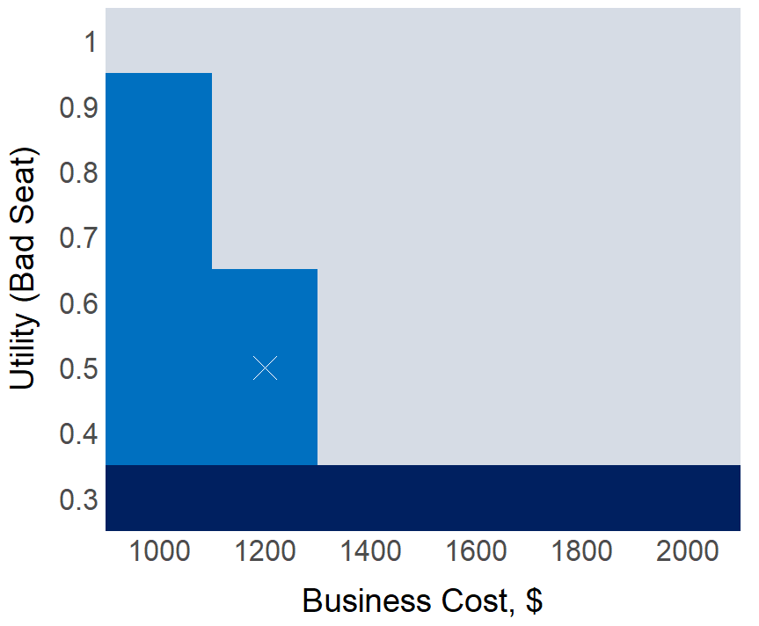
Choosing a Flight Seat Class — Sensitivity Analysis①
①Definition
②Practice
③Use cases
The most cost-effective seat class depends on the comfort level of a “bad seat” and the cost of Business Class.
: Economy
: Business
: First Class
When the comfort of a “bad seat” is low
Choose First Class, regardless of the cost of Business Class.
When the comfort of a “bad seat” is not too low and Business Class is inexpensive
Choose Business Class.
Otherwise
Choose Economy Class.
Comfort level of a “bad seat”
Cost of Business Class ($)
Notes:
このグラフの見方

Slide 55
Choosing a Flight Seat Class — Sensitivity Analysis②
①Definition
②Practice
③Use cases
The most cost-effective seat class depends on the probabilities of getting a “comfortable seat” or a “standard seat” in Economy and Business Class; run 1,000 simulations by sampling from probability distributions.
70%~100%
50%~100%
0%~30%
0%~50%

Slide 56
Choosing a Flight Seat Class — Sensitivity Analysis②
①Definition
②Practice
③Use cases
If the probabilities of getting a comfortable seat or a standard seat in Economy and Business Class are distributed as follows, then Business Class is the most cost-effective choice in about 70% of cases.
Parameters | Values
Probability of a comfortable seat in Business Class | 70~100%
Probability of a comfortable seat in Economy Class | 50~100%
Seat Class | Probability of Being Most Cost-Effective
Economy | 27%
Business | 71%
First Class | 2%

Slide 57
Agenda
1. What is Decision Science, and how do we analyze decisions?
2. Experiencing Decision Science in practice
3. Use cases of Decision Science
Notes:
では、この意思決定科学が世の中でどう使われているか３つの分野におけるユースケースをお話します

Slide 58
Use Cases in Healthcare
①Definition
②Practice
③Use cases
Examples that contributed to the development and updating of national screening and treatment guidelines.
Age-specific colorectal cancer screening guidelines (U.S. Preventive Services Task Force, 2021)
U.S. Preventive Services Task Force (USPSTF)
An independent expert panel that issues evidence-based recommendations on screening and preventive interventions in primary care
In updating colorectal cancer screening guidelines, simulation modeling was used to evaluate life-years gained, number of preventable colorectal cancer cases, and colorectal cancer deaths averted across multiple choices of screening start ages and screening modalities.
The work was commissioned to CISNET (Cancer Intervention and Surveillance Modeling Network)—a consortium of decision scientists, epidemiologists, and health economists from the U.S., Europe, and Australia.
Age-specific screening guidelines were developed by integrating simulation results with evidence from systematic reviews.
US Preventive Services Task Force. Screening for Colorectal Cancer: US Preventive Services Task Force Recommendation Statement. JAMA. 2021;325(19):1965–1977. doi:10.1001/jama.2021.6238
Notes:
医療におけるユースケースです。
個別具体の治療や病気に使えるというのはお分かりいただけたと思いますが、

Slide 59
Use Cases in Healthcare
①Definition
②Practice
③Use cases
Examples that contributed to the development and updating of national screening and treatment guidelines.
COVID-19 booster vaccination guidelines (Roper et al., 2024)
Advisory Committee on Immunization Practices (ACIP)
A committee within the CDC that provides recommendations on vaccine use for the U.S. population
Conducted analyses to identify recommended target groups for booster vaccination in the 2024–2025 season.
In collaboration with the University of Michigan, simulation-based cost-effectiveness analyses were performed comparing two booster doses, one booster dose, no booster, evaluating clinical outcomes (number of infections, hospitalizations, deaths, and adverse events) and costs.
Recommendations for booster vaccination in older adults for 2024–2025 were informed by analyses of vaccine effectiveness using data from hospitals nationwide and the Medicare database, and Safety analyses based on systematic literature reviews.
Roper LE, Godfrey M, Link-Gelles R, et al. Use of Additional Doses of 2024–2025 COVID-19 Vaccine for Adults Aged ≥65 Years and Persons Aged ≥6 Months with Moderate or Severe Immunocompromise: Recommendations of the Advisory Committee on Immunization Practices—United States, 2024. MMWR Morb Mortal Wkly Rep 2024;73:1118–1123. DOI: http://dx.doi.org/10.15585/mmwr.mm7349a2
Notes:
ACIPの助言が正式に採用されると、CDCやHHSの正式なワクチンのレコメンデーションになります。

Slide 60

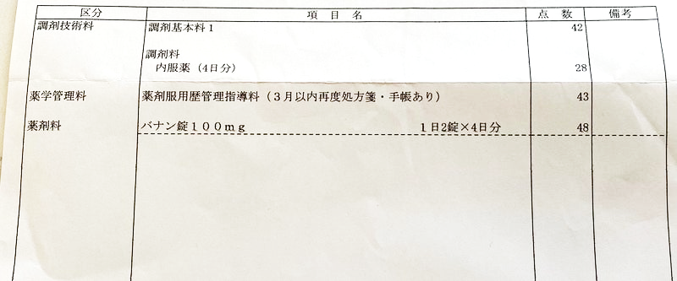



Use Case in Health Insurance Systems
①Definition
②Practice
③Use cases
In Japan, prices of prescription drugs covered by public health insurance are set by the Ministry of Health, Labour and Welfare (MHLW) and are regularly revised.
List of drugs listed in the official drug price schedule
Example of a dispensing statement
アメブロ：処方箋の薬、同じ薬でもコストコの調剤薬局が激安 | 栄養士ママそっち～の簡単美味しいサイクル献立 https://ameblo.jp/socchidiary/entry-12687858014.html
Notes:
日本との関係、また意思決定科学が歴史的に使われてきた分野として

Slide 61
Use Case in Health Insurance Systems
①Definition
②Practice
③Use cases
Since FY2019, cost-effectiveness analysis has been used to adjust prices after insurance listing for selected pharmaceuticals and medical devices.
Process (based on MHLW 2024)
Key Points
Insurance listing of pharmaceuticals & medical devices
Introduced in FY2019 in response to rising healthcare costs due to population aging.
Applied only to products with large market size or very high unit prices.
Company analyses are reviewed and re-analyzed by C2H with independent experts.
After comprehensive assessment, products with poor cost-effectiveness (≥ ¥5 million/QALY) may face price cuts; products contributing to cost savings may receive price increases.
Challenge: Limited evaluation capacity—currently about ~10 products per year; workforce development is needed.
Chuikyo selects products for cost-effectiveness analysis
Manufacturer-led analysis
Independent re-analysis by C2H with health economists and clinical experts
Comprehensive assessment
Post–price-setting price adjustment
Chuikyo: The Central Social Insurance Medical Council
C2H: Center for Health Economics Research, National Institute of Public Health
Overview of the FY2024 Medical Fee Revision: “Cost-Effectiveness Evaluation System” Health Insurance Bureau, Medical Affairs Division, MHLW; C2H
Notes:
中央社会保険医療協議会とは、健康保険制度や診療報酬の改定などについて審議する厚労省の諮問機関

Slide 62


Use Case in Research
①Definition
②Practice
③Use cases
Researchers and funders face limited budgets, making it possible to plan additional studies with high cost-effectiveness.
For a given disease, existing studies show no significant difference between Treatment A and Treatment B. Should we conduct an interventional study comparing A vs. B, or an observational study?

Slide 63
Use Case in Research
①Definition
②Practice
③Use cases
For decision problems faced by researchers and research funders, a model is built using existing evidence to estimate the value of eliminating uncertainty in key parameters.
For a given disease, existing studies show no significant difference between Treatment A and Treatment B. Should we conduct an interventional study comparing A vs. B, or an observational study?
Existing data
Prob.
Effectiveness w/ 95%CI
Treatment costs
Health benefits of treatment
Acceptable budget for additional research, etc.
0.5
1
1.5
Effectiveness of
A relative to B
Build a model and run probabilistic simulations
We can estimate the expected value when unlimited information is available and effectiveness is known with certainty (zero uncertainty)—which serves as a criterion for whether additional research is worth conducting.
Notes:
問の対象になっているパラメータというのは

Slide 64
Use Case in Research
①Definition
②Practice
③Use cases
We can estimate the sample size that maximizes the value of information from additional research.
When further research is potentially valuable, a key question is: How large a sample is needed, given that a census is impossible?
Test different sample sizes in the model
expected incremental value
Conduct additional research if (sample size × expected value per sample) > cost of conducting the study
10
100
1,000
additional sample size
Estimate the expected value of information for a given sample size.
Notes:
一サンプルあたりの追加期待価値

Slide 65
Use Case in Research
①Definition
②Practice
③Use cases
From pilot study data, we can estimate the value of information gained from conducting further research.
We’ve collected data from 100 participants for now, but should we continue the study?
Re-run the model using new data with slightly reduced uncertainty.
New collected data
Newly collected data
Prob.
0.5
1
1.5
Effectiveness of
A relative to B
We can estimate the expected value of additional information from further research.
Value of Information
analysis
(VOI)

Slide 66
Use Case in Research
①Definition
②Practice
③Use cases
An example of Value of Information (VOI) analysis conducted by the UK National Health Service (NHS)
RCT comparing wound dressings to prevent postoperative infection (Reeves et al., 2019)
Question: Should a large RCT be conducted to compare simple dressing, adhesive medical dressing, or no dressing for preventing postoperative infections?
Phase A: Model-based analysis using meta-analysis
Built a model using infection-reduction effects, dressing costs, infection costs, and utilities.
Results suggested adhesive dressing or no dressing was most cost-effective. Eliminating uncertainty in infection-reduction effects yields an expected value of £222 per wound (≈ £2.3 billion population value).
Phase B: Pilot RCT (~400 patients)Updated the model with trial data.
Adhesive dressing had the highest probability of being cost-effective.
Eliminating remaining uncertainty yields £177 per wound (≈ £1.8 billion population value).
Reeves BC, Rooshenas L, Macefield RC, et al. Three wound-dressing strategies to reduce surgical site infection after abdominal surgery: the Bluebelle feasibility study and pilot RCT. Health Technol Assess. 2019;23(39):1-166. doi:10.3310/hta23390

Slide 67
Challenges
Decision science is a support tool, not a substitute for decision-making
Results depend on model assumptions and scope
Choices of assumptions, scope, and parameters can substantially change results.
Conclusions should be read as conditional (“cost-effective under assumptions X and Y”), not absolute.
Comparing analyses with slightly different assumptions helps assess robustness.
Utility is subjective and heterogeneous
The same health state may be valued very differently across individuals.
Utility estimates reflect personal values and experiences and are inherently subjective.
Published average utilities are decision aids, not replacements for real-world decisions.
Notes:
そろそろまとめ

Slide 68
Challenges
Decision science is a support tool, not a substitute for decision-making.
Fundamental limitations in measuring utility
Utility is typically defined on a continuous scale from 0 to 1.
Once utility reaches 0 (death), improvement beyond that point is not realistically observable.
Individuals who experience utility = 0 cannot participate in utility elicitation, creating a structural limitation in measurement.
Limits to expanding the application of cost-effectiveness analysis
Healthcare (Japan)
Currently used mainly for drug and medical device price adjustments; extending it to clinical practice is difficult under the existing system.
Although cost-effectiveness analysis could theoretically justify price increases, in practice it tends to exert stronger downward pressure on prices.
Many Japanese hospitals already face financial strain; applying cost-effectiveness analysis alone risks further undermining hospital management. Complementary institutional reforms and support measures are essential to improve hospital sustainability.

Slide 69
Challenges
Decision science is a support tool, not a substitute for decision-making.
Limits to expanding the application of cost-effectiveness analysis
Research
In basic research or early drug development, long time lags and high uncertainty reduce the usefulness of value-of-information analyses.
Some research should not be judged solely on economic efficiency (e.g., rare diseases with small populations).
Research aimed at fundamental scientific advancement may be worth pursuing even without immediate economic justification.

Slide 70
Summary
Decision science is an interdisciplinary approach that quantitatively integrates effectiveness, costs, and uncertainty to guide optimal choices.
In healthcare, it supports policy decisions such as screening guidelines and drug price revisions.
Results do not provide a single “correct” answer; rather, they clarify which options are rational under which conditions, serving as a tool to facilitate dialogue and consensus-building in decision-making.

Slide 71
Thank you for your attention
Notes:
本講演の練習に付き合ってくださった方に、この場を借りてお礼を申し上げたいと思います。
今後もこの分野で研究を続けていくので、ご関心やご相談がありましたら、
お気軽にご連絡いただけますと幸いです。

