Slide 1
Japan’s Health
Insurance System and Reimbursement for AI Medical Devices
Satoshi Koiso
PhD student in Health Economics and Outcome Research
CHOICE Institute, University of Washington
April 29, 2026, CHOICE Graduate Seminar

Slide 2
Key questions for this talk
Is Japan’s current cost-sharing model reaching its limit?
Can the current pricing scheme capture the value of innovation?
Can the current regulatory and pricing evolution balance technological innovation with the long-term sustainability of the healthcare system?
Notes:
I should note that this is not a research talk.
Instead, my goal today is to pose three critical questions that I believe we must address to navigate the future of Japan's healthcare system.
First, Is Japan's current cost-sharing model reaching its limit? We have universal health coverage, but as I will show, there are significant structural challenges beneath the surface.
Second, Can the current pricing scheme truly capture the value of innovation? Reimbursement listing evaluates medical technologies through a limited set of methods, which creates problems in practice.
Third, Can the current regulatory and pricing evolution balance technological innovation with the long-term sustainability of the healthcare system? The government is developing new frameworks to facilitate innovation — but are they sufficient? I will explore this through a few examples.

Slide 3
Agenda
1. Overview of Japan’s Public Health Insurance System
2. Medical Regulatory Approval and Reimbursement
3. Approval and Reimbursement for AI Medical Devices
Notes:
First, I will introduce the public health insurance system and the mechanism that supports the whole population in Japan, with Japan's unique societal challenges.
Then I will dive into the regulatory approval and reimbursement process in Japan.
And finally, I will explain how AI medical devices fit into — and are changing — the existing approval and reimbursement scheme.

Slide 4
Agenda
1. Overview of Japan’s Public Health Insurance System
2. Medical Regulatory Approval and Reimbursement
3. Approval and Reimbursement for AI Medical Devices

Slide 5
Universal health coverage and demographic challenges
①Insurance
②Regulation
③AI
While supportive public health insurance system is available in Japan, its sustainability and robustness are under increasing strain
Nearly 100% of the population is covered by public health insurance
Demographic changes posing big concerns about sustainability
Aging (approx. 30% over 65 yo)¹
Declining birth rate (1.15–1.2 child births per woman lifetime)²
Regional disparities in healthcare providers and age distribution
1: Annual Report on the Ageing Society FY2025. Cabinet Office Japan. 2025. https://www8.cao.go.jp/kourei/english/annualreport/2025/pdf/2025.pdf
2: Annual Health, Labour and Welfare Report 2025. Ministry of Health, Labour and Welfare https://www.mhlw.go.jp/wp/hakusyo/kousei/25-2/index_en.html
Notes:
In Japan, nearly 100% of the population is covered by public health insurance — people are protected and supported.
However, demographic changes are posing big concerns about its sustainability.
The first issue is aging — approximately 30% of the population is over 65 years old.
We also have a declining birth rate: on average, one woman gives birth to about 1.2 children in their lifetime.
I should note that 2.1 is needed to maintain a stable population.
Finally, there are regional disparities in health care providers and age distribution across the country.

Slide 6




Japan's healthcare system
Medical care/treatment & Charge
Out-of-Pocket payment
Patient
Healthcare Provider
Premium
Claim
Claim payment
Budget
Government
Insurer
Notes:
This diagram explains the structure of Japan's healthcare system.
Patients pay premiums to their insurer.
When they need care, they visit a healthcare provider. The healthcare provider delivers medical treatment and charges the patient, who pays an out-of-pocket fee.
The healthcare provider then submits a claim to the insurer, and the insurer makes a claim payment back to the provider.
The insurer is also supported by a government budget.

Slide 7
Japan's healthcare system
Medical care/treatment & Charge
Out-of-Pocket payment
Patient
Healthcare Provider
Premium
Claim
Claim payment
Budget
Government
Insurer
Notes:
Health expenditure

Slide 8
Rising health expenditure due to aging
①Insurance
②Regulation
③AI
Health expenditure has been rising by 2-3% every year. The growth rate for ≧75 yo is larger than the overall growth rate
In 2023
Overall: 48 trillion JPY ($302 billion)
≧75 yo: 18.6 trillion JPY ($117 billion; 40%)
8.1% of GDP
Annual Health, Labour and Welfare Report 2025. Ministry of Health, Labour and Welfare https://www.mhlw.go.jp/wp/hakusyo/kousei/25-2/index_en.html
Notes:
As you can see from this chart, national health expenditure has been rising by 2 to 3% every year.
The growth rate for those aged 75 and over — shown in dark purple — is larger than the overall growth rate.
In 2023, Japan spent 48 trillion yen in total for health expenditure, which is 300 billion US dollars.
Of that, 18.6 trillion yen — or about 117 billion dollars — was spent on people aged 75 and over, accounting for 40% of the total.
Overall, health expenditure represents 8.1% of Japan's GDP.

Slide 9
Japan's healthcare system
Medical care/treatment & Charge
Out-of-Pocket payment
Patient
Healthcare Provider
Premium
Claim
Claim payment
Budget
Government
Insurer

Slide 10
Different coinsurance by age and income level
①Insurance
②Regulation
③AI
To support vulnerable populations with lower income and higher healthcare needs, coinsurance differ by age and income
≧ 2M JPY
≧ 3.8M JPY
10%
20%
30%
75
20%
70
Retirement
30%
60
Age
6
20%
Annual income
Annual Health, Labour and Welfare Report 2025. Ministry of Health, Labour and Welfare https://www.mhlw.go.jp/wp/hakusyo/kousei/25-2/index_en.html
Notes:
To support vulnerable populations with lower income and higher healthcare needs, the coinsurance — that is, the share patients pay out of pocket — differs by age and income.
For children up to age 6, the share is 20%.
From age 6 through 70, people pay 30%.
Retirement is typically between 60 and 70. This can be a burden, since many people in their 60s no longer have a stable income.
After age 70, the share drops to 20%,
For those 75 and older with lower incomes, it drops further to 10%.
However, for those who earn certain amount — those making 2 million yen or more per year — pay 20%, and those earning 3.8 million yen or more pay 30% regardless of age.

Slide 11
Japan's healthcare system
Medical care/treatment & Charge
Out-of-Pocket payment
Patient
Healthcare Provider
Premium
Claim
Claim payment
Budget
Government
Insurer
Notes:
How much do people actually pay in premiums?

Slide 12
Different insurance provider by age and occupation
①Insurance
②Regulation
③AI
To accommodate different work styles and health risks, 3,000+ health insurers serve the population under 5 sub-systems
Healthcare system for ≧75 yo
75
70
National Health Insurance
Retirement
60
Health Insurance Society
Japan Health Insurance Association
Mutual Aid Association
Age
Farmers, self-employed, unemployed
Run by municipalities
Premium rates depend on income
Employees for large enterprises
Premium rates: 10% of income (half-covered by employer)
Employees for small and medium enterprises
Premium rates: varies (half-covered by employer)
Government employees and teachers
Premium rates: 1.6% of income
6
Occupation
Annual Health, Labour and Welfare Report 2025. Ministry of Health, Labour and Welfare https://www.mhlw.go.jp/wp/hakusyo/kousei/25-2/index_en.html
Notes:
The answer is — it depends, because there are different insurance providers by age and occupation.
To accommodate different work styles and health risks, there are in fact over 3,000 health insurers, organized under five sub-systems.
To be honest — this is very complex, due to confusing nomenclature, even for me. But let me walk you through it.
Those aged 75 and over are covered by a dedicated system called the Healthcare System for 75 and older.
For those under 75, there are four sub-systems.
The first is National Health Insurance — despite the name, this covers only farmers, the self-employed, and the unemployed. It is run by municipal governments, and premium rates depend on income. This is also why, after retirement, more and more people gradually move into this category.
For those who are employed, there are three further sub-systems.
Large enterprise employees are covered by a Health Insurance Society, with premiums typically set at 10% of income, half of which is covered by the employer.
Employees of small and medium enterprises are covered by the Japan Health Insurance Association, with different rates — again, half covered by the employer.
Finally, government employees and teachers are covered by the Mutual Aid Association, at a much lower rate of just 1.6% of income.
As you can see, this system is highly fragmented, with similar hard-to-differentiate system names.
This structure raises a question:
how can we adequately support the elderly? The National Health Insurance and the Healthcare System for 75 and older are both run by governments, without employer contributions. And some municipal governments — particularly in rural areas with large elderly populations — do not collect sufficient tax revenue to fund the system.

Slide 13
Reallocation of budgets
①Insurance
②Regulation
③AI
To fill the gap between budget and expenditure for vulnerable population, budgets are reallocated from employment-based insurance to the others
18.4 trillion JPY
Healthcare system for ≧75 yo
75
1.5 trillion JPY
5.8 trillion JPY
70
National Health Insurance
Retirement
60
Health Insurance Society
Japan Health Insurance Association
Mutual Aid Association
8.7 trillion JPY
Age
2.7 trillion JPY
12.4 trillion JPY
6
Occupation
Ministry of Health, Labour and Welfare https://www.mhlw.go.jp/stf/seisakunitsuite/bunya/kenkou_iryou/iryouhoken/iryouhoken01/index.html
Notes:
To fill the gap between budget and expenditure for vulnerable populations, budgets are reallocated from employment-based insurance to the other two sub-systems.
As I explained, Healthcare System for those 75 and older requires 40% of the national health budgets.
To cover this, 1.5 trillion yen flows in from National Health Insurance, and 5.8 trillion yen is from the employment-based systems.
Similarly, National Health Insurance receives 2.7 trillion yen.
Personally, I find this fragmented system quite inefficient. Every budget transfer requires coordination and administrative resources across multiple organizations. I suspect the legacy structure is simply too entrenched to consolidate into a single unified system.
At the same time, health expenditure is also influenced by the unit cost of healthcare — and that brings us to our next topic.

Slide 14
Agenda
1. Overview of Japan’s Public Health Insurance System
2. Medical Regulatory Approval and Reimbursement
3. Approval and Reimbursement for AI Medical Devices

Slide 15
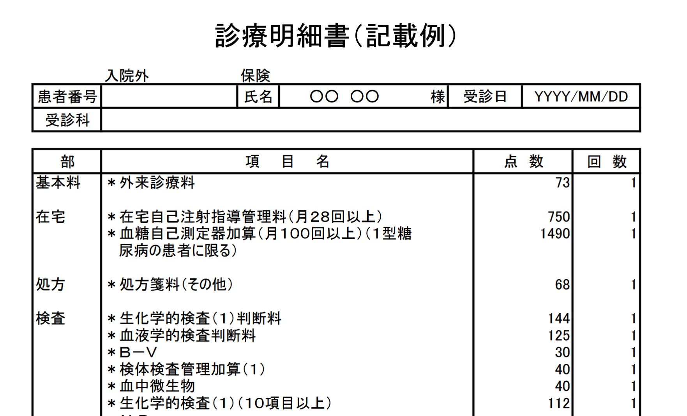
Nationwide standardized points
①Insurance
②Regulation
③AI
Medical services covered by public health insurance are charged by points, determined by fee schedules
Points
Assigned to all medical services, drugs, and technologies covered by insurance
Standardized nationwide
Patients pay…
Points x time x 10 x
coinsurance (%) JPY
Medical Bill Statement (example)
Outpatient
ID
Name
Date
Fee
Medical Services
Points
Time
Basic fees
Outpatient consultation fee
Home care
Self-injection guidance and management fee
Additional charge for self-monitoring of blood glucose device
Prescription
Prescription fee
Lab tests
Biochemical test (I) interpretation fee
Hematological test interpretation fee
Laboratory test management surcharge
Blood microorganisms
Biochemical test (I)
Ministry of Health, Labour and Welfare https://www.mhlw.go.jp/file/06-Seisakujouhou-12400000-Hokenkyoku/0000203025.pdf
Notes:
So how is treatment actually charged?
Medical services covered by public health insurance are charged by points, determined by fee schedules.
When you visit a doctor, you receive a medical bill statement like this one.
For each medical service used during your visit, points are assigned.
These points are standardized nationwide — so you pay the same amount no matter where you seek care.
The amount a patient pays is calculated as:
points, multiplied by the number of times the service was used, multiplied by 10, multiplied by their coinsurance share.

Slide 16

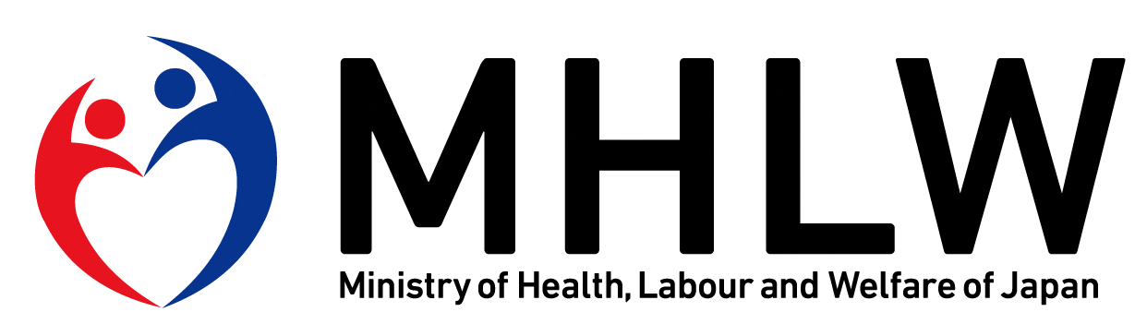
Regulatory approval and listing for reimbursement
①Insurance
②Regulation
③AI
Medical services, pharmaceuticals, and medical technologies must be approved and listed in fee schedule to be covered by health insurance
Regulatory approval
Reimbursement listing by CSIMC
(Central Social Insurance Medical Council)
Discovery research
Similar product available
No similar product
Novelty
No novelty
Preclinical trials
Efficacy comparison
method (I)
Efficacy comparison
method (II)
Cost-based method
Clinical trials (Phase I, II, III)
Match daily price of the most similar existing product
Match the lowest price of similar existing product
Sum manufacturing costs, operational profit, etc.
Regulatory filing to PMDA
Regulatory review by PMDA
Add-on based on innovation, marketability, etc
Add-on based on innovation, marketability, etc
Regulatory approval by MHLW
Foreign Price Adjustment
Pharmaceuticals and Medical Devices Agency (PMDA) https://www.pmda.go.jp/files/000263354.pdf
Central Social Insurance Medical Council https://www.mhlw.go.jp/content/10808000/001508748.pdf
Notes:
To obtain points, medical services, pharmaceuticals, and medical technologies must first be approved and then listed in the fee schedule to be covered by health insurance.
On the left, you can see the regulatory approval process — similar to the FDA process in the United States.
It starts with discovery research, moves through preclinical and clinical trials across three phases, then involves filing to the PMDA — Japan's equivalent of the FDA — followed by regulatory review, and finally approval by the Ministry of Health — similar to HHS in the US.
After approval, the product enters the reimbursement listing process, overseen by the Central Social Insurance Medical Council, or CSIMC.
If a similar drug or device already exists on the market, CSIMC determines whether the new product has novelty or innovation.
If it does, the Efficacy Comparison Method I is applied — matching the daily price of the most similar existing product and adding a premium based on innovation and marketability.
If there is no novelty, Efficacy Comparison Method II is used — matching the lowest price among similar existing products.
If no similar product exists at all, a cost-based method is applied, summing manufacturing costs, operational profit, and similar factors, again with an add-on for innovation.
Finally, prices are adjusted by reference to prices in other countries, including the US, France, and the UK.
Personally, I have some reservations about the efficacy comparison method.
It assumes that the price of the comparator product is itself appropriate.
But that raises a question: how was the comparator's value determined in the first place?
The reimbursement price of a new product may be heavily dependent on whether the baseline comparator was fairly priced to begin with.

Slide 17
Fee schedule revision
①Insurance
②Regulation
③AI
Medical fee schedule is revised every other year considering the overall national budget and basic policy.
Fee revision process
Social Security Council
(Health Insurance WG/Medical WG)
FY 2026 revision
Service fee: +3.3% driven by rising wage pressures
Pharmaceutical: -0.86%
Medical device: -0.01%
Decide revision rate based on healthcare budget
Decide fundamental policy for revision
CSIMC (Central Social Insurance Medical Council)
Decide updated points for each medical fee item
Ministry of Health, Labour and Welfare https://www.mhlw.go.jp/content/12401000/001137908.pdf
Notes:
The medical fee schedule is revised every other year, taking into account the overall national budget and basic policy.
The process works as follows:
the Cabinet Office decides the revision rate based on the healthcare budget.
Simultaneously, the Social Security Council within MHLW decides the fundamental policy for revision — for example, whether to increase points for innovative technologies.
Then CSIMC decides the updated points for each individual medical fee item.
In fact, this fiscal year — FY2026 — we just had a revision this month.
The service fee was increased by 3.3%, driven by rising wage pressures.
However, pharmaceutical and medical device points were reduced — by 0.86% and 0.01% respectively.
This is a typical trend: the overall pharmaceutical and medical device reimbursement points have been gradually declining over time.

Slide 18
Role of Health Technology Assessment
①Insurance
②Regulation
③AI
CEA was introduced in 2019 only for fee schedule revision of drugs and devices with large market sizes or high unit prices
Process
Key Points
Reimbursement listing of drugs & medical devices
Introduced in FY2019 due to rising healthcare costs
Applied only to products with large market size or very high unit prices
Manufacturer analyses are reviewed and re-analyzed by C2H (Center for Outcomes Research and Economic Evaluation for Health) with domain experts
After comprehensive assessment, products with poor cost-effectiveness (≥ 5M JPY/QALY≒ $32K) may face price cuts; products contributing to cost savings may receive price increases
Challenge: Limited evaluation capacity—currently about 10 products per year; workforce development is needed.
CSIMC selects products for CEA
Manufacturer-led analysis
Re-analysis by C2H with health economists and clinical experts
Comprehensive assessment
Post–price-setting price adjustment
Ministry of Health, Labour and Welfare https://www.mhlw.go.jp/content/12400000/001666329.pdf
Notes:
Where does Health Technology Assessment and cost-effectiveness analysis fit in?
CEA was just recently introduced in 2019 — not at the initial reimbursement listing stage, but only for the fee schedule revision of drugs and devices with large market sizes or very high unit prices.
The process works as follows:
after reimbursement listing, CSIMC selects products for CEA.
Manufacturers then conduct their own analysis, which is reviewed and re-analyzed by C2H — the Center for Outcomes Research and Economic Evaluation for Health — together with domain experts such as health economists and clinical specialists.
After comprehensive assessment, products with poor cost-effectiveness — defined as above 5 million yen per QALY, roughly equivalent to 32,000 US dollars, which is approximately Japan's GDP per capita — may face price cuts. Conversely, products that contribute to cost savings may receive price increases.
However, a key challenge is limited evaluation capacity. Currently, only around 10 products are assessed through this process per year, so workforce development is urgently needed. I know that two or three universities are already running workshops for manufacturers and academics to build this capacity.

Slide 19
Regulatory approval specific to medical device
①Insurance
②Regulation
③AI
Medical device is categorized into 4 classes depending on the risk in the event of malfunction. The class determines the approval process and speed
Class
Definition
Approval Process
Regulatory approval
Very low risk to the human body even in the event of a malfunction
(e.g., X-ray film, scalpel)
Discovery research
I
Self-declaration (Submission only)
Preclinical trials
Relatively low risk to the human body even in the event of a malfunction
(e.g., MRI machine, ultrasound machine)
II
3rd party certification
Clinical trials (Phase I, II, III)
Relatively high risk to the human body in the event of a malfunction
(e.g., ventilator, dialysis machine)
Regulatory filing to PMDA
III
3rd party certification
/PMDA approval
Regulatory review by PMDA
Life-threatening risk in the event of a malfunction
(e.g., pacemaker)
IV
PMDA approval
Regulatory approval by MHLW
Pharmaceuticals and Medical Devices Agency (PMDA) https://www.pmda.go.jp/files/000274829.pdf
Notes:
As we move into the topic of AI medical devices, I should first highlight the regulatory approval process specific to medical devices.
Medical devices are categorized into four classes depending on the risk to the human body in the event of a malfunction. The class determines both the approval process and the speed.
Class I poses very low risk — examples include X-ray film and scalpels. These only require a self-declaration, meaning submission only — no detailed review process is needed.
Class II poses relatively low risk — examples include MRI machines and ultrasound machines. These require third-party certification.
Class III poses relatively high risk — examples include ventilators and dialysis machines. These require third-party certification or PMDA approval.
Class IV poses life-threatening risk — an example is a pacemaker. These require PMDA approval.

Slide 20
Reimbursement listing specific to medical device
①Insurance
②Regulation
③AI
For some, value of technology is included in service fee. For others, it can be charged as “functional category” fee, separated from service fee
Application category
Device
Medical service
Evaluation in fee schedule
A (A1, A2, A3)
Existing service fee include reimbursement for new device
Needle
Blood collection
Service fee points for blood collection include the value of needle
Ultrasound machine
Ultrasound examination
Service fee points for ultrasound examination include the value of ultrasound device
B (B1, B2, B3)
New device can be covered by existing “functional category” for technology separated from service fee
Pacemaker
Pacemaker implantation
Service fee points for implantation + technology fee for pacemaker
C (C1, C2)
Fee schedule needs to create new “functional category” for new device
New device
-
Service fee does not cover medical technology fee for new device and new “functional category” is needed
MHLW https://www.mhlw.go.jp/content/10800000/001073851.pdf
Matsumoto et al. Current Medical Technology Reimbursement System in Japan Value in Health Regional Issues, 2023; 34, 118-12
Notes:
There is also a reimbursement listing process specific to medical devices. For some devices, the value of the technology is included in the service fee. For others, it can be charged as functional category fee, separated from service fee.
When a manufacturer applies for reimbursement listing, they must choose an application category.
Category A covers devices like needles and ultrasound machines, which are used in procedures such as blood collection or ultrasound examination. The existing service fee points for those procedures already include the value of the device.
Category B is for devices like pacemakers. In this case, the hospital can charge separately — both for the service fee for the act of implantation, and for a so-called functional category fee for the device as a technology. So the value of the device is separated from the service fee.
Category C applies when no existing service fee or functional category is applicable to the new device. In this case, a brand-new functional category must be created during the reimbursement listing process.
The application category affects the speed of reimbursement listing and incentive for healthcare providers to adopt the device, so manufacturers need to carefully consider which category best fits their new device.

Slide 21
Agenda
1. Overview of Japan’s Public Health Insurance System
2. Medical Regulatory Approval and Reimbursement
3. Approval and Reimbursement for AI Medical Devices

Slide 22
Financial difficulties at macro-level and micro-level
①Insurance
②Regulation
③AI
Downward pressure of healthcare expenditure and shortage of medical workers and demand new medical technologies
Pressures to restrict healthcare expenditure from national perspective
Financial difficulties and labor shortages in healthcare providers
Uneven distribution of healthcare professionals by region and specialty
Rising costs such as personnel and utility expenses due to inflation
Record high of 717 hospital bankruptcies and closures in 2025
80% of university hospitals are in the red
Improving productivity through AI medical devices may help address labor shortages and improve hospital finances
Whether the devices receive insurance coverage and how points are allocated will be the key to widespread adoption
Notes:
As I explained earlier, Japan faces financial difficulties at the macro and micro level.
From the national perspective, there is significant downward pressure to restrict healthcare expenditure.
But there are also challenges at the hospital level. Healthcare providers face financial difficulties and labor shortages, including an uneven distribution of healthcare professionals by region and specialty.
For example, in rural areas without a medical school, hospitals struggle to recruit doctors. And in terms of specialty, many young doctors are increasingly choosing cosmetic medicine after graduation — because other essential specialties are very demanding, requiring overnight surgeries, and the reimbursement rates under the public insurance system are relatively low. Cosmetic medicine, which operates mainly outside the public insurance system, is simply better paying.
On top of this, inflation is increasing personnel and utility costs. Last year, we saw a record high of over 700 hospital bankruptcies and closures, and 80% of university hospitals are in the red.
This is the background against why AI medical technologies are gaining popularity in Japan. Interestingly, many physicians are founding startups to develop AI medical devices themselves, which is an interesting trend to add to their income.
Improving productivity through AI may help address labor shortages and improve hospital finances. But whether these devices receive insurance coverage and how points are allocated will be the key to their widespread adoption.

Slide 23
Difficulty in evaluating AI medical device
①Insurance
②Regulation
③AI
AI is intangible and its effectiveness and function can vary, which causes difficulty in categorizing AI medical devices within existing framework
Regulatory approval
Is it a "medical device" or not?
If so, which Class (I-IV) does it fall under?
Is it possible to do test marketing?
Reimbursement listing
Which application category (A1-C2) applies?
Any add-on evaluation beyond typical tangible medical device?
Fee schedule revision
Any add-on re-evaluation for post-marketing improvement?
Notes:
However, there are practical difficulties in evaluating AI medical devices.
AI is intangible, and its effectiveness and function can vary over time — which causes difficulty in categorizing AI medical devices within the existing regulatory and reimbursement framework.
For regulatory approval, we need to determine: is this actually a medical device or not? If so, which class — from I to IV — does it fall under? And is it possible to do test marketing before the device is fully launched?
For reimbursement listing, the question is: which application category — A1 through C2 — applies? And given the sophistication of AI, is there any add-on evaluation beyond what we would apply to a typical tangible medical device?
And for fee schedule revision, if the AI medical device is upgraded after launch, is there any add-on re-evaluation mechanism for post-marketing improvement?

Slide 24
Regulatory approval for AI medical device
①Insurance
②Regulation
③AI
51 AI medical devices had been approved until Sep 2025. Many devices use image recognition while recent approvals granted to diverse applications
Class
Risk to patients
Examples of AI medical device
Not medical device
None
Medical record creation via voice recognition
Fitness apps
Two-stage approval system
1st stage approval: Market launch with a limited intended use
2nd stage approval: Obtain second-stage approval based on RWD (Real World Data) or clinical trial results
This system can significantly shorten the regulatory approval period (from over 4 years to approx. 1 year~).
I
Very low
(e.g., X-ray film)
NA
II
Relatively low
(e.g., MRI machine)
Behavioral change apps
Smartwatch irregular rhythm notification
Image diagnosis
III
Relatively high
(e.g., ventilator)
Genetic mutation analysis
Treatment planning support
Surgery support
Device control programs
IV
Life-threatening
(e.g., pacemaker)
NA
Pharmaceuticals and Medical Devices Agency (PMDA) https://www.pmda.go.jp/files/000274829.pdf
Notes:
As for the regulatory approval process for AI medical devices, as of September 2025, 51 AI medical devices had been approved. Many use image recognition, while more recent approvals have been granted to a wider variety of applications.
In the classification table: medical record creation via voice recognition and fitness apps are not considered medical devices, as there is no risk to the human body in the event of a malfunction.
AI medical devices typically fall into Class II or III.
Class II — relatively low risk — includes behavioral change apps and smartwatch irregular rhythm notifications, such as the Apple Watch arrhythmia alert.
Class III — relatively high risk — includes genetic mutation analysis, treatment planning support, surgery support, and device control programs.
Image diagnosis spans both Class II and III depending on the application. Class I and IV currently have no applicable AI medical devices.
Japan has also introduced a two-stage approval system.
In the first stage, manufacturers can launch in the market with a limited intended use in clinical settings.
Based on real-world data during this limited launch, manufacturers can then obtain second-stage approval for full market release.
This system can shorten the regulatory approval period — from over four years down to approximately one year.

Slide 25
Reimbursement listing and revision for AI medical device
①Insurance
②Regulation
③AI
Appropriate price for AI medical device remains unclear and is evaluated on a case-by-case basis
Reimbursement listing
Many AI medical devices are filed under C1/C2 categories (new “functional categories”)
While "Cost-Based Method" is the principle for devices with no comparators, the definition of "costs" remains ambiguous
Industries are advocating for the inclusion of server management fees and cybersecurity costs
Evaluations remain on a case-by-case basis
Most devices currently secure reimbursement via "Comparison method + Add-on premiums“
Now possible to claim specialized fees such as “Program Management Fees” or “Program Guidance Fees” as add-ons
"Challenge Application" system
Mechanism to re-evaluate points after listing, based on real-world clinical performance
Requires high-level clinical evidence, such as peer-reviewed publications
Due to this rigor, some companies end up withdrawing their applications
MHLW https://www.mhlw.go.jp/content/12404000/001168428.pdf https://www.mhlw.go.jp/content/10808000/001568750.pdf
Notes:
Reimbursement listing for AI medical devices is more complex than for conventional devices. The appropriate price remains unclear and is evaluated on a case-by-case basis.
For reimbursement listing, many AI medical devices are filed under Category C — requiring creating new functional categories in fee schedule — since there is no comparable existing technology.
While the cost-based method is the principle for devices with no comparators, the definition of 'costs' remains ambiguous. Industries are advocating for the inclusion of server management fees and cybersecurity costs, but evaluations remain on a case-by-case basis.
In practice, most devices currently secure reimbursement via the Comparison Method plus add-on premiums, even when no truly similar product exists. It is also now possible for healthcare providers to claim specialized fees such as 'Program Management Fees' or 'Program Guidance Fees' as add-ons — and here, 'program’ means the software as a medical device.
There is also a so-called Challenge Application System — a mechanism to re-evaluate points after listing, based on real-world clinical performance. However, this system requires high-level clinical evidence, such as peer-reviewed publications. Due to this rigor, some manufacturers end up withdrawing their applications.
https://gemmed.ghc-j.com/?p=69724

Slide 26
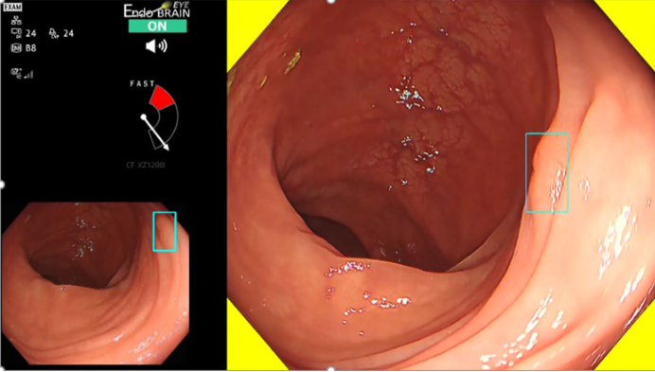
Example I. EndoBRAIN-EYE®
①Insurance
②Regulation
③AI
While AI increases detection, it raises concerns about unnecessary surgeries and higher healthcare spending
Approval
Initial approval (Jan 2020)
Class II
Provided alerts for polyp detection without pinpointing the location
Partial revision approval (Apr 2021)
Added rectangular box display for lesion localization and a speedometer to encourage optimal endoscope movement
AI analyzes endoscopic images in real-time during a colonoscopy
When the system detects a potential lesion (polyp), it triggers an alert to assist abnormality identification
Reimbursement
Initial status (2021):
A1 (All-inclusive): same points (~1,550pts≒$100) regardless of AI use. No incentive despite the software cost (1.5M JPY≒$9,500)
"Challenge Application" (Feb 2022–Feb 2024):
Submitted peer-reviewed data of improved Adenoma Detection Rate
Evaluated as C2 (new ”functional category”)
Add-on 60pts (≒$4) can be added to when the AI assists in the detection and subsequent surgery
AMED https://www.amed.go.jp/en/news/release_20200129.html NetIB-News https://www.data-max.co.jp/article/39367
Cybernet https://www.cybernet.co.jp/company/about/news/press/2021/20210420.html
Notes:
Let me give you two examples.
The first is EndoBRAIN-EYE, an AI-based endoscopic image recognition system.
The AI analyzes endoscopic images in real time during a colonoscopy. When the system detects a potential lesion — a polyp — it triggers an alert to assist the physician in identifying abnormalities.
This product received initial approval as a Class II. At that stage, it provided alerts for polyp detection without pinpointing the location — so the physician knew a lesion might be present, but not exactly where.
One year later, it received a partial revision approval, adding a rectangular box displaying the lesion location and a speedometer to encourage optimal endoscope movement.
For reimbursement, it was initially listed under Category A1, meaning the existing service fee points, around 1,550 points around 100 dollars, already covered the product. In other words, the hospital received the same points whether or not the AI was used — so there was essentially no financial incentive for hospitals to adopt it, despite a software cost of approximately 1.5 million yen, around 9.5 thousand dollars.
The manufacturer then submitted a Challenge Application, providing peer-reviewed data showing an improved adenoma detection rate. This time, the device was evaluated as C2 — a new functional category — and an add-on of 60 points, roughly 4 US dollars, can now be charged when the AI assists in detection and subsequent surgery.
But is this actually a good outcome?
AI increases polyp detection — but polyps are very common, particularly in people over 50, where prevalence can be around 40%. Not all polyps develop into cancer. And without surgery, the hospital cannot charge the add-on fee at all. This creates an incentive for overtreatment. And it could ultimately drive up overall healthcare spending.
検出した病変の位置まで特定することはせずに、音と画面上の色によって医師に警告を発するにとどめた。
https://www.amed.go.jp/news/release_20200129.html
病変位置を矩形表示することで位置特定を容易にすると共に、ソフトウェアに適した速度での内視鏡画像の移動を促すスピードメーターも追加
https://www.cybernet.co.jp/company/about/news/press/2021/20210420.html
当時はA1として包括で評価
医師はこの機器を使っても使わなくても同じ点数しか請求できない
＜参考＞
Ｄ３１３ 大腸内視鏡検査
１ ファイバースコピーによるもの
イ Ｓ状結腸 900点
ロ 下行結腸及び横行結腸 1350点
ハ 上行結腸及び盲腸 1550点
２ カプセル型内視鏡によるもの 1550点
https://shirobon.net/medicalfee/latest/ika/r06_ika/r06i_ch2/r06i2_pa3/r06i23_sec3/r06i233_cls12/r06i233c_D313.html
チャレンジ申請
論文を提出Ishiyama M, Kudo S, et al. Gastrointest Endosc 2022;95:155-63
有用性
大腸内視鏡検査あたりの腫瘍検出率（ADR）が有意に向上し、前癌病変の早期切除が可能となる。
2024年2月チャレンジ申請で「区分C2（新機能・新技術）」
本製品を用いて大腸癌・ポリープ等の病変を検出し内視鏡手術を行った場合、技術料として保険点数が60点加算
Ｋ７２１ 内視鏡的大腸ポリープ・粘膜切除術 60点
ソフトウェアの販売価格は約150万円
https://www.data-max.co.jp/article/39367
Colon polyps are common, especially as you get older. They affect about 20% of adults overall and about 40% over the age of 50
https://my.clevelandclinic.org/health/diseases/15370-colon-polyps

Slide 27
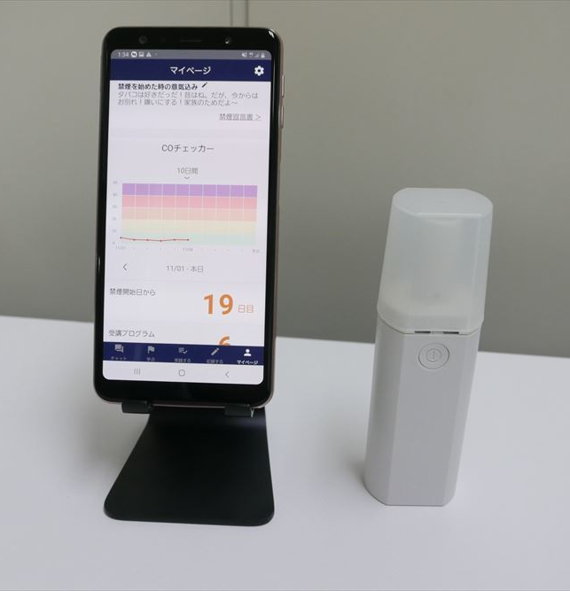
Example II. CureApp SC
①Insurance
②Regulation
③AI
Does this technology hold the same value as the technology that it referred to?
Approval
Aug 2020: Class II
Reimbursement
Insurance listing (Dec 2020):
C2 (new “functional category”)
Fee Structure:
Add-on for “Program Guidance Fees”:
140pts (Instruction on system use; $9)
System add-on fee:
2,400pts (Covers the cost of the software/device; $151)
Reference device:
Implantable neurostimulators
For patients with implanted neurostimulation systems in the brain, spinal cord, or vagus nerve, for home-based management of chronic pain, tremors, or epilepsy
Addresses psychological dependence on nicotine through AI-driven personalized messages and videos
Patient app
Portable CO checker: real-time measurement of carbon monoxide in breath
Physician app: monitoring tool
PMDA https://www.pmda.go.jp/medical_devices/2020/M20200911001/230909000_30200BZX00271000_C100_1.pdf
MHLW https://www.mhlw.go.jp/content/12404000/000693018.pdf
Notes:
The second example is CureApp SC, an app-based treatment for smoking cessation.
It addresses psychological dependence on nicotine through AI-driven personalized messages and videos.
The system consists of a patient app, a portable CO checker — which measures carbon monoxide in the breath in real time — and a physician monitoring app.
It received Class II approval,
and reimbursement listing, under Category C2.
The fee structure includes an add-on for Program Guidance Fees of 140 points, roughly 9 dollars, for instruction on system use to patients, plus a system add-on fee of 2,400 points — approximately 151 dollars — to cover the cost of the software and device.
Here is where it gets interesting. The reference device used for pricing was an implantable neurostimulator — a device used for patients with implanted neurostimulation systems in the brain, spinal cord, or vagus nerve, for home-based management of chronic pain, tremors, or epilepsy.
This raises a question: does a smartphone app and a CO breath checker truly hold the same value as an implantable neurostimulator? The comparator here is a highly invasive, surgically implanted device. Is it appropriate to use that as the pricing reference for a mobile app?
I think this is a concern about how the current comparison methods are being applied to novel digital therapeutics.
クラスII・管理医療機器として2020年8月に承認を取得
https://www.pmda.go.jp/medical_devices/2020/M20200911001/230909000_30200BZX00271000_C100_1.pdf
2020年12月「区分C2（新機能・新技術）」で保険適用
B001-3-2 ニコチン依存症管理料
１ ニコチン依存症管理料１
イ 初回 230 点
ロ ２回目から４回目まで
（１）対面で行った場合 184 点
（２）情報通信機器を用いた場合 155 点
ハ ５回目 180 点
２ ニコチン依存症管理料２（一連につき） 800 点
患者が自分で使う機器に対しては指導料と機器の価格を請求できる
https://www.mhlw.go.jp/content/12404000/001168428.pdf
B100
禁煙治療補助システム指導管理加算 140点
禁煙治療補助システム加算 2,400点
これを参考にして価格が設定された
https://www.mhlw.go.jp/content/12404000/000693018.pdf
C110-2 在宅振戦等刺激装置治療指導管理料
注２ 導入期加算 140 点
C167 疼痛等管理用送信器加算 600 点 ４回分
植込型脳・脊髄・迷走神経刺激装置を装着し、在宅で疼痛・振戦・てんかん管理を行う患者に対し、患者自身が操作する送信器の使い方の説明と機器費用として請求するもの
植込型脳・脊髄・迷走神経刺激装置とこのCO測定器とアプリは同等の価値を持つのだろうか？

Slide 28
Summary: Challenges and opportunities
1. Structural fiscal pressure
Rising healthcare expenditures, driven by aging, are sustained by premiums from the working-class, taxes, and national bond issuance
Operational inefficiencies due to a historically fragmented insurers that the government is attempting to harmonize
2. Dilemma of price setting
While medical services, drugs, and devices are priced via the fee schedule, the system is caught in a "pincer movement" between two opposing forces:
Macro-level: National pressure to restrict healthcare spending
Micro-level: Demands for higher points from healthcare providers and manufacturers due to inflation, rising wages, and material costs
Whether the current pricing scheme is "appropriate" remains a subject of debate
3. Role and reality of AI medical devices
AI medical devices hold the potential to address regional labor shortages and contribute to cost containment
However, many cases are difficult to fit into existing regulatory and value-assessment frameworks
Currently, decisions are being made on a case-by-case basis as regulatory updates and infrastructure developments remain very much a "work in progress."
Notes:
This final slide summarizes the key takeaways from today's presentation.
First, structural fiscal pressure.
Japan faces rising healthcare expenditures driven by aging, sustained by premiums from the working class, taxes, and national bond issuance. There are also operational inefficiencies due to a historically fragmented insurance system — one the government is attempting to harmonize.
Second, the dilemma of price setting.
While medical services, drugs, and devices are priced via the fee schedule, the system is caught in a pincer movement between two opposing forces:
at the macro level, there is national pressure to restrict healthcare spending; at the micro level, healthcare providers and manufacturers are demanding higher points due to inflation, rising wages, and material costs. Whether the current pricing scheme is truly appropriate remains a subject of debate.
Third, the role and reality of AI medical devices.
AI holds real potential to address regional labor shortages and contribute to cost containment.
However, many cases are difficult to fit into existing regulatory and value-assessment frameworks.
Currently, decisions are being made on a case-by-case basis, as regulatory updates and infrastructure developments remain very much a work in progress.

Slide 29
Thank you for your attention!
Contact: skoiso@uw.edu

Slide 30
Appendix

Slide 31
Health expenditure by budget source
①Insurance
②Regulation
③AI
Health expenditure share by source
Medical care/treatment & Charge
①Out-of-Pocket payment
Patient
②Premium
Claim
Healthcare Provider
Claim payment
③Budget
Government
Insurer
Ministry of Health, Labour and Welfare https://www.mhlw.go.jp/stf/seisakunitsuite/bunya/kenkou_iryou/iryouhoken/iryouhoken01/index.html

