Slide 1
Physics 212 HKN Exam 3 Review Session
Steven Kolaczkowski
Gauri Konanoor
Keshav Harisrikanth

Slide 2

RC Circuits
Capacitors instantaneous reaction and time dependence.
At $t=0$
At $t →∞$
$V=IR$ only works for resistors.
Don’t try and apply this to capacitors and sources!!!
Time constant $(τ)$: The fundamental time of a circuit $τ_{RC}=RC \left[=\right]sec$
We will have another time constant for LR and LC circuits
Power
$Σ_{i}P_{i}=0$ Conservation of Energy, time independent
$P=IV \left[=\right]Watts$

Slide 3

LR Circuits
KVL and KCL still apply! (And always will)
$V_{L}=L\frac{dI}{dt} V_{R}=IR$
Inductors will never drastically change current
Same as a Capacitors relation to Voltage
$t=0$
$t→∞$
New Time Constant!!!
$τ_{LR}=\frac{L}{R}$ $τ_{RC}=RC$

Slide 4

LC Oscillators and LRC DC Circuits
For LC circuits, energy alternates between being stored in electric fields (in C) and magnetic fields (in L)
$U_{L}=\frac{1}{2}LI^{2}$ $U_{C}=\frac{1}{2}CV^{2}$ $U_{L}+U_{C}=constant=\frac{Q_{Max}^{2}}{2C}$
$Q\left(t\right)=Qcos(ωt+φ)$ where $ω_{LC}=\frac{1}{\sqrt{LC}}$ and $φ$ is based on the initial conditions
LRC Damped Oscillators:
$ω^{2}= ω_{LC}^{2}−β^{2}$ $β=\frac{R}{2L}$
Critical Damping: $R=2\sqrt{\frac{L}{C}}$

Slide 5

Phasors, Reactance, and Phase Relations
Phasor: A rotating 2D vector whose components can be mapped to physical quantities.
In this class we will only deal with single frequencies and the vertical projection
Want to find out what the horizontal projection is? Want to see what happens when you excite multiple frequencies? Take ECE 210!
Reactance: The relation between Voltage and Current for non-resistive, linear devices
In this class, you can think of reactance as the “resistance” of Capacitors and Inductors
$X_{C}=\frac{1}{ωC} \left[=\right]Ω$ $X_{L}=ωL \left[=\right]Ω$
Phase Relations
Capacitive circuits have $V_{C}\left(t\right)$ lag $I_{C}(t)$ by $90°$
Inductive circuits have $V_{L}(t)$ lead $I_{L}(t)$ by $90°$

Slide 6
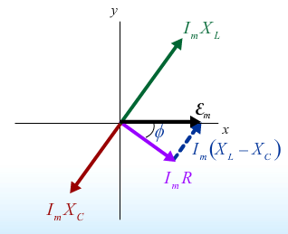

Impedance and AC Circuits
Impedance (Z): The effective “total” resistance of the circuit
$Z^{2}=R^{2}+{\left(X_{L}−X_{C}\right)}^{2}$ $ε_{m}=I_{m}Z$ This looks just like Ohm’s Law!!!
What are the units of $Z$?
All components will rotate at angular frequency $ω$ set by the generator
There will be a phase difference between the generator voltage and the generator current $\left(φ\right)$
$φ=\tan^{−1}\left(\frac{X_{L}−X_{C}}{R}\right)$
Power consumption: Both Capacitors and Inductors
do not absorb power.
$<P_{Generator}> = <P_{Resistor}> =\frac{1}{2} I_{m}ε_{m}\cos\left(φ\right)$

Slide 7

Transformers
A way of transforming an AC Signal to another AC Signal
$V_{S}=\frac{N_{S}}{N_{P}} V_{P}$ $I_{P}=\frac{N_{S}}{N_{P}} I_{S}$ $I_{S}V_{S}=I_{P}V_{P}$

Slide 8

Adjustments to Maxwell’s Equations
Changes to Ampere’s Law and a little bit of history
$\oint{\vec{B}∙d\vec{l}}=μ_{0}I_{enc}=μ_{0}\left(I+I_{D}\right)=μ_{0}\left(I+ε_{0}\frac{dΦ_{E}}{dt}\right)$
Maxwell’s Equations:
Gauss’ Laws: $\oint{\vec{E}∙d\vec{A}}=\frac{Q_{enc}}{ε_{0}}$ $\oint{\vec{B}∙d\vec{A}=0}$
Faraday’s Law: $\oint{\vec{E}}∙d\vec{l}=−\frac{d}{dt} ∫\vec{B}∙d\vec{A}$

Slide 9

Wave Equations and Important Relations
General Wave Equation: $\frac{d^{2}h}{dx^{2}}=\frac{1}{v^{2}}\frac{d^{2}h}{dt^{2}}$
General Wave Solution: $h\left(x,t\right)=Acos(kx−ωt +φ)$
This is a wave traveling in the positive x direction
Very important relations:
$k=\frac{2π}{λ} \left[=\right]m^{−1}$ $ω=2πf\left[=\right]\frac{rads}{s}$
$v=\frac{ω}{k}=λf \left[=\right]\frac{m}{s} \frac{1}{c^{2}}=μ_{0}ε_{0}$
$B⊥E$ ${ B}_{0}=\frac{E_{0}}{c}=E_{0}\frac{1}{\sqrt{μ_{0}ε_{0}}}$

Slide 10

A Hint of Relativity and Quantum
Doppler Shift: The change in frequency of a wave as it is approaching or departing from an observer. $β≡\frac{v}{c}$
Blue Shift (wave travelling towards you): $f^{′}=f\sqrt{\frac{1+β}{1−β}}$
Red Shift (wave travelling away from you): $f^{′}=f\sqrt{\frac{1−β}{1+β}}$
Poynting Vector: A vector quantity that describes the transfer of energy in a wave
$\vec{S}≡\frac{\vec{E}×\vec{B}}{μ_{0}} \left[=\right]\frac{Watts}{m^{2}}$ $<S> =\frac{1}{2} cε_{0}E^{2}=\frac{1}{2} \sqrt{\frac{μ_{0}}{ε_{0}}} E^{2}=\frac{1}{2} \left|\vec{S}\right|$
Photons $(γ)$: Particles of light
$E_{γ}=hf=ℏω$
$p_{γ}=\frac{E}{c}=\frac{h}{λ}$

Slide 11

Polarization
$$\vec{E}\left(z,t\right)=\hat{x}E_{1}\cos\left(kz−ωt+φ_{1}\right)+\hat{y}E_{2}cos⁡(kz−ωt+φ_{2})$$
Linear Polarization: $φ_{1}=φ_{2}±nπ$ for integer $n$
Law of Malus: $I=I_{0}\cos^{2}{(θ)}$
If incident light is Unpolarized $I=\frac{1}{2} I_{0}$
Circular Polarization: $φ_{1}=φ_{2}±\frac{π}{2}$ AND $E_{1}=E_{2}$
Cosine leads Sine
RCP: $leads×lags=propogation$ LCP: $leads×lags=−propogation$
Birefringence: Materials that cause a delay for one polarization of light, but not others
Quarter-Wave Plate: Uses a slow axis and a fast axis to change certain linear polarizations to circular polarizations

Slide 12

Optics
Propagation in media $ε_{0}→ε$ $μ_{0}→μ$ $v=\frac{c}{n}$ $n=\frac{\sqrt{με}}{\sqrt{μ_{0}ε_{0}}}$
Snell’s Law: $n_{2}sinθ_{2}=n_{1}sinθ_{1}$
Total Internal Reflection: When there is no transmitted light
$θ_{c}=\sin^{−1}\left(\frac{n_{2}}{n_{1}}\right)$
Brewster’s Angle: When angle between Reflected and Refracted ray is $90°$
Reflected light is polarized perpendicular to plane of incidence
$\tan\left(θ_{1}\right)=\frac{n_{2}}{n_{1}}$

Slide 13
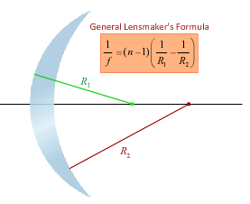

Lenses
$\frac{1}{s}+\frac{1}{s^{′}}=\frac{1}{f}$ where $s$ is the object distance, $s′$ is image distance, and $f$ is focal length
Magnification: the ration of image height to object height.
$M=\frac{h^{′}}{h}=−\frac{s^{′}}{s}$
$M=−\frac{f}{s−f}$ $s^{′}=\frac{fs}{s−f}$
Converging Lenses: $f>0$
Diverging Lenses: $f<0$
Virtual Image: $s^{′}<0$
Principle rays: Horizontal to focus and through center of lens

Slide 14
Exam Advice
Know when and how to use your equation sheet
Don’t panic, just keep on moving
Make sure you are in the right mindset going into the exam
Spend your time showing what you know
DON’T CHEAT
Check you units!!!

Slide 15
Past Exam Questions

Slide 16

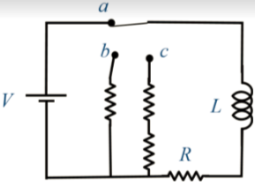


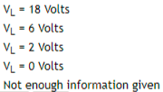

Spring 2017

Slide 17

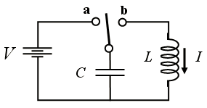

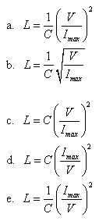

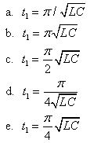
Fall 2010

Slide 18
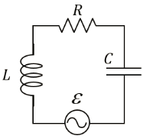






Spring 2015

Slide 19
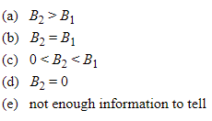
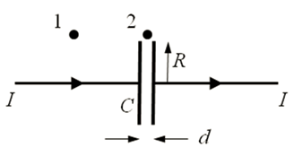
Fall 2010

Slide 20
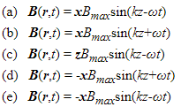
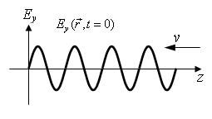
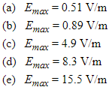

Fall 2010

Slide 21
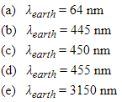
Fall 2010

Slide 22
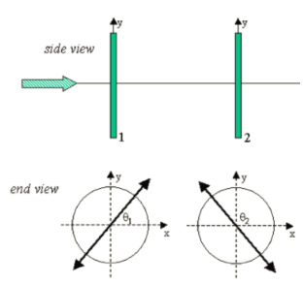


Spring 2013

Slide 23
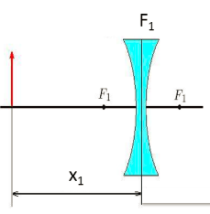



Fall 2015

Slide 24
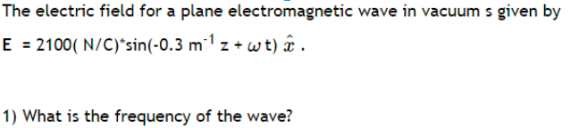



Slide 25
