Slide 1
Physics 212 HKN Final Exam Review Session
Steven Kolaczkowski

Slide 2


Electrostatics $\left(\frac{d}{dt}→0, \vec{B}=0\right)$
Coulomb’s Law: $\vec{F}=\frac{kq_{1}q_{2}}{r^{2}} \hat{r}$
Electric Field $\left(\vec{E}\right)$ and Superposition: $\vec{E}≡\frac{\vec{F}}{q}=\frac{kQ}{r^{2}} \hat{r}=∫k\frac{dq}{r} \hat{r}$
$F_{Total}=Σ_{i}F_{i}=Σ_{i}\frac{kq_{0}q_{i}}{r^{2}} \hat{r}$ $E_{total}=Σ_{i}E_{i}=Σ_{i}\frac{kq_{i}}{r^{2}}\hat{r}$
Electric Fields lines point away from positive charges and towards negative charges
$E_{conductor}=0$ in equilibrium $ΔU=−W_{cons}=−∫\vec{F}∙d\vec{r}=−∫q\vec{E}∙d\vec{l}$
Electric Potential $\left(V\right)$: $ΔV_{a→b}≡\frac{ΔU_{a→b}}{q}=−∫\vec{E}∙d\vec{l}$
$\vec{E}=−∇V=−(\frac{dV}{dx}\hat{x}+\frac{dV}{dy}\hat{y}+\frac{dV}{dz}\hat{z})$
Electric Field lines point from high potential to low potential
Elevation analogy

Slide 3

Electric Flux and Gauss’ Law For Electric Field
Electric Flux: The number of Electric Field lines passing through a certain area
$Φ_{E}=∫\int_{S}{\vec{E}∙d\vec{A}}$
Gauss’ Law: $Φ_{E}=\frac{Q_{enc}}{ε_{0}}$
Only really useful for spheres, point, lines, sheets, and slabs of charge.

Slide 4

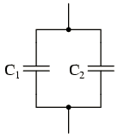

Capacitance and DC Capacitors
$C≡\frac{Q}{V} =\frac{ε_{0}A}{d}$ for a parallel plate capacitor
$U=\frac{1}{2} QV=\frac{1}{2} CV^{2}=\frac{1}{2}\frac{Q^{2}}{C}$
Series Capacitors: $C_{total}=\frac{1}{\frac{1}{C_{1}}+\frac{1}{C_{2}}}=\frac{C_{1}C_{2}}{C_{1}+C_{2}}$
Q is the same for both capacitors
Parallel Capacitors : $C_{total}=C_{1}+C_{2}$
V is the same for both capacitors

Slide 5

Resistance, Ohm’s law, and Kirchhoff's Laws
Ohm’s Law: $J=σE$ this is usually represented as $V=IR$ in circuit analysis
Here J is the current density, $σ$ is the conductivity, I is the current, and R is the resistance
Resistance: a measure of an elements opposition to charge flow $R=\frac{L}{σA}=\frac{ρL}{A}$
Series resistance: $R_{total}=R_{1}+R_{2}$
Resistors in series share the same current ($I$)
Parallel resistance: $R_{total}=\frac{1}{\frac{1}{R_{1}}+\frac{1}{R_{2}}}=\frac{R_{1}R_{2}}{R_{1}+R_{2}}$
Resistors in parallel share the same voltage
Kirchhoff’s Current Law (KCL): Statement of conservation of Charge
$Σ_{in}I=Σ_{out}I$ for any node / equipotential
Kirchhoff’s Voltage Law (KVL): Statement of conservation of Energy
$Σ_{i}V_{i}=0$ for any closed loop

Slide 6

Magnetism
Updated Lorentz Force: $\vec{F}=q(\vec{E}+\vec{v} ×\vec{B})$
Current Carrying Wire: $\vec{F}=I \vec{L} ×\vec{B}$
Right Hand Rules:
1. Thumb in direction of current, figures curl in direction of Magnetic Field
2. Index figure in direction of velocity, middle figure in direction of Magnetic field, thumb in direction of force
3. Figures in direction of current, thumb in direction of magnetic field.
4. Index figure in direction of moment, middle figure in direction of Magnetic Field, thumb in direction of torque.
Torque and Moments
$\vec{τ}=\vec{r}×\vec{F}=\vec{μ}×\vec{B}$ $\vec{μ}=NI\vec{A}$
Potential Energy
$U=−\vec{μ}∙\vec{B}$

Slide 7

Ampere’s Law and Faraday’s Law
Ampere’s law: $\oint{\vec{B}∙d\vec{l}=μ_{0}I_{enclosed}}$
Useful in highly symmetric situations (wires and current sheets)
Wire: $\vec{B}=\frac{μ_{0}I}{2πr} \hat{φ}$
Sheet: $\vec{B}=\frac{1}{2} μ_{0}nI$
Magnetic Flux: Number of Magnetic Field Lines that penetrate a certain area
$Φ_{B}=\vec{B}∙\vec{A}=∯{\vec{B}∙d\vec{A}}$
Faraday’s Law: $ε_{mf}=−\frac{dΦ_{B}}{dt}=\oint{\vec{E}∙d\vec{l}}$
That minus sign is important!!! The induced current / field opposes a change in magnetic flux
Biot-Savart Law: $d\vec{B}=\frac{μ_{0}I}{4π} \frac{d\vec{s}×\hat{r}}{r^{2}}$
Since $\vec{F}=I\vec{L}×\vec{B}$ Force between two wires: $F=\frac{μ_{0}}{2πd} I_{1}I_{2}L$

Slide 8

Inductance
Inductance (L): A substance’s opposition to a change in current
$L≡\frac{Φ_{B}}{I}=\frac{∯{\vec{B}∙d\vec{A}}}{I}=\frac{BA}{I} \left[=\right]\frac{{T∙m}^{2}}{A}=H$
$ε=−L\frac{dI}{dt}$ $U_{L}=\frac{1}{2}LI^{2}$
Solenoid: Circularly coiled wire often used as an Inductor
${\vec{B}}_{solenoid}=Iμ_{0}n\hat{z}$ , where $n$ is the number of coils per unit length
$Φ_{B}=∯{{\vec{B}}_{solenoid}∙d\vec{S}}=B_{solenoid}NA_{solenoid}=Iμ_{0}nNπr^{2}=Iμ_{0}n^{2}zπr^{2}$, where N is the number of coils and z is the length of the solenoid
Energy Density:
$u_{B}=\frac{B^{2}}{2μ_{0}}$ $u_{E}=\frac{1}{2}ε_{0}E^{2}$

Slide 9

LC and LR Circuits
Inductors will never drastically change current
They will produce whatever voltage is required to maintain that current
$t=0$ $t→∞$
Capacitors will never drastically change the amount of charge stored on them
$t=0$ $t→∞$
$V_{L}=L\frac{dI}{dt}$ $V_{R}=IR$
Time constant $(τ)$: The fundamental time of a circuit
The time it takes for a parameter to become $e^{−1}$ its original value
$τ_{RC}=RC$ $τ_{LR}=\frac{L}{R}$

Slide 10

LC Oscillators and LRC Circuits
For LC circuits, energy alternates between being stored in electric fields (in C) and magnetic fields (in L)
$U_{L}=\frac{1}{2}LI^{2}$ $U_{C}=\frac{1}{2}CV^{2}$ $U_{L}+U_{C}=constant=\frac{Q_{Max}^{2}}{2C}$
$Q\left(t\right)=Qcos(ωt+φ)$ where $ω_{LC}=\frac{1}{\sqrt{LC}}$ and $φ$ is based on the initial conditions
LRC Damped Oscillators:
$ω^{2}= ω_{LC}^{2}−β^{2}$ $β=\frac{R}{2L}$
Critical Damping: $R=2\sqrt{\frac{L}{C}}$

Slide 11
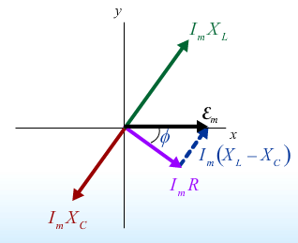

Phasors, Reactance, Impedance, and AC Circuits
Phasor: A rotating 2D vector whose components can be mapped to physical quantities.
In this class we will only deal with single frequencies and the vertical projection
Reactance: The relation between Voltage and Current for non-resistive, linear devices
$X_{C}=\frac{1}{ωC} \left[=\right]Ω$ $X_{L}=ωL \left[=\right]Ω$
Impedance (Z): The effective “total” resistance of the circuit
$Z^{2}=R^{2}+{\left(X_{L}−X_{C}\right)}^{2}$ $ε_{m}=I_{m}Z$
There will be a phase difference between the generator voltage and the generator current $\left(φ\right)$
$φ=\tan^{−1}\left(\frac{X_{L}−X_{C}}{R}\right)$
Power consumption: Both Capacitors and Inductors
do not absorb power.
$<P_{Generator}> = <P_{Resistor}> =\frac{1}{2} I_{m}ε_{m}\cos\left(φ\right)$

Slide 12

Wave Equations and Important Relations
General Wave Equation: $\frac{d^{2}h}{dx^{2}}=\frac{1}{v^{2}}\frac{d^{2}h}{dt^{2}}$
General Wave Solution: $h\left(x,t\right)=Acos(kx−ωt +φ)$
This is a wave traveling in the positive x direction
Very important relations:
$k=\frac{2π}{λ} \left[=\right]m^{−1}$ $ω=2πf\left[=\right]\frac{rads}{s}$
$v=\frac{ω}{k}=λf \left[=\right]\frac{m}{s} \frac{1}{c^{2}}=μ_{0}ε_{0}$
$B⊥E$ ${ B}_{0}=\frac{E_{0}}{c}=E_{0}\frac{1}{\sqrt{μ_{0}ε_{0}}}$

Slide 13

A Hint of Relativity and Quantum
Doppler Shift: The change in frequency of a wave as it is approaching or departing from an observer. $β≡\frac{v}{c}$
Blue Shift (wave travelling towards you): $f^{′}=f\sqrt{\frac{1+β}{1−β}}$
Red Shift (wave travelling away from you): $f^{′}=f\sqrt{\frac{1−β}{1+β}}$
Poynting Vector: A vector quantity that describes the transfer of energy in a wave
$\vec{S}≡\frac{\vec{E}×\vec{B}}{μ_{0}} \left[=\right]\frac{Watts}{m^{2}}$ $<S> =\frac{1}{2} cε_{0}E^{2}=\frac{1}{2} \sqrt{\frac{μ_{0}}{ε_{0}}} E^{2}=\frac{1}{2} \left|\vec{S}\right|$
Photons $(γ)$: Particles of light
$E_{γ}=hf=ℏω$
$p_{γ}=\frac{E}{c}=\frac{h}{λ}$

Slide 14

Polarization
$$\vec{E}\left(z,t\right)=\hat{x}E_{1}\cos\left(kz−ωt+φ_{1}\right)+\hat{y}E_{2}cos⁡(kz−ωt+φ_{2})$$
Linear Polarization: $φ_{1}=φ_{2}±nπ$ for integer $n$
Law of Malus: $I=I_{0}\cos^{2}{(θ)}$
If incident light is Unpolarized $I=\frac{1}{2} I_{0}$
Circular Polarization: $φ_{1}=φ_{2}±\frac{π}{2}$ AND $E_{1}=E_{2}$
Cosine leads Sine
RCP: $leads×lags=propogation$ LCP: $leads×lags=−propogation$
Birefringence: Materials that cause a delay for one polarization of light, but not others
Quarter-Wave Plate: Uses a slow axis and a fast axis to change certain linear polarizations to circular polarizations

Slide 15

Optics
Propagation in media $ε_{0}→ε$ $μ_{0}→μ$ $v=\frac{c}{n}$ $n=\frac{\sqrt{με}}{\sqrt{μ_{0}ε_{0}}}$
Snell’s Law: $n_{2}sinθ_{2}=n_{1}sinθ_{1}$
Total Internal Reflection: When there is no transmitted light
$θ_{c}=\sin^{−1}\left(\frac{n_{2}}{n_{1}}\right)$
Brewster’s Angle: When angle between Reflected and Refracted ray is $90°$
Reflected light is polarized perpendicular to plane of incidence
$\tan\left(θ_{1}\right)=\frac{n_{2}}{n_{1}}$

Slide 16
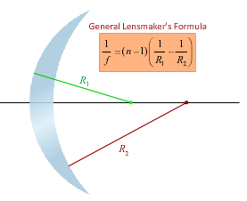

Lenses and Mirrors
$\frac{1}{s}+\frac{1}{s^{′}}=\frac{1}{f}$ where $s$ is the object distance, $s′$ is image distance, and $f$ is focal length
$s$ is ALWAYS positive
Magnification: the ration of image height to object height.
$M=\frac{h^{′}}{h}=−\frac{s^{′}}{s}$
$M=−\frac{f}{s−f}$ $s^{′}=\frac{fs}{s−f}$
Converging Lenses and Concave Mirrors: $f>0$
Diverging Lenses and Convex Mirrors: $f<0$
Plane Mirror: $f=∞, M=1, s^{′}=−s$
Mirror Focus: Small angle approximation $f=\frac{R}{2}$
Virtual Image: $s^{′}<0$
Principle rays: Horizontal to focus and through center of lens

Slide 17
Exam Advice
Know when and how to use your equation sheet
Don’t panic, just keep on moving
Make sure you are in the right mindset going into the exam
Spend your time showing what you know
DON’T CHEAT
Check you units!!!

Slide 18
Past Exam Questions

Slide 19
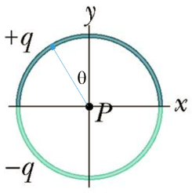


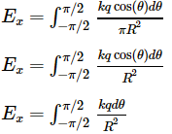

Fall 2015

Slide 20




Fall 2015

Slide 21
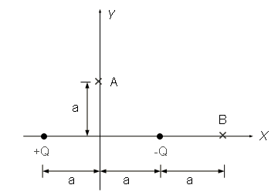
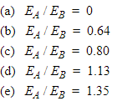


Fall 2009 and Spring 2015

Slide 22

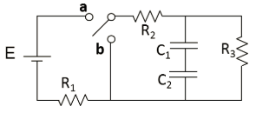

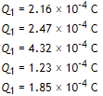

Fall 2015

Slide 23
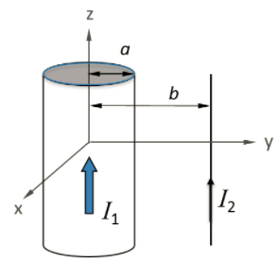



Fall 2015

Slide 24
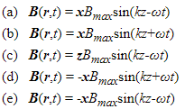
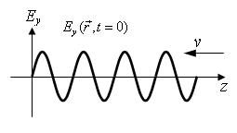
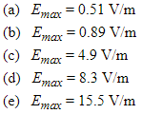

Fall 2010

Slide 25
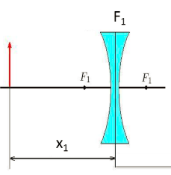



Fall 2015

Slide 26
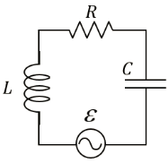






Spring 2015

