Slide 1
HKN ECE 342 Review Session 1
Anthony Li
Milan Shah
Minghao Liu

Slide 2
KVL/KCL
Sum of all voltages in a loop is 0
Sum of current entering a node equals sum of current exiting a node

Slide 3

Incremental/Small Signal Model
Can be numerically derived from Taylor Series approximation (up to first-order term)
Taylor Series: $y = f(x0) + f’(x0)(x − x0) + \frac{f’’(x0)(x−x0)2}{2} + …$

Slide 4
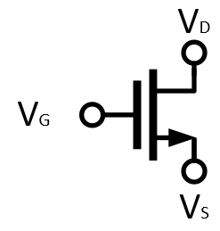
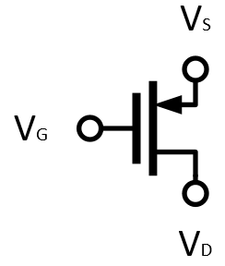
MOSFET’s
NMOS
PMOS

Slide 5
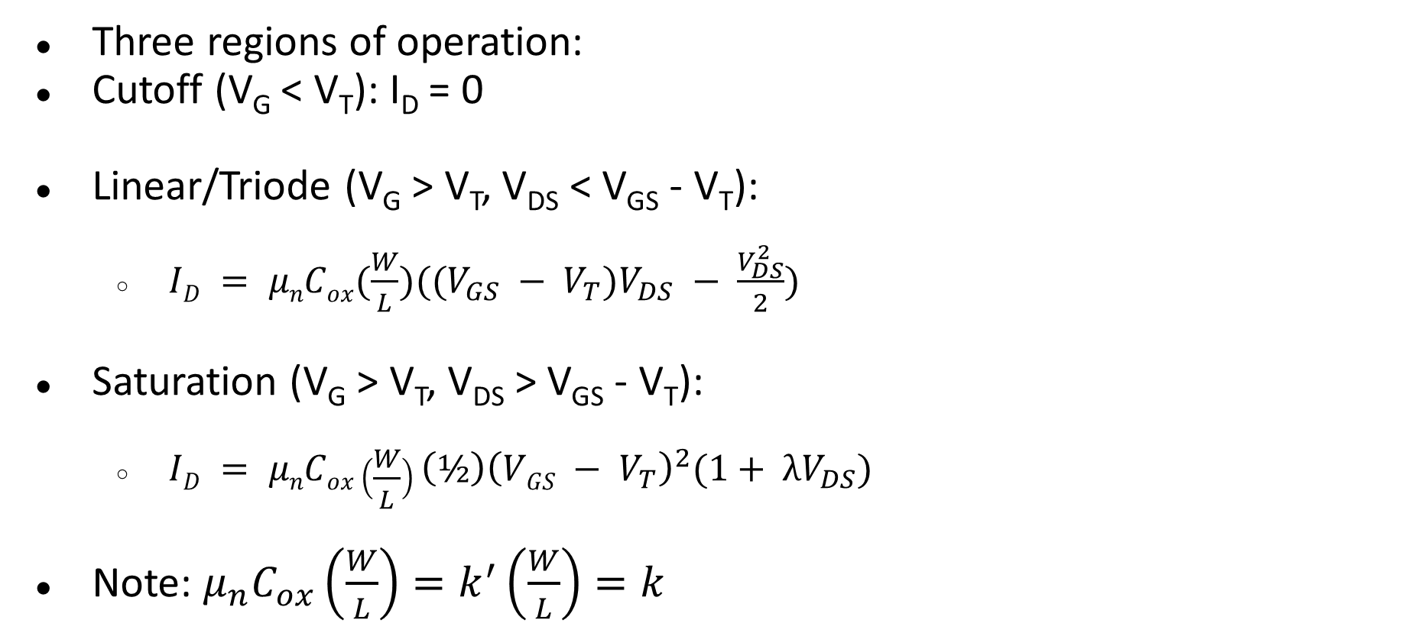
MOSFET Operating Point
Three regions of operation:
Cutoff (V_{G} < V_{T}): I_{D} = 0
Linear/Triode (V_{G} > V_{T}, V_{DS} < V_{GS} - V_{T}):
$ID = μnCox(\frac{W}{L})((V_{GS} − V_{T})V_{DS} − \frac{V_{DS}^{2}}{2})$
Saturation (V_{G} > V_{T}, V_{DS} > V_{GS} - V_{T}):
$ID = μnCox\left(\frac{W}{L}\right){\left(½\right)\left(VGS − V_{T}\right)}^{2}(1+ λV_{DS})$
Note: $μ_{n}C_{ox}\left(\frac{W}{L}\right)=k^{′}\left(\frac{W}{L}\right)=k$

Slide 6
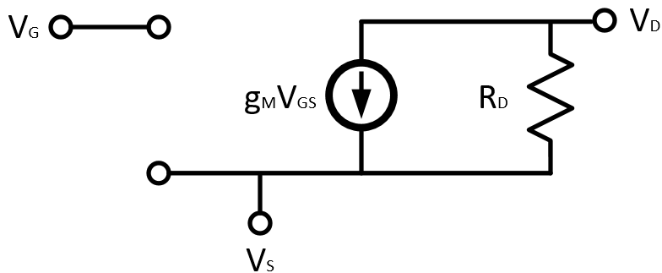

MOSFET Incremental Model
Transconductance: $g_{m}=\frac{2I_{D}}{V_{OV}}$

Slide 7
Gain Calculation
A_{v} = -G_{M}R_{out}
G_{M} = Small signal transconductance, ratio of i_{out} to v_{in}
R_{OUT} = Equivalent incremental output resistance

Slide 8
Common Amplifier Topologies
Diode-tied Transistor
Common Source/Drain/Gate
Common Source with Degeneration
Common Drain with Modulation
Cascode
Diode Tied Transistor

Slide 9


Diode-Tied Transistor
R_{OUT} = $\frac{1}{g_{m}}||r_{ds}≈\frac{1}{g_{m}}$ for $g_{m}r_{ds}≫1$ or $r_{ds}→∞$
Diode Tied Transistor

Slide 10
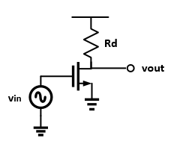
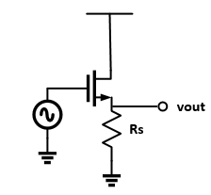
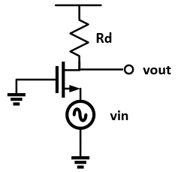
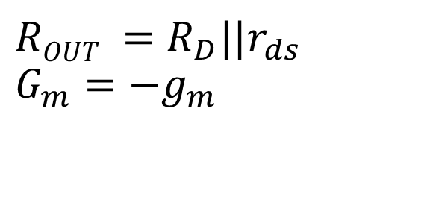
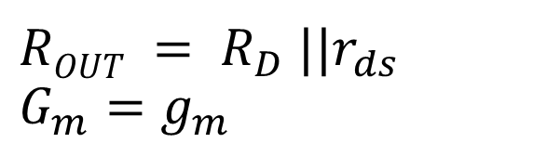
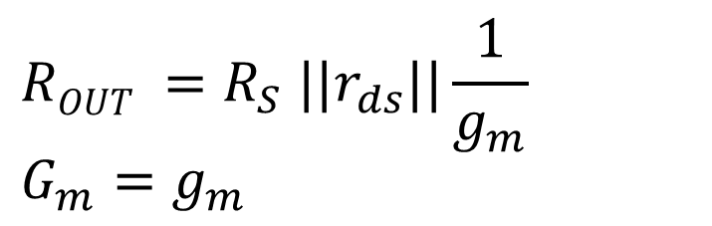
Common Source/Drain/Gate
$$ROUT =R_{S} ||r_{ds}||\frac{1}{g_{m}}$$
$$G_{m}=g_{m}$$
$$ROUT = R_{D} ||r_{ds}$$
$$G_{m}=g_{m}$$
$$ROUT =R_{D}||r_{ds}$$
$$G_{m}=−g_{m}$$
Notes:
Common Source. Your basic amplifier topology. Notice the infinite input resistance and inverted gain.
Common Drain. Also known as a level shifter. These make great buffers. Source follower?
Common Gate. good current buffer i believe.

Slide 11
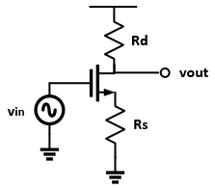
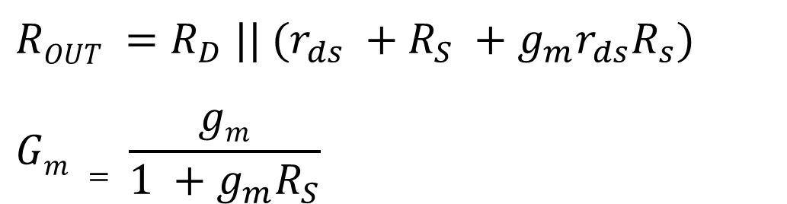
Degeneration
When a resistance is “viewed” through the drain, it appears bigger by a factor related to the transconductance.
$$ROUT =R_{D} || (r_{ds} +R_{S} +g_{m}r_{ds}R_{s})$$
$$Gm = \frac{gm}{1 +g_{m}R_{S}}$$
Notes:
Note that these formulas simplify to the common source ones if Rs is zero. Also remember that these equations rely on rds not being infinity.

Slide 12
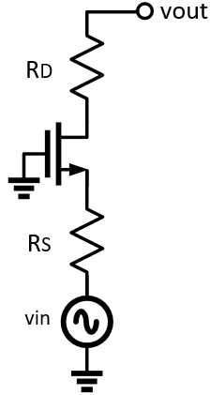
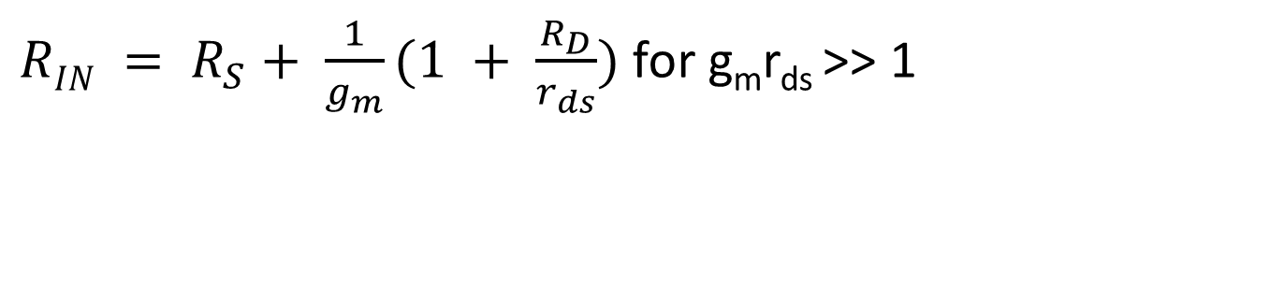

Modulation
Resistances seen through the source seem smaller:
$RIN = R_{S}+ \frac{1}{g_{m}}(1 + \frac{R_{D}}{r_{ds}})$for g_{m}r_{ds} >> 1
$$R_{IN}$$

Slide 13
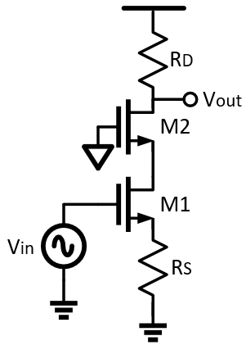

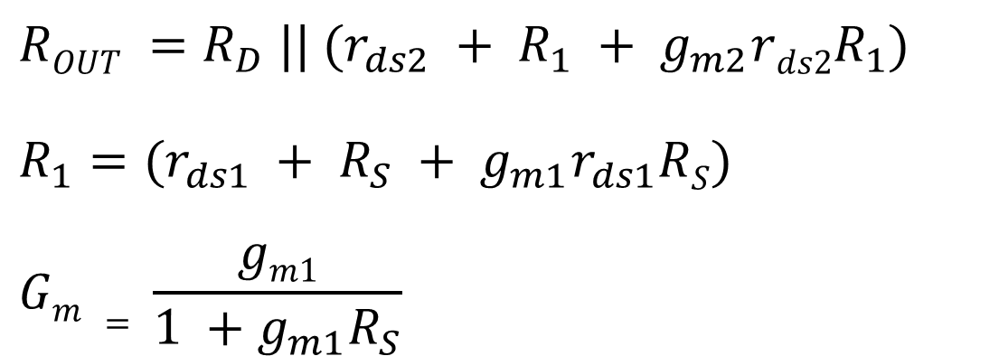
Cascode
$$ROUT =R_{D} || (r_{ds2} + R_{1} + g_{m2}rds2R_{1})$$
$$R_{1}=(r_{ds1} + R_{S} + g_{m1}r_{ds1}RS)$$
$$Gm = \frac{gm1}{1 +g_{m1}R_{S}}$$
$$R_{1}$$

Slide 14
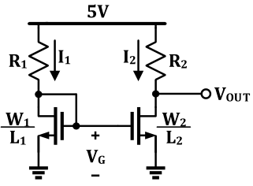


Current Mirrors
Transistors sharing the same $V_{OV}$ “mirror” current – just a ratio of transistor sizing.
$$I_{2}=\frac{W_{2}/L_{2 }}{W_{1}/L_{1}}I_{1}$$
Notes:
Minghao

Slide 15
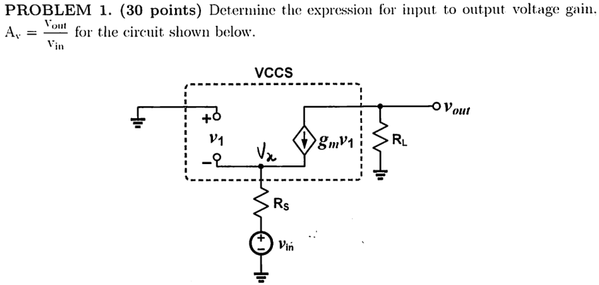
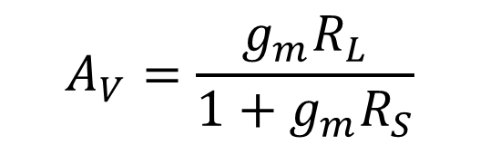
Problem 1 – Sp16 Midterm 1
$$A_{V}=\frac{g_{m}R_{L}}{1+g_{m}R_{S}}$$
Notes:
Milan

Slide 16
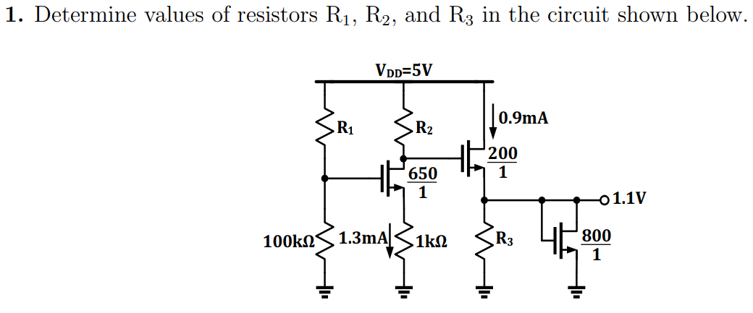
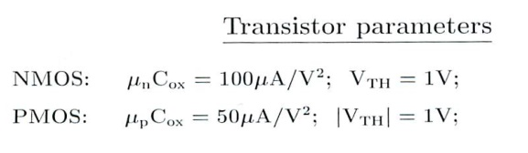

Problem 2
$$R_{1}=100 kΩ$$
$$R_{2}=2 kΩ$$
$$R_{3}=2.2 kΩ$$
Notes:
Minghao

Slide 17
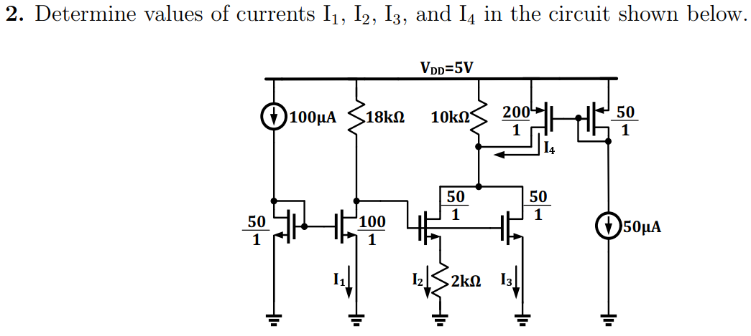

Problem 3
$$I_{1}=200 μA$$
$$I_{2}=100 μA$$
$$I_{3}=400 μA$$
$$I_{4}=200 μA$$
Notes:
Minghao

Slide 18
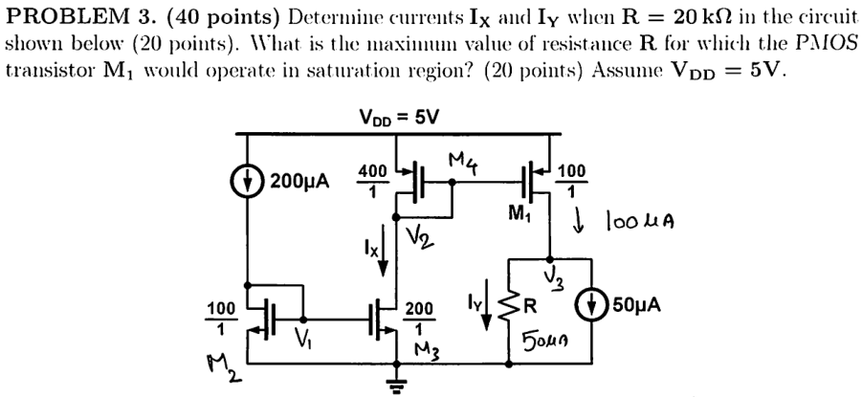

Problem 4 – Sp16 Midterm 1
$$I_{X}=400 μA$$
$$I_{Y}=50 μA$$
$$R_{max}=96 kΩ$$
Notes:
Milan

Slide 19
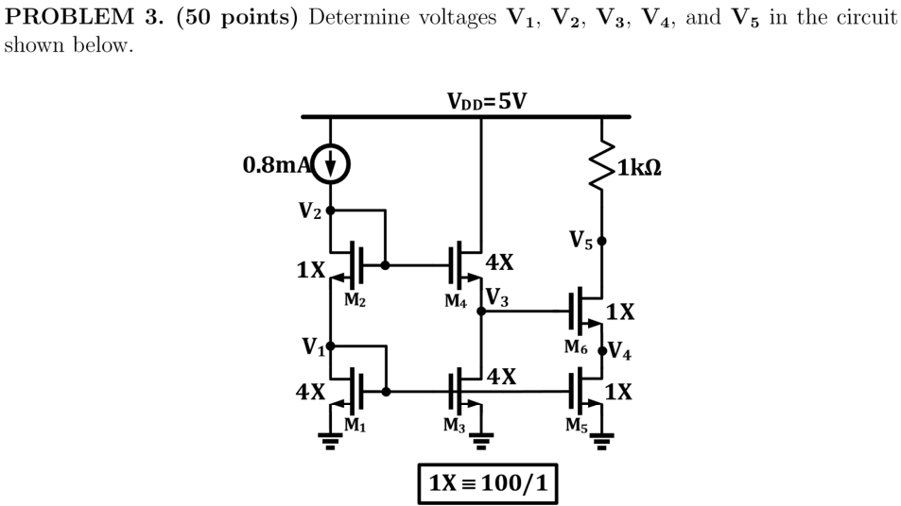

Problem 5 – Fa16 Midterm 1
$$V_{1}=1.2 V$$
$$V_{2}=2.6 V$$
$$V_{3}=1.4 V$$
$$V_{4}=0.2 V$$
$$V_{5}=4.8 V$$
Notes:
Anthony

Slide 20
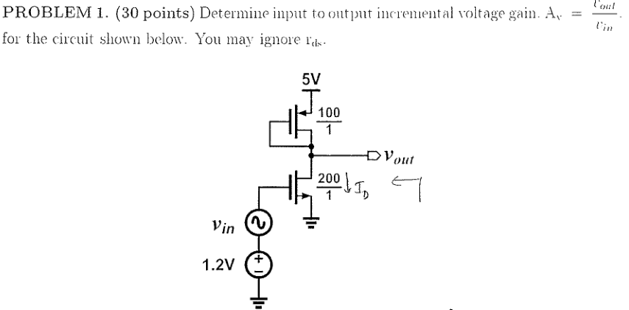
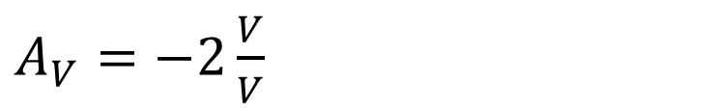
Problem 6 – Sp16 Midterm 2
$A_{V}=−2\frac{V}{V}$
Notes:
Anthony

