Slide 1
Physics 214 HKN Final Exam Review Session
Steven Kolaczkowski
Dhruv patel
Paul Reckamp

Slide 2
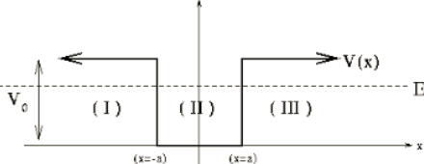

Finite Potential Wells and Boundary Conditions
Normalization: since ${\left|ψ\left(x\right)\right|}^{2}$ is a probability, the sum of all probabilities must be one
$1=∫{\left|ψ\left(x\right)\right|}^{2}$
With changing potentials we force two boundary conditions to be met:
$ψ\left(x^{−}\right)=ψ\left(x^{+}\right)$ and $\frac{dψ\left(x^{−}\right)}{dx}=\frac{dψ\left(x^{+}\right)}{dx}$
$\cos\left(kx\right)=\frac{e^{ikx}+e^{−ikx}}{2}$
$\sin\left(kx\right)=\frac{e^{ikx}−e^{−ikx}}{2i}$
$k=\sqrt{\frac{2m}{ℏ^{2}}\left(E−V\right)}$

Slide 3

Reflections and Tunneling
How does k change when we pass from a classically aloud region to a classically forbidden one? What happens when we go back?
$k=\sqrt{\frac{2m}{ℏ^{2}}\left(E−V\right)}$
Transmission $T\sim Ge^{−2KL}$ where $G=16\frac{E}{U_{0}}(1−\frac{E}{U_{0}})$, $K=\sqrt{\frac{2m}{ℏ^{2}}\left(U_{0}−E\right)}$, and L is the thickness of the barrier

Slide 4


Time Dependent Schrödinger Equation (TDSE): dotting your $i$’s and crossing your $h$’s
TISE: $−\frac{ℏ^{2}}{2m}\frac{d^{2}ψ\left(x\right)}{dx^{2}}+U\left(x\right)ψ\left(x\right)=Eψ\left(x\right)$
Now we are going to took at time dependent wave functions $Ψ\left(x,t\right)=ψ_{n}\left(x\right)e_{}^{−iω_{n}t}$
TDSE: $−\frac{ℏ^{2}}{2m}\frac{d^{2}Ψ\left(x,t\right)}{dx^{2}}+U\left(x\right)Ψ\left(x,t\right)=iℏ\frac{dΨ\left(x,t\right)}{dt}$
Superposition principle: can be solved by $Ψ\left(x,t\right)=aψ_{0}\left(x\right)e^{−iω_{0}t}+bψ_{1}\left(x\right)e^{−iω_{1}t}+ …$
Notice that this can not be solved by TISE

Slide 5

Normalization and Orthogonality
Normalization:
$∫{\left|Ψ\left(x,t\right)\right|}^{2}dx=∫{\left|ψ\left(x\right)\right|}^{2}dx=∫ψ^{∗}\left(x\right)ψ\left(x\right)dx=1$
Does this change with superposition? Will it change over time?
Orthogonality Principle:
${(aψ}_{n})\left(bψ_{m}\right)=\left\{\begin{aligned}0 if n≠m \\ ab if n=m\end{aligned}\right.$

Slide 6

Taking Quantum to Higher Dimensions
$−\frac{ℏ^{2}}{2m}∇^{2}Ψ\left(r,t\right)+U\left(r\right)Ψ\left(r,t\right)=iℏ\frac{dΨ\left(r,t\right)}{dt}$
Wavefunctions still need to be normalized in all space.
In this class we will only deal with rectangular potentials or spherical potentials with no $φ$ dependence $ψ\left(r,θ,φ\right)=R\left(r\right)Θ\left(θ\right)Φ\left(φ\right)=R\left(r\right)Φ(φ)$
Want to see $φ$ dependent potentials? Go to grad school!!!
Hydrogen Atom Energy: $E_{n}=−\frac{13.6eV}{n^{2}}$

Slide 7

Quantum Numbers
$n$ (Principal): $n≥1$ describes the size of the orbital
$l$(Angular or Orbital): $0≤l≤n−1$ describes the shape of the orbital
$L^{2}=l\left(l+1\right)ℏ^{2}=L_{x}^{2}+L_{y}^{2}+L_{z}^{2}$
Why can’t $L_{x}=L_{y}=0$?
$m$ (Magnetic): $−l≤m≤l$ describes the orientation of the orbital
$L_{z}=mℏ$
$$ψ_{n,l,m}\left(r,θ,φ\right)=R_{n,l}\left(r\right)Y_{l,m}(θ,φ)$$
$Y_{l,m}=P\left(θ\right)e^{imφ}$

Slide 8

Spin and Moments
$U=−μ ∙B=μ_{z}B_{z}$
Stern-Gerlach: Electrons can only have two possible spin projections:
$s_{z}=\left(±\frac{1}{2}\right)ℏ=m_{s} ℏ$

Slide 9

Classes of Particles and Beyond Hydrogen (kinda)
Fermions: half integer spins
Can NEVER share all the same quantum numbers (Pauli Exclusion Principle)
Ex: electrons, quarks, protons, neutrons
Bosons: integer spins
Prefer to share all quantum numbers (This is the reason lasers work!)
Ex: photons $(γ)$, gluons, pions, $α$-particles
Want to learn more? Take Physics 470!!!
For single electrons in atoms: $E_{n}=−\frac{13.6eV}{n^{2}}Z^{2}$ where $Z$ is the number of protons

Slide 10
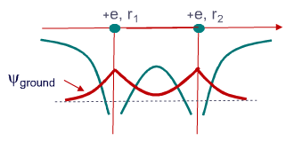
Random Condensed Matter Topics
Molecular Potentials
Band Theory and Band Structure
Conduction and Valence Bands
How does Temperature affect electron transport
Want to learn more? Take ECE 340 or PHYS 460 or I assume some Material Science class?

Slide 11
Exam Advice
Know when and how to use your equation sheet
Don’t panic, just keep on moving
Make sure you are in the right mindset going into the exam
Spend your time showing what you know
DON’T CHEAT

Slide 12
Past Exam Questions

Slide 13
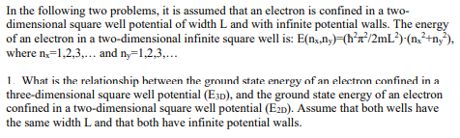



Fall 2001

Slide 14


Fall 2001

Slide 15




Fall 2001

Slide 16
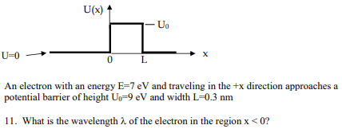




Fall 2001

Slide 17
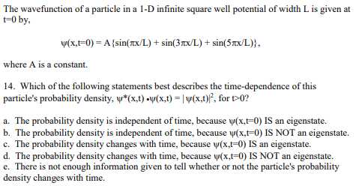


Fall 2001

Slide 18
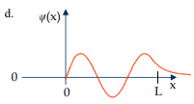
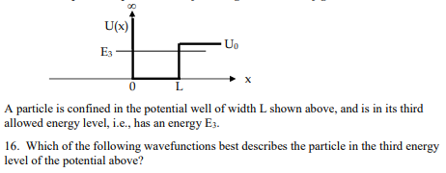
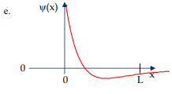
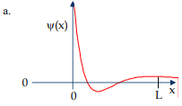
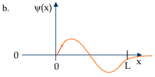
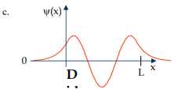
Fall 2001

Slide 19



Spring 2010

Slide 20

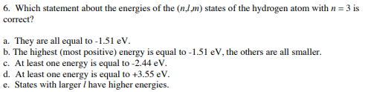
Spring 2010

Slide 21
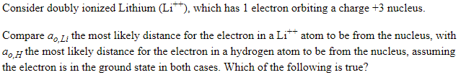

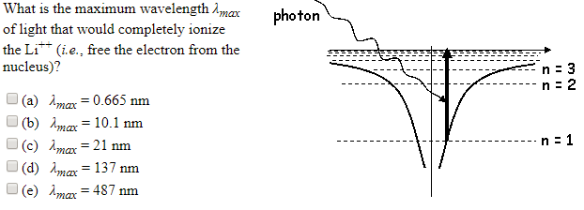
Spring 2010 26 & 27

Slide 22



Spring 2009

Slide 23
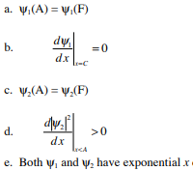
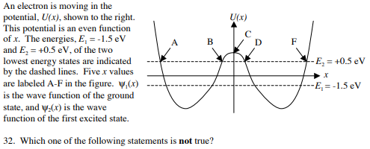


Spring 2010

Slide 24


Spring 2009

Slide 25
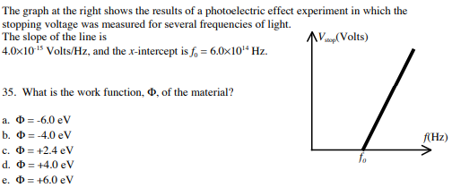

Spring 2010

Slide 26
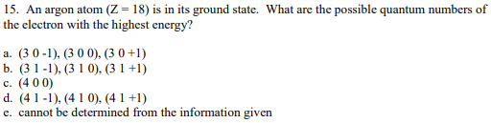
Spring 2009

