Slide 1
210 Midterm 2 HKN Fall 2017 Review
Yda Hoffer-Sohn, Andrew Joerger, Richard Nai

Slide 2


Phasors and Impedance
Euler’s Formula:
$e^{±jθ}= \cos{θ}±j\sin{θ}$
$Re\left\{e^{jθ}\right\}= \cos{θ}= \frac{e^{jθ}+e^{−jθ}}{2}, Im\left\{e^{jθ}\right\}= \sin{θ}= \frac{e^{jθ}− e^{−jθ}}{2j}$
AC signal:
$f\left(t\right)≜Re\left\{Fe^{jωt}\right\}$
$F=\left|F\right|e^{jθ}$
Impedance:
Unit of Ohms, defined as ratio of voltage to current through circuit component: $Z=\frac{V}{I}$
$Z_{c}= \frac{1}{jωC}$
$Z_{L}=jωL$
$Z_{R}=R$
Note: $\frac{\tan^{−1}{(∅)}}{\tan^{−1}{(θ)}}=\tan^{−1}\left(∅\right)−\tan^{−1}{(θ)}$

Slide 3

AC Circuit Analysis
Steady State
Oscillates indefinitely or remains constant
Does not approach 0 for $t\overset{→}{}∞$,$\lim_{t→∞}{f(t)}= f_{ss}(t)$
Transient
Approaches zero over time, $\lim_{t→∞}{f_{tr}(t)}=0$
Given ODE $\frac{dy}{dt}+y\left(t\right)=f(t)$
Zero-State
Initial value zero, Set y$\left(t_{0}\right)=0$ and solve for $y(t)$
Zero-Input
Sources zero, set $f\left(t\right)=0$and $y(t_{0})=k$

Slide 4

Average and Available Power
Average Power:
$P_{avg}=\frac{1}{2} Re\left\{VI^{∗}\right\}=\frac{1}{2} Re\left\{V^{∗}I\right\}$
Available Power:
$P_{a}= \frac{{|V_{s}|}^{2}}{{8R}_{T}}, R_{T}=Re\{Z\}$
Matched Load:
$Z_{T}={Z_{L}}^{∗}$

Slide 5
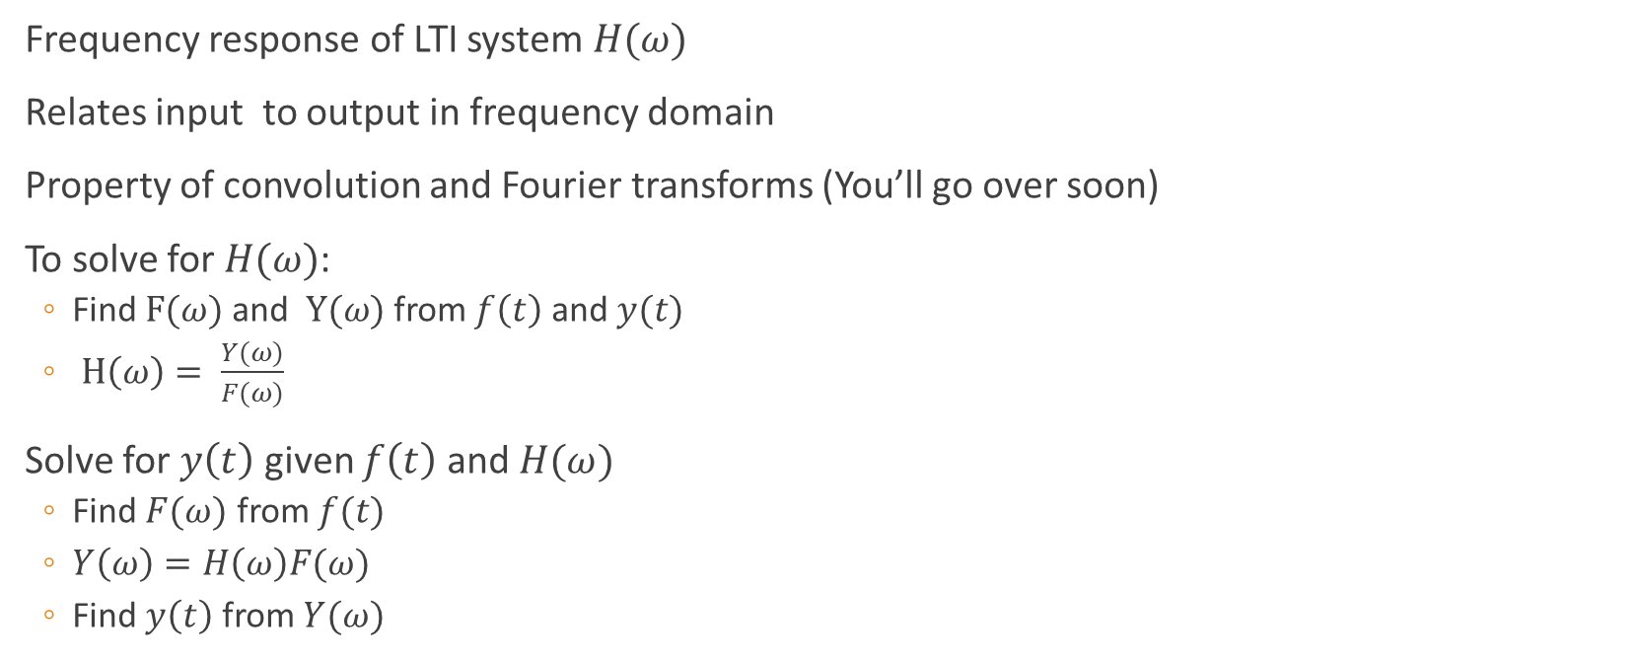
Frequency Response
Frequency response of LTI system $H(ω)$
Relates input to output in frequency domain
Property of convolution and Fourier transforms (You’ll go over soon)
To solve for $H(ω)$:
Find $F(ω)$ and $Y(ω)$ from $f\left(t\right)$ and $y(t)$
$H\left(ω\right)= \frac{Y(ω)}{F(ω)}$
Solve for $y\left(t\right)$ given $f\left(t\right)$ and $H(ω)$
Find $F(ω)$ from $f(t)$
$Y\left(ω\right)=H\left(ω\right)F(ω)$
Find $y\left(t\right)$ from $Y(ω)$

Slide 6
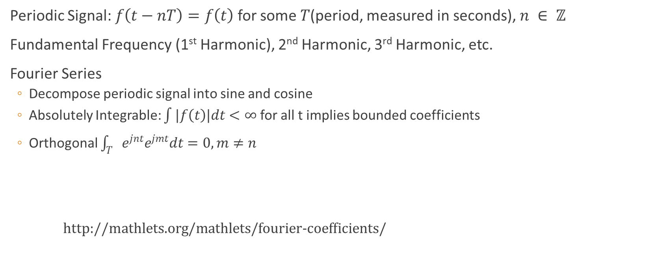
Fourier Coefficients
Periodic Signal: $f\left(t−nT\right)=f\left(t\right)$ for some $T$(period, measured in seconds), $n ∈ ℤ$
Fundamental Frequency (1st Harmonic), 2nd Harmonic, 3rd Harmonic, etc.
Fourier Series
Decompose periodic signal into sine and cosine
Absolutely Integrable: $\int{|f\left(t\right)|dt}<∞$ for all t implies bounded coefficients
Orthogonal $\int_{T}{e^{jnt}e^{jmt}dt}=0, m≠n$
http://mathlets.org/mathlets/fourier-coefficients/

Slide 7
Questions?

Slide 8
Past Problems

Slide 9
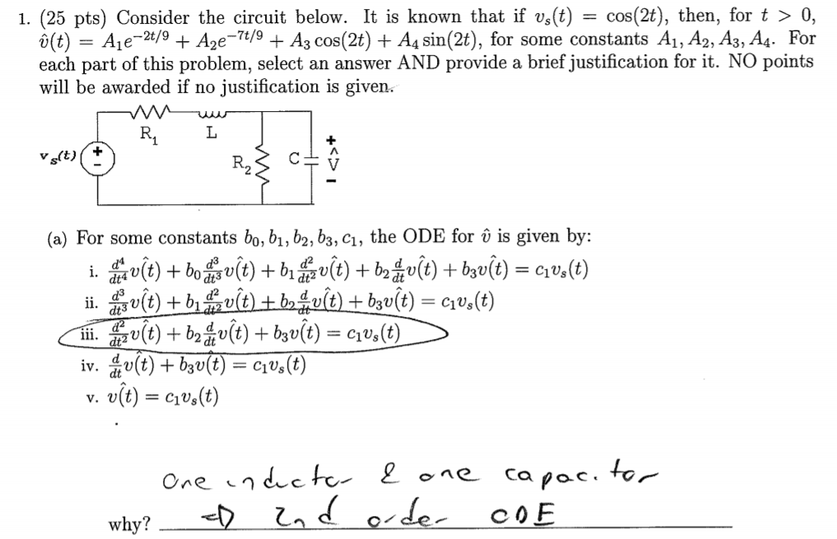
Spring 2017 Question 1

Slide 10
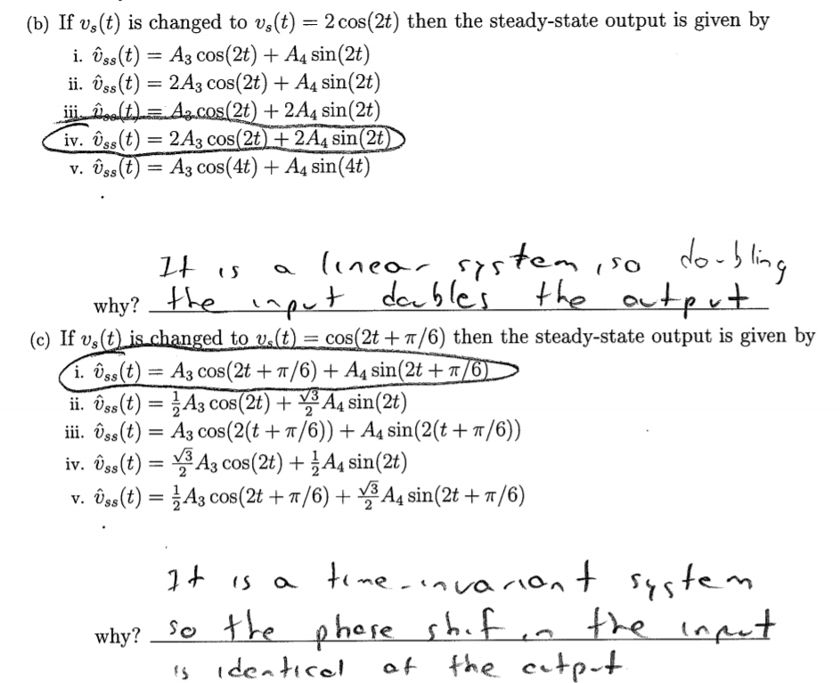

Slide 11
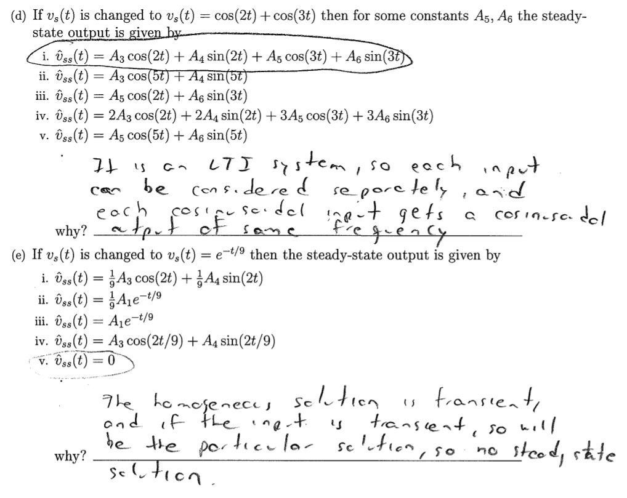

Slide 12
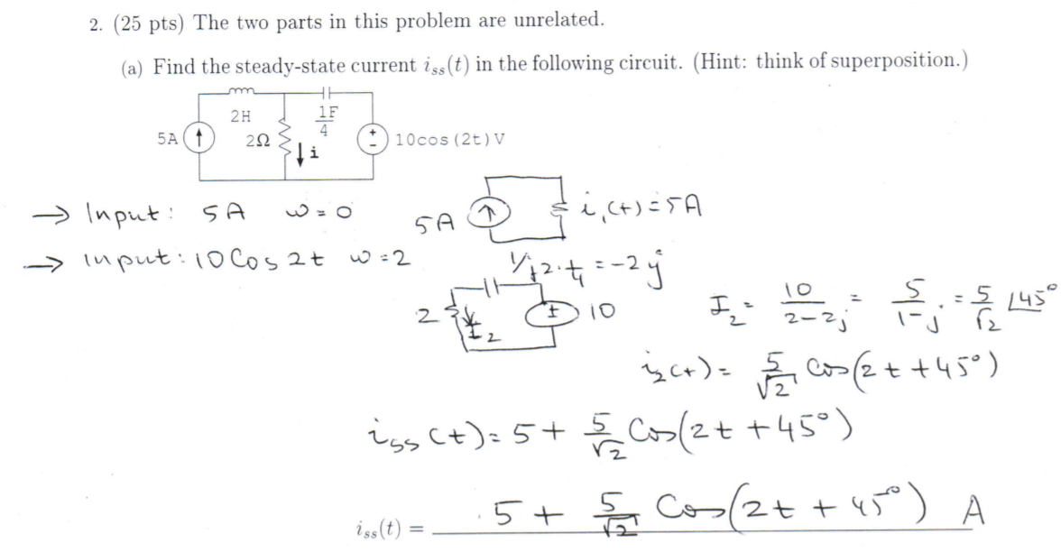
Fall 2014 Question 2

Slide 13
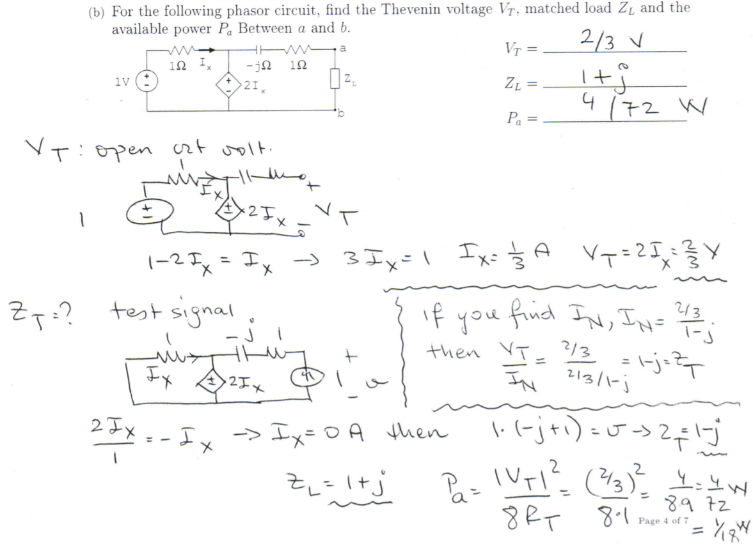

Slide 14
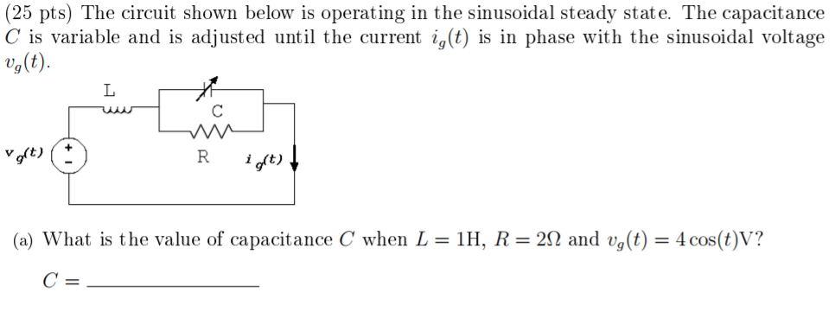
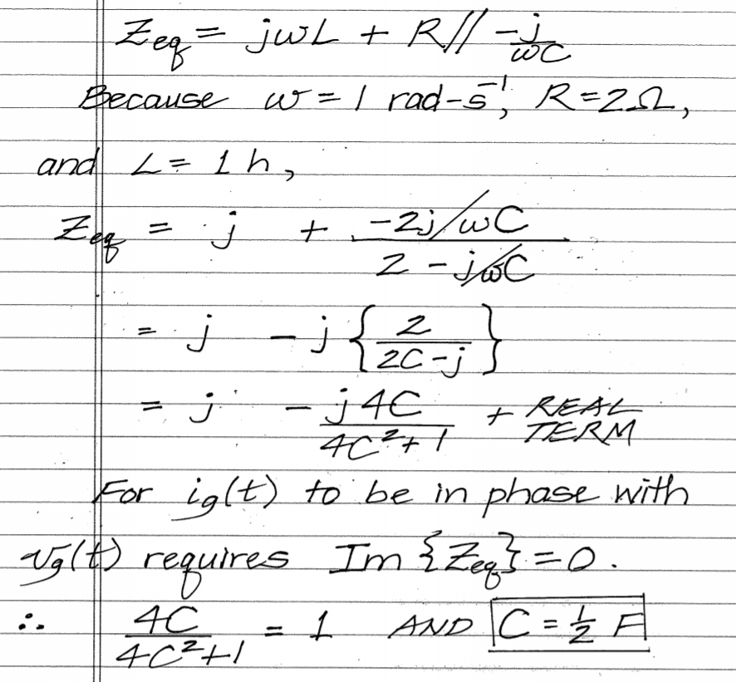
Spring 2017 Question 2

Slide 15
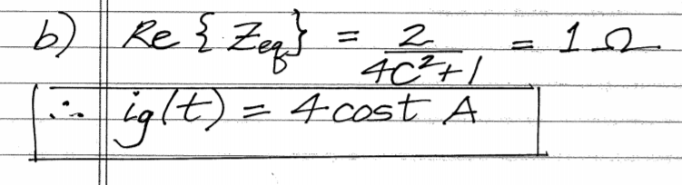

Slide 16
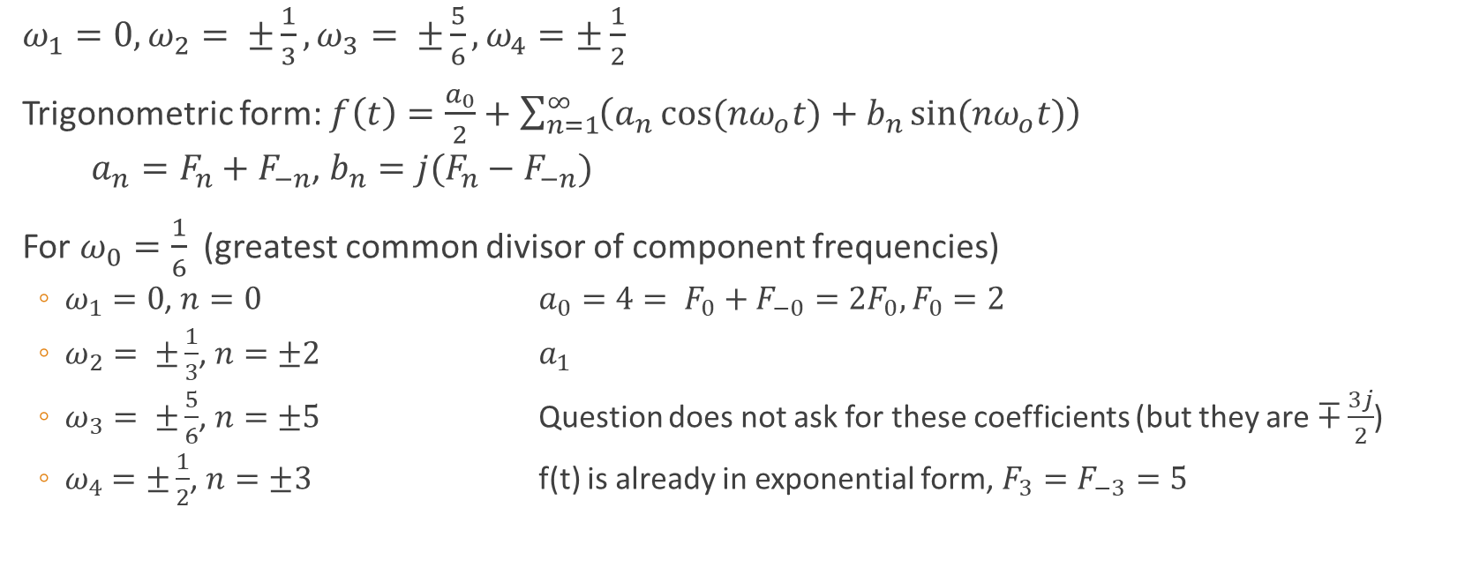

Consider the signal: $f\left(t\right)=2+\cos\left(\frac{t}{3}\right)+3\sin\left(\frac{5t}{6}\right)+5e^{\frac{jt}{2}}+5e^{\frac{−jt}{2}}$ Find its period T, and fundamental frequency $ω_{0}$ Find the Fourier Coefficients $F_{0},F_{1},F_{−1},F_{2},F_{−2},F_{3},F_{−3}$
$ω_{1}=0,ω_{2}= ±\frac{1}{3},ω_{3}= ±\frac{5}{6},ω_{4}=±\frac{1}{2}$
Trigonometric form: $f\left(t\right)=\frac{a_{0}}{2}+\sum_{n=1}^{∞}{\left(a_{n}\cos{{(nω}_{o}t)}+b_{n}\sin{{(nω}_{o}t)}\right)}$
$a_{n}=F_{n}+F_{−n}$, $b_{n}=j(F_{n}−F_{−n})$
For $ω_{0}=\frac{1}{6}$ (greatest common divisor of component frequencies)
$ω_{1}=0$, $n=0$ $a_{0}=4= F_{0}+F_{−0}=2F_{0}, F_{0}=2$
$ω_{2}= ±\frac{1}{3}$, $n=±2$ $a_{1}$
$ω_{3}= ±\frac{5}{6}$, $n=±5$ Question does not ask for these coefficients (but they are $∓\frac{3j}{2}$)
$ω_{4}=±\frac{1}{2}$, $n=±3$ f(t) is already in exponential form, $F_{3}=F_{−3}=5$

Slide 17
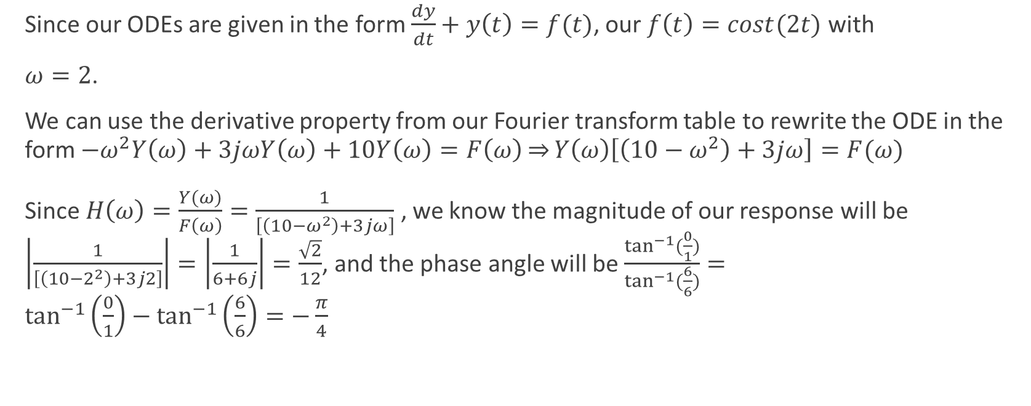

LTI system described by ODE: $$\frac{d^{2}y}{{dt}^{2}}+3\frac{dy}{dt}+10y\left(t\right)=\cos{(2t)}$$ Find the steady-state solution
Since our ODEs are given in the form $\frac{dy}{dt}+y\left(t\right)=f(t)$, our $f\left(t\right)=cost(2t)$ with
$ω=2$.
We can use the derivative property from our Fourier transform table to rewrite the ODE in the form ${−ω}^{2}Y\left(ω\right)+3jωY\left(ω\right)+10Y\left(ω\right)=F\left(ω\right)\overset{⇒}{}Y\left(ω\right)\left[\left(10−ω^{2}\right)+3jω\right]=F(ω)$
Since $H\left(ω\right)=\frac{Y(ω)}{F\left(ω\right)}=\frac{1}{\left[\left(10−ω^{2}\right)+3jω\right]}$ , we know the magnitude of our response will be $\left|\frac{1}{\left[\left(10−2^{2}\right)+3j2\right]}\right|=\left|\frac{1}{6+6j}\right|=\frac{\sqrt{2}}{12}$, and the phase angle will be $\frac{\tan^{−1}{(\frac{0}{1})}}{\tan^{−1}{(\frac{6}{6})}}=\tan^{−1}\left(\frac{0}{1}\right)−\tan^{−1}\left(\frac{6}{6}\right)=−\frac{π}{4}$

Slide 18


Convert signal to phasor form: $$f_{1}\left(t\right)=2\cos{(2t−\frac{π}{2}})+\sin{(2t+\frac{π}{2})}$$
$2\cos\left(2t−\frac{π}{2}\right)=2\sin\left(2t\right),\sin\left(2t+\frac{π}{2}\right)=\cos\left(2t\right)$
Using Euler’s Formula: $e^{±jθ}= \cos{θ}±j\sin{θ}$
$f_{1}\left(t\right)=−2j\sin\left(2t\right)+cos⁡(2t)$
$Re\left\{f\left(t\right)\right\}=1$, $Im\left\{f\left(t\right)\right\}=−2$ $\overset{→}{} 1−2j$

Slide 19

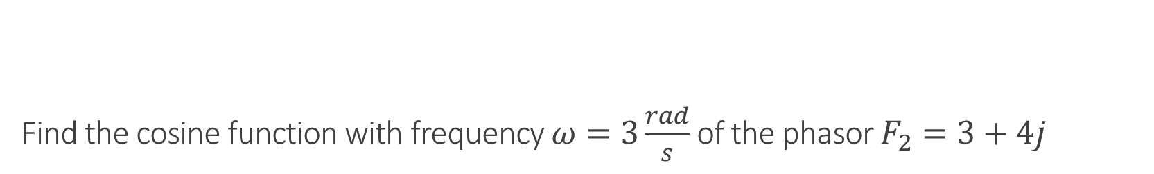
Find the cosine function with frequency $ω=3\frac{rad}{s}$ of the phasor $F_{2}=3+4j$
The frequency and symmetry is given, otherwise we couldn’t really specify it on our own:
$\left|F_{2}\right|=\sqrt{\left(3^{2}+4^{2}\right)}=5$ , $∅= \tan^{−1}\left(\frac{4}{3}\right)$
$f_{2}\left(t\right)=5cos⁡(3t+(\tan^{−1}\left(\frac{4}{3}\right))$

