Slide 1
HKN ECE 342 Review Session 2
Anthony Li
Milan Shah

Slide 2
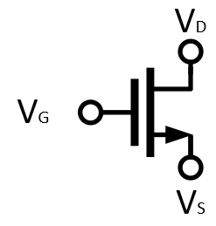
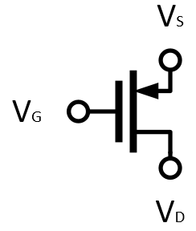
MOSFET’s
NMOS
PMOS

Slide 3
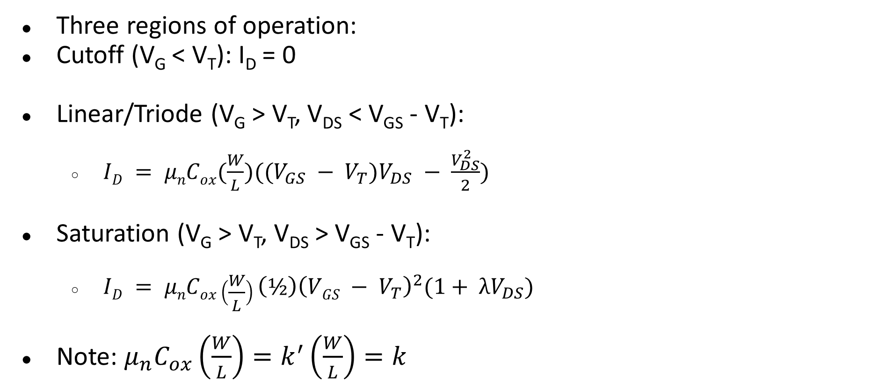
MOSFET Operating Point
Three regions of operation:
Cutoff (V_{G} < V_{T}): I_{D} = 0
Linear/Triode (V_{G} > V_{T}, V_{DS} < V_{GS} - V_{T}):
$ID = μnCox(\frac{W}{L})((V_{GS} − V_{T})V_{DS} − \frac{V_{DS}^{2}}{2})$
Saturation (V_{G} > V_{T}, V_{DS} > V_{GS} - V_{T}):
$ID = μnCox\left(\frac{W}{L}\right){\left(½\right)\left(VGS − V_{T}\right)}^{2}(1+ λV_{DS})$
Note: $μ_{n}C_{ox}\left(\frac{W}{L}\right)=k^{′}\left(\frac{W}{L}\right)=k$

Slide 4
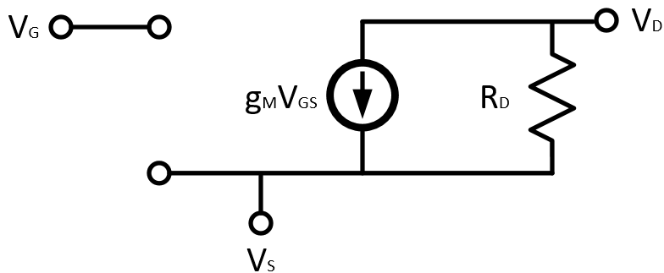

MOSFET Incremental Model
Transconductance: $g_{m}=\frac{2I_{D}}{V_{OV}}$

Slide 5
Gain Calculation
A_{v} = -G_{M}R_{out}
G_{M} = Small signal transconductance, ratio of i_{out} to v_{in}
R_{OUT} = Equivalent incremental output resistance

Slide 6
Common Amplifier Topologies
Diode-tied Transistor
Common Source/Drain/Gate
Common Source with Degeneration
Common Drain with Modulation
Cascode
Diode Tied Transistor

Slide 7


Diode-Tied Transistor
R_{OUT} = $\frac{1}{g_{m}}||r_{ds}≈\frac{1}{g_{m}}$ for $g_{m}r_{ds}≫1$ or $r_{ds}→∞$
Diode Tied Transistor

Slide 8
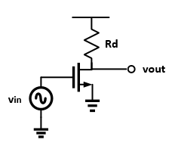
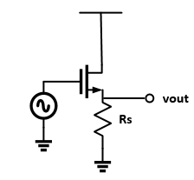
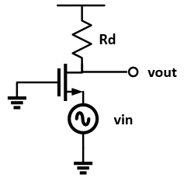
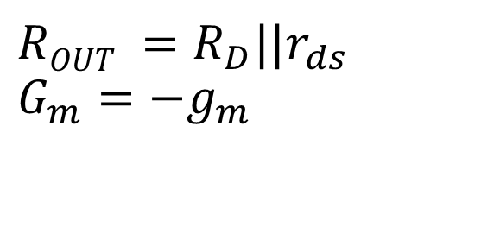
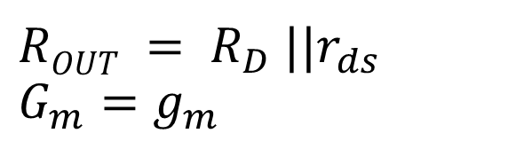
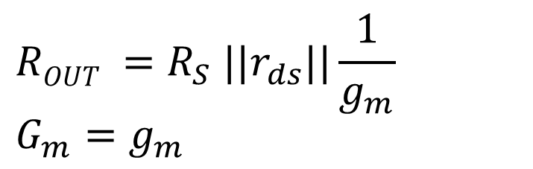
Common Source/Drain/Gate
$$ROUT =R_{S} ||r_{ds}||\frac{1}{g_{m}}$$
$$G_{m}=g_{m}$$
$$ROUT = R_{D} ||r_{ds}$$
$$G_{m}=g_{m}$$
$$ROUT =R_{D}||r_{ds}$$
$$G_{m}=−g_{m}$$
Notes:
Common Source. Your basic amplifier topology. Notice the infinite input resistance and inverted gain.
Common Drain. Also known as a level shifter. These make great buffers. Source follower?
Common Gate. good current buffer i believe.

Slide 9
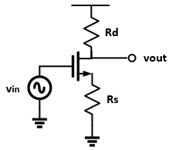
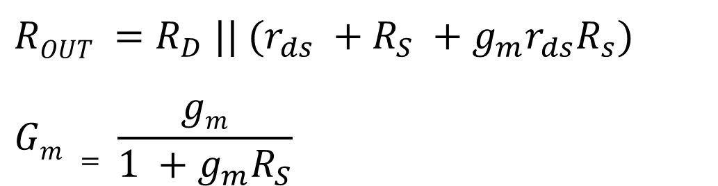
Degeneration
When a resistance is “viewed” through the drain, it appears bigger by a factor related to the transconductance.
$$ROUT =R_{D} || (r_{ds} +R_{S} +g_{m}r_{ds}R_{s})$$
$$Gm = \frac{gm}{1 +g_{m}R_{S}}$$
Notes:
Note that these formulas simplify to the common source ones if Rs is zero. Also remember that these equations rely on rds not being infinity.

Slide 10
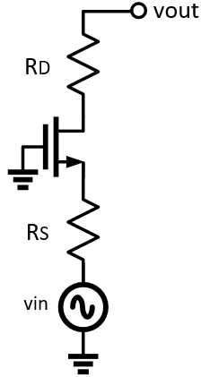
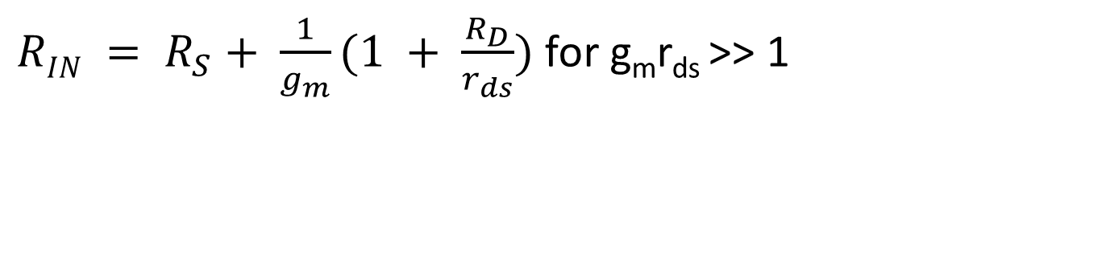

Modulation
Resistances seen through the source seem smaller:
$RIN = R_{S}+ \frac{1}{g_{m}}(1 + \frac{R_{D}}{r_{ds}})$for g_{m}r_{ds} >> 1
$$R_{IN}$$

Slide 11
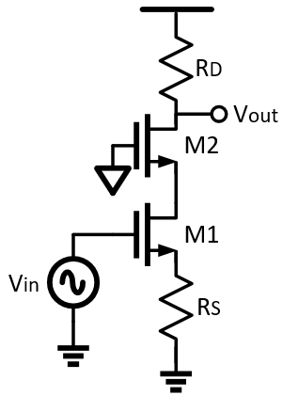

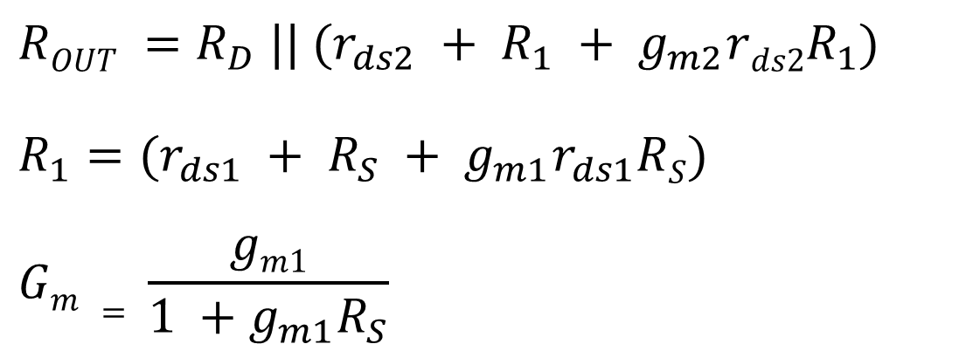
Cascode
$$ROUT =R_{D} || (r_{ds2} + R_{1} + g_{m2}rds2R_{1})$$
$$R_{1}=(r_{ds1} + R_{S} + g_{m1}r_{ds1}RS)$$
$$Gm = \frac{gm1}{1 +g_{m1}R_{S}}$$
$$R_{1}$$

Slide 12
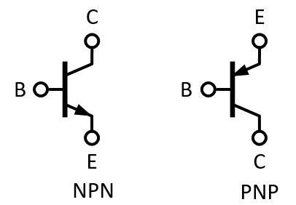
BJT

Slide 13
Regions of Operation
Three regions of operation:
Cutoff: V_{E} > V_{B} < V_{C}
Saturation: V_{E} < V_{B} > V_{C}
Forward Active: V_{E} > V_{B} > V_{C}
V_{T} = kt/q
I_{C} = ꞵI_{B}
I_{E} = I_{C} + I_{B}
Ꞵ = g_{m}R_{𝜋}

Slide 14
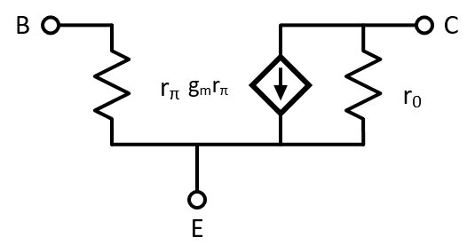
BJT Small Signal Model

Slide 15
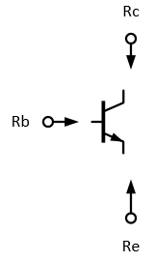


Terminal Impedance
R_{C} = r_{o}
R_{B} = R_{ℼ}
R_{E} = $\frac{Rℼ}{ꞵ+1}$
Diode-Tied = $\frac{Rℼ}{ꞵ+1}$
Diode Tied Transistor

Slide 16
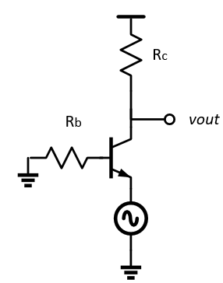
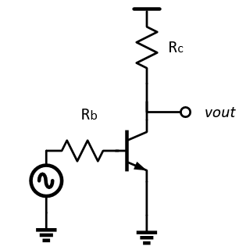
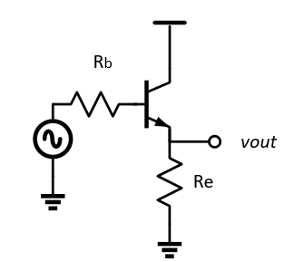
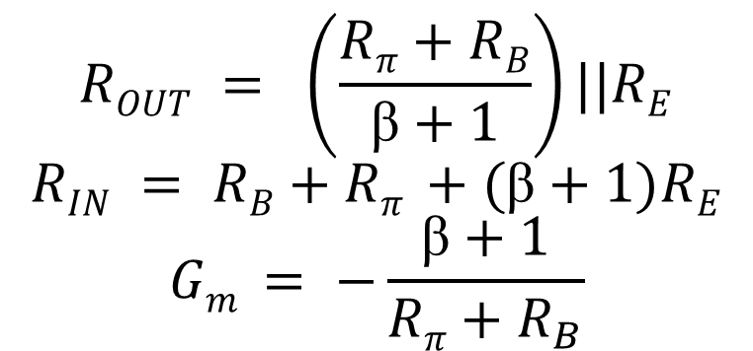
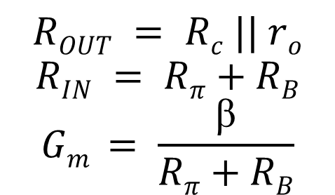
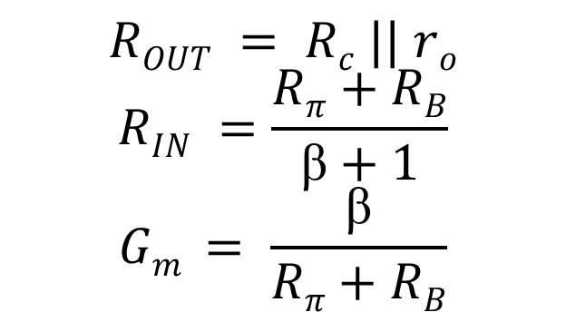
Common Emitter/Collector/Base
$$ROUT = \left(\frac{Rπ+RB}{ꞵ+1}\right)||RE$$
$$RIN = RB+Rπ +(ꞵ+1)RE$$
$$Gm = −\frac{ꞵ+1}{Rπ+R_{B}}$$
$$ROUT = Rc || ro$$
$$RIN =\frac{Rπ+RB}{ꞵ+1}$$
$$Gm = \frac{ꞵ}{Rπ+RB}$$
$$ROUT = Rc || ro$$
$$RIN = Rπ+RB$$
$$Gm = \frac{ꞵ}{Rπ+RB}$$

Slide 17
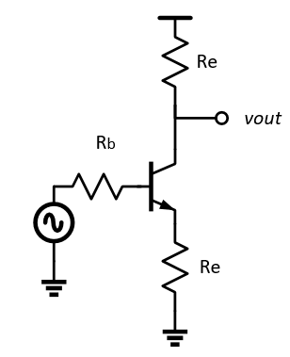
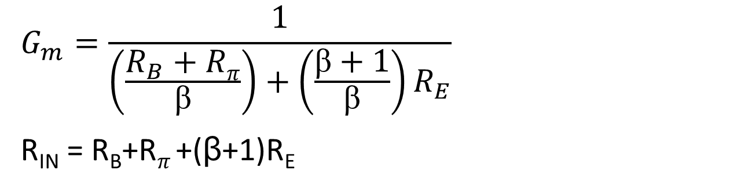
Degeneration
When a resistance is “viewed” through the collector, it appears bigger by a factor related to the transconductance.
$$G_{m}=\frac{1}{\left(\frac{R_{B}+Rπ}{ꞵ}\right)+\left(\frac{ꞵ+1}{ꞵ}\right)R_{E}}$$
R_{IN} = R_{B}+R_{𝜋} +(ꞵ+1)R_{E}

Slide 18
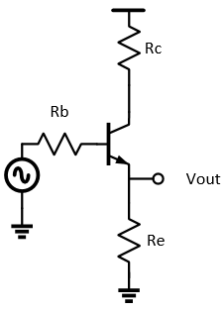
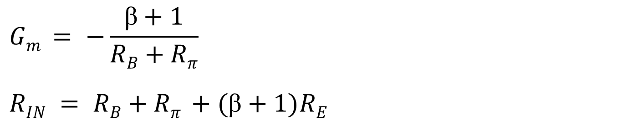
Modulation
Resistances seen through the Emitter seem smaller.
$$Gm = −\frac{ꞵ+1}{RB+Rπ}$$
$$RIN = RB+Rπ +(ꞵ+1)RE$$

Slide 19
Bode Plots
Magnitude
Pole: Roll down by 20 db/dec, 6 db/oct
Zero: Roll up by 20 db/dec, 6 db/oct
Phase: arctan(ω/ω_{p})
Usually -90° for poles, +90° for zeros
ω_{ugf} = 20log|A_{n}| * ω_{pn} where n is the pole located before unity gain frequency

Slide 20
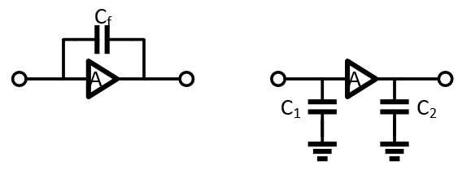

Miller Effect
$C_{1}=C_{f}\left(1+A\right)$
$C_{2}=C_{f}(1+\frac{1}{A})$

Slide 21
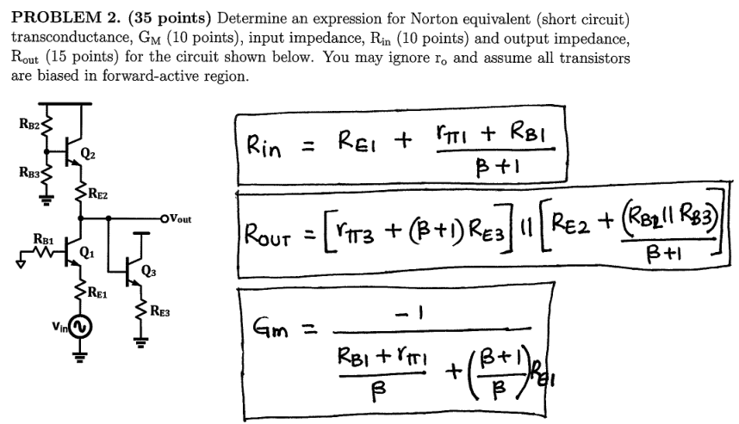
Problem 1: Midterm 3 Fa17

Slide 22
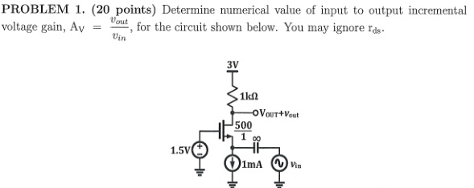
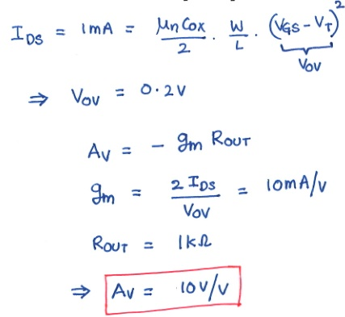
Problem 2: Midterm 2 Fa16

Slide 23
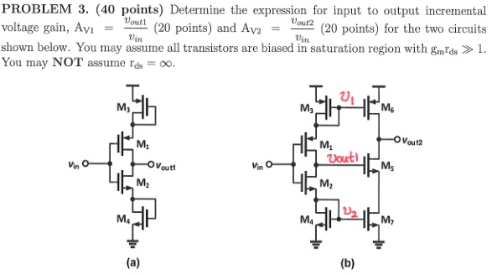

Problem 3: Midterm 2 Fa16
A. $G_{m}=\frac{g_{m_{2}}}{1+\frac{g_{m_{2}}}{g_{m_{4}}}}+\frac{g_{m_{1}}}{1+\frac{g_{m_{1}}}{g_{m_{3}}}}$, $R_{out}=\left(\frac{1}{g_{m_{4}}}+r_{ds_{2}}+\frac{g_{m_{2}}}{g_{m_{4}}}r_{ds_{2}}\right)||\left(\frac{1}{g_{m_{3}}}+r_{ds_{1}}+\frac{g_{m_{1}}}{g_{m_{3}}}r_{ds_{1}}\right)$
B. Refer to solutions

