Slide 1
HKN Phys 212 Exam 2 Review Session
Steven Kolaczkowski

Slide 2

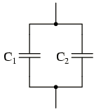

Capacitors in Circuits
Series Capacitors: $C_{total}=\frac{1}{\frac{1}{C_{1}}+\frac{1}{C_{2}}}=\frac{C_{1}C_{2}}{C_{1}+C_{2}}$
Q is the same for both capacitors
Parallel Capacitors : $C_{total}=C_{1}+C_{2}$
V is the same for both capacitors
$C≡\frac{Q}{V} E=\frac{1}{2}CV^{2}=\frac{1}{2}QV=\frac{1}{2}\frac{Q^{2}}{C}$

Slide 3

Resistance, Ohm’s law, and resistors
Ohm’s Law: $J=σE$ this is usually represented as $V=IR$ in circuit analysis
Here J is the current density, $σ$ is the conductivity, I is the current, and R is the resistance
Resistance: a measure of an elements opposition to charge flow $R=\frac{L}{σA}=\frac{ρL}{A}$
Series resistance: $R_{total}=R_{1}+R_{2}$
Resistors in series share the same current ($I$)
Parallel resistance: $R_{total}=\frac{1}{\frac{1}{R_{1}}+\frac{1}{R_{2}}}=\frac{R_{1}R_{2}}{R_{1}+R_{2}}$
Resistors in parallel share the same voltage

Slide 4

Kirchhoff's Laws
Kirchhoff’s Current Law (KCL): Statement of conservation of Charge
$Σ_{in}I=Σ_{out}I$ for any node / equipotential
Kirchhoff’s Voltage Law (KVL): Statement of conservation of Energy
$Σ_{i}V_{i}=0$ for any closed loop

Slide 5

RC Circuits
Capacitors instantaneous reaction and time dependence.
At $t=0$
At $t →∞$
$V=IR$ only works for resistors.
Don’t try and apply this to capacitors and sources!!!
Time constant $(τ)$: The fundamental time of a circuit $τ_{RC}=RC$
We will have another time constant for LR and LC circuits
Power
$Σ_{i}P_{i}=0$ Conservation of Energy, time independent
$P=IV$

Slide 6

Magnetism
Updated Lorentz Force: $\vec{F}=q(\vec{E}+\vec{v} ×\vec{B})$
Current Carrying Wire: $\vec{F}=I \vec{L} ×\vec{B}$
Right Hand Rules:
1. Thumb in direction of current, figures curl in direction of Magnetic Field
2. Index figure in direction of velocity, middle figure in direction of Magnetic field, thumb in direction of force
3. Figures in direction of current, thumb in direction of magnetic field.

Slide 7

Torque and Moments
Torque is the rotational force applied to an object
$\vec{τ}=\vec{r}×\vec{F}=\vec{μ}×\vec{B}$
Magnetic Moment ($\vec{μ}$): Related to the amount of area and current in a system
$\vec{μ}=NI\vec{A}$
Potential Energy of a magnetic system: $U=−\vec{μ}∙\vec{B}$

Slide 8

Biot-Savart Law and Ampere’s Law
Biot-Savart Law: $d\vec{B}=\frac{μ_{0}I}{4π} \frac{d\vec{s}×\hat{r}}{r^{2}}$
Since $\vec{F}=I\vec{L}×\vec{B}$ Force between two wires: $F=\frac{μ_{0}}{2πd} I_{1}I_{2}L$
Very Situational
Ampere’s law: $\oint{\vec{B}∙d\vec{l}=μ_{0}I_{enclosed}}$
Useful in highly symmetric situations (wires and current sheets)
Wire: $\vec{B}=\frac{μ_{0}I}{2πr} \hat{φ}$
Sheet: $B=\frac{1}{2} μ_{0}nI$

Slide 9

Electromotive Force and Faraday’s Law
Magnetic Flux: Number of Magnetic Field Lines that penetrate a certain area
$Φ_{B}=\vec{B}∙\vec{A}=∯{\vec{B}∙d\vec{A}}$
Electromotive Force: the Voltage accumulated by traveling one complete path.
$ε=−\frac{dΦ_{B}}{dt}=\oint{\vec{E}∙d\vec{l}}$
That minus sign is important!!! The induced current / field opposes a change in magnetic flux

Slide 10

Inductance and Inductors
Inductance (L): A substance’s opposition to a change in current
$L≡\frac{Φ_{B}}{I}=\frac{∯{\vec{B}∙d\vec{A}}}{I}=\frac{BA}{I} \left[=\right]\frac{{T∙m}^{2}}{A}=H$
$ε=−L\frac{dI}{dt}$ $U_{L}=\frac{1}{2}LI^{2}$
Solenoid: Circularly coiled wire often used as an Inductor
${\vec{B}}_{solenoid}=Iμ_{0}n\hat{z}$ , where $n$ is the number of coils per unit length
Proof using Ampere’s Law
$Φ_{B}=∯{{\vec{B}}_{solenoid}∙d\vec{S}}=B_{solenoid}NA_{solenoid}=Iμ_{0}nNπr^{2}=Iμ_{0}n^{2}zπr^{2}$, where N is the number of coils and z is the length of the solenoid
Energy Density:
$u_{B}=\frac{B^{2}}{2μ_{0}}$ $u_{E}=\frac{1}{2}ε_{0}E^{2}$

Slide 11

LR Circuits
KVL and KCL still apply! (And always will)
$V_{L}=L\frac{dI}{dt} V_{R}=IR$
Inductors will never drastically change current
Same as a Capacitors relation to Voltage
$t=0$
$t→∞$
New Time Constant!!!
$τ_{LR}=\frac{L}{R}$ $τ_{RC}=RC$

Slide 12
Exam Advice
Know when and how to use your equation sheet
Don’t panic, just keep on moving
Make sure you are in the right mindset going into the exam
Spend your time showing what you know
DON’T CHEAT

Slide 13
Past Exam Questions

Slide 14

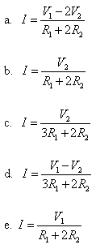
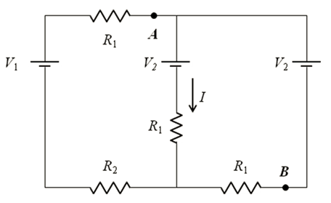

Fall 2010

Slide 15

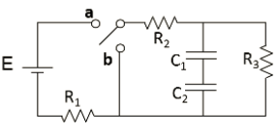
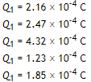


Fall 2015

Slide 16
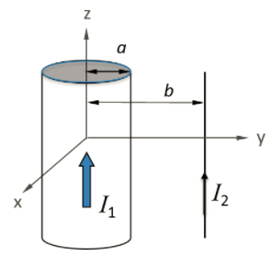



Fall 2015

Slide 17

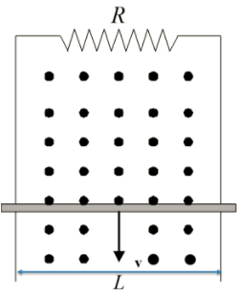



Fall 2015

Slide 18

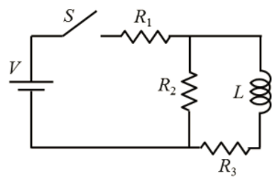



Spring 2014

Slide 19
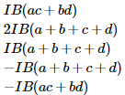
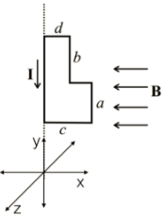





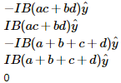
Spring 2014

Slide 20
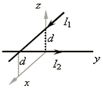


Fall 2010

