Slide 1
HKN ECE 210 Exam 2 Review Session
Corey Snyder
David Yan

Slide 2
Topics
Solving RC and RL Circuits with Differential Equations - Corey
Phasor Method and Complex Impedance - David
Sinusoidal Steady-State Analysis - David
Average and Maximum Power Transfer - Corey
Resonance - David
Frequency Response of LTI Systems - Corey
Periodic Signals, Fourier Series, and LTI System Response to Periodic Signals - Corey

Slide 3
LTI Steady State Response for Co-sinusoidal Inputs
When presented with a co-sinusoidal input to an LTI system,
1. Transform the co-sinusoidal input into phasor domain
2. Transform the system’s components into the phasor domain
3. Calculate the phasor of the quantity that you would like to analyze
All previous resistive circuit analysis methods still apply
4. Map this phasor back to the time domain
This gives us the steady-state response to a co-sinusoidal input
Notes:
For any LTI system, a cosinusoidal input of a given frequency will yield a phase shifted and scaled cosinusoidal output of the same frequency.

Slide 4
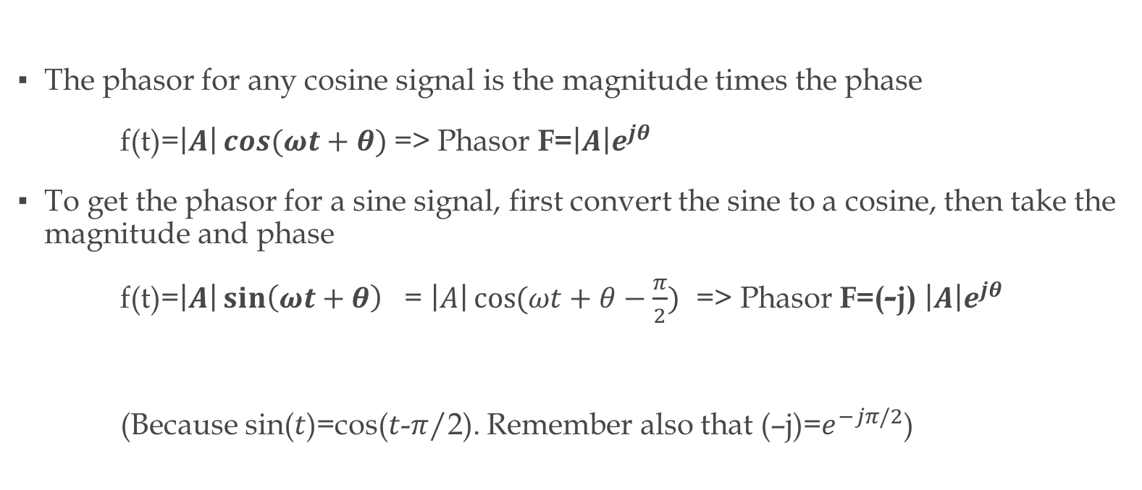
Phasors for Cosines and Sines
The phasor for any cosine signal is the magnitude times the phase
f(t)=$\left|A\right|\cos{(ωt+θ)}$=> Phasor F=$\left|A\right|e^{jθ}$
To get the phasor for a sine signal, first convert the sine to a cosine, then take the magnitude and phase
f(t)=$\left|A\right|\sin\left(ωt+θ\right)$ = $\left|A\right|\cos{(ωt+θ−\frac{π}{2})}$ => Phasor F=(-j) $\left|A\right|e^{jθ}$
(Because sin($t$)=cos($t$-$π$/2). Remember also that (–j)=$e^{−jπ/2}$)
Notes:
The students should have a good grasp of Euler’s formula and the rules for manipulation of complex numbers. We include these additional notes here:
$$\cos{φ}=\frac{e^{jφ}{+e}^{−jφ}}{2}$$
$$\sin{φ}=\frac{e^{jφ}{−e}^{−jφ}}{j2}$$

Slide 5
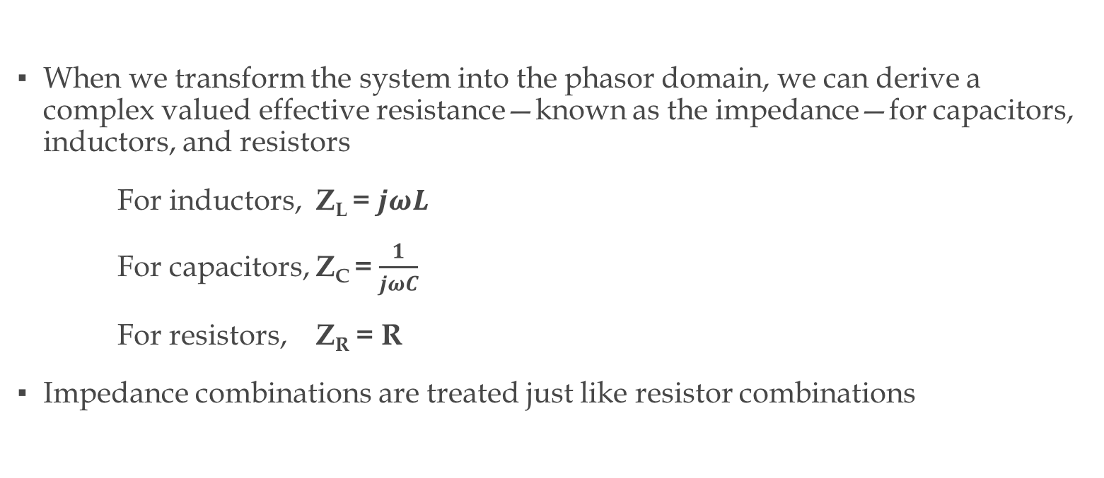
Impedance in the Phasor Domain
When we transform the system into the phasor domain, we can derive a complex valued effective resistance—known as the impedance—for capacitors, inductors, and resistors
For inductors, Z_{L} = $jωL$
For capacitors, Z_{C} = $\frac{1}{jωC}$
For resistors, Z_{R} = R
Impedance combinations are treated just like resistor combinations

Slide 6
Superposition of Phasors
The weighted sum of
f₃(t)=k₁f₁(t) +k₂f₂(t),
where f₁(t) and f₂(t) are co-sinusoids with phasors F₁, F_{2,} has phasor
F₃=k₁F₁+k₂F₂
if and only if f₁(t) and f₂(t) have the same frequency

Slide 7
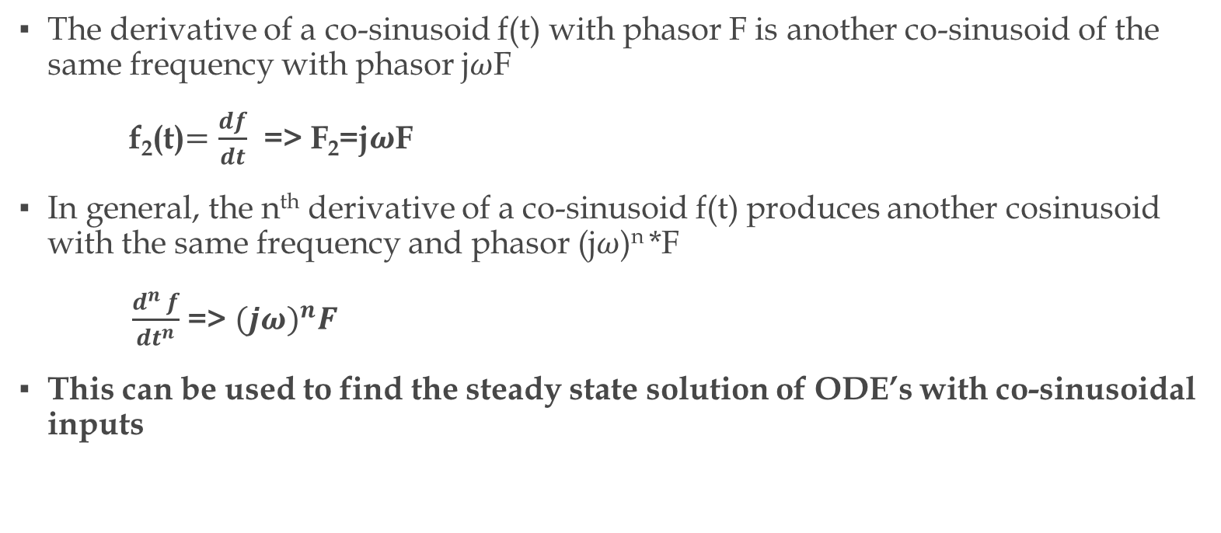
Derivative Principle of Phasors
The derivative of a co-sinusoid f(t) with phasor F is another co-sinusoid of the same frequency with phasor j$ω$F
f₂(t)$=\frac{df}{dt}$ => F₂=j$ω$F
In general, the n^{th} derivative of a co-sinusoid f(t) produces another cosinusoid with the same frequency and phasor (j$ω$)^{n} *F
$\frac{d^{n} f}{dt^{n}}$ => ${(jω)}^{n}F$
This can be used to find the steady state solution of ODE’s with co-sinusoidal inputs

Slide 8
INSERT AVERAGE AVAILABLE POWER HERE

Slide 9
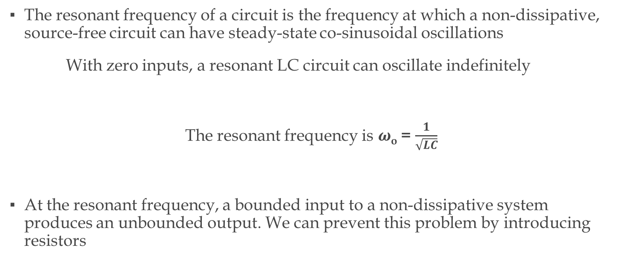
Resonance
The resonant frequency of a circuit is the frequency at which a non-dissipative, source-free circuit can have steady-state co-sinusoidal oscillations
With zero inputs, a resonant LC circuit can oscillate indefinitely
The resonant frequency is $ω$_{o} = $\frac{1}{\sqrt{LC}}$
At the resonant frequency, a bounded input to a non-dissipative system produces an unbounded output. We can prevent this problem by introducing resistors

Slide 10

LC Simplifications at Resonant Frequency
At $ω=ω$_{o} ,
a capacitor and an inductor in series becomes an effective short circuit
a capacitor and an inductor in parallel becomes an effective open circuit

Slide 11
Please place the following questions at the end of the slides

Slide 12
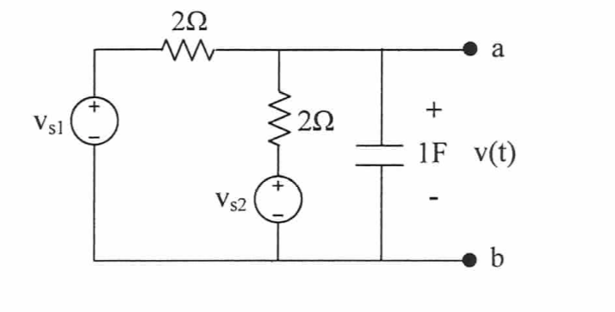
Fall ‘12, Exam II, P2
If vs1= cos(t), vs2=sin(t), find the matched load Z_{L}, and the maximum available power

Slide 13
Fall ‘12, Exam II, P2
If vs1= cos(t), vs2=cos(2t), find v(t)

Slide 14
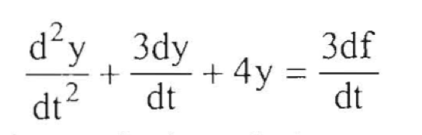
Fall ‘08, Exam II, P2, part (a)
Find the particular solution of the differential equation if f(t)=6cos(t)

Slide 15
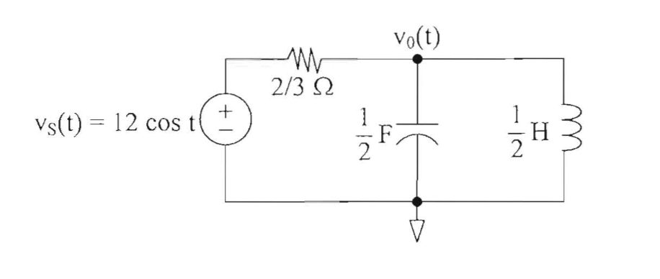
Fall ‘08, Exam II, P2, part (b)
Find the steady-state output voltage v_{o}(t)

Slide 16
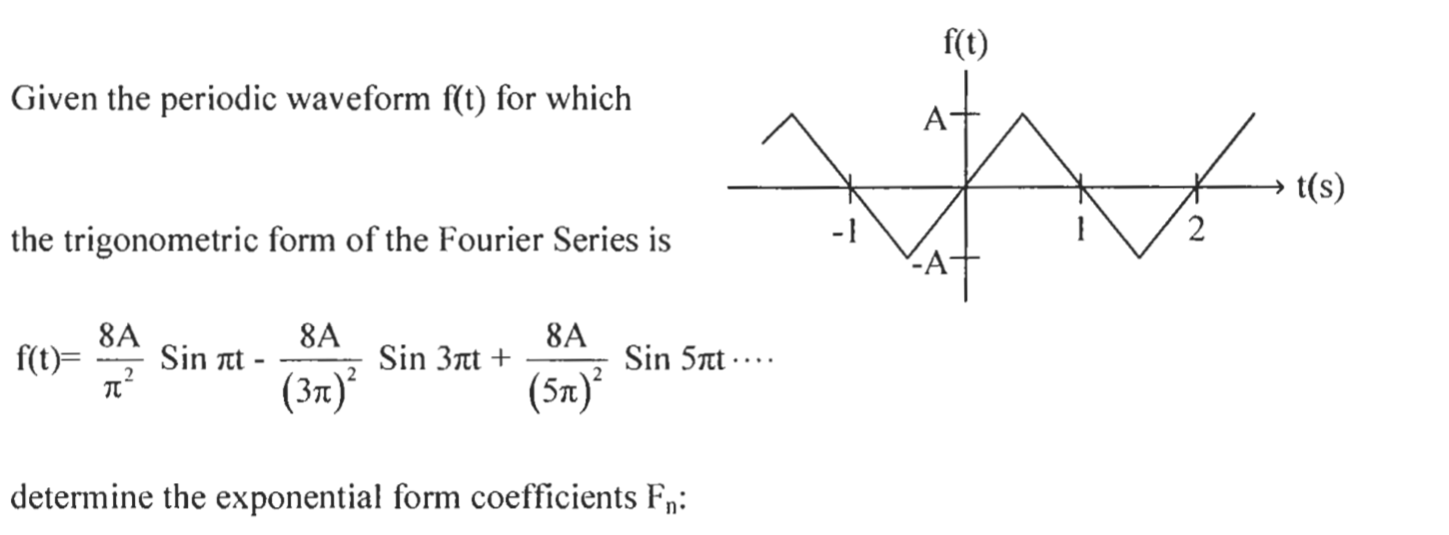
Spring ’12, Exam II, P4, part (a)

Slide 17
Spring ’12, Exam II, P4, part (b)

Slide 18
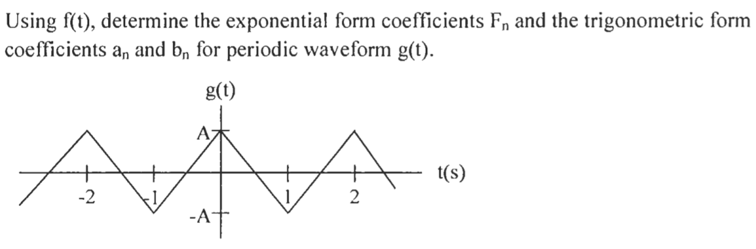
Spring ’12, Exam II, P4, part (c)

Slide 19

Appendix: Complex Number Review
Euler’s Identity:
$e^{±jφ}$= $\cos{φ}±jsinφ$
$$\cos{φ}=\frac{e^{jφ}{+e}^{−jφ}}{2}$$
$$\sin{φ}=\frac{e^{jφ}{−e}^{−jφ}}{j2}$$
Notes:
The previous exam’s slides contain more notes on complex numbers. Additionally, so does Appendix A of the textbook.

