Slide 1
HKN ECE 313 Final Exam Review Session
Corey Snyder

Slide 2
Topics, Topics, Topics
Discrete and Continuous Random Variables
Discrete Distributions
Continuous Distributions
Conditional Probability, Bayes’ Rule, Total Probability, Independence
Maximum Likelihood Parameter Estimation
Binary Hypothesis Testing
Markov and Chebyshev’s Inequalities
Functions of Random Variables
Joint Random Variables
Joint PDFs of Functions of Random Variables
Correlation and Covariance
Minimum Mean Square Error Estimation
Unconstrained
Linear
Law of Large Numbers and Central Limit Theorem
Bivariate Gaussian Distribution

Slide 3
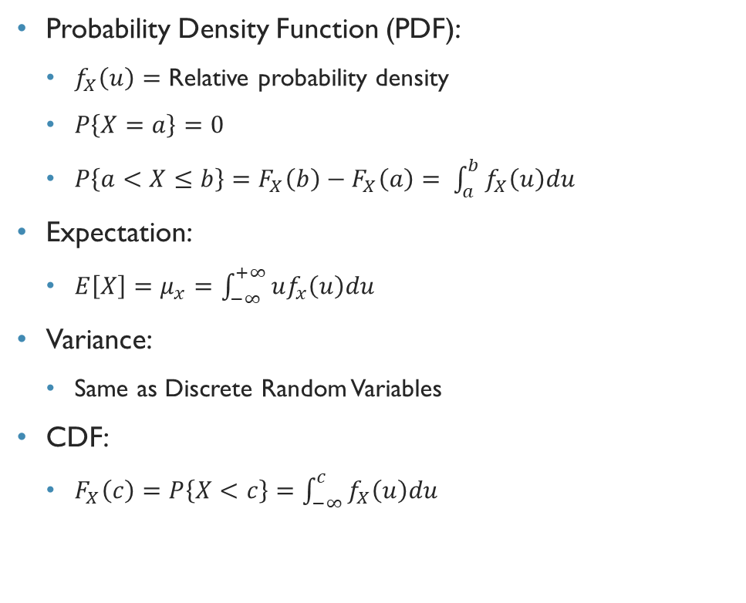
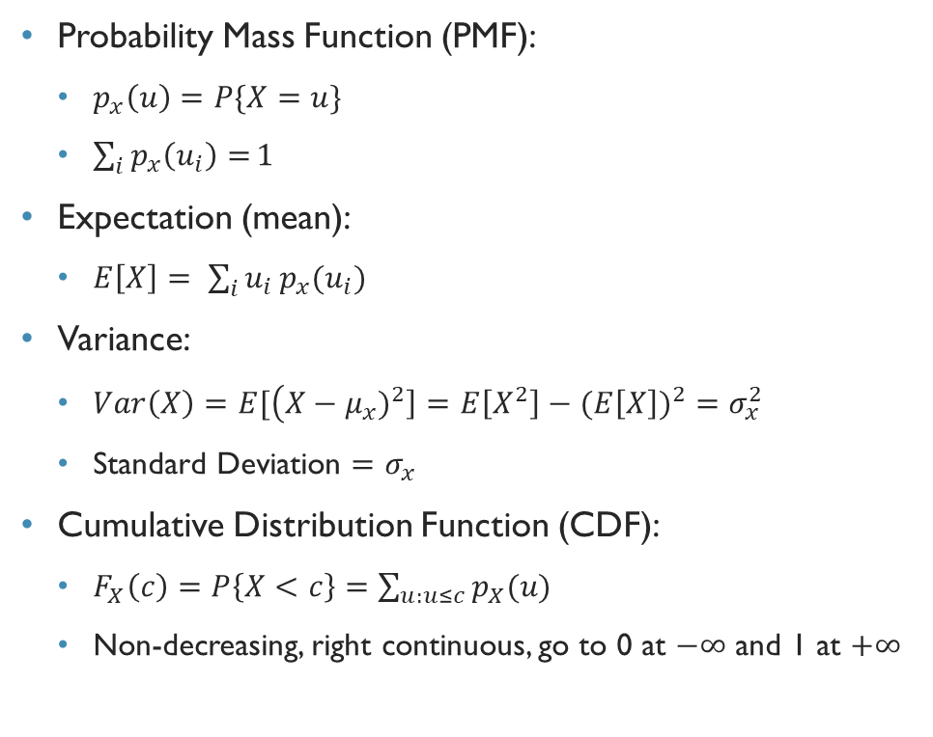
Discrete and Continuous Random Variables
Probability Mass Function (PMF):
$p_{x}\left(u\right)=P\{X=u\}$
$\sum_{i}{p_{x}\left(u_{i}\right)=}1$
Expectation (mean):
$E\left[X\right]= \sum_{i}{u_{i}}p_{x}(u_{i})$
Variance:
$Var\left(X\right)=E[\left(X−μ_{x})^{2}\right]=E\left[X^{2}\right]−(E\left[X\right])^{2}=σ_{x}^{2}$
Standard Deviation $=σ_{x}$
Cumulative Distribution Function (CDF):
$F_{X}\left(c\right)=P\left\{X<c\right\}=\sum_{u:u≤c}{p_{X}(u)}$
Non-decreasing, right continuous, go to 0 at $−∞$ and 1 at $+∞$
Probability Density Function (PDF):
$f_{X}\left(u\right)=$ Relative probability density
$P\left\{X=a\right\}=0$
$P\left\{a<X≤b\right\}=F_{X}\left(b\right)−F_{X}\left(a\right)= \int_{a}^{b}{f_{X}\left(u\right)du}$
Expectation:
$E\left[X\right]=μ_{x}=\int_{−∞}^{+∞}{uf_{x}\left(u\right)du}$
Variance:
Same as Discrete Random Variables
CDF:
$F_{X}\left(c\right)=P\left\{X<c\right\}=\int_{−∞}^{c}{f_{X}\left(u\right)du}$

Slide 4
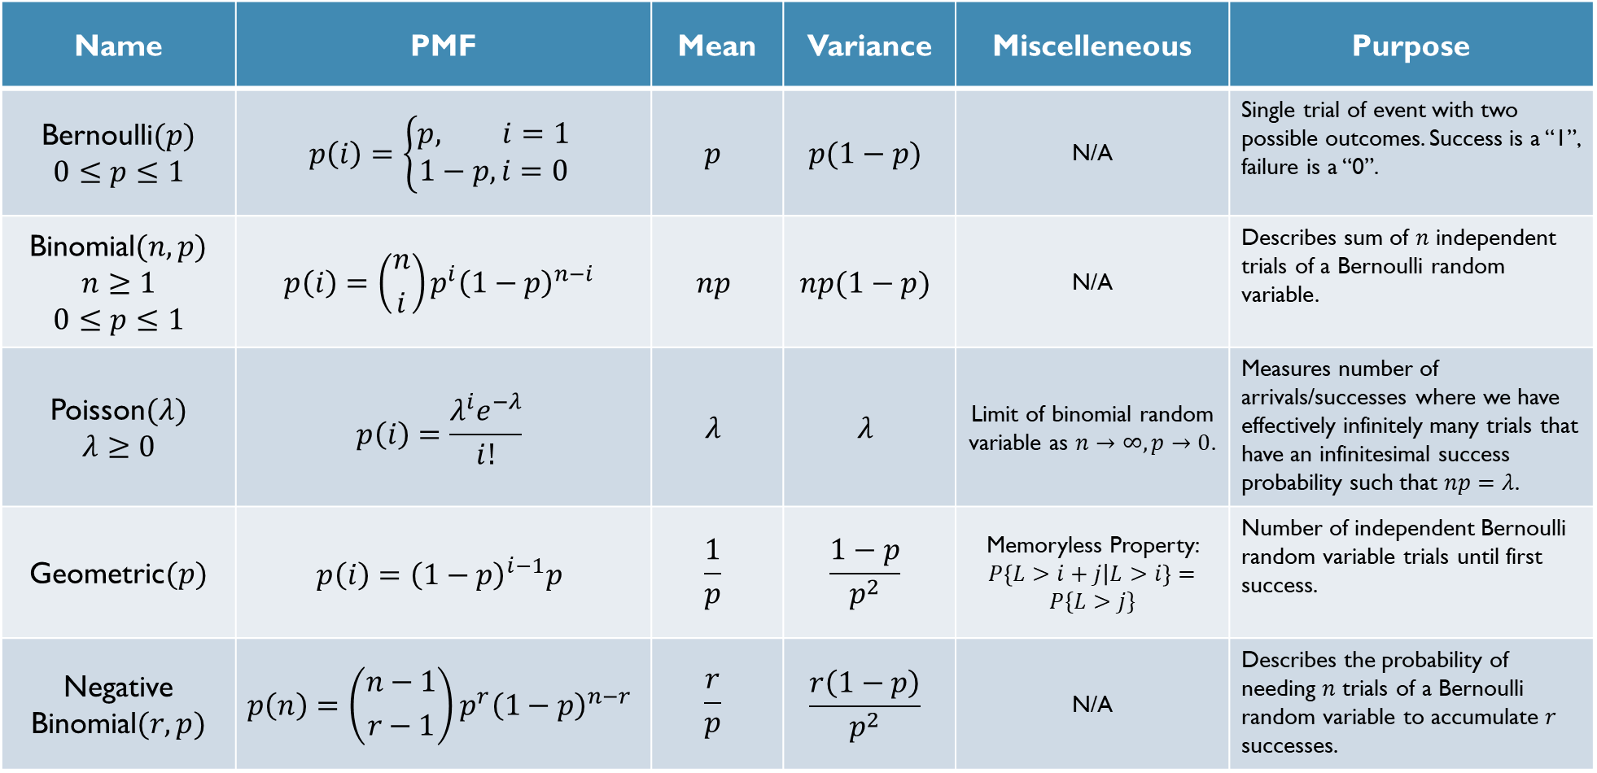
Discrete Distributions
Name | PMF | Mean | Variance | Miscelleneous | Purpose
Bernoulli$(p)$ $$0≤p≤1$$ | $$p\left(i\right)=\left\{\begin{aligned}p, i=1 \\ 1−p,i=0\end{aligned}\right.$$ | $$p$$ | $$p(1−p)$$ | N/A | Single trial of event with two possible outcomes. Success is a “1”, failure is a “0”.
Binomial$(n,p)$ $$n≥1$$ $$0≤p≤1$$ | $$p\left(i\right)=\left({n \atop i}\right)p^{i}{\left(1−p\right)}^{n−i}$$ | $$np$$ | $$np(1−p)$$ | N/A | Describes sum of $n$ independent trials of a Bernoulli random variable.
Poisson$(λ)$ $$λ≥0$$ | $$p\left(i\right)=\frac{λ^{i}e^{−λ}}{i!}$$ | $$λ$$ | $$λ$$ | Limit of binomial random variable as $n→∞,p→0$. | Measures number of arrivals/successes where we have effectively infinitely many trials that have an infinitesimal success probability such that $np=λ$.
Geometric$(p)$ | $$p\left(i\right)={\left(1−p\right)}^{i−1}p$$ | $$\frac{1}{p}$$ | $$\frac{1−p}{p^{2}}$$ | Memoryless Property: $P\left\{L>i+j | L>i\right\}=P\{L>j\}$ | Number of independent Bernoulli random variable trials until first success.
Negative Binomial$(r,p)$ | $$p\left(n\right)=\left({n−1 \atop r−1}\right)p^{r}{\left(1−p\right)}^{n−r}$$ | $$\frac{r}{p}$$ | $$\frac{r\left(1−p\right)}{p^{2}}$$ | N/A | Describes the probability of needing $n$ trials of a Bernoulli random variable to accumulate $r$ successes.

Slide 5
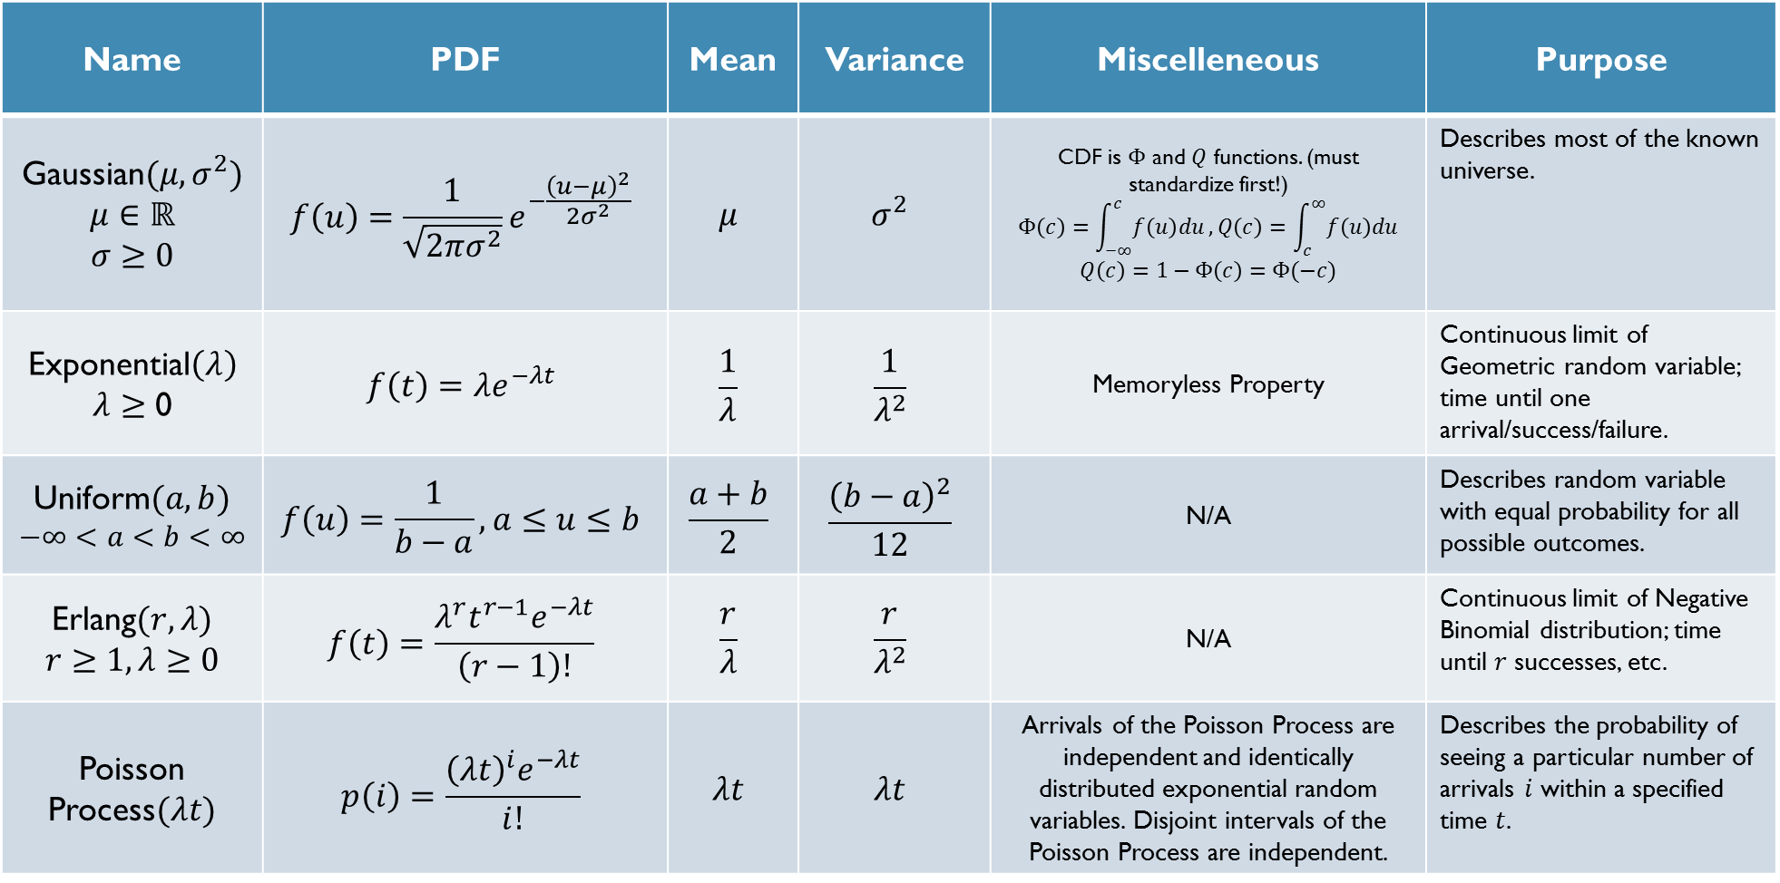
Continuous Distributions
Name | PDF | Mean | Variance | Miscelleneous | Purpose
Gaussian$(μ,σ^{2})$ $$μ∈ℝ$$ $$σ≥0$$ | $$f\left(u\right)=\frac{1}{\sqrt{2πσ^{2}}}e^{−\frac{{\left(u−μ\right)}^{2}}{2σ^{2}}}$$ | $$μ$$ | $$σ^{2}$$ | CDF is $Φ$ and $Q$ functions. (must standardize first!) $$Φ\left(c\right)=\int_{−∞}^{c}{f\left(u\right)du}, Q\left(c\right)=\int_{c}^{∞}{f\left(u\right)du}$$ $$Q\left(c\right)=1−Φ\left(c\right)=Φ(−c)$$ | Describes most of the known universe.
Exponential$\left(λ\right)$ $λ≥$ 0 | $$f\left(t\right)=λe^{−λt}$$ | $$\frac{1}{λ}$$ | $$\frac{1}{λ^{2}}$$ | Memoryless Property | Continuous limit of Geometric random variable; time until one arrival/success/failure.
Uniform$(a,b)$ $$−∞<a<b<∞$$ | $$f\left(u\right)=\frac{1}{b−a}, a≤u≤b$$ | $$\frac{a+b}{2}$$ | $$\frac{{\left(b−a\right)}^{2}}{12}$$ | N/A | Describes random variable with equal probability for all possible outcomes.
Erlang$(r,λ)$ $$r≥1, λ≥0$$ | $$f\left(t\right)=\frac{λ^{r}t^{r−1}e^{−λt}}{\left(r−1\right)!}$$ | $$\frac{r}{λ}$$ | $$\frac{r}{λ^{2}}$$ | N/A | Continuous limit of Negative Binomial distribution; time until $r$ successes, etc.
Poisson Process$(λt)$ | $$p\left(i\right)=\frac{{\left(λt\right)}^{i}e^{−λt}}{i!}$$ | $$λt$$ | $$λt$$ | Arrivals of the Poisson Process are independent and identically distributed exponential random variables. Disjoint intervals of the Poisson Process are independent. | Describes the probability of seeing a particular number of arrivals $i$ within a specified time $t$.

Slide 6
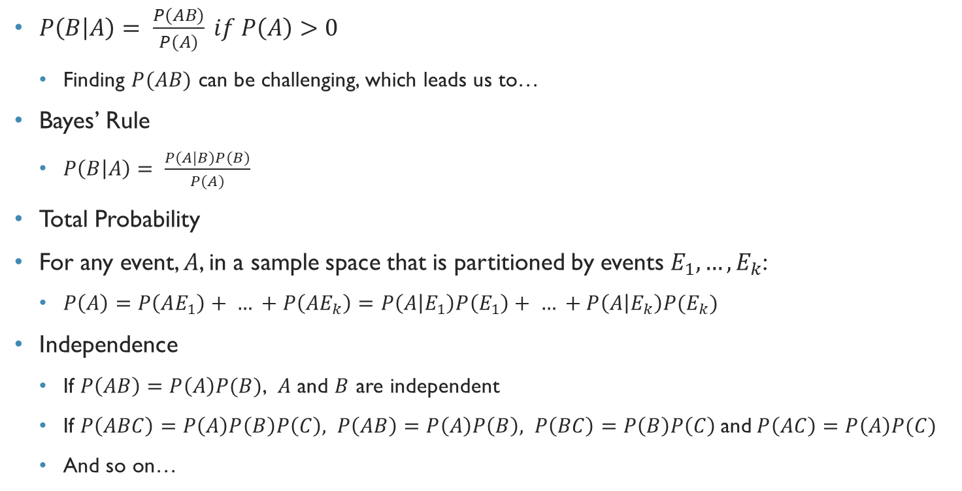
Conditional Probability, Independence, Total Probability, Bayes’ Rule
$P\left(B | A\right)= \frac{P(AB)}{P(A)} if P\left(A\right)>0$
Finding $P(AB)$ can be challenging, which leads us to…
Bayes’ Rule
$P\left(B | A\right)= \frac{P(A|B)P(B)}{P(A)}$
Total Probability
For any event, $A$, in a sample space that is partitioned by events $E_{1},…,E_{k}$:
$P\left(A\right)=P\left(AE_{1}\right)+ … +P\left(AE_{k}\right)=P\left(A | E_{1}\right)P\left(E_{1}\right)+ … +P\left(A | E_{k}\right)P(E_{k})$
Independence
If $P\left(AB\right)=P\left(A\right)P(B)$, $A$ and $B$ are independent
If $P\left(ABC\right)=P\left(A\right)P\left(B\right)P\left(C\right), P\left(AB\right)=P\left(A\right)P\left(B\right), P\left(BC\right)=P\left(B\right)P\left(C\right)$and$P\left(AC\right)=P\left(A\right)P(C)$
And so on…

Slide 7
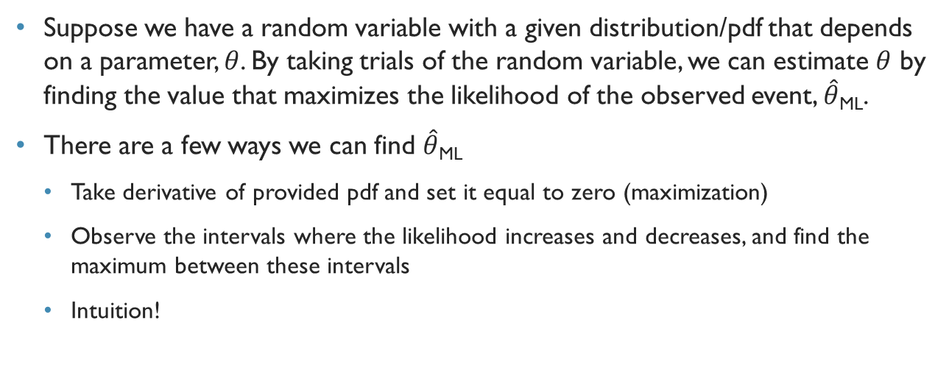
Ml parameter estimation
Suppose we have a random variable with a given distribution/pdf that depends on a parameter, $θ$. By taking trials of the random variable, we can estimate $θ$ by finding the value that maximizes the likelihood of the observed event, $\hat{θ}$_{ML}.
There are a few ways we can find $\hat{θ}$_{ML}
Take derivative of provided pdf and set it equal to zero (maximization)
Observe the intervals where the likelihood increases and decreases, and find the maximum between these intervals
Intuition!

Slide 8
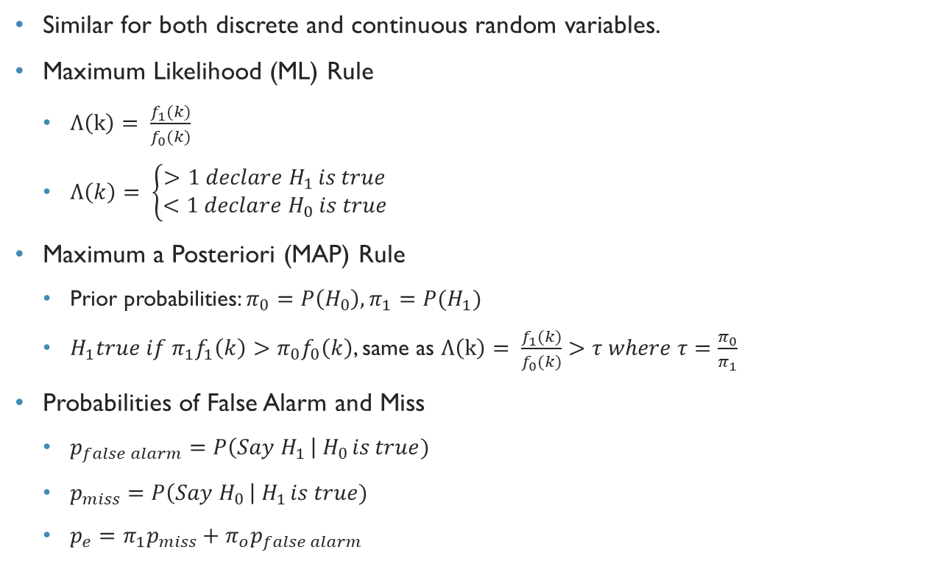
Binary hypothesis testing
Similar for both discrete and continuous random variables.
Maximum Likelihood (ML) Rule
$Λ\left(k\right)= \frac{f_{1}(k)}{f_{0}(k)}$
$Λ\left(k\right)= \left\{\begin{aligned}>1 declare H_{1 }is true \\ <1 declare H_{0} is true\end{aligned}\right.$
Maximum a Posteriori (MAP) Rule
Prior probabilities: $π_{0}=P\left(H_{0}\right), π_{1}=P{(H}_{1})$
$H_{1}true if π_{1}f_{1}\left(k\right)>π_{0}f_{0}\left(k\right)$, same as $Λ\left(k\right)= \frac{f_{1}(k)}{f_{0}(k)}>τ where τ=\frac{π_{0}}{π_{1}}$
Probabilities of False Alarm and Miss
$p_{false alarm}=P\left(Say H_{1 }\right| H_{0 }is true)$
$p_{miss}=P\left(Say H_{0 }\right| H_{1 }is true)$
$p_{e}=π_{1}p_{miss}+π_{o}p_{false alarm}$

Slide 9
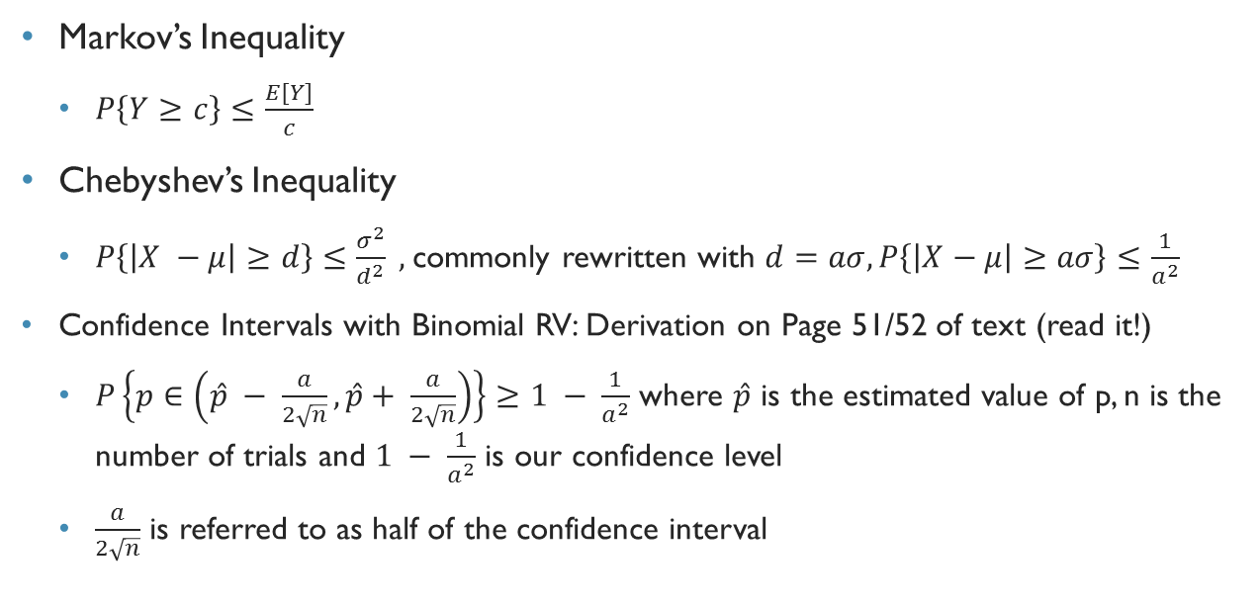
Markov and Chebyshev Inequalities
Markov’s Inequality
$P\left\{Y≥c\right\}≤\frac{E[Y]}{c}$
Chebyshev’s Inequality
$P\left\{\left|X −μ\right|≥d\right\}≤\frac{σ^{2}}{d^{2}} ,$commonly rewritten with $d=aσ, P\left\{\left|X−μ\right|≥aσ\right\}≤\frac{1}{a^{2}}$
Confidence Intervals with Binomial RV: Derivation on Page 51/52 of text (read it!)
$P\left\{p∈\left(\hat{p} − \frac{a}{2\sqrt{n}}, \hat{p}+ \frac{a}{2\sqrt{n}}\right)\right\}≥1 − \frac{1}{a^{2}}$ where $\hat{p}$ is the estimated value of p, n is the number of trials and $1 − \frac{1}{a^{2}}$ is our confidence level
$\frac{a}{2\sqrt{n}}$ is referred to as half of the confidence interval

Slide 10

Functions of random variables
If we have linear scaling: $Y=aX+b$
$E\left[Y\right]=aE\left[X\right]+b$
$Var\left(Y\right)= a^{2}Var\left(X\right)$
$f_{y}\left(v\right)= f_{x}(\frac{v−b}{a})\frac{1}{\left|a\right|}$

Slide 11
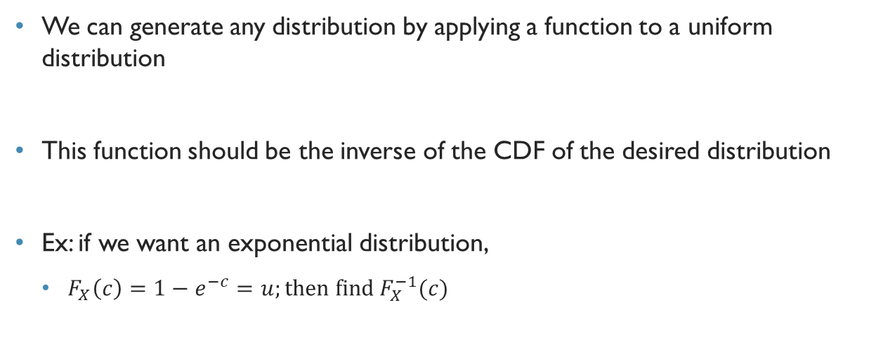
Functions of Random Variables
We can generate any distribution by applying a function to a uniform distribution
This function should be the inverse of the CDF of the desired distribution
Ex: if we want an exponential distribution,
$F_{X}\left(c\right)=1−e^{−c}=u;then find{ F}_{X}^{−1}(c)$

Slide 12
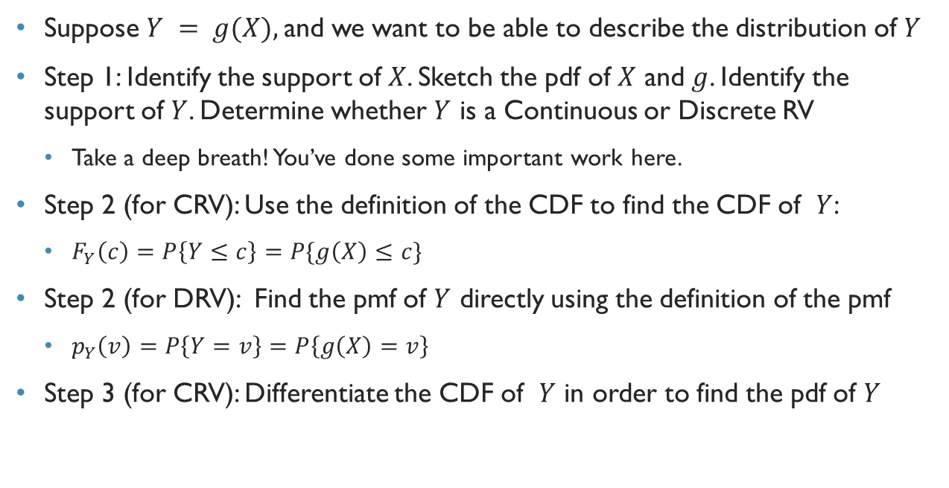
Functions of random variables
Suppose $Y = g(X),$and we want to be able to describe the distribution of $Y$
Step 1: Identify the support of $X$. Sketch the pdf of $X$ and $g$. Identify the support of $Y$. Determine whether $Y$ is a Continuous or Discrete RV
Take a deep breath! You’ve done some important work here.
Step 2 (for CRV): Use the definition of the CDF to find the CDF of $Y$:
$F_{Y}\left(c\right)=P\left\{Y≤c\right\}=P\{g\left(X\right)≤c\}$
Step 2 (for DRV): Find the pmf of $Y$ directly using the definition of the pmf
$p_{Y}\left(v\right)=P\left\{Y=v\right\}=P\left\{g\left(X\right)=v\right\}$
Step 3 (for CRV): Differentiate the CDF of $Y$ in order to find the pdf of $Y$

Slide 13
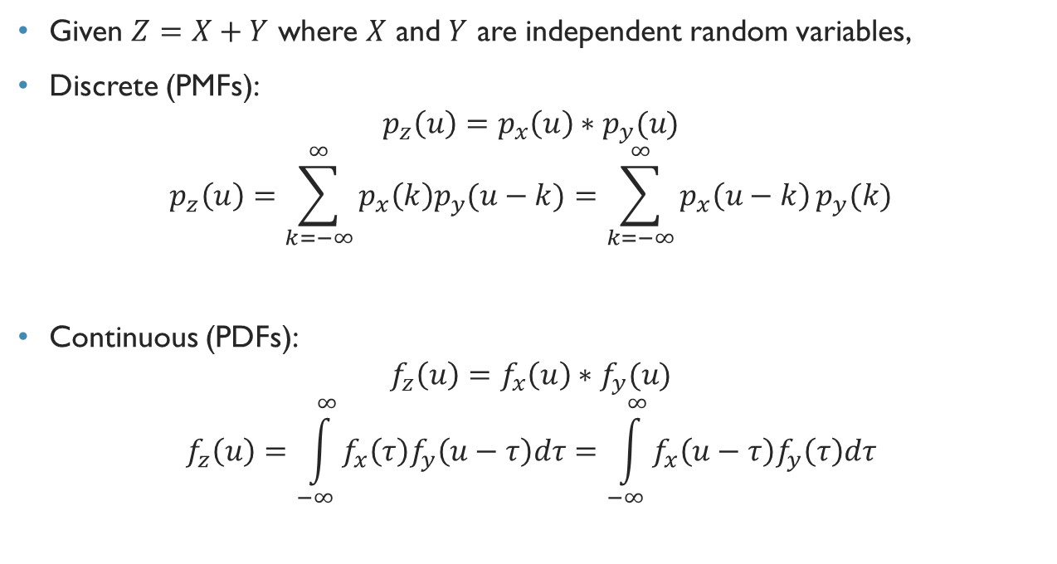
Functions of Random Variables
Given $Z=X+Y$ where $X$ and $Y$ are independent random variables,
Discrete (PMFs):
$$p_{z}\left(u\right)=p_{x}\left(u\right)∗p_{y}(u)$$
$$p_{z}\left(u\right)=\sum_{k=−∞}^{∞}{p_{x}\left(k\right)p_{y}(u−k)}=\sum_{k=−∞}^{∞}{p_{x}\left(u−k\right)}p_{y}(k)$$
Continuous (PDFs):
$$f_{z}\left(u\right)=f_{x}\left(u\right)∗f_{y}(u)$$
$$f_{z}\left(u\right)=\int_{−∞}^{∞}{f_{x}\left(τ\right)f_{y}\left(u−τ\right)dτ}=\int_{−∞}^{∞}{f_{x}\left(u−τ\right)f_{y}\left(τ\right)dτ}$$

Slide 14
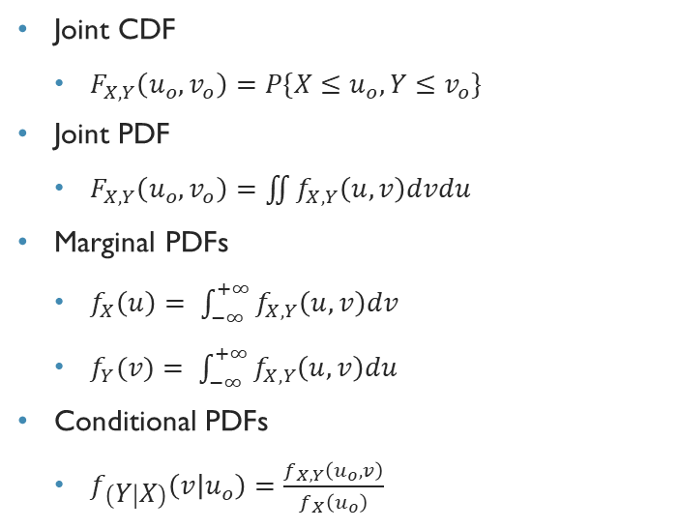
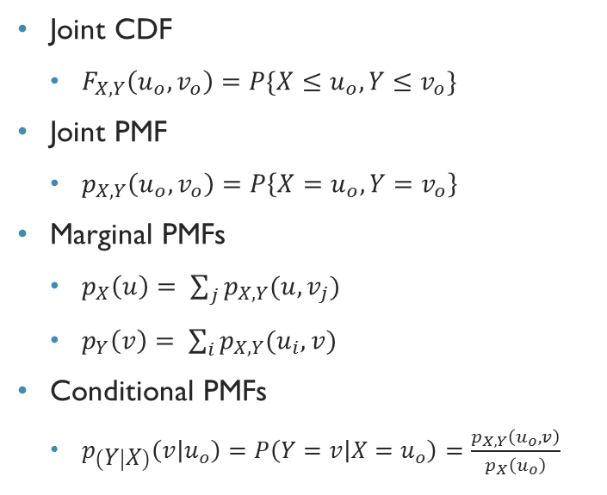
Joint cdf, pmf, and pdf
Discrete Random Variables
Continuous Random Variables
Joint CDF
$F_{X,Y}\left(u_{o},v_{o}\right)=P\{X≤u_{o}, Y≤v_{o}\}$
Joint PMF
$p_{X,Y}\left(u_{o},v_{o}\right)=P\left\{X=u_{o}, Y=v_{o}\right\}$
Marginal PMFs
$p_{X}\left(u\right)= \sum_{j}{p_{X,Y}(u,v_{j})}$
$p_{Y}\left(v\right)= \sum_{i}{p_{X,Y}(u_{i},v)}$
Conditional PMFs
$p_{\left(Y | X\right)}\left(v | u_{o}\right)=P\left(Y=v | X=u_{o}\right)=\frac{p_{X,Y}\left(u_{o},v\right)}{p_{X}\left(u_{o}\right)}$
Joint CDF
$F_{X,Y}\left(u_{o},v_{o}\right)=P\{X≤u_{o}, Y≤v_{o}\}$
Joint PDF
$F_{X,Y}\left(u_{o},v_{o}\right)=\iint{f_{X,Y}\left(u,v\right)dvdu}$
Marginal PDFs
$f_{X}\left(u\right)= \int_{−∞}^{+∞}{f_{X,Y}\left(u,v\right)dv}$
$f_{Y}(v)= \int_{−∞}^{+∞}{f_{X,Y}\left(u,v\right)du}$
Conditional PDFs
$f_{\left(Y | X\right)}\left(v | u_{o}\right)=\frac{f_{X,Y}\left(u_{o},v\right)}{f_{X}\left(u_{o}\right)}$

Slide 15
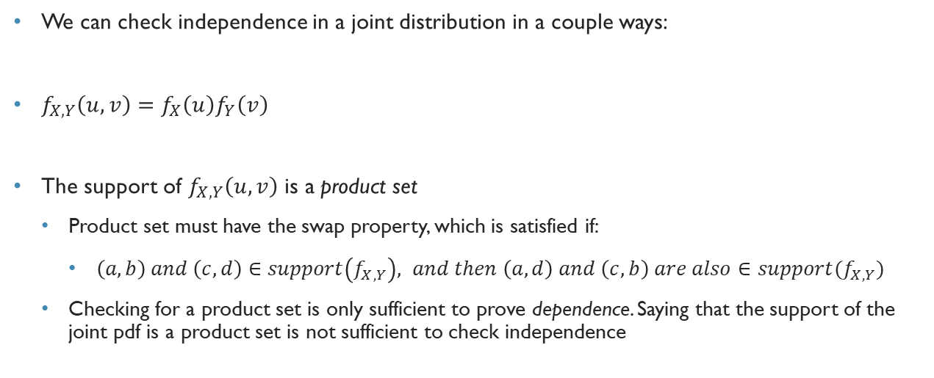
Independence of joint distributions
We can check independence in a joint distribution in a couple ways:
$f_{X,Y}\left(u,v\right)=f_{X}\left(u\right)f_{Y}\left(v\right)$
The support of $f_{X,Y}\left(u,v\right)$ is a product set
Product set must have the swap property, which is satisfied if:
$\left(a,b\right) and \left(c,d\right)∈support\left(f_{X,Y}\right), and then \left(a,d\right) and \left(c,b\right) are also∈support(f_{X,Y})$
Checking for a product set is only sufficient to prove dependence. Saying that the support of the joint pdf is a product set is not sufficient to check independence

Slide 16
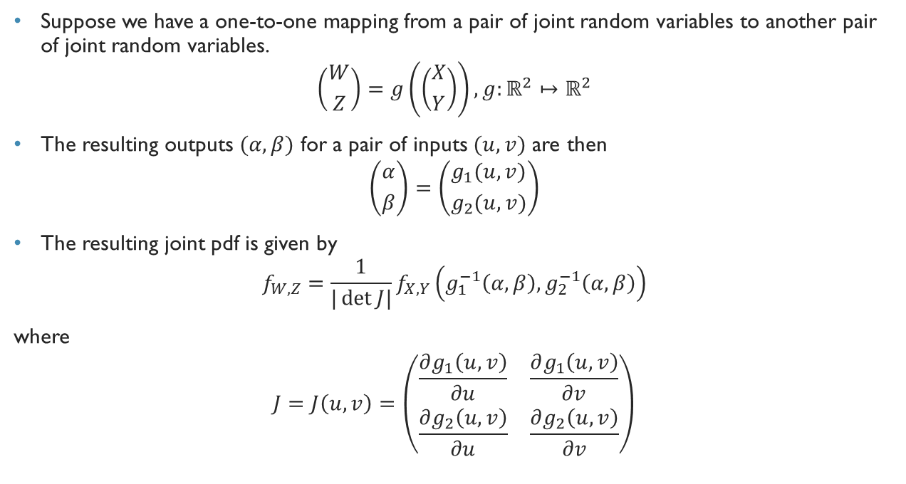
Joint PDFs of Functions of Random Variables
Suppose we have a one-to-one mapping from a pair of joint random variables to another pair of joint random variables.
$$\left({W \atop Z}\right)=g\left(\left({X \atop Y}\right)\right), g:ℝ^{2}↦ℝ^{2}$$
The resulting outputs $(α,β)$ for a pair of inputs $(u,v)$ are then
$$\left({α \atop β}\right)=\left({g_{1}(u,v) \atop g_{2}(u,v)}\right)$$
The resulting joint pdf is given by
$$f_{W,Z}=\frac{1}{|\det{J|}}f_{X,Y}\left(g_{1}^{−1}\left(α,β\right),g_{2}^{−1}\left(α,β\right)\right)$$
where
$$J=J\left(u,v\right)=\left(\begin{matrix}\frac{∂g_{1}\left(u,v\right)}{∂u} & \frac{∂g_{1}\left(u,v\right)}{∂v} \\ \frac{∂g_{2}\left(u,v\right)}{∂u} & \frac{∂g_{2}\left(u,v\right)}{∂v}\end{matrix}\right)$$

Slide 17
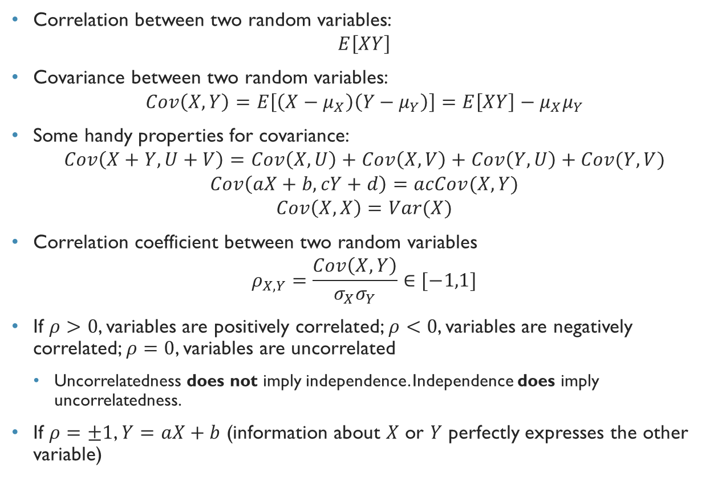
Correlation and Covariance
Correlation between two random variables:
$$E\left[XY\right]$$
Covariance between two random variables:
$$Cov\left(X,Y\right)=E\left[\left(X−μ_{X}\right)\left(Y−μ_{Y}\right)\right]=E\left[XY\right]−μ_{X}μ_{Y}$$
Some handy properties for covariance:
$$Cov\left(X+Y,U+V\right)=Cov\left(X,U\right)+Cov\left(X,V\right)+Cov\left(Y,U\right)+Cov(Y,V)$$
$$Cov\left(aX+b,cY+d\right)=acCov(X,Y)$$
$$Cov\left(X,X\right)=Var(X)$$
Correlation coefficient between two random variables
$$ρ_{X,Y}=\frac{Cov\left(X,Y\right)}{σ_{X}σ_{Y}}∈[−1,1]$$
If $ρ>0$, variables are positively correlated; $ρ<0$, variables are negatively correlated; $ρ=0$, variables are uncorrelated
Uncorrelatedness does not imply independence. Independence does imply uncorrelatedness.
If $ρ=±1$, $Y=aX+b$ (information about $X$ or $Y$ perfectly expresses the other variable)

Slide 18
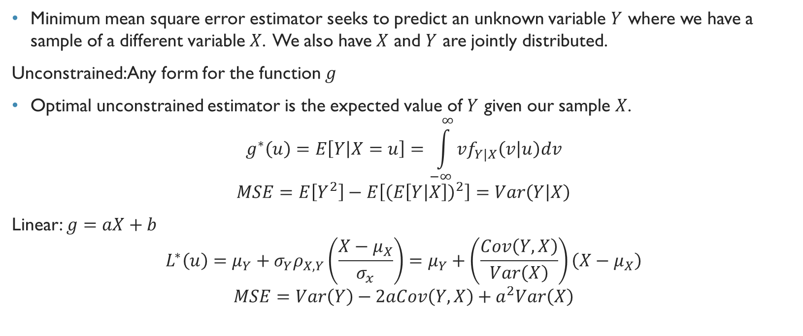
Minimum MSE Estimators
Minimum mean square error estimator seeks to predict an unknown variable $Y$ where we have a sample of a different variable $X$. We also have $X$ and $Y$ are jointly distributed.
Unconstrained: Any form for the function $g$
Optimal unconstrained estimator is the expected value of $Y$ given our sample $X$.
$$g^{∗}\left(u\right)=E\left[Y | X=u\right]=\int_{−∞}^{∞}{vf_{Y|X}\left(v | u\right)dv}$$
$$MSE=E\left[Y^{2}\right]−E\left[{\left(E\left[Y | X\right]\right)}^{2}\right]=Var\left(Y | X\right)$$
Linear: $g=aX+b$
$$L^{∗}\left(u\right)=μ_{Y}+σ_{Y}ρ_{X,Y}\left(\frac{X−μ_{X}}{σ_{x}}\right)=μ_{Y}+\left(\frac{Cov\left(Y,X\right)}{Var\left(X\right)}\right)\left(X−μ_{X}\right)$$
$$MSE=Var\left(Y\right)−2aCov\left(Y,X\right)+a^{2}Var\left(X\right)$$

Slide 19
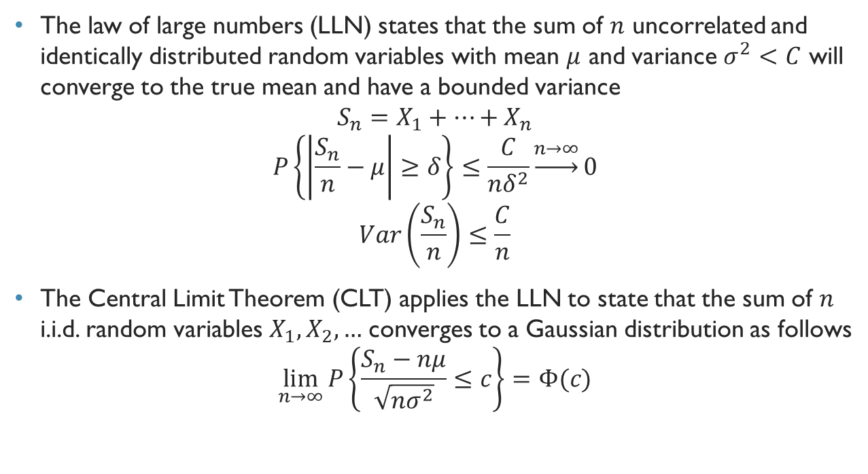
Law of Large Numbers and Central Limit Theorem
The law of large numbers (LLN) states that the sum of $n$ uncorrelated and identically distributed random variables with mean $μ$ and variance $σ^{2}<C$ will converge to the true mean and have a bounded variance
$$S_{n}=X_{1}+…+X_{n}$$
$$P\left\{\left|\frac{S_{n}}{n}−μ\right|≥δ\right\}≤\frac{C}{nδ^{2}}\underset{→}{n→∞}0$$
$$Var\left(\frac{S_{n}}{n}\right)≤\frac{C}{n}$$
The Central Limit Theorem (CLT) applies the LLN to state that the sum of $n$ i.i.d. random variables $X_{1},X_{2},…$ converges to a Gaussian distribution as follows
$$\lim_{n→∞}{P\left\{\frac{S_{n}−nμ}{\sqrt{nσ^{2}}}≤c\right\}=Φ(c)}$$

Slide 20
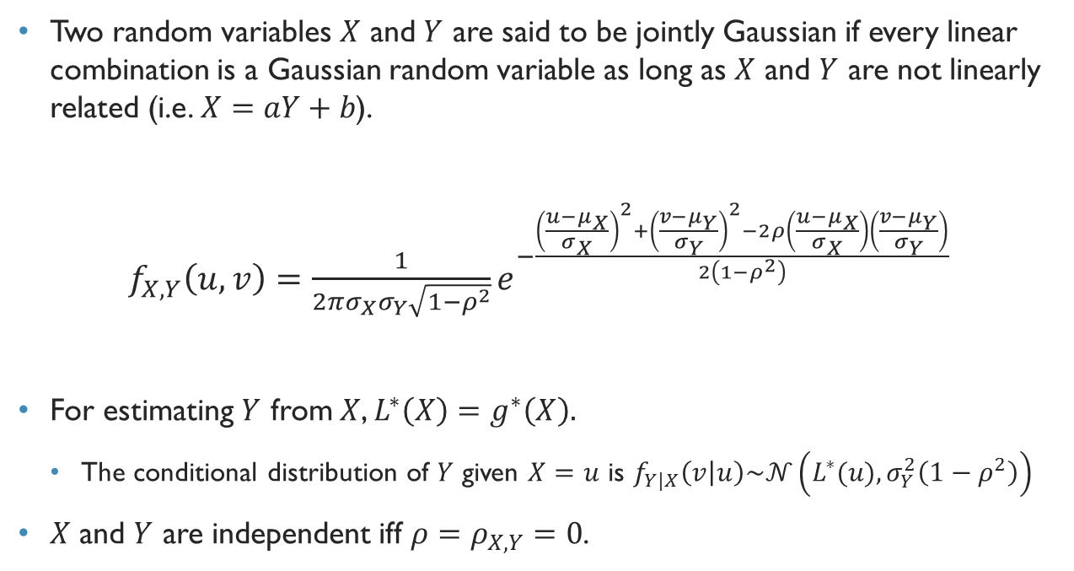
Joint Gaussian Distribution
Two random variables $X$ and $Y$ are said to be jointly Gaussian if every linear combination is a Gaussian random variable as long as $X$ and $Y$ are not linearly related (i.e. $X=aY+b$).
$f_{X,Y}\left(u,v\right)=\frac{1}{2πσ_{X}σ_{Y}\sqrt{1−ρ^{2}}}e^{−\frac{{\left(\frac{u−μ_{X}}{σ_{X}}\right)}^{2}+{\left(\frac{v−μ_{Y}}{σ_{Y}}\right)}^{2}−2ρ\left(\frac{u−μ_{X}}{σ_{X}}\right)\left(\frac{v−μ_{Y}}{σ_{Y}}\right)}{2\left(1−ρ^{2}\right)}}$
For estimating $Y$ from $X$, $L^{∗}\left(X\right)=g^{∗}\left(X\right).$
The conditional distribution of $Y$ given $X=u$ is $f_{Y|X}\left(v | u\right)\sim 𝒩\left(L^{∗}(u),σ_{Y}^{2}\left(1−ρ^{2}\right)\right)$
$X$ and $Y$ are independent iff $ρ=ρ_{X,Y}=0$.

Slide 21
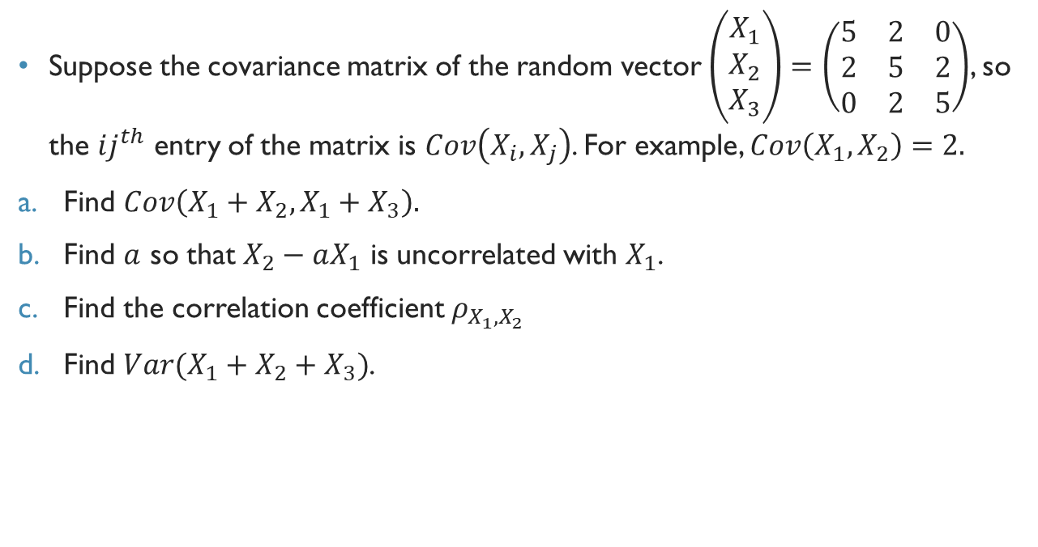
FA14 Final Problem 10
Suppose the covariance matrix of the random vector $\left(\begin{matrix}X_{1} \\ X_{2} \\ X_{3}\end{matrix}\right)=\left(\begin{matrix}5 & 2 & 0 \\ 2 & 5 & 2 \\ 0 & 2 & 5\end{matrix}\right)$, so the $ij^{th}$ entry of the matrix is $Cov\left(X_{i},X_{j}\right)$. For example, $Cov\left(X_{1},X_{2}\right)=2.$
Find $Cov\left(X_{1}+X_{2},X_{1}+X_{3}\right).$
Find $a$ so that $X_{2}−aX_{1}$ is uncorrelated with $X_{1}$.
Find the correlation coefficient $ρ_{X_{1},X_{2}}$
Find $Var(X_{1}+X_{2}+X_{3})$.

Slide 22
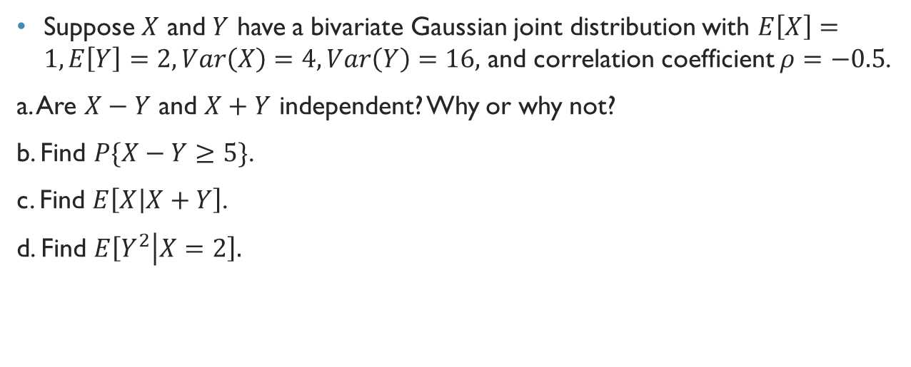
SP16 Final Problem 8
Suppose $X$ and $Y$ have a bivariate Gaussian joint distribution with $E\left[X\right]=1, E\left[Y\right]=2,Var\left(X\right)=4,Var\left(Y\right)=16,$ and correlation coefficient $ρ=−0.5$.
a. Are $X−Y$ and $X+Y$ independent? Why or why not?
b. Find $P\{X−Y≥5\}$.
c. Find $E\left[X | X+Y\right]$.
d. Find $E\left[Y^{2} | X=2\right].$

Slide 23
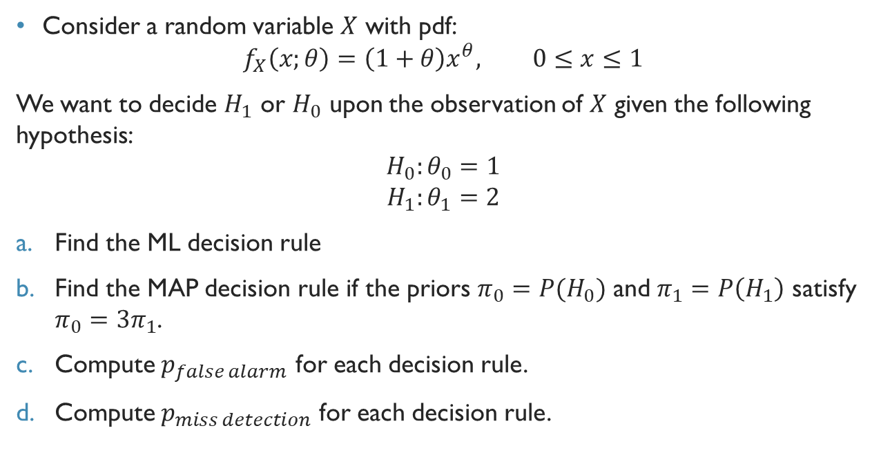
FA15 Final Problem 5
Consider a random variable $X$ with pdf:
$$f_{X}\left(x;θ\right)=\left(1+θ\right)x^{θ}, 0≤x≤1$$
We want to decide $H_{1}$ or $H_{0}$ upon the observation of $X$ given the following hypothesis:
$$H_{0}:θ_{0}=1$$
$$H_{1}:θ_{1}=2$$
Find the ML decision rule
Find the MAP decision rule if the priors $π_{0}=P(H_{0})$ and $π_{1}=P\left(H_{1}\right)$ satisfy $π_{0}=3π_{1}$.
Compute $p_{false alarm}$ for each decision rule.
Compute $p_{miss detection}$ for each decision rule.

Slide 24
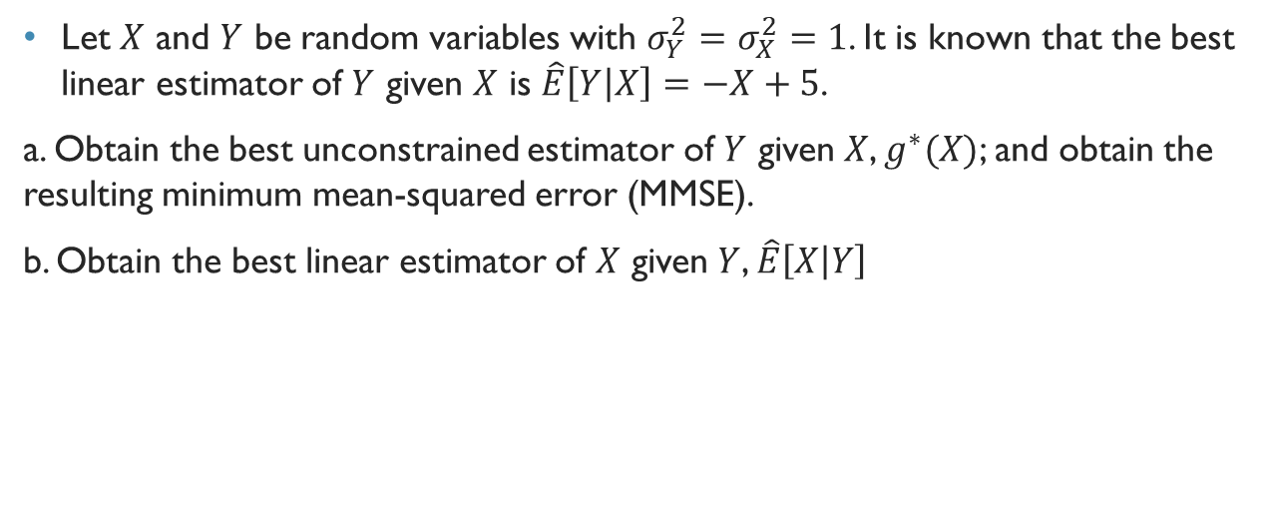
Fa15 Final Problem 4
Let $X$ and $Y$ be random variables with $σ_{Y}^{2}=σ_{X}^{2}=1$. It is known that the best linear estimator of $Y$ given $X$ is $\hat{E}\left[Y | X\right]=−X+5$.
a. Obtain the best unconstrained estimator of $Y$ given $X$, $g^{∗}(X)$; and obtain the resulting minimum mean-squared error (MMSE).
b. Obtain the best linear estimator of $X$ given $Y$, $\hat{E}\left[X | Y\right]$

Slide 25
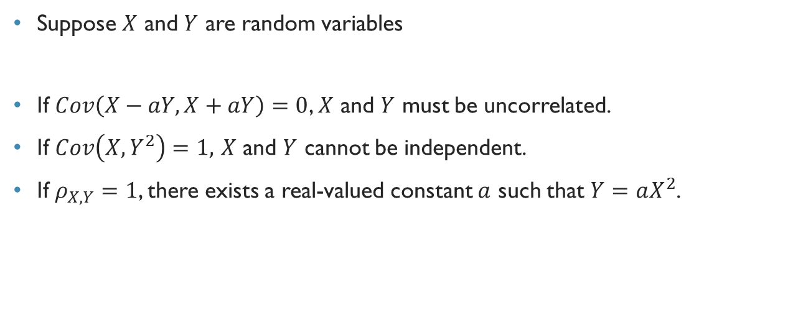
T/F Section FA15 Final
Suppose $X$ and $Y$ are random variables
If $Cov\left(X−aY,X+aY\right)=0$, $X$ and $Y$ must be uncorrelated.
If $Cov\left(X,Y^{2}\right)=1,$ $X$ and $Y$ cannot be independent.
If $ρ_{X,Y}=1$, there exists a real-valued constant $a$ such that $Y=aX^{2}$.

Slide 26
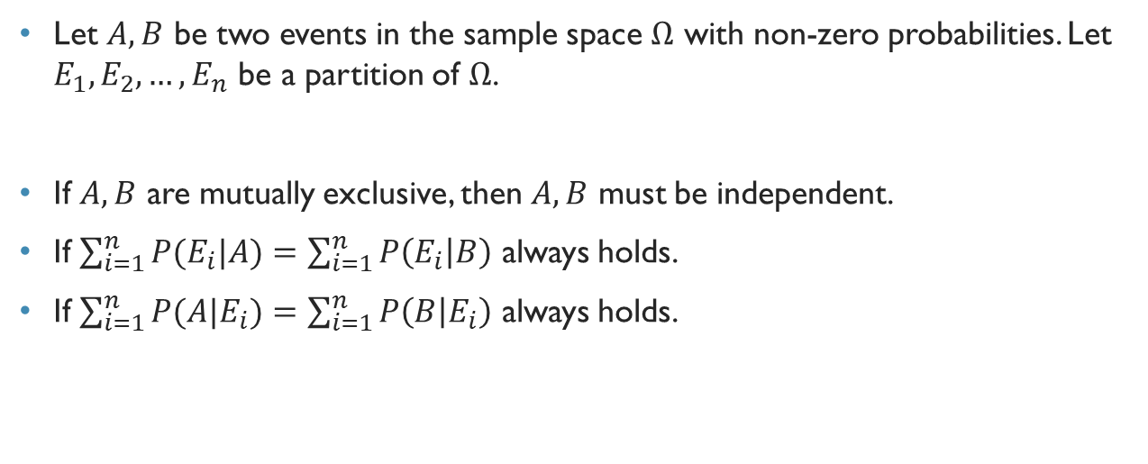
T/F Section FA15 Final
Let $A,B$ be two events in the sample space $Ω$ with non-zero probabilities. Let $E_{1},E_{2},…,E_{n}$ be a partition of $Ω$.
If $A,B$ are mutually exclusive, then $A,B$ must be independent.
If $\sum_{i=1}^{n}{P(E_{i}|A)}=\sum_{i=1}^{n}{P\left(E_{i} | B\right)}$ always holds.
If $\sum_{i=1}^{n}{P(A|E_{i})}=\sum_{i=1}^{n}{P\left(B | E_{i}\right)}$ always holds.

Slide 27
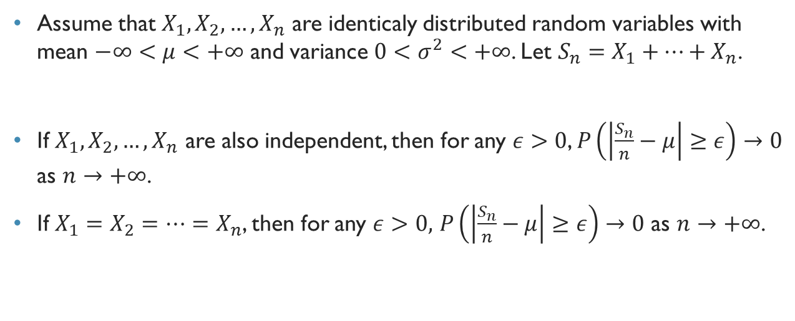
T/F Section FA15 Final
Assume that $X_{1},X_{2},…,X_{n}$ are identicaly distributed random variables with mean $−∞<μ<+∞$ and variance $0<σ^{2}<+∞$. Let $S_{n}=X_{1}+…+X_{n}$.
If $X_{1},X_{2}, …,X_{n}$ are also independent, then for any $ε>0$, $P\left(\left|\frac{S_{n}}{n}−μ\right|≥ε\right)→0$ as $n→+∞$.
If $X_{1}=X_{2}=…=X_{n}$, then for any $ε>0,$ $P\left(\left|\frac{S_{n}}{n}−μ\right|≥ε\right)→0$ as $n→+∞$.

Slide 28

T/F Section FA15 Final
Let $X$ and $Y$ be random variables such that $P\left(X>0\right)=1$ and $P\left(Y<0\right)=1$.
$X$ and $Y$ are always negatively correlated.
$E[XY]$ is always negative.

