Slide 1

ECE 391 Exam 2 HKN Review Session
By: Kevin Guo, Mrigank Bhardwaj, and Evan Lissoos

Slide 2



Virtual Memory
In x86, virtual memory is implemented in 2 ways
Segmentation
Linux doesn’t really use segmentation
Since it can’t be turned off in x86, all segments are set to the entire memory space
0-4GB for Kernel Code, Kernel Data, User Code, User Data
“Flat memory model”
Paging
Key to how Linux manages memory from context switching to memory allocation
x86 supports 4KB and 4MB pages
Virtual memory is handled in hardware by the Memory Management Unit (MMU)

Slide 3
Paging
Translation Lookaside Buffer (TLB)
Small and fast cache that stores the translations for pages
Located in the MMU
Page Directory Base Register (PDBR) or Control Register 3 (cr3)
Pointer to the base of the page directory
Flushes the TLB when written to
Page directory/tables
Table that holds pointers to page tables or to pages
Includes extra bits
User/Supervisor
Read/Write
Global Flag
Page Size

Slide 4
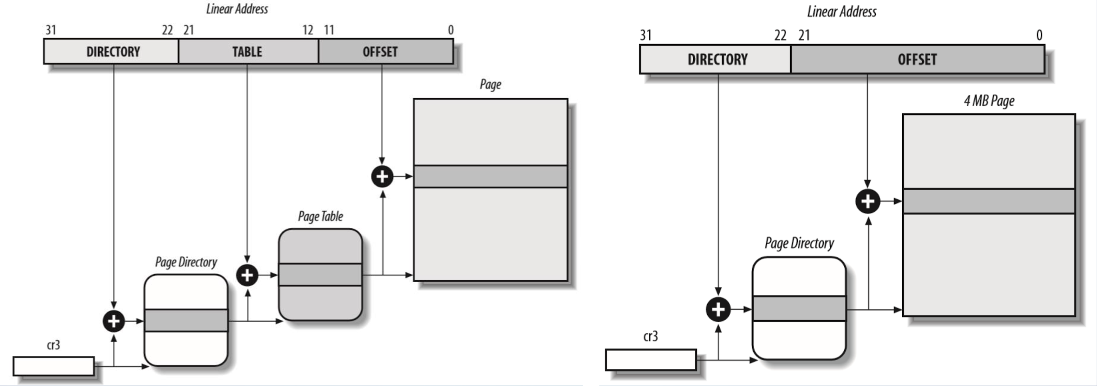
Paging (continued)

Slide 5
Paging (continued)
Pros and Cons of Different Page Sizes
Larger
Faster table walk
More TLB hits (less misses)
More fragmentation over smaller pages
Both suffer from internal and external memory fragmentation
Smaller
Slower table walk
Less TLB hits (more misses)
Less fragmentation than larger pages
Internal Fragmentation: wasted space from rounding up (ex. allocating a 4KB page when only 3KB needed)
External Fragmentation: uneven free pages waste space and make it difficult to allocate a page of appropriate size (ex. 4MB page free except for a single 4KB page prevents a 4MB page from being

Slide 6
Paging (continued)
Few other things to remember
MP3 kernel maps kernel code to 0x400000-0x800000 (4MB-8MB)
Same virtual and physical address
Video memory is a single 4KB page
Less levels => faster (on TLB miss)
Page faults
Minor - page in memory, but marked as not
Major - page not in memory
Invalid - address not part of memory space, or invalid permissions (privilege/write)

Slide 7

Mode
What the heck is this? And why is it so convoluted and weird?
The Build Buffer:
A system to represent 2D image data in memory, and allow for window scrolling in a larger image with few writes/deletes.
We “reverse” the planes so that they don’t collide into each other when shifting. Could also add spaces between all planes.
We can shift around the relative position of these planes in the build buffer, so we don’t need to worry about the size.
To determine which plane you write to, you set a mask. 4 planes for each single memory address. (IE, each virtual address = 4 pixels)

Slide 8


Slide 9
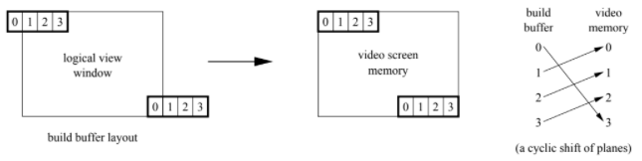
Mode
2. Map from logical view -> video screen memory:
Just a basic cyclic shift. Nothing fancy here.

Slide 10
Mode
3. Palette
Each ‘pixel’ in ModeX takes up a byte of memory, corresponding to an entry in a 256-color palette- this helps save memory, while allowing us a wider range of color, letting us pick what color we want (or changing the palette to easily change existing pixels). The palette is made up of 18 bits, which allows us the full RGB range.
4. Double-Buffering
Not actually used in your MP (I think?) But basically you write to two different regions, and alternate which region you actually display.

Slide 11
R T (D) C
The RTC is a clock which generates interrupts at a certain frequency.
Most of dealing with the RTC is just knowing what the right code to copy from OSDev is, to initialize the RTC and to change its frequency. Remember, the commands there use a different syntax, so the ordering of the arguments are flipped. https://wiki.osdev.org/RTC
There are other alternatives to the RTC, like the Programmable Interrupt Timer (PIT), which has more priority, and can generate interrupts faster. You’ll use that later.

Slide 12
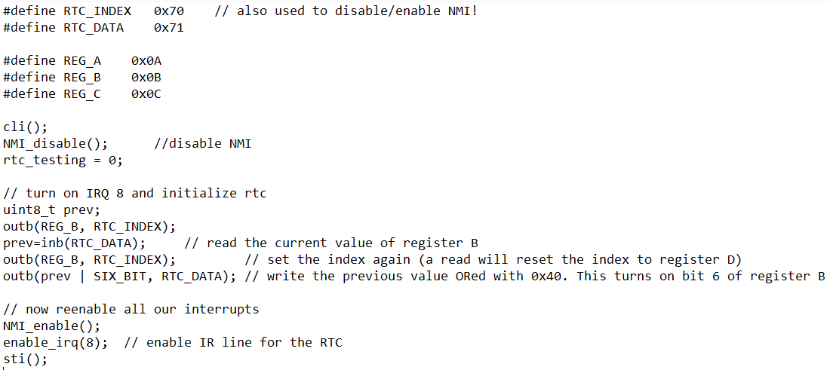
R T (D) C
Initialization:

Slide 13
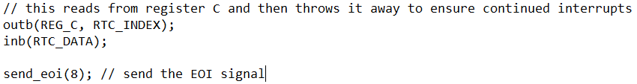
R T (D) C
Frequency Change:
Handling Interrupts:

Slide 14
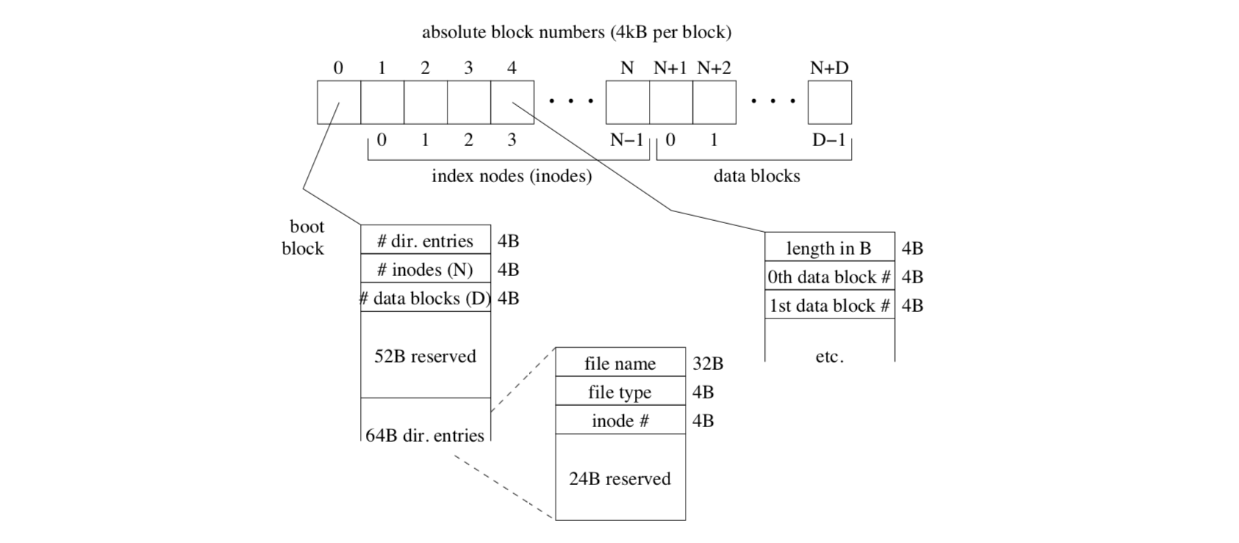
File System
Inode: info about a file that the filesystem needs, i.e. type, access permissions, owner, etc.

Slide 15
Tux Controller Example Question
Go To Practice Exam 2015

Slide 16
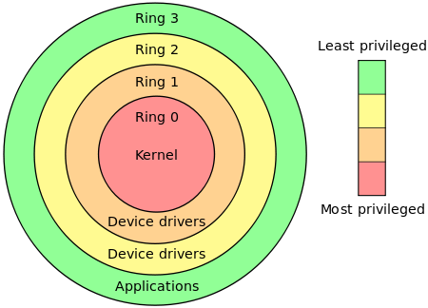
System Calls
System calls are how user-level processes get the kernel to do things for them. We don’t let user-level processes do things like access hardware, access hard drive, or do critical important kernel things, because we only trust the kernel to do that.
In OS, there are rings of protection. Lower priority can’t access resources in higher priority. Priority level is encoded in paging.
In your OS, you only have ring 3 (user level) and ring 0 (kernel level), and system calls are what let you jump between these levels.
Notes:
If your untrustworthy friend wanted to borrow some money, would you let him/her walk into your safe and trust them to borrow the exact amount of money? NO! You’d take the exact money and bring to them.
That’s how system calls work! We can never trust those sneaky user-level processes to do just what they say they’ll do, so we do it for them.

Slide 17
System Calls
You invoke system calls by calling IDT Vector 0x80, and passing in name and arguments in different registers (EAX for system call number), to tell them which specific call you want executed.
The system call library will push all registers to stack, then jump to the actual desired system call handler.
Now you’re in kernelspace! Now the kernel will look at your system call request and decide if it wants to handle it, then return.
The system call will pass in its return value in EAX.

Slide 18
Questions? Anything we missed?
Notes:
If your untrustworthy friend wanted to borrow some money, would you let him/her walk into your safe and trust them to borrow the exact amount of money? NO! You’d take the exact money and bring to them.
That’s how system calls work! We can never trust those sneaky user-level processes to do just what they say they’ll do, so we do it for them.

