Slide 1
PHYS 213 Midterm Exam HKN Review Session
Steven Kolaczkowski

Slide 2
First Law of Life
Check your units

Slide 3

First Law of Thermodynamics
Check Your Units
$dU=dQ+dW_{on}=dQ−PdV$
If volume is constant: $dU=dQ$

Slide 4

Entropy, Temperature, and the Second Law of Thermodynamics
CHECK YOUR UNITS
$S≡k_{B}ln⁡(Ω)$ where $Ω$ is the number of microstates
$Ω_{total}=Ω_{1}∗Ω_{2}∴S_{total}=S_{1}+S_{2}$
$dS=\frac{1}{T}dU+\frac{P}{T}dV−\frac{μ}{T}dN$
For an Isolated system $ΔS≥0$ or $ΔS_{Universe}≥0$
If $ΔS=0$the process is reversible
Temperature: $\frac{1}{T}≡{\left(\frac{dS}{dU}\right)}_{V,N}$

Slide 5

Equilibrium and Counting Microstates
We will observe the macrostate with the most microstates (maximum entropy)
Distinguishable: $Ω=M^{N}$ Indistinguishable: $Ω=\frac{M^{N}}{N!}$
$S_{total}$ is maximized when T is constant across system (thermal equilibrium)

Slide 6

Heat Capacity and Latent Heat
Heat capacity: the amount of energy required to raise the temperature of a material by 1K
$C_{V}=\frac{dQ}{dT} \left[=\right]\frac{J}{K}$
$c_{v_{mol}}=\frac{1}{n} \frac{dQ}{dT} \left[=\right]\frac{J}{mol∙K}$ $c_{v_{mass}}=\frac{1}{m}\frac{dQ}{dT} \left[=\right]\frac{J}{kg∙K}$
$C_{v,tot }=C_{v,1}+C_{v,2}$
$dQ=C_{v}∙dT=mc_{v_{mass}}∙dT \left[=\right] J$
Latent Heat: The amount of energy needed to transition between states of matter
T does not change during a phase change!
$L_{f}=\frac{ΔQ_{solid→liquid}}{m_{solid}} \left[=\right] \frac{J}{kg}$ $L_{v}=\frac{ΔQ_{liquid→gas}}{m_{liquid}} \left[=\right] \frac{J}{kg}$

Slide 7

Ideal Gases and Equipartition
CHECK YOUR UNITS
Equipartition: The idea that thermal energy on average is distributed equally among all modes of motion
$<K>=\frac{k_{B}T}{2}$ for each quadratic degree of freedom
Monoatomic Gases: 3 Diatomic Gases: 5 Solids: 6
Mass doesn’t matter for calculating energy, but it does for finding average velocity
Ideal Gas Law: Assuming that particles will not collide or interact with each other, only with the walls of the container, and are volumeless
Works best with low densities and high temperatures (a few, fast moving particles)
$PV=\frac{2}{3}N<K>_{trans}=NkT=nRT$

Slide 8

Solids, More Heat Capacities, and Internal Energy
CHECK YOUR UNITS
$U=N<K>$
Ideal Solids
$U_{total}=N\left(<\frac{1}{2}m{\vec{v}}^{2}>_{trans}+<\frac{1}{2}k{\vec{r}}^{2}>\right)=2N<K>_{trans}=3Nk_{B}T$
We will assume that ideal solids are incompressible $dU=dQ$ and $c_{mol}=\frac{1}{n}\frac{dU}{dT}=3N_{A}k_{B}$
Temperature effects
Expansion: $α=\frac{1}{L}\frac{dL}{dT}$ for linear expansion $β=\frac{1}{v}\frac{dV}{dT}=3α$ for volumetric expansion
Heat Flow: $\frac{dQ}{dt}\frac{1}{A}=−κ\frac{dT}{dx}$ where $κ$ is the thermal transfer coefficient

Slide 9

Boltzmann Distributions and Quantum Oscillators
“The best thing in the world”-V, 2018/4/7
For a Quantum Oscillator, energy is discretized by $ε=hf$ and $U_{q}=qε=k_{B}T=qhf$
Total number of states given N oscillators and q energy quanta $Ω\left(N,q\right)=\frac{\left(N−1+q\right)!}{q!\left(N−1\right)!}$
$S=k\ln\left(Ω\right)$ $ΔS=k\ln\left(\frac{q+N}{q+1}\right)≈k\frac{N}{q}$ $\frac{1}{T}=\frac{dS}{dU}≈\frac{kN}{qhf}$
Probability of State having energy $E_{n}$: $P\left(E_{n}\right)=\frac{e^{− \frac{E_{n}}{k_{B}T}}}{Z}$
Partition function: $Z=Σ_{all states} e^{− \frac{E_{n}}{k_{B}T}}$
REMEMBER TO TAKE INTO ACCOUNT DEGENERACY!!!
“Actually the Partition function is my favorite thing in the world”-V, 10 mins later
R
S

Slide 10

More 213 Stuff
Atmospheres: $ΔU=mgh$ therefore $\frac{P\left(h\right)}{P\left(0\right)}=e^{−\left(\frac{mgh}{k_{B}T}\right)}$ and $<h> =\frac{k_{B}T}{mg}$
“You get this from the Boltzmann distribution, the best thing in the world”-V, 30mins later

Slide 11
Exam Advice
When doing problems, PLEASE PLEASE PLEASE CHECK YOUR UNITS!!!
You will be shocked how many questions you can solve just matching units and having a basic idea of what they are asking for
Know when and how to use your equation sheet
Don’t panic, just keep on moving
Make sure you are in the right mindset going into the exam
Spend your time showing what you know
DON’T CHEAT

Slide 12
Past Exam Questions
Spring 2015 1-4, 14, 15, 17, 21-23
Fall 2014 2,9, 13-15
Fall 2013 7,8

Slide 13






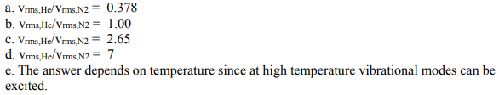
Spring 2015

Slide 14

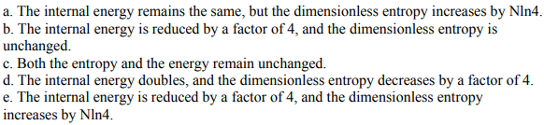
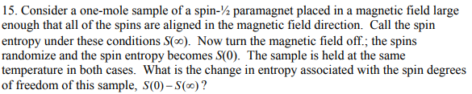

Spring 2015

Slide 15
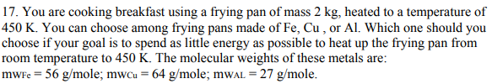

Spring 2015

Slide 16
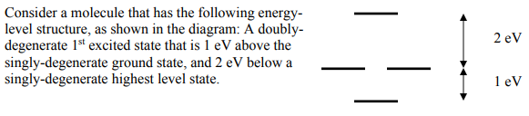





Spring 2015

Slide 17
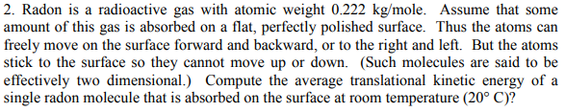

Fall 2014

Slide 18
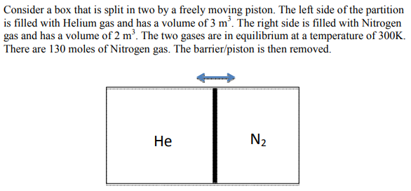

Fall 2014

Slide 19
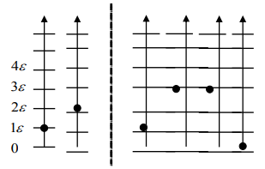

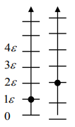



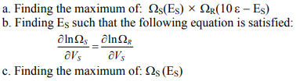
Fall 2014

Slide 20



Fall 2013

