Slide 1

HKN ECE 220: Fall 2017 Midterm 1
AJ Schroeder, Evan Lissoos, Utsav Kawrani
23rd September, 2017

Slide 2
Pseudo-Ops
.ORIG x3000
.END
.FILL
.BLKW#3
§
§
;;the first instruction should be at x3000
;;indicate this is the end of the program
#-3 ;;#-3, #5, #0, xFFC0, xABCD, etc.
;;how many memory location you want to put
.STRINGZ “Hello, World!” ;;Null-terminated TRAP x25 ;;same as HALT

Slide 3
Examples
§ How to clear R0?
§ AND R0, R0, #0
How to do copy R1 to R0?
ADD R0, R1, #0 ;;remember: and <= 15
-16 <= immediate value
How to get –R0?
NOT R0, R0
§ ADD R0, R0, #1

Slide 4
LC-3 Review: I/O
I/O Interactions
Polling vs Interrupts
Polling
Loop indefinitely until data is available by checking status registers (KBSR, DSR)
Interrupts
Allows program to perform other work while no data is available
Upon reception of interrupt, pause current code execution and execute special interrupt handling functions
Return to interrupted code once interrupt has been handled
Will be covered in depth in ECE 391!

Slide 5
LC-3 Review: I/O
Memory Mapped I/O
Map I/O to specific memory addresses
Removes the need for dedicated I/O channels
Accessing the mapped memory address gives access to the input or output device
Reading from xFE02 (KBDR) returns a char of what key was pressed on the keyboard
Writing ‘a’ to xFE06 (DDR) will display ‘a’ on the display
Check the status register (KBSR, DSR) of the respective input/output before reading or writing

Slide 6
LC-3 Review: Keyboard Input
Reading from the keyboard
Poll KBSR until ready bit is set then access input data stored in lower 8 bits of KBDR
POLL | LDI BRzp LDI | R1, KBSR POLL R0, KBDR | ; Check status register ; Loop while ready bit not set ; Get keyboard input
KBSR | .FILL | xFE00 | ; KBSR address
KBDR | .FILL | xFE02 | ; KBDR address

Slide 7
LC-3 Review: Display Output
Writing to the display
Poll DSR until ready bit is set then write display data to DDR
POLL | LDI BRzp STI | R1, DSR POLL R0, DDR | ; Check status register ; Loop while ready bit not set ; Write display data
DSR | .FILL | xFE04 | ; DSR address
DDR | .FILL | xFE06 | ; DDR address

Slide 8
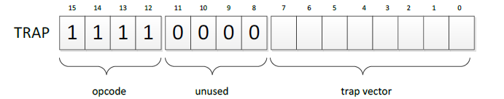
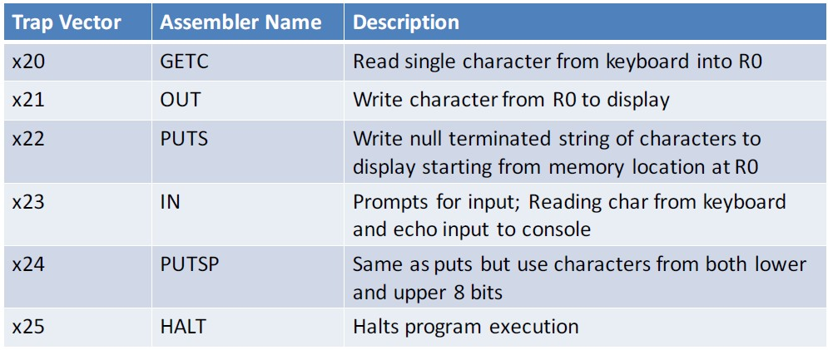
TRAPS
TRAP function
Passes control to operating system
Programmers can use complex operations without specialized knowledge

Slide 9
TRAPS: How they work
TRAP function is called by the user
The 8-bit trap vector is used as the index of the service routine’s address in the trap vector table
– - the table is stored in memory at 0x0000 – 0x00FF
The PC is loaded with the address of the service routine
After executing the service routine, control returns to the user program
MAR <- ZEXT(trapvector) MDR <- MEM[MAR]
R7 <- PC PC <- MDR

Slide 10
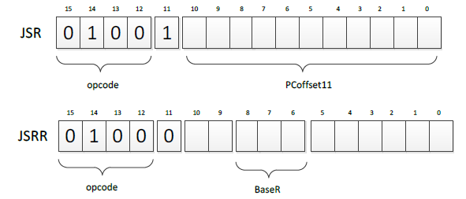
Subroutines
Similar to service routines but not part of the OS
Useful if there is a code segment that needs to be executed multiple times
Subroutines can be invoked by JSR or JSRR
Return is implemented with RET instruction
TEMP <- PC If(IR[11] == 0)
PC <- BaseR
Else
PC <- PC + SEXT(PCoffset11) R7 <- TEMP

Slide 11
Subroutines: Callee and Caller Save
Subroutine will save and restore registers that it modifies except for the return values
The only visible change should be the return value (if any) upon return
Caller should save registers that could be modified by the subroutine if they contain important data
R7 would need to be saved since JSR and JSRR overwrite its value

Slide 12
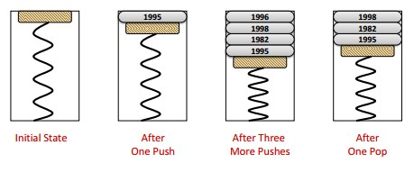
Stacks
Last-In-First-Out (LIFO)
Stack operations
Push: puts a new thing on top of the stack
Pop: removes whatever is on the top of the stack
IsEmpty: checks if the stack is empty
IsFull: checks if the stack is full
Example:

Slide 13
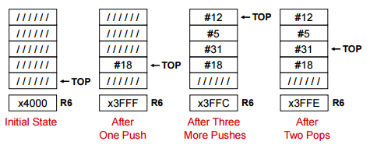
Stacks(continued)
Implementation
Keep elements stationary, just move the pointer
More efficient than moving everything
Example: Calculator
Questions?

Slide 14
Practice Questions
Assuming 3 items have been pushed onto the stack. After a POP operation, will the last item pushed onto the stack be erased from memory? Explain.

Slide 15
Is polling I/O is more efficient than interrupt-driven I/O? Explain.

Slide 16
In LC-3, what is the benefit of using a subroutine?

Slide 17
Explain what is a stack underflow.

Slide 18
The input stream of a stack is a list of all the elements we pushed onto the stack, in the order that we pushed them. If the input stream is ZYXWVUTSR, create a sequence of pushes and pops such that the output stream is YXVUWZSRT.

Slide 19
How many instructions, in terms of R1, are run in this program?
LD R0, OP1
LD R2, OP2
ADD R1, R0, #0
TOP:
ADD R2, R2, R0
ADD R1, R1, #-1
BRp TOP
HALT
OP1:
.FILL #SOME_NUMBER
OP2:
.FILL #10

Slide 20
Tips
.asm (PASS 1) : a symbol table is created (PASS2): .obj (the excutable)
Use LABELS
Use semicolon to comment
BR = BRnzp
Draw a flow chart if necessary
Try to remember what kind of numbers are in the registers that you are using. Write them down when calculation gets complicated.
Assign different registers to specific functionality when the task is complex (R1 for row count, R2 for column count, etc)
Make register table. It’s extremely useful.
R7 should not be changed. Ever!!!
Don’t get frustrated, breathe and start over.

