Slide 1
Physics 214 Exam 1 HKN Review Session
Steven Kolaczkowski
Dhruv Patel

Slide 2

Traveling Waves and Harmonics
The standard equation for a traveling wave is $y\left(x,t\right)=Acos⁡(kx−ωt +φ)$
$A$: the Amplitude of the wave
$k$ : the wavenumber, associated with the wave’s momentum and has units of ($length^{−1}$) $k=\frac{2π}{λ}$
$ω$ : the radial frequency, has units of $\frac{radians}{secound}$, related to standard frequency ($f$) by $2πf=ω$
$φ$ : the relative phase of the wave
Ex: $\sin\left(kx−ωt+90°\right)=\cos\left(kx−ωt\right)$
This is for a wave traveling in the positive x directions $v=\frac{ω}{k}$

Slide 3

Adding Waves and Intensity
Waves can constructively or destructively interfere
$A_{total}=A_{1}+A_{2}+A_{3}+ …$
$A_{1}\left(\cos\left(kx−ωt+φ_{0}\right)+\cos\left(kx−ωt+φ_{1}\right)\right)=2A_{1}\cos\left(\frac{φ_{0}−φ_{1}}{2}\right)\cos\left(kx−ωt+\left(\frac{φ_{0}+φ_{1}}{2}\right)\right)$
Intensity ($I$): A measure of the power provided by a wave over a given area
$I∝A^{2}$
$I_{Max}={\left|A_{1}+A_{2}\right|}^{2}$, $I_{Min}={\left|A_{1}−A_{2}\right|}^{2}$
If $A_{1}=A_{2}$ then $I={4A}_{1}^{2}\cos^{2}{(\frac{φ_{0}−φ_{1}}{2})}$

Slide 4

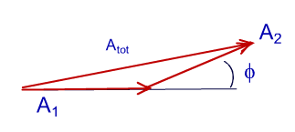

Phasors
A mathematical tool to help visualize time dependent systems
Each phasor, like a vector, has a magnitude and a direction
In this course we will only deal with phasors that share a frequency $ω_{0}=ω_{1}=ω$ (YAY!!!)
When adding phasors, we must account for their relative phase to each other
Since all frequencies are the same, adding phasors is just like adding vectors (because it is)
It is the projection of these vectors onto the horizontal axis that we care about (in this class)

Slide 5

Interference
Interference Minima: N slits there are (N-1) minima between maxima
Peak Thickness: Thickness is proportional to $\frac{1}{N}$ (the more slits, the skinnier the peaks are)
Maxima Location: Located every phase change of $2π$or when interfering waves are integer wavelengths out of phase. $d\sin\left(θ_{n}\right)=nλ$ under small angel approximation:$θ_{n}=\frac{nλ}{d}$ where d is the distance between slits and $λ$ is the wavelength.
Minima Location: Located every phase change of $\frac{2π}{N}$
Intensity: $I=I_{0}{\left(\frac{\sin\left(\frac{Nφ}{2}\right)}{\sin\left(\frac{φ}{2}\right)}\right)}^{2}$ where $φ=\frac{2πdsin\left(θ\right)}{λ}≈\frac{2πθ}{λ}$

Slide 6
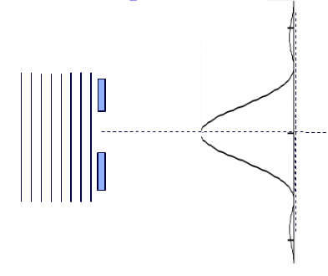

Diffraction
We can have interference between a wave going though a single slit!
This patter will have minima when the waves from the top of the slit destructively interfere (are $180°$ out of phase)
This happens at angles described by
$\sin\left(θ_{m}\right)=\frac{mλ}{a}$ or if angles are small $θ_{m}=\frac{mλ}{a}$
Intensity: $I=I_{0}{\left(\frac{\sin\left(\frac{β}{2}\right)}{\frac{β}{2}}\right)}^{2} where β≈\frac{2πaθ}{λ}$
Notice: $β$ and $φ$are essentially the same thing, only
one uses the slit spacing (d) and the other use the
slit width (a)

Slide 7


Diffraction and Interference AT THE SAME TIME!
Don’t panic! We still get to use all the equations from before, we just need to make sure we account for both mechanism.
Multiplying these two factors together we get
the gross equation: $I=I_{0}{\left(\frac{\sin\left(\frac{Nφ}{2}\right)}{\sin\left(\frac{φ}{2}\right)}\right)}^{2}{\left(\frac{\sin\left(\frac{β}{2}\right)}{\frac{β}{2}}\right)}^{2}$

Slide 8

Rayleigh Criteria
Need to be able to differentiate two waves that are next to each other in a grating
Rayleigh Limit $\frac{Δλ}{λ}≥\frac{1}{Nm}$
Light from two sources can be differentiated if they are a certain angle apart where
$θ_{c}=\frac{1.22λ}{D}$ for holes and $\frac{λ}{a}$ for slits. $a$ is the slit width and $D$ is the diameter of the beam
This can be translated to a spatial size of beam limit $Δl=\frac{.122f_{lense}λ}{D_{beam}}$

Slide 9


Photons ($γ$): Treating light as a particle
$E_{γ}=hf=ℏω=\frac{hc}{λ}$ h is Plank’s constant = $6.626×{10}^{−34}J∙s$
$ℏ=\frac{h}{2π}=1.0545×{10}^{−34}J∙s$ pronounced “h-bar”
When we work with quantum particles we describe them by their wavefunction ($ψ$)
[Insert physical interpretation of $ψ$ here], while ${\left|ψ\right|}^{2}$ is the probability of finding the particle at a specific location
We can treat the ${\left|ψ\right|}^{2}=P$ just like we treated $I$ and $ψ$ just like A
$P=4P_{1}cos{\left(\frac{φ}{2}\right)}^{2}$ IT’S THE SAME AS BEFORE!!!
Distinguishable vs. Indistinguishable
If we know exactly what path the particle is taking, $P_{total}={\left|ψ_{1}\right|}^{2}+{\left|ψ_{2}\right|}^{2}$
If we have no way of knowing the path, $P_{total}={\left|ψ_{1}+e^{iφ}ψ_{2}\right|}^{2}$
This is by far the more useful case in quantum mechanics and where all the craziness comes from

Slide 10

Particles? Waves? What’s the difference‽
How do we assign momentums to massless things like photons?
We use the DeBroglie Equation $p=\frac{h}{λ}=\frac{hf}{c}=\frac{ℏω}{c}=\frac{E}{c}=ℏk$
Energy:
Massive particles: $E=\frac{p^{2}}{2m}$
Light: $E=ℏω=hf$
Well how do we assign wavelength to a massive particle?
DeBroglie again!!! $E=\frac{p^{2}}{2m}=\frac{h^{2}}{2mλ^{2}} ∴λ=\frac{h}{\sqrt{2mE}}$

Slide 11
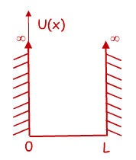

Time Independent Schrödinger Equation (TISE) and the Infinite Potential Well
$$−\frac{ℏ^{2}}{2m}\frac{d^{2}ψ\left(x\right)}{dx^{2}}+U\left(x\right)ψ(x)=Eψ(x)$$
Free Particle solution: if we have no potential ,$U\left(x\right)=0$, then our original harmonic wave solutions works and we can say $ψ\left(x\right)=cos⁡(kx)$ or $ψ\left(x\right)=sin⁡(kx)$
You can verify that this will get us $\frac{k^{2}ℏ^{2}}{2m}ψ\left(x\right)=Eψ(x)$
Infinite Square Well: We need a function that is zero at x=0 and x=L
From our options above, $ψ\left(x\right)=\sin\left(k_{n}x\right)$ works if $k_{n}=\frac{nπ}{L}=\frac{2π}{λ_{n}}$
$λ_{n}=\frac{2L}{n}$ and $E_{n}=\frac{n^{2}π^{2}ℏ^{2}}{2mL^{2}}=\frac{n^{2}h^{2}}{8mL^{2}}$
$n$ is the energy level of the system

Slide 12
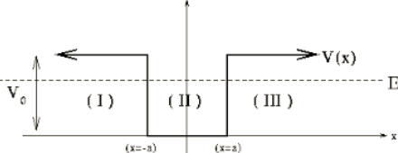

Finite Potential Wells and Boundary Conditions
Normalization: since ${\left|ψ\left(x\right)\right|}^{2}$ is a probability, the sum of all probabilities must be one
$1=∫{\left|ψ\left(x\right)\right|}^{2}$
With changing potentials we force two boundary conditions to be met:
$ψ\left(x^{−}\right)=ψ\left(x^{+}\right)$ and $\frac{dψ\left(x^{−}\right)}{dx}=\frac{dψ\left(x^{+}\right)}{dx}$
$\cos\left(kx\right)=\frac{e^{ikx}+e^{−ikx}}{2}$

Slide 13
Exam Advice
Know when and how to use your equation sheet
Don’t panic, just keep on moving
Make sure you are in the right mindset going into the exam
Spend your time showing what you know
DON’T CHEAT

Slide 14
Past Exam Questions

Slide 15
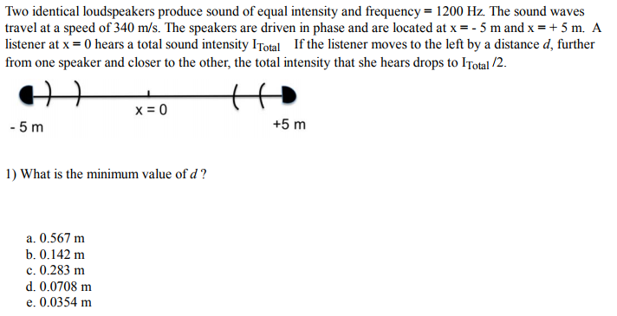
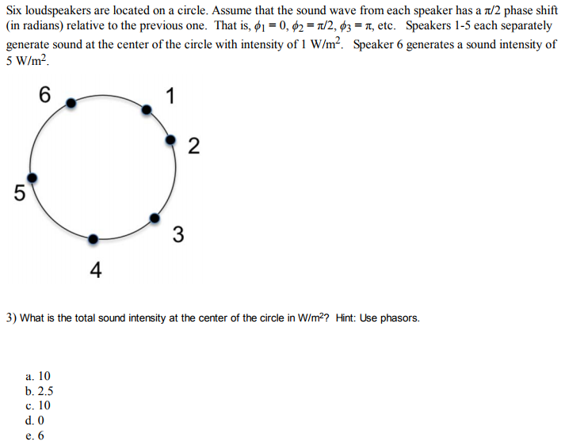
Spring 2017

Slide 16
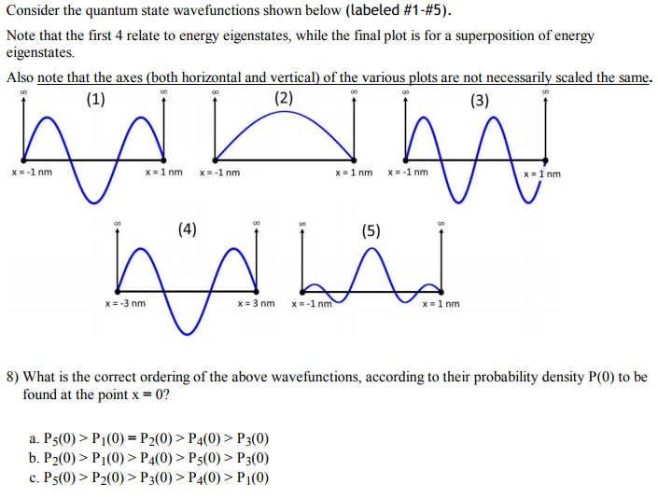
Spring 2017

Slide 17
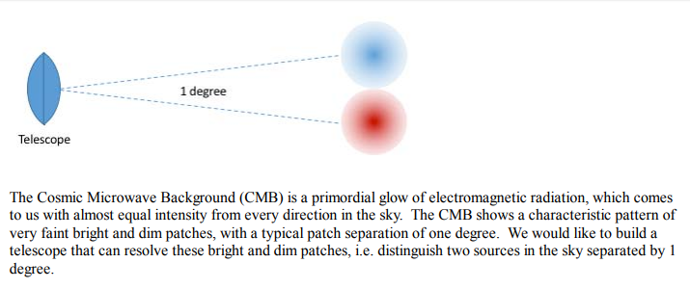
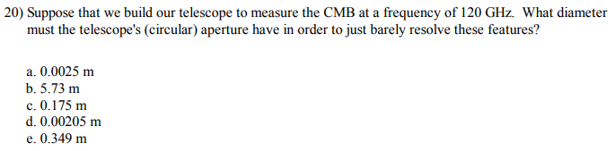
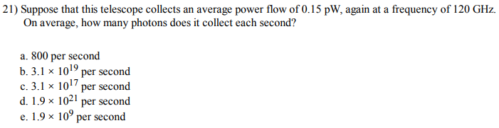
Spring 2017

Slide 18
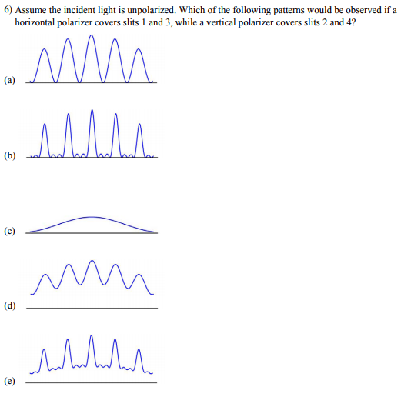
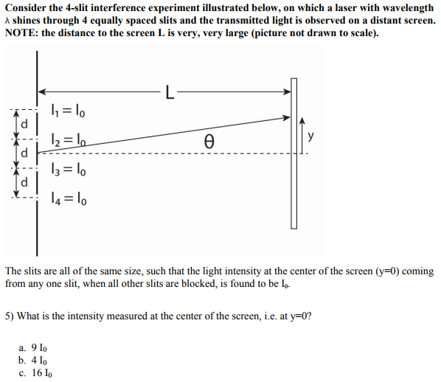

Spring 2016

Slide 19
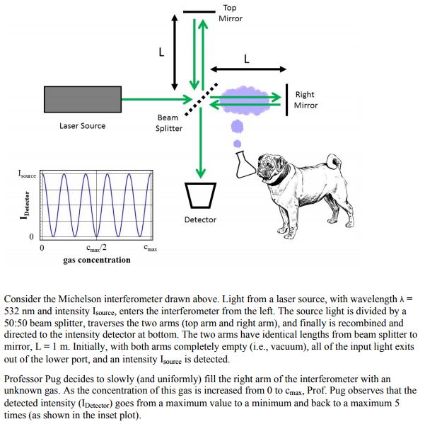
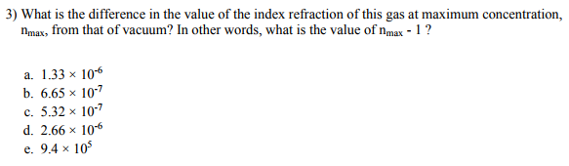
Fall 2016

Slide 20
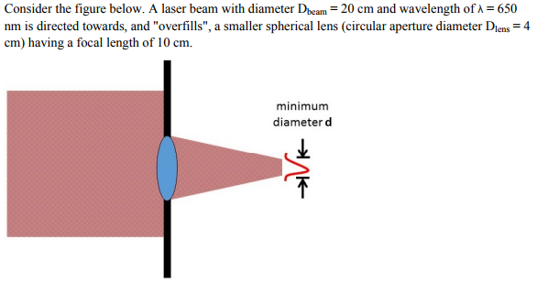
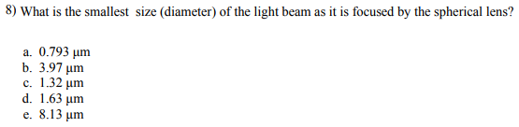
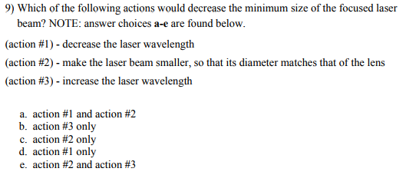
Fall 2016

Slide 21
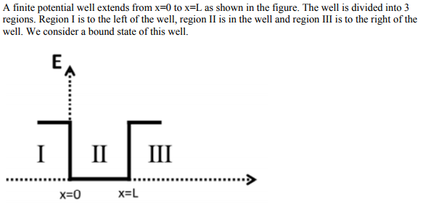
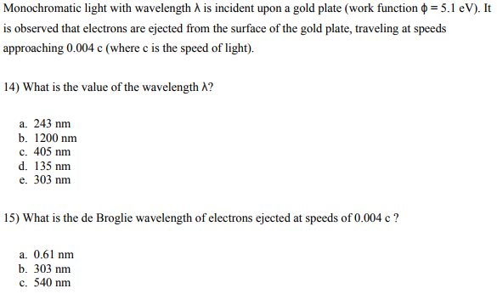
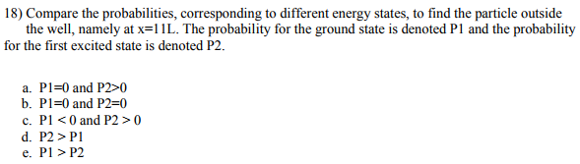
Fall 2016

Slide 22
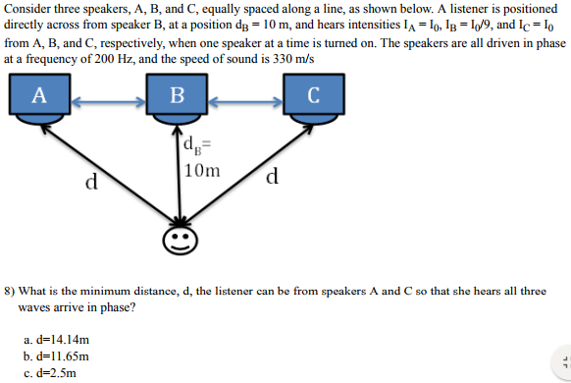
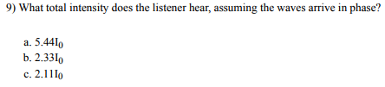
Fall 2015

Slide 23
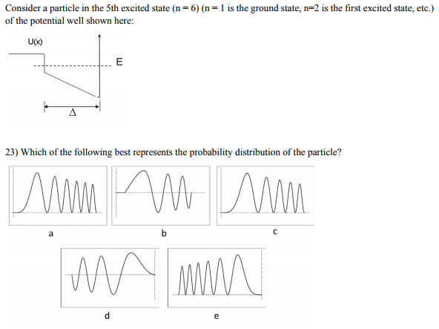

Fall 2015

Slide 24
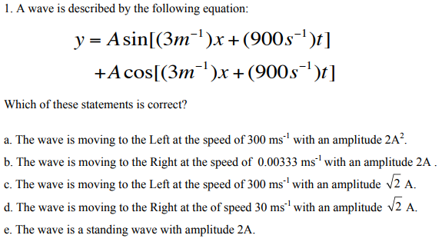
Fall 2014

Slide 25
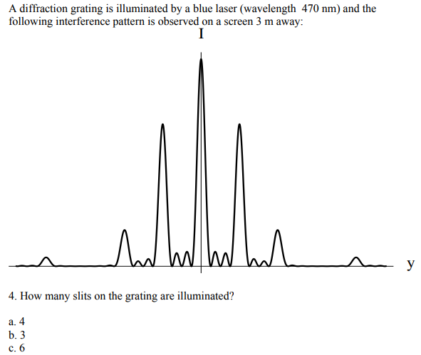
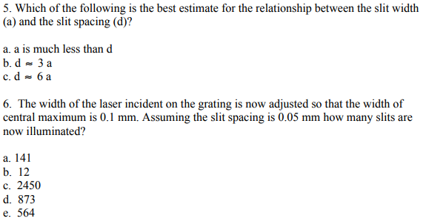
Fall 2014

Slide 26
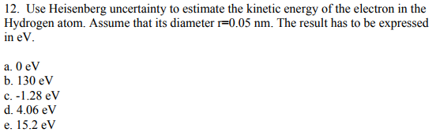
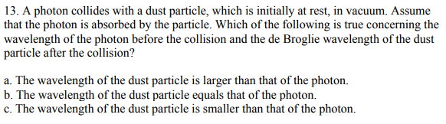
Fall 2014

Slide 27
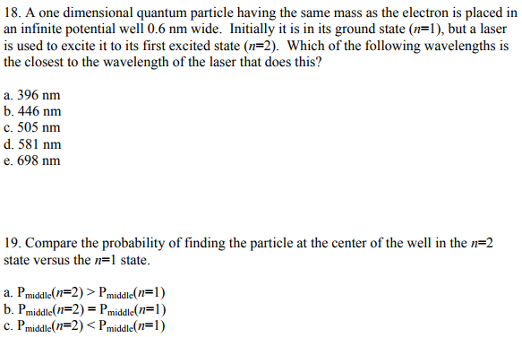
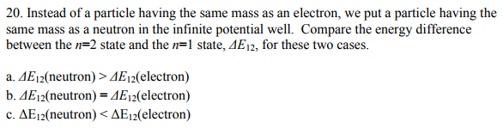
Fall 2014

Slide 28
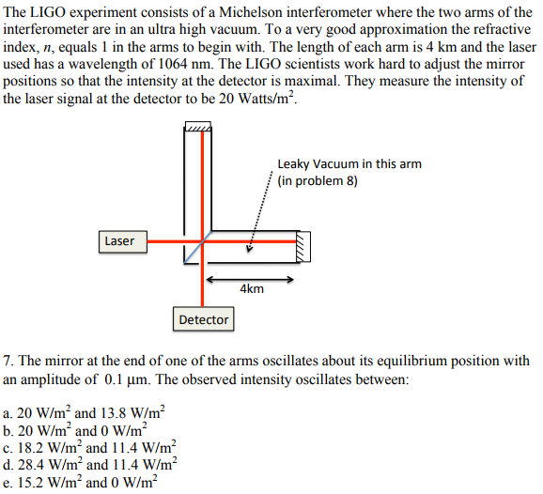
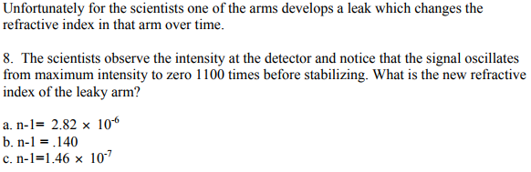
Fall 2014

