Slide 1

MEMORY HIERARCHY
sirisha.pptx
Memory hierarchy is one of the most required things in computer as it helps in Optimising memory available in the computer

Slide 2
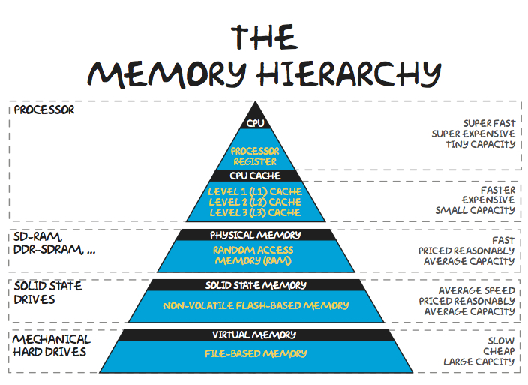
There are multiple levels present in the memory

Slide 3
PRIMARY MEMORY:
Primary memory is the memory that the CPU can access directly, that is, data values can be read from and written to primary memory using a unique address for each memory location. Primary memory is volatile (it will lose its contents if power is turned off) and comprises the CPU's registers and cache memory and RAM.
All applications, files, and data are kept on secondary storage, which is larger and has a longer access time.
A CPU or processor cannot access secondary memory directly.
The operating system loads any process into Primary Memory, which is comparatively smaller and can be directly accessed by the CPU in order to execute it.
Because only those programs are loaded in Primary Memory and are ready to be performed, the CPU may access them quickly, thus improving the system's speed.

Slide 4
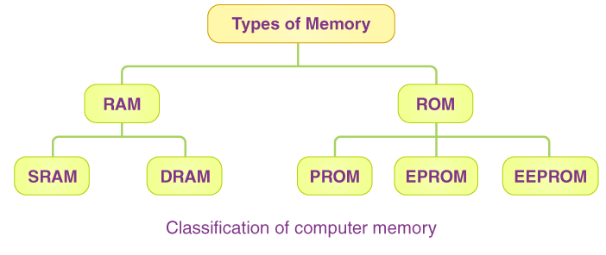
Classification of Primary Memory
Classify Primary Memory into two parts:
Read-Only Memory or ROM
Random Access Memory or RAM

Slide 5
SECONDARY MEMORY:
Secondary memory is a storage device that can store data and programs permanently, even when the computer is off. It's also known as external or auxiliary memory.
Some characteristics of secondary memory:
Non-volatile: Retains data even when the computer is turned off.
Less costly: Cheaper than primary memory.
High storage capacity: Can store large amounts of data.
Removable or fixed: Can be either embedded or removable
Secondary memory is used for a variety of purposes, including: Backing up data, Disaster recovery, and Storing critical or classified data.
Some examples of secondary memory devices are hard disk drives (HDD), Solid-state disk (SSD), Flash memory, Magnetic tapes, Floppy disks, Paper storage.

Slide 6
Difference between RAM and ROM :
RAM | ROM
RAM stands for random acess memory | ROM stands for read only memory
You can modify , edit or erase data in RAM | Data in ROM can not be modified or erased
RAM is volatile memory | ROM is non volatile memory
Speed of RAM is more than speed of ROM | ROM is slower than RAM
ROM is costly as compared to RAM | ROM is cheap as compared to RAM
Storage capacity is 1MB to 16MB. | Storage capacity is 1GB to 2GB

