Slide 1
Computer Networks

Slide 2
What is a network?
When two or more nodes are connected by some kind of communication network.
A node is any device connected to a network.
Communication can be bounded or unbounded.
A server is usually the central node on a network, but “the cloud” has replaced much of functions servers used to serve.

Slide 3
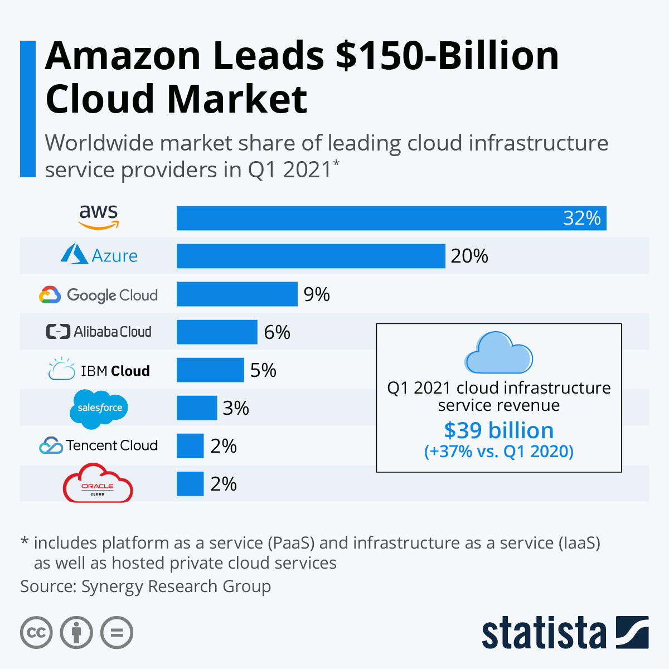

Slide 4
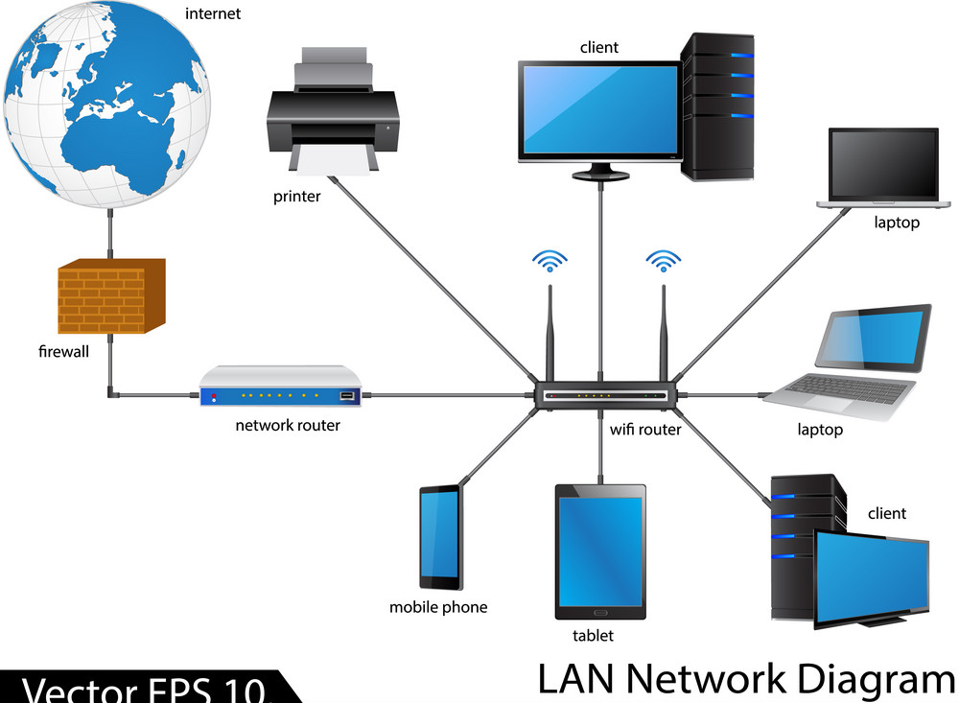

Slide 5
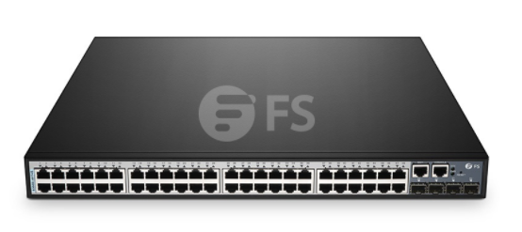
Nodes
device such as laptop, desktop or phone
A Switch connects nodes to each other.
Router connects to internet
Services such as printers

Slide 6
Communication Media
Three Parts:
Hardware that is source or sender
Hardware that is destination or receiver
Some connection between them.
Connection is called communication channel or transmission medium
Comms have a bandwidth ,the maximum amount of data transferred per unit time, in bps (bits per second)

Slide 7
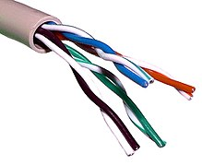
Bounded Media
STP (shielded Twisted Pair)
Less interference and crosstalk
But more expensive
.
UTP (unshielded Twisted Pair)
Pairs of wires twisted together with RJ45
Issues
Attenuation
Electromagnetic interference
Eavesdropping
Crosstalk
Advantages
Inexpensive and easy
Fast transmission rate
Been widely ised and tested
Used in many different types of network

Slide 8
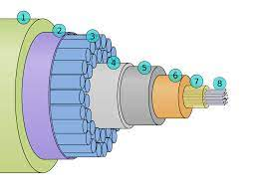
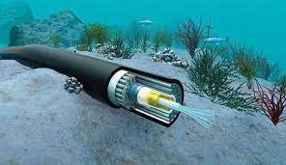
Fibre Optic Cable
Glass or plastic surrounded by protective materials.
Connection SC connector
Advantages
Faster transmission rate.
More secure.
Can be sent further will less attenuation.
Not affected EMI
Immune to lighting and electrical surges.

Slide 9
