Slide 1
IP Addresses
Partha Chakraborty
Lecturer
Department of Computer Science and Engineering
Comilla University

Slide 2
CONTENTS
  INTRODUCTION
  CLASSFUL ADDRESSING
    DIFFERENT NETWORK CLASSES
    SUBNETTING
  CLASSLESS ADDRESSING
    SUPERNETTING
    CIDR (CLASSLESS INTERDOMAIN ROUTING)

Slide 3

What is an IP Address?
An IP address is a
32-bit
address.
The IP addresses
are
unique.

Slide 4
Address space rule
…………..
…………..
addr1
addr15
addr2
…………..
The address space in a protocol
That uses N-bits to define an
Address is: 2^{N}
…………..
…………..
addr41
addr226
addr31
…………..
…………..

Slide 5
IPv4 and IPv6 address space
IPv4 an address consists of 32 bits which limits the address space to 4294967296 (2³²) possible unique addresses.
The most obvious distinguishing feature of IPv6 is its use of much larger addresses. The size of an address in IPv6 is 128 bits, which is four times larger than an address in IPv4. A 32-bit address space allows for 2³² or 4,294,967,296 possible addresses. A 128-bit address space allows for 2¹²⁸ or 340,282,366,920,938,463,463,374,607,431,768,211,456 (3.4 × 1038) possible addresses.

Slide 6
Binary Notation
01110101 10010101 00011101 11101010

Slide 7
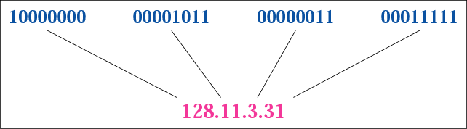
Figure 4-1
Dotted-decimal notation

Slide 8
Hexadecimal Notation
0111 0101 1001 0101 0001 1101 1110 1010
75 95 1D EA
0x75951DEA

Slide 9
Example 1
Change the following IP address from binary notation to dotted-decimal notation.
10000001 00001011 00001011 11101111
Solution
129.11.11.239

Slide 10
Example 2
Change the following IP address from dotted-decimal notation to binary notation:
111.56.45.78
Solution
01101111 00111000 00101101 01001110

Slide 11
Example 3
Find the error in the following IP Address
111.56.045.78
Solution
There are no leading zeroes in
Dotted-decimal notation (045)

Slide 12
Example 3 (continued)
Find the error in the following IP Address
75.45.301.14
Solution
In decimal notation each number <= 255
301 is out of the range

Slide 13
Example 4
Change the following binary IP address
Hexadecimal notation
10000001 00001011 00001011 11101111
Solution
0X810B0BEF or 810B0BEF16

Slide 14
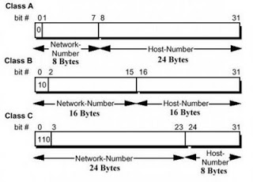
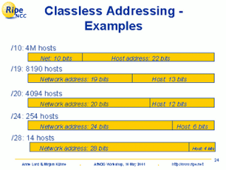
Classful vs Classless Addressing

Slide 15
CLASSFUL
ADDRESSING

Slide 16
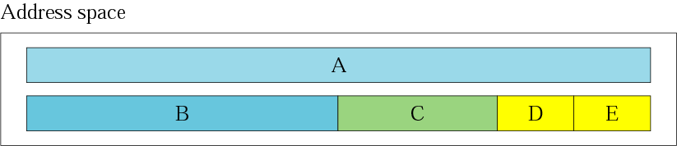
Figure 4-2
Occupation of the address space

Slide 17
In classful addressing the address space is
divided into 5 classes:
A, B, C, D, and E.

Slide 18
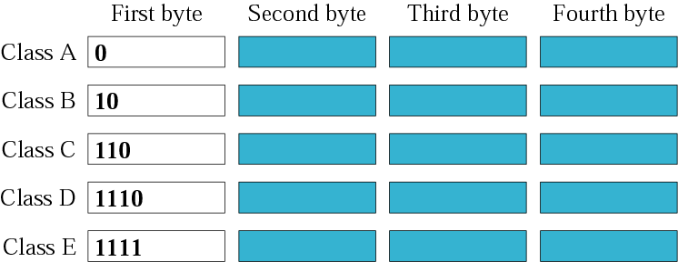
Figure 4-3
Finding the class in binary notation

Slide 19
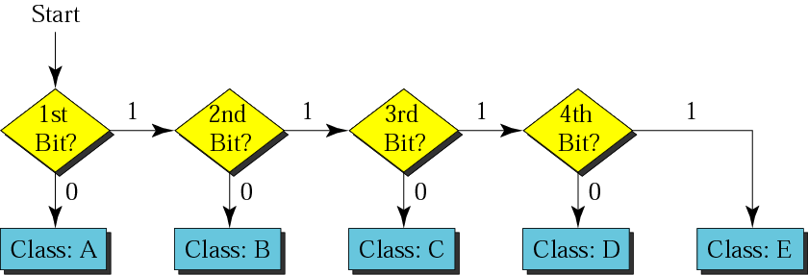
Figure 4-4
Finding the address class

Slide 20
Example 5
Show that Class A has
2³¹ = 2,147,483,648 addresses

Slide 21
Example 6
Find the class of the following IP addresses
00000001 00001011 00001011 11101111
11000001 00001011 00001011 11101111
Solution
00000001 00001011 00001011 11101111
1st is 0, hence it is Class A
11000001 00001011 00001011 11101111
1st and 2nd bits are 1, and 3rd bit is 0 hence, Class C

Slide 22

Figure 4-5
Finding the class in decimal notation

Slide 23
Example 7
Find the class of the following addresses
158.223.1.108
227.13.14.88
Solution
158.223.1.108
1st byte = 158 (128<158<191) class B
227.13.14.88
1st byte = 227 (224<227<239) class D

Slide 24
IP address with appending port number
158.128.1.108:25
the four octet before colon is the IP address
The number after colon 25 is the port number

Slide 25
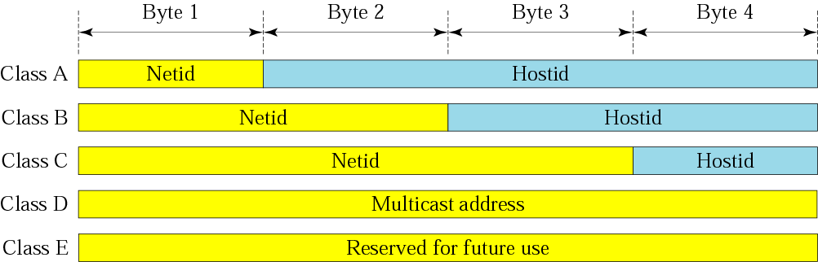
Figure 4-6
netid and hostid
Class A - supports 16 million hosts on each of 126 networks
Class B - supports 65,000 hosts on each of 16,000 networks
Class C - supports 254 hosts on each of 2 million networks

Slide 26
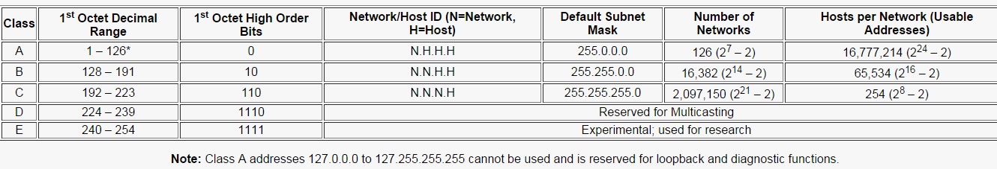
Figure 4-6
Overview

Slide 27
Figure 4-6
Static Versus Dynamic IP Addresses
Static Versus Dynamic IP Addresses
An IP address can be static or dynamic. A static IP address will never change and it is a permanent Internet address. A dynamic IP address is a temporary address that is assigned each time a computer or device accesses the Internet.
What is My IP Address?
To view your IP address you can use the ipconfig command line tool. ipconfig displays all current TCP/IP network configuration values and refreshes Dynamic Host Configuration Protocol (DHCP) and Domain Name System (DNS) settings.
To launch the command prompt from a Windows-based computer click: Start > All Programs > Accessories >Command Prompt. Type ipconfig and press the Enter key.

Slide 28
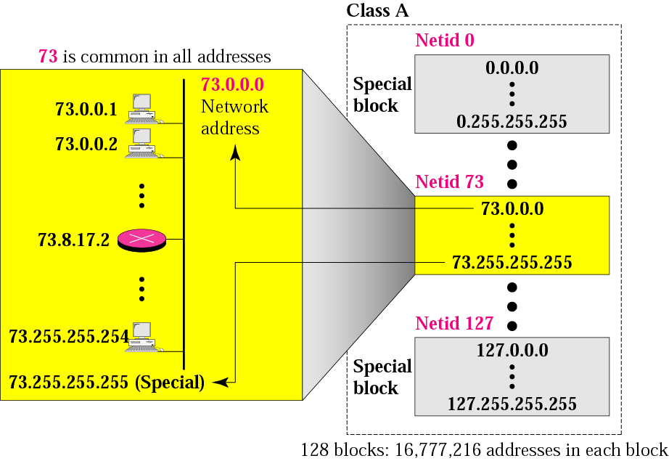
Figure 4-7
Blocks in class A

Slide 29
Millions of class A addresses
are wasted.

Slide 30
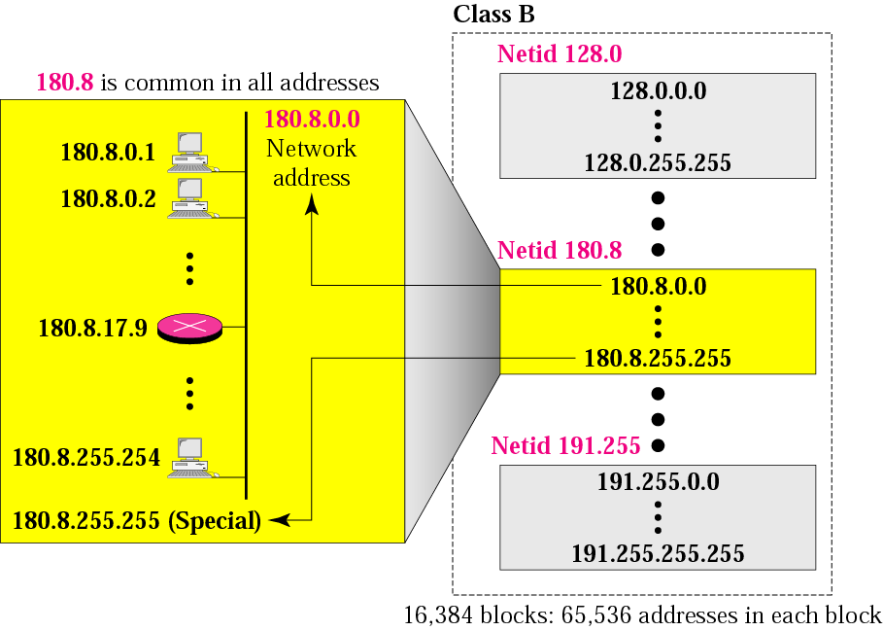
Figure 4-8
Blocks in class B

Slide 31
Many class B addresses
are wasted.

Slide 32
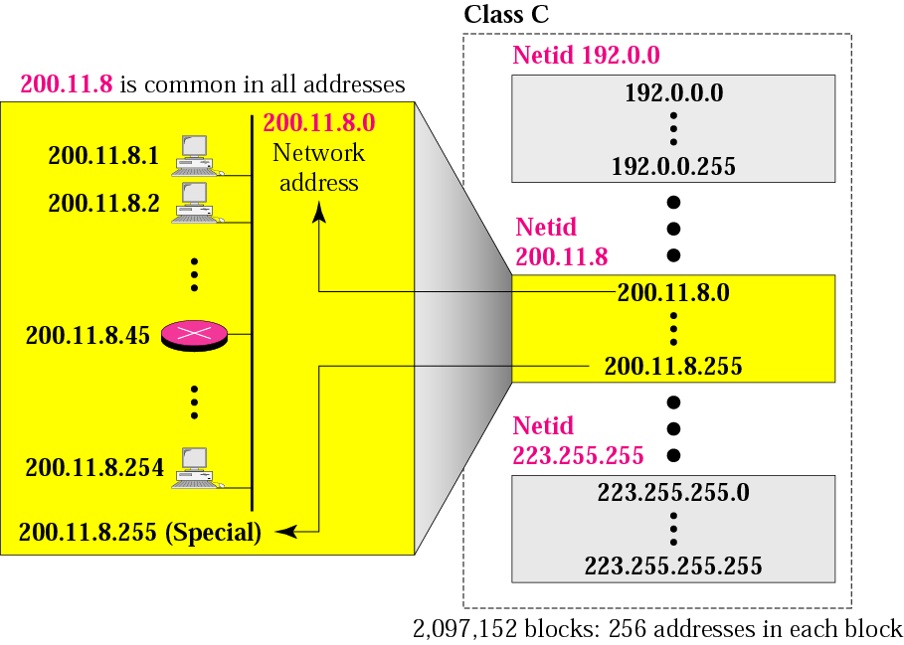
Figure 4-9
Blocks in class C

Slide 33
The number of addresses in
a class C block
is smaller than
the needs of most organizations.

Slide 34
Class D addresses
are used for multicasting;
there is only
one block in this class.

Slide 35
Class E addresses are reserved
for special purposes;
most of the block is wasted.

Slide 36
The Class D address class was created to enable multicasting in an IP address. A multicast address is a unique network address that directs packets with that destination address to predefined groups of IP addresses. Therefore, a single station can simultaneously transmit a single stream of data to multiple recipients.
The Class D address space, much like the other address spaces, is mathematically constrained. The first four bits of a Class D address must be 1110. Therefore, the first octet range for Class D addresses is 11100000 to 11101111, or 224 to 239. An IP address that starts with a value in the range of 224 to 239 in the first octet is a Class D address.
A Class E address has been defined. However, the Internet Engineering Task Force (IETF) reserves these addresses for its own research. Therefore, no Class E addresses have been released for use in the Internet. The first four bits of a Class E address are always set to 1s. Therefore, the first octet range for Class E addresses is 11110000 to 11111111, or 240 to 255.

Slide 37
Network Addresses
The network address is the first address.
The network address defines the network to the rest of the internet.
Given the network address, we can find the class of the address, the block, and the range of the addresses in the block

Slide 38
In classful addressing,
the network address
(the first address in the block)
is the one that is assigned
to the organization.

Slide 39
Example 8
Given the network address 132.21.0.0, find the
class, the block, and the range of the addresses
Solution
The 1st byte is between 128 and 191.
Hence, Class B
The block has a netid of 132.21.
The addresses range from
132.21.0.0 to 132.21.255.255.

Slide 40
MASK
An IP address has two components, the network address and the host address. A subnet mask separates the IP address into the network and host addresses (<network><host>). Subnetting further divides the host part of an IP address into a subnet and host address (<network><subnet><host>) if additional subnetwork is needed. Use the Subnet Calculator to retrieve subnetwork information from IP address and Subnet Mask.
It is called a subnet mask because it is used to identify network address of an IP address by perfoming a bitwise AND operation on the netmask.
A Subnet mask is a 32-bit number that masks an IP address, and divides the IP address into network address and host address. Subnet Mask is made by setting network bits to all "1"s and setting host bits to all "0"s. Within a given network, two host addresses are reserved for special purpose, and cannot be assigned to hosts. The "0" address is assigned a network address and "255" is assigned to a broadcast address, and they cannot be assigned to hosts.

Slide 41
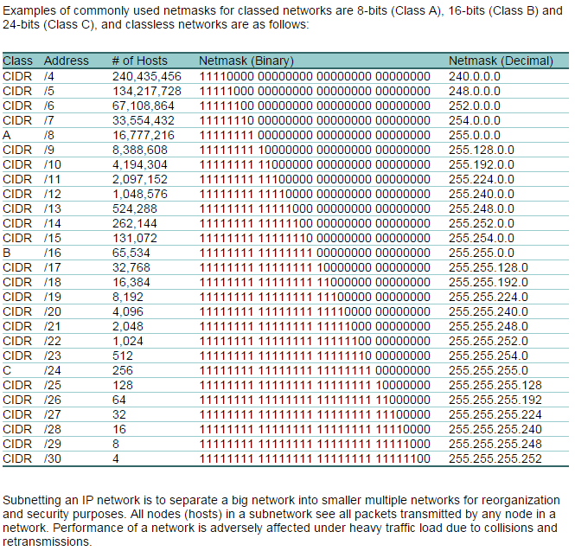
MASK

Slide 42
Mask
A mask is a 32-bit binary number.
The mask is ANDeD with IP address to get
  The block address (Network address)
  Mask And IP address = Block Address

Slide 43
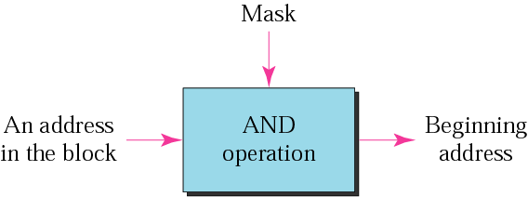
Figure 4-10
Masking concept

Slide 44
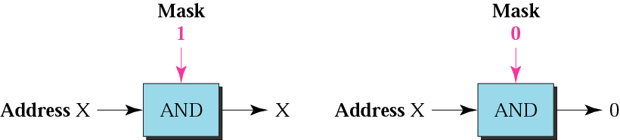
Figure 4-11
AND operation

Slide 45
The network address is the
beginning address of each block.
It can be found by applying
the default mask to
any of the addresses in the block
(including itself).
It retains the netid of the block
and sets the hostid to zero.

Slide 46
Default Mask
Class A default mask is 255.0.0.0
Class B default mask is 255.255.0.0
Class C Default mask 255.255.255.0

Slide 47
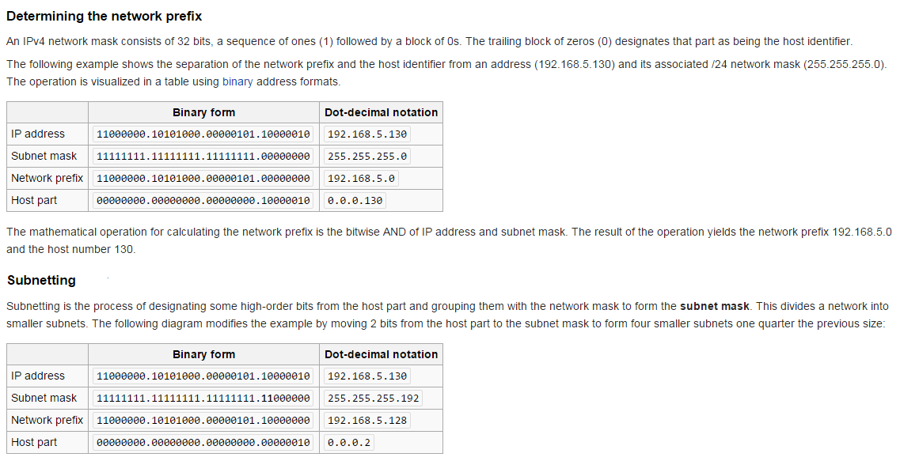
Note

Slide 48
Subnetting/Supernetting
and
Classless Addressing

Slide 49
CONTENTS
SUBNETTING
SUPERNETTING
CLASSLESS ADDRSSING

Slide 50
SUBNETTING

Slide 51

A subnetwork or subnet is a logical subdivision of an IP network.
The practice of dividing a network into two or more networks
is called subnetting.
In subnetting you borrow bits from the host part

Slide 52
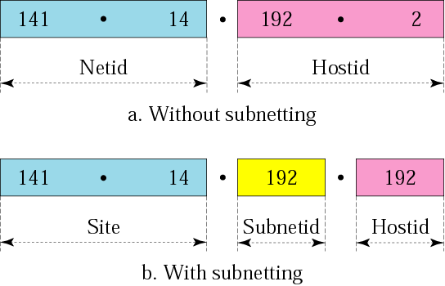
Figure 5-3
Addresses in a network with
and without subnetting

Slide 53
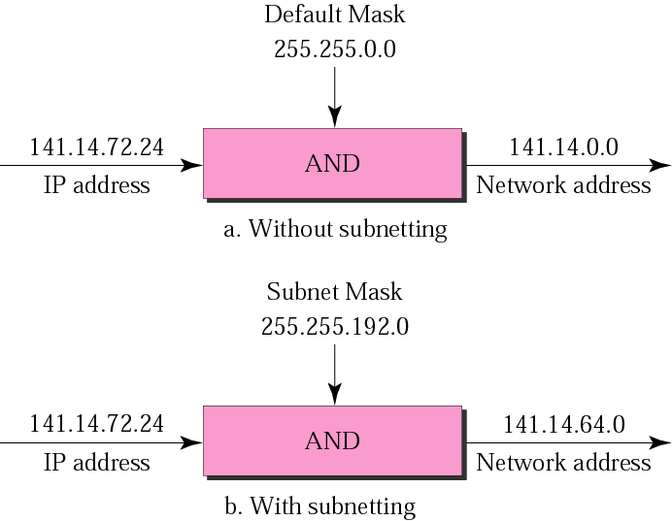
Figure 5-5
Default mask and subnet mask

Slide 54
Finding the Subnet Address
Given an IP address, we can find the subnet address the same way we found the network address. We apply the mask to the address. We can do this in two ways: straight or short-cut.

Slide 55
Straight Method
In the straight method, we use binary notation for both the address and the mask and then apply the AND operation to find the subnet address.

Slide 56
Example 9
What is the subnetwork address if the destination address is 200.45.34.56 and the subnet mask is 255.255.240.0?

Slide 57
Solution
11001000 00101101 00100010 00111000
11111111 11111111 11110000 00000000
11001000 00101101 00100000 00000000
The subnetwork address is 200.45.32.0.

Slide 58
Short-Cut Method
    ** If the byte in the mask is 255, copy the byte in the address.
    ** If the byte in the mask is 0, replace the byte in the address with 0.
    ** If the byte in the mask is neither 255 nor 0, we write the mask and the address in binary and apply the AND operation.

Slide 59
Example 10
What is the subnetwork address if the destination address is 19.30.80.5 and the mask is 255.255.192.0?
Solution
See next slide

Slide 60
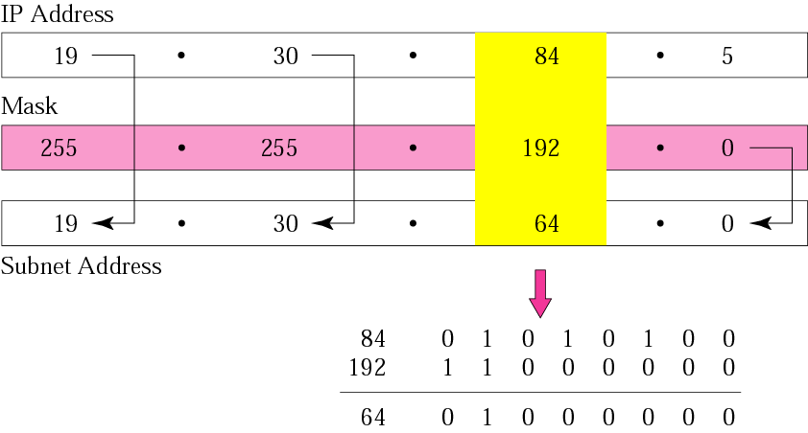
Figure 5-6
Solution

Slide 61
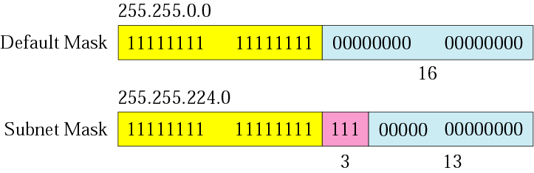
Figure 5-7
Comparison of a default mask and
a subnet mask

Slide 62
The number of subnets must be
a power of 2.

Slide 63
Example 11
A company is granted the site address 201.70.64.0 (class C). The company needs six subnets. Design the subnets.
Solution
The number of 1s in the default
mask is 24 (class C).

Slide 64
Solution (Continued)
The company needs six subnets. This number 6 is not a power of 2. The next number that is a power of 2 is 8 (2³). We need 3 more 1s in the subnet mask. The total number of 1s in the subnet mask is 27 (24 + 3).
The total number of 0s is 5 (32 − 27). The mask is

Slide 65
Solution (Continued)
11111111 11111111 11111111 11100000
or
255.255.255.224
    The number of subnets is 8.
    The number of addresses in each subnet is 2⁵ (5 is the number of 0s) or 32.
See Next slide

Slide 66
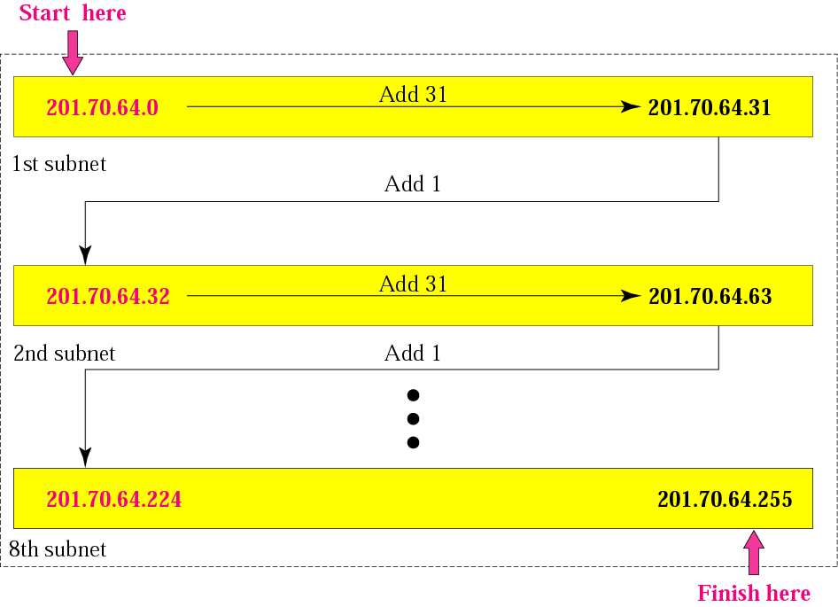
Figure 5-8
Example 3

Slide 67
Example 12
A company is granted the site address 181.56.0.0 (class B). The company needs 1000 subnets. Design the subnets.
Solution
The number of 1s in the default mask is 16 (class B).

Slide 68
Solution (Continued)
The company needs 1000 subnets. This number is not a power of 2. The next number that is a power of 2 is 1024 (2¹⁰). We need 10 more 1s in the subnet mask.
The total number of 1s in the subnet mask is 26 (16 + 10).
The total number of 0s is 6 (32 − 26).

Slide 69
Solution (Continued)
The mask is
11111111 11111111 11111111 11000000
or
255.255.255.192.
The number of subnets is 1024.
The number of addresses in each subnet is 2⁶ (6 is the number of 0s) or 64.
See next slide

Slide 70
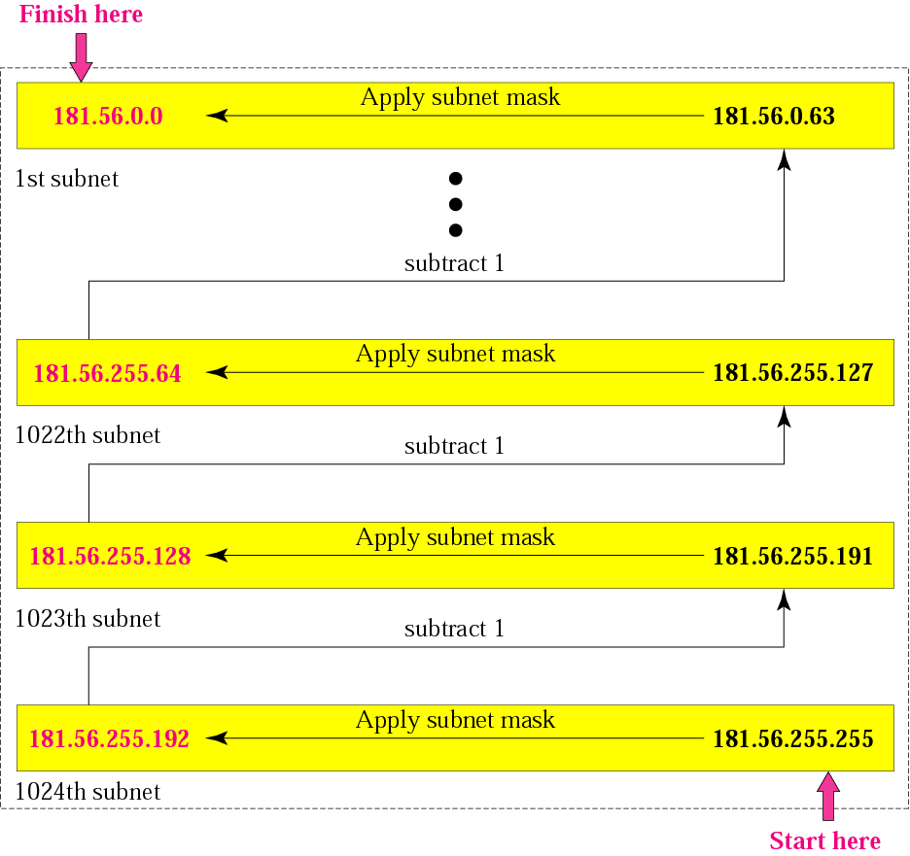
Figure 5-9
Example 4

Slide 71
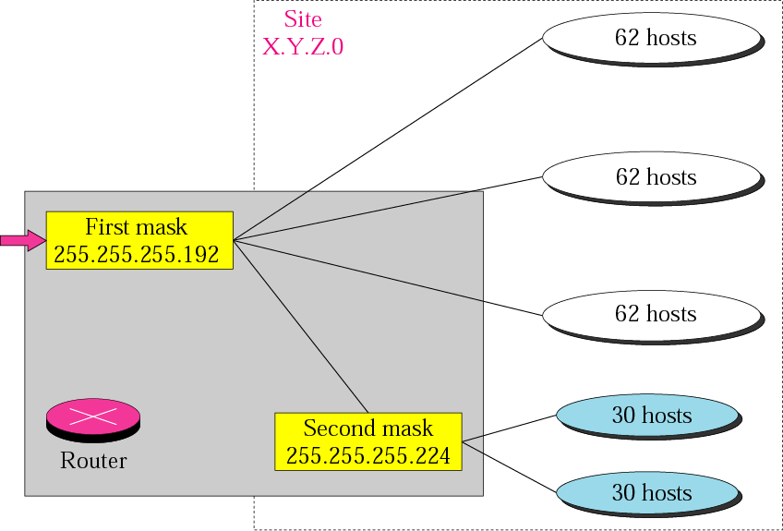
Figure 5-10
Variable-length subnetting

Slide 72
SUPERNETTING

Slide 73
What is suppernetting?
Supernetting is the opposite of subnetting
In subnetting you borrow bits from the host part
Supernetting is done by borrowing bits from the network side.
And combine a group of networks into one large supernetwork.

Slide 74
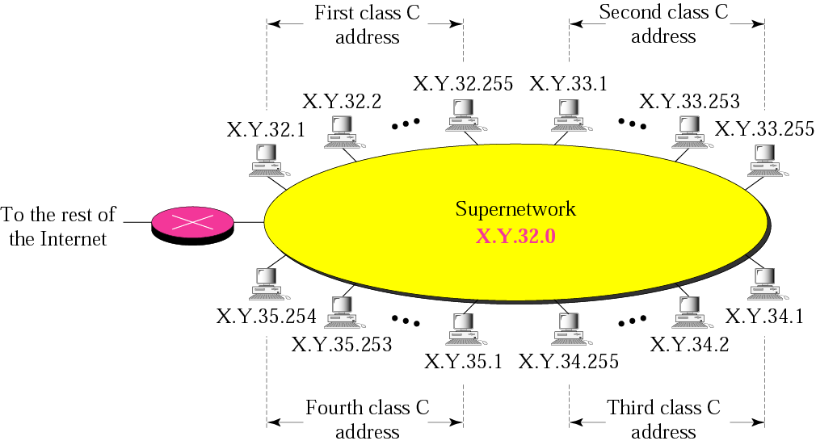
Figure 5-11
A supernetwork

Slide 75
Rules:
❐ The number of blocks must be a power of 2 (1, 2, 4, 8, 16, . . .).
❐ The blocks must be contiguous in the address space (no gaps between the blocks).
❐ The third byte of the first address in the superblock must be evenly divisible by the number of blocks. In other words, if the number of blocks is N, the third byte must be divisible by N.

Slide 76
Example 5
A company needs 600 addresses. Which of the following set of class C blocks can be used to form a supernet for this company?
198.47.32.0 198.47.33.0 198.47.34.0
198.47.32.0 198.47.42.0 198.47.52.0 198.47.62.0
198.47.31.0 198.47.32.0 198.47.33.0 198.47.52.0
198.47.32.0 198.47.33.0 198.47.34.0 198.47.35.0

Slide 77
Solution
1: No, there are only three blocks.
2: No, the blocks are not contiguous.
3: No, 31 in the first block is not divisible by 4.
4: Yes, all three requirements are fulfilled.

Slide 78
In subnetting,
we need the first address of the
subnet and the subnet mask to
define the range of addresses.

Slide 79
In supernetting,
we need the first address of
the supernet
and the supernet mask to
define the range of addresses.

Slide 80
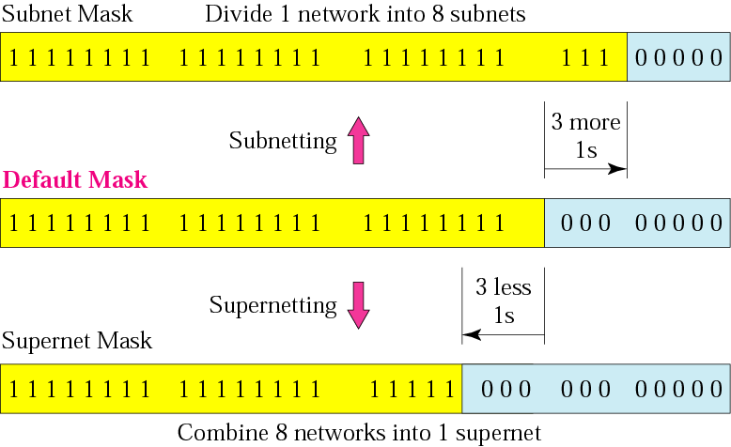
Figure 5-12
Comparison of subnet, default,
and supernet masks

Slide 81
Example 13
We need to make a supernetwork out of 16 class C blocks. What is the supernet mask?
Solution
We need 16 blocks. For 16 blocks we need to change four 1s to 0s in the default mask. So the mask is
11111111 11111111 11110000 00000000
or
255.255.240.0

Slide 82
Example 14
A supernet has a first address of 205.16.32.0 and a supernet mask of 255.255.248.0. A router receives three packets with the following destination addresses:
    205.16.37.44
    205.16.42.56
    205.17.33.76
Which packet belongs to the supernet?

Slide 83
Solution
We apply the supernet mask to see if we can find the beginning address.
205.16.37.44 AND 255.255.248.0 ➔  205.16.32.0
205.16.42.56 AND 255.255.248.0 ➔  205.16.40.0
205.17.33.76 AND 255.255.248.0 ➔  205.17.32.0
Only the first address belongs to this supernet.

Slide 84
Example 15
A supernet has a first address of 205.16.32.0 and a supernet mask of 255.255.248.0. How many blocks are in this supernet and what is the range of addresses?
Solution
The supernet has 21 1s. The default mask has 24 1s. Since the difference is 3, there are 2³ or 8 blocks in this supernet. The blocks are 205.16.32.0 to 205.16.39.0. The first address is 205.16.32.0. The last address is 205.16.39.255.

Slide 85
5.3
CLASSLESS
ADDRESSING

Slide 86
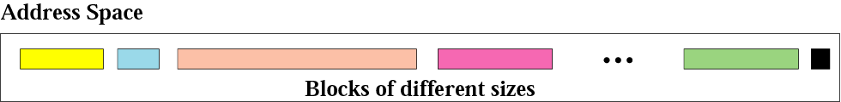
Figure 5-13
Variable-length blocks

Slide 87
Number of Addresses in a Block
There is only one condition on the number of addresses in a block; it must be a power of 2 (2, 4, 8, . . .). A household may be given a block of 2 addresses. A small business may be given 16 addresses. A large organization may be given 1024 addresses.

Slide 88
Beginning Address
The beginning address must be evenly divisible by the number of addresses. For example, if a block contains 4 addresses, the beginning address must be divisible by 4. If the block has less than 256 addresses, we need to check only the rightmost byte. If it has less than 65,536 addresses, we need to check only the two rightmost bytes, and so on.

Slide 89
Example 16
Which of the following can be the beginning address of a block that contains 1024 addresses?
205.16.37.32
190.16.42.0
17.17.32.0
123.45.24.52
Solution
To be divisible by 1024, the rightmost byte of an address should be 0 and the second rightmost byte must be divisible by 4. Only the address 17.17.32.0 meets this condition.

Slide 90
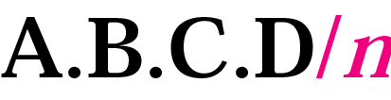
Figure 5-14
Slash notation

Slide 91
Slash notation is also called
CIDR
notation.

Slide 92
Example 17
A small organization is given a block with the beginning address and the prefix length 205.16.37.24/29 (in slash notation). What is the range of the block?

Slide 93
Solution
The beginning address is 205.16.37.24. To find the last address we keep the first 29 bits and change the last 3 bits to 1s.
Beginning: 11001111 00010000 00100101 00011000
Ending : 11001111 00010000 00100101 00011111
There are only 8 addresses in this block.

Slide 94
Example 17 cont’d
We can find the range of addresses in Example 17 by another method. We can argue that the length of the suffix is 32 − 29 or 3. So there are 2³ = 8 addresses in this block. If the first address is 205.16.37.24, the last address is 205.16.37.31 (24 + 7 = 31).

Slide 95
A block in classes A, B, and C
can easily be represented in slash
notation as
A.B.C.D/ n
where n is
either 8 (class A), 16 (class B), or
24 (class C).

Slide 96
Example 18
What is the network address if one of the addresses is 167.199.170.82/27?
Solution
The prefix length is 27, which means that we must keep the first 27 bits as is and change the remaining bits (5) to 0s. The 5 bits affect only the last byte. The last byte is 01010010. Changing the last 5 bits to 0s, we get 01000000 or 64. The network address is 167.199.170.64/27.

Slide 97
Example 19
An organization is granted the block 130.34.12.64/26. The organization needs to have four subnets. What are the subnet addresses and the range of addresses for each subnet?
Solution
The suffix length is 6. This means the total number of addresses in the block is 64 (2⁶). If we create four subnets, each subnet will have 16 addresses.

Slide 98
Solution (Continued)
Let us first find the subnet prefix (subnet mask). We need four subnets, which means we need to add two more 1s to the site prefix. The subnet prefix is then /28.
Subnet 1: 130.34.12.64/28 to 130.34.12.79/28.
Subnet 2 : 130.34.12.80/28 to 130.34.12.95/28.
Subnet 3: 130.34.12.96/28 to 130.34.12.111/28.
Subnet 4: 130.34.12.112/28 to 130.34.12.127/28.
See Figure 5.15

Slide 99
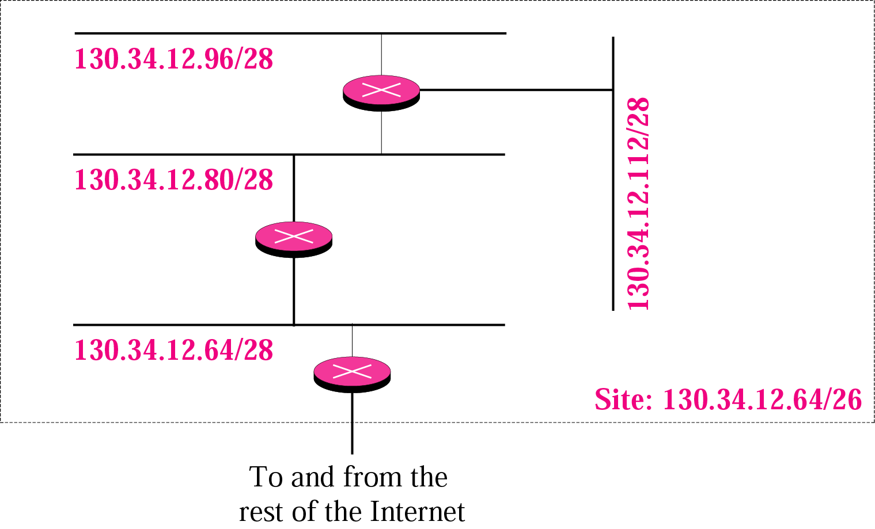
Figure 5-15
Example 19 cont’d

Slide 100
Example 20
An ISP is granted a block of addresses starting with 190.100.0.0/16. The ISP needs to distribute these addresses to three groups of customers as follows:
1. The first group has 64 customers; each needs 256 addresses.
2. The second group has 128 customers; each needs 128 addresses.
3. The third group has 128 customers; each needs 64 addresses.
Design the subblocks and give the slash notation for each subblock. Find out how many addresses are still available after these allocations.

Slide 101
Solution
Group 1
For this group, each customer needs 256 addresses. This means the suffix length is 8 (2⁸ = 256). The prefix length is then 32 − 8 = 24.
01: 190.100.0.0/24  ➔190.100.0.255/24
02: 190.100.1.0/24 ➔190.100.1.255/24
…………………………………..
64: 190.100.63.0/24➔190.100.63.255/24
Total = 64 × 256 = 16,384

Slide 102
Solution (Continued)
Group 2
For this group, each customer needs 128 addresses. This means the suffix length is 7 (2⁷ = 128). The prefix length is then 32 − 7 = 25. The addresses are:
001: 190.100.64.0/25 ➔190.100.64.127/25
002: 190.100.64.128/25 ➔190.100.64.255/25
………………..
128: 190.100.127.128/25 ➔190.100.127.255/25
Total = 128 × 128 = 16,384

Slide 103
Solution (Continued)
Group 3
For this group, each customer needs 64 addresses. This means the suffix length is 6 (2⁶ = 64). The prefix length is then 32 − 6 = 26.
001:190.100.128.0/26 ➔190.100.128.63/26
002:190.100.128.64/26 ➔190.100.128.127/26
…………………………
128:190.100.159.192/26 ➔190.100.159.255/26
Total = 128 × 64 = 8,192

Slide 104
Solution (Continued)
Number of granted addresses: 65,536
Number of allocated addresses: 40,960
Number of available addresses: 24,576

