Slide 1
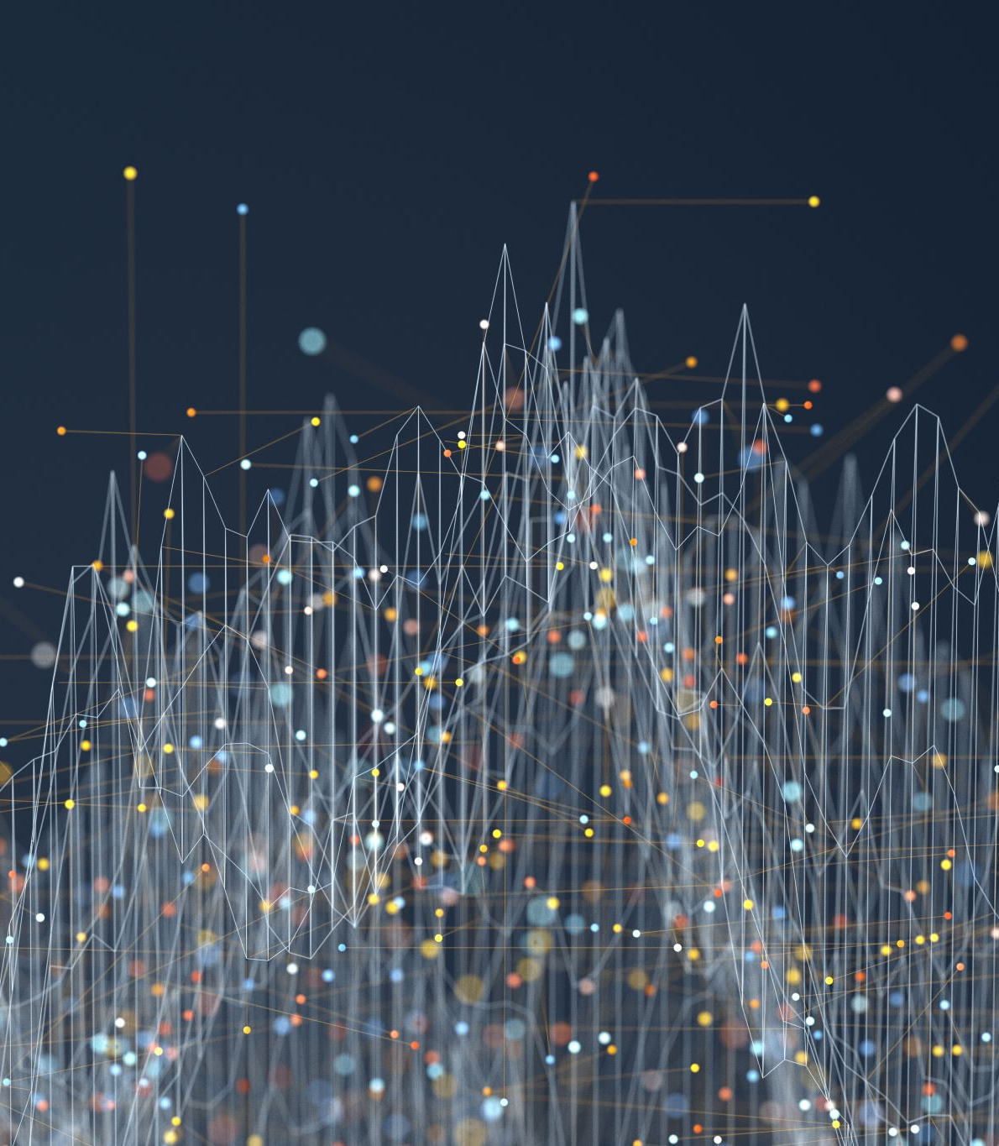
Autism Detection
Nihir Singh, Sriparno Majumdar, Suramay Pidara, Jaideep Bellani

Slide 2
Why We Built This
Every year, 62 births in every 10000 is diagnosed with Autism Spectrum disorder.
There is a shortage of mental health specialists with a doctor/patient ratio of 1:870.
In order to get an appointment for a diagnosis with a counsellor, it can take up to two years. The age autism is best treated is between 1-3 years.
We aim to reduce the number of false positive cases, providing people who need help the most early and efficiently.
We aim to harness the power of machine learning and computer vision, to predict autism disorders and recommend whether you should visit a counsellor for a professional diagnosis.

Slide 3
Background and Theory
The diagnosis of autism is based heavily on two major factors:
Mood Instability: Autistic children are unable to control their emotions when looking at a fixed stimuli. Due to the lack of development in motor control, they are unable to control their facial expressions and might end up displaying numerous emotions in a short amount of time.
Eye Contact: Autistic children are unable to maintain good eye contact. Due to heightened senses and ADHD, autistic children are unable to focus on the task in front and end up looking at their surroundings more often.

Slide 4
Usage and Functioning
The patient first lands on our interactive survey form that allows the parents/patient to fill out their details and any history of diagnosis.
They are then directed to the react application, wherein they go to the page that fits best with their age. For children less than 4 years, we show them a video while also recording their faces. For children above 4, we have created a game that the patient can play and during that, we collect their facial data.
The facial data is then downloaded and stored on the server and the backend comes into play. Two models analyze the video and output their predictions to a final results page. We also give you the option to send the reports generated by out model to your doctor for any further analysis they might need.

Slide 5
Design Strategy
We divided our web application into three main parts and started its development:
The front-end: It comprises of a react.js application that enables us to capture video from the user and
Gaze Tracking/Eye Detection: It utilizes a Berkeley Vision model in order to track the eyes of a patient with reference to a central object on the screen.
Emotion Detection: It uses the Google Vision neural network inorder to predict emtions from frames captured by the react application of the patients face.

Slide 6
The Front-end
The front end of the app is powered by react.js. It is made to ease flow and use.
The application is split into two main parts, one for kids less than 4 years of age and one for kids above that age.
For children that are under the age of 4 years old, the application displays a happy or sad stimuli in the form of a video. While the stimuli plays, it captures the facial data of the patient and as soon as it finishes, allows the user to download the data onto the server.
For children above the age of 4, the react.js application has a built in game that the child can play while his/her facial emotions are recorded and saved.
The saved video is then analyzed using the AI model and the results are displayed on a result page.

Slide 7
Gaze Tracking/Eye Detection
The recorded video from the front-end, is recognized by the gaze tracking model. It utilizes a Berkeley deep vision framework to isolate the pupils and detect the eyes.
The prediction function within the model, calculates the distance from the center of the object to the all the points that the model has drawn and if a certain number are extremely far away from the object, it provides a percentage that the child could be autistic.

Slide 8
Emotion Detection
The recorded video is received by the emotion detection model, which utilizes a deep neural network implementation from the google vision API.
The model first extracts frames from the video every 5ms and then the extracted frames go through a face scrapper that crops the background and focuses on the face.
Finally, the cropped faces go through the neural network that predicts their emotions and outputs a JSON file.

Slide 9
AWS
We used the portability and scalability of AWS to host our website on the cloud.
We initialized an AWS EC2 instance so that we could run our model on the could and trained our AI models on the machine.
We also used the sagemaker framework to test our AI models and view analytics.

Slide 10
Small Demo

Slide 11
The Future and Funding

