Slide 1
Neural Networks

Slide 2
Definition :
A Neural Network is a computational model made up of connected nodes called neurons that process data in layers to learn patterns and relationships from the data.
As neural network is based up on the coordination of neurons in human brain.
In the human brain, neurons are connected and communicate through electrical signals.
Similarly, in a neural network:
Nodes = Artificial neurons
Connections = Weights
Signal passing = Data flow
Each neuron receives input, processes it, and passes the output to the next neuron.

Slide 3
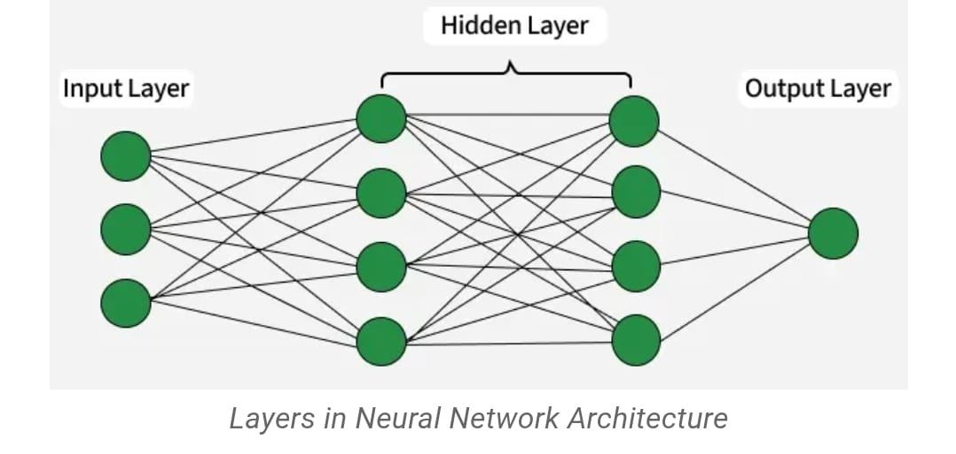

Slide 4
Mathematical Formula :
Each neuron performs this calculation:
Step 1: Weighted Sum
𝑍=𝑊1𝑋1+𝑊2𝑋2+𝑊3𝑋3+𝑏
Where:
X = Input
W = Weight
b = Bias
Step 2: Activation Function
𝐴=𝑓(𝑍)
Where f is the activation function.

Slide 5
In Neural networks there are only 3 layers through which the process is done or takes place
1 . Input Layer :
It’s the First layer of Neural networks which receives the input of the given
data .
Neural network can have only one input data
Example: Age, Salary, Marks, Image pixels
2. Hidden Layer :
It Performs calculations of thee given data and Learns patterns in the data by
by calculating all the possibilities.
A neural network can have many hidden layers.

Slide 6
3. Output Layer :
It’s a Final layer of neural networks where it Produces the prediction or result
based up on the suggestion of the hidden layer.
Example outputs:
Yes / No
Price prediction

Slide 7
Types of Neural Networks :
1. Feedforward Neural Network:
Simplest neural network where the Data moves in only
one direction.
2. Convolutional Neural Network (CNN) :
Used for:
Image recognition
Face detection
Object detection

Slide 8
3. Recurrent Neural Network (RNN)
Used for:
Text
Speech
Time series data

Slide 9
Applications of Neural Networks :
Neural networks are used in many real-world applications.
Image Recognition:
Example:
Face recognition
Natural Language Processing :
Used in chatbots and translation systems.
Medical Diagnosis:
Detect diseases from scans.
Self Driving Cars:
Object detection and road recognition.
Recommendation Systems :
Used by companies like Netflix, Amazon, and YouTube

Slide 10
Advantages of Neural Networks :
Can learn complex patterns
Works well with large data
Works with High accuracy
Useful in deep learning tasks
Disadvantages :
It Requires large amount of data
High computational cost
Difficult to interpret (black box)
Training consumes large amount of time

