Slide 1
SYRIATEL CHURN PREDICTION. Prediction for customer retention Strategy Author: STEPHEN MWAURA

Slide 2
Customer Churn
As per Accenture 2024 research, 77% of consumers are shifting from one telecommunication to another much faster than they did three years ago.
This means that telecommunication companies (telcos) must put in extra effort to retain their customers.
What can business do to retain customers ?
I try to answer the question through Prediction models.

Slide 3
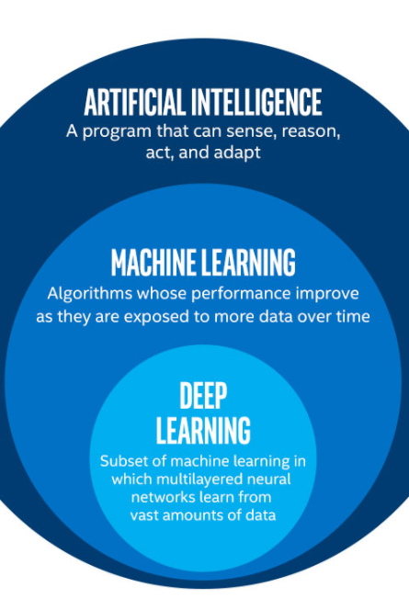
OBJECTIVE - Develop a high classification model to identify at risk customers early. - Enable Syriatel to implement targeted retention measures and stabilize revenue shares.
This Photo by Unknown Author is licensed under CC BY-SA

Slide 4
THE BUSINESS PROBLEM Attrition crises
Rising attrition rates pose a direct threat to revenue stability and competitive market position in the Syriatel landscape
Maintain profitability in a saturated market
Identify key drivers of customer defection
Implement proactive loyalty programs
Enhance competitive market share

Slide 5
DATASET PROFILE
3333 Records – Comprehensive customer activity logs from Kaggle’s dataset
21 Features- Usage metrics account metadata and service interaction history.
Customer activity- Data spans call minutes, charges across different times, and plan subscriptions.
Clean data- Zero missing or duplicate values found during cleaning

Slide 6
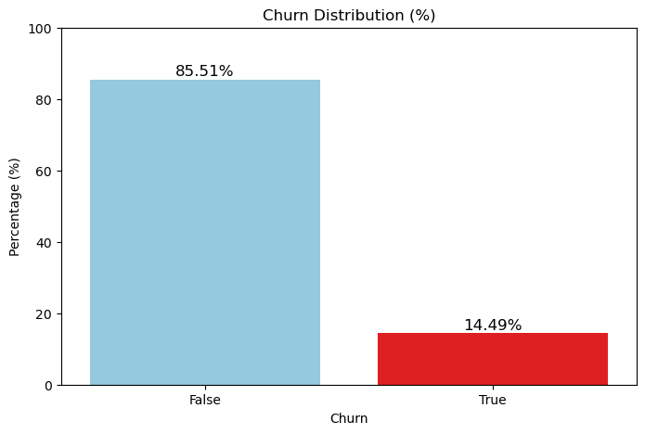
Exploratory Data Analysis
14.49 % of the 3,333 customers have terminated their contract with Syriatel company.
This is a total of 483 customers lost.
False = Not churned
True = Churned

Slide 7
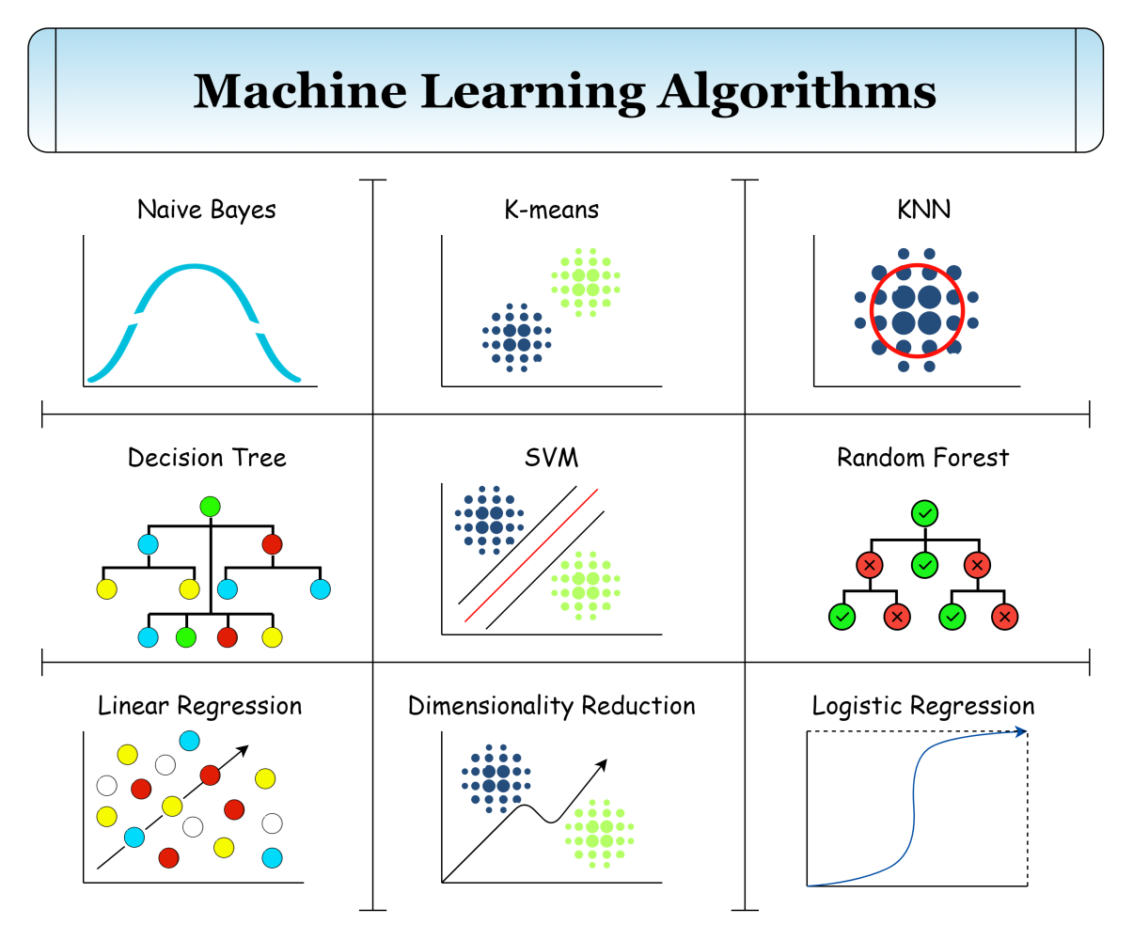
MODEL SELECTION AND EVALUATION
Logistic Regression- Baseline model for probabilistic classification
Decision Tree- Non-linear logic capturing complex feature interactions
Random Forest- Ensemble method reducing variance and overfitting

Slide 8
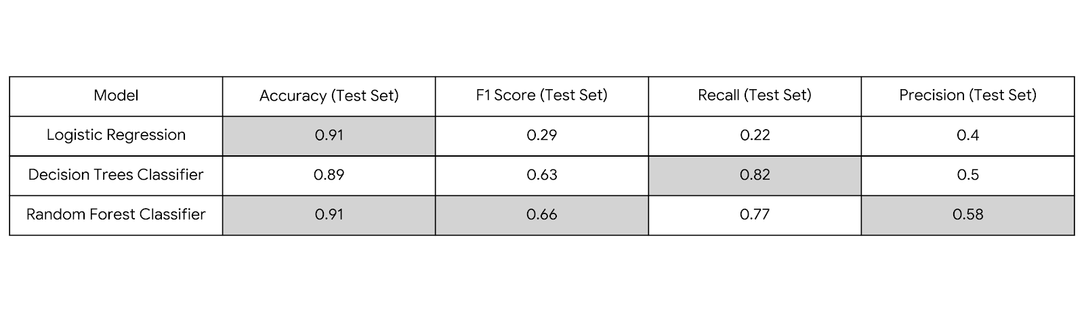
MODEL PERFORMANCE metrics

Slide 9
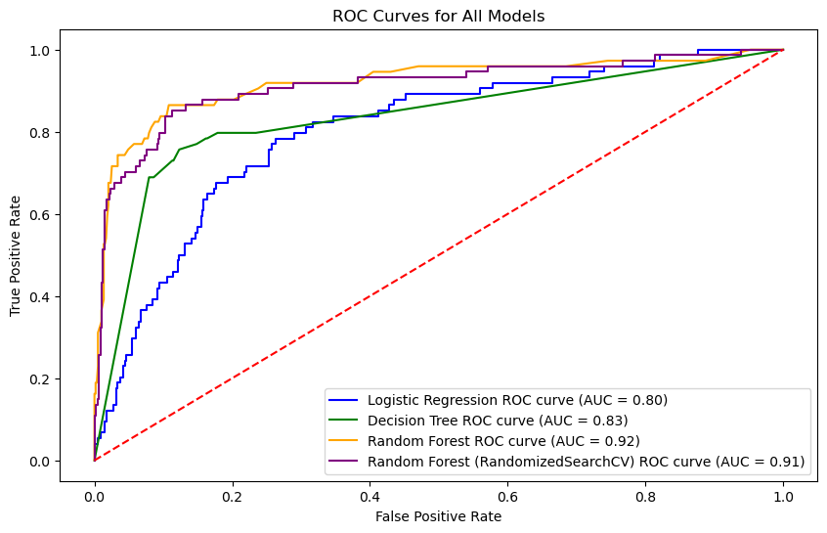
RECEIVER OPERATING CHARACTERISTIC(ROC) AND AREA under Curve(AUC)
Random Forest Classifier has high ROC Curve approaching to left corner and a high AUC of 0.92,
The Classifier therefore able to distinguish churn and non-churn customers.

Slide 10
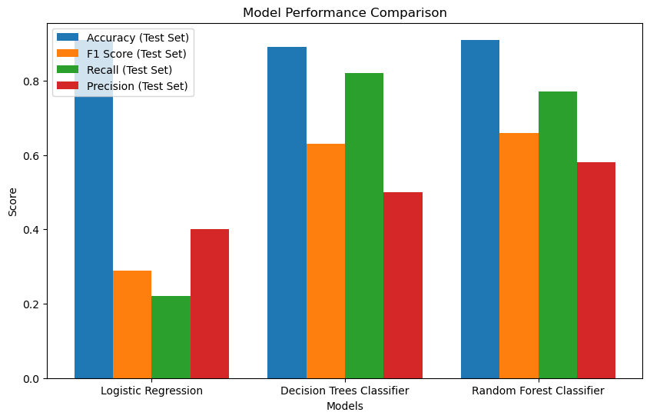
Model COMPARISON
Random Forest Classifier performs better. This is explained by the high Accuracy, F1 Score , recall and Precision as highlighted on the metrics table.
Recall = 77%
F1 Score = 66%
Accuracy = 91%
Precision = 58%

Slide 11
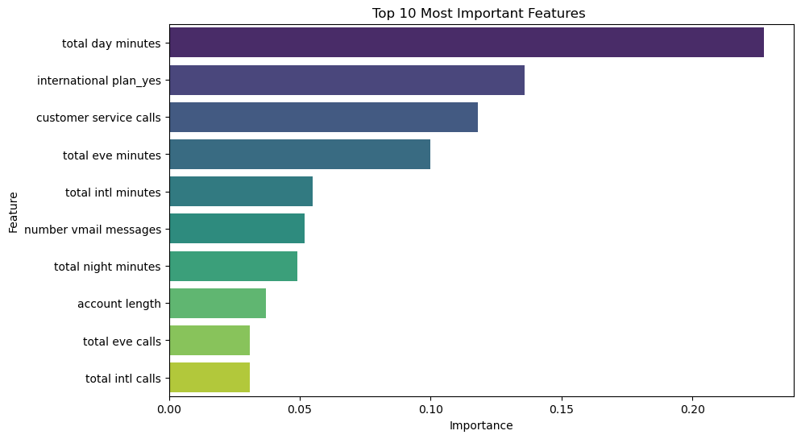
Features influencing customer churn
Total duration of calls during the day and in the evening. Can be churn signals if reduce call duration.
Total duration of international calls. Customers with high international usage may churn if they find cheaper alternatives.

Slide 12
Recommendations
Syriatel adopt the Random Forest Classifier which has better evaluation metrics as the primary model for churn prediction.
Syriatel should implement customer retention initiatives that target the key drivers of churn, particularly those related to call usage and pricing.
The company should focus on improving customer service efficiency and satisfaction. Since the number of customer service calls is a significant predictor of churn.

Slide 13
NEXT STEPS
To improve the effectiveness of this churn prediction project, the next step is to deploy the best-performing model into a real-world environment where it can be used to predict churn risk for active customers.
Syriatel can then use these predictions to implement targeted retention strategies such as offering discounts, loyalty rewards, or improved customer support to customers identified as high-risk
The company should focus on improving customer service efficiency and satisfaction. Since the number of customer service calls is a significant predictor of churn.

Slide 14
Thank you QUESTIONS?
https://github.com/S-Mwaura/SyrialTel-Customer-Churn-Prediction-ML

