Slide 1
Twitter Sentiment Analysis
Natural Language Processing model for Classifying Tweets into Positive, Negative and Neutral Sentiments.
Author: Stephen Mwaura

Slide 2
Natural Language Processing (NLP)
Natural language processing (NLP) techniques bridge the gap between human language and machine understanding.
Text preprocessing: Raw tweets are cleaned by removing stop words, punctuation, numbers, and special characters that add noise without contributing to sentiment.
TF-IDF vectorization: Cleaned text is converted into numerical feature vectors that represent the importance of each word in each tweet.
Final output: Unstructured Twitter data becomes structured numerical features that machine learning algorithms (like Logistic Regression and LinearSVC) can process.
Why this matters: Without NLP transformation, models cannot interpret text, emojis, hashtags, or slang commonly found in tweets.

Slide 3
Business Problem & Overview
The Problem: Manual tweet analysis is slow, costly, and impractical at scale, causing companies to miss critical customer feedback.
The Solution: Automated sentiment classification using a machine learning model.
The Benefits: Real-time monitoring, early issue detection, and data-driven decisions.
The Sentiments in the dataset are: Positive, Negative, and No Emotion Toward Brand/Product.

Slide 4
Dataset & Class Imbalance
Source: CrowdFlower via data.world |
Content: Apple and Google tweets (SXSW) |
Size: 9,093 tweets
Labels: Sentiment toward brand/product
Distribution: Neutral 59.3% | Positive 32.8% | Negative 6.3% | "I can't tell" 1.7%
Challenge: Model could achieve 59% accuracy by predicting only "Neutral"
Solution: Use macro F1 score instead of accuracy

Slide 5
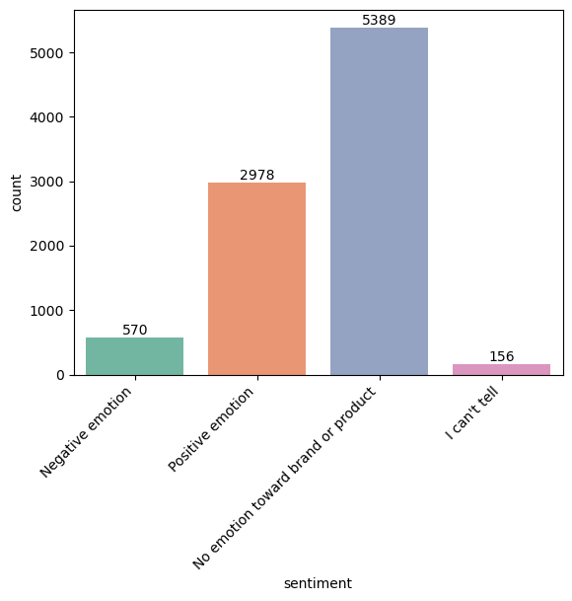
Sentiment Distribution

Slide 6
Target Brand and Sentiment Distribution
Apple and Google products are frequently mentioned across the tweet dataset
These brand mentions appear consistently in both positive and negative sentiments
This high volume of brand-specific mentions confirms the dataset is highly relevant to the business problem
The data is properly focused on monitoring customer sentiment toward major technology brands

Slide 7
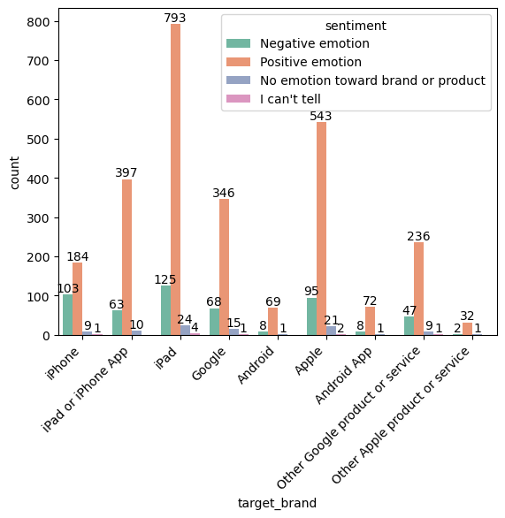
Target and Sentiments

Slide 8
Text Preprocessing
Text Preprocessing (Cleaning Tweets)
Remove stop words (the, and, is)
Remove punctuation, URLs, numbers
Lowercase all text
Result: Clean, meaningful words for analysis
After Preprocessing (Top Words)
iPad (2,800) - Most discussed
google (2,200)
apple (2,000)
iPhone (1,500)
Austin (1,200) - SXSW location

Slide 9
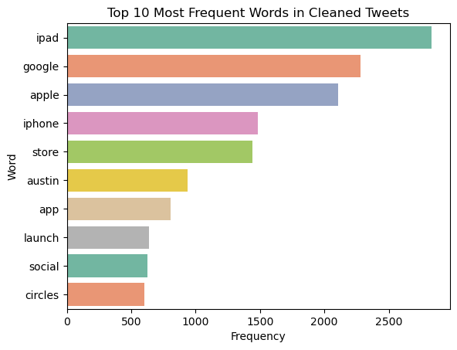
Data Preprocessing

Slide 10
Target Brand Merging
All Apple-related products (iPhone, iPad, Apple) were merged into one brand feature of apple
All Google-related products (Google, Android, Android App) were merged into another feature google
Grouping brand mentions together reduced overall feature dimensionality
This helped the model focus on brand-level sentiment rather than product-specific noise

Slide 11
Feature Engineering
Feature engineering transforms raw Twitter data into a structured format that machine learning models can effectively learn from.
Combining text preprocessing with TF-IDF vectorization enables strong classification performance, especially for Logistic Regression and LinearSVC.
Text cleaning eliminates stop words to reduce noise and improve model performance.
TF-IDF (Term Frequency–Inverse Document Frequency) converts textual data into numerical vectors that machine learning algorithms can process.

Slide 12
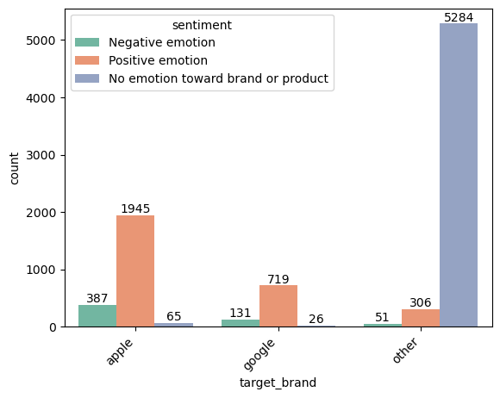
Merged Target Brands

Slide 13
Models Used and their Performance Summary
Model | Accuracy | Macro F1
Naïve Bayes | 84% | 0.58
Logistic Regression | 91% | 0.73
LinearSVC (WINNER) | 91% | 0.78

Slide 14
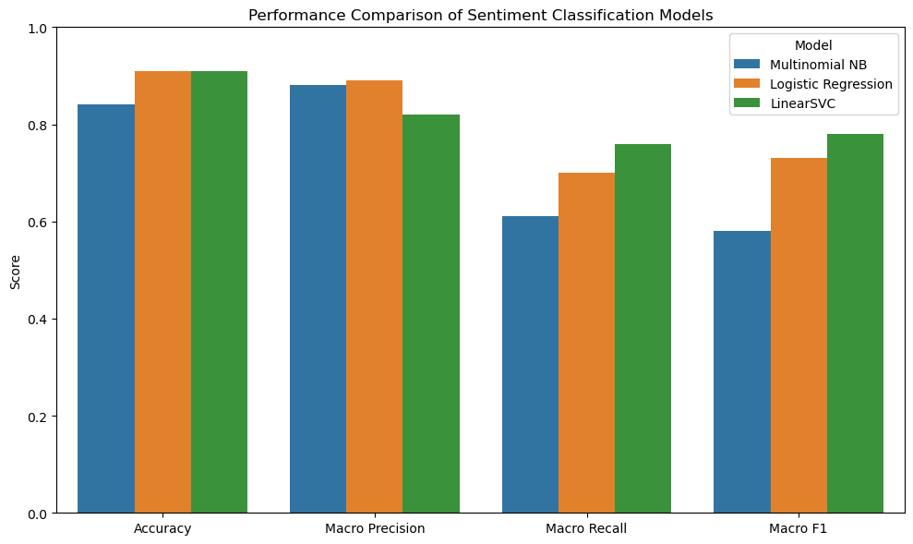
Model Performance

Slide 15
Why LinearSVC Won
High overall accuracy (91%)
Best macro F1 score (0.78)
Balanced performance across all sentiment classes
Best at detecting minority negative class
Hyperparameter tuning done using GridSearchCV + Class weighting + Macro F1 optimization

Slide 16
Handling Class Imbalance
Problem: 59% Neutral | 33% Positive | 6% Negative
Solutions Applied:
Macro F1 Score for evaluation (not accuracy)
Class weighting - Higher penalty for misclassifying negative
Future Improvements:
• SMOTE (Synthetic Minority Oversampling)
• Under sampling majority class

Slide 17
Feature Importances
Feature importances quantify how much each word or attribute influences the model's final prediction
Higher importance means that feature has a greater impact on determining sentiment class
Lower importance means the model largely ignores that feature when making decisions

Slide 18
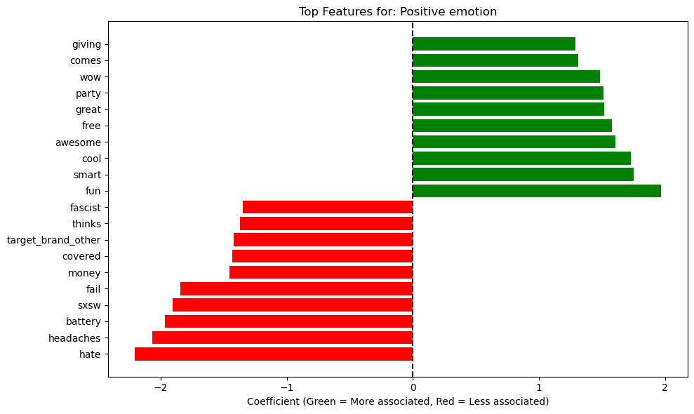
Top Feature Importances for Positive emotion

Slide 19
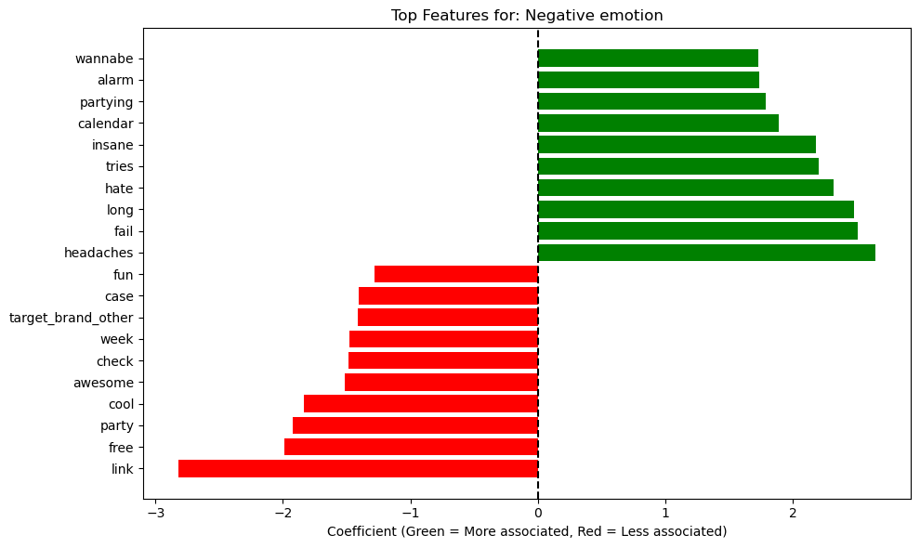
Top Feature Importances for Negative emotion

Slide 20
Feature Importance Insights
* Positive Emotion Class: Strongest associations are "giving" (1.8), "wow" (1.5), "great" (1.3), "awesome" (1.1), "cool" (1.0), and "fun" (0.8). Negative words like "hate" (-2.6) and "fail" (-1.8) are correctly pushed away.
* Neutral Class: Characterized by "target_brand_other" (2.8), "link" (0.8), and "congress" (0.8). Emotional words like "partying" (-1.2) and specific brands like "Apple" (-0.9) push tweets away from neutrality.
* Overall: The model cleanly separates positive (happy words), neutral (informational content), and negative (complaint words) sentiment with intuitive boundaries.

Slide 21
LIME Explanation Example
Tweet: "So far the longest line at #sxsw has been at the Apple store"
Prediction Probabilities:
Negative: 5%
Neutral: 69% ✓ PREDICTION
Positive: 27%
Top Influential Words: longest (+0.19), Apple (+0.14), line (+0.10)
Interpretation: Observation about crowd, no sentiment expressed

Slide 22
Key Insights
Neutral tweets dominate (59%) – Most users share facts, not feelings
Negative sentiment is hardest to detect – Sarcasm, abbreviations, and limited context obscure genuine complaints
Positive sentiment is easiest – Clear praise words like fun, great, and cool signal strong sentiment
Technical issues drive negativity – Terms like fail, hate, battery, and alarm consistently indicate frustration
Brand names matter – Apple and Google dominate conversations, each evoking strong sentiment polarity
Sarcasm remains a major challenge – Models struggle to distinguish ironic praise from genuine criticism

Slide 23
Recommendations
Monitor negative keywords (hate, fail, headaches) in real time
Prioritize bug fixes - Negative sentiment = software/performance issues
Leverage positive tweets to guide marketing campaigns
Enhance customer support - Respond quickly on Twitter
Use BERT for sarcasm & context understanding
Add emojis, hashtags, mentions as features
Conduct periodic monitoring after product launches/updates

Slide 24
Conclusion
Twitter is a valuable real-time source of consumer opinions
Positive sentiment → Product satisfaction (love, great, excellent)
Negative sentiment → Technical issues (crash, broken, problem)
LinearSVC achieved 91% accuracy with balanced performance
Challenge: Negative tweets harder to classify due to sarcasm & limited context
Future: BERT, emoji features, aspect-based sentiment analysis

Slide 25
🙏 Thank You
Questions?
Stephen Mwaura
GitHub | LinkedIn

