Slide 1
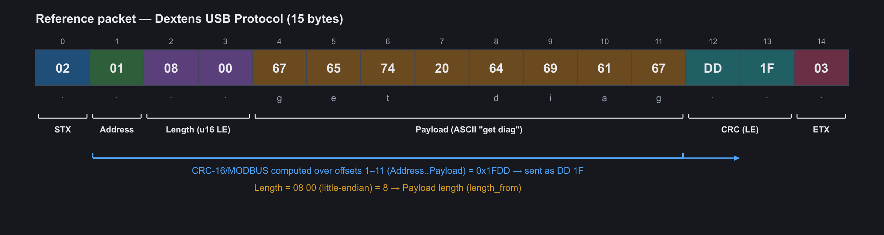
DEMO · ENGINEERING TOOLS
Firmware Protocol Decoder
Decode, verify and reverse-engineer embedded packets — offline
UART
USB-CDC
RS485
CAN
Modbus
Custom binary
Vinaya Kumar · October 2026 · v1.0
Notes:
Opening (30 s):
- Personal debugging tool built for firmware work: UART, USB-CDC, RS485, CAN payloads, Modbus and custom binary frames.
- Key message: describe a protocol once as data, then every packet decodes deterministically - offline, no AI needed.
- Demo follows the same flow as these slides; the app is already open with the reference packet preloaded.

Slide 2
THE PROBLEM
Decoding bytes by hand is slow and error-prone
Counting offsets
Endianness & types
Re-computing CRCs
Unknown frames
Copy HEX from a terminal, count bytes, find where the payload starts — every time.
Is 34 12 = 4660 or 13330? Signed? Scaled ×0.1? Easy to get wrong under pressure.
Which CRC-16? Which init, which bytes, which byte order? Trial and error.
Legacy devices with no spec: which byte is the counter, which is the checksum?
Idea: describe the protocol once as data (JSON). The tool does the counting, converting and checking — and never guesses what it doesn't know.
Firmware Protocol Decoder
2
Notes:
The problem (45 s):
- Ask the audience: who has counted HEX offsets on paper or recomputed a CRC in an online calculator this month?
- Each pain point maps to a feature we'll see: layout engine, endian-aware types, CRC engine, diff analyzer.

Slide 3
CAPABILITIES
One tool for the whole packet-debugging loop
Decode
Verify
Define
Field table, packet layout and HEX/ASCII view — all colour-linked.
16 CRC presets + custom parameters, 6 checksums, STX/ETX and length checks.
Protocol editor or JSON: dynamic lengths, bit fields, value names, scaling.
Compare
Reverse-engineer
Build
TX/RX Analyzer: request vs response, field and byte differences.
Diff Analyzer: counters, patterns and verified CRC placement.
Packet builder fills frame, length and CRC; CRC calculator & search.
Python 3.11 · PySide6 · offline · Windows & Linux · JSON definitions · 131 automated tests
Firmware Protocol Decoder
3
Notes:
What it does (45 s): walk the six tiles left-to-right, top-to-bottom; each one is a demo later.
Stress the bottom line: single dependency (PySide6), runs offline, 131 automated tests.

Slide 4
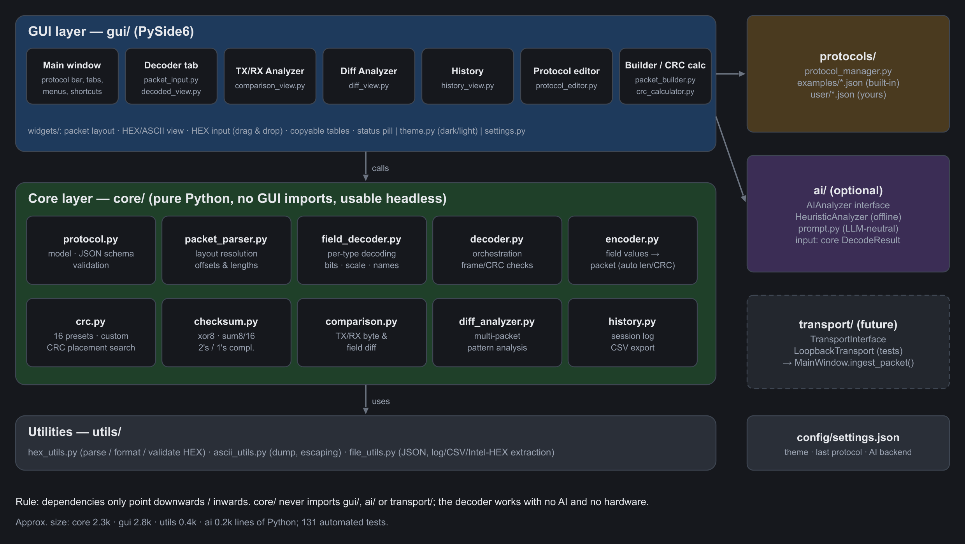
DESIGN
Layered architecture — the core never depends on the GUI
▸ core/ — decoding engine, CRC, encoder, analysis. No Qt.
▸ gui/ — PySide6 views and dialogs; composes core calls.
▸ protocols/ — JSON definitions: examples + yours.
▸ ai/ — optional, pluggable, offline default.
▸ transport/ — interface ready for live capture.
Firmware Protocol Decoder
4
Notes:
Architecture (60 s):
- Core is pure Python with no Qt imports: scriptable and testable headless.
- GUI only composes core functions. AI and transport sit beside the GUI and only consume the core's result.
- Rule: dependencies point downwards; the decoder works with no AI and no hardware.

Slide 5
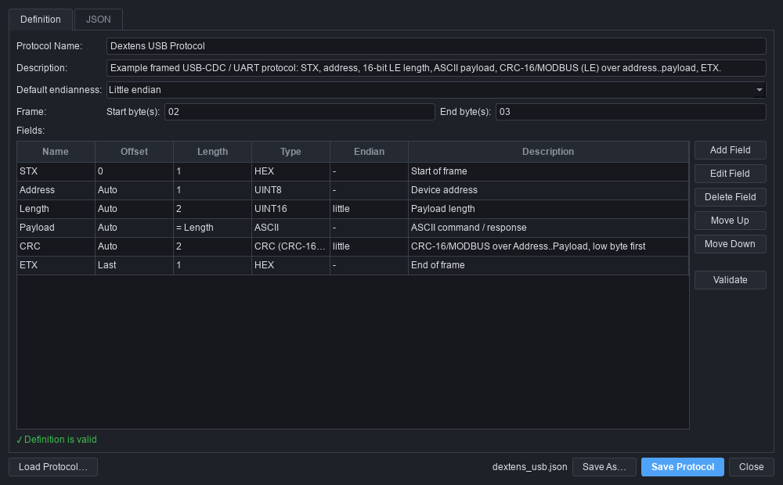
PROTOCOL DEFINITION
Define a protocol once — as data, not code
{ "name": "Dextens USB Protocol",
"default_endian": "little",
"frame": { "start_byte": "02", "end_byte": "03" },
"fields": [
{ "name": "STX", "type": "hex",
"offset": 0, "length": 1 },
{ "name": "Address", "type": "uint8" },
{ "name": "Length", "type": "uint16" },
{ "name": "Payload", "type": "ascii",
"length_from": "Length" },
{ "name": "CRC", "type": "crc", "length": 2,
"crc": { "algorithm": "CRC-16/MODBUS",
"range_start": "Address",
"range_end": "Payload" } },
{ "name": "ETX", "type": "hex",
"offset": "last", "length": 1 }
] }
▸ Dynamic lengths: auto · last · from-end · length_from · remaining
▸ 16 types, endian, bit fields, value names, scale/unit, expected bytes
Firmware Protocol Decoder
5
Notes:
Define once (60 s):
- Show the JSON: Length is a 16-bit LE field; Payload length comes from it (length_from); CRC follows automatically; ETX is anchored at the end.
- Switch to the app: Protocol -> Edit. Show the field table, open the CRC field (algorithm, range Address..Payload), then the JSON tab.
- Validation runs live (green 'Definition is valid').

Slide 6
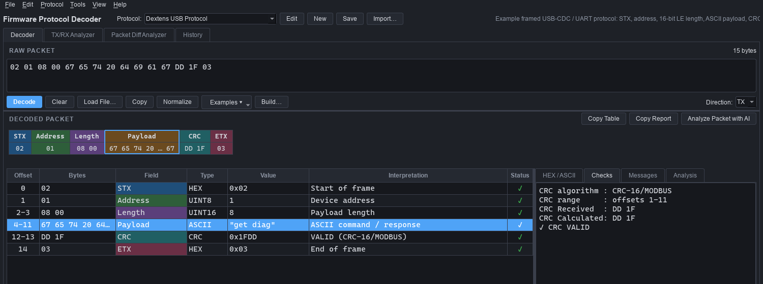
LIVE DEMO
Demo 1 — decode the reference packet
1
Layout strip, table and HEX view share colours
2
"get diag" — length from a 2-byte LE field
3
CRC-16/MODBUS: received = calculated
Firmware Protocol Decoder
6
Notes:
DEMO 1 - Decode (90 s):
1. App open, Dextens selected, packet 02 01 08 00 67 65 74 20 64 69 61 67 DD 1F 03 preloaded.
2. Press Ctrl+Enter. Point at the layout strip, then the table: same colours.
3. Click 'Payload' in the layout: row selects, bytes highlight in HEX/ASCII tab.
4. Checks tab: CRC received DD 1F, calculated DD 1F, VALID.
5. Status bar: green 'Packet valid'.

Slide 7
UNDER THE HOOD
The reference packet, byte by byte
Length is 2 bytes
CRC found, not guessed
15-byte packet + 8-byte payload only fits 08 00 as a little-endian UINT16.
CRC search: only CRC-16/MODBUS over offsets 1–11, low byte first, matches.
Firmware Protocol Decoder
7
Notes:
Byte map (45 s):
- The spec table assumed a 1-byte length; the packet only fits a 2-byte LE length (08 00).
- The CRC variant was not guessed: the built-in CRC placement search tried all presets/ranges/byte orders - exactly one matched.

Slide 8
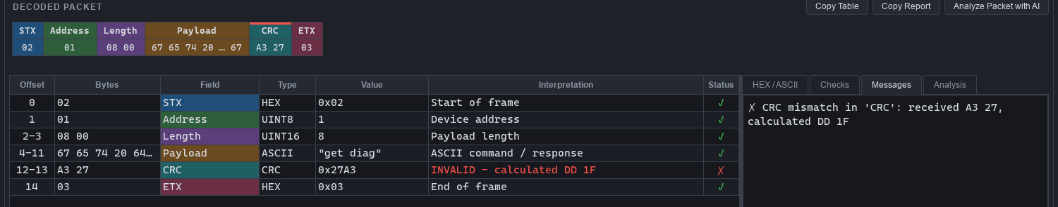
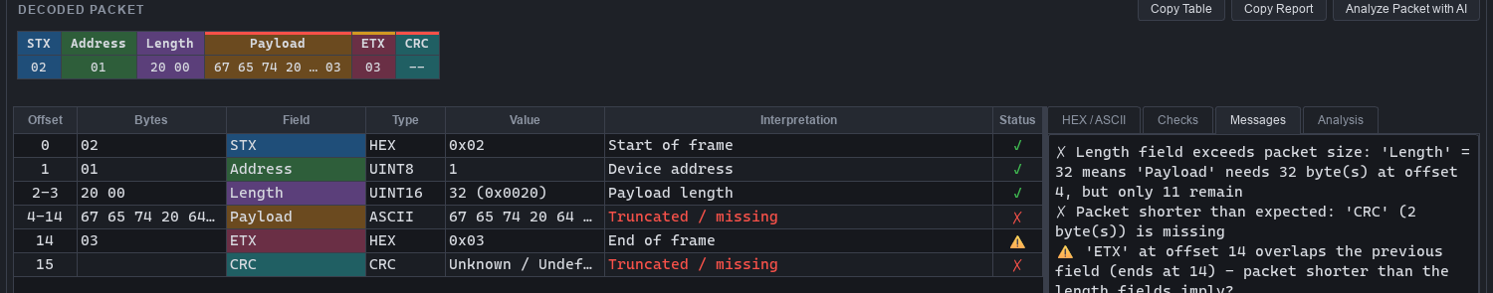
LIVE DEMO
Demo 2 — malformed packets are explained, never crash
Corrupted CRC → status CRC ERROR; payload still decoded; calculated value shown
Length field = 0x20 → exceeds packet size; truncated fields marked; every problem explained
Firmware Protocol Decoder
Fuzz test: 120 random packets across the 3 example protocols — zero exceptions.
8
Notes:
DEMO 2 - Malformed packets (60 s):
1. Examples -> 'TX: corrupted CRC': status CRC ERROR, payload still decoded, calculated vs received shown.
2. Examples -> 'TX: length field too large': Length = 32 exceeds packet; truncated fields marked red; messages explain.
3. Type garbage (e.g. '02 0G'): 'Invalid HEX data ... line 1, column 4'. Nothing crashes.

Slide 9
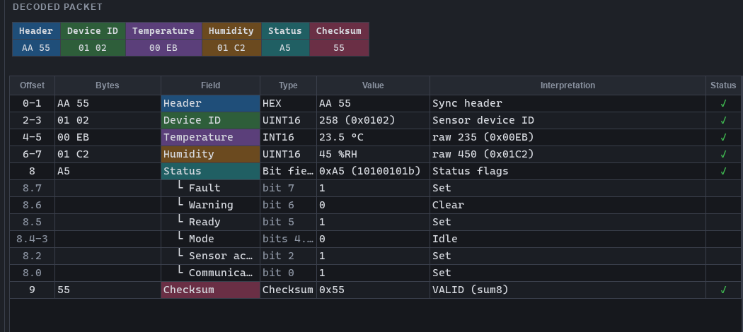
LIVE DEMO
Demo 3 — bit fields, scaling and value names
▸ Scaling: int16 × 0.1 → 23.5 °C, raw value kept
▸ Bit fields: 0xA5 → Fault, Ready, Mode (2-bit enum)…
▸ Value names: Modbus 0x03 → Read Holding Registers
▸ Expected bytes: sync header AA 55 enforced
▸ Checksum: SUM-8 verified
Firmware Protocol Decoder
9
Notes:
DEMO 3 - Rich types (60 s):
1. Select 'Simple Sensor Packet', Examples -> Reading 1.
2. Temperature int16 x 0.1 = 23.5 C; Humidity 45 %RH; raw value in Interpretation.
3. Status 0xA5 expands into bit rows: Fault=1, Warning=0, Ready=1, Mode (2 bits)=Idle, Sensor active, Comm OK.
4. Checksum: SUM-8 VALID.
Optional: Modbus RTU example shows function-code names incl. exceptions.

Slide 10
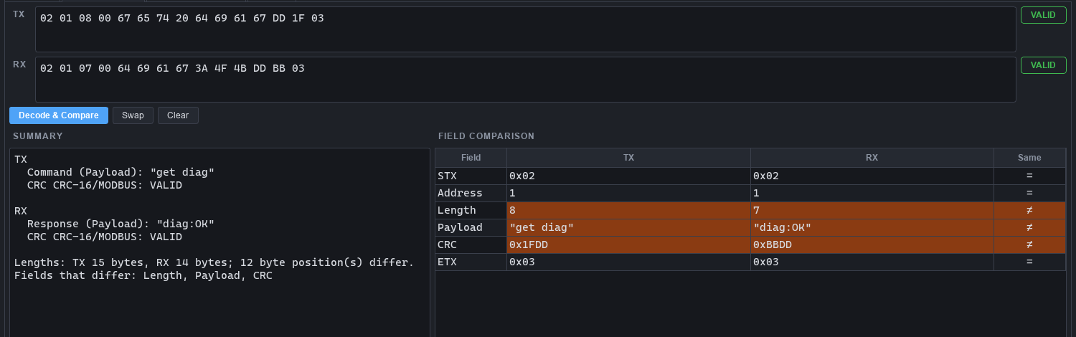
LIVE DEMO
Demo 4 — TX/RX Analyzer: request vs response
Command vs response
Differences highlighted
Logged
"get diag" → "diag:OK", both CRCs valid
Length, Payload, CRC fields and byte positions
Both packets go to History (CSV export)
Firmware Protocol Decoder
10
Notes:
DEMO 4 - TX/RX (45 s):
1. Open TX/RX Analyzer tab (Alt+2). TX 'get diag' and RX 'diag:OK' are prefilled.
2. Decode & Compare: Command vs Response summary, both CRCs valid.
3. Field comparison highlights Length, Payload, CRC; byte view highlights differing positions.

Slide 11
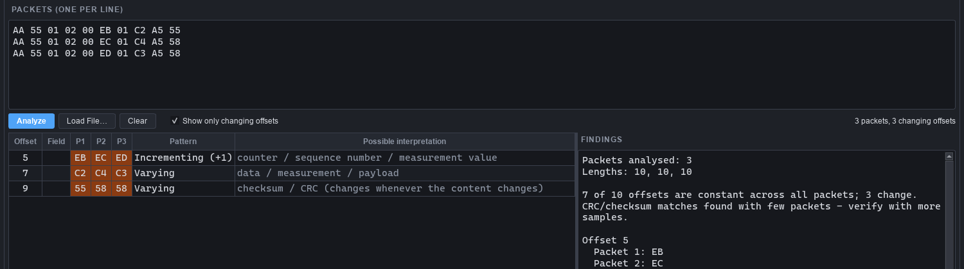
LIVE DEMO
Demo 5 — reverse-engineer unknown frames
Patterns
Verified checks
Honest labels
Constant, ±1 counters, steps, toggles, 16/32-bit LE/BE values
CRC / checksum placement that matches every packet
Meanings shown only as "Possible interpretation"
Field names are added only when packet 1 decodes cleanly with the selected protocol.
Firmware Protocol Decoder
11
Notes:
DEMO 5 - Reverse engineering (75 s):
1. Packet Diff Analyzer tab (Alt+3): three sensor readings are prefilled; Analyze.
2. Offset 5 incrementing -> 'Possible interpretation: counter / sequence / measurement'.
3. Last byte: verified 'sum8 over offsets 0-8' in ALL packets - a computed fact, not a guess.
4. Point out wording: inferred meanings are always labelled 'Possible interpretation'.

Slide 12
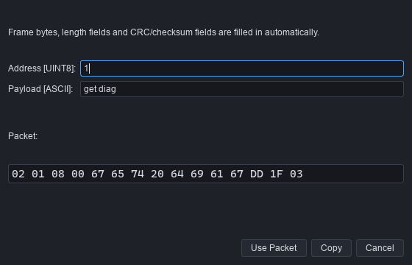
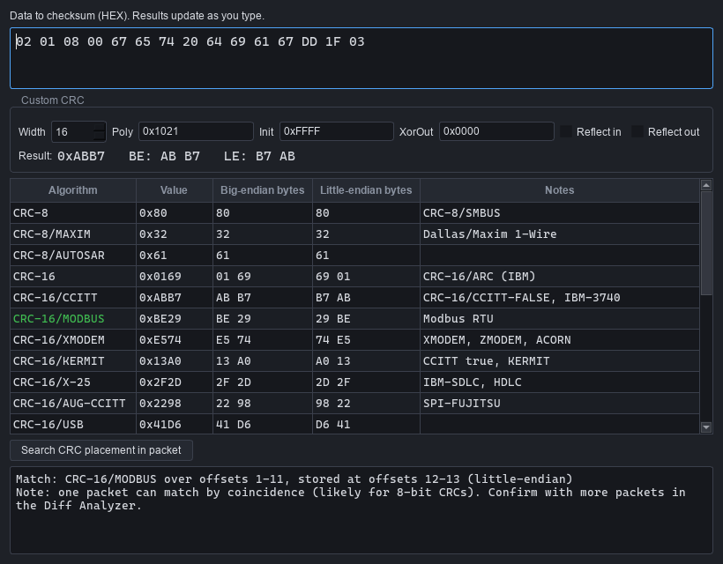
LIVE DEMO
Demo 6 — build packets and find CRCs
▸ Type only Address + Payload; frame, length and CRC are computed
▸ Values may be names, 0x…, or engineering units
Firmware Protocol Decoder
12
Notes:
DEMO 6 - Build & CRC tools (60 s):
1. Ctrl+B: Build Packet. Change Payload to 'get ver' - Length and CRC update live. Use Packet -> decodes VALID.
2. Ctrl+K: CRC calculator. Shows every preset over the data; 'Search CRC placement' finds CRC-16/MODBUS 1-11 LE.

Slide 13
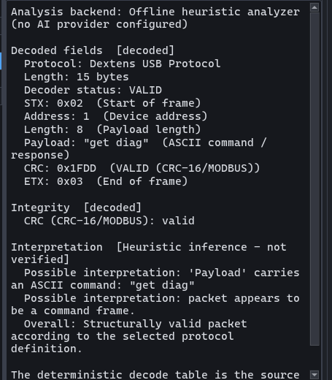
DESIGN PRINCIPLE
AI analysis — optional, pluggable, clearly labelled
▸ Decoder = source of truth. AI only reads the DecodeResult.
▸ Labelled inference. "AI inference" / "Possible interpretation".
▸ Offline by default. Heuristic backend, no network.
▸ Provider-neutral. Subclass AIAnalyzer; prompt pins the model to the decode.
Firmware Protocol Decoder
13
Notes:
AI - optional and honest (60 s):
1. Back to Decoder, click 'Analyze Packet with AI'.
2. Default backend is an offline heuristic (no provider configured) - stated in the report header.
3. Decoded facts are copied from the decoder; inferences are in a separate, labelled section.
4. Adding an LLM = subclass AIAnalyzer + build_prompt(); no change to the decoder.

Slide 14
VERIFICATION
Engineering quality
131
16
0
1
automated tests
CRC presets verified
against check values
crashes on fuzzed
random packets
runtime dependency
(PySide6)
▸ Reference packet decoded field-by-field and re-encoded byte-for-byte in the test suite
▸ Invalid packets covered: bad HEX, truncation, oversized length, missing STX/ETX, CRC mismatch, trailing bytes
▸ GUI smoke tests drive the real window headless: Decode button, Ctrl+Enter, tabs, dialogs, ingest hook
▸ Core has no GUI imports — decoding is scriptable: decode_packet(protocol, data).to_text()
Firmware Protocol Decoder
14
Notes:
Quality (45 s):
- 131 tests across HEX parsing, types, CRC, decoder, model, analysis and GUI (headless).
- All 16 CRC presets checked against the standard '123456789' check values.
- Reference packet is decoded and encoded byte-for-byte in tests.

Slide 15
WHAT'S NEXT
Roadmap
Encoder tab
Live capture
Auto-detection
Live encode, deliberate bad CRC/length for negative tests, sequences, C/Python export
UART / USB-CDC / CAN / TCP via TransportInterface + stream framers
Decode against every protocol and rank by validity
AI inference
Conditional layouts
Replay & test generation
Propose field layouts from diff-analyzer evidence
Structure by function code (e.g. Modbus data)
Packet replay, firmware log analysis, HEX editor
Firmware Protocol Decoder
15
Notes:
Roadmap (30 s): the architecture already has the seams for each item; the encoder tab is next.

Slide 16
GET STARTED
Try it
cd protocol_decoder
pip install -r requirements.txt
python main.py
python -m unittest discover -s tests -t .
▸ README.md — user guide
▸ docs/…Design_Document.docx — design reference
▸ protocols/examples/ — Dextens, Modbus RTU, Sensor
▸ protocols/user/ — your protocols
Questions?
Describe the protocol once. Let the tool count, convert and check.
Firmware Protocol Decoder
16
Notes:
Close (30 s): show the three commands; mention README + design document in docs/. Invite questions.

