Slide 1
Firmware Binary
Comparison Tool
Know exactly what changed between two firmware builds —
where, in which function, and whether it was expected.
Demo · v1.0.0 frozen baseline · 16 October 2026
.bin · Intel .hex · .elf | GUI · CLI · HTML / CSV / JSON reports
Notes:
Introduce the tool: a desktop and command-line utility for embedded firmware engineers. Goal of the demo: show how quickly we can answer 'what exactly changed between these two builds?'.

Slide 2
Why a byte diff is not enough
MOTIVATION
Questions engineers actually ask before releasing firmware
Where did it change?
Was it expected?
Which function?
Which controller?
MCU addresses, not file offsets. BIN, HEX and ELF use different address views.
Version strings, build timestamps and CRCs always change — real changes must stand out.
Removing one call shifts all later code: hundreds of functions differ without being edited.
Is this image really for the STM32F411 / PIC32MX575 we expect?
▪ Generic diff tools show offsets and raw bytes — no regions, no expectations, no symbols.
▪ Manual review of hex dumps is slow and misses changes hidden behind code shifts.
▪ This tool answers all four questions in one view, and as a CI gate from the command line.
Firmware Binary Comparison Tool · v1.0.0
2
Notes:
Set the scene with the four questions. Mention the watchdog example we will use later: a 3-line change produced 92,000 different bytes.

Slide 3
What the tool does
OVERVIEW
Feature overview
Byte comparison
Regions & expectations
Functions & modules
BIN / HEX / ELF by MCU address, size changes, gap fill, 64 MB in ~0.1 s
Named regions, expected areas (version, CRC …), EXPECTED vs UNEXPECTED verdict
ELF / linker map symbols, relocation-aware: real edits vs side effects
Controller identification
Hex viewer & memory map
Reports & CLI
STM32F411RET, PIC32MX575F512L … with evidence and confidence
Synchronised hex view, navigation, search, filters, visual block map
HTML, CSV, JSON; firmware-diff with CI exit codes
Firmware Binary Comparison Tool · v1.0.0
3
Notes:
Six capability areas. Everything runs locally, needs only Python 3.11, and never modifies the firmware files.

Slide 4
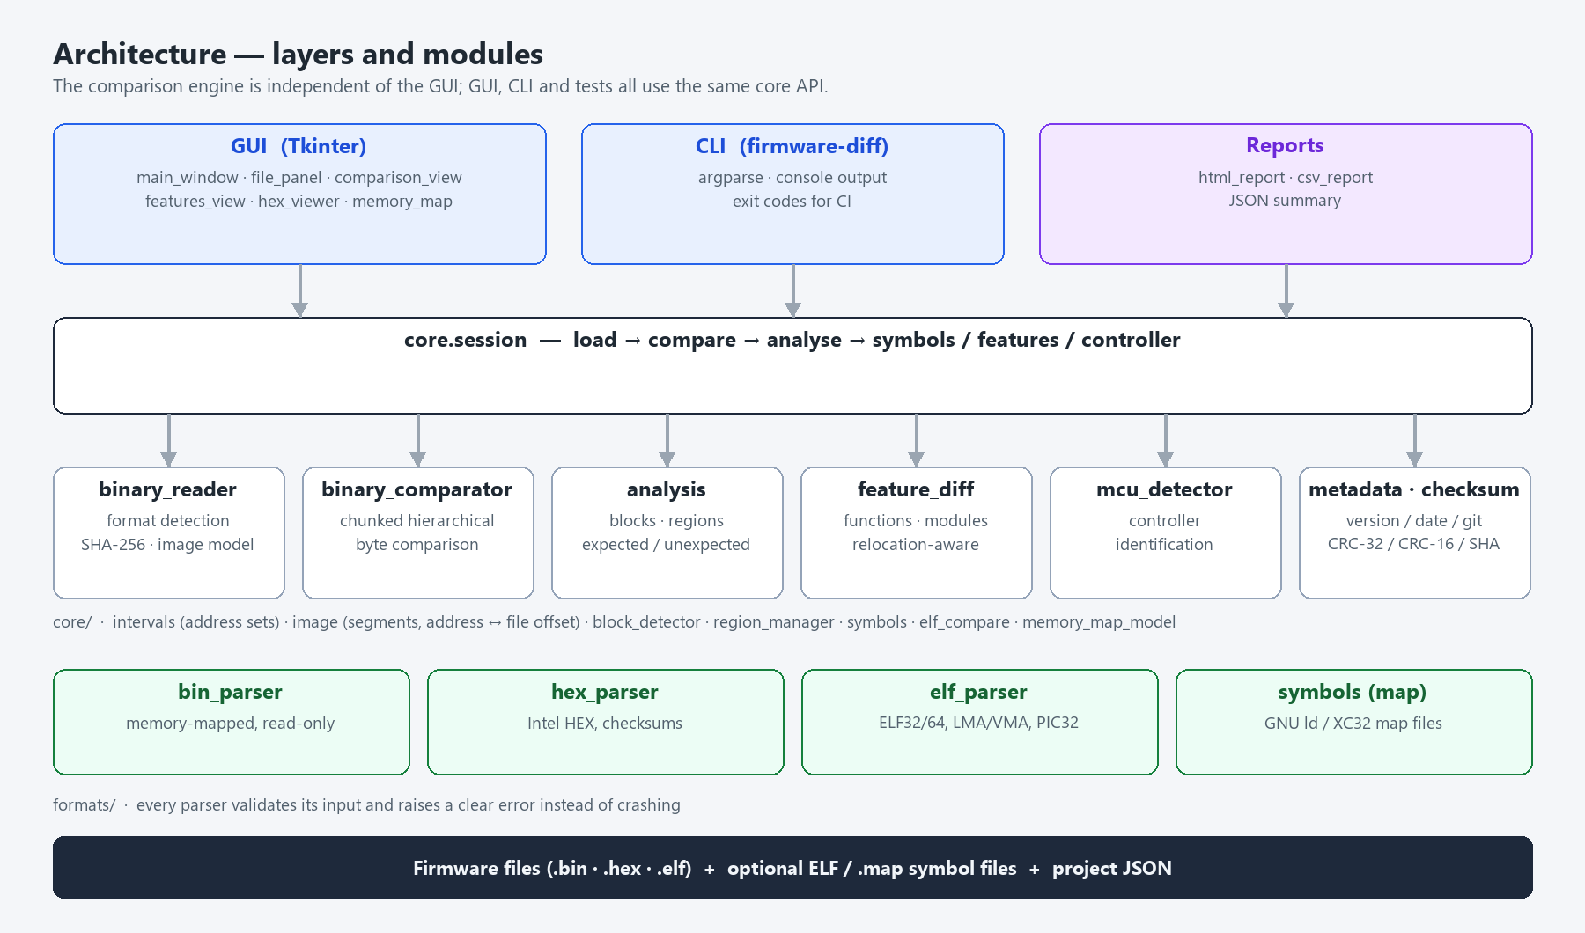
Architecture
DESIGN
GUI-independent engine shared by GUI, CLI and tests
Firmware Binary Comparison Tool · v1.0.0
4
Notes:
Layers: formats parse and validate files; core holds the engine (IntervalSet-based differences, analysis, symbols, controller detection); session orchestrates; GUI, CLI and reports are thin front ends. Standard library only.

Slide 5
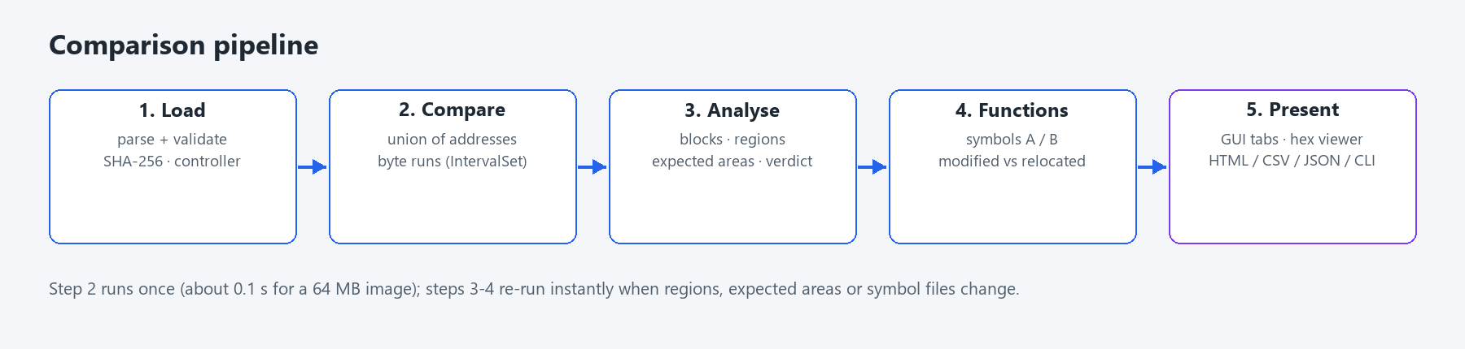
How a comparison runs
DESIGN
Five steps — the expensive one runs once
▪ Union of addresses: bytes present in only one image are differences — nothing is silently ignored.
▪ Hierarchical scan: 64 KiB chunks, identical areas skipped at memcmp speed, differences stored as runs.
▪ Instant re-analysis: editing regions, expected areas or symbol files does not re-compare bytes.
Firmware Binary Comparison Tool · v1.0.0
5
Notes:
Explain the union-of-addresses idea and the run-based storage that keeps large images fast.

Slide 6
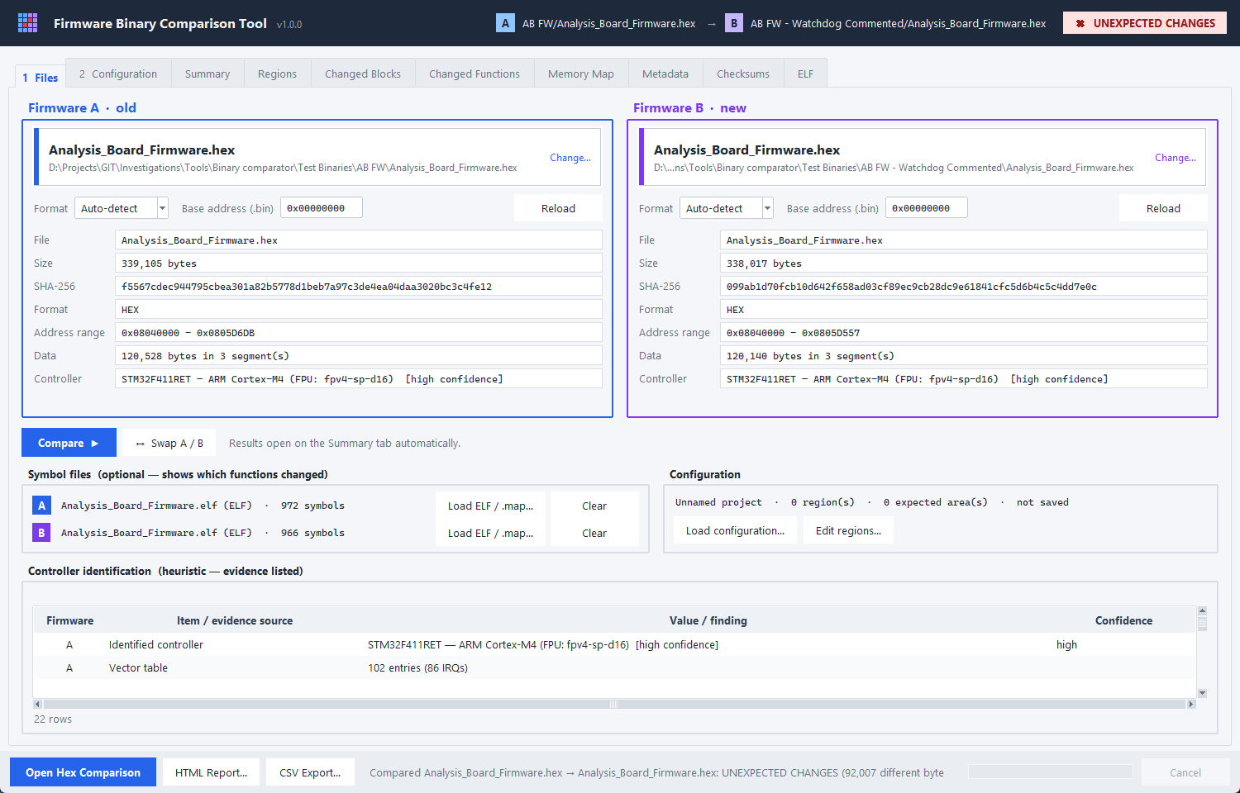
Step 1 · Select the firmware
DEMO
Drop zones, base address, symbol files, configuration
▪ A / B cards: click or drop a file; name, size, SHA-256, format, address range
▪ Base address for raw .bin files
▪ Controller identified automatically
▪ Symbol files (ELF / .map) unlock function-level results
▪ Compare runs automatically → Summary
Firmware Binary Comparison Tool · v1.0.0
6
Notes:
Live: drop Analysis_Board_Firmware.hex (old) and the watchdog-commented build (new), load both ELFs as symbol files. Point out the controller row: STM32F411RET, Cortex-M4 with FPU.

Slide 7
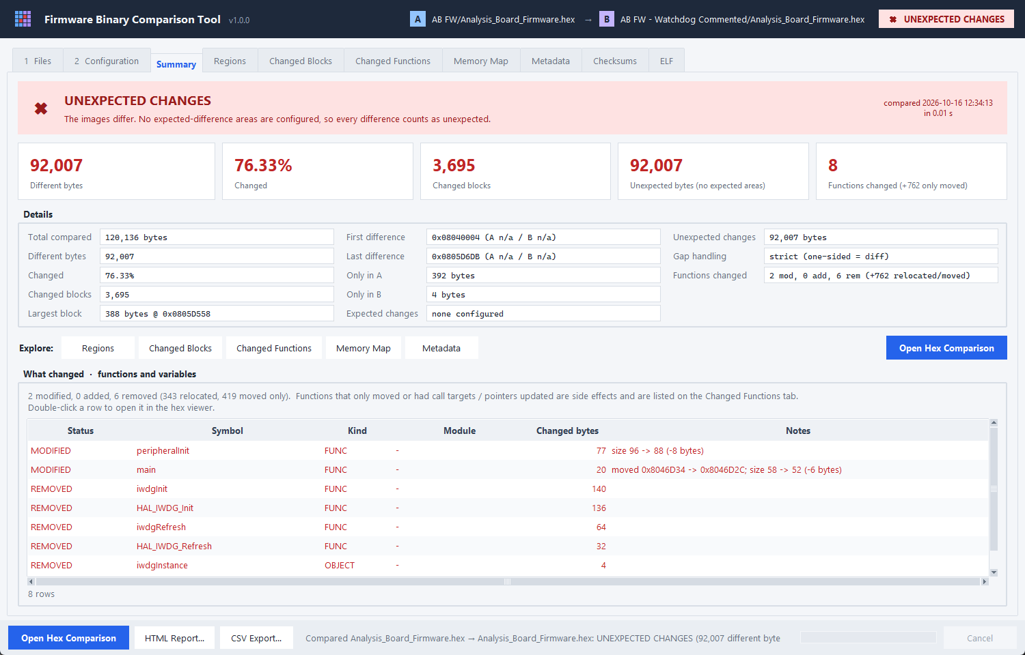
Step 2 · The answer at a glance
DEMO
Verdict, key numbers and what changed
92,007 bytes differ (76 %)
…because one call was removed and all later code shifted.
2 functions modified
6 symbols removed
peripheralInit and main lost their watchdog calls; the IWDG driver was dropped by the linker.
Firmware Binary Comparison Tool · v1.0.0
7
Notes:
Key message: the byte count is huge, the real change is tiny. The 'What changed' list shows exactly the watchdog edit.

Slide 8
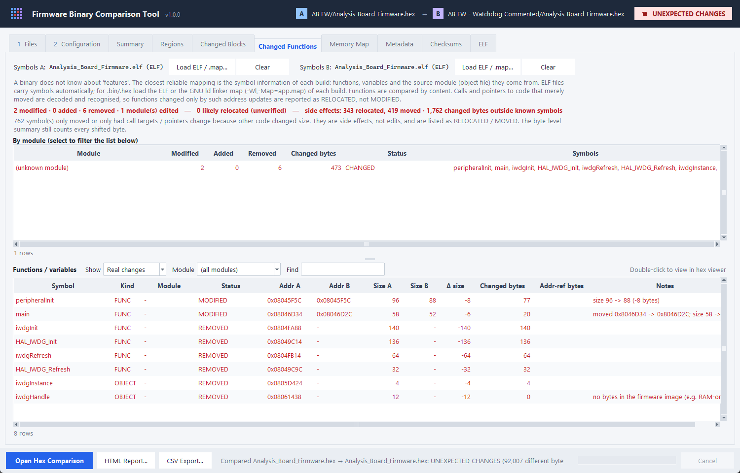
Real edits vs side effects
HIGHLIGHT
Relocation-aware function comparison
Before
350 'modified'
After
2 modified · 6 removed
▪ Calls (BL / JAL) and pointers are decoded in both builds
▪ Same target symbol → RELOCATED, not an edit
▪ 762 side effects listed separately
▪ ARM Thumb-2 and MIPS32 (PIC32)
Firmware Binary Comparison Tool · v1.0.0
8
Notes:
This is the key innovation. Removing a call shifts later code, changing branch offsets and literal pools everywhere. The tool resolves each reference to symbol+offset in both builds and only counts real content changes.

Slide 9
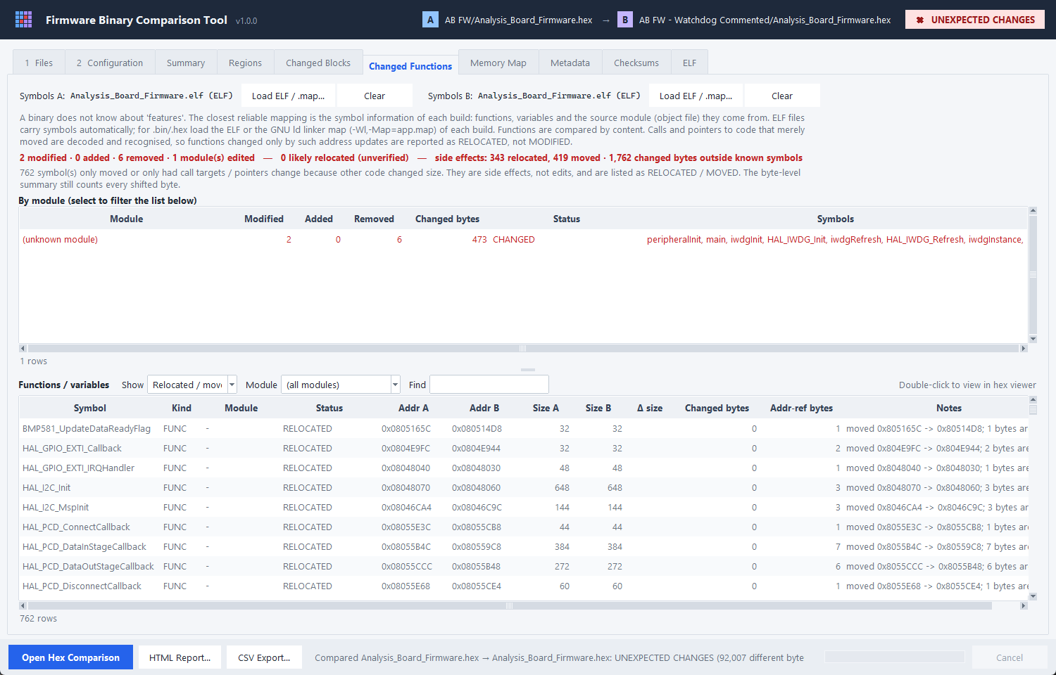
Side effects stay visible
HIGHLIGHT
Relocated / moved symbols on their own filter
▪ RELOCATED: only call targets / pointers changed
▪ MOVED: identical code at a new address
▪ LIKELY RELOCATED: references to unnamed data — listed for review, never hidden
▪ Module view from linker map files (motor.o, uart.o …)
Firmware Binary Comparison Tool · v1.0.0
9
Notes:
Nothing is hidden: switch the filter to see the 762 side effects and their notes.

Slide 10
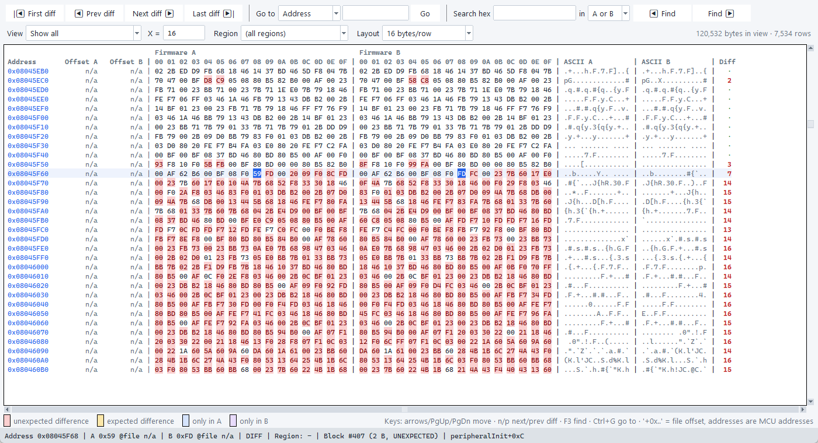
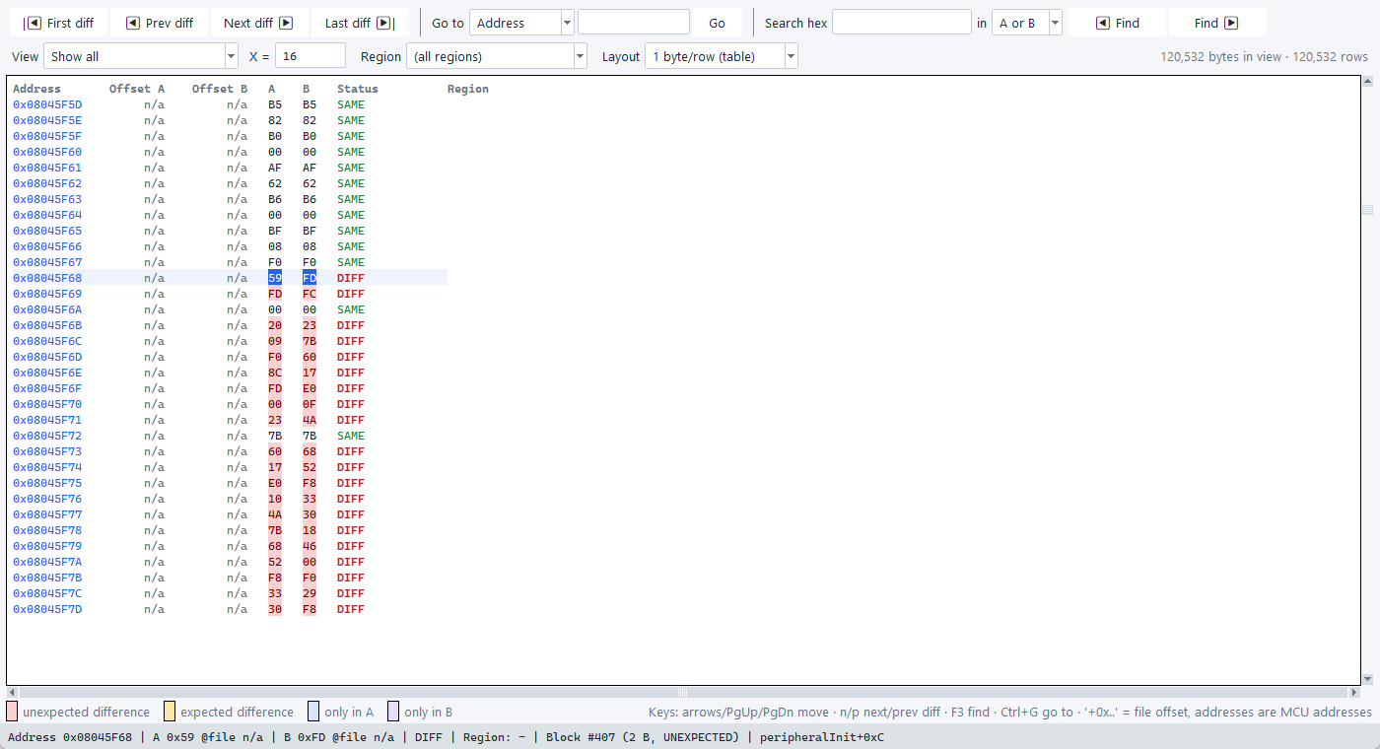
Hex comparison viewer
DEMO
Synchronised, virtualised — scrolls MB-sized images instantly
▪ First / prev / next / last difference
▪ Go to address or file offset
▪ Hex search in A, B or both
▪ Filters: diffs only, region, block size
▪ Status bar: offsets, region, block, function
Firmware Binary Comparison Tool · v1.0.0
10
Notes:
Double-click peripheralInit in the function list to jump here. Show n / p keys and the 1-byte table layout (Address | A | B | Status).

Slide 11
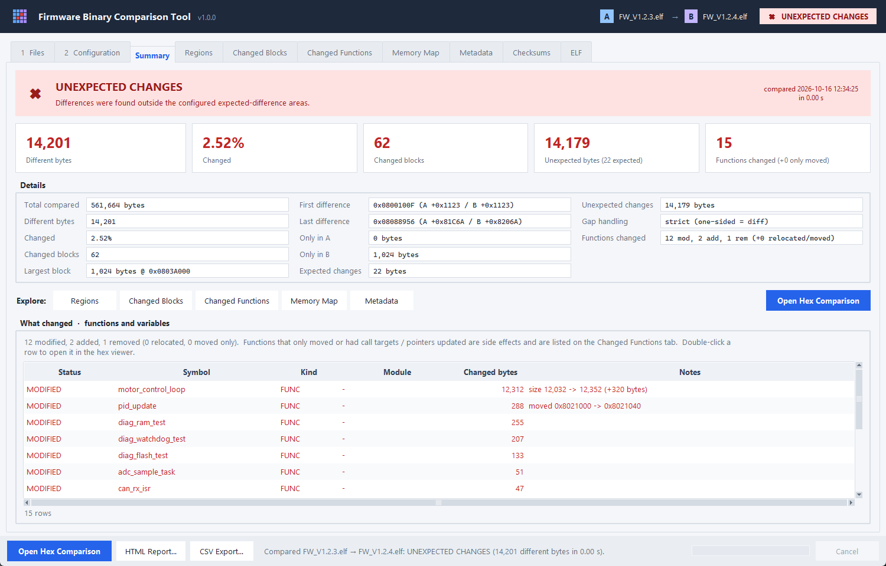
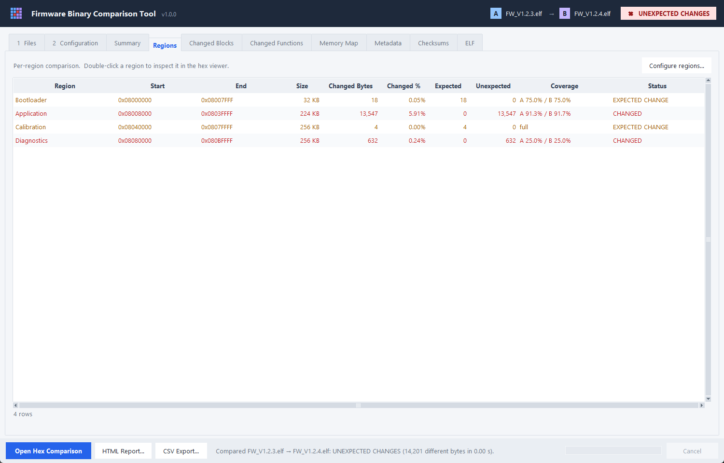
Regions and expected changes
DEMO
Version, timestamp and CRC are allowed to change — nothing else is
Summary: 22 expected bytes (version, timestamp, git hash, CRC) are separated from 14,179 unexpected ones.
Regions: Bootloader and Calibration show EXPECTED CHANGE only; Application and Diagnostics really changed.
Firmware Binary Comparison Tool · v1.0.0
11
Notes:
Example project with Bootloader / Application / Calibration / Diagnostics and expected areas for version, build timestamp, git hash and CRC. Bootloader and Calibration are EXPECTED CHANGE only; Application and Diagnostics have unexpected changes.

Slide 12
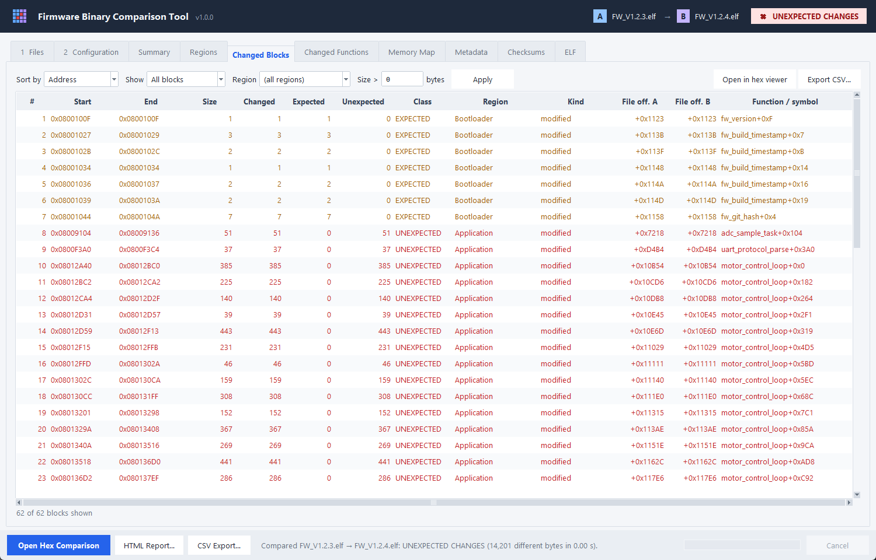
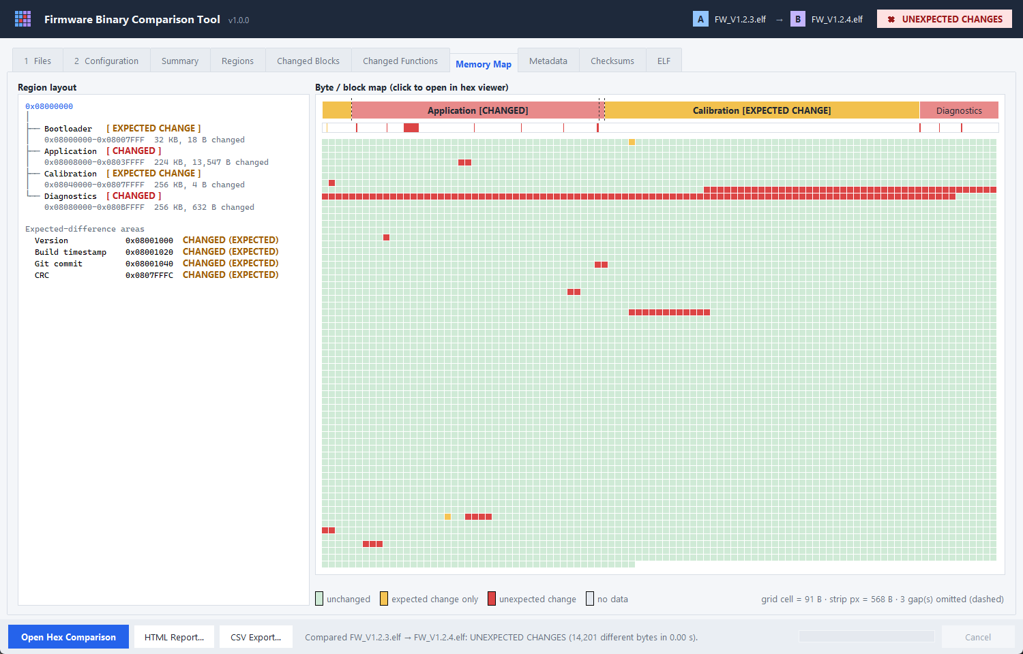
Changed blocks and memory map
DEMO
Where the changes are — as a table and as a picture
Every block with size, class, region, file offsets and the function it falls in; sortable and filterable.
Memory map: red = unexpected, amber = expected only. Click any cell to open the hex viewer there.
Firmware Binary Comparison Tool · v1.0.0
12
Notes:
Blocks can be sorted by address, size or region and filtered by class or size; each row names the function. The map: red = unexpected, amber = expected only; click a cell to open the hex viewer.

Slide 13
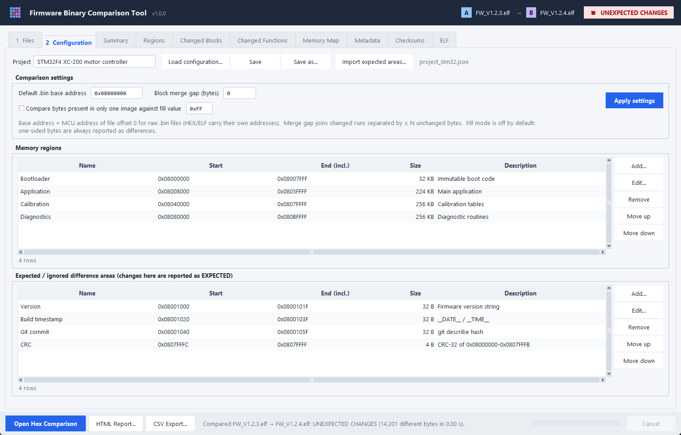
Configuration
SETUP
Reusable project files: regions, expected areas, settings
▪ Add / edit / remove / reorder
▪ End address or +size
▪ Validation: ranges, duplicates, overlaps
▪ Gap fill for sparse HEX vs full BIN (opt-in)
▪ Saved as JSON, used by GUI and CLI
Firmware Binary Comparison Tool · v1.0.0
13
Notes:
Expected areas are never assumed — the engineer configures them explicitly.

Slide 14
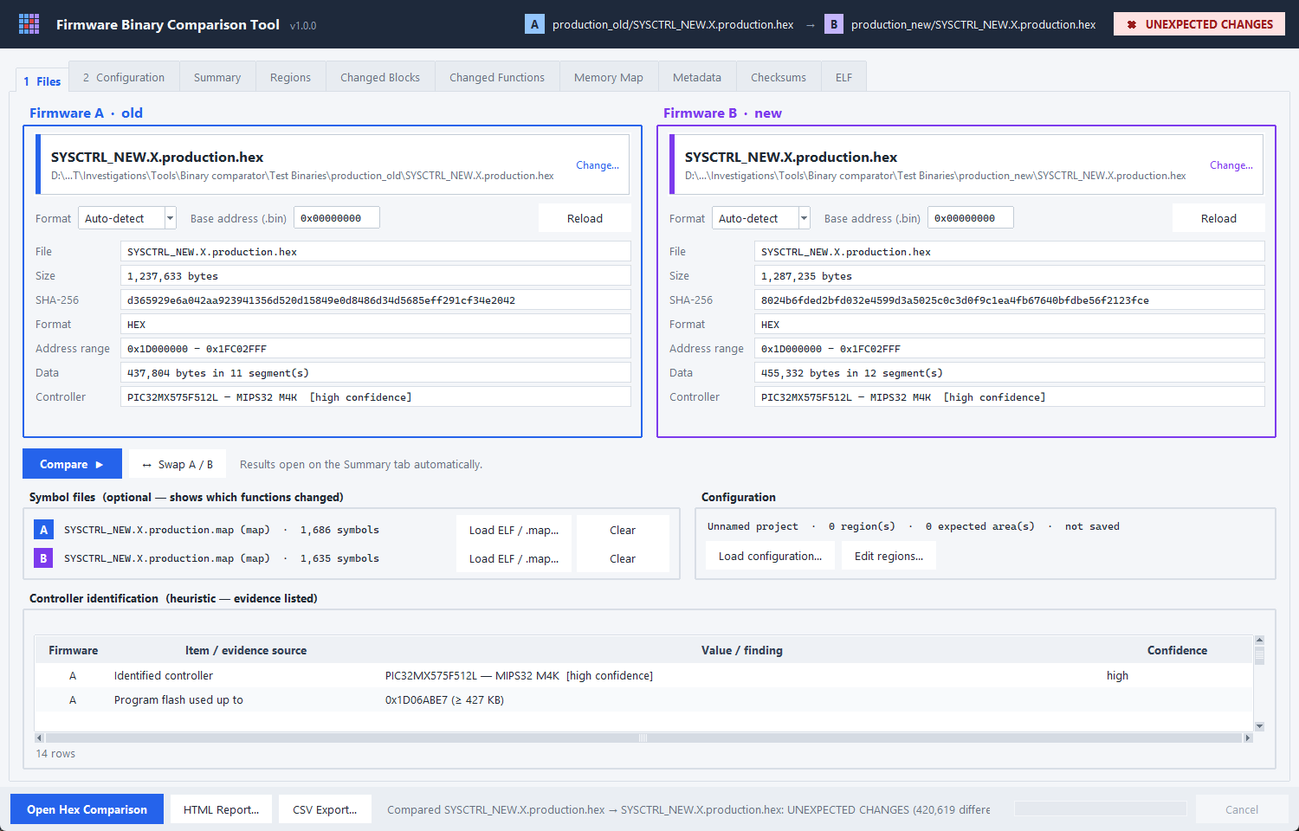
Controller identification
HIGHLIGHT
Exact part from symbols, family from the image layout
▪ PIC32MX575F512L from the XC32 map — 512 KB flash, 100 pins
▪ STM32F411RET from ELF debug info — Cortex-M4F, 512 KB, LQFP64
▪ HEX / BIN only: family from flash layout, config words, vector table
▪ Warning if A and B target different controllers
Firmware Binary Comparison Tool · v1.0.0
14
Notes:
Every identification lists its evidence and confidence. An application at 0x08040000 is flagged as sitting behind a bootloader.

Slide 15
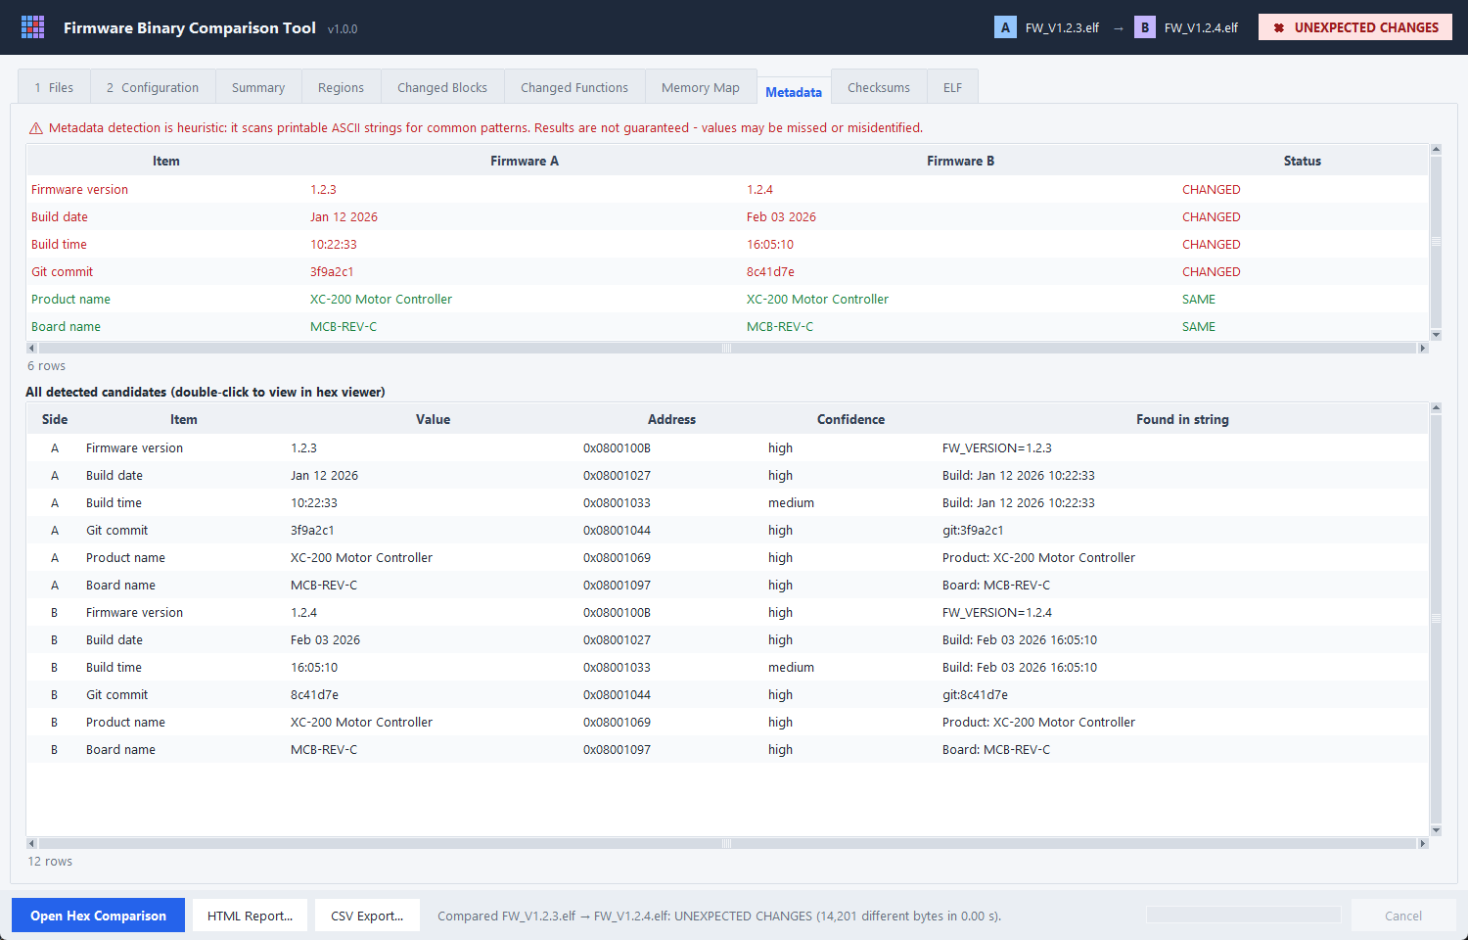
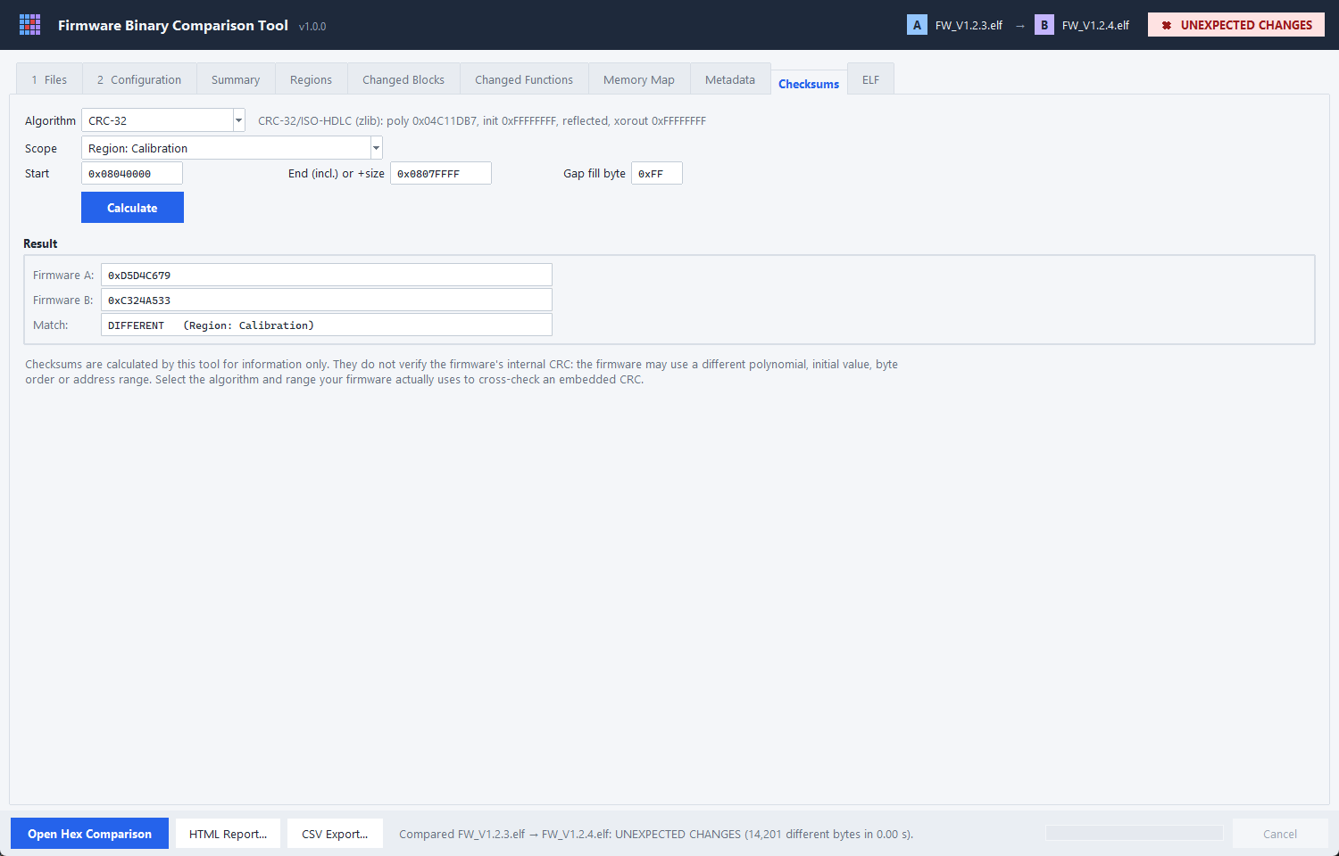
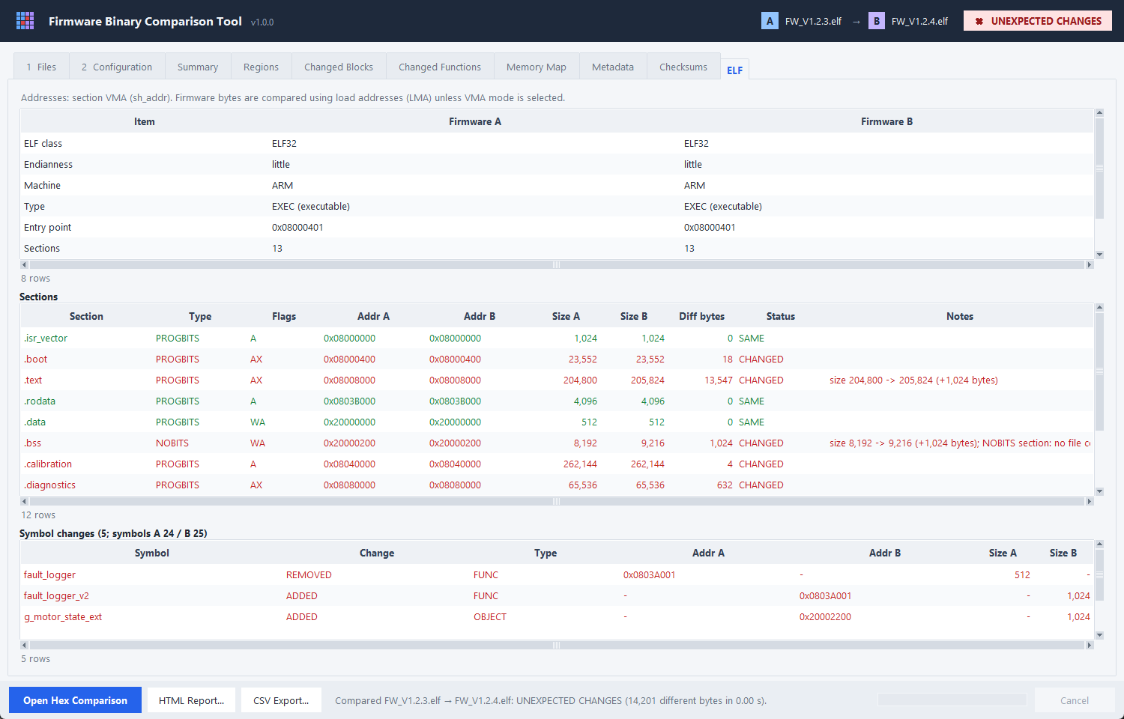
Metadata · Checksums · ELF
DEMO
Supporting analysis
Heuristic metadata: version, build date/time, git, product, board
CRC-32 / CRC-16 / SHA-256 over file, image, region or range
ELF sections, build info and symbol changes
Firmware Binary Comparison Tool · v1.0.0
15
Notes:
Metadata detection is heuristic and says so. Checksums never assume the firmware's own CRC algorithm.

Slide 16
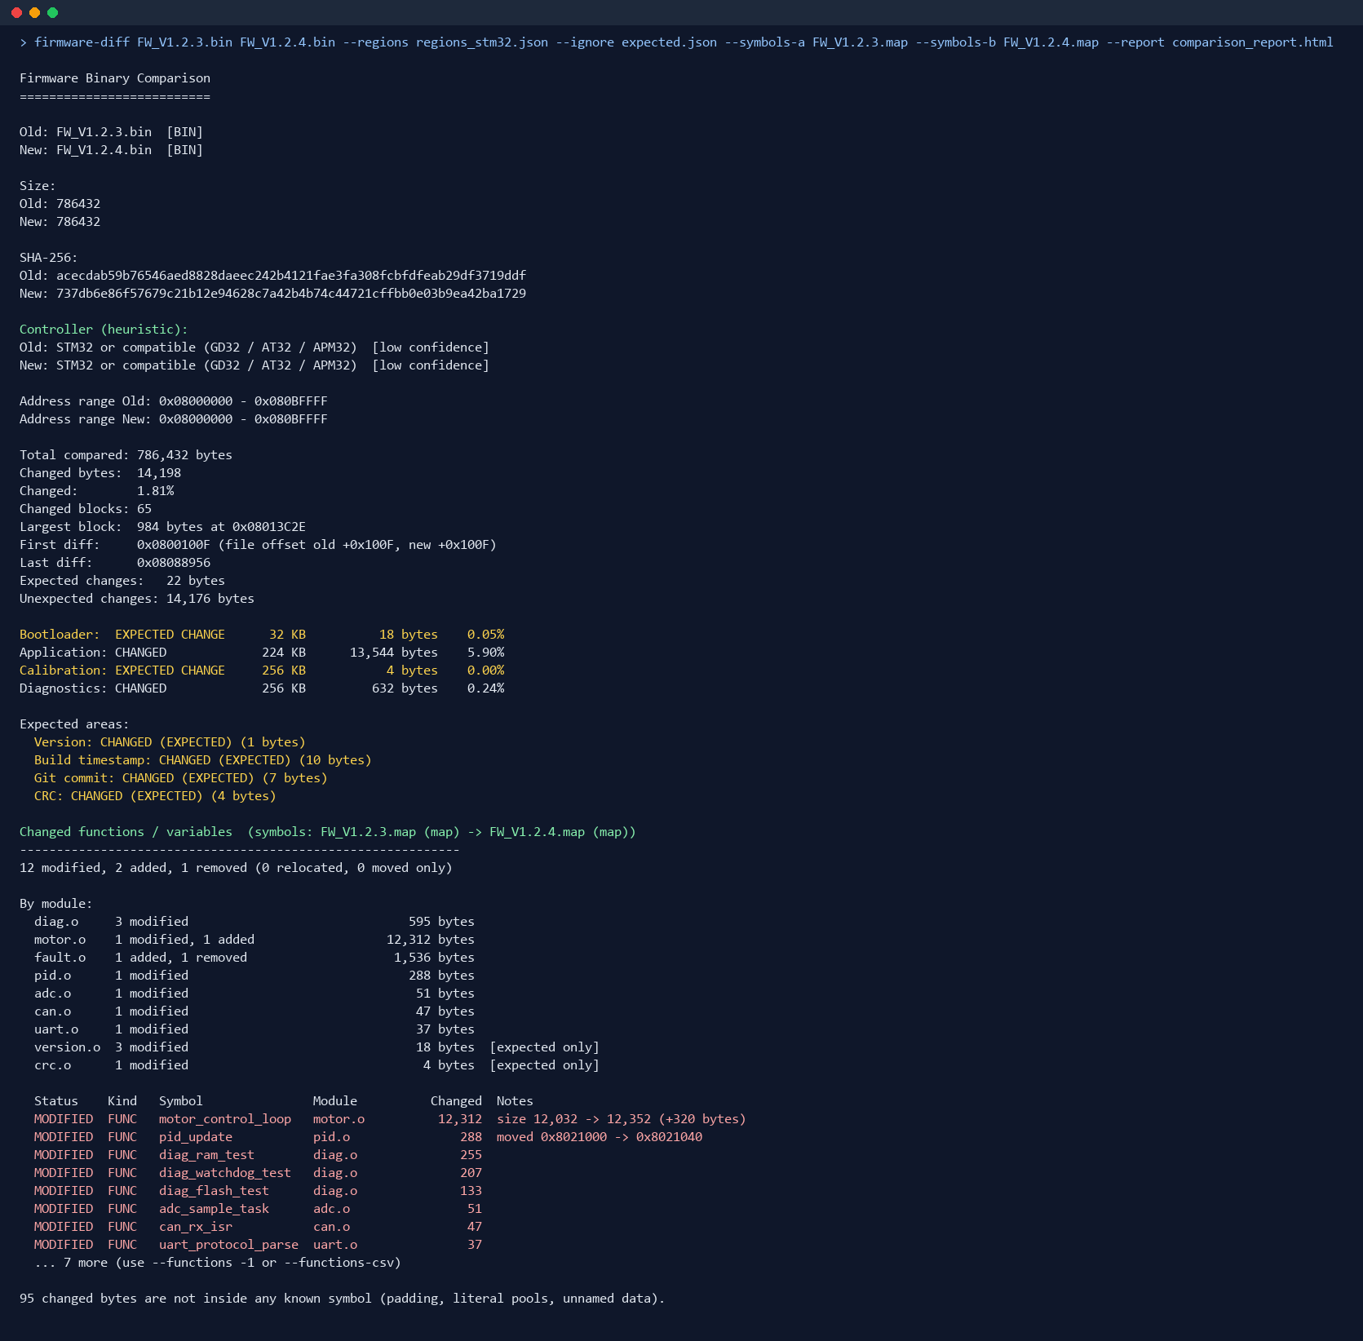
Command line & CI
AUTOMATION
Same engine, scriptable — exit codes gate a release
Exit codes
▪ 0 identical or expected changes only
▪ 1 unexpected changes
▪ 2 error (missing / malformed file, bad config)
▪ --report / --csv / --json
▪ --symbols-a / --symbols-b
▪ --regions / --ignore
▪ --fill, --merge-gap, --checksum
Firmware Binary Comparison Tool · v1.0.0
16
Notes:
Show the one-line CI usage: firmware-diff old.bin new.bin --regions project.json --report r.html. A non-zero exit code fails the pipeline on unexpected changes.

Slide 17
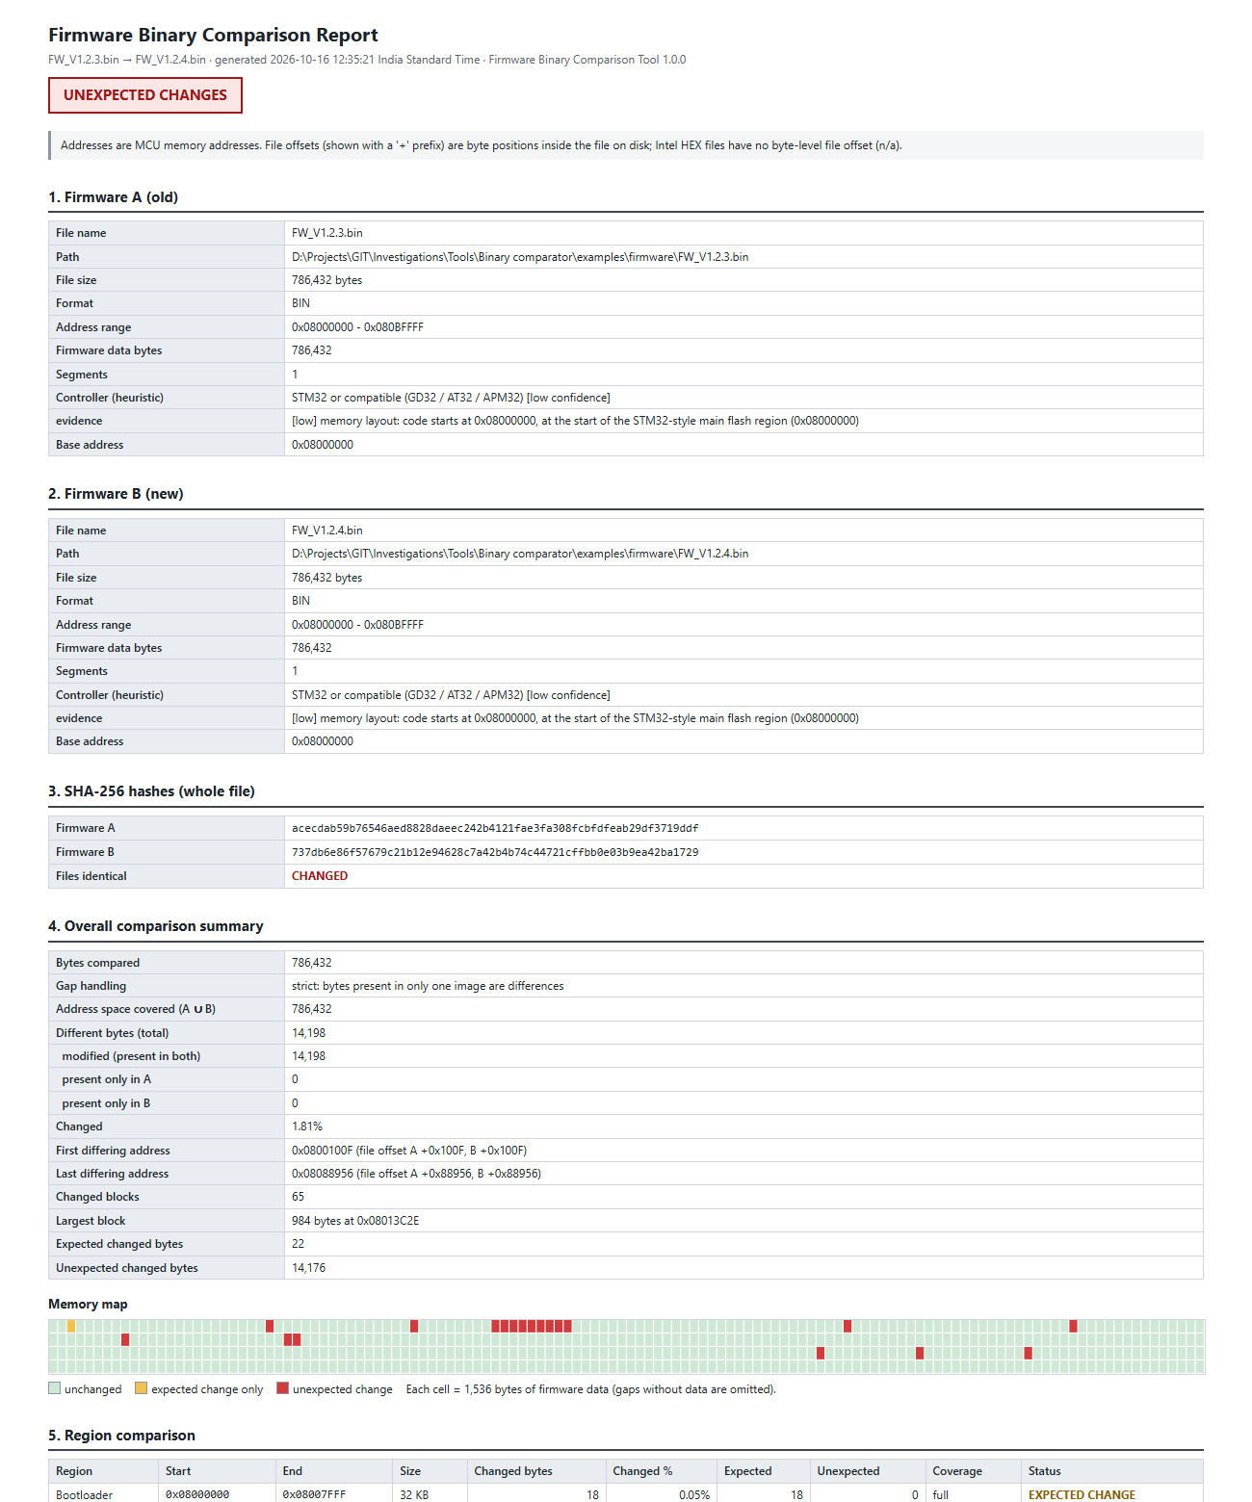
HTML engineering report
OUTPUT
Self-contained, printable, shareable
▪ Firmware A / B information incl. controller
▪ SHA-256 hashes, overall summary, memory map
▪ Region comparison
▪ Changed blocks with function names
▪ Expected and unexpected changes
▪ Function and module changes, side effects
▪ Metadata differences, ELF comparison, timestamp
▪ CSV exports for blocks and functions; JSON summary
Firmware Binary Comparison Tool · v1.0.0
17
Notes:
Open docs/sample_comparison_report.html in a browser to show the full report.

Slide 18
Quality and performance
QUALITY
Verified on synthetic and production firmware
84
0.1 s
2
0
automated tests
64 MB comparison
production firmware families
runtime dependencies
▪ Engine: randomised tests against a naive byte-by-byte reference; interval algebra against Python sets.
▪ Formats: malformed / truncated HEX and ELF, overlapping records, files verified unmodified.
▪ Functions: real Thumb-2 and MIPS32 machine code, aliases, linker labels, renamed compiler symbols.
▪ Production: STM32F411 watchdog change → exactly 2 modified + 6 removed; PIC32MX575 release diff.
▪ GUI: smoke test drives the real window — load, compare, tabs, hex navigation, filters, search.
Firmware Binary Comparison Tool · v1.0.0
18
Notes:
Mention the freeze: v1.0.0 baseline with a SHA-256 manifest of every file (docs/FREEZE_v1.0.0.md).

Slide 19
Limitations and next steps
ROADMAP
v1.0.0 is frozen — candidates for the next version
▪ Heuristics: metadata and controller identification are best-effort, with evidence shown
▪ Decoding: MOVW/MOVT, microMIPS / MIPS16e and RISC-V not decoded yet
▪ Maps: GNU ld and XC32 only (IAR / Keil: use their ELF)
▪ Formats: no Motorola S-record yet
▪ Same-size MODIFIED can be a side effect of header / struct changes
Possible next steps
▪ S-record and IAR / Keil map support
▪ RISC-V and MOVW/MOVT reference decoding
▪ Batch / folder comparison of release sets
▪ Git integration: compare two tags directly
▪ Packaged installer (PyInstaller scripts ready)
Firmware Binary Comparison Tool · v1.0.0
19
Notes:
Invite feedback on priorities for the next version.

Slide 20
Thank you — questions?
Byte-exact comparison · regions & expectations · real edits vs side effects · controller identification
Run: python firmware_compare_gui.py · python firmware_diff.py old.bin new.bin --report r.html
Docs: docs/Firmware_Binary_Comparison_Tool_Design_v1.0.docx · README.md · docs/FREEZE_v1.0.0.md
Notes:
Close: where to find the tool, the design document and the freeze manifest.

