Slide 1

Predicting Global Wheat Crop Yields Using a Combination of CNN and LSTM Blocks
Sungjoon Park
Apr. 30th, 2024

Slide 2
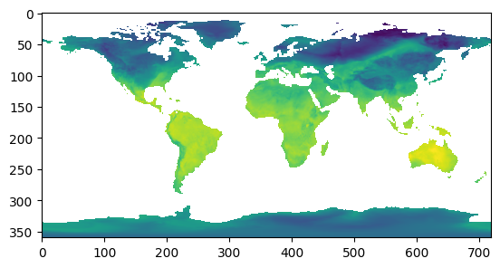
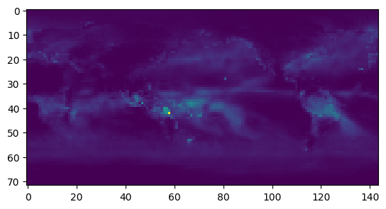
Objective and Data
Objective: Making a model that can accurately predict global wheat crop yields using meteorological image datasets
Data
Input: Global near-surface temperature and precipitation heatmaps (Monthly)
Source: Climate Data Store by Copernicus
Samples (Left: near-surface temperature, Right: precipitation)
Target: Global yearly wheat crop yield per hectare (unit: ton)
Source: Our World in Data
Periods: Training (1980-2015), Validation (2016-2018), Test (2019)

Slide 3
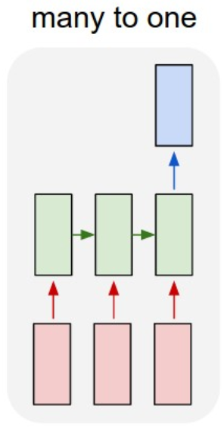
Model
CNN block
LSTM block
Monthly
Temp Images
Monthly
Precip Images
Crop yield of
the current year
ResNet
ResNet
Monthly Temp
CNN features
Monthly Precip
CNN features
Monthly concatenated
CNN features

Slide 4


Two Tricks
Auto-regressive prediction
Positional Encoding
Crop yield via
a fully-connect layer
The previous
Target value
Monthly features
Monthly features

Slide 5
Positional Encoding Example
Target:
2024 Crop yield
Target:
2024 Crop yield
Feb +Feb_pos_enc | Mar +Mar_pos_enc | … | Jan +Jan_pos_enc
Jun +Jun_pos_enc | Jul +Jul_pos_enc | … | May +May_pos_enc
Monthly features for each layer
(Feb 2023 ~ Jan 2024)
Monthly features for each layer
(Jun 2023 ~ May 2024)

Slide 6
Model Training and Performance
Configurations
Framework: PyTorch
CNN Block Pre-trained Model: ResNet15
Loss function: MSE
Optimizer: Adam
Learning rate: 1e-3
Hyperparameter-tuning: hidden size of the LSTM
Results
Hidden Dim | 64 | 128 | 256 | 512
Epoch when best | 100 | 100 | 100 | 29
Test MSE | 0.0057 | 0.005 | 0.0014 | 0.0006

Slide 7
Limitations and Future Work
Incorporate additional inputs
Humidity and soil type heatmaps
Hyperparameter-tuning: hidden size of the LSTM
Comparison study
Results
More diverse hyperparameter-tuning
CNN Block pre-trained model
Position Encoding Strategy
Loss functions (e.g. L1 Loss)
Optimizers
Learning rates

