Slide 1
Self-Supervised Learning for Arsenic Skin Image Dataset
Chosen Methods: SimCLR, Barlow Twins, MAE
Dataset: Arsenic Skin Image BD (Mendeley)
Focus: Binary Classification (Healthy vs Arsenicosis-affected)

Slide 2
Dataset Overview
- 1.5K original + 8.9K augmented images
- Smartphone-captured real-world skin photos
- Binary labels: Healthy / Affected
- Goal: Learn robust skin features without labels

Slide 3
Implications for SSL choice
Images: use computer vision SSL methods.
Limited dataset (1.5k originals,8.9k augmented) → SSL helps learn features without many labels.
Variations in lighting, cameras, skin texture → need methods robust to such changes.
Binary classification (healthy vs affected) → SSL should produce strong embeddings for fine-tuning.
High intra-class variability → choose SSL that enforces intra-class invariance and inter-class discrimination.

Slide 4
Chosen SSL Methods
SimCLR – Contrastive Learning (with negatives)
Barlow Twins – Redundancy Reduction (no negatives)
MAE – Masked Autoencoder (reconstruction)
All three fit small/medium image datasets and subtle skin texture learning.

Slide 5
SimCLR: Contrastive Learning
What it is:
A self-supervised learning (SSL) method for images.
Learns feature representations without needing labels.
Focuses on similarity between augmented versions of the same image.

Slide 6
SimCLR: Contrastive Learning
Why suitable for our dataset:
Already has augmented images, perfect for SimCLR.
Can learn robust representations with few labels.
Handles variations (lighting, angle, texture) in skin images effectively.

Slide 7
SimCLR: Contrastive Learning
Why it’s called “Contrastive”:
It contrasts positive and negative pairs to learn meaningful features.
Objective: make similar things close, dissimilar things distant in feature space.
Positive pair:
Two images that are different views of the same original image.
Negative pair:
Two images that come from different original images.

Slide 8
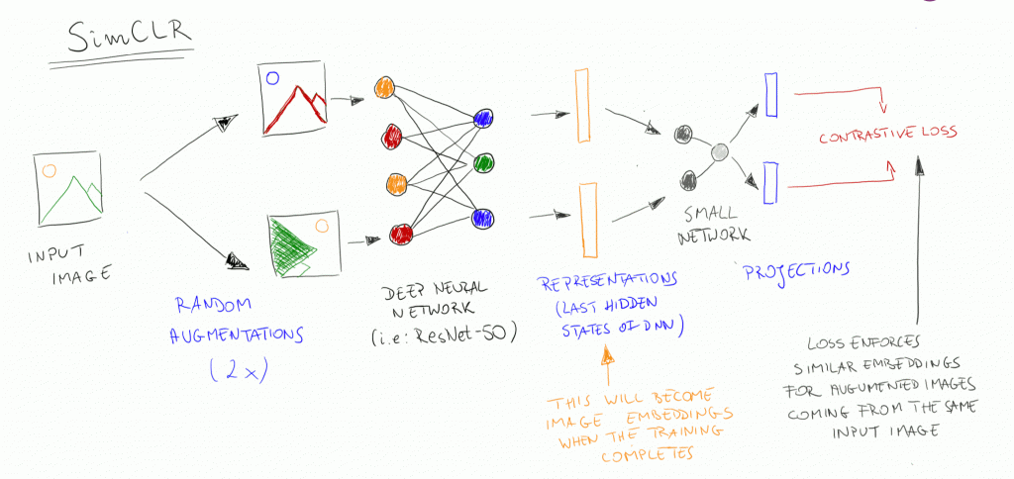
SimCLR: Contrastive Learning

Slide 9
Barlow Twins: Redundancy Reduction
Idea:
Take two views of the same image → make their representations similar
Also, make each feature dimension different (decorrelated)
No explicit negatives needed

Slide 10
Barlow Twins: Redundancy Reduction
Why it fits:
Dataset is moderate → no need for huge negative sets
Captures texture, color, lesion shapes
Produces robust embeddings from variable images

Slide 11
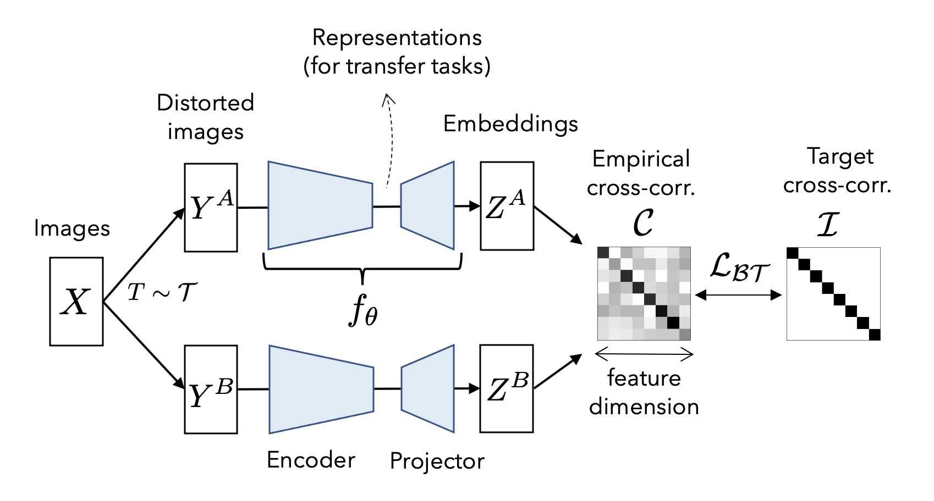
Barlow Twins: Redundancy Reduction

Slide 12
MAE: Masked Autoencoder
Idea:
Hide random parts of the image → network predicts missing parts
Forces model to learn subtle skin patterns
Learns global structure (overall skin region) and local details (spots, texture)
Works efficiently — only a part of the image is processed (less computation)

Slide 13
MAE: Masked Autoencoder
Why it fits:
Captures skin texture and lesion details
Uses all images (labeled + unlabeled)
Good for few labeled examples → learn embeddings first, then fine-tune

Slide 14
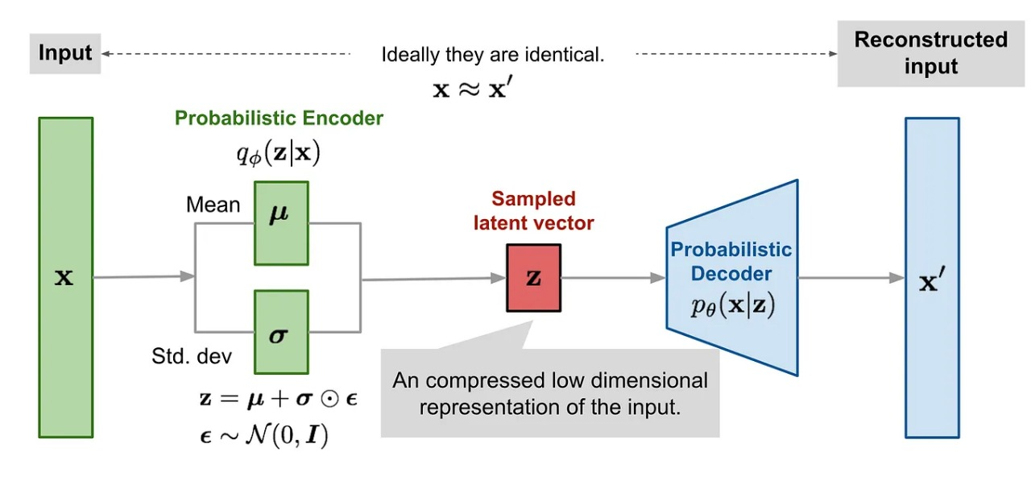
MAE: Masked Autoencoder

Slide 15
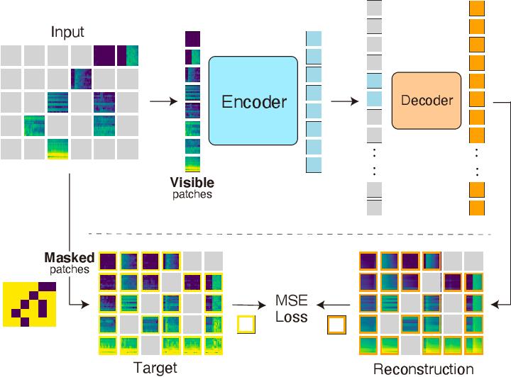
MAE: Masked Autoencoder

Slide 16
Why Not Other SSL Models
BYOL / SimSiam – collapse risk on small data.
VICReg – complex tuning, large-batch needed.
DINO/iBOT – needs ViT & big compute.
SwaV – clustering fails for 2-class data

