Slide 1

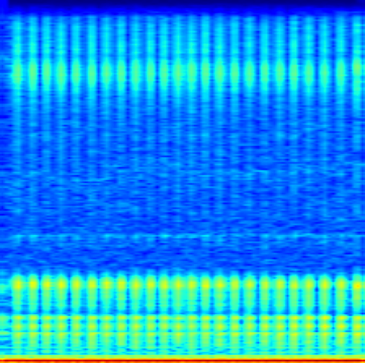
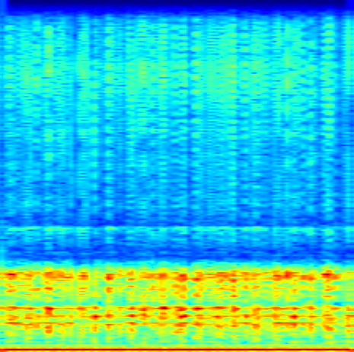
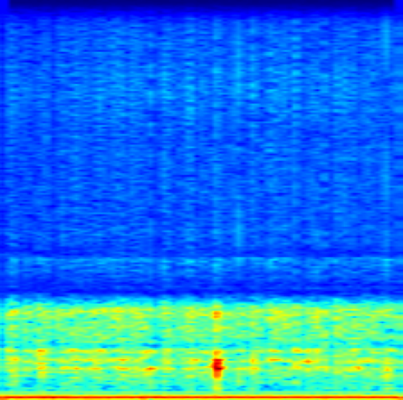
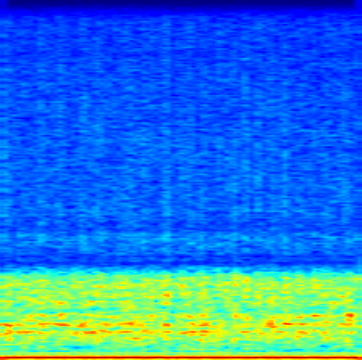
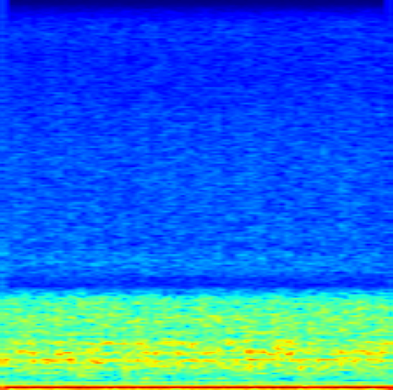
(a) not_boiling
(b) boiling1
(c) boiling2
(d) boiling3
(e) boiling4
(f) boiling5

Slide 2
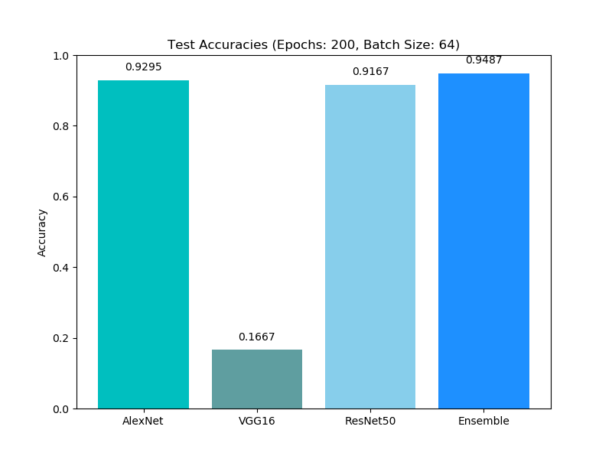
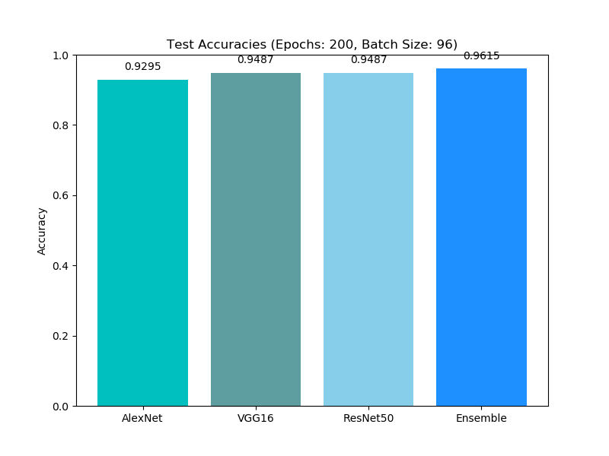
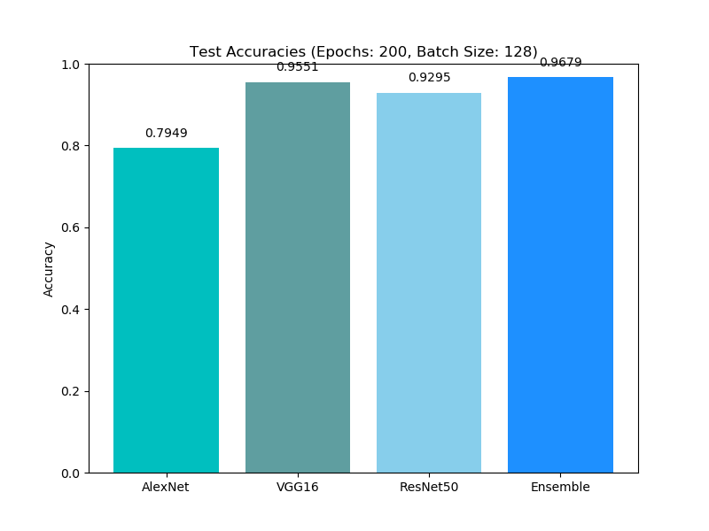
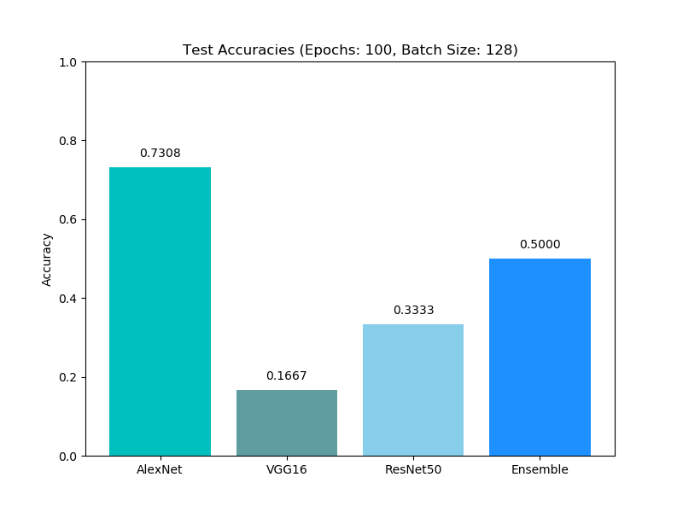
(a) Epoch：200, Batch Size：64
(b) Epoch：200, Batch Size：96
(c) Epoch：200, Batch Size：128
(d) Epoch：100, Batch Size：128

Slide 3
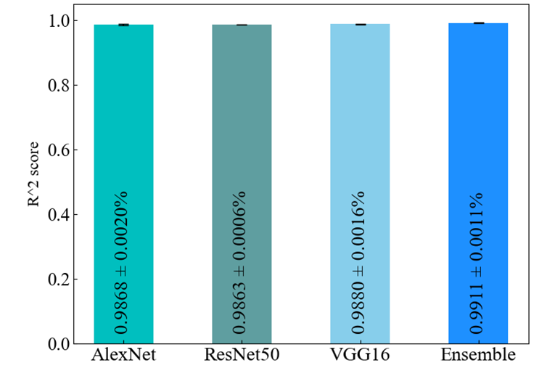
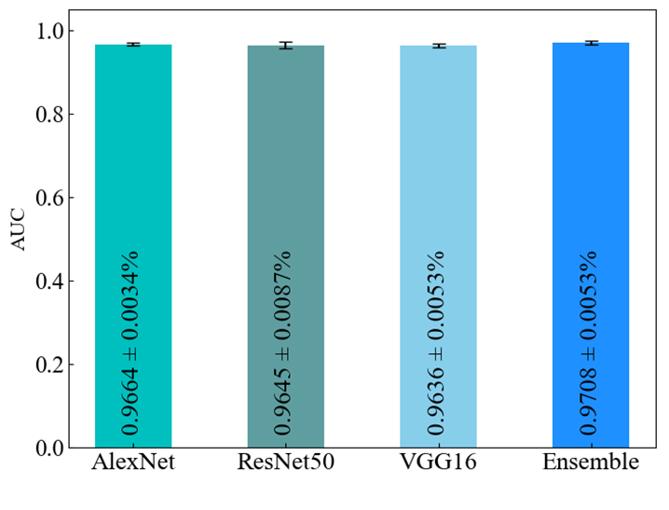
(a)R² score
(b)AUC

Slide 4
Shunt
Resist
Tl
V1
V2
DC
power
Electrode
Voltmeter 1
Voltmeter 2
Hydrophone
Thermocouple
Stirring rod
Pt
Ultrapure water
Auxiliary heater
Hot Plate

Slide 5
Steam
Generator
Turbine
Generator
Control
Rods
Heat
Exchanger
Condenser
Hot
Sodium
Pump
Secoudary
Sodium
Core
Pump
Cold
Sodium
Pump
Primary
Sodium

Slide 6
Control
Rods
Hot
Sodium
Core
Cold
Sodium

Slide 7
Control
Rods
Hot
Sodium
Core
Cold
Sodium

Slide 8
Control
Rods
Hot
Sodium
Core
Cold
Sodium

