Slide 1

 | S.S.V.P.S’s B. S. Deore Polytechnic, Dhule Department of Computer Engineering Academic Year : 2025 – 2026
Presentation on Capstone Project Execution (CPE–316004)
Topic: | Krishi Sakha
Presented by: | 1. Gujar Jayesh Nagesh
 | 2. Kor Darshan Pruthviraj
 | 3. Puranik Amay Tushar
 | 4. Patil Krish Chandrashekhar
Guided by: | Ms. R. S. Patil
Semester: | Sixth (K Scheme) | Date : 06/03/2026

Slide 2
Abstract
Krushi Sakha is an Android application that provides season-wise crop information (like: Pre-sowing, Sowing management, Nutrient & Water schedule, Crop protection, Storage, etc ) to farmers. Built with Java and Firebase, it features role-based access - Users can browse crops while Admins can Add/Edit/Delete crop data with images. The app offers an intuitive Material Design UI, real-time database synchronization, and offline support, serving as a digital assistant for the farming community.

Slide 3
Content
1. Introduction
2. Literature Survey
3. Scope of the project
4. Methodology
5. Details of designs, working and processes.
6. Results and applications
7. Conclusion and future scope
8. References and Bibliography

Slide 4
1. Introduction
Agriculture is the backbone of the Indian economy, yet rural farmers lack access to scientific, stage-wise cultivation guidance.
The Necessity: Traditional methods are often inaccurate for modern soil conditions, leading to poor yields and financial loss.
The Solution: Krushi Sakha provides a scientific roadmap through a structured 5-pillar architecture: Pre-Sowing, Sowing, Nutrients, Protection, and Storage.
User Accessibility: The app features a dedicated Login and Registration system to provide secure, personalized access for every farmer.

Slide 5
2. Literature Review
2.1 Study of Existing Systems
Our team reviewed existing agricultural apps and found that while most require registration, they often lack offline support.
Secure Access: Like leading systems, Krushi Sakha implements an Authentication Module to ensure secure access control for user data.
The Gap: Existing apps do not integrate a complete, stage-by-stage guide from pre-sowing to post-harvest storage in one place.
Language Barrier: Most information in current apps is too complex for low-literacy farmers; our system simplifies this content.

Slide 6
2. Literature Review
2.2 Problem Statement
Farmers face several challenges that motivated the development of Krushi Sakha:
Lack of knowledge regarding correct sowing timing and soil preparation.
Incorrect use of fertilizers and pesticides, leading to health hazards and soil degradation.
Inability to identify crop diseases early, resulting in large-scale crop loss.
Difficulty for farmers to manage and secure their own agricultural data profile.

Slide 7
2. Literature Review
2.3 Problem Definition
There is an urgent need for a system that provides structured, offline-capable guidance with secure user management.
Proposed System: An Android application that requires user authentication to access scientific roadmaps.
Core Goal: To improve requirement quality and farming efficiency by validating agricultural data before it reaches the farmer.

Slide 8
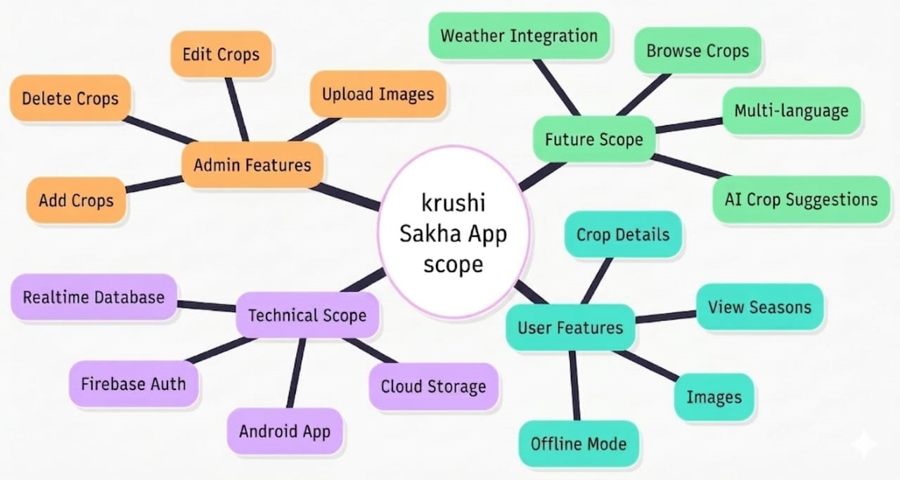
3. Scope of the project

Slide 9
4. Methodology
4.1 Technologies used:
Android Studio (Java): Used to develop the frontend, backend logic, and user authentication modules.
Firebase Authentication: Handles secure sign-in and account creation for both Farmers and Admins.
Firebase Realtime Database: Stores user profiles and hierarchical crop data nodes.
Firebase Disk Persistence: Enables the app to serve text data even when the device is completely offline.

Slide 10
4. Methodology
4.2 User Authentication Flow
​Farmer Registration: Users provide their Name, Email, and Password, which are validated and stored in Firebase.
​Farmer Login: Existing users authenticate via secure credentials to enter the main dashboard.
​Admin Login: The role of Admin is give statically by defining the role in database as Admin

Slide 11
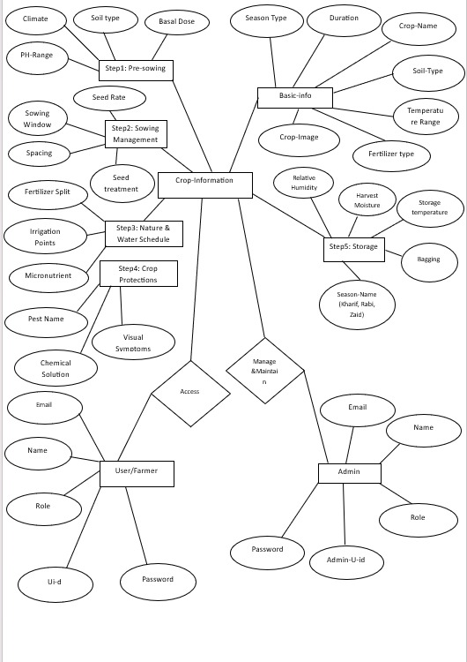
5. Details of designs, working & processes
5.1 ER Diagram

Slide 12
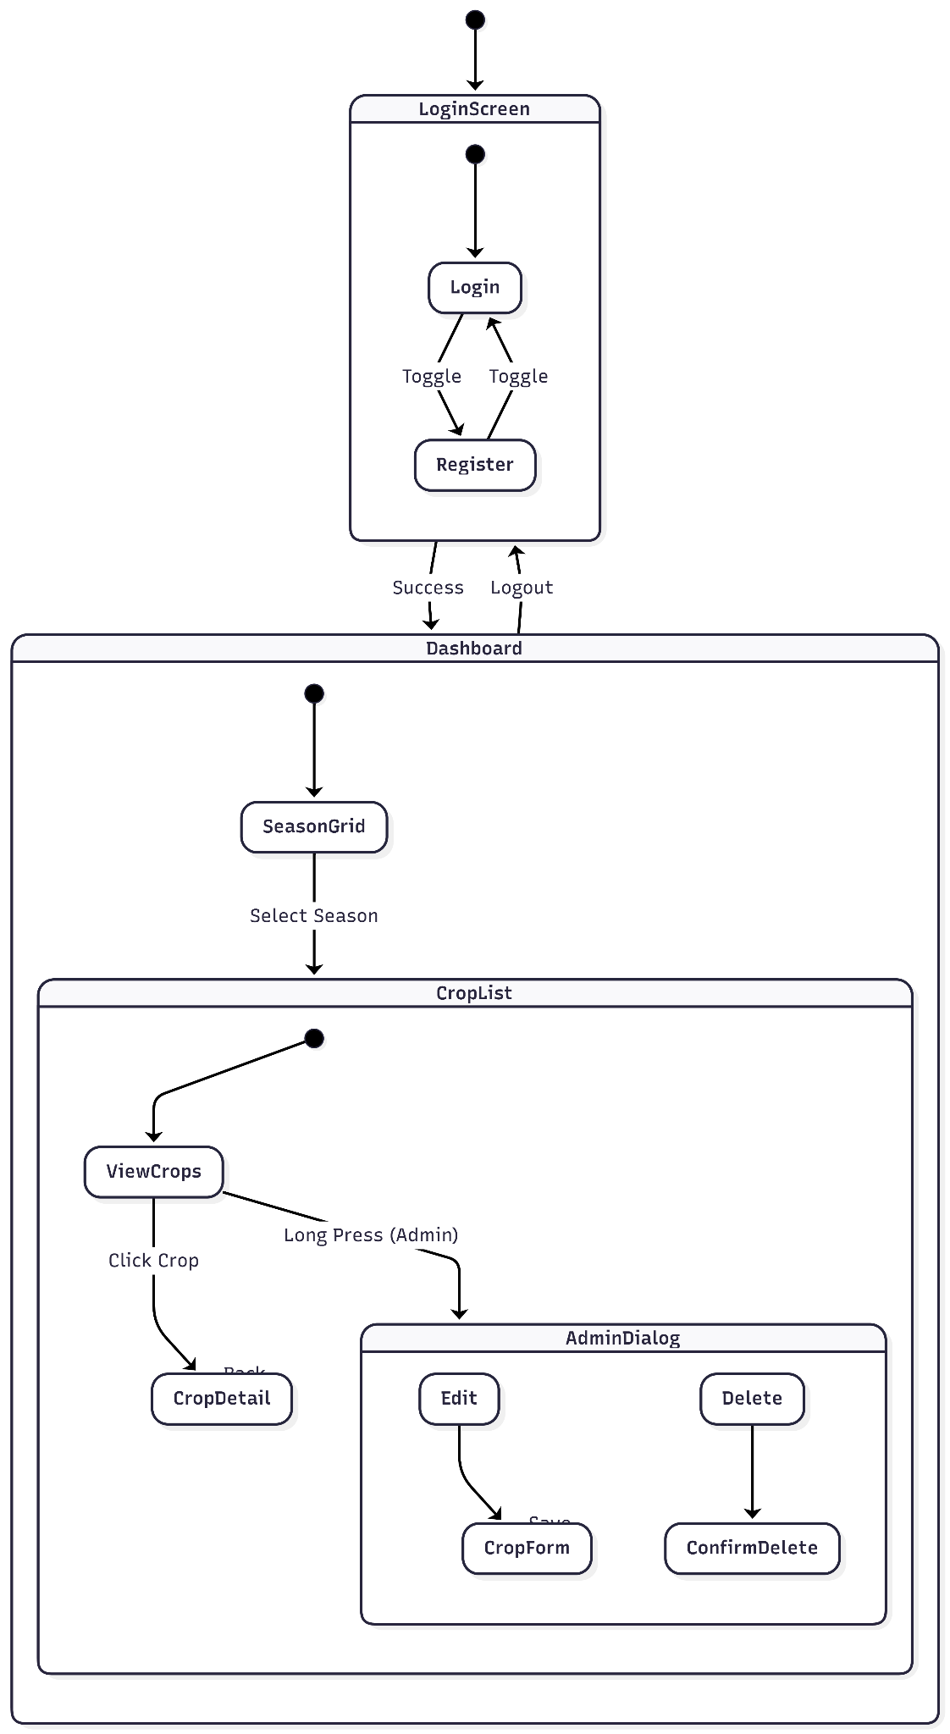
5. Details of designs, working & processes
5.2 UI Flow

Slide 13
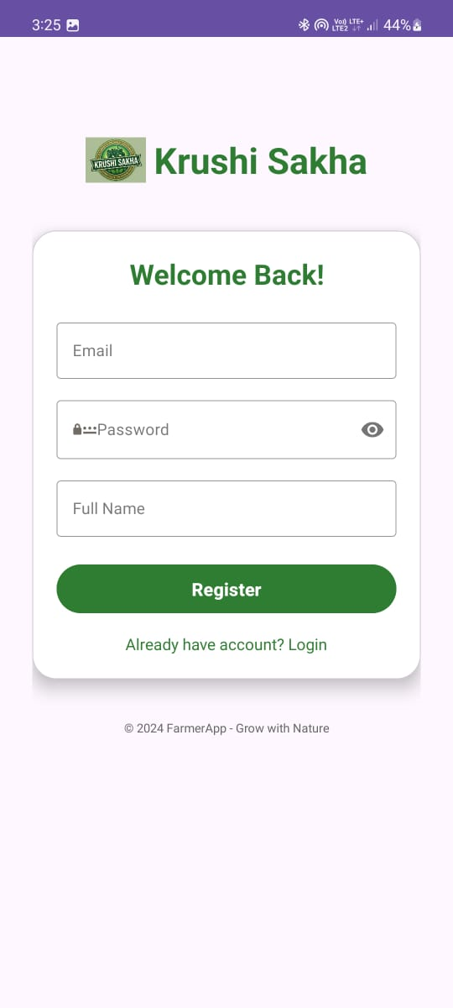
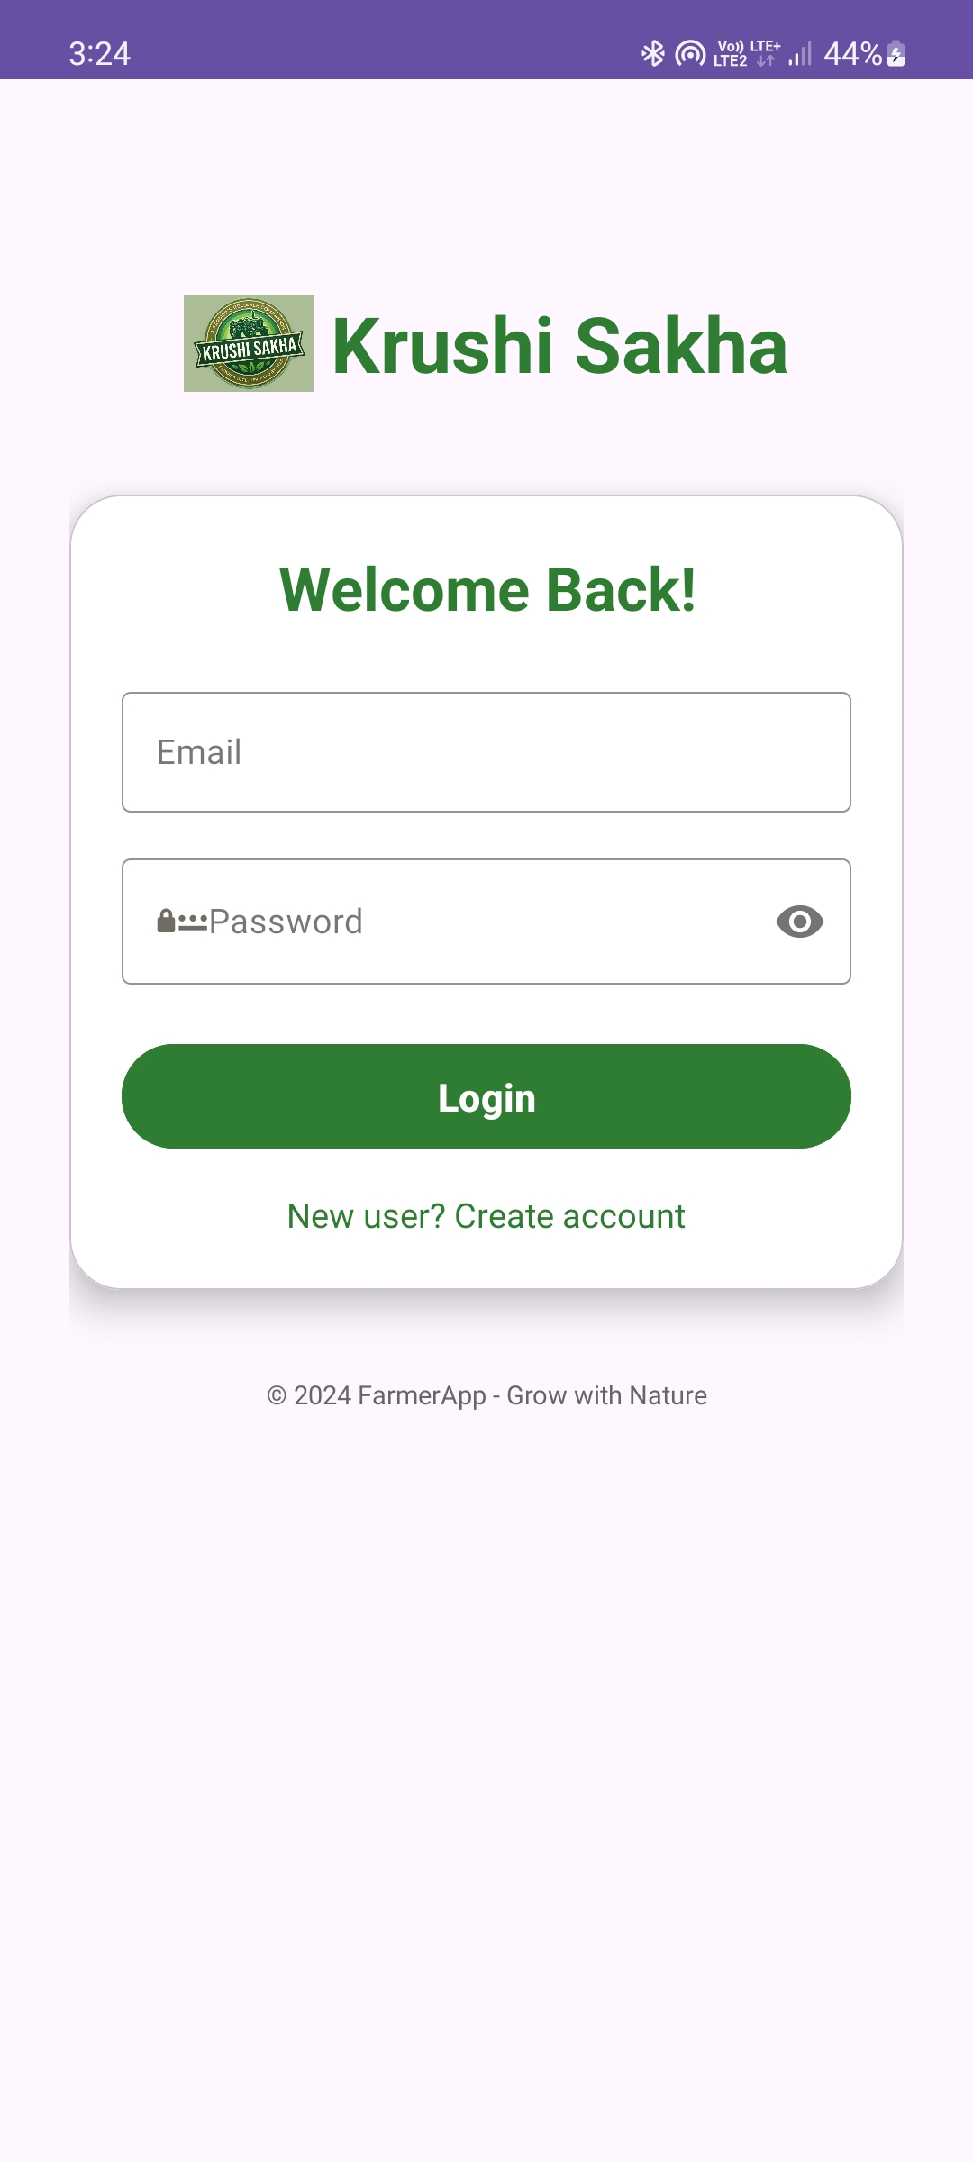
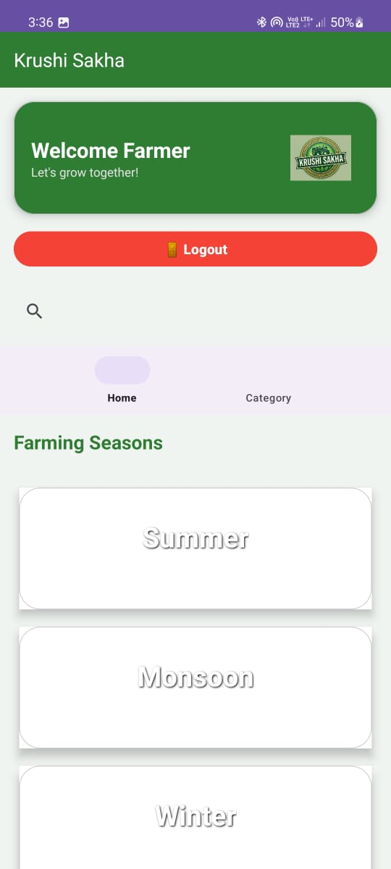
6. Results and Applications
Fig. Register Page Fig. Login Page Fig. Farmer Dashboard

Slide 14
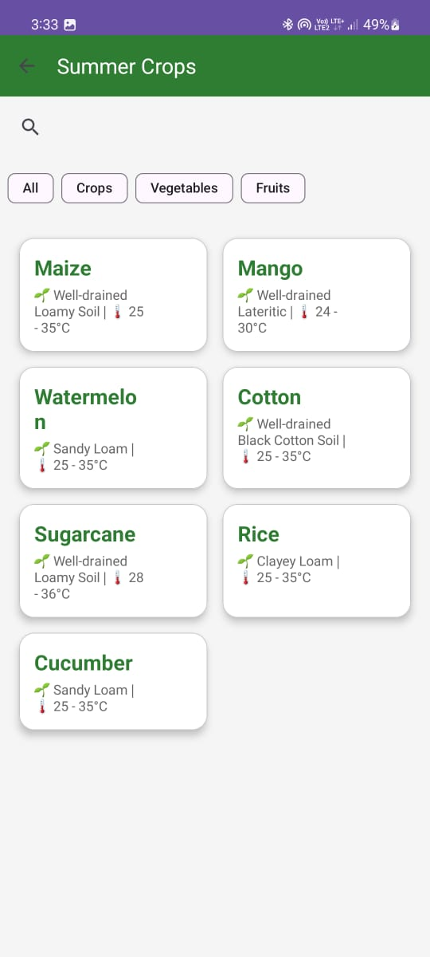
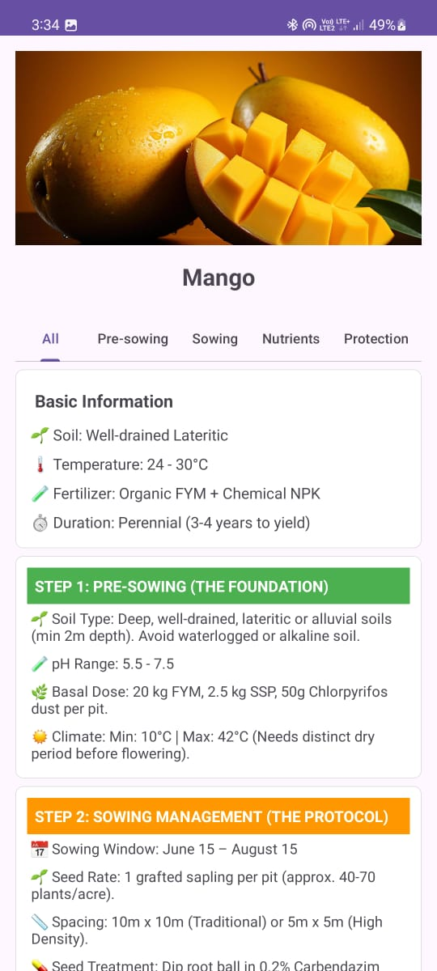
6. Results and Applications
Fig. Seasons Page Fig. Crop Info Page

Slide 15
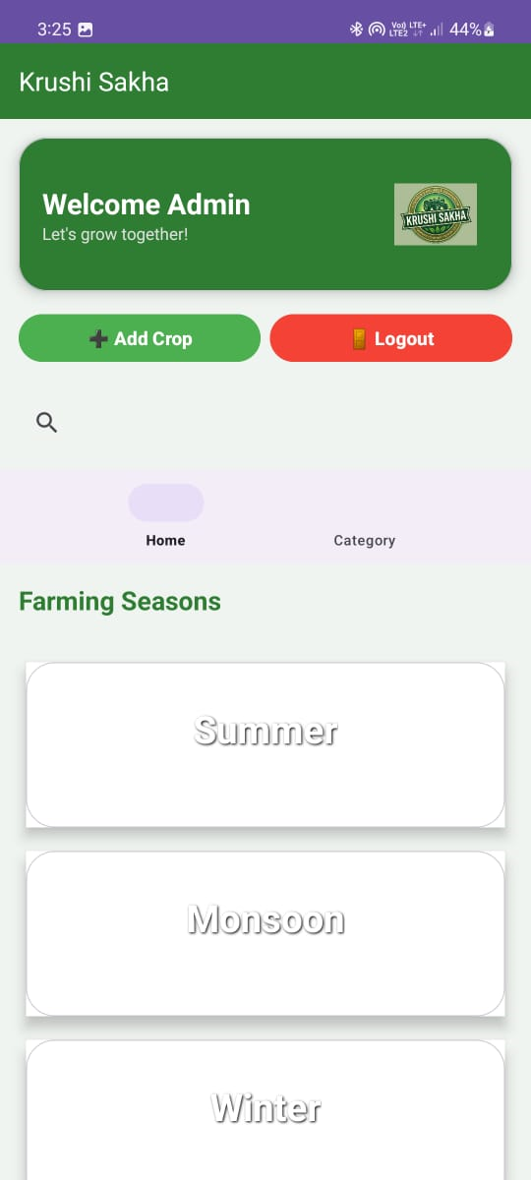
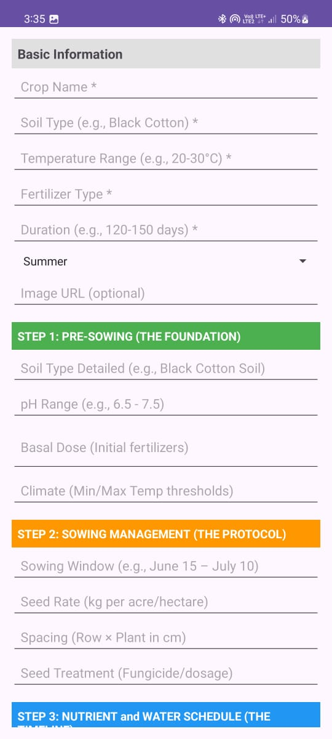
6. Results and Applications
Fig. Admin Page Fig. Add Crop

Slide 16
7. Conclusion and future scope
7.1 Future Scope:-
Weather Integration
Voice-Based Search
AI Crop Suggestions
Multi-language Support
Database Expansion
Advanced Filtering
iOS Version Development
Dashboard & Analytics
Offline Architecture Upgrade

Slide 17
7. Conclusion and future scope
​7.2 Conclusion
Krushi Sakha is a helpful Android app that gives farmers scientific advice through a simple five-step process. We used Firebase as a Realtime Database to store crop data and manage accounts securely. The app includes a special Admin module that allows our team to add, edit, and delete crop information and photos easily. We designed the app to work fully offline so farmers can access guidance even without internet. With its high-contrast green theme for sunlight visibility, this project helps farmers find mistakes in traditional methods and provides a clear roadmap for better results.

Slide 18
8. References and Bibliography
8.1 References:-
Krushi Darshani
MPKV Calender
ICAR Websites
Central Institute of Agriculture Engineering

Slide 19
8. References and Bibliography
8.1 Bibliography:-
Books:
Software Engineering by Roger Pressman
Android Programming by Bill Phillips
Firebase Essentials by Neil Smyth
Research Papers:
"Mobile Application for Crop Advisory" (2022)
"Offline Agricultural Advisory System" by R.V. Patil
Websites:
Android Developer Docs
Firebase Google Docs
ICAR Crop Guidelines

Slide 20
Thank You

