Slide 1

Quantitative Results
(Temperature Scaling Per Class)
Class | IoU | Dice
Background | 0.9835 | 0.9917
Red | 0.4617 | 0.6317
Yellow | 0.4404 | 0.6115
Green | 0.6437 | 0.7832
Mixed Red | 0.4008 | 0.5723
Mixed Yellow | 0.4452 | 0.6161
Mean — All Classes | 0.5626 | 0.7011
Mean — Foreground | 0.4784 | 0.6430

Slide 2
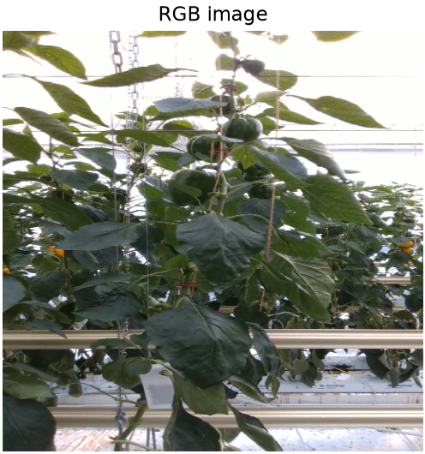
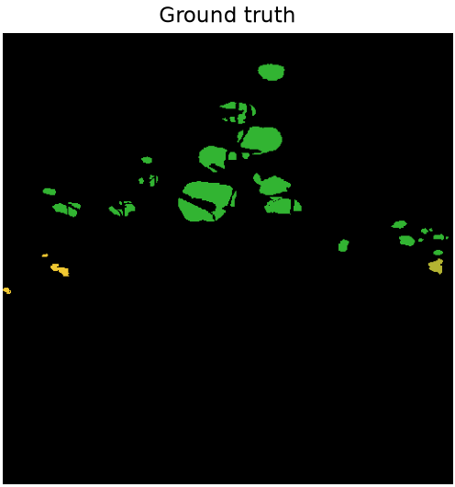
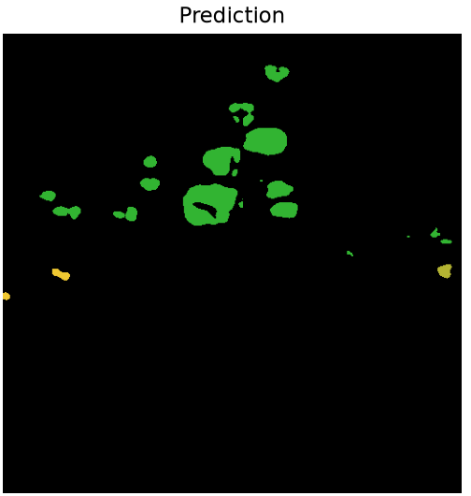
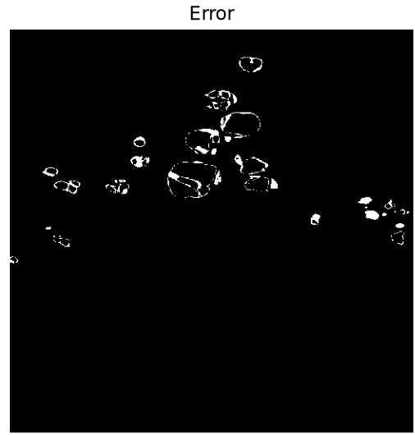
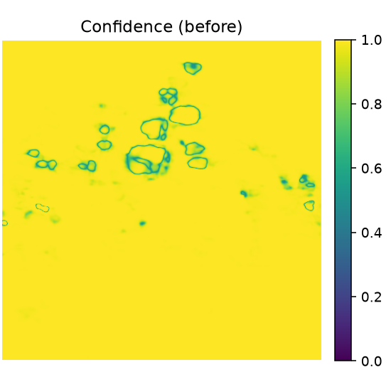
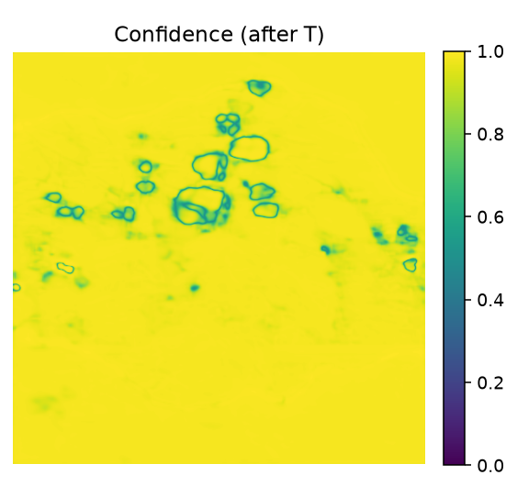
Findings (Temperature Scaling)
Example eval-split image (ID 1600938524353174). Confidence is high almost everywhere before scaling; after applying T = 1.39, confidence drops slightly and more evenly across the whole image, softening the model's overall overconfidence.

Slide 3
Quantitative Results
(Temperature Scaling)
Category | Metric | Before | After
Segmentation | Pixel Accuracy | 0.9805 | 0.9805
 | mIoU — All Classes | 0.5626 | 0.5626
 | mDice — All Classes | 0.7011 | 0.7011
 | mIoU — Foreground | 0.4784 | 0.4784
 | mDice — Foreground | 0.6430 | 0.6430
Calibration | ECE — All Pixels | 0.0102 | 0.0120
 | ECE — Foreground | 0.2269 | 0.1929
 | Brier — All Pixels | 0.0326 | 0.0316
 | Brier — Foreground | 0.5144 | 0.4869
Fitted temperature T = 1.3909 (LBFGS on 1,260,000 val pixels, NLL 0.1179 → 0.1064). T only rescales confidence, so segmentation metrics are identical before/after; green values mark where calibration improved.

Slide 4
Quantitative Results
(MSP Per Class)
Class | IoU | Dice
Background | 0.9835 | 0.9917
Red | 0.4617 | 0.6317
Yellow | 0.4404 | 0.6115
Green | 0.6437 | 0.7832
Mixed Red | 0.4008 | 0.5723
Mixed Yellow | 0.4452 | 0.6161
Mean — All Classes | 0.5626 | 0.7011
Mean — Foreground | 0.4784 | 0.6430

Slide 5
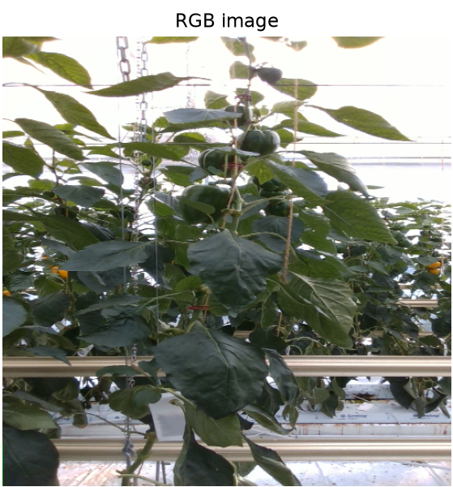
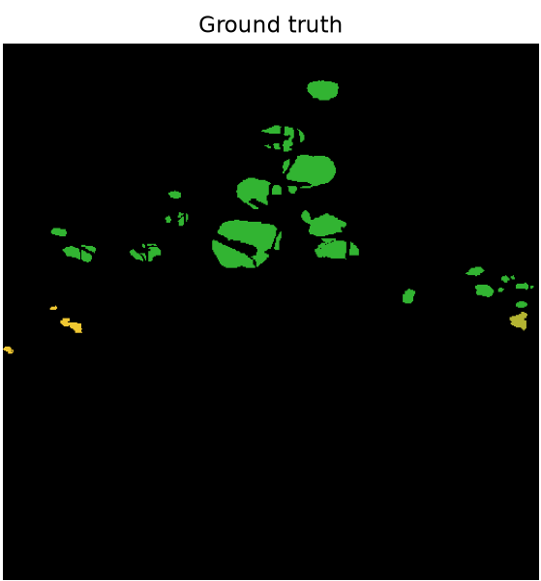
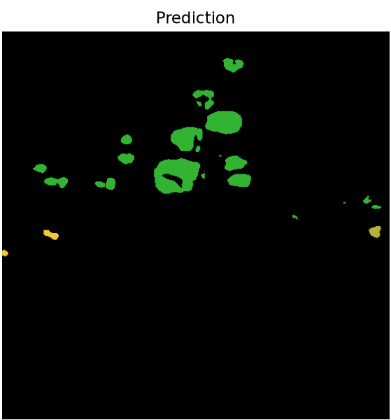
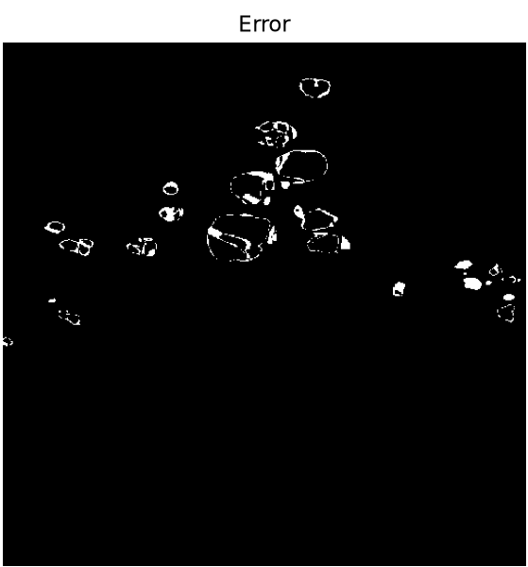
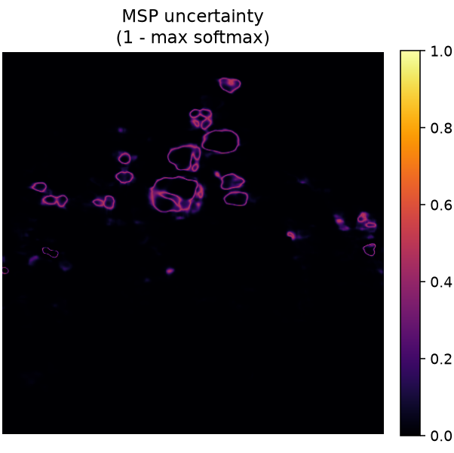
Findings (MSP)
Example eval-split image (ID 1600938524353174). MSP uncertainty (1 - max softmax) lights up almost exclusively along pepper boundaries — exactly where the error map shows the model actually gets pixels wrong, which is why it works reasonably as an error detector (foreground AUROC 0.65).

Slide 6
Quantitative Results
(Maximum Softmax Probability)
Category | Metric | Value
Segmentation | Pixel Accuracy | 0.9805
 | mIoU — All Classes | 0.5626
 | mDice — All Classes | 0.7011
 | mIoU — Foreground | 0.4784
 | mDice — Foreground | 0.6430
Calibration | ECE — All Pixels | 0.0102
 | ECE — Foreground | 0.2269
 | Brier — All Pixels | 0.0326
 | Brier — Foreground | 0.5144
Uncertainty Quality | AUROC — All Pixels | 0.8961
 | AUROC — Foreground | 0.6471
 | AUPR — All Pixels | 0.3150
 | AUPR — Foreground | 0.4305

Slide 7
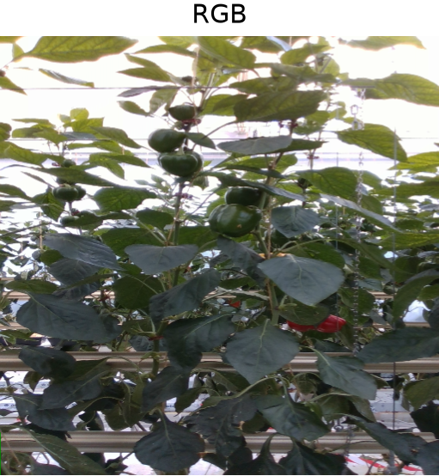
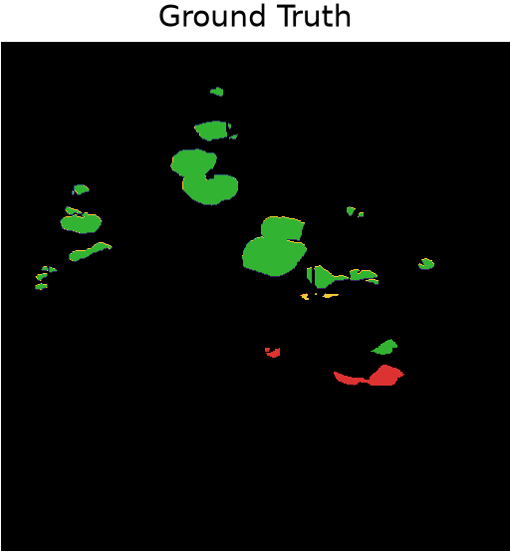
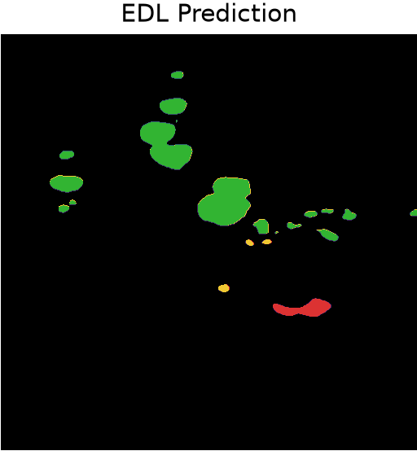
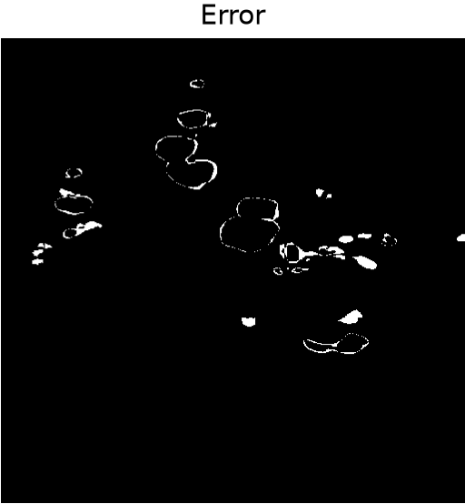
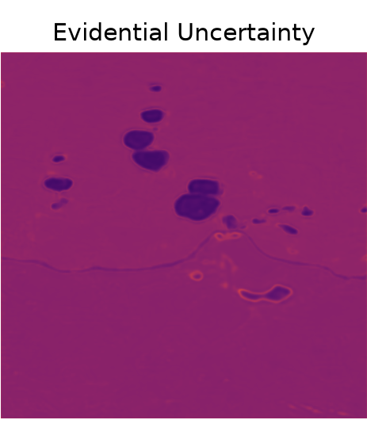
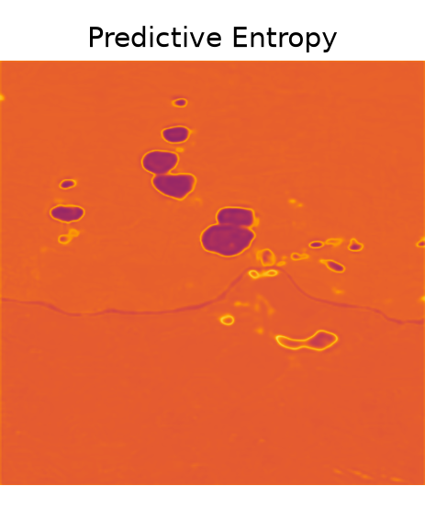
Findings (Evidential Deep Learning)
Example eval-split image (ID 1600938543151239). Evidential uncertainty stays low across most of the frame and rises mainly at ripe-pepper boundaries and the occluded region, tracking predictive entropy closely and matching where the prediction disagrees with ground truth.

Slide 8
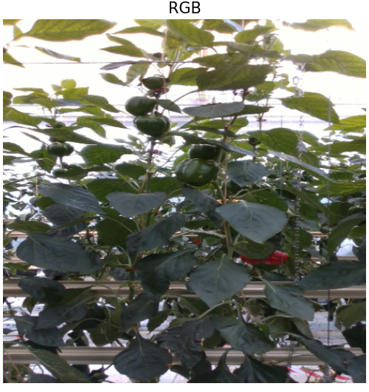
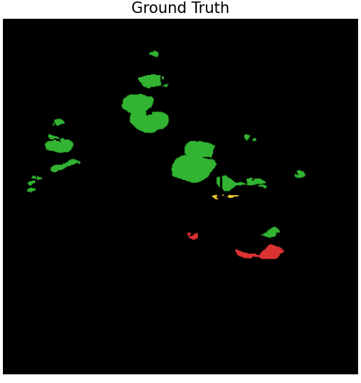
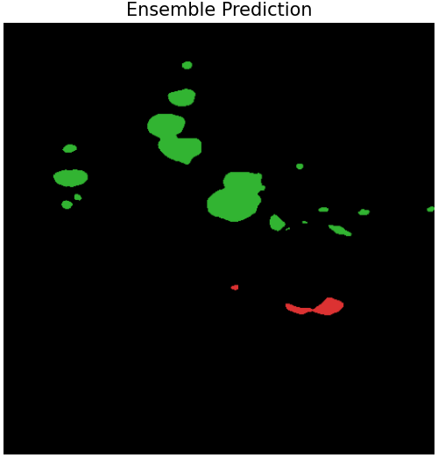
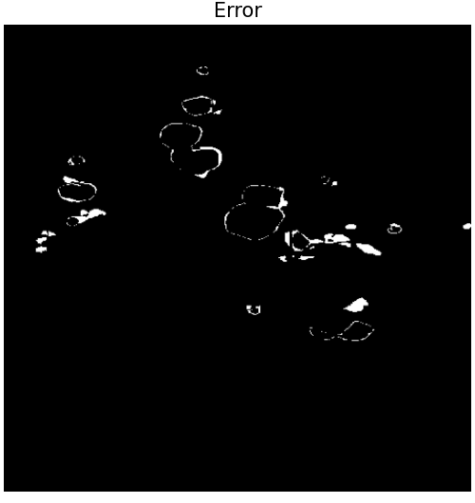
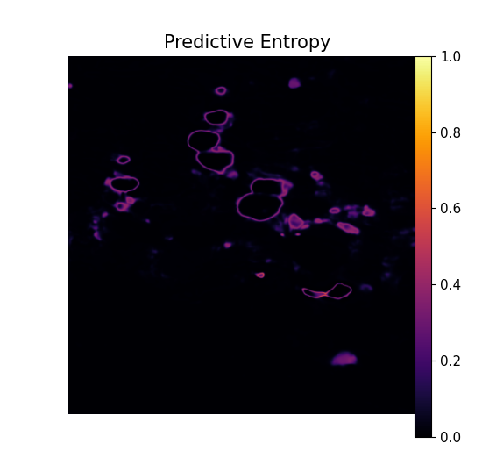
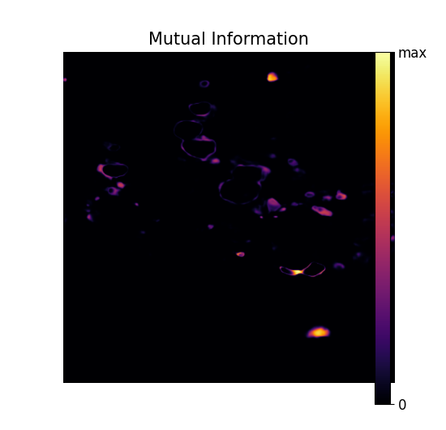
Findings (Deep Ensembles)
Example eval-split image (ID 1600938543151239), 5-member ensemble. Predictive entropy and mutual information both concentrate on pepper boundaries, exactly where the ensemble errs (foreground error-detection AUROC 0.73 / 0.70), and foreground mIoU improves to 0.540 from the single baseline model's 0.478.

