Slide 1


SMART INDIA HACKATHON 2025
Problem Statement ID – SIH25045
Problem Statement Title- Blockchain-Based Supply Chain Transparency for Agricultural Produce
Theme- Agriculture and Food Tech
PS Category- Software
Team Name (Registered on portal)-Bits Biters

Slide 2

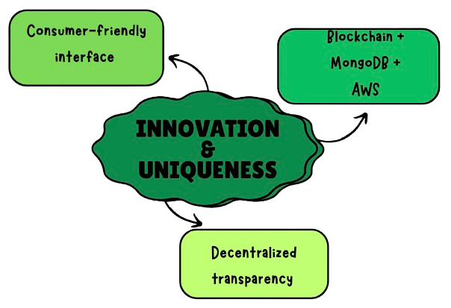
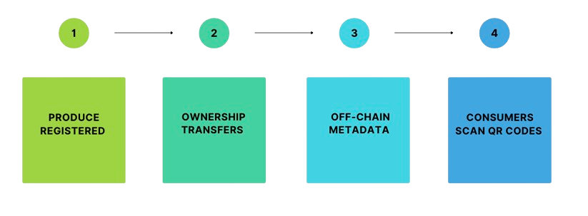
AgriChain
Bits Biters
Proposed Solution:
- A blockchain-based system to track agricultural produce from farm to consumer.
- Ensures transparency in pricing, quality, and origin.
- Allows stakeholders to verify transactions and reduce exploitation.
Innovation & Uniqueness:
Detailed Explanation:

Slide 3
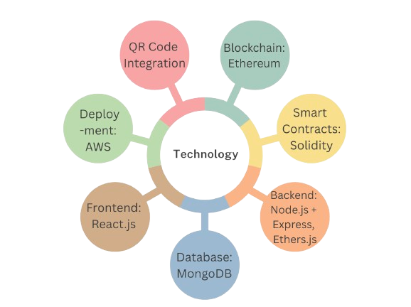
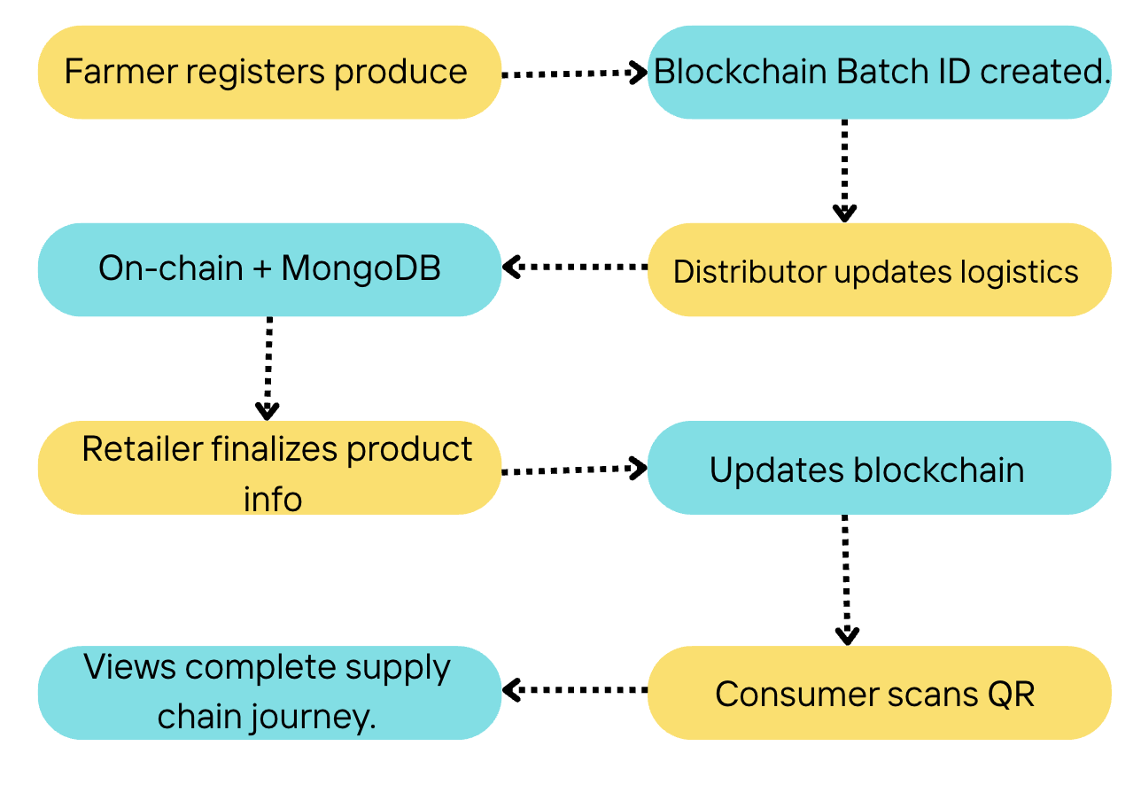
TECHNICAL APPROACH
Bits Biters
Methodology:
Technologies to be used

Slide 4
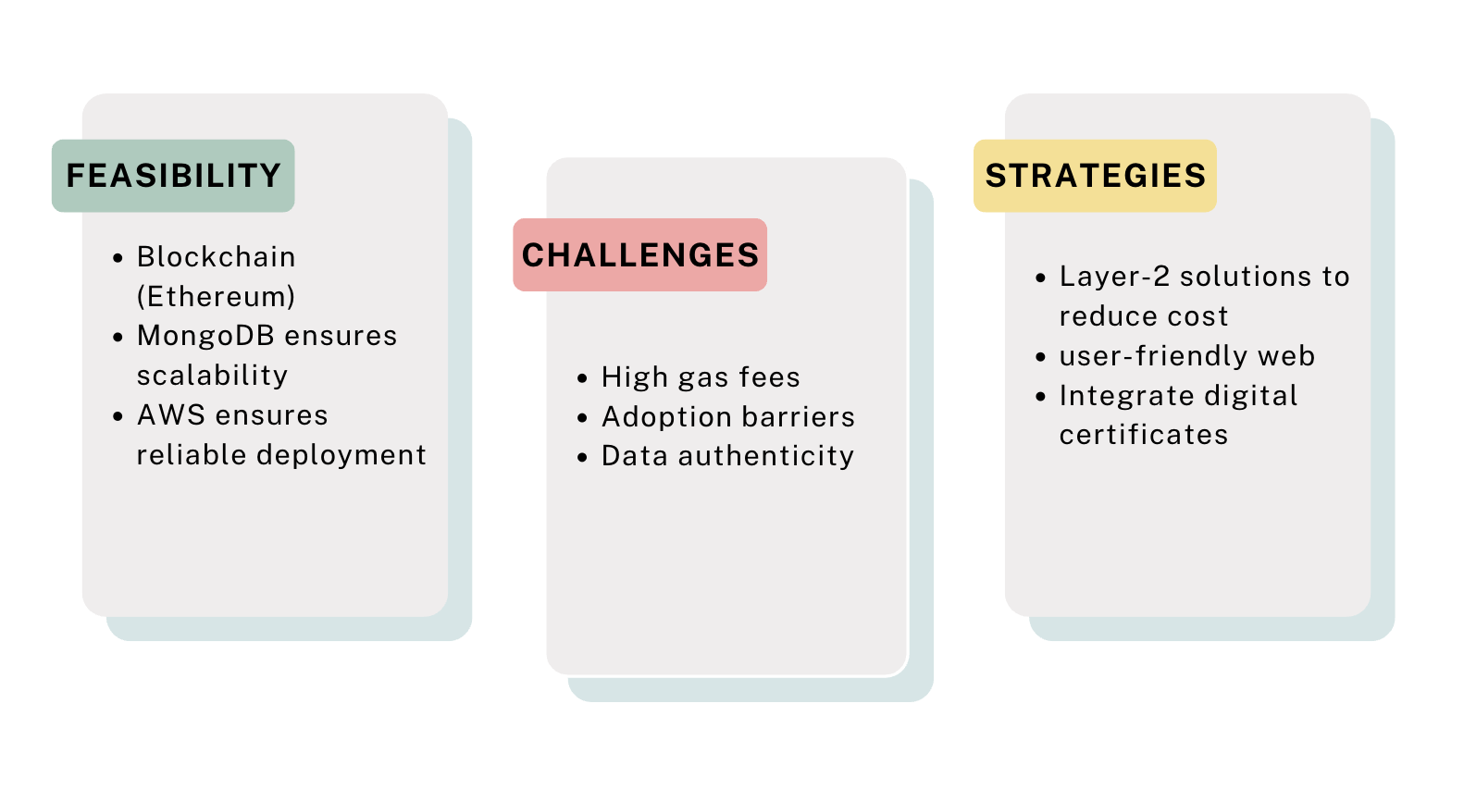
FEASIBILITY AND VIABILITY
Bits Biters

Slide 5
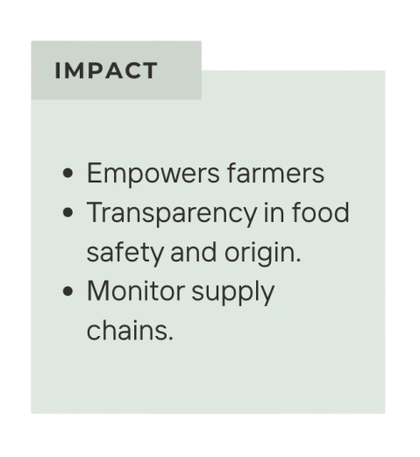
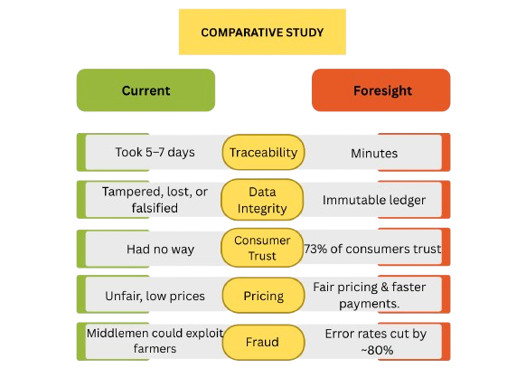

IMPACT AND BENEFITS
Bits Biters

Slide 6
RESEARCH AND REFERENCES
Bits Biters
SiLKe Project – Germany’s blockchain food traceability initiative.
Tracifier (Hamburg-based startup for agri traceability).
Hardhat documentation.
Ethereum & MongoDB official docs.
AWS deployment best practices for blockchain apps.

