Slide 1
Pedestrian Sign Detection
Team: S Sankara Subramanian, Muhammed Kaif,Sanjeev Kumar Upadhyay, Arun

Slide 2
Problem Statement
Develop a solution for recognizing the hand signals provided by pedestrians and take appropriate actions on the Autonomous Vehicle.

Slide 3
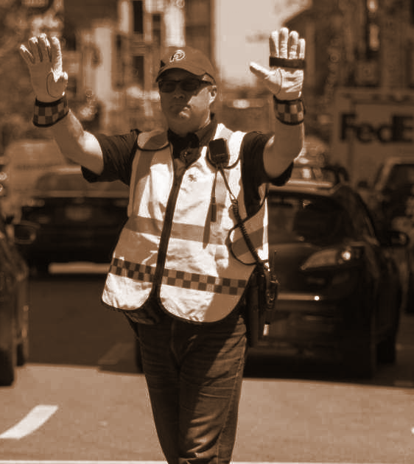
Solution
We propose to create a program to understand normal message signals and make the Autonomous Vehicle take appropriate measures.

Slide 4
How it works
Step 3
Step 2
Step 1
The video is captured with the help of OpenCV. Then keypoints from various elements are extracted using mediapipe.
These keypoints and landmarks are used to train the new model.
By using this model, the signal that the pedestrian is showing is interpreted.

Slide 5
Extraction of keypoints using mediapipe
First, the video is captured with the help of OpenCV.
The keypoints are extracted from the face, pose, left and right hand with the help of mediapipe.
Each of these keypoints are connected with the help of mediapipe drawing utilities and the Holistic model is created.

Slide 6
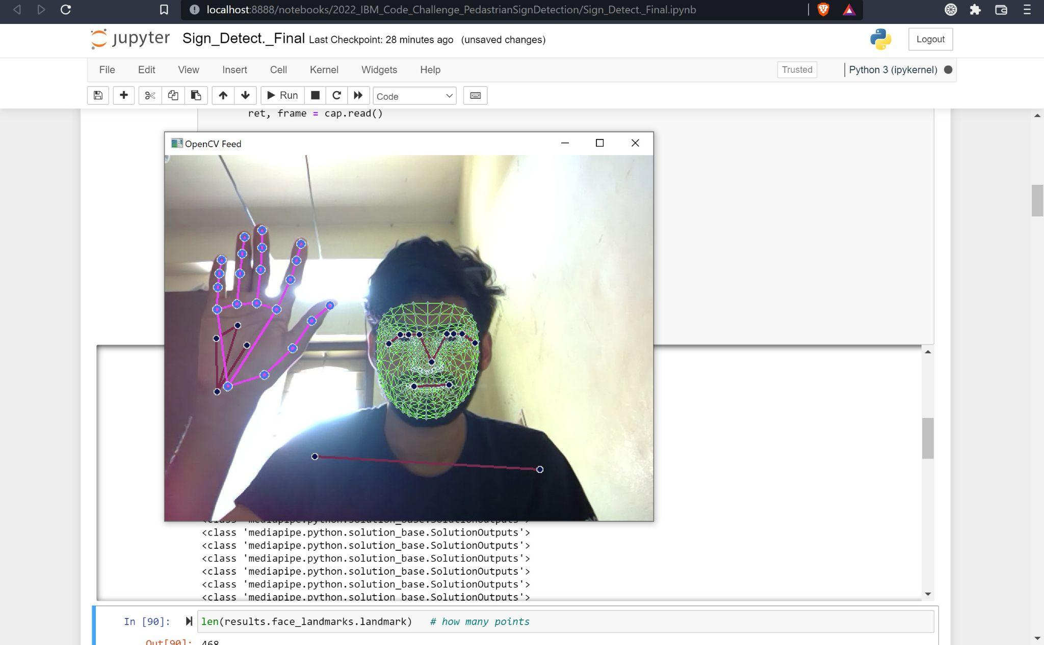
Fig 1. Extracting Keypoints using Mediapipe.

Slide 7
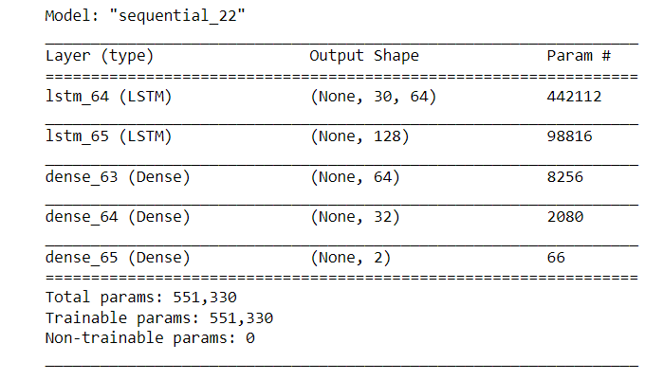
Build and Train LSTM Neural Network
Build the LSTM model and used for training.
Fig 2. Model Parameters.

Slide 8
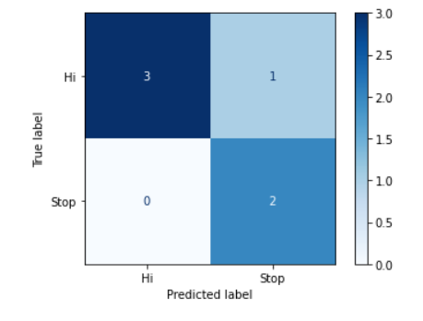
Evaluation using Confusion Matrix and Accuracy
Model is evaluated using Confusion Matrix and accuracy is analyzed.
Fig 3. The Confusion Matrix.

Slide 9
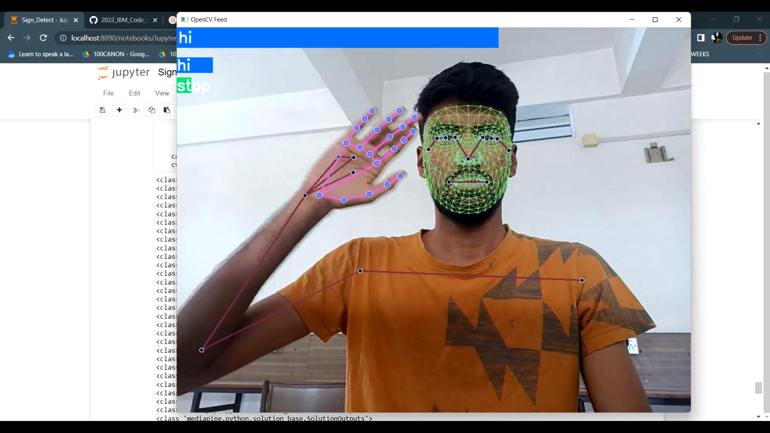
Test in Real Time
The results are tested in Real Time.
Fig 4. Testing Of ‘HI’ signal.

Slide 10
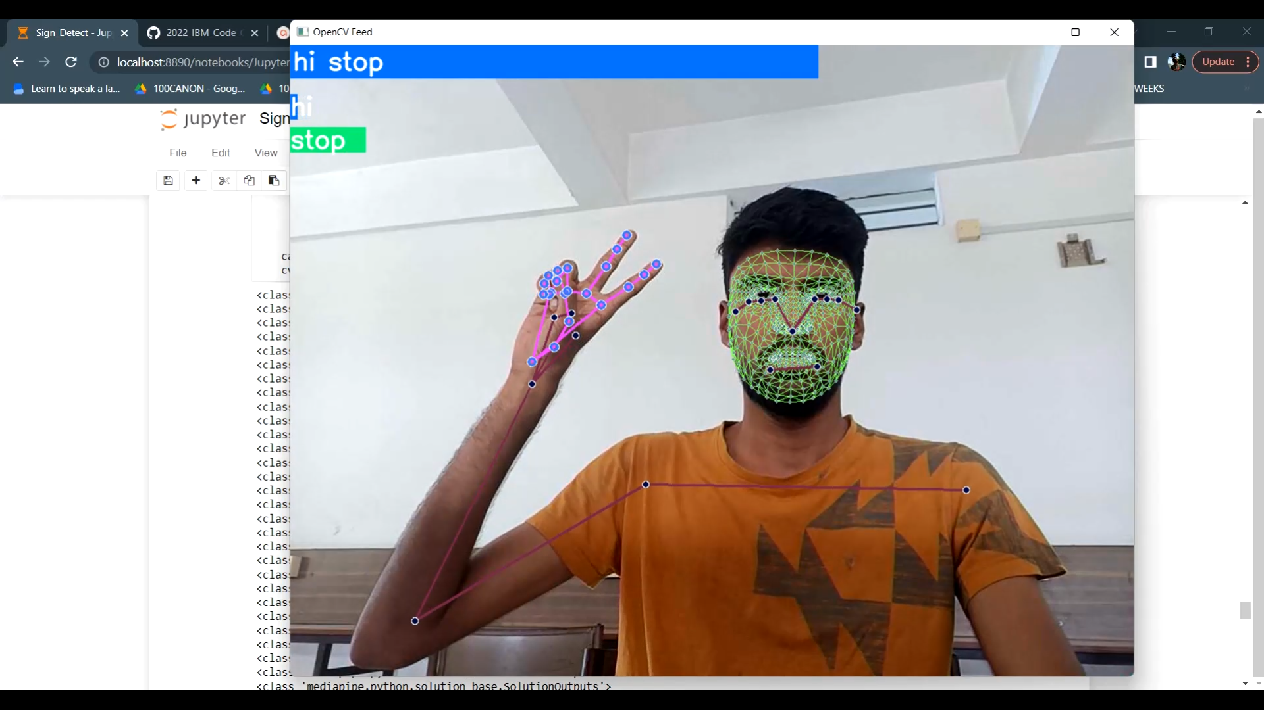
Fig 5. Testing of ‘STOP’ signal.

Slide 11






Tools Used
Jupyter Notebook
Python
Tensorflow
Opencv
Keras
Scikit learn

Slide 12
Links
Github : https://github.com/S-Sankara/2022_IBM_Code_Challenge_PedastrianSignDetection.git
Readme: https://github.com/S-Sankara/2022_IBM_Code_Challenge_PedastrianSignDetection/blob/main/README.md

Slide 13
Contributions
Sanjeev - Collection of Dataset.
Muhammed Kaif - Extraction of keypoints using mediapipe.
S Sankara Subramanian - Model building and training.
Arun - Verification and modification.

Slide 14
Thank you!

