Slide 1
Gender Detection Project
BY
NISHANTH JS

Slide 2
Project Overview
Objective: Develop an AI-based system to detect gender from facial images.
Real-Time Processing: Processes live video streams or image inputs.
Core Technologies: Deep Learning and Computer Vision.
Pre-trained Model: Caffe deep learning model for classification.
Application: Can be used in security systems, social apps, and more.

Slide 3
Technologies and Workflow
Programming Language: Python for scripting and control.
Libraries: OpenCV for image processing, NumPy for data handling.
Deep Learning Framework: Caffe for loading the gender detection model.
Workflow:
Capture image/video input.
Detect and preprocess the face.
Apply the Caffe model for classification.
Display detected gender on the output.

Slide 4
Implementation and Challenges
Setup:
Install OpenCV, Caffe, and required libraries.
Load the pre-trained model (gender_net.caffemodel).
Key Challenges:
Handling low-light or poor-quality images.
Ensuring real-time performance with optimized processing.
Avoiding bias by using a diverse dataset.
Integration into different platforms (e.g., mobile/web).

Slide 5
Results and Future Scope
Results:
Achieved high accuracy through extensive testing.
Metrics: Precision, Recall, F1 Score (e.g., ~90% accuracy).
Successfully detects gender in real-time from webcam feeds.
Future Scope:
Enhance accuracy with larger, more diverse datasets.
Add features like emotion or age detection.
Develop a mobile app or cloud-based service.

Slide 6
Conclusion and Q&A
Conclusion:
Developed an AI system for accurate, real-time gender detection.
Utilized Deep Learning and Computer Vision technologies effectively.
Potential applications in security, marketing, and social analytics.
Q&A:
Invite questions from the audience.
Thank you

Slide 7
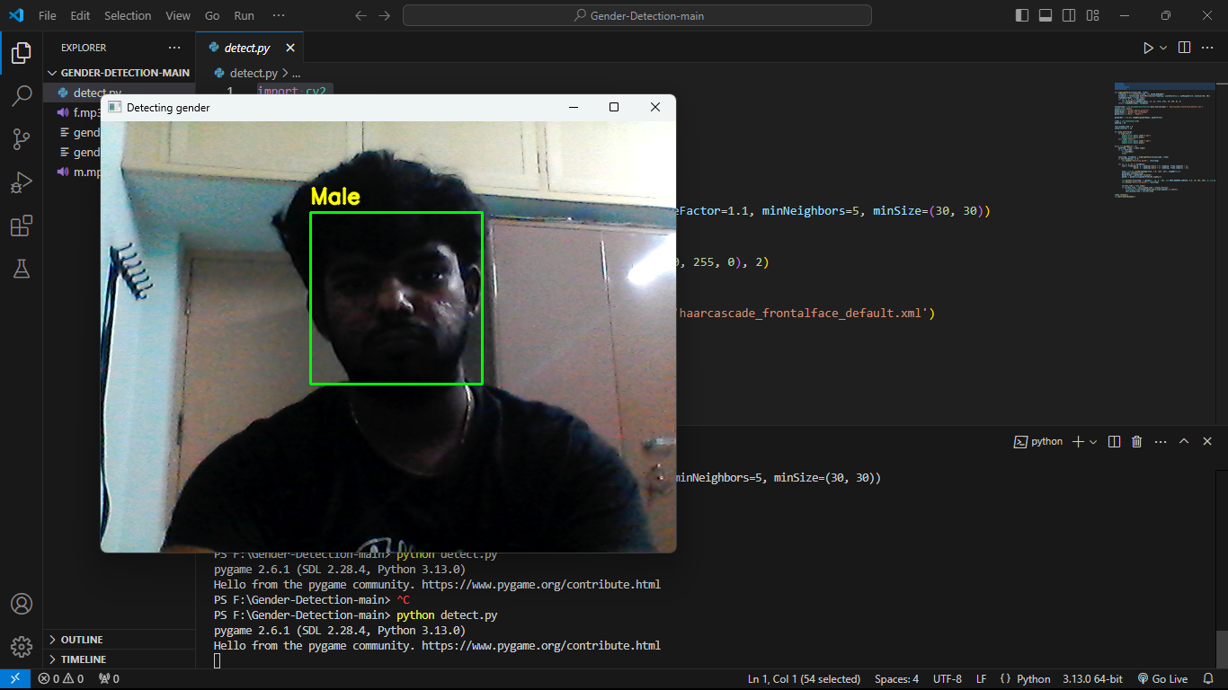
OUTPUT:

