Slide 1
Autonomous Wheelchair with a storable map-generation system
Presented by,
S.Silvan
V.Surendar
S.Thirunavukkarsu
Guided by,
Ms.S.Madhavi.,M.E

Slide 2
Content
Abstract
Aim
Objective
Problem statement
Literature survey
Exiting system
Disadvantages
Proposed system
Advantages
Architecture diagram
Hardware requirements
Software requirements

Slide 3
Modules description
Screenshot
Conclusion
References

Slide 4
Abstract
Physically handicap people depend upon a wheelchair for navigation which restricts their mobility to a short-range mostly within indoors. The system must be manually controlled else map must be created and stored by the developers for navigation in an indoor location autonomously. All the user needed indoor map is difficult to create by a developer where he must be aware of the blueprint. We are proposing a solution where the system can generate an storable map based on which the user can navigate autonomously in the stored map location. The system perceives the environment through sensor data and constructs a 2D map and a path graph that consists of nodes to track walls, intersections, and rooms. Pathfinding algorithm is used to find the path between the current position and destination and the path is used to navigate to the destination autonomously.

Slide 5
Aim
Our aim is to develop a storable map generation algorithm for an autonomous wheelchair to navigate in map less indoor location autonomously.

Slide 6
Objective
To develop a storable map generation algorithm for Autonomous wheelchair.
Reduction of the time and cost required to develop a map.
Improving autonomacity for frequently accessing areas.

Slide 7
Problem statement
Provide handicap people to drive the wheelchair autonomously.
In general autonomous wheelchair depends upon the map developed by the developer, thus it requires manual input from the user to navigate in the mapless environment.
Our system overcomes this by tracing the path of Autonomous wheelchair while visiting and use it to generate a storable map by itself which can saved and used in frequently accessing areas.

Slide 8
Literature Survey
Sateesh Reddy Avutu, Dinesh Bhatia and B. Venkateswara Reddy (2016) ‘Design of low-cost manual cum Electric-powered wheelchair for Disabled person’s to use in indoor’.
Approach:
This paper presents employement of Mechanical lever and gear box system. The lever is used to change mode of operation and the gear box system is used, to establish the contact between wheels of the wheel chair and two DC motors. The calculated result shows the robustness of the manual cum powered wheelchair design. Based on the result we ensure that the proposed wheelchair will improve the quality of the life of the elderly people and those with disabilities.
Disdvantages:
It requires manual commands for operation. Through slight modifications we can make the system autonomous which will make the system more convenient to the user.

Slide 9
Khyati Meena ,Shubham Gupta and Vijay Khar (2017) ‘Voice Controlled Wheelchair’.
Approach:
The powered wheel chair depends on motors for locomotion and voice recognition for command. The circuit comprises of an Arduino, HM2007 Voice recognition module and Motors. The voice recognition module recognizes the command by the user and provides the corresponding coded data stored in the memory to Arduino Microcontroller. Arduino Microcontroller controls the locomotion accordingly. The wheelchair also has provision for joystick for physically disabled people who can move their hands.
Disadvantage:
One problem with voice control is that the voice’s limited bandwidth renders it impossible to make frequent small adjustments to the wheelchair’s velocity.

Slide 10
Harkishan Singh Grewal, Neha Thotappala Jayaprakash, Aaron Matthews, Chinmay Shrivastav, and Kiran George (2018) ‘Autonomous Wheelchair Navigation in Unmapped Indoor Environments’.
Approach:
A novel approach to selecting a destination for an autonomous wheelchair in an unmapped indoor environment using a camera, ranging LIDAR, and computer vision is presented. The system scans the environment at startup and compiles a list of possible destinations for a user to easily make an selection. The proposed system was tested in a simulated shopping mall environment where destinations included various stores. The computer vision system was tested with images of store-fronts at various distances and angles.
Disadvantage:
Using Wi-Fi Fingerprinting Localization can give better results than this method hence this method will take more time for path finding using computer vision.

Slide 11
Tarun Debnath, AFM Zainul Abadin & Md. Anwar Hossain (2018) ‘Android Controlled Smart Wheelchair for Disabilities’.
Approach:
This paper describes a control technology of wheelchair which may feel more flexible than traditional joystick controlled one. The main objective of our research is to develop new control architecture for a motorized wheelchair as well as an embedded system for monitoring critical patients. Controlling is possible by android operated mobile or tab. In addition to button control, motion sensor controlling mechanism also has implemented. If the patient is in hostile condition, the wheelchair will produce an alert by raising the alarm with the measurement of the heartbeat at a particular interval.
Disadvantage:
Inclusion of the storeable map generation system can make it more efficient to navigate independently in emergency situation to nearby hospitality.

Slide 12
Behnam Irani, Jingchuan Wang and Weidong Chen (2018) ‘A Localizability Constraint-Based Path Planning Method for Autonomous Vehicles’.
Approach:
A localizability constraint (LC)-based path planning method for autonomous vehicles which plans the navigation path according to LRF sensor model of the vehicle in an effort to maintain a satisfactory level of localizability throughout the path, as well as to reduce the overall localization error. This method is not limited to any specific algorithm in the optimization stage. Paths planned with and without LC are compared, and the influence of the LRF sensor model on planning outcomes is discussed through simulations.
Disadvantage:
SLAM along with Kalman filtering and particle filtering algorithms based localization is more efficient than Constraint-Based planning method and considered to be with less localization errors.

Slide 13
Wenjing Li, Dan Hu and Zhiyong Lin (2018) ‘Indoor Space Dimensional Model Supporting the Barrier-free Path-finding’.
Approach:
A three-layer indoor space dimensional model, it contains geometric information, topological information and semantic information based on several traditional indoor space models. First geometric information, topological information and semantic information were extracted from the source data. Then the general semantic description of the indoor space and the topological relations of indoor space components were constructed. The three layers of information were merged into a dimensional model, which was the basis for indoor path planning in different scenes.
Disadvantage:
It requires more processing power due to generation of three layer of the indoor space dimensions. Hence, other major operation of the system can slow down.

Slide 14
Ananthakrishnan D.S, Jishnu Prakash K, Renjith R and Dr.Ansamma John (2019) ‘Autonomous Indoor Navigation for Wheelchairs using Signboards’.
Approach:
An autonomous indoor navigation system for wheelchairs based on sign board recognition. The system uses a deep learning model to detect signboards from surroundings and Azure Text Analytics API is used to extract the text from the signboard images. The system runs on a Raspberry Pi minicomputer and can be installed on any powered wheelchair.
Disadvantage:
Development of such system are expensive.Hence it cannot be afforded by most of the people.

Slide 15
Rami Alkhatib, Afif Swaidan, Jana Marzouk, Maher Sabbah, Samir Berjaoui and Mohamad O.Diab (2019) ‘Smart Autonomous Wheelchair’.
Approach:
Smart wheelchairs are an assistive wheeled mobility device. Wheelchair made it easier for many to pursue their life activities including education, work and social life. A smart autonomous wheelchair is developed in this paper to enhance the maneuvering tasks. The wheelchair requires no human intervention during navigation and perception in addition to processing which is based on computer vision techniques.
Disadvantage:
Can be only operated in stored map location. Including map generation and storing algorithm will make it more reliable and efficient.

Slide 16
Hassan M. Qassim and Heba Lakany (2019) ‘Virtual Environment Modelling using Simulated Laser Scanners’.
Approach:
A semiautonomous electric wheelchair that has capabilities of navigating through various environments which include different types and sizes of obstacles. This paper describes a methodology to use a range laser scanner mounted on an electric wheelchair to map different environments. The electric wheelchair is simulated in a virtual environment. Mapping the environment is dependent on the information provided by the range laser. An algorithm was developed in MATLAB to record the data received by the range laser and use the data to map the environments and produce a 2D map. The suggested algorithm has been tested using two virtual environments representing rooms with different features. The results showed that range laser scanner can be used on an electric wheelchair platform for efficient mapping of the environment.
Disadvantage:
Including our map storable algorithm can give make the system more efficient in autonomous navigation.

Slide 17
Jose Victorio Salazar Luces, Kengkij Promsutipong and Yasuhisa Hirata (2020) ‘Indoor Way finding for an Electric Wheelchair Based on Wi-Fi Fingerprinting Localization’.
Approach:
A method to enable the device to navigate toward the user upon request by using onboard sensors and the existing Wi-Fi infrastructure. Specifically, A map created with the Received Signal Strength Indicator (RSSI) of existing Wi-Fi access points (using a method called Fingerprinting). When a user requests an assistive device, the RSSI values at the user’s position are sent to it, and the device determines the rough position of the user using a KNN algorithm. However, typical Fingerprinting methods are affected by infrastructural changes which alter the profile of RSSI values at each location. Therefore, that the map is constantly updated while the device moves in order to avoid errors due to changes in the infrastructure. The request originated with an error of 2.612 m, and it was able to navigate towards it
Disadvantage:
These systems are still quite expensive, and having this system implemented is difficult

Slide 18
Existing system
The existing system requires map as input to navigate autonomously in unknown indoor.
A map is created and stored by the developer for navigation in indoor autonomously.

Slide 19
Limitations
High cost
Requires map to navigate autonomously
High execution time
Performance issues

Slide 20
Proposed system
Our proposed system creates a storable map by itself by tracking the path.
The map can be stored temporarily or permanently.
The stored map can be used for navigating autonmously without manual input.

Slide 21
Advantages
User can create his own map without any prerequisite knowledge.
Requires less time and memory space.

Slide 22
Architecture diagram
Arduino
Microcontroller
User
Ultrasonic Sensor
Authentication
Motor Driver
Controller
DC Motor
Localization
Hardware Interface

Slide 23
Hardware requirements
Arduino microcontroller (UNO R3)
Ultrasonic sensor (HC-SR04)
DC motor (1A)
Battery (12V)
Bluetooth (HC-05)
Map generator

Slide 24
Software requirements
Python IDE
Arduino IDE

Slide 25
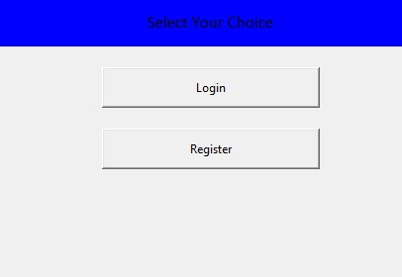
Authentication
Authentication in the system is carried out in two phase as follows, Password based Authentication for sign in and OTP based Authentication for registering a new user.
The password gets encrypted and decrypted using bcrpyt encryption and decryption algorithm

Slide 26
Controller
A Centralized system needs to control all the operations of the system to make it more reliable and efficient. The controller acts as the centralized system communicates with all other modules.
After successful authentication, the controller module gets initialized. The computer-user interaction is carried out in this module.
In the map generation phase, the system operates in manual mode where the user has to control the system. While navigating in manual mode the system creates a map by interacting with the map generation module.
If the user chooses to load the map the user is requested to enter the destination node from the displayed graph-structured map. The sytem will obtaining the path and navigate to the destination.
Obstacle avoidance is the task of satisfying some control objective subject to non-collision position constraints.The obstacle detection system can detect both static and dynamic obstacles. Obstacles are detected through the data perceived from an ultrasonic sensor mounted at the front. While right and left turn the obstacle is detected using the side-mounted sensors.

Slide 27
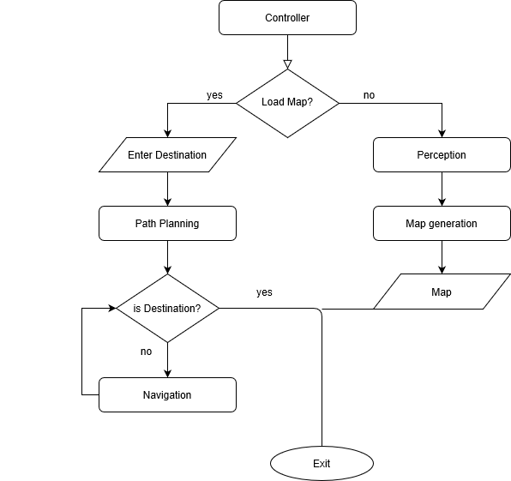
Flow diagram of Controller

Slide 28
Hardware Interface
Hardware interface acts as the middleware between the hardware and software it handles Perception and Navigation of the wheelchair. Its role is to send navigation instructions and receive sensor data from the hardware which is required to generate a map.
Navigation of the wheelchair can be classified into two modes as follows,
In Manual mode, the system works based on user commands. The user has to control the system via commands for each action. The user can control the system using the arrow keys in the keyboard.
In Autopilot mode, the presence of the map, the user need not control the system manually. The user has to specify the destination whereas the system plans the path from the current location to the destination. Using the path the system reaches the destination automatically.

Slide 29
Localization
Localization is a step implemented in the majority of robots and vehicles to locate with a really small margin of error. There are many different techniques to help an autonomous vehicle locate itself.
A very popular technique if we also want to estimate the map exists. It is called SLAM (Simultaneous Localization And Mapping). In this technique, we estimate our position but also the position of landmark. Its can be categorized into two major phases.
Global localization is to locate its position in the global environment. It is carried out using the sensor data perception phase. The environment is mapped through the sensor data received and the map can be used to localize itself.
The goal of pose tracking is to maintain accurate tracking of a vehicle’s pose during the whole task. The pose of the system is to be updated during each movement of the wheelchair. The map in the system is a graph structure hence the localization can be represented as x and y coordinates.

Slide 30
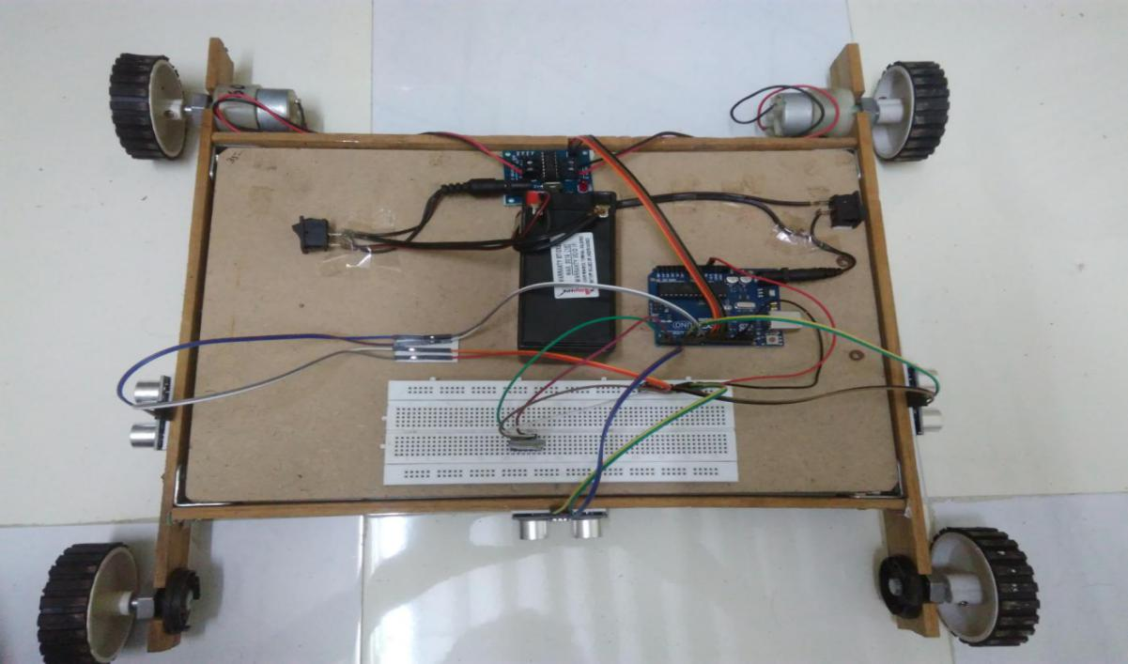
Screenshot

Slide 31
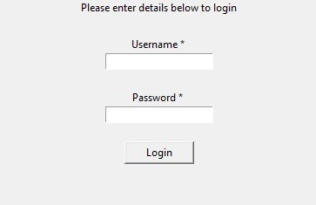
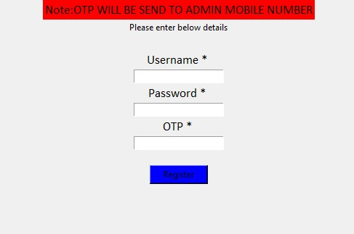

Slide 32
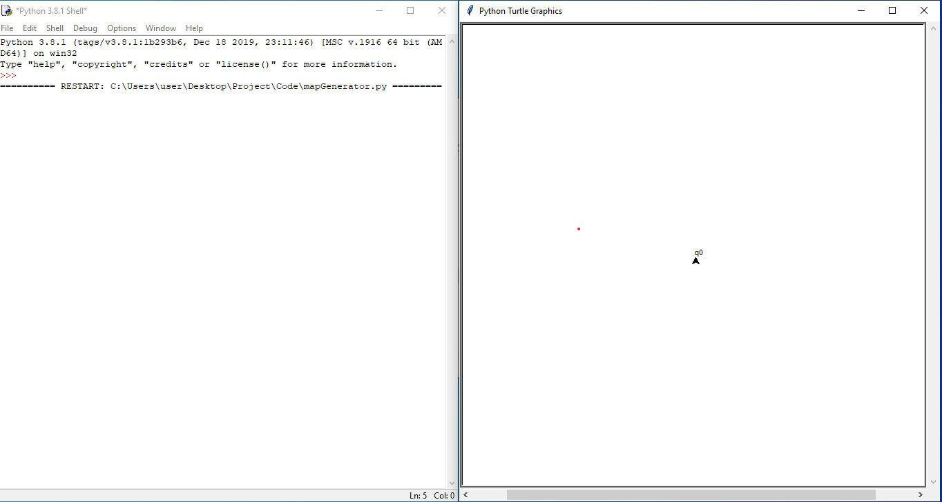

Slide 33
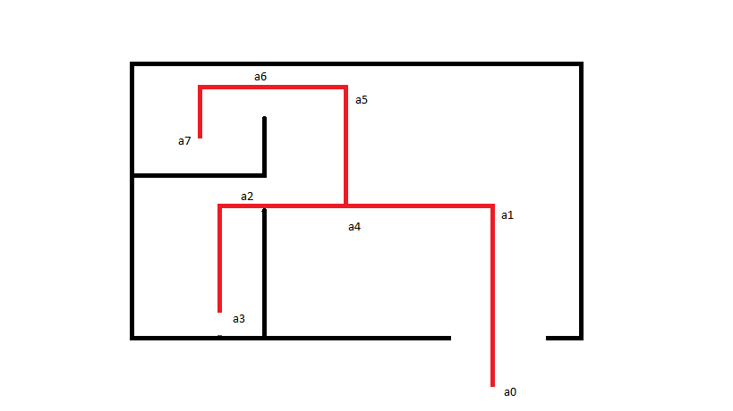

Slide 34
Conclusion
The system generates a storable map based on the path tracked by the system, thus indoor navigation can be made autonomous and improved by using the map generated by the system at minimum cost and time.
Furthermore, navigation can be made more accurate by generating a 3D map and adding computer vision to the system whereas our system cannot detect doors, tables, and chairs which can detected by including computer vision

Slide 35
Reference
Sateesh Reddy Avutu, Dinesh Bhatia and B. Venkateswara Reddy (2016) ‘Design of low-cost manual cum Electric-powered wheelchair for Disabled person’s to use in indoor’, International Conference on Next Generation Computing Technologies,pp. 178-184.
Khyati Meena ,Shubham Gupta and Vijay Khar (2017) ‘Voice Controlled Wheelchair’, 2017 2nd International Journal of Electronics, Electrical and Computational System, Volume 6,pp-23-27.
Harkishan Singh Grewal, Neha Thotappala Jayaprakash, Aaron Matthews, Chinmay Shrivastav, and Kiran George (2018) ‘Autonomous Wheelchair Navigation in Unmapped Indoor Environments’, National Science Foundation under grant no. ECCS-1150507.
Tarun Debnath, AFM Zainul Abadin & Md. Anwar Hossain (2018) ‘Android Controlled Smart Wheelchair for Disabilities’ ,Global Journal of Computer Science and Technology: G Interdisciplinary, Volume 18, Issue 1,Online ISSN: 0975-4172.

Slide 36
Behnam Irani, Jingchuan Wang and Weidong Chen (2018) ‘A Localizability Constraint-Based Path Planning Method for Autonomous Vehicles’, IEEE transactions on Intelligent Transportation Systems, ISSN:1524-9050.
Wenjing Li, Dan Hu and Zhiyong Lin (2018) ‘Indoor Space Dimensional Model Supporting the Barrier-free Path-finding’, National Science Foundation of China under Grant No. 41271449.
Ananthakrishnan D.S, Jishnu Prakash K, Renjith R and. Dr. Ansamma John (2019) ‘Autonomous Indoor Navigation for Wheelchairs using Signboards’, IEEE transactions on Intelligent Transportation Systems under Grant.
Rami Alkhatib, Afif Swaidan, Jana Marzouk, Maher Sabbah, Samir Berjaoui and Mohamad O.Diab (2019) ‘Smart Autonomous Wheelchair’, IEEE , Grant no:978-1-7281-3578-6/19.
Hassan M. Qassim and Heba Lakany (2019) ‘Virtual Environment Modelling using Simulated Laser Scanners’, 2 nd International Conference On Electrical, Communication, Computer, Power And Control Engineering ICECCPCE19, pp-143-147.
Jose Victorio Salazar Luces, Kengkij Promsutipong and Yasuhisa Hirata (2020) ‘Indoor Way finding for an Electric Wheelchair Based on Wi-Fi Fingerprinting Localization’, IEEE/SICE International Symposium on System Integration, pp-513-518.

Slide 37
THANK YOU

