Slide 1

SIT764 PROJECT ANALYSIS AND DESIGN
Project Title
Agribusiness Simulation networked application
Prepared By: Team A

Slide 2

Team members and Supervisor(TEAM A):
Wei Lou, Supervisor
Saurav Suman, Team Leader
Malyun Muhudin Hilowle, Project Owner
Sarabpreet Singh, UI Designer
Sneha Latha Talari , Frontend Developer
Ishmeen Chawla, Backend Developer
Gurjant Singh, Backend Developer

Slide 3
Description of Project:
The Yarra Ranges Tech School seeks the development of a Networked Agribusiness Simulation application to simulate the effects changing weather patterns, water availability, and increasing population have on food supply. The simulation needs to assess long‐term sustainable solutions and address key functions of distribution and sourcing. The interactive simulator shall allow for analysis of Global food markets and pitching ideas for sustainable food supply in the Tec Schools purpose built Scenario Simulation room.

Slide 4
Technologies to be used:
Backend (DevOps,SQL)
Application (PHP)
Frontend (HTML5, JavaScript)
Eclipse IDE
Other Web resources

Slide 5

Ideation:
Statistical view of the change in food supply in the form of graphs and pie charts.
Interactive UI by providing button and fields to put custom values
Collect data from multiple resources for more accuracy.
Provide various services like Register, News about weather and so on.

Slide 6
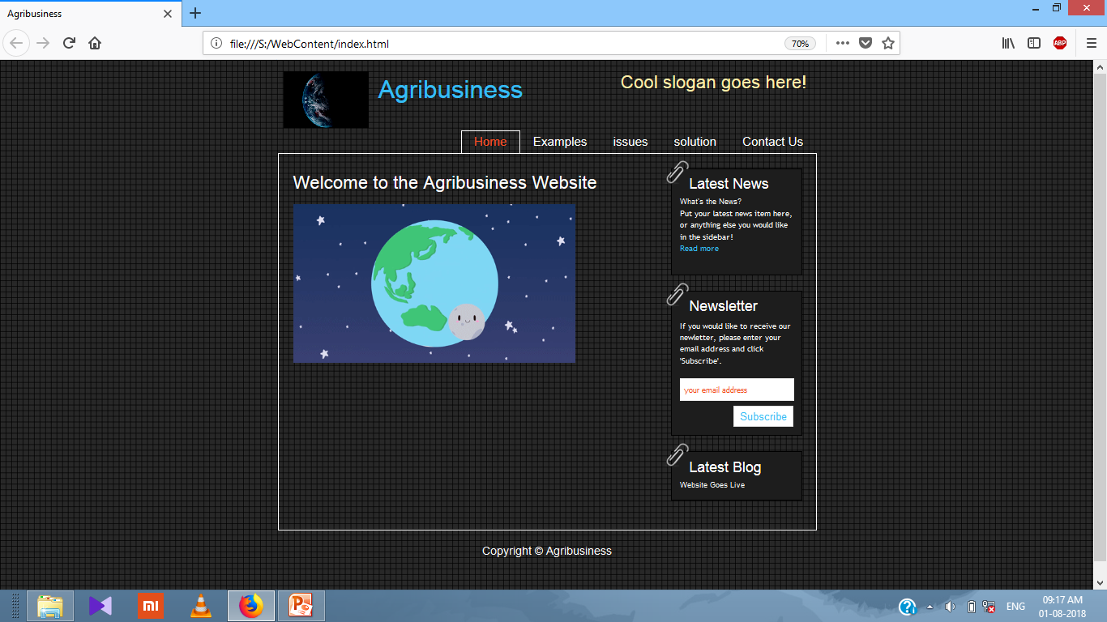
Screenshot of Ideation: Home page

Slide 7
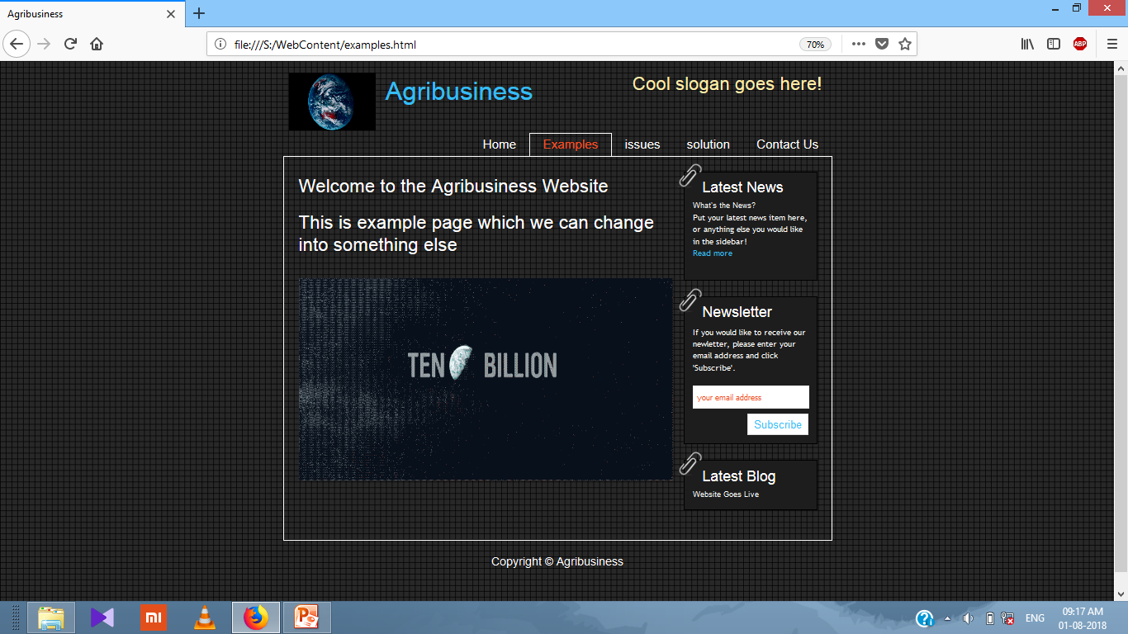
Screenshot of Ideation: Example/optional

Slide 8
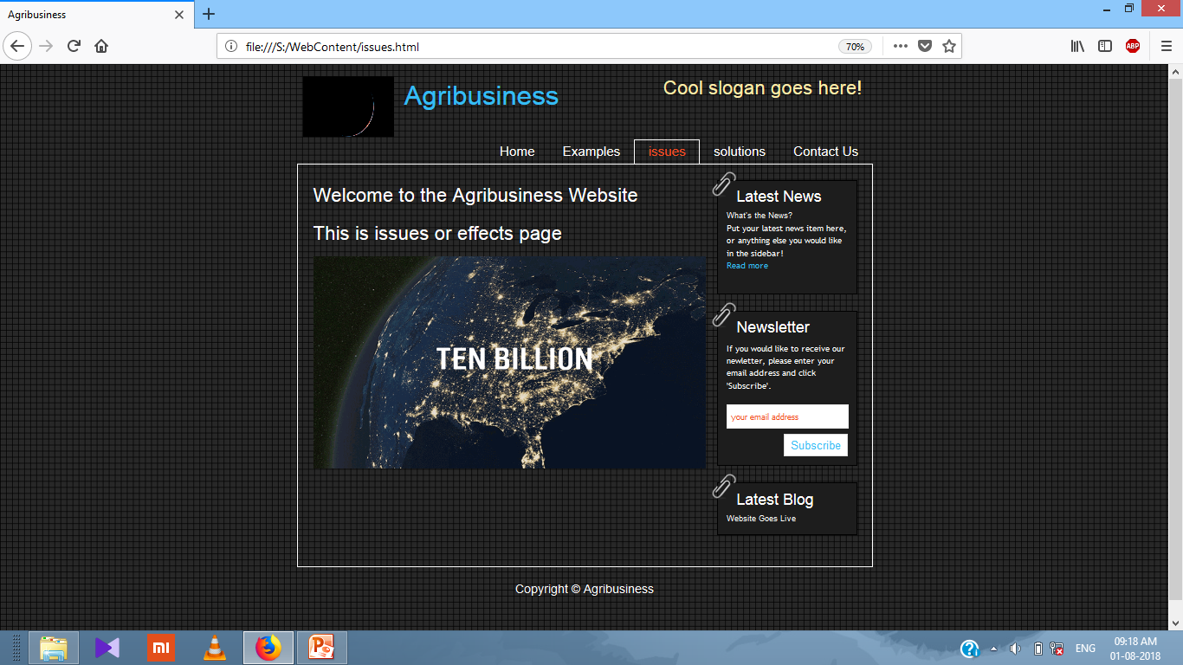
Screenshot of Ideation: Issues

Slide 9
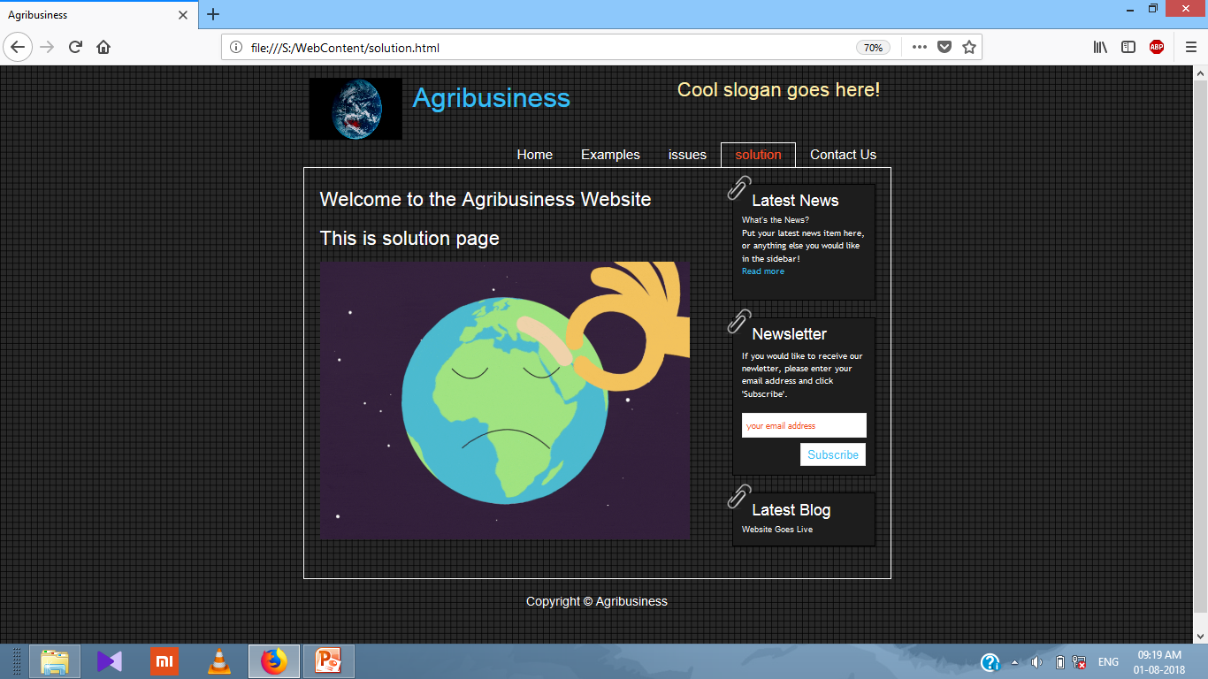
Screenshot of Ideation: Solution

Slide 10
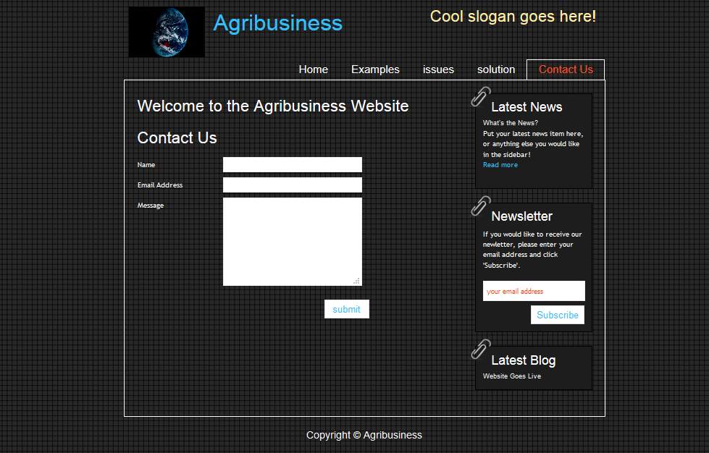
Screenshot of Ideation: Contact Us

Slide 11
Thank you…

