Slide 1

Capstone Project
Students’ Early Attrition Modelling for Clearwater State University

Slide 2
Points To Be Covered
Key Drivers of Early Attrition
Modelling
Recommendations

Slide 3

KEY DRIVERS
Early Attrition

Slide 4
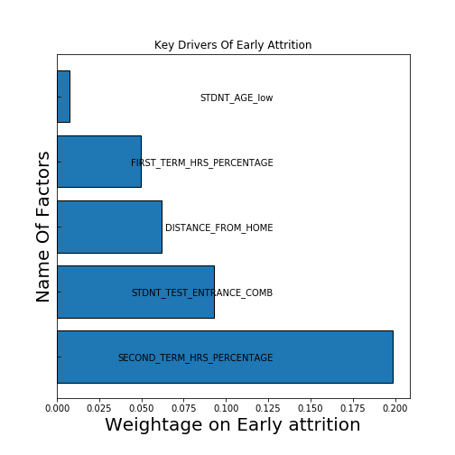
Grade Points
Students having higher percentage of Earned Hours out of Attempted hours are less likely to drop out.
Entrance Exam
Entrance Exam signifies the potential of student, to recruit better students management should consider this factor as key driver.

Slide 5
Modelling
Business Interpretation

Slide 6
AUC-Accuracy Summary
Model Name | Overall Accuracy | Area under the curve
KNN | 85.220000 | 0.520322
Bagged Trees Classifier | 81.950000 | 0.651731
Support Vector Classifier | 80.370000 | 0.580625
Gradient Boost Classifier | 80.290000 | 0.674483
Random Forest Classifier | 77.060000 | 0.668282
Naïve Bayes | 75.260000 | 0.619697
Decision Trees Classifiers | 71.470000 | 0.587116
Logistic Regression | 0.791176 | 0.672794
AdaBoost Classifier | 0.782353 | 0.654141

Slide 7
Recommended Interventions For Early
ATTRITION

Slide 8

Competitive Exam
Entrance Exam
01
Competetive Exams can be very useful to recruit potential students.
Targets Potential Students
Credit Relation Regulations
Credit System
Students struggling in grades must be targeted to provide them extra attention, and there should be periodical mandatory sessions related to career guidance.
02
Bounded Credit System
Student Age
Mental and Social Health
03
Intelligence and wisdom comes with time and experience, therefore students living alone for first time must be taken care for healthy environment.
Counselling with younger students
Distance From
Home
More Remote More Responsibility
04
Students studying far away from home (International Students)
Must feel safe and comfortable, as there could be several issues like: Ragging, Home sickness, Discrimination
Prioritized Complain
System

Slide 9
THANKS
FOR YOUR ATTENTION

