Slide 1

Scheme Eligibility Assistant
Explainable government-scheme eligibility and grounded Q&A, built on MongoDB
Team members: Nalin Ahuja, Adamya Singh Thakur
Reg. No: 2427010036, 2427010181
Submitted To: Ms. Surabhi Agrawal
Notes:
Introduce the project: a web app that tells a citizen which schemes they qualify for and why, and answers questions with citations.

Slide 2
Problem: Finding the right scheme is hard
570
Eligibility rules are buried in long scheme pages: age bands, income caps, category, land, BPL, state.
Central and state schemes all have different shapes, and rules change over time.
Citizens rely on middlemen; CSC operators screen many people by hand.
A chatbot that guesses about someone's benefits can cause real harm.
unique schemes parsed from 601 myScheme PDFs
113
457
central
state / UT
covering 34 states and UTs (Hugging Face: shrijayan/gov_myscheme)

Slide 3
Objectives
1
Eligibility checker
2
Grounded Q&A
Profile → Eligible / Ineligible / Needs more info for every scheme, a reason per rule, every check saved with a checksum
Answers only from retrieved scheme text, cites sources, refuses when unsure
3
Personal tools
4
NoSQL depth
Ranked recommendations, an application tracker with reminders, and a grievance portal
CRUD, validation, $facet / $bucket aggregation, geospatial $geoNear, arrayFilters, transactions, TTL
Notes:
Core design principle: the language model never decides eligibility. Code decides facts; text generation only explains them.

Slide 4
Why MongoDB over a relational database
Need | Relational | MongoDB
Variable-shaped schemes | Sparse columns / EAV | Flexible documents + JSON Schema
Recursive rule tree | Adjacency list + recursive CTE | Nested sub-document, one read
Audit with exact inputs | Joins to versioned tables | Embedded snapshots, no joins
Text + vector search | Extensions | Text index + vector search beside data
Atomic rule publish | Transactions | Multi-document transactions
Trade-off accepted: no foreign keys, so we enforce unique indexes, validators and insert-only versions instead.

Slide 5
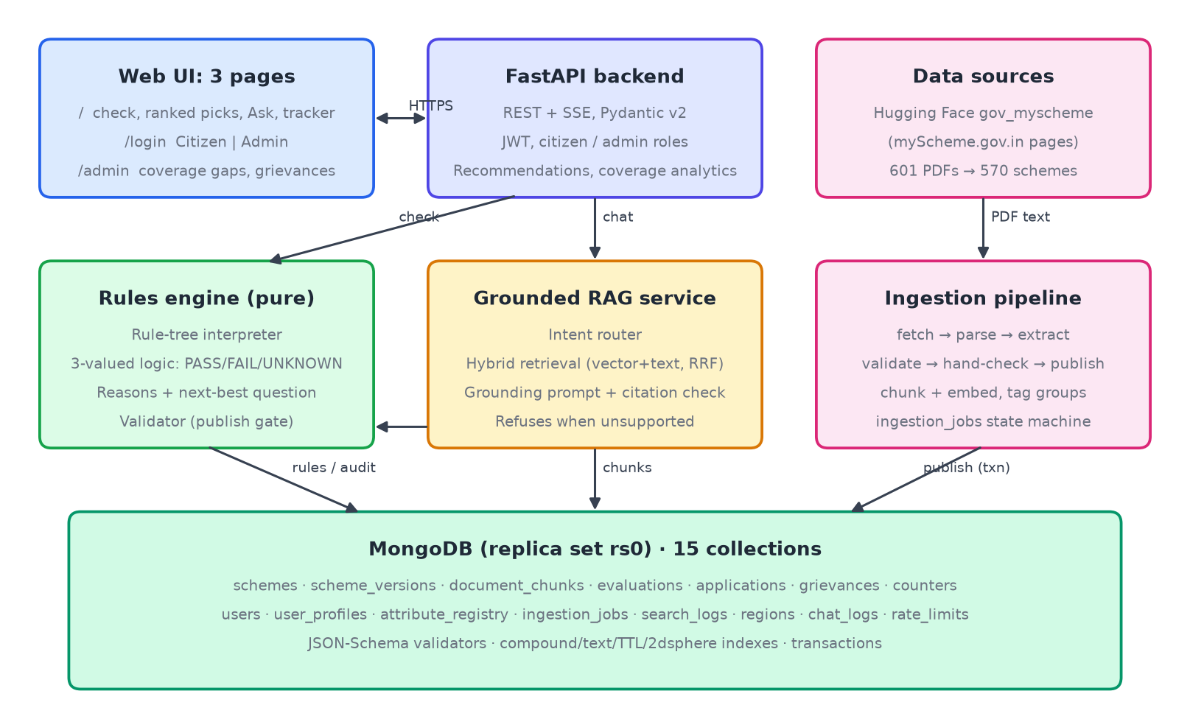
Architecture: three subsystems, one database
Notes:
Web UI talks only to FastAPI. The RAG service hands eligibility questions to the rules engine. Ingestion publishes rules only after validation and human review.

Slide 6
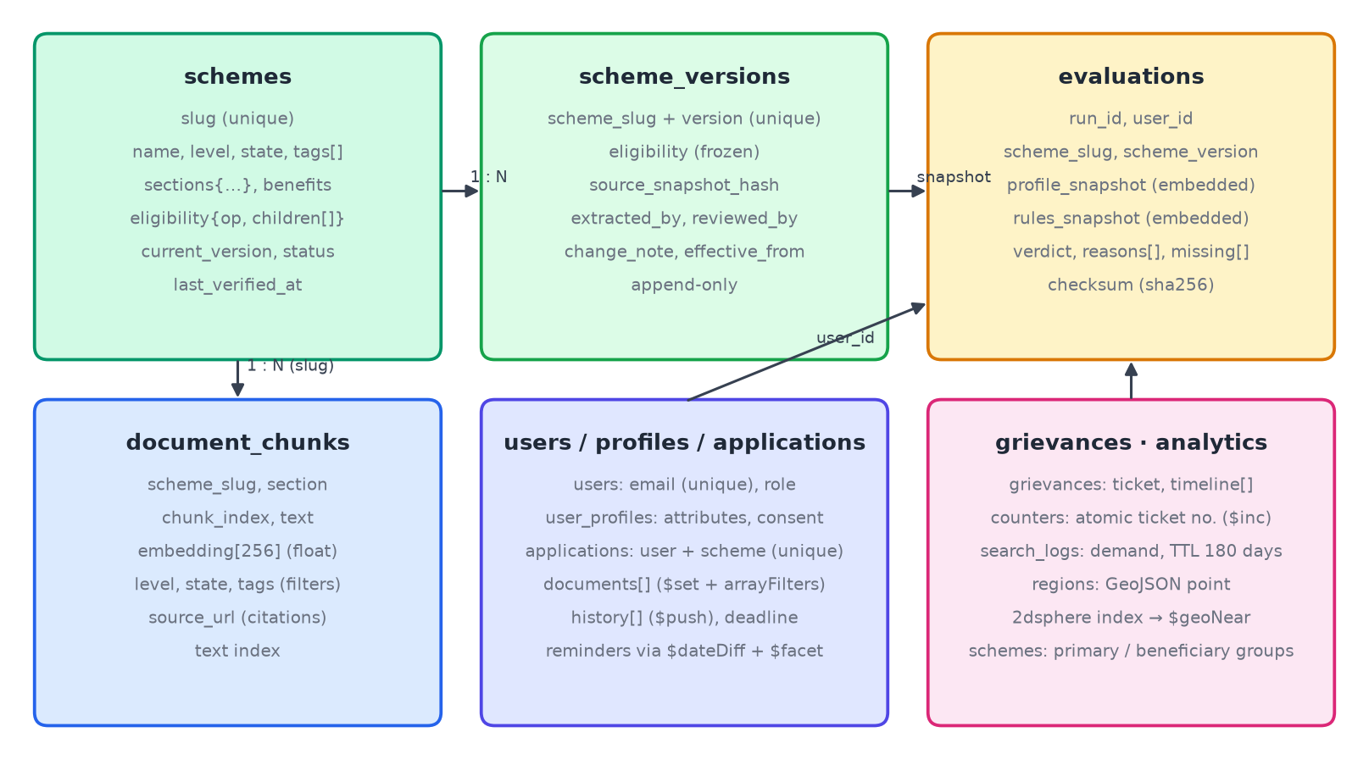
Data model: embed, reference, snapshot
Embed what is read together: scheme + its rule tree; tracker checklist + history
Reference what changes on its own: chunks, versions, applications by slug
Snapshot what must never change: each evaluation stores the rules and profile it used
15 collections; unique / compound / text / TTL / 2dsphere indexes

Slide 7
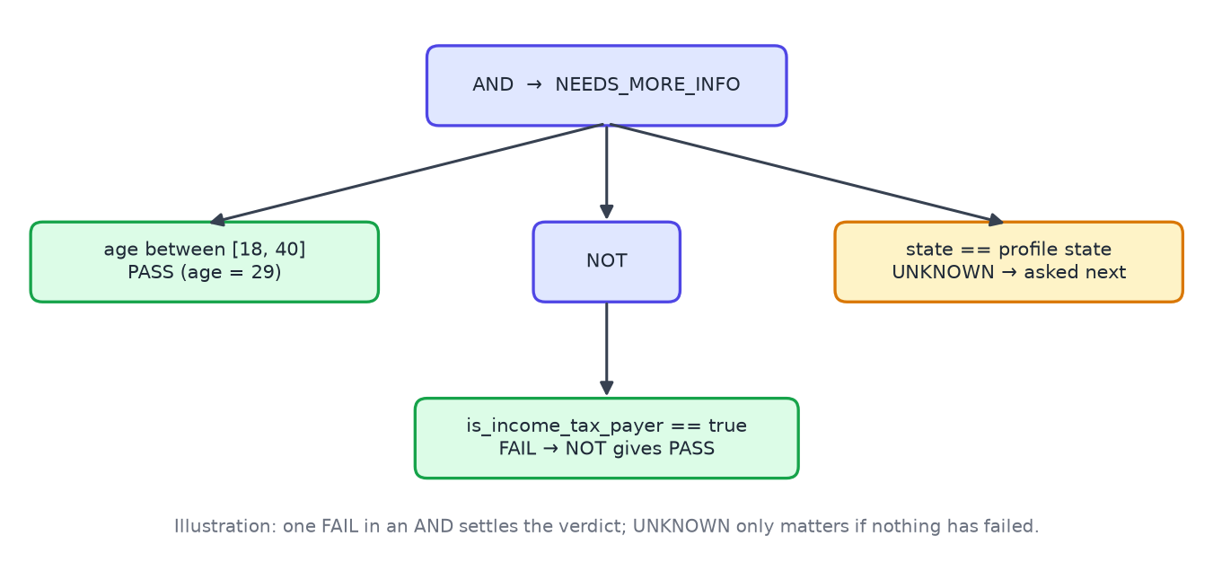
A scheme is one document
{ "slug": "apy", "name": "Atal Pension Yojana",
"level": "central", "status": "published",
"current_version": 1,
"eligibility": { "op": "AND", "children": [
{ "id": "r1", "attribute": "age",
"operator": "between", "value": [18, 40],
"source_quote": "The minimum age of joining
APY is 18 years and maximum is 40 years." },
{ "op": "NOT", "children": [
{ "id": "r2",
"attribute": "is_income_tax_payer",
"operator": "==", "value": true } ] } ] } }
Groups AND / OR / NOT nest to any depth. Every leaf keeps the sentence it came from, and the validator checks it is really in the source text.

Slide 8
CRUD across the collections
C
Create
R
Read
register · insert_many evaluations per check · version in a transaction · grievance with atomic ticket no. · save scheme to tracker
filter / text-search / paginate schemes · detail by slug · user history (index-ordered) · ranked recommendations
U
Update
D
Delete
profile ($set, upsert) · tracker status + checklist ($set with arrayFilters) · grievance reply ($push)
delete my data (profile, history, tracker) · remove checklist item ($pull) · retire a scheme (soft delete)

Slide 9
Advanced MongoDB features
JSON Schema validators
Transactions
$facet · $bucket
Database rejects bad verdicts, operators, ages
Insert version N+1 + repoint scheme atomically
Coverage gaps by state and group; reminders; dashboards
Index tuning
Geospatial + TTL
Text + vector search
ESR compound indexes, checked with explain()
2dsphere + $geoNear for nearby states; logs expire on their own
$text + embeddings merged with RRF; $vectorSearch on Atlas
Notes:
Check pre-filter: published, central or Assam: 570 → 16 docs examined
User history, newest first: 5295 → 61 docs examined
All verdicts of one run: 5295 → 15 docs examined
Audits of one scheme version: 5295 → 347 docs examined
Chunks of one scheme: 3991 → 9 docs examined

Slide 10
From scheme text to published rules
Parse PDF
Extract rules
Validate
Hand-check
Publish (txn)
909
502 / 570
16
rule leaves proposed with a source quote each
proposals pass automatic validation
hand-checked schemes published
Validator checks: registered attributes only · operator matches type · quote really appears in the source · numbers appear in the quote · no contradictory ranges. Unchecked proposals are used only as clearly labelled "unverified" recommendation hints.

Slide 11
Grounded Q&A that refuses to guess
1
Route the question
2
Hybrid retrieval
3
Grounded answer
Eligibility → rules engine; info → retrieval; off-topic → refuse. Spelling and plural matching (yojna → yojana)
Section chunks; vector similarity + MongoDB text search, merged with Reciprocal Rank Fusion
Only numbered sources, each passage must contain the question's topic words; no valid citation → refusal
The model only explains; verdicts always come from the engine.

Slide 12
Security, validation and testing
Security
Testing
• PBKDF2-SHA256 password hashes, JWT bearer tokens
• Separate Citizen / Admin login; the server checks the role
• Admin routes return 403 to citizens
• Grievances and trackers visible only to their owner
• No Aadhaar or ID numbers stored; delete-my-data
• Audit records insert-only with SHA-256 checksum
• Truth tables for AND / OR / NOT
• Property tests (Hypothesis): NOT(NOT(x)) = x
• Fixture profiles → expected verdicts
• Validator rejects invented or malformed rules
• API tests: CRUD, login roles, tracker, ranking, coverage, grievances
Last run: 122 passed, 0 failed

Slide 13
Results
100%
9.8 ms
3991
1.00
fixture verdict accuracy (35/35)
median to check all published schemes + write audit
text chunks indexed for retrieval
hybrid retrieval Recall@5

Slide 14
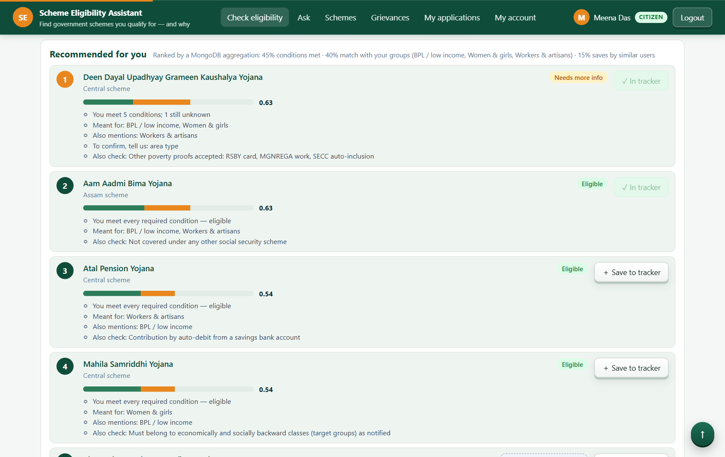
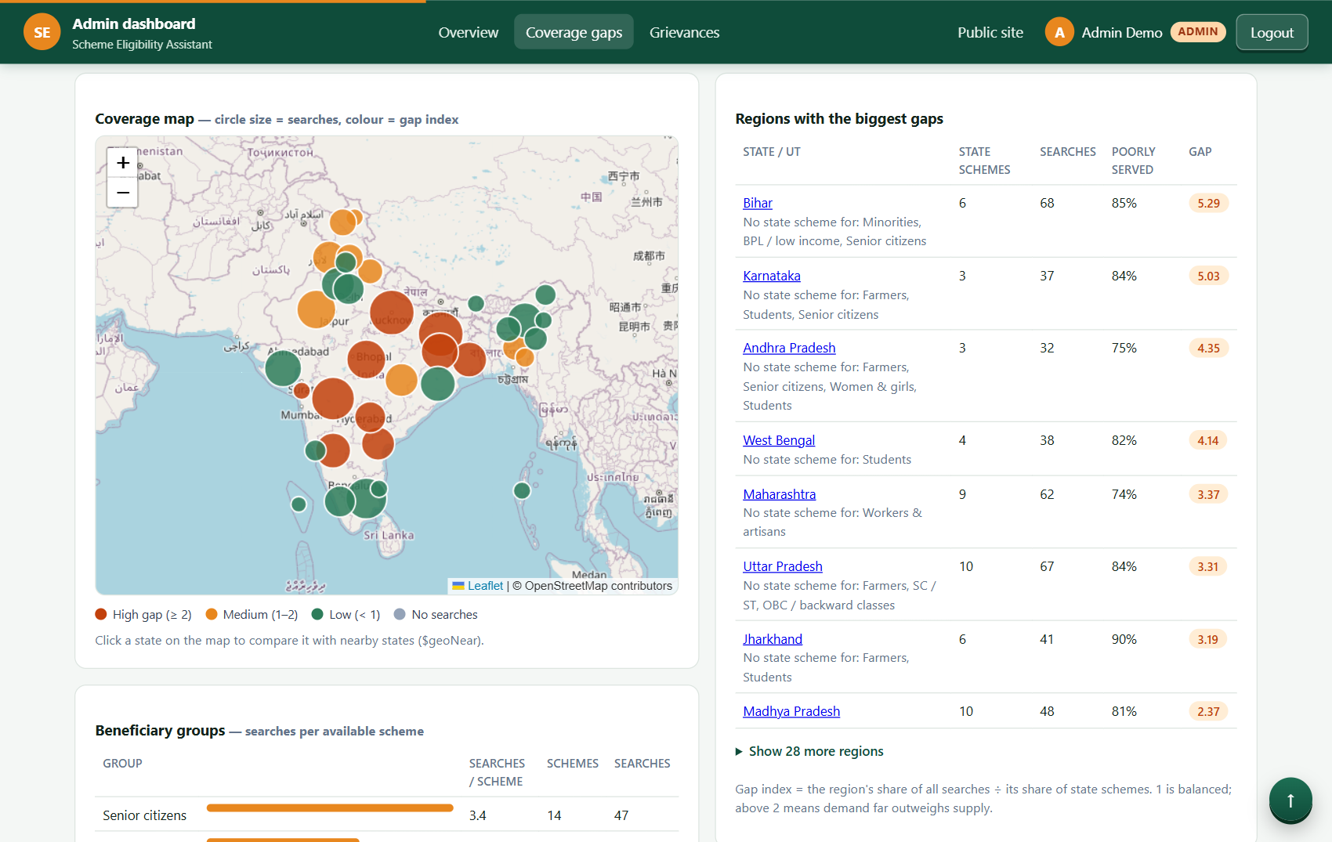
The working application
Citizen: ranked recommendations with reasons, Save to tracker
Officer: coverage-gap map and tables ($facet, $bucket, $geoNear)

Slide 15
Indexes: Documents examined per query
Notes:
Measured with explain('executionStats'); collection scan forced with hint({$natural: 1}). Every indexed plan is FETCH <- IXSCAN.

Slide 16
Conclusion and next steps
MongoDB's document model fits rule-heavy, variable government data: one document per scheme, immutable versions, self-contained audit records, plus ranked recommendations, a tracker, grievances and coverage-gap analytics built on aggregation and geospatial indexes.
Next: ingest from the official API Setu feed, add district-level data, move to Atlas Vector Search, and add a Hindi UI.

