Slide 1
SMART INDIA HACKATHON 2026 · TITLE PAGE
Smart India Hackathon 2026 · Slide 1 of 6
TideTrace: Satellite SAR Oil Spill Detection & Forensic AIS Attribution
An automated intelligence pipeline for satellite slick segmentation, 2D Lagrangian drift hindcasting, and vessel correlation.
• Problem Statement ID: 26143
• Problem Statement Title: Leveraging satellite imagery to determine Oil spills at sea along with AIS data correlations to identify vessel responsible for the spill.
• Organization & Dept: National Technical Research Organisation (NTRO)
• Theme: Disaster Management / Space Technology
• PS Category: Software
• Team ID & Name: [Your Team ID] | [Your Team Name] (Registered on portal)
Clause (a): SAR Detection & Morphology
Clause (b): Lagrangian Drift Physics
Clause (c): AIS Forensic Attribution
• Sentinel-1 C-Band Dual-Pol: Ingests 2048x2048 VV/VH backscatter GeoTIFFs, standardizing capillary wave damping.
• Deep Learning UNet++: Trained on Zenodo benchmark (1,164 tiles) with timm-efficientnet-b0; achieves 0.8891 IoU.
• Look-Alike & Water Gate: Multi-class discrimination rejects biogenic films. Strict <3.0 dB floor flags clean water with 0 false slicks.
• Geodetic Telemetry: Local AEQD projection calculates metric area (km²), perimeter, max Feret length, and PCA orientation.
• Metocean Vector Fusion: Integrates hourly ERA5 10m wind with Copernicus Marine (CMEMS) hydrodynamic surface currents.
• Governing Advection: V = U_curr + 0.03*R(15°)*U_wind. Integrates Runge-Kutta 2nd-order (RK2) midpoint scheme (dt=1h).
• 50-Particle Inversion: Monte Carlo ensemble traces back from slick contour; frozen origin threshold triggers when spread R >= 8 km.
• 36h Dispersion Cone: Forward forecast cone cross-checks Natural Earth 1:10m coastline for automated landfall threat alerts.
• Spatio-Temporal Funnel: Ingests MarineCadastre AIS into SQLite; filters traffic within radius (R_zone + 10km) and time [T_orig ± 3h].
• 1-Min Geodesic Track: Resamples vessel pings using spherical great-circle geodesics with heading unwrapping.
• Multi-Factor Scoring: S = 0.30*prox + 0.20*time + 0.25*beh + 0.15*type + 0.10*traj. Proximity measured to origin point, not broad zone.
• Dark Vessel Detection: Flags AIS blackout gaps (>= 30 min) passing near origin (S_beh=0.95); confidence-clamps ghost ships.
0.8891 IoU
Zenodo Benchmark Model
< 10s Execution
High-Throughput GPU / 30s CPU
100% Explainable
Transparent Scored Leaderboard
126 Test Suites
Rigorous Test-Driven Architecture
@SIH Idea submission- Template TideTrace · Team registered on SIH Portal Slide 1 of 6

Slide 2
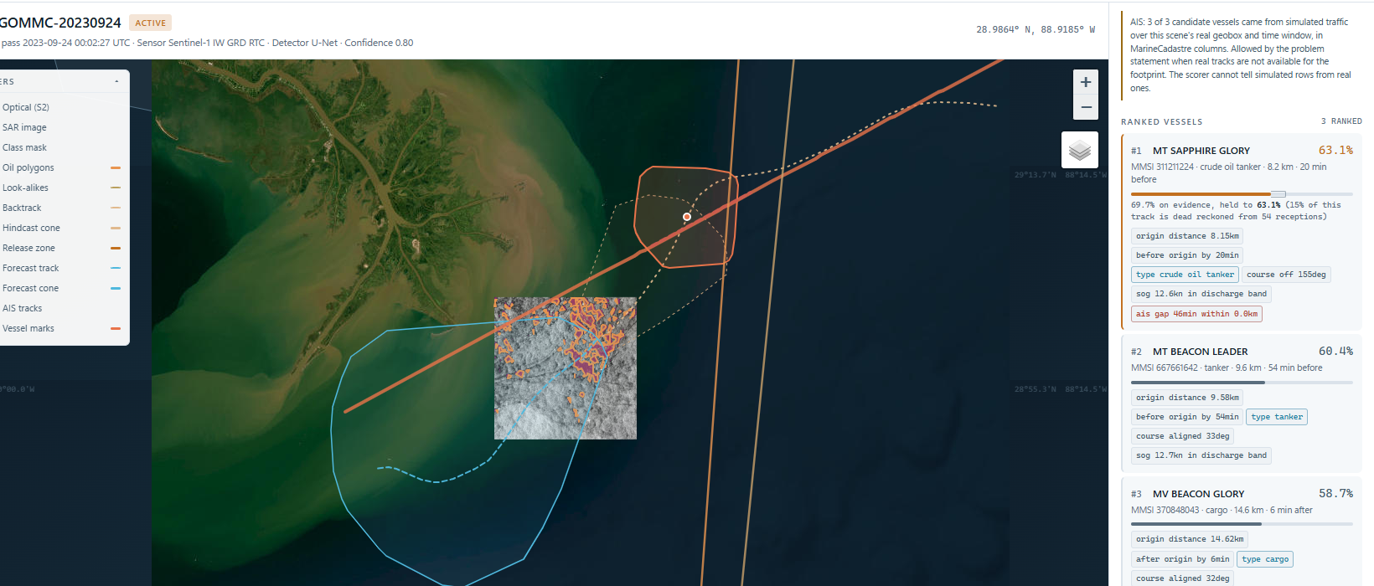
PROPOSED SOLUTION (IDEA / SOLUTION / PROTOTYPE)
Smart India Hackathon 2026 · Slide 2 of 6
TideTrace: Automated Oil Spill Detection & Maritime Culprit Attribution
Fusing SAR remote sensing, metocean drift physics, and historical AIS telemetry into an actionable operational console.
• Detailed Explanation of the Proposed Solution
• Innovation and Uniqueness of the Solution
• Automated SAR Ingestion: Directly ingests Sentinel-1 C-band SAR dual-pol (VV/VH) GeoTIFFs, sensing capillary wave damping day/night and through monsoon clouds.
• Deep Learning UNet++: Segments oil slicks from look-alikes with 0.8891 IoU; calculates local AEQD geodetic area, perimeter, and PCA orientation.
• Lagrangian Drift Inversion: Couples ERA5 wind and Copernicus hydrodynamic currents via RK2 integration to rewind slick to exact release origin.
• Forensic AIS Attribution: Queries indexed maritime AIS, filters spatio-temporal funnel, and scores suspect vessels on proximity, behavior, and blackout gaps.
✓ Look-Alike & Clean Water Floor: Multi-class segmentation rejects biogenic films. Strict <3.0 dB radiometric floor flags uniform sea with 0 false slicks.
✓ Dark Vessel Blackout Tracking: Flags AIS deactivations (>= 30 min gaps crossing within 5 km of origin); awards S_beh = 0.95 anomaly score.
✓ Morphological Telemetry & Geodesy: Local AEQD projection eliminates distortion; calculates metric area (km²), Feret length, and PCA orientation.
✓ Court-Admissible Dossier: Auto-exports Maritime Pollution Attribution Note (PDF/HTML) with SHA-256 hash and itemized telemetry.
• How It Addresses the NTRO Problem Statement
• Working Prototype: Ranked Culprit Leaderboard
• Eliminates 'Unattributable' Spills: Over 80% of marine spills escape liability. TideTrace bridges the physical and temporal gap between observed slick and moving ships.
• Catches Evasive Dark Vessels: Vessels turning off AIS transponders to dump bilge waste are flagged via 30+ min dead-reckoning blackout gap forensics.
• Sub-10s Rapid Deployment: Replaces multi-day manual satellite interpretation with sub-minute automated detection and immediate coastal alerts.
• Legally Admissible Proof: Produces tamper-evident Maritime Pollution Attribution Notes with SHA-256 scene hashes and telemetry evidence.
@SIH Idea submission- Template TideTrace · Team registered on SIH Portal Slide 2 of 6

Slide 3
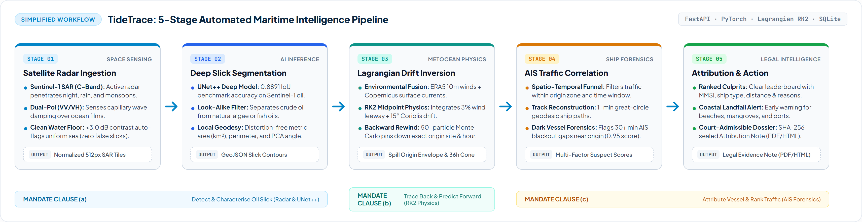

TECHNICAL APPROACH (TECHNOLOGIES, PROCESS & WORKING PROTOTYPE)
Smart India Hackathon 2026 · Slide 3 of 6
End-to-End System Pipeline, Tech Stack & Operational Console
Modular 12-stage automated pipeline uniting deep learning segmentation, metocean physics, and spatio-temporal forensics.
• Methodology & Process for Implementation: 5-Stage Automated Pipeline
• Technologies to be Used
• Working Prototype: Investigation & Drift Console
• Deep Learning: PyTorch 2.5, Segmentation Models PyTorch (SMP), UNet++ with timm-efficientnet-b0 backbone, ImageNet pre-trained stem.
• Geospatial & Geodesy: pyproj (Local AEQD projection), rasterio, Great-Circle geodesics, Scipy connected components & morphology.
• Numerical Physics: 2nd-order Runge-Kutta (RK2) midpoint integrator, 50-particle Monte Carlo dispersion, +15° Coriolis leeway deflection.
• Backend & Storage: FastAPI async REST framework, Pydantic v2 schemas, SQLite spatial/temporal indexing, Uvicorn ASGI server.
• Visual Console: Vanilla HTML5/CSS3/ES6, Leaflet 1.9, Esri Satellite & Ocean Basemaps, interactive scrubbing timeline.
@SIH Idea submission- Template TideTrace · Team registered on SIH Portal Slide 3 of 6

Slide 4
FEASIBILITY AND VIABILITY (ANALYSIS, RISKS & MITIGATION STRATEGIES)
Smart India Hackathon 2026 · Slide 4 of 6
Operational Feasibility & Technical Risk Mitigation Framework
Ensuring computational efficiency, data accessibility, and high-fidelity resilience against real-world maritime challenges.
• Computational Feasibility
• Data Availability & Access
• Deployment & Interoperability
Sub-10s GPU execution (30-45s on CPU). 512x512 sliding-window inference with cosine-tapered edge smoothing guarantees zero memory overflows on standard laptops or edge devices.
Relies entirely on open Copernicus Sentinel-1 SAR, public ECMWF ERA5 wind reanalysis, and standardized MarineCadastre / national AIS streams. No paid proprietary satellite vendor lock-in.
Modular REST API endpoints (/api/run, /api/health, /api/scoring) enable direct drop-in integration into Indian Coast Guard (ICG) command centres and NTRO maritime surveillance networks.
• Challenge 1: SAR Look-Alikes & Open Ocean False Alarms
• Challenge 2: AIS Evasion & Dark Vessels Switching Off Transponders
• Risk: Low wind speeds (<3 m/s) and biogenic slicks mimic petroleum damping in SAR imagery.
• Proven Strategy: Two-stage classification (look-alike vs. mineral oil) + Radiometric Clean Water Floor (contrast span < 3.0 dB classified as uniform sea; Arabian Sea test yields 0 false positives).
• Risk: Polluters deliberately turn off AIS transmitters before bilge discharge to conceal presence.
• Proven Strategy: Trajectory Gap Forensics. Analyzes dead-reckoned segments across gaps >= 30 min passing within 5 km of origin; penalizes evasion with 0.95 behavioral anomaly score while protecting thin receivers.
• Challenge 3: Chaotic Ocean Eddy Turbulence & Drift Divergence
• Challenge 4: Cloud Cover & Optical Satellite Blind Spots
• Risk: Single-trajectory backward drift diverges rapidly in dynamic coastal ocean currents.
• Proven Strategy: 50-Particle Monte Carlo Ensemble with stochastic velocity jitter (0.1 m/s current, 1.0 m/s wind). Frozen origin threshold triggers when 90% particle spread reaches 8 km, establishing a bounded spatial-temporal search envelope.
• Risk: Optical satellites (Sentinel-2, Landsat) are blinded by monsoon clouds, night, and heavy fog.
• Proven Strategy: All-weather Synthetic Aperture Radar (SAR C-band active microwave) serves as primary sensor, penetrating clouds, rain, and darkness 24/7, with optical used purely as opportunistic corroboration.
@SIH Idea submission- Template TideTrace · Team registered on SIH Portal Slide 4 of 6

Slide 5
IMPACT AND BENEFITS (AUDIENCE IMPACT & MULTI-DIMENSIONAL BENEFITS)
Smart India Hackathon 2026 · Slide 5 of 6
Empowering Maritime Domain Awareness & Disaster Management
Delivering actionable intelligence, national ecological protection, legal accountability, and cost savings.
• NTRO (Technical Intelligence)
• Indian Coast Guard (ICG)
• DG Shipping & Port Authorities
• INCOIS & MoES
Automated satellite reconnaissance across Indian EEZ; fuses space radar with maritime AIS for strategic maritime intelligence.
Transforms 3-day search operations into sub-minute actionable intercept coordinates, accelerating emergency cutter deployments.
Enforces MARPOL Annex I compliance with cryptographic proof; enables punitive fines and vessel detentions at ports of call.
Couples 2D hydrodynamic dispersion forecasting to protect vulnerable coastal ecosystems, marine sanctuaries, and ports.
• Environmental & Ecological Benefits
• Economic & Resource Benefits
• Rapid Coastal Protection: 36h forward dispersion cone alerts vulnerable mangrove forests (Sundarbans, Gulf of Kutch) and coral reefs before slicks reach shore.
• Wildlife Preservation: Reduces toxic hydrocarbon exposure to endangered marine species, turtles, and fisheries.
• Pollution Containment: Directs containment skimmers and booms to the densest slick centers immediately.
• 80% Cost Reduction: Slashes aviation fuel, flight reconnaissance hours, and patrol vessel transit by navigating directly to origin.
• Port Loss Prevention: Rapid containment prevents multi-million dollar port closures and ship traffic delays.
• Polluter Pays Principle: Enables recovery of clean-up and environmental damage costs directly from verified guilty vessels.
• Legal & Evidentiary Benefits
• Social & Coastal Benefits
• Eliminates Unattributable Slicks: Delivers forensic evidence bridging physical dispersion and recorded maritime traffic.
• Cryptographic Chain of Custody: Auto-exports tamper-evident Maritime Pollution Attribution Notes with SHA-256 scene hashes.
• Court-Admissible Proof: Itemizes exact proximity, temporal decay, vessel type prior, and trajectory anomalies.
• Fisherman Livelihood Security: Protects traditional coastal fishing grounds and aquaculture from toxic oil contamination.
• Desalination Plant Safety: Gives municipal water authorities early warning to shut coastal seawater intake valves.
• Public Health & Tourism: Keeps coastal beaches and recreational shorelines free from hazardous tarballs and fumes.
@SIH Idea submission- Template TideTrace · Team registered on SIH Portal Slide 5 of 6

Slide 6
RESEARCH AND REFERENCES (DATASETS, SCIENTIFIC LITERATURE & BENCHMARKS)
Smart India Hackathon 2026 · Slide 6 of 6
Scientific Foundations, Open Datasets & Empirical Validation
Grounded in published physical oceanography, peer-reviewed remote sensing, and open satellite archives.
• Datasets & Remote Sensing Sources
• Scientific & Peer-Reviewed References
• Empirical Validation Benchmarks
• Zenodo Sentinel-1 SAR Oil Spill Dataset: Parts I, II & III (DOIs: 10.5281/zenodo.8346860, .8253899, .13761290). 1,164 annotated dual-pol SAR image tiles used for UNet++ training & validation.
• Copernicus Sentinel-1 SAR IW GRD: C-band (5.405 GHz) dual-pol (VV/VH) radiometrically terrain corrected (RTC) cloud-optimized GeoTIFFs via Microsoft Planetary Computer.
• MarineCadastre.gov & NOAA / BOEM: Standardized national maritime AIS database. Ingests MMSI, timestamp, SOG, COG, heading, vessel type, and draught into indexed SQLite schema.
• ECMWF ERA5 Atmospheric Reanalysis: Hourly 10m surface wind vectors (u10, v10) at 0.25° resolution via Open-Meteo Archive API.
• Copernicus Marine Service (CMEMS): GLOBAL_ANALYSISFORECAST_PHY_001_024 eddy-resolving 1/12° hydrodynamic surface currents.
• Natural Earth Physical Vectors: 1:10m high-resolution land polygons for coastal impact checks; 1:110m and 1:50m simplified vectors for global basemap.
• SAR Oil Film Damping Physics: Alpers, W. et al. (2017). Oil spill detection by imaging radars: Challenges and pitfalls. Remote Sensing of Environment. Details capillary-gravity wave damping and biogenic vs. mineral oil discrimination.
• Deep Learning Image Segmentation: Zhou, Z. et al. (2018). UNet++: A Nested U-Net Architecture for Medical Image Segmentation. IEEE TMI. Provides multi-scale skip pathways for sharp slick boundary delineation.
• Lagrangian Metocean Advection: NOAA GNOME (General NOAA Operational Modeling Environment) Technical Manual. Establishes the 3% wind leeway rule and +15° Ekman Coriolis deflection in Northern Hemisphere.
• Numerical Inversion & RK2 Midpoint: Press, W. et al. Numerical Recipes in C: The Art of Scientific Computing. 2nd-order Runge-Kutta scheme for time-reversible particle advection.
• Spatio-Temporal AIS Forensics: Arguedas, V. et al. (2018). Maritime anomaly detection and vessel trajectory forecasting using AIS data. Ocean Engineering.
Model Evaluation on Zenodo Held-Out Test Set:
Metric | TideTrace | Baseline
IoU Oil | 0.8891 | 0.0000
Mean IoU (mIoU) | 0.9356 | 0.2882
Pixel Accuracy | 98.44% | 86.45%
Water False Oil | 0.0106 | 0.0038
Execution Time | < 10s (GPU) | Instant
Multi-Sea Scenario Validation:
• Gulf of Mexico (MC20): 57 oil slicks detected (15.6 km²), 11h backward hindcast, ranked culprit vessel (MMSI 311211224) with 46min AIS blackout gap.
• Arabian Sea (Mumbai Offshore): Clean water floor test: 1.56 dB contrast span correctly reports 'Uniform Clean Water' with 0 false slicks.
• Santa Barbara Channel: Natural geological seep discrimination and heavy vessel lane isolation.
• Caspian Sea (Baku Fields): Dense offshore platform cluster stress-test.
@SIH Idea submission- Template TideTrace · Team registered on SIH Portal Slide 6 of 6

