Slide 1

SMART INDIA HACKATHON 2026
TideTrail SRM: Deep Learning Super-Resolution of Sentinel-2 Imagery, 10 m to 2.5 m
Problem Statement ID - SIH26142
Problem Statement Title- Deep Learning Based Super Resolution Mapping (SRM) from Medium Resolution Satellite Imageries
Theme- Space Technology
PS Category- Software
Team ID- SIH361
Team Name - Meridian

Slide 2
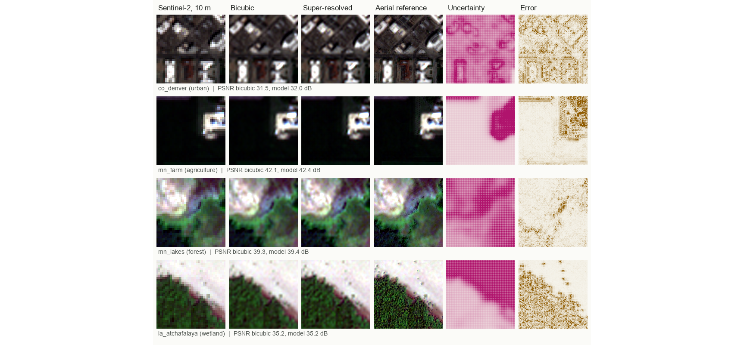
Meridian
PROPOSED SOLUTION (IDEA / SOLUTION / PROTOTYPE)
TideTrail SRM: Super-Resolution Mapping of Sentinel-2 Imagery
• How It Addresses the NTRO Problem Statement
• Innovation and Uniqueness of the Solution
- 4x Sharper, Spectrally Faithful: Sentinel-2 blue, green, red and NIR go from 10 m to 2.5 m on an exact grid. Averaged back to 10 m, the result matches the satellite pixel (error 0.0001).
- Validated, Not Claimed: 4 held-out scenes in CO, LA, MN, scored against 0.6 m aerial imagery: 37.25 dB PSNR, bicubic 37.00 dB.
- Error Is Accounted For: every pixel carries an uncertainty value; it ranks real error (rank correlation 0.24) and its 90% intervals held 91% of the time.
- Detail On A Safe Base: the network adds learned detail to a bicubic enlargement, so it starts from a faithful image instead of inventing one.
- Consistency Step: after inference every 10 m pixel is moved back to what the satellite measured; only the detail inside it is kept.
- Doubt Is Shown: a second map marks where detail is inferred, not observed, so analysts can discount it.
Prototype: 10 m and 2.5 m, Swipe to Compare
• Detailed Explanation of the Proposed Solution
Step 1 Data In: Sentinel-2 L2A bands B2, B3, B4 and B8 at 10 m, uploaded as a GeoTIFF.
Step 2 Pre-process: reflectance, cloud screening, sub-pixel registration and radiometric matching to aerial references.
Step 3 Super-resolve: residual CNN with sub-pixel convolution, tiled inference, uncertainty head.
Step 4 Validate: PSNR, SSIM, spectral angle, NDVI, water and edge checks on regions the model never saw.
Slide 2 of 6

Slide 3
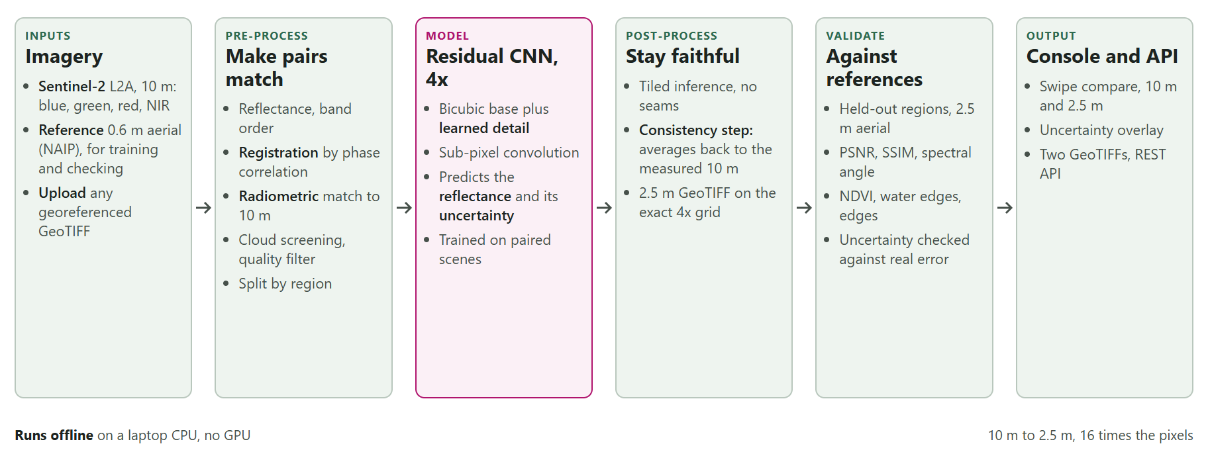
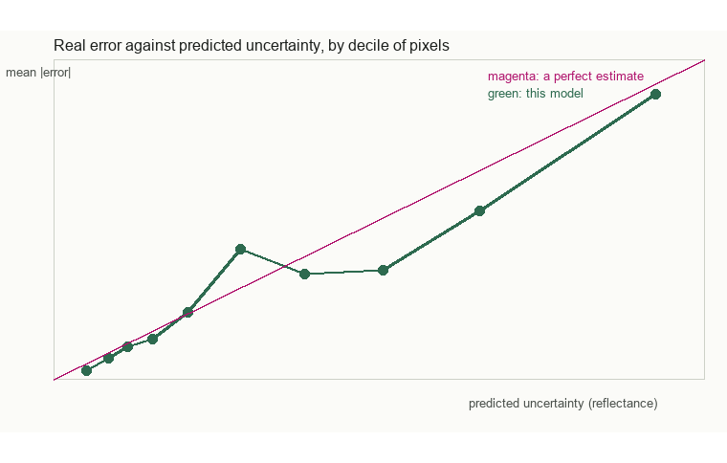
Meridian
TECHNICAL APPROACH (TECHNOLOGIES, PROCESS & WORKING PROTOTYPE)
• Architecture Pipeline
• Technologies to be Used
• Prototype: Uncertainty and Accuracy Panels
- Deep Learning: PyTorch residual CNN, 0.69 M parameters, sub-pixel convolution, Laplace uncertainty head; trained on 27 Sentinel-2 and aerial pairs.
- Geospatial & Backend: rasterio on Cloud Optimized GeoTIFFs, phase-correlation registration, FastAPI; runs fully offline on a CPU.
- Visual Console: Vanilla HTML5/ES6, Leaflet 1.9, swipe compare, NDVI and water layers, uncertainty overlay.
Slide 3 of 6

Slide 4
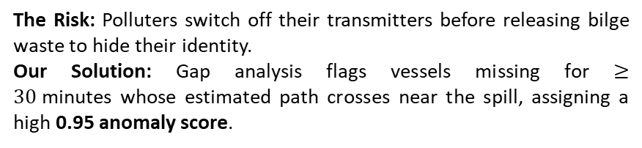
Meridian
FEASIBILITY AND VIABILITY (ANALYSIS, RISKS & MITIGATION STRATEGIES)
1. Compute & Speed | • under 45 s to enhance a 3.2 km scene on a laptop CPU; no GPU needed. • Training is resumable on the same CPU; this checkpoint is 250 iterations.
2. Data Access | • Free and open: Sentinel-2 L2A from Copernicus, NAIP aerial references from USDA. • NTRO's own high-resolution imagery can serve as the reference.
3. Deployment | • REST API and GeoTIFFs on the input's own grid, for existing GIS tools. • Standalone Reliability: Runs completely on-premise without cloud latency.
• Challenge 1: Invented Detail
• Challenge 2: The Reference Disagrees
The Risk: a sharper image can contain texture the satellite never saw, and mislead an analyst.
Our Solution: learned detail on a bicubic base, a step that keeps every 10 m value, and an uncertainty map that marks inferred detail.
The Risk: aerial and satellite images differ in date, sun angle and registration; averaged to 10 m the aerial image sits 0.05 reflectance from Sentinel-2.
Our Solution: sub-pixel registration, per-band radiometric matching, cloud screening, and a reference anchored to the Sentinel-2 pixels.
• Challenge 3: Generalising to India
The Risk: free aerial references exist only in the US, so Indian scenes cannot be scored directly.
Our Solution: region-held-out testing in states the model never saw, an uncertainty map that reports doubt, and retraining on NTRO references when supplied.
Slide 4 of 6

Slide 5
Meridian
IMPACT AND BENEFITS
• Environmental Value
- Crop Stress: Spots field
level change early.
- Water Extent: Tracks floods and
shrinking wetlands.
Operational Impact:
NTRO Intelligence
Sharper 2.5 m views from free 10 m imagery, doubt marked.
Crop Monitoring
Field-scale NDVI; error against the aerial reference 0.026, bicubic 0.027.
Urban Analysis
Edge F1 0.45 against 0.41 for bicubic: buildings and roads are crisper.
Disaster Assessment (NDMA)
- Water-edge overlap 0.84 against 0.81 for bicubic, for flood and shoreline mapping.
• Economic & Resource ROI
- No Imagery Fees: Works on free
Sentinel-2 data.
- Better Triage: Aims costly high-
resolution tasking.
• Social & Planning Value
- Disaster Response: Faster, sharper
flood and damage maps.
- Local Planning: Street-level views
of growing towns.
Slide 5 of 6

Slide 6
Meridian
RESEARCH AND REFERENCES
1. Dong et al. (2016), SRCNN, IEEE TPAMI · arXiv:1501.00092 | IEEE Xplore
2. Lim et al. (2017), EDSR, CVPR Workshops · arXiv:1707.02921
3. Wang et al. (2018), ESRGAN, ECCV Workshops · arXiv:1809.00219
4. Liang et al. (2021), SwinIR, ICCV Workshops · arXiv:2108.10257
5. Lanaras et al. (2018), DSen2, ISPRS J. Photogramm. Remote Sens. 146 · arXiv:1803.04271 | DOI
6. Cornebise et al. (2022), WorldStrat, NeurIPS Datasets and Benchmarks · arXiv:2207.06418
7. Michel et al. (2022), SEN2VENuS dataset, Data 7(7), 96 · DOI
8. Wald, Ranchin and Mangolini (1997), Fusion of satellite images of different spatial resolutions, PE&RS 63(6)
9. Kendall and Gal (2017), Uncertainties in Bayesian deep learning, NeurIPS · arXiv:1703.04977
10. Data: ESA Sentinel-2 L2A · Copernicus Data Space | Planetary Computer | USDA NAIP
Slide 6 of 6

