Slide 1

Linux Course
Level 1
Class 2

Slide 2
Objectives & Syllabus
El training tendrá como objetivo brindar al equipo
los conocimientos básicos y necesarios de Linux, para que puedan
llevar a cabo sus tareas de manera más eficiente.
Linux Intro & Usage Basics
Running Commands and Getting Help
Browsing the Filesystem
Users, Groups and Permissions
Using the bash Shell
Standard I/O and Pipes
Text Processing Tools
vim: An Advanced Text Editor
Investigating and Managing Processes
Configuring the Bash Shell
Finding and Processing Files
Essential System Administration Tools

Slide 3

Browsing
The Linux Filesystem

Slide 4
Objectives
● Describe important elements of the filesystem hierarchy
● Copy, move, and remove files
● Create and view files
● Manage files with Nautilus

Slide 5
Linux File Hierarchy Concepts
/
├── bin
├── boot
│ ├── extlinux
│ └── grub
├── dev
├── etc
├── home
│ ├── mtkach
├── lib
├── lib64
├── lost+found
├── media
│ ├── cdrom -> cdrom0
│ ├── cdrom0
│ ├── Home
│ ├── MacOSX
│ ├── Shared
│ ├── usb -> usb0
│ └── usb0
├── mnt
├── opt
│ └── spotify
├── proc
├── root
├── run
├── sbin
├── selinux
├── srv
├── sys
├── tmp
├── usr
│ ├── bin
│ ├── games
│ ├── include
│ ├── lib
│ ├── local
│ ├── sbin
│ ├── share
│ └── src
├── var
│ ├── backups
│ ├── cache
│ ├── games
│ ├── lib
│ ├── local
│ ├── lock -> /run/lock
│ ├── log
│ ├── mail
│ ├── opt
│ ├── run -> /run
│ ├── spool
│ └── tmp
└── Volumes
├── MacOSX -> /media/MacOSX
└── Shared -> /media/Shared
● Files and directories are organized into
a single-rooted inverted tree structure
● Filesystem begins at the root directory,
represented by a lone / (forward slash) character.
● Names are case-sensitive
● Paths are delimited by /

Slide 6
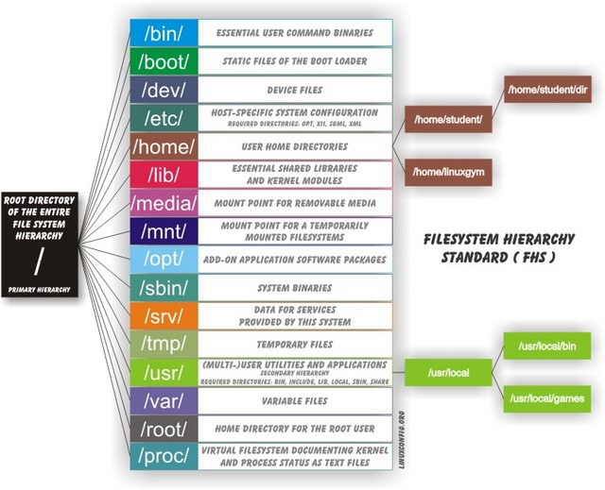
Some Important Directories
● Home Directories: /root,/home/username
● User Executables: /bin, /usr/bin, /usr/local/bin
● System Executables: /sbin, /usr/sbin, /usr/local/sbin
● Other Mountpoints: /media, /mnt
● Configuration: /etc
● Temporary Files: /tmp
● Kernels and Bootloader: /boot
● Server Data: /var, /srv
● System Information: /proc, /sys
● Shared Libraries: /lib, /usr/lib, /usr/local/lib

Slide 7
Current Working Directory
● Each shell and system process has a current working directory (cwd)
● pwd
* Displays the absolute path to the shell's cwd
* eg:
homer@springfield:~$ pwd
/home/homer

Slide 8
File and Directory Names
● Names may be up to 255 characters
● All characters are valid, except the forward-slash
* It may be unwise to use certain special characters in file or directory
names (eg: >, <, $, ?, *, ', “, etc.)
* Some characters should be protected with quotes when referencing
them (eg: >, <, $, ?, *, ', “, etc.)
● Names are case-sensitive
* Example: MAIL, Mail, mail, and mAiL
* Again, possible, but may not be wise

Slide 9
Absolute and Relative Pathnames
● Absolute pathnames (eg: '/bin/cp', '/home/user/.bashrc', etc.)
* Begin with a forward slash
* Complete "road map" to file/directory location
* Can be used anytime you wish to specify a file name
● Relative pathnames (eg: './script.sh', '../myproj/python.py', etc.)
* Do not begin with a slash
* Specify location relative to your current working directory
* Can be used as a shorter way to specify a file name

Slide 10
Changing Directories
● cd changes directories
* To an absolute or relative path:
■ cd /home/$USER/Desktop
■ cd ../Documents
* To a directory one level up:
■ cd ..
* Shortcut to your home directory:
■ cd
* To your previous working directory:
■ cd -

Slide 11
Listing Directory Contents
● Lists the contents of the current directory or a specified directory
● Usage:
* ls [options] [files_or_dirs]
● Examples:
* ls -a (include hidden files)
* ls -l (display extra information)
* ls -R (recurse through directories)
* ls -lt (extra information sorted by descending modified time)
* ls -lh (extra information with sizes displayed in 'human format')
* ls -ld (directory and symlink information)
● More at: man ls -OR- ls --help

Slide 12
Copying Files and Directories
● cp - copy files and directories
● Usage:
* cp [options] file destination
● More than one file may be copied at a time if the destination is a
directory:
* cp [options] file1 file2 dest
● More at: man cp -OR- cp –-help
The Destination
● If the destination is a directory, the copy is placed there
● If the destination is a file, the copy overwrites the destination
● If the destination does not exist, the copy is renamed

Slide 13
Moving/Renaming Files and Dirs
● mv - move and/or rename files and directories
● Usage:
* mv [options] file destination
● More than one file may be moved at a time if the destination is a
directory:
* mv [options] file1 file2 destination
● Destination works like cp
● More at: man mv -OR- mv --help

Slide 14
Creating and Removing Files
● touch - create empty files or update file timestamps
● rm - remove files
● Usage:
* rm [options] <file>...
● Example:
* rm -i file (interactive)
* rm -r directory (recursive)
* rm -f file (force)
● Be very careful with the following:
* rm -rf directory (force recursive remove)

Slide 15
Creating & Removing Directories
● mkdir creates directories
* mkdir -p creates all the new parent directories in the path
● rmdir removes empty directories
● rm -r recursively removes directory trees

Slide 16
Browsing the FS graphically
● Nautilus is Gnome's graphical filesystem browser.
Other examples:
* Thunar in XFCE
* Dolphin in KDE
* etc...
● Accessed via...
* Applications->System Tools->File Browser (distro dependent)
* Desktop icons
■ Home: Your home directory
■ Computer: Root filesystem, network resources and removable media

Slide 17
Moving and Copying graphically
● Drag-and-Drop
* Drag: Move on same filesystem, copy on different filesystem
* Drag + Ctrl: Always copy
* Drag + Shift: Always move
* Drag + Alt: Ask whether to copy, move or create symbolic link (alias)
● Context menu
* Right-click a file or directory to rename, cut, copy or paste (and
more)

Slide 18
Determining File Content
● Files can contain many types of data
● Check file type with file before opening to determine appropriate
command or application to use
● file [options] <filename>...
● Reference file:
* /usr/share/file/magic.mgc (Debian based)
* /usr/share/magic (RedHat based)

Slide 19
Summary
● Questions and Answers
● Summary
* The Linux filesystem hierarchy
* Command-line file management tools
* Using a graphical file manager

