Slide 1

Linux Course
Level 1

Slide 2
Objectives & Syllabus
El training tendrá como objetivo brindar al equipo los
conocimientos básicos y necesarios de Linux, para que puedan llevar a cabo sus tareas de
manera más eficiente.
Linux Intro & Usage Basics
Running Commands and Getting Help
Browsing the Filesystem
Users, Groups and Permissions
Using the bash Shell
Standard I/O and Pipes
Text Processing Tools
vim: An Advanced Text Editor
Investigating and Managing Processes
Configuring the Bash Shell
Finding and Processing Files
Essential System Administration Tools

Slide 3

Linux
Intro

Slide 4

Linux Origins
● 1984: Richard Stallman starts The GNU Project and the Free Software Foundation
--> Creates open source version of UNIX utilities
--> Creates the General Public License (GPL)
■ Software license enforcing open source principles
● 1991: Linus Torvalds
--> Creates open source, UNIX-like kernel, released under the
GPL
--> Ports some GNU utilities, solicits assistance online
● Today:
--> Linux kernel + GNU utilities = complete, open source,
UNIX-like operating system
■ Packaged for targeted audiences as distributions

Slide 5
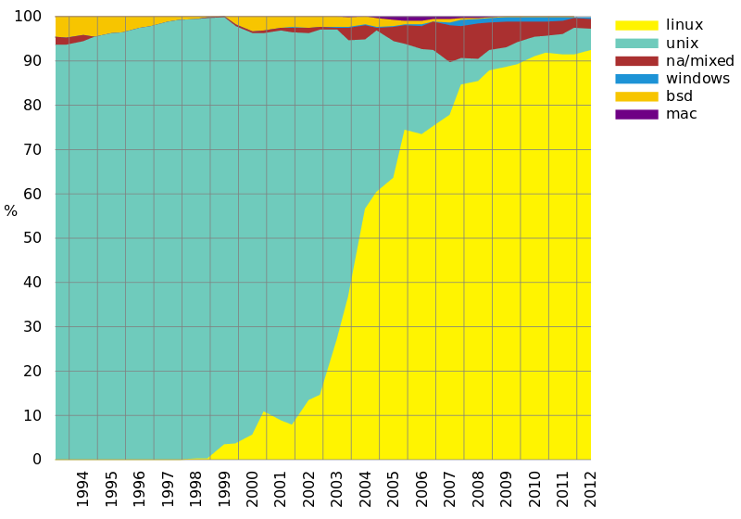

Why Linux?
Stability
Security
Hardware
TCO
Freedom
Graph of supercomputer OS market share according to TOP500.

Slide 6
Linux Principles
● Everything is a file (including hardware)
● Small, single-purpose programs
● Ability to chain programs together to perform complex tasks
● Avoid captive user interfaces
● Configuration data stored in text

Slide 7
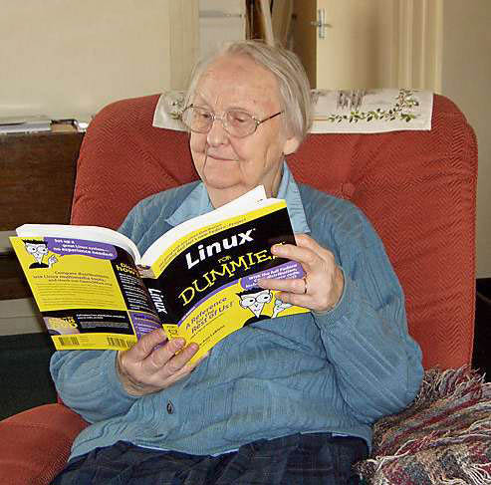
Linux
First Steps

Slide 8
Objectives
● Log into a Linux system
● Access the command line from X
● Change your password
● Understand the nature of root privileges
● Elevate your privileges
● Edit plain text files

Slide 9
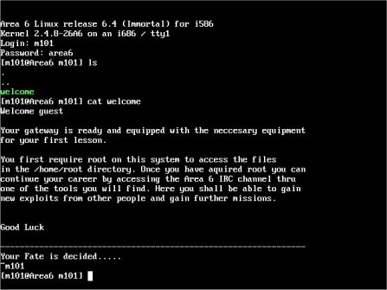
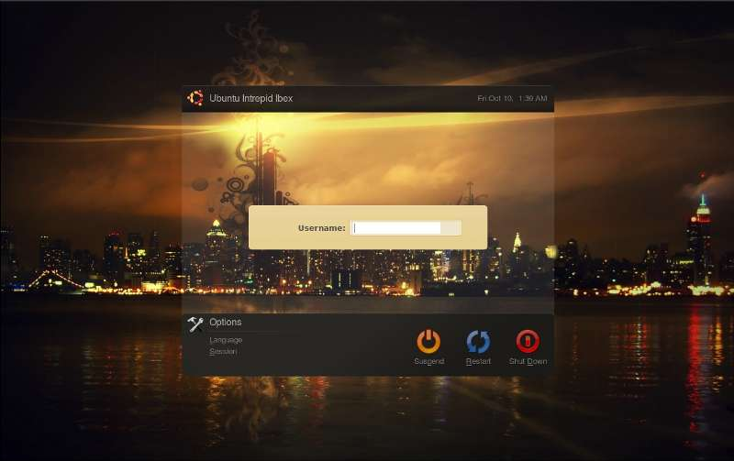
Logging in to a Linux System
● Two types of login screens:
virtual consoles (text-based)
graphical logins (display managers)
● Login using login name and password
● Each user has a home directory for personal file storage

Slide 10



Linux Graphical Desktop
Elements of the X Window System
● The X Window System is Linux's graphical subsystem
● Xorg is the particular version of the X Window System
--> Open source implementation of X
● Look and behavior largely controlled by the desktop environment
● A few desktop environments available in Linux:
--> XFCE: lightweight and fast desktop environment
--> GNOME: the default desktop environment
--> KDE: an alternate desktop environment

Slide 11
Virtual ↔ Graphical Consoles
Switching between virtual consoles and the graphical environment
● A typical Linux system will run six virtual consoles and one
graphical console
--> Server systems often have only virtual consoles
--> Desktops and workstations typically have both
● Switch among virtual consoles by typing:
Ctrl-Alt-F[1-6]
● Access the graphical console by typing:
Ctrl-Alt-F7, Ctrl-Alt-F8 or Ctrl-Alt-F9 (depending on distro)
● New terminal inside a desktop: xterm, gnome-terminal, etc.

Slide 12
Your Password
● To change your password from a terminal:
passwd
● eg: To change your password using GNOME, navigate to:
System->Preferences->About Me and then click Password.
● Best practices:
--> Change it regularly
--> Select a password that is hard to guess
--> Don't use the same password everywhere

Slide 13
Linux Superuser: 'root'
● The root user: a special administrative account
--> root has complete control over the system
■ ...and an unlimited capacity to damage it!
● Do not login as root unless necessary
--> Normal (unprivileged) users' potential to do damage
is more limited
Changing Identities → Elevating privileges
● su - creates new shell as root
● sudo command runs command as root
-->Requires prior configuration by a system-administrator
● id shows information on the current user

Slide 14
Linux Text Editors
● The nano editor (easier)
-->Easy to learn, easy to use
-->Not as feature-packed as some advanced editors
● Other editors:
-->gedit, a simple graphical editor (casual editor)
-->vim, an advanced, full feature editor (recommeded)
-->gvim, a graphical version of the vim editor

Slide 15
Summary Linux First Steps
● Any Questions?
● Summary
--> Login name and password
--> Switching between virtual console and graphical desktop
--> gnome-terminal, xterm, etc.
--> passwd
--> su, sudo
--> nano

Slide 16

Running Commands
And
Getting Help

Slide 17
Objectives
● Execute commands at the prompt
● Explain the purpose and usage of some
simple commands
● Use the built-in help resources in Linux

Slide 18
Running Commands
● Commands have the following syntax:
--> command options arguments
● Each item is separated by a space
● Options modify a command's behavior
--> Single-letter options usually preceded by '-'
■ Can be passed as -a -b -c or -abc
--> Full-word options usually preceded by '--'
■ Example: --help
● Arguments are filenames or other data needed by the command
● Multiple commands can be separated by ;
Some Simple Commands
● date - display date and time
● cal - display calendar

Slide 19

Getting Help
● Don't try to memorize everything!
● Many levels of help
--> whatis
--> apropos
--> command --help
--> man and info
--> /usr/share/doc/
--> Google !

Slide 20
Getting Help: whatis
The whatis Command
● Displays short descriptions of commands
● You need to know the command name
● Uses a database that is updated nightly
● Often not available immediately after install
$ whatis cal
cal (1) - displays a calendar
TIP: Trigger creation/update of DB with makewhatis (root only)

Slide 21
Getting Help: apropos
The apropos Command is similar to whatis (uses its DB)
● Displays short descriptions of commands
● Uses a database that is updated nightly
● Often not available immediately after install
● Searches all the commands with a given keyword
in its name AND description
$ apropos rsyslog
rsyslog.conf (5) - rsyslogd(8) configuration file
rsyslogd (8) - reliable and extended syslogd

Slide 22
Getting Help: --help option
● Displays usage summary and argument list
● Used by most, but not all, commands
$ date --help
Usage: date [OPTION]... [+FORMAT] or:
date [-u|--utc|--universal] [MMDDhhmm[[CC]YY][.ss]]
Display the current time in the given FORMAT,or set the system date.
...argument list omitted...
Reading Usage Summaries
● Printed by --help, man and others
● Used to describe the syntax of a command
--> Arguments in [] are optional
--> Arguments in CAPS or <> are variables
--> Text followed by ... represents a list
--> x|y|z means "x or y or z"
--> -abc means "any mix of -a, -b or -c"

Slide 23
Getting Help: man
● Provides documentation for commands
● Almost every command has a man "page"
● Pages are grouped into sections (or "chapters")
● Collectively referred to as the Linux Manual
● man [<section>] <command>
Navigating man Pages
● While viewing a man page
--> Navigate with arrows, PgUp, PgDn
--> /text searches for text
--> n/N goes to next/previous match
--> q quits
● Searching the Manual
--> man -k keyword lists all matching pages
--> Uses whatis database (like apropos)
Manual Sections:
1 User Commands
2 System Calls
3 Library Calls
4 Special Files
5 File Formats
6 Games
7 Miscellaneous
8 Administrative
Commands
TIP: more in 'man man'

Slide 24
Getting Help: info
● Similar to man, but often more in-depth
● Run info without args to list all page
● info pages are structured like a web site
--> Each page is divided into "nodes"
--> Links to nodes are preceded by *
--> info [command]
● Navigating info Pages: While viewing an info page
-->Navigate with arrows, PgUp, PgDn
-->Tab moves to next link
-->Enter follows the selected link
-->n/p /u goes to the next/previous/up-one node
-->s text searches for text (default: last search)
-->q quits info

Slide 25
Getting Help: Other sources
● The /usr/share/doc directory
--> Subdirectories for most installed packages
--> Location of docs that do not fit elsewhere
■ Example configuration files
■ HTML/PDF/PS documentation
■ License details
● Google
● Cloudbuilders ;-)
● Communities / Forums
● etc...

Slide 26
Summary Getting Help
● Questions and Answers
● Summary
--> Running Commands
--> Getting Help

