Slide 1
MACHINE LEARNING MINI-PROJECT / PROBLEM 79
OBSERVED SITES
620
Predicting Coral Reef
Regimes
Hawaiian reef dataset
INPUT PREDICTORS
20
from human and natural influences
Human + biophysical
A leakage-aware, four-class classification study
REGIME LABELS
1 / 2 / 3 / 5
Nominal classes
Team | SHREE VERDHAN M | SUHAS
Prediction is not causation.
Generalization beyond Hawaii is untested.
UE24CS352A | PES University

Slide 2
01 / PROBLEM
Can observed pressures classify a reef regime?
RESEARCH QUESTION
SCOPE BOUNDARIES
Can 20 anthropogenic and biophysical predictors classify a Hawaiian reef site into its observed regime label?
Predicts the dataset label from observed predictors.
Does not estimate causal effects.
Four target classes in the supplied dataset
Not a future-time forecast.
1
2
3
5
Regime 4 is absent in the source subset.
Objective: compare model families, inspect class-wise errors and report limitations.
UE24CS352A | Machine Learning Mini-Project | Problem 79
02

Slide 3
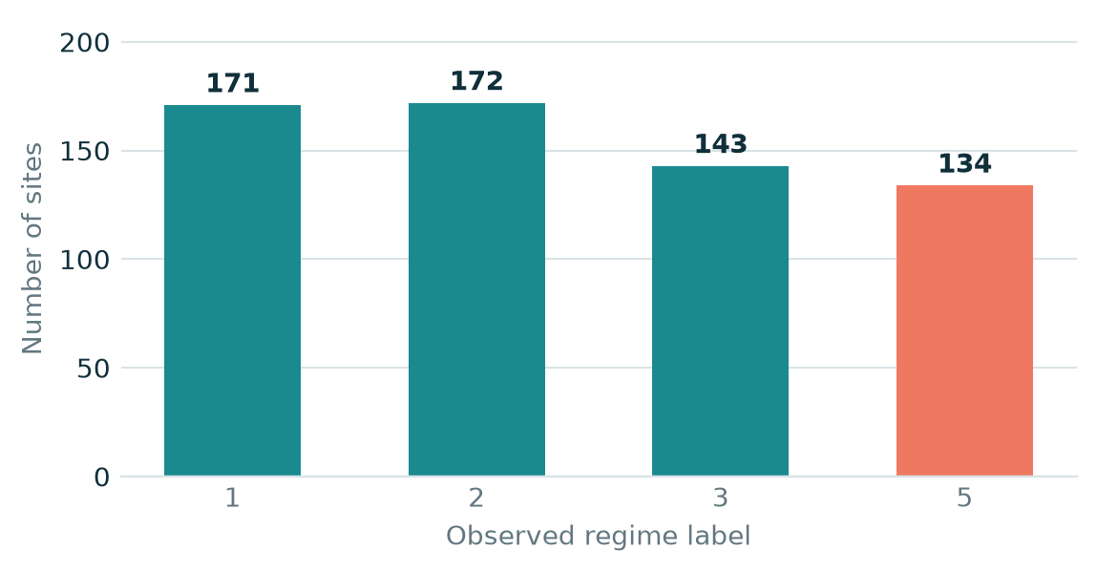
02 / DATA
Small dataset, explicit feature boundary
SITES
PREDICTORS
TRAINING SPLIT
HELD-OUT TEST
620
20
496
124
All observations
Effluent through Depth
80% / stratified
20% / one evaluation
CLASS DISTRIBUTION
DATA QUALITY & LEAKAGE SAFEGUARDS
Missing values: Complexity 113; Depth 12.
Median imputation is fitted inside each model pipeline.
Regime one-hot columns, IDs, coordinates and ecological response columns are excluded from inputs.
Split: stratified 80/20, random_state = 42. Labels are nominal: 1, 2, 3 and 5.
UE24CS352A | Machine Learning Mini-Project | Problem 79
03

Slide 4
03 / METHOD
A controlled evaluation pipeline
1
2
3
4
5
Audit
Split
Compare
Select
Evaluate
Validate rows, labels
and predictor schema
Stratified 80/20
train / test
5-fold stratified CV
on training only
Highest mean
CV macro-F1
One held-out test
evaluation
CANDIDATE MODELS
Most-frequent baseline
Logistic Regression
WHY MACRO-F1?
It averages F1 across classes, so performance on smaller or harder classes is not hidden by the overall sample mix. CV chooses the model; the held-out test set does not.
RBF SVM
Random Forest
Gradient Boosting
Random Forest + 5 interactions
UE24CS352A | Machine Learning Mini-Project | Problem 79
04

Slide 5
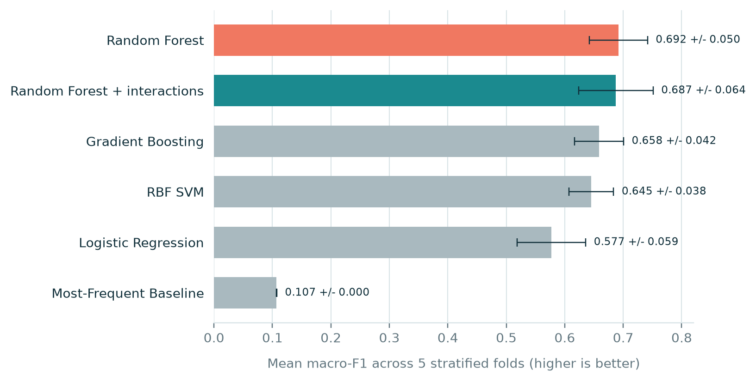
04 / RESULTS
Random Forest led cross-validation
Mean macro-F1 across five stratified folds; error bars show fold standard deviation.
SELECTED MODEL
Random
Forest
0.692
Mean CV macro-F1
RF + interactions: 0.687
The interaction ablation did not improve CV macro-F1 in this run; the simpler 20-feature model was selected.
UE24CS352A | Machine Learning Mini-Project | Problem 79
05

Slide 6
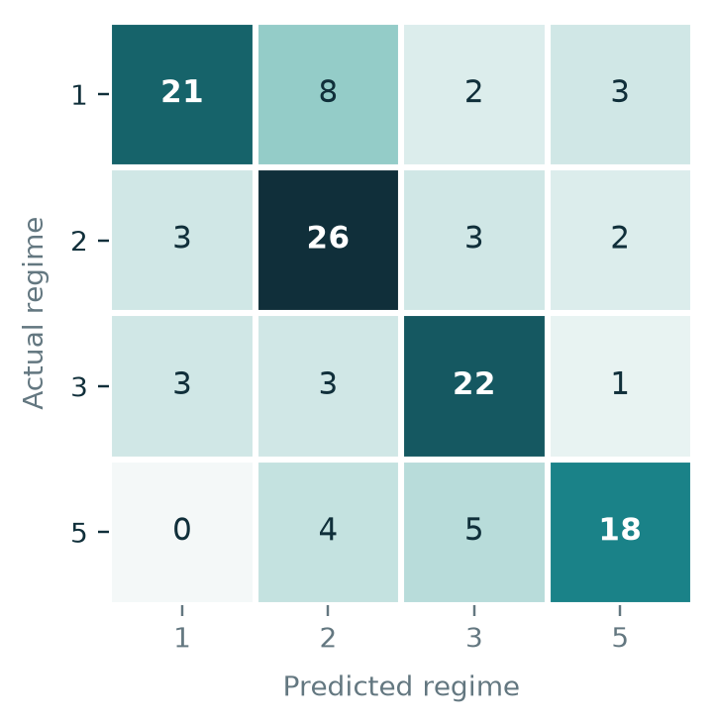
05 / EVALUATION
Held-out test performance and errors
ACCURACY
MACRO-F1
BALANCED ACCURACY
TEST SAMPLES
70.2%
70.2%
70.2%
124
87 of 124 correct
Across four classes
Mean class recall
Held out from selection
CONFUSION MATRIX
PER-CLASS RECALL
R1
0.618
R2
0.765
R3
0.759
R5
0.667
R1 has the lowest recall in this test split.
UE24CS352A | Machine Learning Mini-Project | Problem 79
06

Slide 7
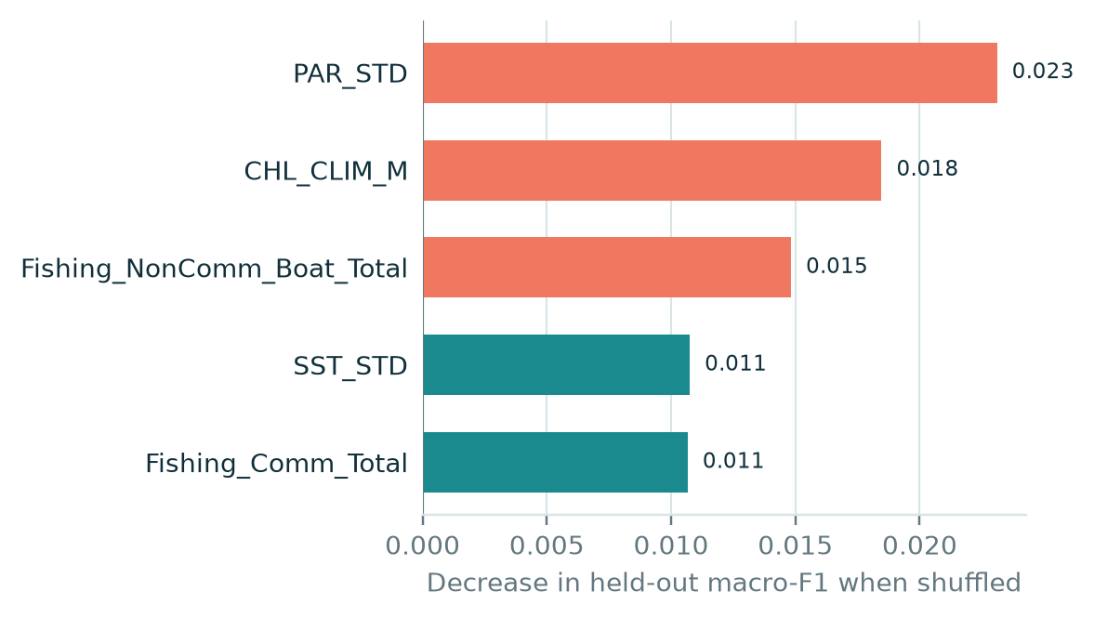
06 / INTERPRETATION
Signals, errors and limits
TOP THREE IN THIS RUN
1. PAR_STD
2. CHL_CLIM_M
3. Fishing_NonComm_Boat_Total
INTERPRET CAREFULLY
Permutation importance is predictive, not causal.
Negative or small values are possible and should not be overinterpreted.
Scope limits: modest sample, Hawaiian sites only, regime 4 absent in source subset, no independent geographic validation.
UE24CS352A | Machine Learning Mini-Project | Problem 79
07

Slide 8
07 / CONCLUSION
A reproducible baseline - not a causal claim
TAKEAWAY
REPRODUCIBILITY
Random Forest achieved 0.692 mean CV macro-F1 and 0.702 held-out macro-F1.
Run from the project root:
python run_project.py
For document-only refresh after names/results change:
LIVE DEMO CHECKLIST
Show data audit and split sizes
python regenerate_deliverables.py
Open model_comparison_cv.csv
Outputs are saved under results/.
Explain one confusion-matrix error
Explain one limitation / no causality
UE24CS352A | Machine Learning Mini-Project | Problem 79
08

Slide 9
08 / REFERENCES
Sources and questions
Primary ecological study
Jouffray et al. (2019). Parsing human and biophysical drivers of coral reef regimes. Proceedings of the Royal Society B, 286:20182544. https://doi.org/10.1098/rspb.2018.2544
Stanford CS229 reference project
Cheng, Murphy & Walecka. Predicting Coral Reef Regimes from Human and Natural Influences. https://cs229.stanford.edu/proj2019spr/report/56.pdf
Reference poster
https://cs229.stanford.edu/proj2019spr/poster/56.pdf
Dataset repository
https://github.com/JBjouffray/Hawaii_RegimesPredictors
Questions? Be ready to explain the split, macro-F1 selection, one class error, and one limitation.
UE24CS352A | Machine Learning Mini-Project | Problem 79
09

