Slide 1
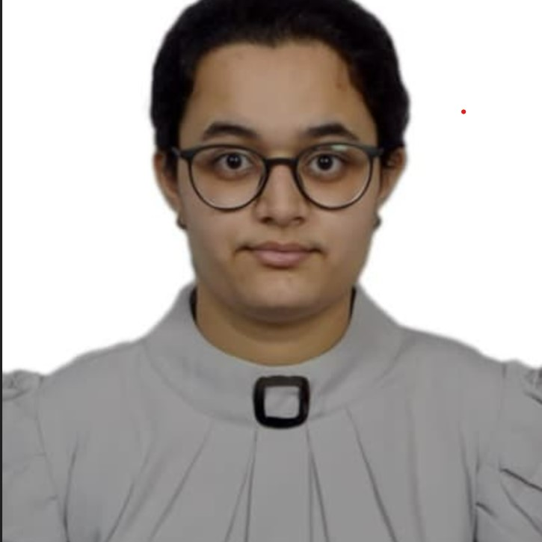



Vanshika Singh
Senior Analyst/Software Engineer
Bachelor of Engineering
Electronics & Communication Engineering : 2018 - 2022
Bangalore
vanshika.singh@capgemini.com
Skills
+91 8130320861
C# | Basics, OOPS, Exception Handling, Arrays, Collection and Generics, Delegates and Events, File Io and Serialization.
.NET Framework | ADO.NET, ASP.NET with MVC4 and WEB API, Entity Framework.
Database | SQL
Tools | GIT, POSTMAN
UI Technology | HTML5, CSS & Angular
Java | Basic, OOPS, Exception Handling, Arrays
A5
Full Stack Developer
Understanding of RDBMS concepts using SQL Server.
Practical understanding of C# and SQL concept using Visual Studio and SQL Server.
Hands on experience in developing applications using .NET Framework, ADO.NET Core
Understanding of HTML5, CSS and Angular CLI.
E-Commerce Shopping Cart Application
Completed end to end case study of Shopping Cart System which is a Web Based Application. It is implemented to make sellers life easier by advertising their products and selling them directly to the customers/buyers. It’s main object is to act as a bridge between the seller and the customer/buyer by registering the customers/buyers and sellers. The seller will list their products and the customer/buyer can make payment directly to the seller.
Technologies used:
ANGULAR
ASP.NET CORE
Microsoft SQL Server
Check out my work on GitHub

