Slide 1

UE21CS390A – Capstone Project Approval
Project Title : Multicontextual learning through incontext
pruning with biomedical knowledge graph
Project ID : PW24_BJD_08
Project Guide : Prof. Bhaskarjyoti Das
Project Team : 111_279_700_721

Slide 2
Multicontextual learning through incontext pruning with biomedical knowledge graph
Outline
Problem Statement
Why use LLM + KG
Novelty
Approach
Scope and Feasibility study
Dataset
Applications
Expected Deliverables
Timeline

Slide 3
Problem Statement
Multicontextual learning through incontext pruning with biomedical knowledge graph
An approach where a model is trained to adapt to various contexts, pruned for efficiency within each context, and enriched with domain-specific knowledge using a bio-medical knowledge graph. This could be particularly useful in applications where the operating conditions or requirements vary, and leveraging context-specific knowledge is essential for optimal performance.
The proposed solution is to implement "multicontextual learning through incontext pruning" by incorporating a biomedical knowledge graph, enabling the LLM to access and utilize detailed, domain-specific data for improved accuracy.

Slide 4
Multicontextual learning through incontext pruning with biomedical knowledge graph
Multicontextual Learning:
Definition: Multicontextual learning involves training a machine learning model to operate effectively in multiple contextual environments.
Contexts: Each context represents a specific set of conditions, data distributions, or tasks. The goal is to make the model adaptable and capable of performing well across different scenarios.
Incontext Pruning:
Definition: Pruning is a technique used to reduce the complexity of a model by removing certain components. In the context of multi contextual learning, incontext pruning involves selectively removing connections, features, or parameters from the model while considering the specific context in which the model is operating.
Purpose: Pruning is often employed to improve model efficiency, reduce computational resources, and potentially enhance generalization by removing unnecessary or redundant information.
Knowledge Graph:
Definition: A knowledge graph is a structured representation of knowledge that captures relationships between entities. It consists of nodes (entities) and edges (relationships) connecting these entities.
Purpose: Knowledge graphs are used to organize and represent information in a way that facilitates reasoning and makes complex relationships explicit. They are often employed to incorporate domain-specific knowledge into machine learning models.

Slide 5
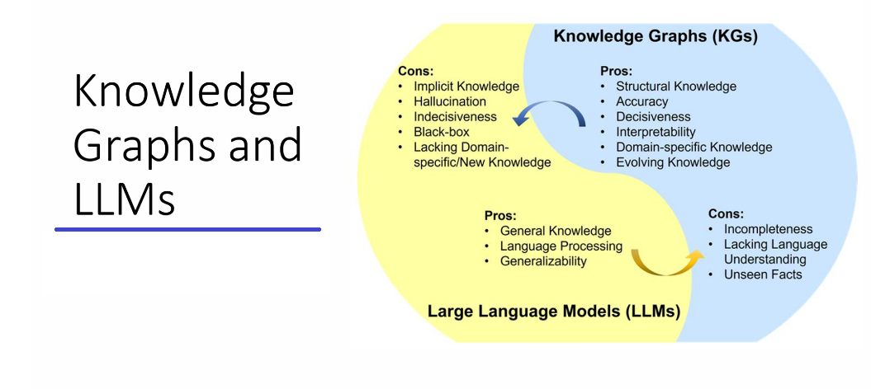
Multicontextual learning through incontext pruning with biomedical knowledge graph
LLM + KG

Slide 6
Multicontextual learning through incontext pruning with biomedical knowledge graph
Why use LLM + KG
LLMs : The “implicit representation” of knowledge in LLM has been
shown to generate non-factual information(hallucination).
Solution : Utilization of domain-specific data for pre-training the LLM
Implemented in PubMedBERT, BioBERT
Drawback: Pre-training of an LLM from scratch is not practical
Prompt tuning: An alternative approach proposed as a means to enhance LLM performance
through the use of zero-shot , few-shot and Chain-of-Thought prompting
Strategies.
Drawback: The success of prompt tuning is heavily dependent on the quality of the prompts.
If the prompts are not well-designed, the model may not learn the desired
behavior or knowledge.

Slide 7
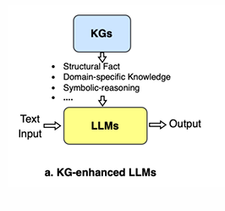
Multicontextual learning through incontext pruning with biomedical knowledge graph
KG-enhanced LLMs:
To address such knowledge intensive tasks, an alternative approach which integrates knowledge graphs (KG) with language models
Retrieval-Augmented Generation (RAG) was recently introduced. This method involves enhancing a parametric pre-trained LLM with the ability to access a non-parametric memory containing updated knowledge about the world (for e.g., Wikipedia)
Here we use Knowledge graph based RAG to provide domain-specific ground truth context at the prompt level.

Slide 8
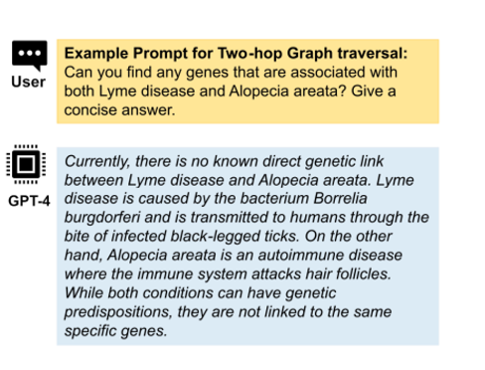

Multicontextual learning through incontext pruning with biomedical knowledge graph
NOVELTY
As shown in Fig 1. GPT-4 gives false answers to domain specific questions in realm of biomedicine
We are integrating biomedical knowledge graph to LLM to get an improved response as shown in Fig 2.
Uniqueness lies in improving the framework to build accurate biomedical prompts for LLM leveraging biomedical knowledge graphs.
Fig 1
Fig 2

Slide 9
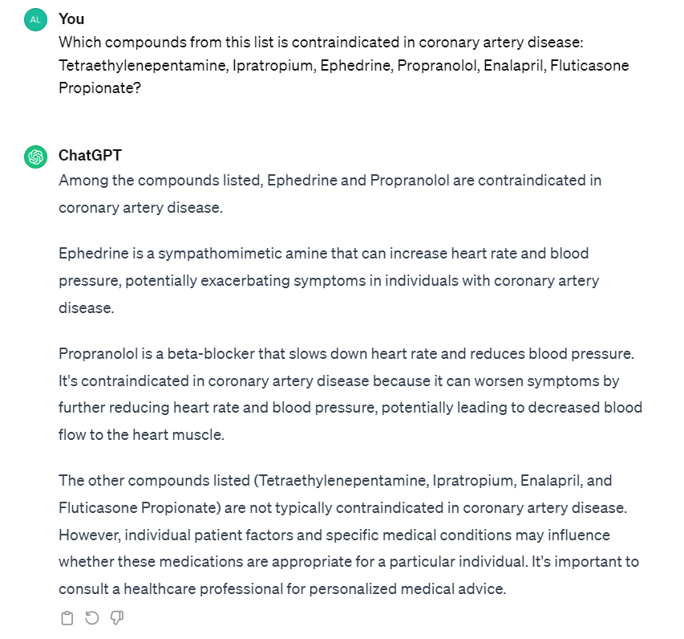
Multicontextual learning through incontext pruning with biomedical knowledge graph
Expected answer from LLM with KG-RAG :
The compounds contraindicated in the
condition coronary artery disease from
the given list are Ipratropium,
Ephedrine, and Fluticasone Propionate.

Slide 10
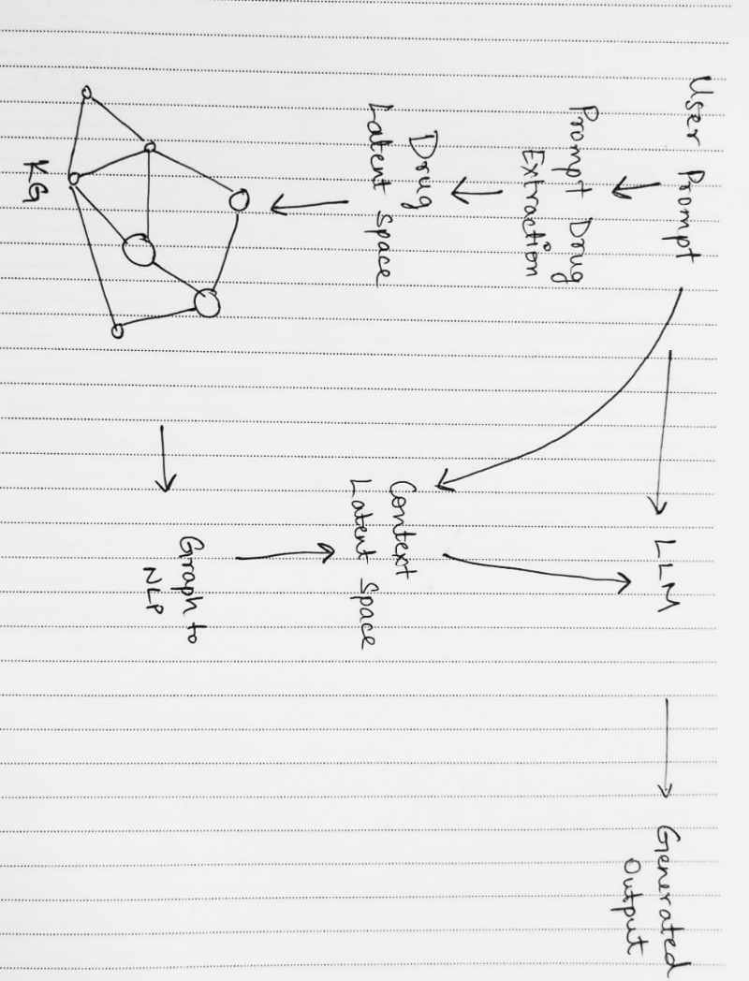
Multicontextual learning through incontext pruning with biomedical knowledge graph
Approach

Slide 11
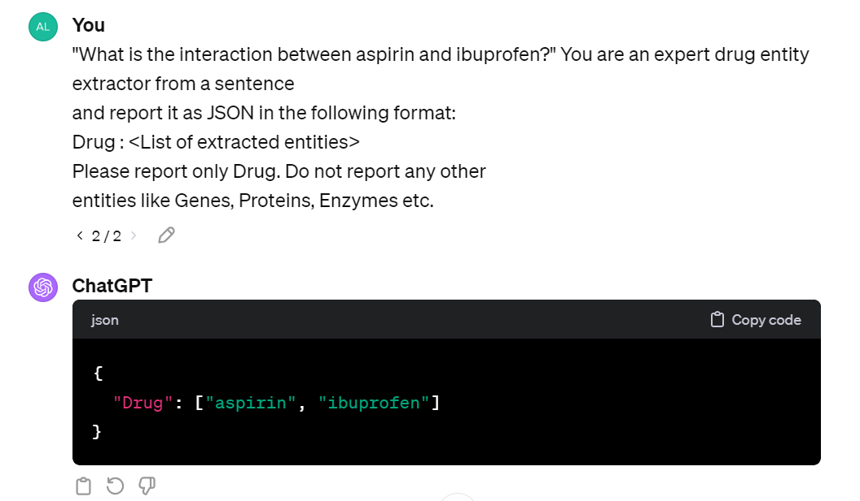
Multicontextual learning through incontext pruning with biomedical knowledge graph
Approach
User Prompt: "What is the interaction between aspirin and ibuprofen?"
Drug entity recognition: The system recognizes "aspirin" and "ibuprofen" as the drug entities using system prompt

Slide 12
Multicontextual learning through incontext pruning with biomedical knowledge graph
Drug Latent Space: The information on "aspirin" and "ibuprofen" is represented in a latent space, encoding properties like mechanism of action, metabolism, and existing DDI data.
Drug Graph context: The relevant context from the graph database for "aspirin" and "ibuprofen" is selected, showing potential interaction points.
Approach

Slide 13
Multicontextual learning through incontext pruning with biomedical knowledge graph
Context Pruning : the input prompt and all the extracted contextual
associations were embedded to the same vector space (Context Latent space
using a sentence transformer model then pruning associations is done.)
Prompt-aware context: The context that is specifically about the interaction between "aspirin" and "ibuprofen" is generated.
Large Language Model (LLM): The input prompt, when combined with the prompt-aware context, resulted in an enriched prompt that was used as input to the LLM for text generation.
Generated output: The final output generated by the model, which might be something like: "Aspirin and ibuprofen both affect platelet aggregation and the gastrointestinal lining. Taking them together can increase the risk of gastrointestinal bleeding and may reduce the cardioprotective effects of aspirin. It is generally recommended to use them with caution and under medical advice."
Approach

Slide 14
Multicontextual learning through incontext pruning with biomedical knowledge graph
Scope
Objective: Integrate structured knowledge from biomedical knowledge graphs into Language Models (LLMs) for improved domain-specific accuracy.
Dynamic Retrieval: The framework dynamically fetches relevant information from knowledge graphs during text generation.
Performance Comparison: Evaluate enhanced LLMs against baseline models without knowledge graph integration, demonstrating significant improvements.
Adaptability: Explore the framework's adaptability to various prompt types, showcasing its versatility in enhancing LLMs across diverse scenarios. Our approach is independent to a graph query language, which enhances prompt flexibility

Slide 15
Multicontextual learning through incontext pruning with biomedical knowledge graph
Do not need any training data for operation
Selectively includes relevant associations from the KG, making efficient use of the input token space.
Ready access to abundant data on biomedicine
Reference papers on unifying Large Language Models and Knowledge Graphs
Our method demonstrates the capability to handle a variety of domain specific biomedical tasks without the need for additional pre-training or fine-tuning of the general-purpose LLMs. This approach not only streamlined the process but also made our approach cost-effective and time efficient.
Feasibility study

Slide 16
Multicontextual learning through incontext pruning with biomedical knowledge graph
CHALLENGES
Challenges include ensuring real-time access to the knowledge graph, maintaining data privacy, and aligning the LLM's learning process with the structured data from the knowledge graph.

Slide 17
Multicontextual learning through incontext pruning with biomedical knowledge graph
Ogbl-ddi: https://ogb.stanford.edu/docs/linkprop/#ogbl-ddi
DrugMechDB : https://sulab.github.io/DrugMechDB
SPOKE : https://spoke.rbvi.ucsf.edu/neighborhood.html
DATASETS

Slide 18
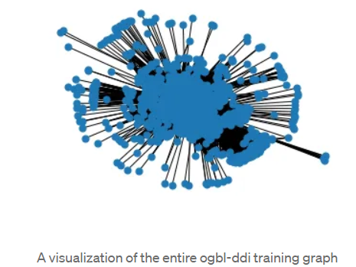
Multicontextual learning through incontext pruning with biomedical knowledge graph
Ogbl-ddi:
DATASETS
4,267 nodes
1,334,889 edges
Average node degree - 501
Clustering coefficient - 0.51

Slide 19
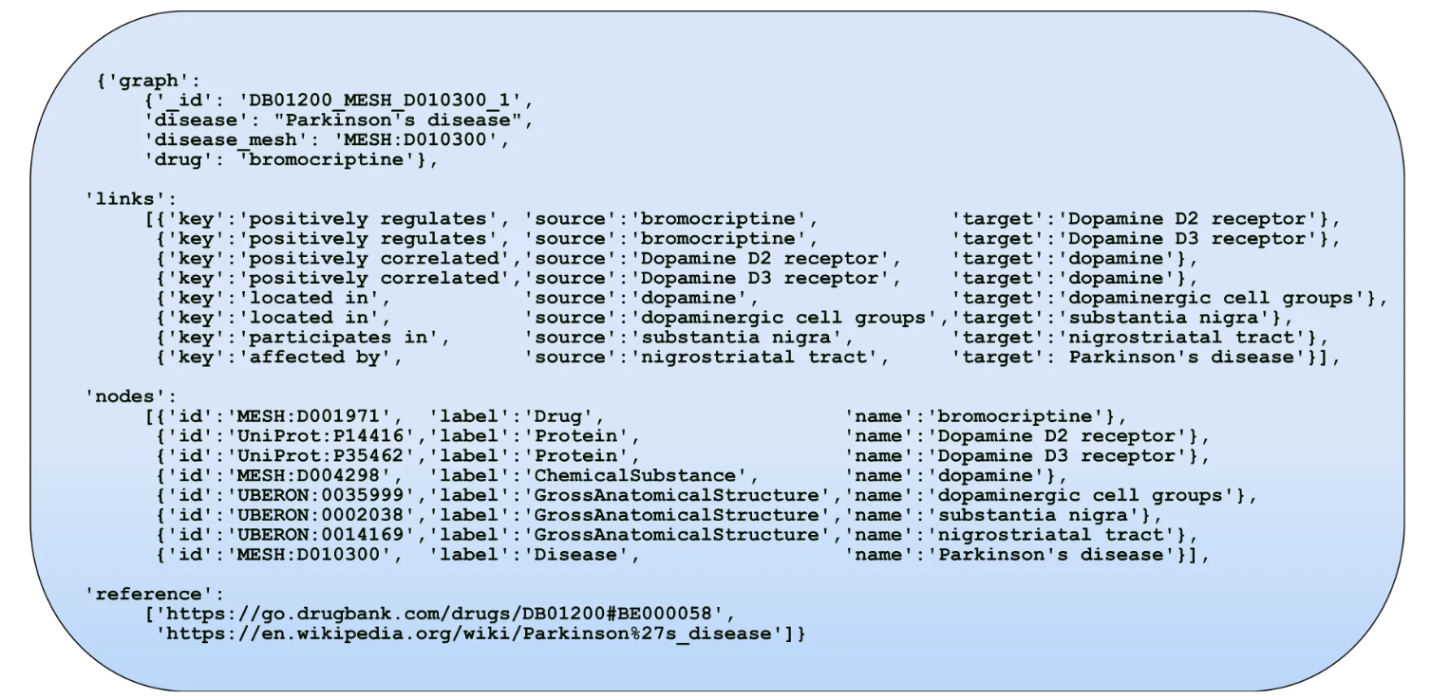
Multicontextual learning through incontext pruning with biomedical knowledge graph
DrugMechDB: A Curated Database of Drug Mechanisms
DATASETS

Slide 20
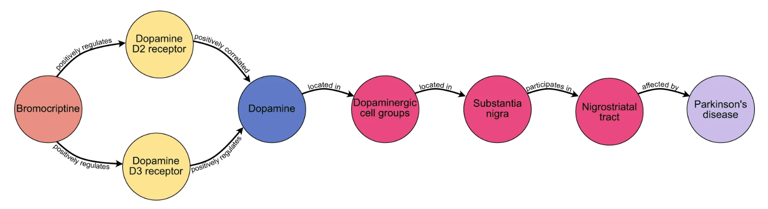
Multicontextual learning through incontext pruning with biomedical knowledge graph
DATASETS

Slide 21
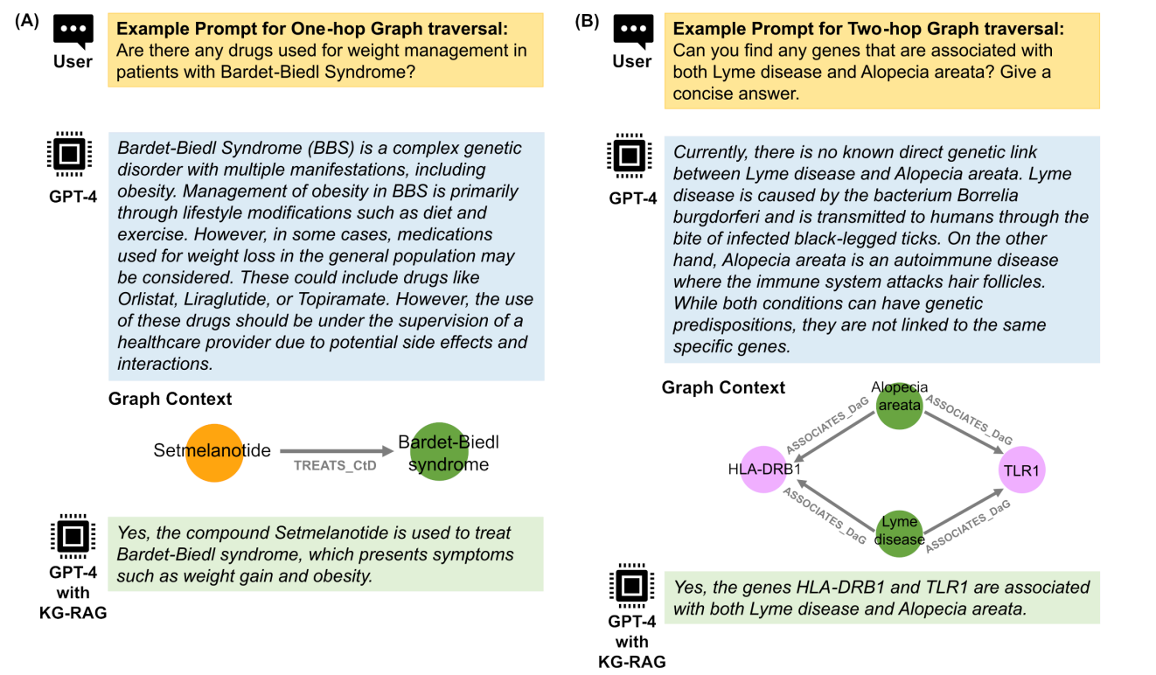
Multicontextual learning through incontext pruning with biomedical knowledge graph
DATASETS

Slide 22
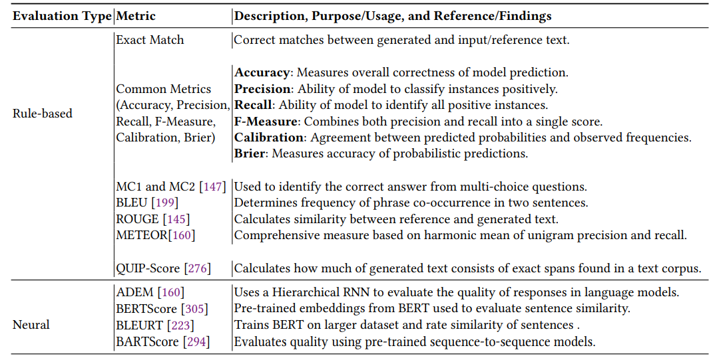
Multicontextual learning through incontext pruning with biomedical knowledge graph
Evaluation Metrics

Slide 23
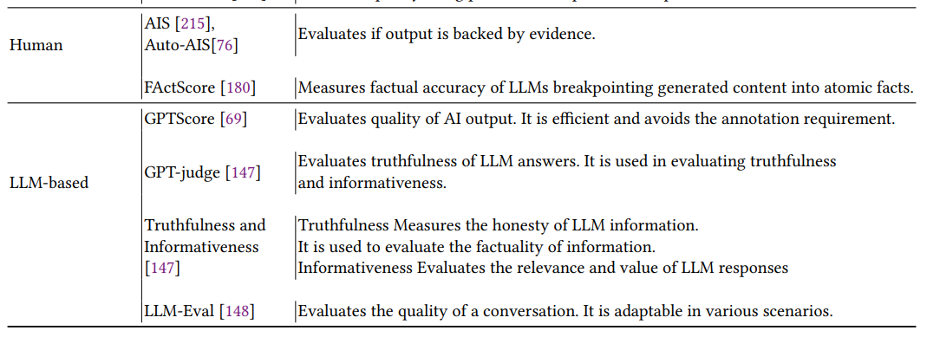
Multicontextual learning through incontext pruning with biomedical knowledge graph
Evaluation Metrics

Slide 24
Multicontextual learning through incontext pruning with biomedical knowledge graph
Applications/Use cases
Real-world Applications of Enhanced Biomedical LLMs
Medical Research: Assisting researchers in summarizing medical literature and generating hypotheses.
Clinical Decision Support: Providing evidence-based recommendations to clinicians.
Personalized Medicine: Offering tailored medical information based on individual patient data.
Drug Discovery: Accelerating the identification of potential drug candidates.
Health Information Systems: Improving the accuracy of information provided to patients and healthcare professionals.
Medical Education: Assisting in the training of medical students with up-to-date and contextually relevant information.

Slide 25
Multicontextual learning through incontext pruning with biomedical knowledge graph
Expected Deliverables
Capstone-I deliverables
Development of an LLM integrated with a biomedical knowledge graph that demonstrates a measurable improvement in accuracy and contextual understanding in the biomedicine domain.
Capstone-II deliverables
Evaluation of the performance of the enhanced LLM against existing models.
Optimization of the framework on biomedical datasets

Slide 26
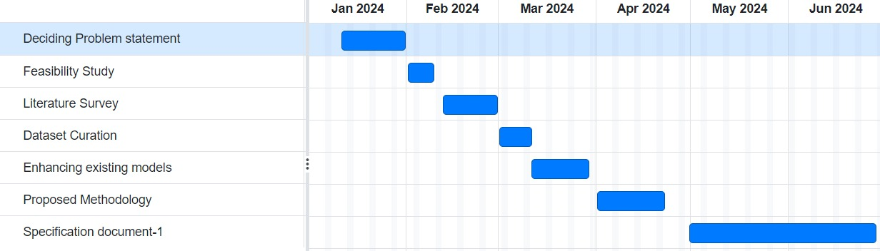
Multicontextual learning through incontext pruning with biomedical knowledge graph
Project Timeline

Slide 27
Multicontextual learning through incontext pruning with biomedical knowledge graph
Shirui Pan- Unifying Large Language Models and Knowledge Graphs: A Roadmap JOURNAL OF LATEX CLASS FILES-2024
Struct GPT A General Framework for Large Language Model to Reason over Structured Data
Yanjun Gao1 , Ruizhe Li2 , John Caskey1 , Dmitriy Dligach3 , Timothy Miller4 , Matthew M. Churpek1 and Majid Afshar1-Medical KG into LLM for Diagnosis Prediction:The paper "Leveraging A Medical Knowledge Graph into Large Language Models for Diagnosis Prediction"
Karthik Soman1 , Peter W Rose2 , John H Morris3 , Rabia E Akbas1 , Brett Smith4 , Braian Peetoom1 , Catalina Villouta-Reyes1 , Gabriel Cerono1 , Yongmei Shi5 , Angela Rizk-Jackson5 , Sharat Israni5 , Charlotte A Nelson6 , Sui Huang4 , Sergio E Baranzini-Biomedical knowledge graph-enhanced prompt generation for large language models
Garima Agrawal, Tharindu Kumarage, Zeyad Alghami, Huan Liu-Can Knowledge Graphs Reduce Hallucinations in LLMs? : A Survey
References

Slide 28
Multicontextual learning through incontext pruning with biomedical knowledge graph
References
Jeff Z. Pan, Simon Razniewski, Jan-Christoph Kalo, Sneha Singhania, Jiaoyan Chen, Stefan Dietze, Hajira Jabeen, Janna Omeliyanenko, Wen Zhang, Matteo Lissandrini, Russa Biswas, Gerard de Melo, Angela Bonifati, Edlira Vakaj, Mauro Dragoni, Damien Graux. 2023. Large Language Models and Knowledge Graphs: Opportunities and Challenges
Cunxiang Wang, Xiaoze Liu, Yuanhao Yue, Xiangru Tang, Tianhang Zhang, Cheng Jiayang, Yunzhi Yao, Wenyang Gao, Xuming Hu, Zehan Qi, Yidong Wang, Linyi Yang, Jindong Wang, Xing Xie, Zheng Zhang, Yue Zhang. 2023. Survey on Factuality in Large Language Models: Knowledge, Retrieval and Domain-Specificity
Hui Wu, Yuanben Zhang, Zhonghe Han, Yingyan Hou, Lei Wang, Siye Liu, Qihang Gong, Yunping Ge. 2024. Quartet Logic: A Four-Step Reasoning (QLFR) framework for advancing Short Text Classification

Slide 29
Thank You

