Slide 1

MODEL DOCTOR
Automated ML Audit Toolkit
A General-Purpose Auditor for Diagnosing Common ML Pipeline Failures
Yousuf S. R. Sakkaf
Notes:
WHAT:
Model Doctor is a general-purpose Python auditor that inspects an already-trained ML pipeline — the model plus the train/test data it was fit on — and flags common failure patterns automatically, without being hardcoded to any single model type or dataset.
WHY:
Clients increasingly hire ML practitioners not to build a model from scratch, but to audit and rescue one that already exists and isn't performing as expected — a differentiated, high-trust service compared to commodity model-building work. Manually checking a pipeline for every known failure mode is slow and easy to get wrong; this project automates that check.
Deck Flow:
1. The problem — why pipelines fail silently
2. What the tool detects, and why these categories specifically
3. Proof-of-work — 4 deliberately-flawed pipelines, built to break it
4. Generalizability — real and synthetic data it was never tuned against
5. Confidence scoring — going beyond severity alone
6. Beyond the notebook — CLI and live dashboard
7. Automated test suite
8. Key Challenges and Learnings
9. Conclusion and Future Scope

Slide 2




The Problem: Pipelines Fail Silently
The Central Question
A scaler fit before the train/test split
Duplicate rows leaking across splits
Can a single, model-agnostic auditor reliably catch real ML pipeline failures across different model types and datasets —
Accuracy reported on severely imbalanced data
while staying silent on pipelines that were built correctly?
A model that has simply memorized its training set
These rarely throw errors — they silently produce misleadingly good metrics that only surface once a model is already in production.
Notes:
WHAT:
Four examples of pipeline failures that don't throw exceptions — they just quietly produce numbers that look fine until the model reaches production.
WHY:
Each of these is genuinely hard to catch by eye: a leaked scaler still produces a valid-looking accuracy score; a model trained on duplicated data still "validates" against its own test set. The whole reason to automate this is that manual review misses exactly these cases.
HOW:
This project answers the central question in two stages, shown later in this deck: first, build pipelines that deliberately contain each of these bugs and confirm the auditor catches them (proof-of-work); second, run the same, unmodified auditor against real and synthetic data it has never seen, to confirm it isn't just memorizing its own test fixtures (generalizability).

Slide 3


What This Tool Detects
Data Leakage
Train/Test Contamination
Misleading Metrics
Scaler/encoder fit before the split
Duplicate rows across splits
Accuracy hiding a weak macro-F1
Overfitting Signals
Data Quality Issues
Class Imbalance
Large train/test performance gap
Missing values, column mismatches
Majority-class-only blindness
Every finding also carries a confidence score — how far past its flagging threshold it sits, not just severity.
Notes:
WHAT:
All 6 categories were implemented — not an arbitrary personal selection, but the exact Core Requirements named in the official problem statement.
WHY THESE AND NOT SOMETHING ELSE:
"Duplicate detection" and "missing-value detection" are not missing — they're already here, just organized under the failure mode they actually cause rather than as generic top-level checks: duplicate detection is train/test contamination specifically (the failure mode that matters for a pipeline), and missing-value detection is folded into data quality alongside column-mismatch and unseen-category checks.
General EDA — distributions, correlations, outlier exploration — is deliberately out of scope.
Model Doctor audits an already-trained pipeline's integrity; EDA is a different, upstream task that happens before modeling starts, not something you audit a trained pipeline for after the fact. Conflating the two would blur what the tool is actually for.
HOW:
Each detector is against a fitted estimator/Pipeline's own attributes (.steps, .predict, .predict_proba) rather than checking for a specific class, which is what lets one auditor work across LogisticRegression, RandomForest, XGBoost, and DecisionTree without per-model special-casing.

Slide 4
Proof-of-Work: 4 Deliberately-Flawed Pipelines
Built specifically to break the auditor — then confirmed it caught every one.
#
Dataset
Model
Bug Demonstrated
Result
1
breast_cancer
LogisticRegression
Scaler fit before split
Critical
2
wine
RandomForest
Duplicate rows injected
Critical
3
diabetes (regression)
XGBoost
Unconstrained depth
Critical
4
breast_cancer (imbalanced)
LogisticRegression
Severe imbalance + misleading acc.
Critical
Every intended bug was caught, correctly scored as critical, with a plain-language explanation and a concrete suggested fix.
Notes:
WHAT:
Four pipelines, each engineered to contain exactly one known bug, spanning 3 model types and both classification and regression.
WHY:
Rather than rely on organizer-provided broken examples, this project builds its own proof-of-work — demonstrating the auditor catches real bugs it was never told about in advance, only shown the resulting fitted model and data.
HOW:
Pipeline 1: StandardScaler fit on the full dataset before the split, so it "sees" test-set statistics during training.
Pipeline 2: 8 training rows deliberately duplicated into the test set.
Pipeline 3: an unconstrained, deep XGBoost regressor on a small (442-row) dataset — a textbook overfitting setup.
Pipeline 4: breast_cancer resampled to a ~62:1 class imbalance, with a regularized LogisticRegression that leans toward the majority class.
Each pipeline's exact evidence numbers (contamination %, R² gap, accuracy vs. macro-F1) are detailed in the notebook's own Interpretation blocks.

Slide 5
Generalizability: Beyond Our Own Fixtures
The same, unmodified auditor — run against data it was never tuned against.
Titanic
INDUSTRY.csv
make_classification
make_regression
Real data
Real, 15,000 rows
Synthetic
Synthetic
1 Critical
0 Findings
1 Warning
1 Warning
Genuine duplicate feature-rows — not a planted bug
Clean pass on a properly-built, honestly-weak model
Moderate, correctly-scaled overfitting signal
Moderate, correctly-scaled overfitting signal
Generalizability is weighted second most heavily among this challenge's evaluation criteria — right after detection breadth.
Notes:
WHAT:
Four checks run against data and models the detectors were never tuned against: two real external datasets (Titanic, INDUSTRY.csv) and two synthetic datasets.
WHY:
Proof-of-work alone only shows the auditor catches bugs it was built to catch.
This is the harder, more meaningful test: does it hold up on genuinely unfamiliar data, in both directions — correctly flagging real problems, and correctly staying quiet on real, honest work?
HOW — the two standout results:
Titanic:
Built with a correctly-written pipeline, no injected bugs at all — yet still flagged critical contamination, because several passengers genuinely share identical feature values once identifier columns are dropped.
This is real, unplanted evidence the tool works on unfamiliar data, not a manufactured example.
INDUSTRY.csv:
A regularized RandomForest with an R² near zero (a poor model) still produced zero findings — correctly, because Model Doctor audits pipeline integrity, not model quality. Those are different questions, and conflating them would make the tool less trustworthy.

Slide 6
Confidence Scoring: Beyond Severity
Severity answers “how bad.” Confidence answers “how sure are we this isn’t a borderline call.”
Borderline Case
Clear-Cut Case
Class imbalance ratio: 4.3 : 1
(threshold is 4.0 : 1)
Class imbalance ratio: 24 : 1
(threshold is 4.0 : 1)
51%
99%
confidence
confidence
Both are flagged with the same severity — but confidence makes the difference between them visible, computed directly from each detector's own threshold math, not a separately invented number.
Notes:
WHAT:
Every finding across all 6 detectors now carries a confidence score (0-100%), in addition to its severity label.
WHY:
Severity alone treats a value that's just barely past its flagging threshold identically to one that's wildly past it, as long as both land in the same bucket.
That loses real information — a real auditor would treat those two cases very differently.
This is a genuine enhancement, not a checkbox: it changes what a reader can conclude from a finding, not just how it looks.
HOW:
Confidence rises from 50% (just past threshold — genuinely borderline) toward 99% as a value moves further past that threshold, computed from numbers each detector already produces — a gap, a ratio, a percentage — never a separately invented certainty judgment.
This was implemented, tested (2 dedicated tests confirming confidence scales with severity and stays bounded 0-1), and is visible in every report format: HTML, Markdown, the CLI, and the dashboard.

Slide 7


Beyond the Notebook: The CLI
Command-Line Tool
Works identically in a Colab shell or a local terminal — a plain script, not a server.
python model_doctor_cli.py \
--model model.pkl \
--train train.csv \
--test test.csv \
--target Survived \
--out report.html
Audits any saved .pkl / .joblib model — satisfies the “works via CLI” bonus directly
Timestamped output filenames, glob-based “latest model” pickup — matches real ML-ops file conventions
Shares audit_from_files() with the dashboard’s “existing model” mode — one function, two interfaces
Non-Technical GUI Too
Mode 1: upload a CSV, pick a target and model — trains and audits in one step.
Mode 2: upload an existing .pkl model plus its train/test CSVs — audits it as-is.
Both shown in full on the next two slides. No code required — goes beyond the brief entirely.
Notes:
WHAT:
The CLI script — model_doctor_cli.py — audits any saved model from a terminal or Colab shell.
WHY:
Someone integrating this into a real workflow wants a script callable on any saved model, not a notebook they have to open and run cell-by-cell.
HOW:
Takes --model, --train, --test, --target, --out. Internally calls the same audit_from_files() function the dashboard's second mode uses, so this wasn't two separate builds — one function, two interfaces.
Output filenames are timestamped by default, and the notebook's own CLI demo cell shows the realistic pattern of picking up the most recently created model via glob rather than a hardcoded filename.

Slide 8
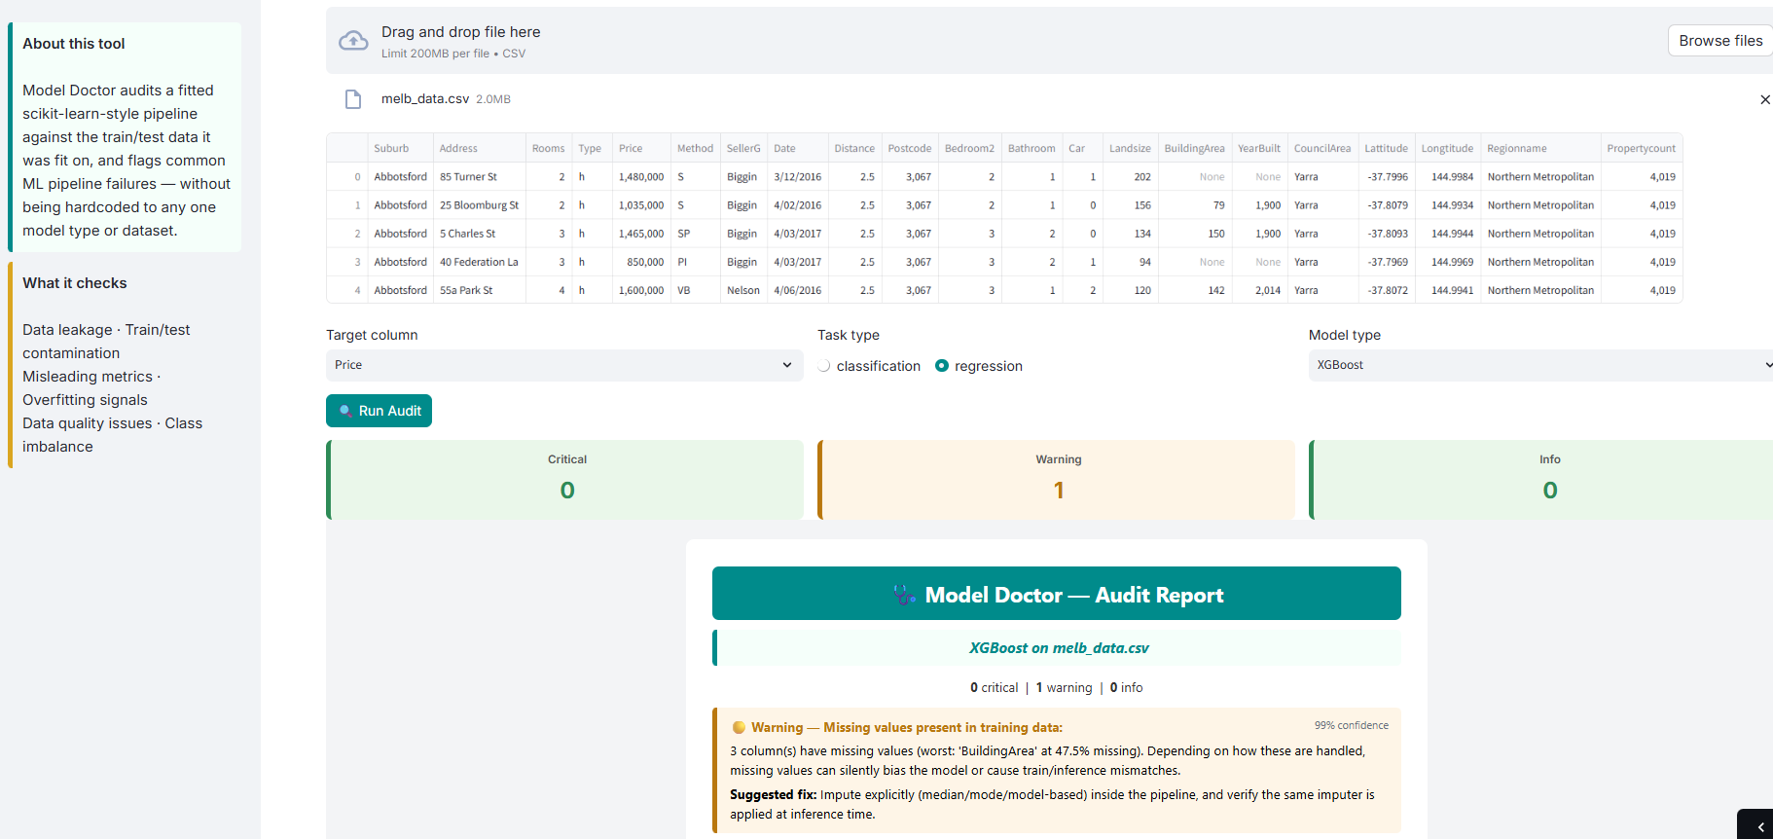
Live Dashboard: Train & Audit a New Model
How It Works
Upload any CSV
Pick target column, task type, and model (LogisticRegression / RandomForest / XGBoost)
One click trains the model and runs the full audit
KPI row + full report render inline, with confidence % on every finding
Built-in cleanup for messy numeric columns (currency symbols, commas) with a friendly warning — not a crash
Notes:
WHAT:
The dashboard's first mode: Upload a raw CSV, and it handles training and auditing end to end.
WHY:
This is the fastest way for someone to try the tool on their own data with zero setup — no notebook, no CLI, no code.
HOW:
The app splits train/test itself, fits the chosen model correctly (no injected bugs — this is a genuinely honest pipeline by construction), and runs the same run_audit() every other interface uses. The KPI cards are colored by severity with a matching background tint (not just a border), fixed after an earlier version made critical/warning/info look nearly identical.
Target-column cleaning handles common real-world formatting issues (commas, currency symbols) with a warning rather than crashing outright, since raw uploaded CSVs are rarely as clean as curated ones.

Slide 9
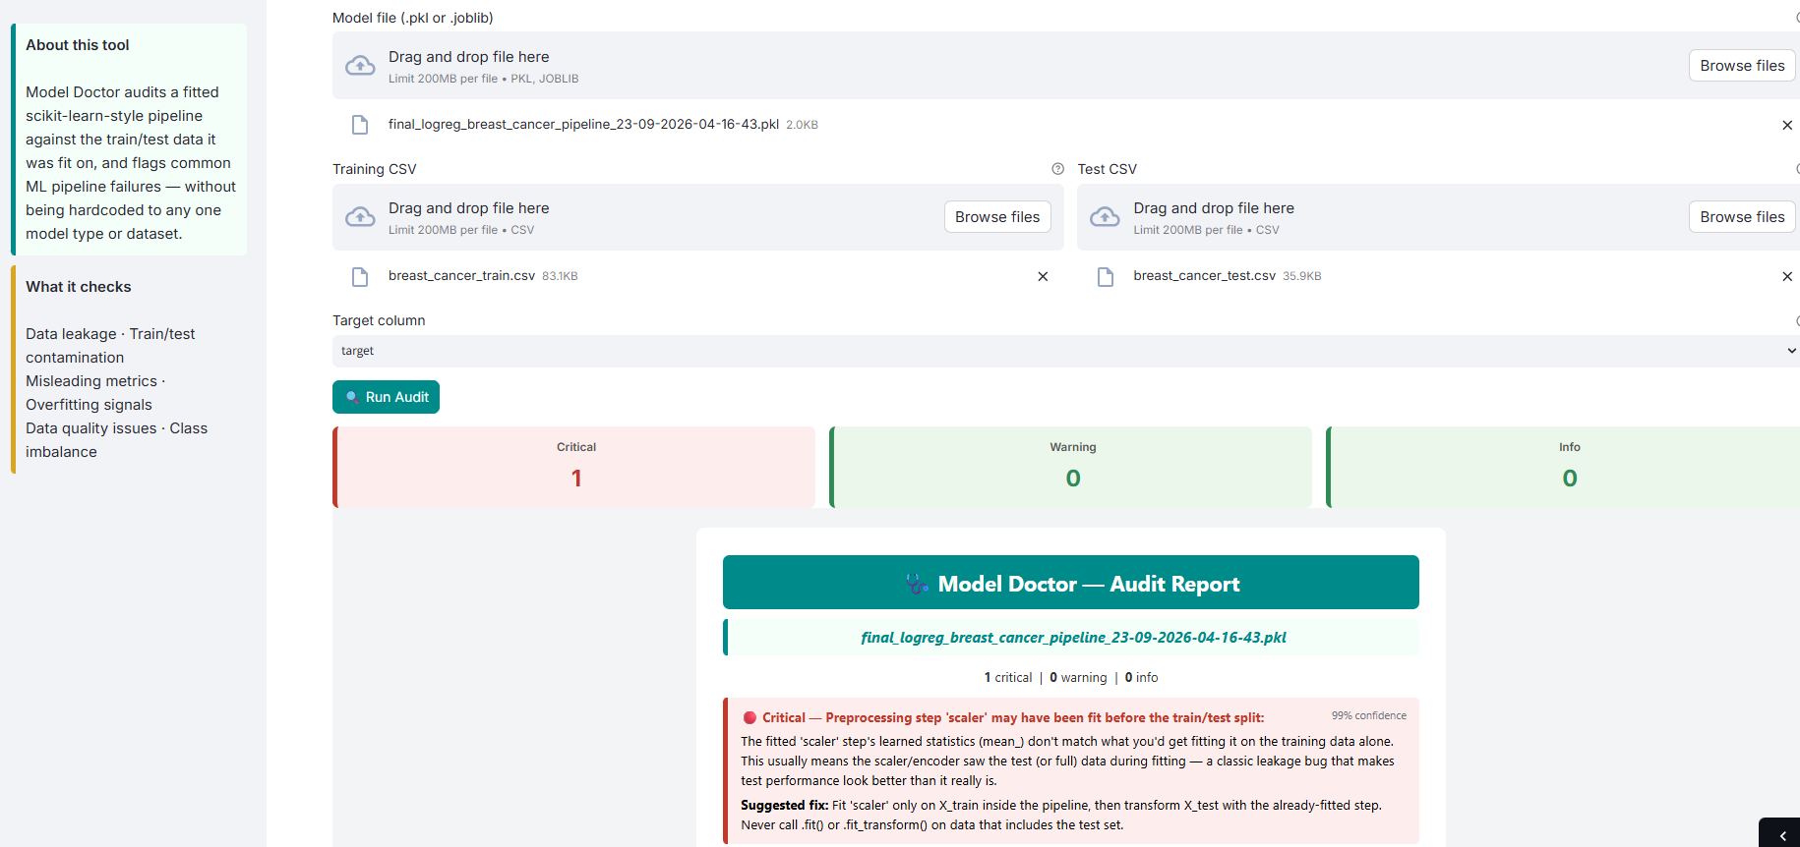
Live Dashboard: Audit an Existing Model
How It Works
Upload a fitted .pkl / .joblib model
Upload the exact train and test CSVs it was evaluated on
Target column is a real dropdown, populated from the uploaded CSV — no manual typing, no typos
Runs audit_from_files() — the same function backing the CLI
This is the GUI equivalent of the CLI bonus feature
Notes:
WHAT:
The dashboard's second mode: Bring an already-trained model and audit it as-is, without retraining anything.
WHY:
This mirrors a common real scenario — someone hands you a model file and asks "is this pipeline okay?" without wanting it retrained from scratch.
HOW:
The target-column field started as a free-text input, which meant typing an exact, case-sensitive column name by hand — error-prone.
Fixed by reading the uploaded training CSV's header the moment it's uploaded and populating a real dropdown, matching the first tab's experience.
Uses Streamlit's file-object .seek(0) reset so the same upload can be previewed for column names and then saved to disk without going stale.

Slide 10

Validation: 15 Automated Tests
Each of the 6 detectors gets a positive test (fires on a genuinely broken scenario) and a negative test (stays silent on a clean one)
2 additional tests confirm confidence scores scale with severity and stay bounded between 0 and 1
1 end-to-end smoke test runs the full run_audit() pipeline
Every fixture is built fresh inside the test itself — no dependency on project CSVs, so tests stay fast, deterministic, and independent
15 / 15
tests passing
pytest Tests/ -v
Notes:
WHAT:
15 pytest tests, covering every detector's positive and negative behavior plus confidence-score sanity checks.
WHY:
A test suite proving the auditor catches what it claims to catch is an explicit requirement of this challenge, not just good practice.
HOW:
Tests build their own minimal synthetic fixtures inline (via make_classification/make_regression or small hand-built DataFrames) rather than depending on Titanic.csv, INDUSTRY.csv, or any other project file — standard practice, since a test that depends on an external file can fail for reasons that have nothing to do with whether the detector logic actually works.
Symmetry matters here: every detector originally had only a "does it fire" test; two "does it stay silent" tests were added afterward specifically to close that gap for misleading-metrics and overfitting.
All 15 tests, grouped by detector:
Train/test contamination
- test_detects_duplicate_rows_across_splits
- test_no_false_positive_on_clean_split
Preprocessing leakage
- test_detects_scaler_fit_before_split
- test_no_false_positive_when_scaler_fit_correctly
Class imbalance
- test_detects_severe_class_imbalance
- test_no_false_positive_on_balanced_classes
- test_confidence_scales_with_severity_of_imbalance
- test_confidence_is_bounded
Misleading metrics
- test_detects_accuracy_f1_gap_on_imbalanced_data
- test_no_false_positive_on_balanced_metrics
Overfitting signal
- test_detects_overfitting_regression
- test_no_false_positive_on_well_fit_regression
Data quality
- test_detects_missing_values
- test_detects_column_mismatch
End-to-end
- test_run_audit_end_to_end_smoke

Slide 11

Key Challenges & Learnings
Scope: Why These 6 Categories
Detection vs. Correction Is a Different Problem
Not an arbitrary choice — these are the exact Core Requirements named in the brief. “Duplicates” and “missing values” aren’t gaps: they’re folded into contamination and data-quality respectively. General EDA is out of scope by design — auditing a trained pipeline is a different task from exploring data before modeling.
The brief's bonus asks for auto-suggest, apply, and re-run with a before/after comparison. The key learning: detecting a bug is a check, but automatically and safely correcting six different failure types across four model types is six mini-projects, not one feature. Judged too high-risk to attempt without threatening everything already working.
Bonus items actually implemented: severity scoring, confidence scoring, and the CLI-on-any-.pkl feature.
Notes:
On detectors:
This is covered in more depth on the "What This Tool Detects" slide and in the notebook's own cover section.
On auto-fix:
The risk isn't conceptual, it's concrete — correctly rewriting someone's pipeline for leakage means safely restructuring their fit/transform calls;
for imbalance it means correctly applying class_weight or resampling;
for overfitting it means correctly reducing model capacity — each fix is effectively its own project, multiplied by 6 failure types and 4 model types.

Slide 12
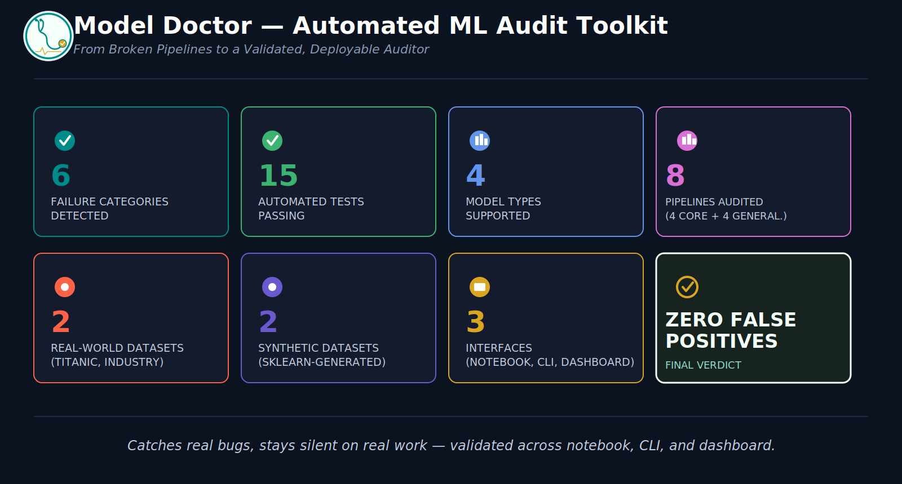
Notes:
The full project, in eight numbers — detection scope, validation depth, and the final verdict, all in one view.
This is a recap of results already earned, not a spoiler of the conclusion before the case for it has been made.
Every number here is traceable to a specific slide already shown: 6 failure categories, 15 passing tests, 4 model types, 8 total audits run (4 proof-of-work + 4 generalizability), 2 real-world datasets, 2 synthetic datasets, 3 separate interfaces, and zero false positives as the final verdict.

Slide 13


Conclusion & Future Scope
Final Verdict
Zero false positives across every tested scenario, real and synthetic alike — severity- and confidence-aware, model-agnostic auditing is achievable without hardcoding to any single dataset or model type.
Future Scope
Auto-suggest-and-apply-fix, with a before/after comparison — the highest-effort deprioritized bonus (see previous slide)
Extending leakage detection to more preprocessing types (e.g. SimpleImputer, not just scaler-style attributes)
A CLI flag to run the full generalizability suite against a user-supplied model directly
GITHUB: Model Doctor Repo
STREAMLIT: Model Doctor Dashboard
Thank You
Notes:
Closing summary, remaining future work, and where to find everything — repository, live dashboard.
This project set out to answer one question: can one auditor genuinely generalize across model types and unfamiliar data.
Every result in this deck — 4/4 proof-of-work pipelines caught, 4/4 generalizability checks behaving correctly, 15/15 tests passing — supports the same answer.
The future-scope items are the honest remainder: known, scoped, and deliberately not rushed.
Recap of Toolkit:
model_doctor.py — the core detector library, 6 categories, confidence-scored.
model_doctor_demo.ipynb — proof-of-work, generalizability, and test-suite narrative.
model_doctor_cli.py — audits any saved .pkl/.joblib model from a terminal.
model_doctor_dashboard.py — live, no-code GUI, two modes.
Tests/test_detectors.py — 15 automated tests.

