Slide 1
Bike Rental Demand
Analysis & Insights
Yousuf S. R. Sakkaf

Slide 2
Project Objective
Understand rental demand patterns
Analyze impact of weather & time
Identify peak usage behavior
Enable data-driven decisions

Slide 3
Dataset Overview
1000 hourly records
Time range: Jan–Feb
Key variables:
Temperature, Humidity, Windspeed
Weather conditions
Time Slots
Casual & Registered users

Slide 4
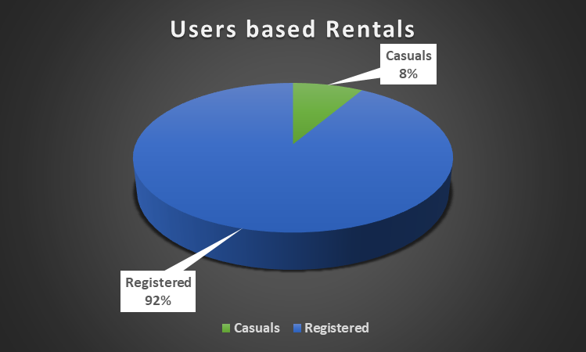
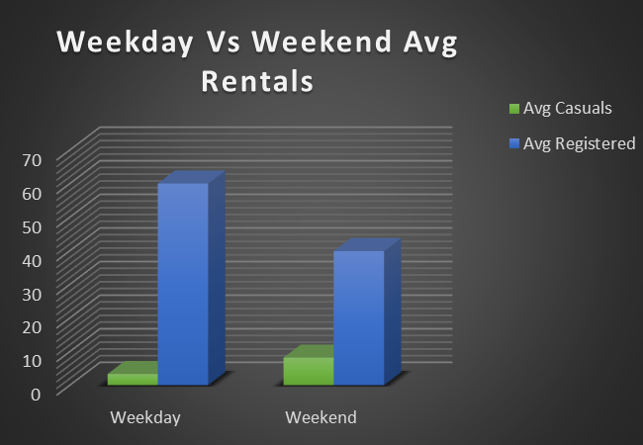
Users Activity
Notes:
Registered users dominate the system, indicating consistent commuter-driven demand.
Casual usage increases during weekends, suggesting recreational usage patterns

Slide 5
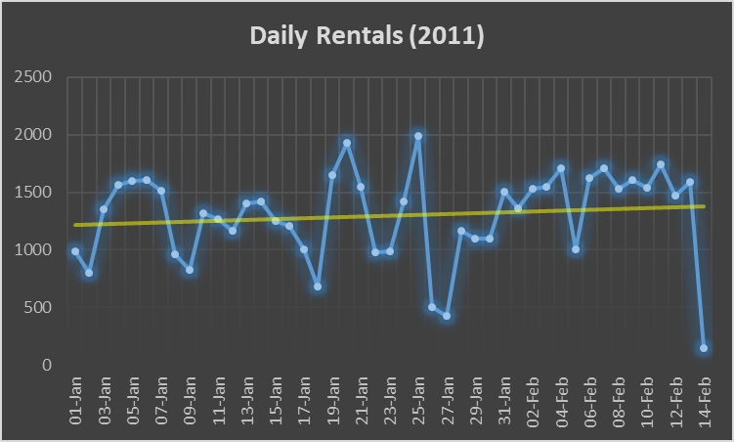
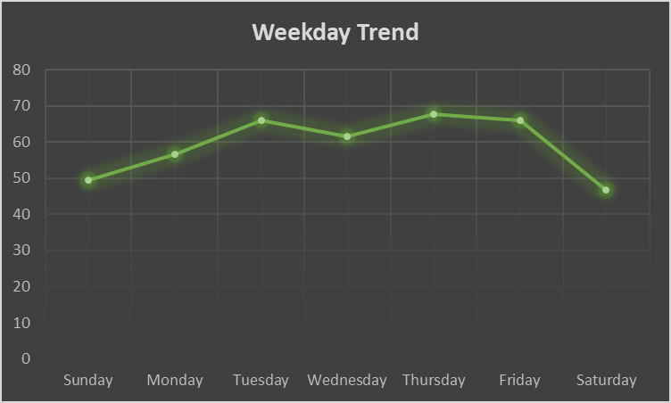
Trend Analysis
Notes:
Rental demand fluctuates daily with visible peaks and drops.
Mid-week demand is highest, weekends show different usage behavior.

Slide 6
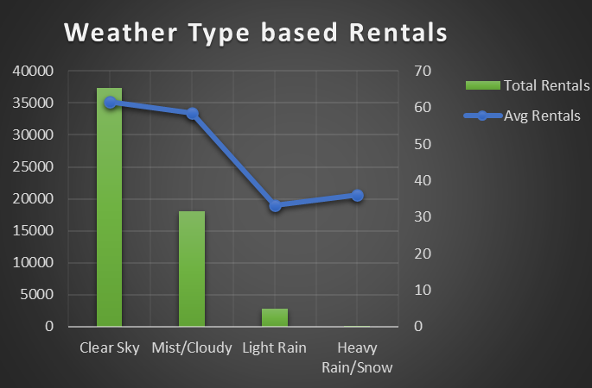
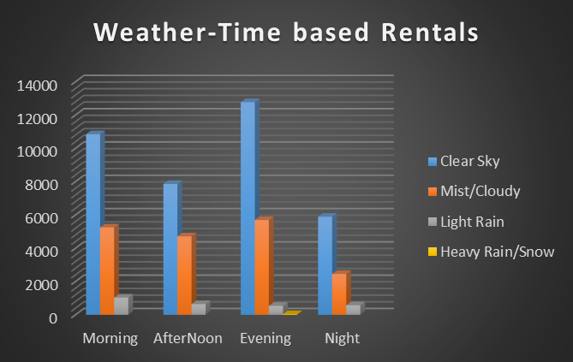
Weather Impact
Notes:
Clear weather drives higher demand, while adverse conditions reduce usage.
Evening time too have higher usage

Slide 7
KPIs
KPI | Values
🚲 Total Rentals | 58304
📊 Average Rentals/Hr | 58
⏰ Peak Hour | 5 PM
☀️ Best Weather | Clear Sky
🌆 Peak Time Slot | Evening
Notes:
Clear weather drives higher demand, while adverse conditions reduce usage.
Evening time too have higher usage

Slide 8
Heat Map
Notes:
Peak demand occurs during evening hours, especially on weekdays.
Apart from these two Heat Maps, we have Heat Maps for Humidity based as well as Windspeed based, but it doesn’t significantly show any additional changes.

Slide 9
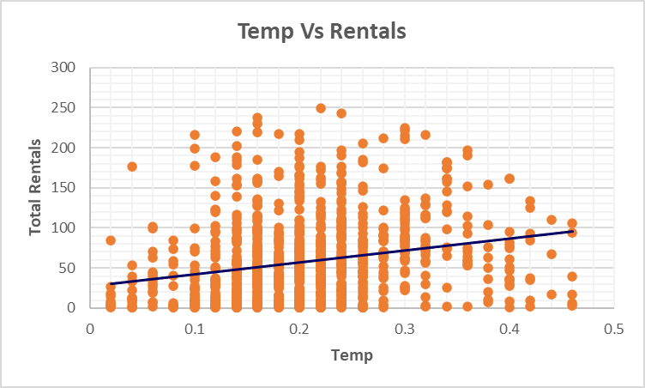
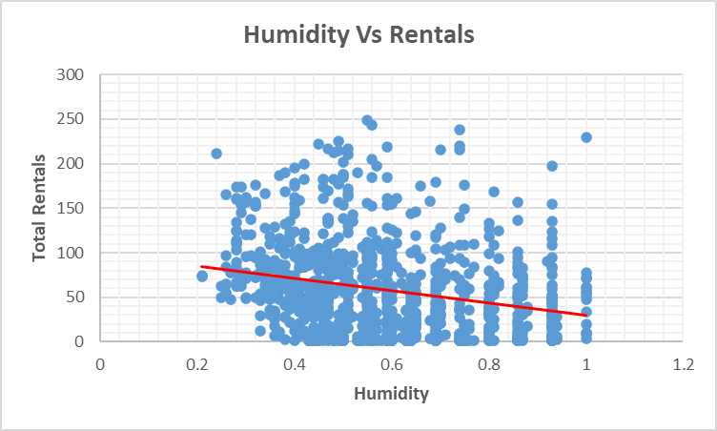
Scatter Analysis
Notes:
Higher temperatures are associated with increased rental activity.
Additional we have scatter analysis for Humidity Vs Rentals as well as Windspeed Vs Rentals.
With Increase in Humidity, the rental usage decreases

Slide 10
Descriptive Analysis
Notes:
Descriptive analysis shows that rental demand is highly variable, with registered users contributing the majority of usage, while environmental factors such as humidity exhibit moderate variability.

Slide 11
Correlation Analysis
Notes:
Temperature positively correlates with demand, while humidity shows a negative relationship.

Slide 12
Forecasting
Notes:
Forecasting suggests stable demand patterns with predictable fluctuations
We have considered forecasting from 15th February till 18th March

Slide 13
Key Insights
Peak demand occurs during evenings
Registered users dominate rental usage
Weather significantly impacts demand
Demand shows high variability
Business Recommendations
Increase bike availability during peak hours
Use weather forecasts for demand planning
Target casual users on weekends
Offer promotions during low-demand periods

Slide 14
Conclusion
Demand driven by time & weather factors
Strong reliance on regular commuters
Opportunity for demand optimization & forecasting

Slide 15
THANK YOU
FOR YOUR ATTENTION

