Slide 1
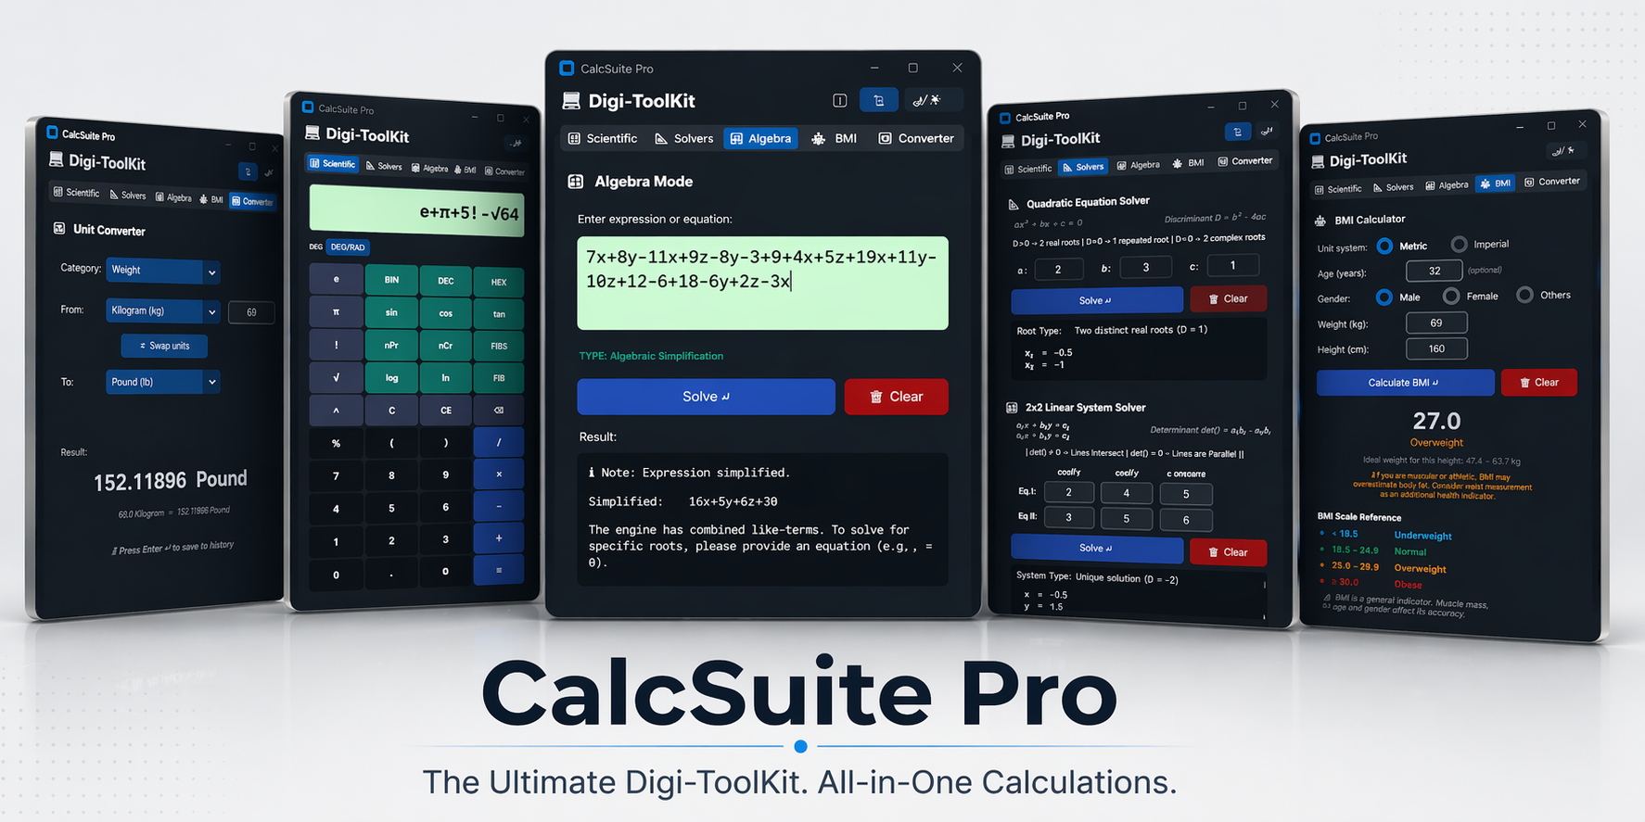
Yousuf S. R. Sakkaf | Version 7.6 Final Release
Notes:
Why did I build CalcSuite Pro?
The baseline assignment asked for a simple calculator script, but the software engineering industry demands scalable systems.
I approached this project not as a basic GUI task, but as a full-scale architectural challenge.
How did I achieve this?
By engineering a 'Digi-ToolKit'—a multi-tool workstation built with a strict focus on secure parsing, resilient data validation, and dynamic state management, proving the application can scale far beyond standard arithmetic.

Slide 2
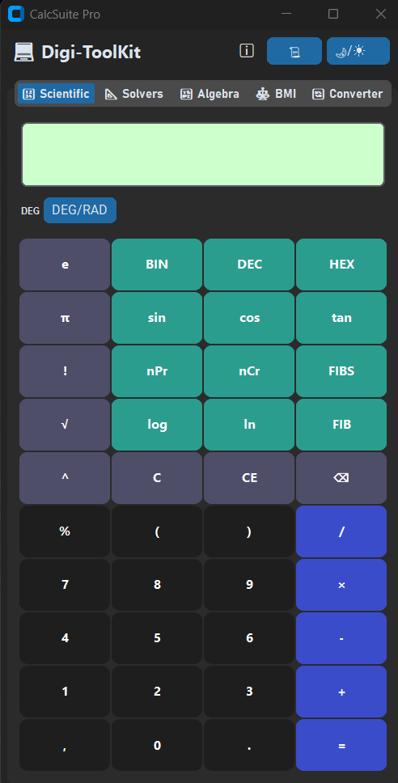
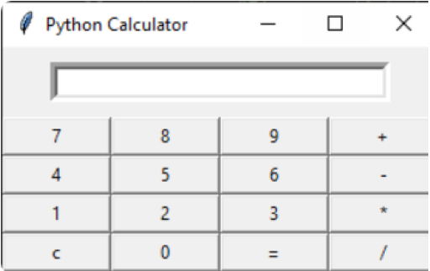
Project Scope & Requirements
Core Identity
A professional, multi-tool mathematical workstation.
The Requirements
Documented Baseline: Basic Tkinter GUI for standard arithmetic.
Additional Expansion 1: Integration of essential scientific operations.
Additional Expansion 2: Implementation of algebraic variable simplification.
The Delivered Suite
Architecture: 5-Tab CustomTkinter GUI replacing the single-screen constraint.
Logic: Regex-powered dispatcher engineered for complex algebra.
Security: Standard evaluation replaced with a zero-trust AST parsing engine.
Notes:
Why deliberately expand the scope from a single calculator into a 5-tab workstation?
To demonstrate commercial-grade system architecture.
A single tab proves you can write a math loop; five tabs prove you can manage complex application boundaries.
How is this structured?
I compartmentalized specific computer science challenges: secured parsing in the Scientific Engine, Deterministic algorithms in the Solvers, heuristic routing in the Algebra tab, and dynamic data handling in the BMI and Converter tabs.
This proves the application operates as a complete, resilient desktop environment.

Slide 3
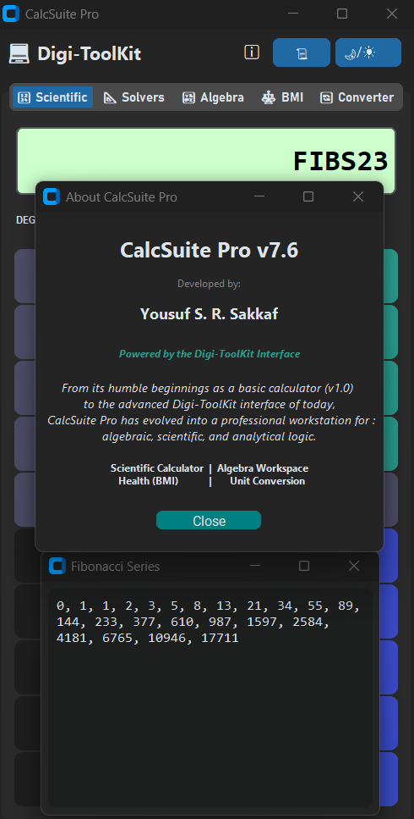
Architecture & UI/UX
Framework Selection:
Adopted customtkinter (Python 3.10+) to replace legacy graphics.
Enabled hardware-accelerated rendering and native Light/Dark themes.
Object-Oriented Structure:
Centralized state management via a primary GUI Class.
Five independent TabView frames routed through a single master window.
UX Engineering:
Engineered a 450ms state-transition delay to prevent jarring UI flashes.
Implemented responsive grid geometry to prevent window clipping.
Notes:
Why did I bypass standard Tkinter?
Because standard Tkinter lacks the hardware-accelerated rendering necessary for modern UI persistence.
How does the application manage five independent tools without suffering memory leaks or state collision?
By wrapping the entire application state within a single main Object-Oriented Class.
This allows global resources—like the History Manager—to capture and tag data across all five tabs simultaneously without relying on fragile inter-class callback loops.
Furthermore, why implement a specific 450-millisecond auto-redirect delay?
To highlight the UX Engineering: I programmed it specifically to support the engine's 'Smart Routing.’
If a user is in the Scientific Tab and enters an algebraic equation with variables (especially for simplification), the system doesn't just throw an error (when the user press “=“ button or ENTER).
It automatically intercepts the variables and physically redirects the user's UI to the Algebra tab.
The 450ms delay ensures this cross-tab transition happens smoothly without jarring screen flashes, creating a seamless bridge between the different mathematical engines.
Finally, I programmed strict modifier-key guards (Shift/Ctrl/Alt) to protect the execution threads from phantom keystrokes.

Slide 4
Tab 1 - Scientific Engine & Security
The Security Imperative:
Abandons vulnerable eval() and exec() functions entirely.
AST Parsing Engine:
Deconstructs mathematical strings into structural nodes via Python's ast module.
Nodes are strictly verified against a hardcoded operator whitelist.
Predictable Execution:
Explicit operators (e.g., 2*x) deliberately enforced to prevent parser ambiguity.
+
*
5
2
x
Example AST: 2*x + 5
Notes:
Why is Python's built-in eval() function strictly prohibited in this application?
Because executing arbitrary strings as live code creates a catastrophic code-injection vulnerability.
How did I secure the core engine?
I utilized Python's Abstract Syntax Tree (ast) module.
The engine safely parses mathematical strings into structural nodes, explicitly whitelisting only safe operations.
Furthermore, why build a custom AST parser rather than importing a heavy Computer Algebra System like SymPy?
To prove foundational competency in tokenization. To guarantee absolute computational predictability, the engine intentionally enforces explicit operators, protecting the parser from the ambiguity of standard calculator logic.
DEFENSE NOTE:
While the backend AST parser handles implicit multiplication via keyboard input perfectly, the UI buttons are deliberately programmed to enforce explicit operators (e.g., requiring 2*sin(30)).
This is a strict design choice to prevent any string-concatenation ambiguity and guarantee zero-trust security during UI evaluation.

Slide 5
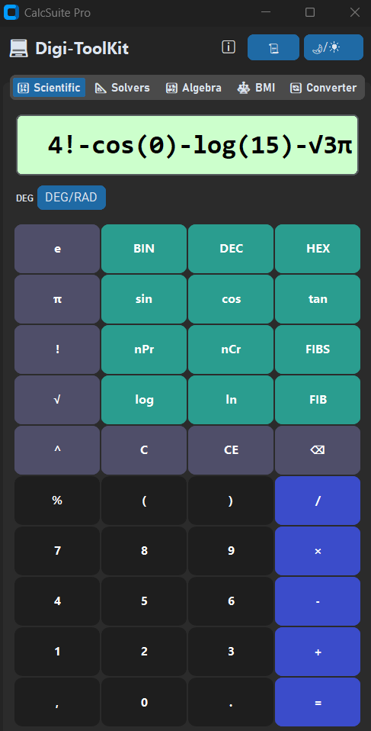
Tab 1 - Scientific Engine (Advanced Features)
Fulfilling Additional Requirements:
Engine scaled beyond standard arithmetic to include comprehensive scientific operations.
Advanced Mathematical Suite:
Non-Linear Math: Natively handles roots (√), powers (^), logs, and trigonometry (with global DEG/RAD tracking).
Combinatorics & Sequences: Integrated functions for factorials, nPr, nCr, and Fibonacci generation.
Radix Conversions: Programmed specific computational translations (DEC to BIN/HEX, and BIN to DEC).
Constant Integration:
Hardcoded support for mathematical constants (π and e) directly within the AST parsing sequence.
Notes:
To understand why I selected these specific advanced features, you have to look at the target user.
I wanted to build a true computer science and engineering toolkit, which requires moving beyond basic arithmetic to support discrete mathematics, like Combinatorics, and non-linear math like Trigonometric and Logarithmic.
How does the engine handle this safely?
Instead of writing fragile, separate parsers for every new function, I hardcoded constants like Pi and Euler's number directly into the AST parsing sequence so they evaluate seamlessly alongside standard integers.
For the base conversions, I deliberately engineered a decimal-centric translation system.
Rather than building a sprawling multi-radix matrix, the engine specifically translates Decimal values into Binary or Hexadecimal, and converts Binary strings back to Decimal.
This architectural choice keeps the computational overhead incredibly light while fulfilling the exact bitwise translation needs of a programmer.

Slide 6
Tab 3 - Smart Algebra (Engine Logic)
The 7-State Dispatcher:
Engine auto-detects natural language input and routes to one of 7 distinct mathematical states (from pure arithmetic to bracket expansion).
Dictionary-Based Engine Scope:
Establishes a deliberate architectural boundary against full CAS (Computer Algebra Systems).
Utilizes robust Dictionary mapping (defaultdict) to safely extract, collect, and stack polynomial like-terms.
Proactive Architecture:
Type 7 Guardrail natively intercepts unsupported logic (cross-terms like xy, or polynomials degree > 2) before evaluation, returning graceful UI hints.
The Smart Dispatcher
Type 1 : Numeric Bypass
Type 1 : Numeric Bypass
Type 2 : Simplification
Type 2 : Simplification
Type 3 : Linear (1 var)
Type 3 : Linear (1 var)
Type 4 : Linear (2x2)
Type 4 : Linear (2x2)
Type 5 : Quadratic
Type 5 : Quadratic
Type 6 : Bracket Expansion
Type 7 : Polynomial Guard
Notes:
The fundamental challenge with algebraic input is that it is entirely unstructured.
Why did I build a 7-State Smart Dispatcher instead of a standard parser?
Because the engine needs to dynamically deduce human intent from a raw string.
By scanning for structural triggers—like a comma or an equals sign—the dispatcher instantly knows whether it's looking at a linear equation or a 2x2 system.
How does it process the math without relying on a massive external Computer Algebra System?
The engine tokenizes the string and maps the variables using Python's defaultdict.
This allows it to mathematically stack like-terms dynamically without throwing dictionary KeyErrors.
Finally, to ensure absolute thread stability, I had to protect the engine from impossible inputs. How?
I programmed a Polynomial Guard that proactively scans for cross-variables and polynomial degrees exceeding 2.
It intercepts unsupported equations before they ever reach the execution phase, safely aborting the process and returning a graceful UI hint.

Slide 7
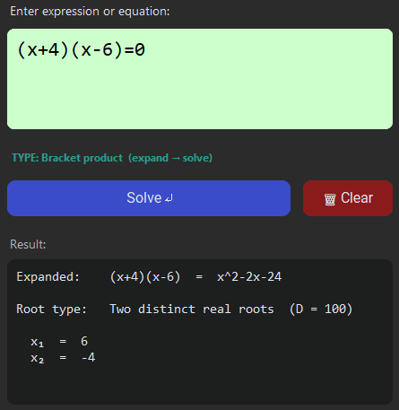
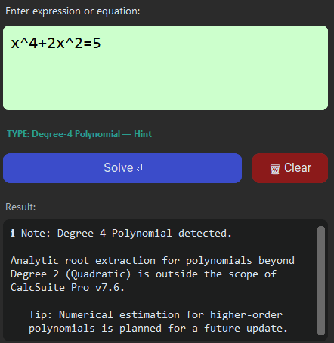
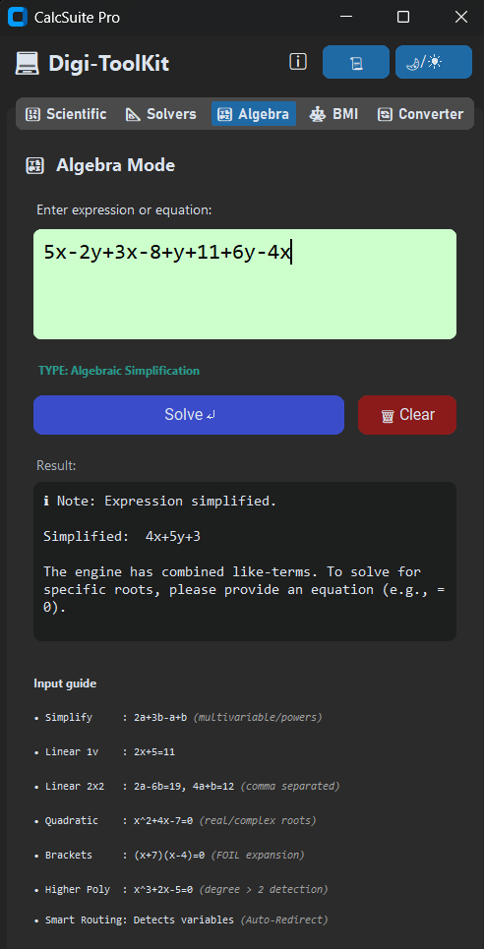
Tab 3: Smart Algebra (Live Execution)
State 6: Dictionary-Based Expansion
State 7: Architecture Shield (Polynomial Guard)
State 2: Algebra Workspace (Heuristic Simplification)
State Routing Completion:
State 1 & 3: Standard arithmetic (Numeric Bypass) and Single-Variable Linear (1v) equations are evaluated natively within this workspace.
State 4 & 5: Advanced Linear 2x2 and Quadratic systems evaluate natively here, with dedicated deterministic counterparts in the Solvers Tab (Next Slide)
Notes:
Previous Slide detailed the theoretical architecture, but this slide demonstrates the engine in live execution.
First, looking at the simplification output, you can see how the engine directly fulfills Additional Expansion 2.
Why does it handle this so cleanly?
Because the dispatcher isolates expressions without an equals sign and uses the dictionary mapping to mathematically stack like-terms.
How does the UI handle more complex logic, like bracket products?
I specifically designed the result output as a multi-line, read-only textbox rather than a standard single-line display.
When the dispatcher intercepts a bracket, it dynamically renders the intermediate polynomial expansion for step-by-step transparency.
Finally, the guardrail image proves the absolute resilience of the application state. Notice how the engine reacts to an unsupported Degree-4 polynomial?
Instead of throwing a fatal terminal error, it gracefully intercepts the out-of-scope degree and renders an instructional UI prompt.
To close the loop on our 7-state architecture, State 1 evaluates standard arithmetic and parses Boolean equality statements and State 3 parses single variable linear equations natively, while complex 2x2 and quadratic systems are routed to our dedicated Solvers engine—which brings us to our next tab.

Slide 8
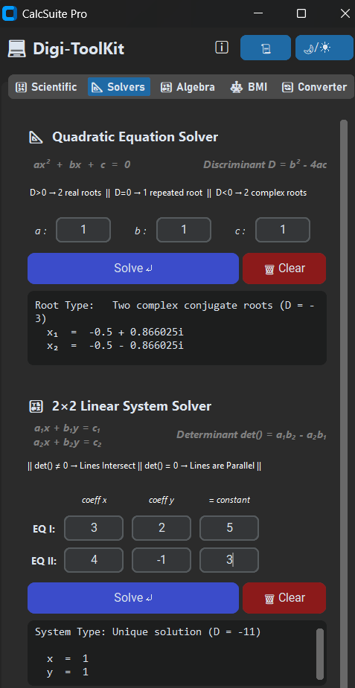
Tab 2 - Structured Solvers
Structured vs. Freeform UX:
Provides a dedicated coefficient-only interface for users with predefined mathematical systems, bypassing full-equation typing.
Matrix Calculus (2x2 Systems):
Implementation of Cramer’s Rule to instantly detect parallel lines and evaluate intersecting coordinate variables.
Complex-Plane Processing:
Utilizes the cmath library to evaluate negative discriminants, outputting high-fidelity complex roots ( i ) natively in the UI.
Notes:
While Algebra Tab was built for freeform equation processing, Tab 2 represents our Structured Solvers.
Why build a separate Solvers tab if the Algebra tab can already solve quadratics?
The answer is User Experience and intent. The Algebra tab is for 'blind' entry—a user pastes or write an equation, and the engine has to parse and classify it.
However, if a user already knows they are holding a 2x2 linear system or a quadratic equation, forcing them to type out all the x and y variables is inefficient.
Solvers Tab provides a clean, coefficient-only template.
Beyond UX, this tab houses our highest-precision algorithms.
For linear systems, it utilizes Cramer’s Rule for matrix evaluation.
For quadratics, I specifically integrated Python's cmath library.
This allows the UI to successfully process negative discriminants and return accurate complex roots in the imaginary plane, proving the engine is equipped for advanced scientific workloads.

Slide 9
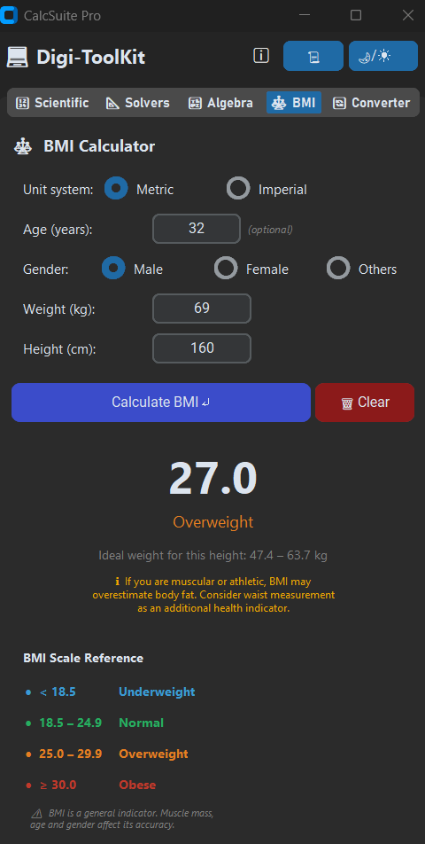
Tab 4 - Dynamic BMI Analytics
Applied Scalar Mathematics:
Transitioning the engine from abstract algebra to real-world continuous data formulas (BMI = kg/m²).
Dynamic UI State Rendering:
Programmed threshold evaluations that trigger immediate visual feedback based on standardized medical categories.
Real-Time Data Handling:
Engineered to securely parse and float-cast user inputs, preventing application crashes from invalid continuous data.
Notes:
After proving the engine's capability with abstract systems in Tabs 2 and 3, I engineered Tab 4—Dynamic BMI Analytics—to demonstrate applied scalar mathematics.
Why a math workstation needs a health tool?
The answer is UI state manipulation.
While the Algebra engine outputs raw text, the BMI engine is designed to evaluate continuous data against strict medical thresholds.
When the user inputs their metrics, the engine securely casts the strings to floats, runs the scalar formula, and instantly triggers a dynamic UI state change.
While I am demonstrating the standard metric inputs here, I engineered the fields to be polymorphic—meaning it contains an under-the-hood routing system for Imperial data as well.
I also integrated optional demographic weighting (Age/Gender) that dynamically alters the final medical classification string.
This proves the architecture isn't just a static calculator, but a highly responsive analytics dashboard capable of translating raw numbers into visual, state-based feedback.

Slide 10
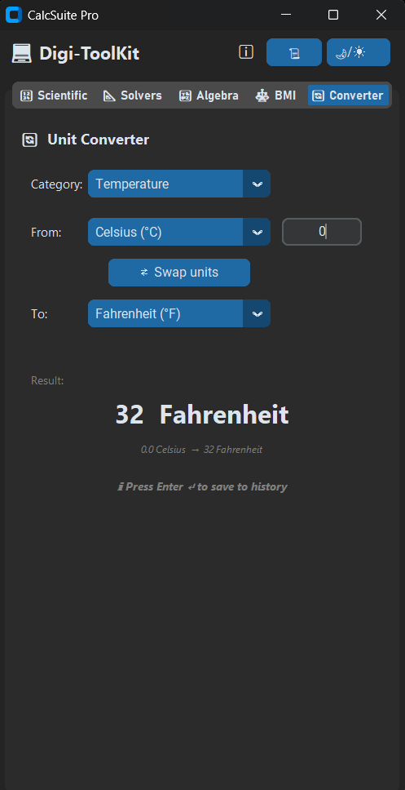
Tab 5 - Scientific Converter
Curated Scientific Scope:
Deliberately restricted to the 5 fundamental physical quantities (Length, Area, Weight, Speed, Temperature) to maintain a professional, bloat-free engineering environment.
Dual-Logic Routing System:
Engineered the backend to dynamically switch between two distinct mathematical paradigms based on the active category.
Multiplicative vs. Affine Transitions:
Seamlessly handles standard zero-intercept ratio scaling (for Length/Area/Weight/Speed) alongside complex non-zero intercept formulas (for Temperature).
Notes:
The final core feature is Tab 5, the Scientific Converter.
During the design phase, a major architectural decision was: which units do we include?
I deliberately restricted the scope to five fundamental physical quantities: Length, Area, Weight, Speed, and Temperature.
This prevents the application from becoming a bloated, consumer-level app and keeps it focused as a professional engineering workstation.
The real technical defense here is how the engine handles the data routing?
The first four categories—Length, Area, Weight, and Speed—are mathematically simple.
They are zero-intercept transformations; you just multiply by a constant ratio.
However, Temperature requires an entirely different mathematical paradigm.
It is a transformation requiring specific additive and subtractive offsets, because 0 Celsius does not equal 0 Fahrenheit.
I engineered the backend router to instantly detect the active category and dynamically switch its evaluation logic, proving the UI can seamlessly manage structurally different mathematical operations under a unified interface.

Slide 11
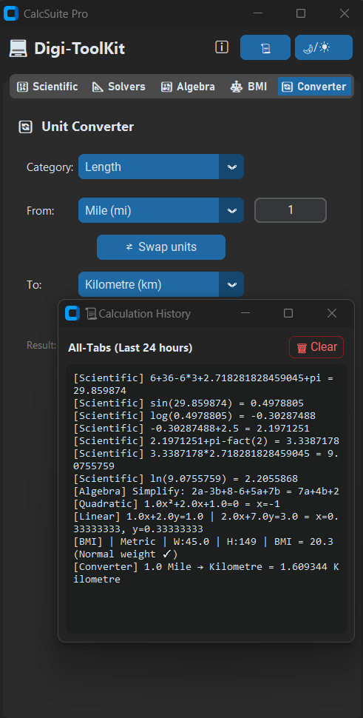
Unified History Architecture
In-Memory Session Logging:
Engineered a unified HistoryManager that captures outputs from all tabs for the active session, deliberately wiping upon exit for data privacy.
Contextual Data Tagging:
Programmed the engine to automatically prefix all entries (e.g., [Scientific], [BMI]) to maintain clear cross-tab workflow tracking.
Event-Driven Filtering:
Implemented selective logging logic—such as the Converter only committing to history on explicit Enter or Swap commands—to prevent keystroke spam.
External Routing & Auto-Pruning:
Ensured external windows (like the FIBS sequence popup) route data back to the core log, while a timedelta sweep silently prunes active sessions older than 24 hours.
Notes:
To keep the user's workflow centralized, I engineered a unified HistoryManager.
Because users jump rapidly between tools, the system automatically injects contextual tags like '[BMI]' or '[Scientific]' into the log to keep the data readable.
I also implemented event-driven logging to prevent data spam—for instance, the live-updating Converter only commits to history on an explicit 'Enter' command, and even external sequences like the FIBS popup are safely routed back to this core log.
The real architectural defense here, however, is how the system handles memory and data sanitization.
I engineered a dual-layer protocol: one for the user, and one for the machine.
For the user, I built a manual 'Clear' protocol.
Because this is an in-memory session log, this gives the user immediate agency and privacy to wipe sensitive calculations on demand.
For the machine, I implemented a timedelta auto-prune. If a user leaves the workstation running for days, an infinitely growing list would cause a memory leak.
The timedelta silently sweeps the background, pruning records older than 24 hours to protect system RAM.
It is a dual-layered approach protecting both user privacy and hardware stability.

Slide 12
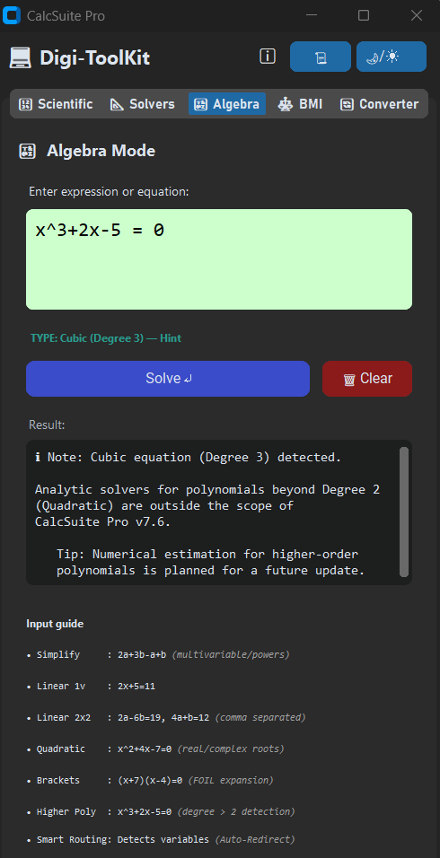
Defensive Architecture & Troubleshooting
Smart Kernel Redirection:
Auto-routes unsupported variables across tabs to prevent execution failure (e.g., separating Euler's 'e' from algebraic 'e').
Graceful Exception Handling:
Intercepts fatal system crashes and outputs educational UI hints within the Algebra workspace.
Singleton Window Control:
Enforces strict instance-checking to prevent duplicate UI rendering and front-end memory leaks.
AST Secure Evaluation:
Bypasses vulnerable eval() protocols in favor of strict Abstract Syntax Tree parsing to eliminate injection risks.
Notes:
Slide 12 covers the reality of the development process: defensive architecture.
The biggest hurdle wasn't making the math work; it was handling unpredictable user behavior.
To protect the core engine, I had to implement strict security.
First, to prevent code-injection vulnerabilities, I completely bypassed Python's standard eval() function, implementing strict AST (Abstract Syntax Tree) parsing instead.
Second, I tackled 'Variable Clashes’.
In the Scientific tab, 'e' is Euler's number.
If a user typed an algebraic expression like '5e + 2', standard calculators would resolve it by putting the value of ”e” instead of considering it as a character.
To solve this, I engineered a Smart Redirect that detects stray variables, suspends the thread, and safely ports the user's input directly into the Algebra tab.
Third, once inside that Algebra workspace, I re-engineered how the system handles bad inputs.
Instead of throwing fatal Python errors when a user types an impossible equation, the engine catches the exception and outputs educational 'Hints'—which you can see on the screen here.
Finally, I built Singleton window controls to prevent UI memory leaks from users spamming buttons.
I implemented two distinct behaviors:
If a user clicks the History button multiple times, the active window seamlessly refreshes its data stream.
But if they spam the 'About' button, the window physically 'shakes' to acknowledge the click without spawning duplicate frames.
It's important to note these four features are just the tip of the iceberg.
The full development cycle required dozens of iterative patches—from rewriting percentage decimal logic, to isolating Fibonacci edge-cases, to building regex protocols that safely strip leading zeros (like 0090) to prevent parser crashes, to completely rebuilding the BMI tab for Imperial dual-inputs.

Slide 13
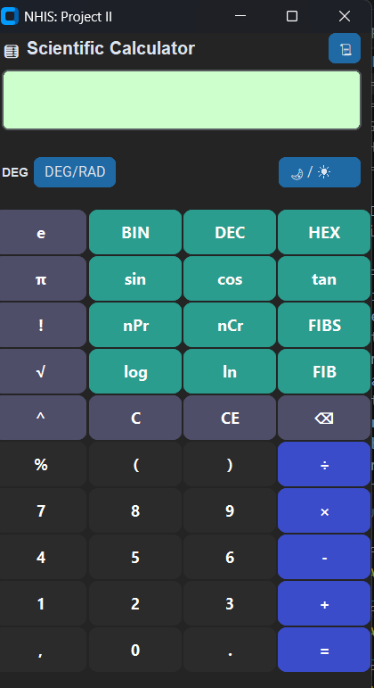
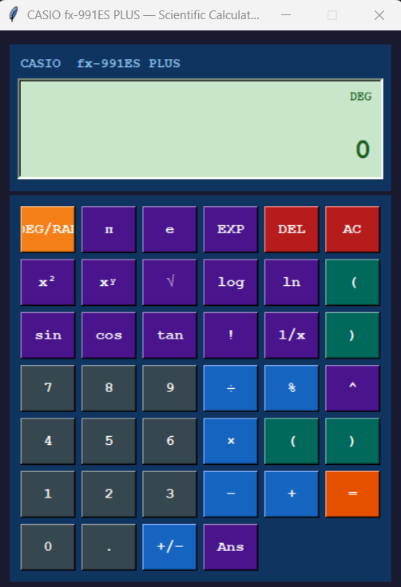
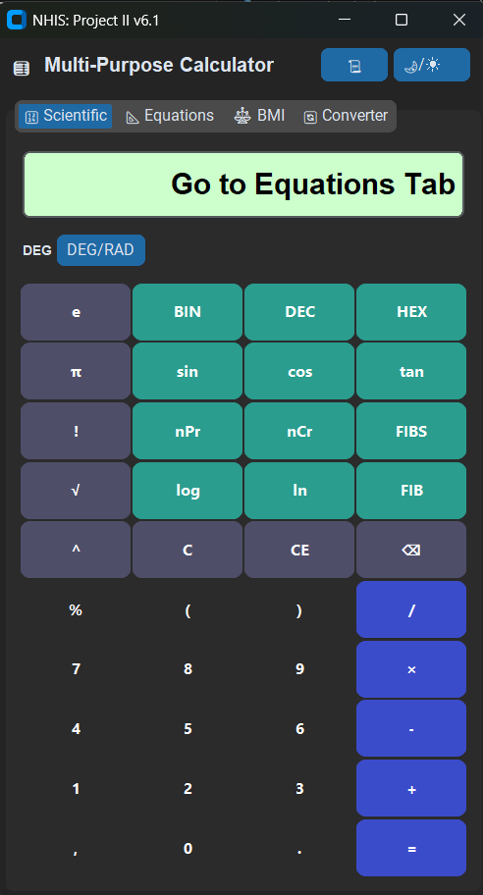
Evolution Phase 1 (The Engineering Roadmap)
v1.0 - UI Genesis
Overcame legacy Tkinter rigidity & History-Pane duplication bugs.
v6.1 - Monolithic Bottleneck
Parser failed on algebraic strings, so expanded into a Multi-Tool suite.
v4.0 - Core Engine Polish
Finalized grid geometry, integrated Fibonacci generators, and replaced eval() with an AST parser.
Notes:
To understand the final architecture of CalcSuite Pro, we have to look at the trial-and-error roadmap.
Starting on the bottom left, Version 1 was built exactly to the initial requirements: a basic Tkinter prototype.
However, 'legacy' Tkinter was rigid and buggy.
I faced inverted theme toggles and a severe memory leak where the History window infinitely duplicated itself.
As I mentioned earlier in Slide 3, this is exactly why I made the architectural decision to migrate entirely to CustomTkinter.
By Version 3, the layout was clean, and I had added hover animations, decimal limiters, and Fibonacci generators.
Moving to the center, Version 4 focused entirely on security.
Standard calculators use eval(), which is a massive code-injection vulnerability.
I engineered the strict AST parser to replace it, and wrote regex patches to prevent the engine from crashing on leading zeros, like typing '0090’.
But moving to the top right, we hit the project's biggest wall in Version 5.4.
The Scientific tab was a monolith.
When users typed algebraic characters, it threw a massive 'Feature Unavailable' error.
The single parser couldn't separate arithmetic from algebra.
That bottleneck forced a massive expansion: I broke the monolith into a 'Multi-Tool' suite.
I built the Equations tab to handle the Algebra, and I engineered the BMI and Converter tabs to push the engine beyond abstract math into real-world, continuous data handling—like processing imperial heights and live unit swaps.
By Version 6.4, it was no longer just a calculator; it was a toolkit.

Slide 14
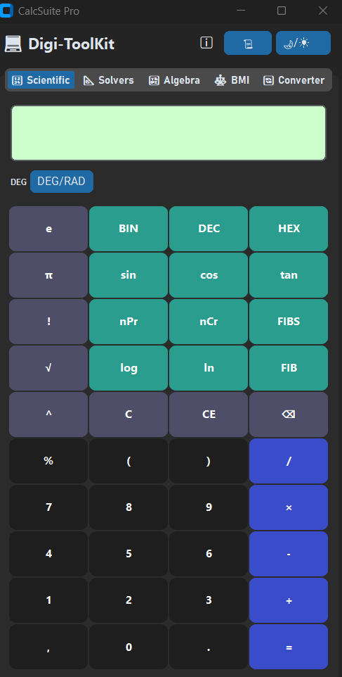
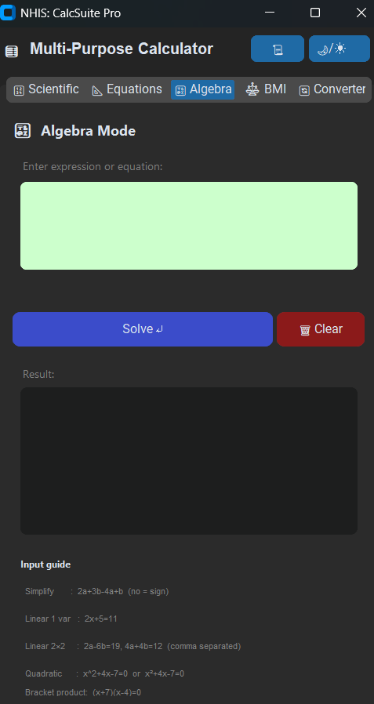
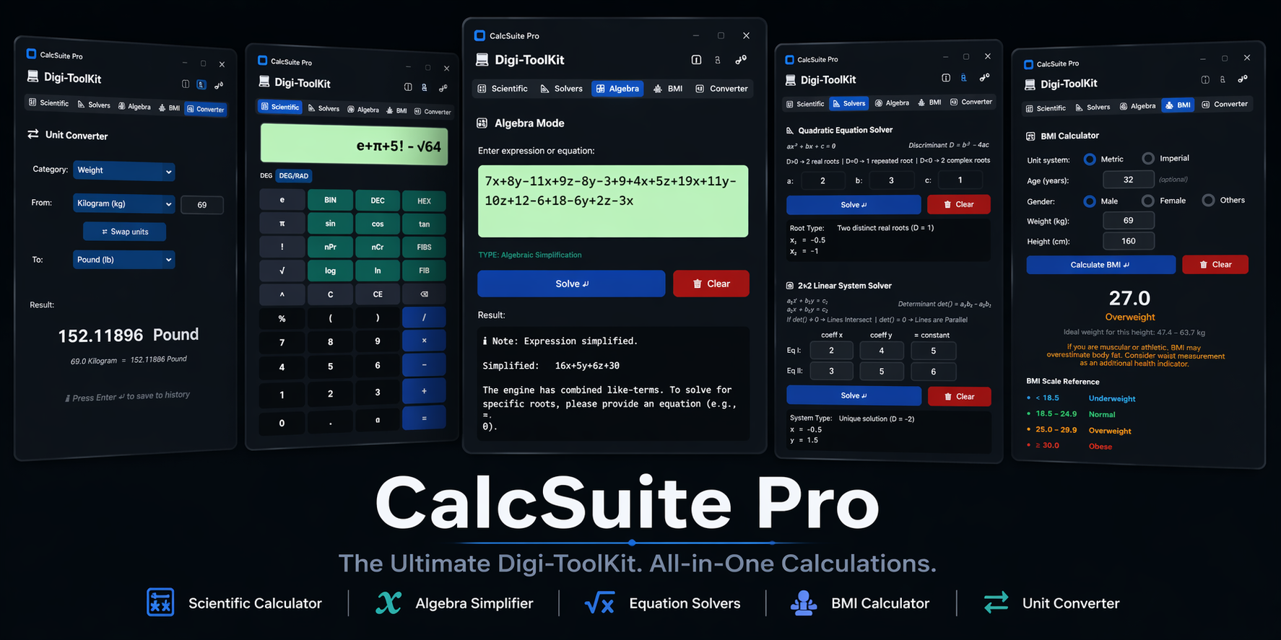
Evolution Phase 2 (The Digi-ToolKit Journey)
v7.0 - The Algebra Pivot
Engineered the Smart Algebra tab powered by a 7-State Dispatcher.
v7.6 - CalcSuite Pro
Final stable release. All core architectural fixes applied and Digi-ToolKit unified.
v7.5 - Smart Redirection
Implemented 450ms automatic cross-tab redirects and strict regex limits.
Notes:
Following the timeline to the top left of Slide 14, even that new Equations tab had a fatal flaw.
During dry-runs, users didn't want rigid input boxes; they wanted to type expressions freely.
So, in Version 7.0, I completely pivoted.
I engineered the Smart Algebra tab, powered by a 7-State Dispatcher that auto-detects what the user wants to do.
This is where I renamed the Equations Tab to “Solvers” Tab as well so as to differentiate between it and “Algebra” Tab.
This was the moment I rebranded the project to 'CalcSuite Pro’.
However, that pivot created a new UX fracture:
If users typed variables in the Scientific tab, they got an error telling them to manually switch to the Algebra tab.
Moving to the center, I solved this in Version 7.5 by engineering the Smart Redirect.
It detects the stray variable, suspends execution, and ports the user's input directly to Algebra with a calculated 450ms transition delay—fast enough to be seamless, but slow enough that it doesn't feel like a glitch.
During this phase, I also stripped out legacy zombie code and fixed deep terminal regex warnings to ensure the backend was as clean as the frontend.
Finally, landing on the bottom right, you see the culmination of this journey: Version 7.6.
This final release was about absolute stability.
I implemented Epsilon tolerances to eliminate floating-point binary errors, engineered dictionary-based polynomial mapping, and fixed final UI geometry bugs—like the Fibonacci error overflow. It is a complete evolution from a fragile, single-screen prototype into a highly secure, professional Digi-ToolKit.

Slide 15
Conclusion & Future Scope
CalcSuite Pro successfully evolved from a fragile prototype into a stable, professional multi-tool workstation.
It proves that robust mathematical logic can seamlessly power an intuitive, fail-safe user experience.
📦 Standalone Executable (.exe):
Converting the core Python files into a standard, click-to-run desktop application for zero-dependency deployment.
🌐 Web Migration (Streamlit):
Decoupling the backend logic to deploy the calculator as a high-performance browser-based web application.
📈 Graphing & Visualization:
Engineering a dynamic plotting engine for the Scientific and Solvers tabs to visualize equations in real-time.
🔄 Live API Integration:
Connecting the Unit Converter to real-time internet data for live currency and commodity exchange rates.
📊 BMI Health Analytics:
Expanding the BMI tab to store historical data and generate visual health-trend charts for users.
🔊 Accessibility Integration:
Implementing Text-to-Speech (TTS) and voice-navigation to assist users with visual impairments.
🧩 Modular Math Packs:
Adding specialized modules for advanced calculus and solvers without altering the core 7-State Dispatcher.
Notes:
To conclude, CalcSuite Pro represents more than just a functional calculator; it represents a successful engineering pivot.
We began with a monolithic, vulnerable prototype and arrived at a modular, zero-trust workstation.
We’ve proven that we don't have to sacrifice a professional user experience to achieve hardcore mathematical precision.
Looking ahead, the roadmap is focused on accessibility and scale.
By migrating to a Streamlit web framework and compiling into native executables, we remove the barriers to entry for the end-user.
Furthermore, by integrating live APIs for the converter and adding dynamic graphing for the solvers, we transition this tool from a static utility into a live, analytical engine.

Slide 16
THANK YOU
FOR YOUR ATTENTION
Notes:
Thank you for your time.
I am now open to any questions regarding the architecture or the logic behind CalcSuite Pro.

