Slide 1
Industry Performance EDA
Decoding the Market Leaders
Yousuf S. R. Sakkaf | Version 2.0
Notes:
What is this project?
A comprehensive EDA on 15,000 company records across 5 industries, 4 countries, 3 regions.

Slide 2
Dataset Overview : The Starting Point
15,000 company records · 5 Industries · 4 Countries · 3 Regions · Founded: 1990–2020 · Each column below was present in the raw dataset before any transformation.
15,000
12
5
4
Total Records
Original Columns
Industries
Countries
id ✗
profit_margin_percent
Unique identifier — no analytical value (will be dropped)
Profit margin as a percentage
company_name
founded_year
Name of the company
Year company was established
industry
customer_count
Business sector — 5 categories
Total number of customers
country
market_rating
Country of operation — 4 countries
Market performance score (1–5)
employee_count
created_date
Total number of employees
Record creation date
annual_revenue_million
region
Annual revenue in USD millions
Geographic region — 3 regions
Key Gap: These columns tell us who a company is and how big it is — but none of them measure how efficiently it operates.
Notes:
The 12 original columns: - id: row identifier, no analytical value — first thing will be dropped in next step - company_name: text identifier - industry, country, region: categorical — all perfectly balanced (3,000 per industry, 3,750 per country) - employee_count, annual_revenue_million, profit_margin_percent, customer_count, market_rating: the five base numerical metrics - founded_year: year of establishment — will become company_age after engineering - created_date: stored as text initially — needed date conversion The bottom banner states the core problem: these columns measure SIZE, not EFFICIENCY. A company with 5,000 employees earning $500M and one with 500 employees earning $500M look identical. Without efficiency ratios, we cannot differentiate them. This sets up the Feature Engineering slide perfectly.

Slide 3
Analytical Framework : 8-Phase EDA Pipeline
Our Goal: 15,000 companies. We need to decode the Market Leaders. This pipeline systematically uncovers what separates them from the remaining.
01
02
03
04
05
06
07
08
Understand
the Problem
Import &
Inspect
Handle
Missing Data
Explore
Characteristics
Transform
Data
Visualize
Relationships
Handle
Outliers
Communicate
Findings
Define the goal
Load & validate
0 missing · 0 dupes
Profile baseline
Engineer features
Uni/Bi/Multivariate
Detect & decide
Decode leaders
✅ Missing Values 0 across 15,000 rows
✅ Duplicates 0 — every entry unique
✅ Data Types created_date & categories corrected
✅ Column Count 12 → 21 (−1 dropped, +10 engineered)
Phases 01–04: Data Auditing & Quality
Phases 05–08: Statistical Discovery & Decoding
Notes:
HOW WAS DATA PREPARED? Phases 1-4 (Auditing):
Dataset loaded successfully — 15,000 rows × 12 columns confirmed.
Zero missing values, zero duplicates; created_date converted from text to proper date format.
Categorical columns (industry, country, region) optimized to category dtype for efficiency. Phases 5-8 (Discovery):
Phase 5 is the pivotal phase — base data was too uniform to produce insight, so 10 features were engineered.
Phase 6 covers three visual layers (univariate, bivariate, multivariate).
Phase 7 applies IQR outlier detection with a deliberate retention decision.
Phase 8 communicates findings through the dashboard and this presentation. The gold Phase 08 is highlighted deliberately — it is the destination. All other phases exist to get there.

Slide 4
Feature Engineering : From Raw Data to Analytical Value
All 12 original metrics showed near-perfect uniformity — every company looked identical on base metrics. Feature engineering was the only way to expose the operational differences that actually matter.
12
−1
+10
= 21
Original
Columns
id dropped
(no value)
Engineered
Features
Analysis-Ready
Columns
company_age
age_tier
Converts founding year into comparable years of age
Lifecycle stage: Growth / Established
rev_per_emp
rating_tier
Revenue ÷ employees — removes the size advantage
Performance: Low / Average / Market Leader
rev_per_customer
revenue_tier
Revenue ÷ customers — measures customer value
Revenue scale: Micro / Medium / Large / Enterprise
cust_per_emp
customer_tier
Customers ÷ employees — measures operational scale
Volume: Niche / Standard / Mass-Scale
industry_density
business_model
Number of competitors in the same sector
Combined revenue × customer tier strategy label
Notes:
WHY FEATURE ENGINEERING? The original brief required analysis of 12 base columns. However, all base metrics showed perfect uniformity — a characteristic of synthetic data.
Standard EDA on this data produces nothing useful. The 10 engineered features: EFFICIENCY RATIOS (most important): - rev_per_emp: Removes the size advantage — compares companies on a per-employee basis regardless of workforce size - rev_per_customer: Measures the quality of each customer relationship - cust_per_emp: Measures scalability — customers served per employee TIER CLASSIFICATIONS: - customer_tier has THREE values: Niche / Standard / Mass-Scale (as visible in the donut chart later) - business_model combines revenue_tier × customer_tier into one strategic label (e.g. 'Large / Niche') Column math: 12 original − 1 dropped (id) + 10 engineered = 21 final columns.

Slide 5
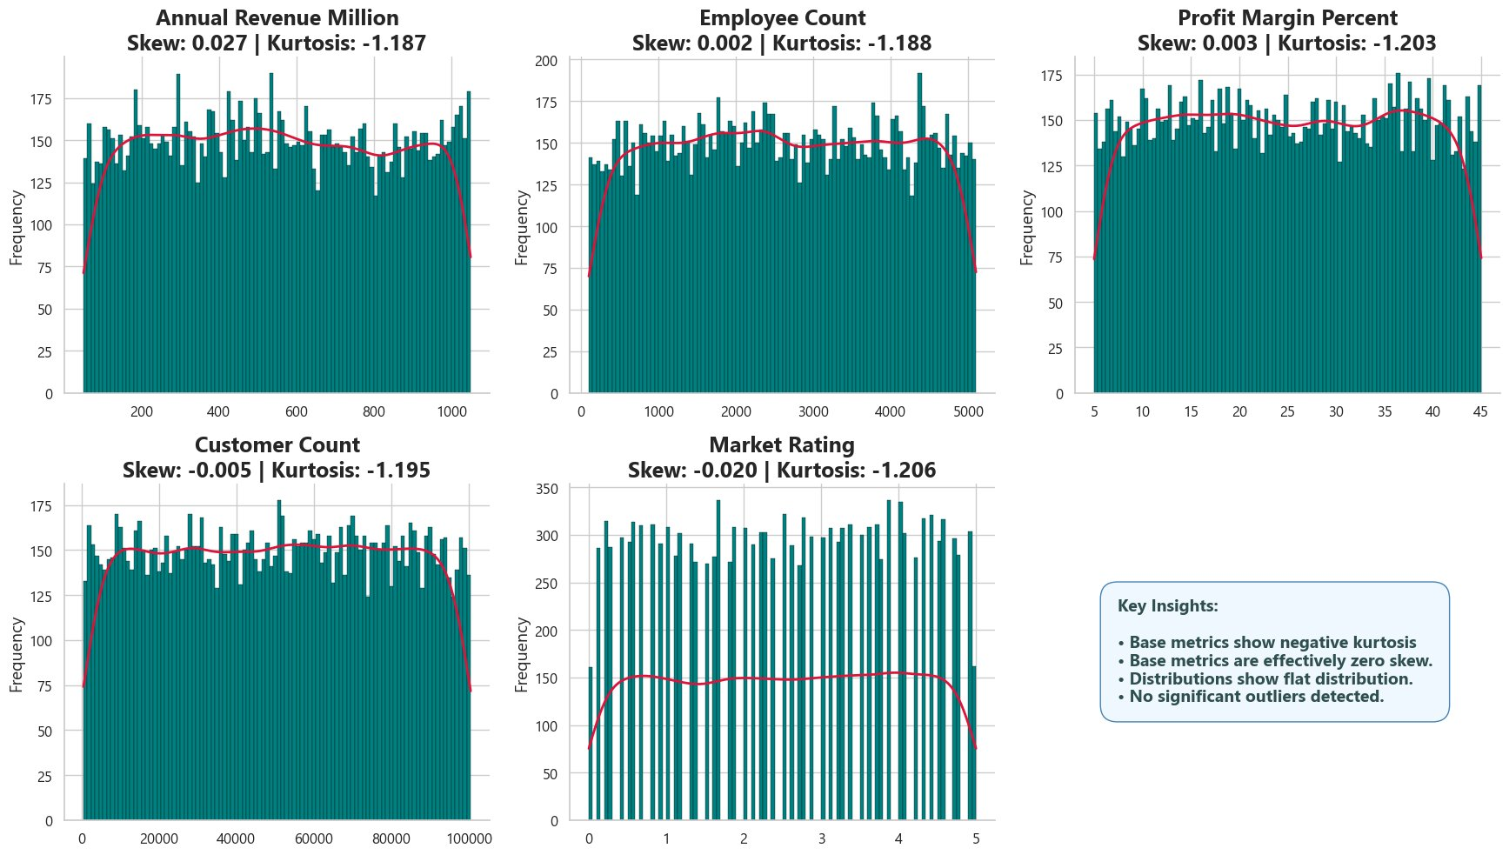
Univariate Analysis : Base Metric Distributions
Base metric distributions examined one variable at a time — skewness and kurtosis included
Near-zero skewness
Range: −0.020 to +0.027 across all 5 columns. Perfectly symmetrical — mean and median nearly identical throughout.
Negative kurtosis (≈ −1.19)
Platykurtic — flatter than normal. No dominant cluster at any value range. Every point in the distribution is equally likely.
Baseline established for comparison
With symmetrical, bounded distributions confirmed across all base metrics, any deviation found in engineered features will be statistically meaningful — not noise
No outliers in base data
Clean, bounded distributions with no extreme points — confirmed formally by the IQR outlier phase later.
Notes:
WHAT DO INDIVIDUAL VARIABLES SHOW? CHARTS SHOWN: Histogram dashboard for 5 base numerical metrics (Annual Revenue, Employee Count, Profit Margin, Customer Count, Market Rating). CHARTS ALSO ANALYZED IN UNIVARIATE (not shown in PPT, present in notebook): - Horizontal bar grid for 3 categorical metrics (Industry, Country, Region): all perfectly balanced — 3,000 per industry, 3,750 per country - Statistical summary tables with mean, median, standard deviation, skewness and kurtosis for all base columns KEY VALUES: - Annual Revenue: Skew 0.027 | Kurt −1.187 | Mean $549.7M | Median $543.9M - Employee Count: Skew 0.002 | Kurt −1.188 - Profit Margin: Skew 0.003 | Kurt −1.203 - Customer Count: Skew −0.005 | Kurt −1.195 - Market Rating: Skew −0.020 | Kurt −1.206 The red KDE curve sits almost flat across each histogram — no concentration anywhere.
This is the baseline problem that motivates everything that follows.
Standard EDA on this data would conclude there is nothing to find.
The next slide shows what feature engineering reveals.

Slide 6
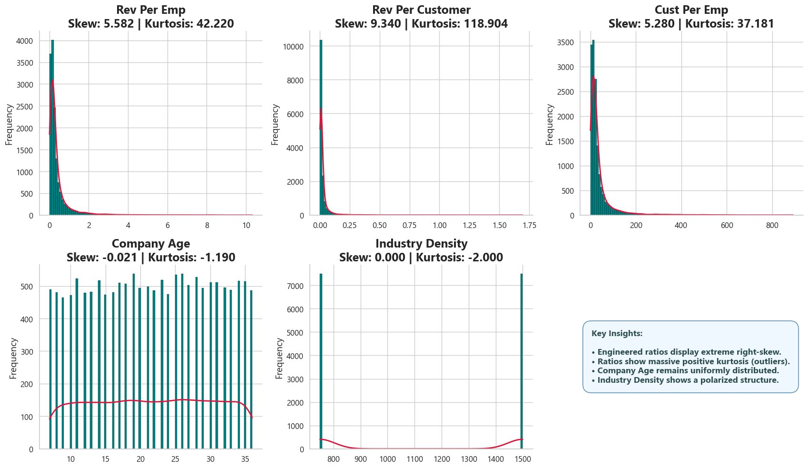
Univariate Analysis : Skewness & Kurtosis of Engineered Features
Rev/Emp: Skew 5.58, Kurt 42.2
Extreme right tail. Most companies cluster at low efficiency — a small group extends dramatically to the right.
Rev/Customer: Skew 9.34, Kurt 118.9
The most extreme distribution in the dataset. Near-vertical spike at low values with an exceptionally heavy right tail.
Cust/Emp: Skew 5.28, Kurt 37.2
Same right-skewed pattern — the outlier group operating at dramatically higher customer-per-employee scale is visible.
Age & Density: still flat
Company Age (skew −0.021) and Industry Density (skew 0.000) remain uniform — structural, not performance features.
Notes:
WHAT CHANGED AFTER ENGINEERING? CHARTS SHOWN: Histogram dashboard for 5 engineered numerical metrics (Rev/Emp, Rev/Customer, Cust/Emp, Company Age, Industry Density). KEY SKEWNESS & KURTOSIS VALUES: - Rev/Emp: Skewness 5.582, Kurtosis 42.220 - Rev/Customer: Skewness 9.340, Kurtosis 118.904 ← most extreme in the dataset - Cust/Emp: Skewness 5.280, Kurtosis 37.181 - Company Age: Skewness −0.021, Kurtosis −1.190 (uniform — expected) - Industry Density: Skewness 0.000, Kurtosis −2.000 (perfectly flat — only two distinct values) WHAT THIS MEANS:
The long right tails in the efficiency ratio histograms ARE the Market Leader group — companies operating at a fundamentally different efficiency level.
Kurtosis of 118.9 for Rev/Customer means the distribution is extremely peaked with very heavy tails.
The outlier phase will formally isolate this group.

Slide 7
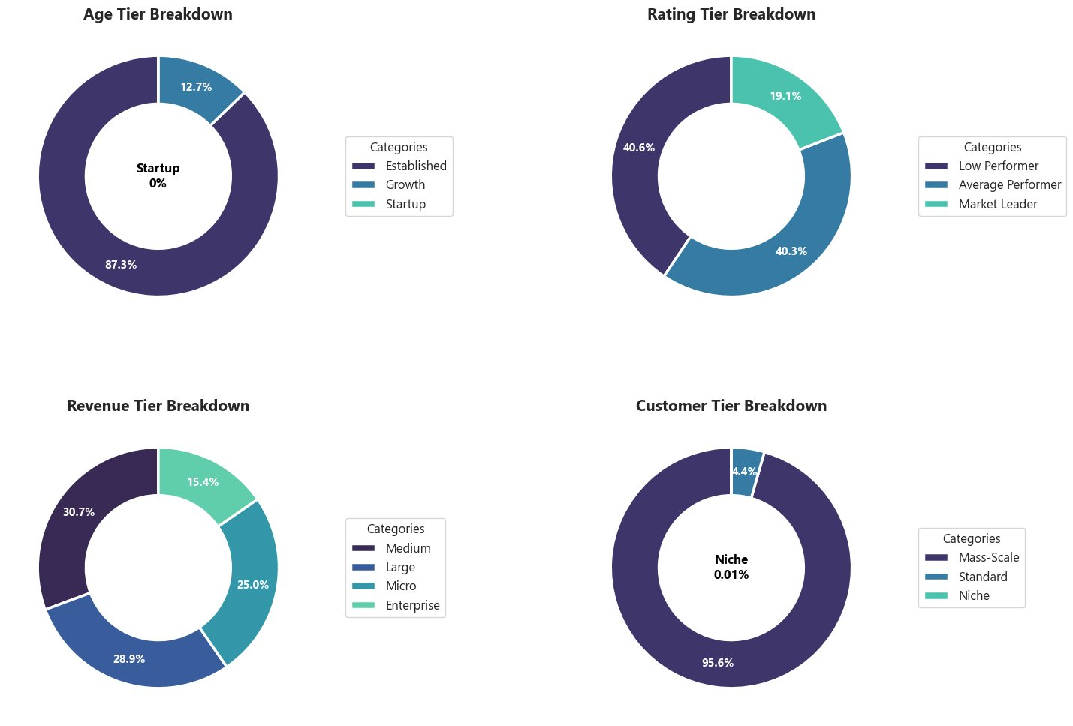
Univariate Analysis : Engineered Tier Composition
87.3% Established
No startups present. This is a snapshot of a mature, established market — companies with 10+ years dominate entirely.
40/40/20 Rating Split
19.1% of companies carry a Market Leader rating based on the market_rating column alone. Only 3.4% satisfy all five funnel conditions simultaneously — as seen in the Elite Funnel slide
Revenue more varied
Medium (30.7%), Large (28.9%), Micro (25%), Enterprise (15.4%). Being established does not guarantee high revenue.
95.6% Mass-Scale, 4.4% Niche
Customer Tier also has a Standard band (near 0%). Mass-Scale operators dominate. True Niche operators are extremely rare.
Notes:
HOW DO TIERS BREAK DOWN? CHARTS SHOWN: Donut chart grid for 4 engineered tier distributions (Age Tier, Rating Tier, Revenue Tier, Customer Tier). CHARTS ALSO ANALYZED (not shown in PPT, present in notebook): - Horizontal bar chart for business model distribution (combining revenue_tier × customer_tier) - Statistical frequency tables for all tier columns KEY FINDINGS: AGE TIER:
87.3% Established (10+ years), 12.7% Growth, 0% Startup.
This confirms the dataset represents a mature market — not an early-stage ecosystem. RATING TIER:
40.6% Low, 40.3% Average, 19.1% Market Leaders.
The 40/40/20 split is one of the most important findings — this exact ratio holds across all 5 industries, 4 countries, and 3 regions.
This proves that categorical variables alone cannot predict performance tier. REVENUE TIER:
More evenly distributed.
Medium companies (30.7%) outnumber Enterprise (15.4%) — being established does not guarantee high revenue. CUSTOMER TIER:
Three values — Mass-Scale (95.6%), Standard (near 0%), Niche (4.4%).
The Standard band is extremely thin.
The Niche segment (4.4%) is what the later multivariate analysis will identify as disproportionately efficient.

Slide 8
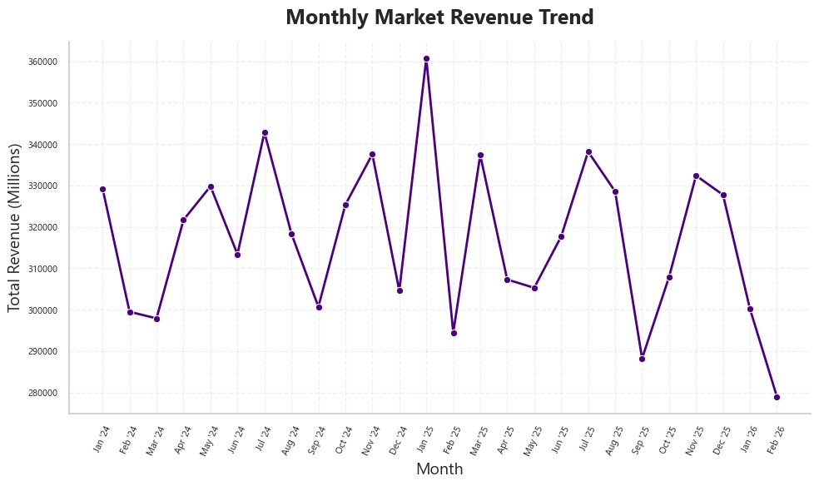
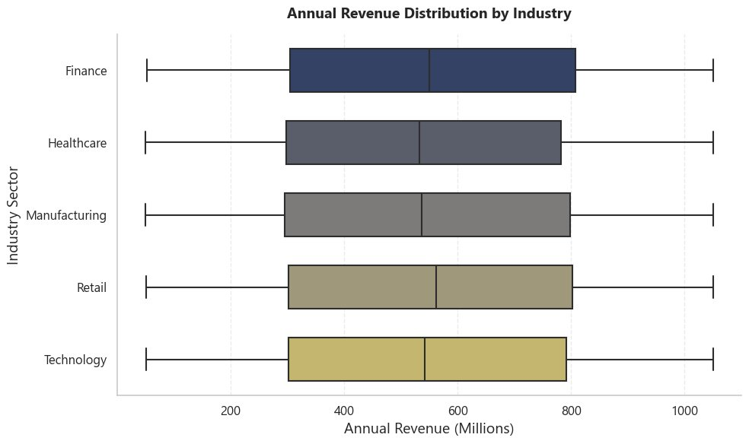
Bivariate Analysis : Revenue Trends & Industry Performance
Time-series trends and cross-industry revenue distribution compared
Revenue is seasonal
Three peaks per year aligned with Q1, Q2, Q3 starts. A low-revenue month reflects the natural cycle — not poor performance.
Jan 2025: highest spike
~$360B total revenue. Q1 budget-release effect. Feb 2026 drop is the start of a new cycle, not a declining trend.
Industry = no advantage
All 5 industry boxplots show near-identical spread — comparable medians around $550M, overlapping distributions, and no visible outlier points. No sector holds a meaningful revenue advantage.
Sector cannot predict outcome
Whether a company is Finance or Technology tells us nothing about its revenue. The null finding is visually confirmed.
Notes:
HOW DO VARIABLES INTERACT? CHARTS SHOWN: Monthly Market Revenue Trend (top) + Annual Revenue Distribution by Industry — Boxplot (bottom). CHARTS ALSO ANALYZED IN BIVARIATE (not shown in PPT, present in notebook): - Standard scatter plot: Customer Count vs Annual Revenue — rectangular block shape, near-zero correlation - Hexbin density plot: Employee Count vs Annual Revenue — uniform density, no diagonal concentration - Quarterly profit trend: Q1 always lowest margins, Q4 always highest — margin cycle is counter to revenue cycle - Total Market Wealth by Business Model — Treemap: Mass-Scale models control bulk of total market wealth - Cross-tab heatmap: Industry vs Business Model — every sector uses same business model mix in identical proportions - Industry vs Market Ratings — Stacked bar: 40/40/20 split identical across all 5 sectors KEY FINDINGS:
MONTHLY:
Revenue oscillates between ~280,000–360,000 million with no long-term trend.
Three seasonal peaks per year. Context is essential for interpreting any single month's figure. INDUSTRY BOXPLOT:
Q1≈$300M, Median≈$550M, Q3≈$800M for ALL five industries.
No visual difference between sectors.
This is the definitive proof that industry sector cannot predict revenue outcome.

Slide 9
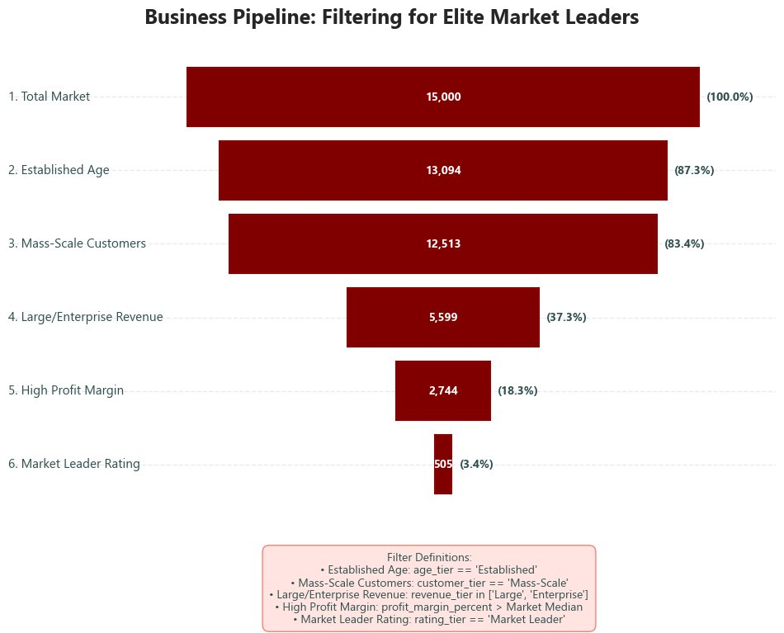
Identifying Market Leaders : The Elite Funnel
Being established is the norm
Filters 2 and 3 barely narrow the pool — 87.3% pass the age filter and 83.4% pass the customer scale filter. Being established and mass-scale is a baseline expectation in this market, not a differentiator.
Revenue separates the market
Filter 4 eliminates 6,914 companies in a single step — the largest exit in the entire pipeline. Having scale but insufficient revenue is the most common failure mode.
Margin and rating are the final gatekeepers
Even after clearing the revenue threshold, only 18.3% survive the profit margin filter and just 3.4% clear the final rating check. Strong revenue alone is not enough.
505 is the benchmark
These 505 companies simultaneously satisfy all five conditions. Their operational profile — decoded in the slides that follow — defines what Market Leader status actually looks like from the inside.
19.1% carry a Market Leader rating — based on market_rating score alone. Only 3.4% satisfy all five conditions simultaneously.
Notes:
WHO ARE THE MARKET LEADERS? CHARTS SHOWN: Business Pipeline Funnel FUNNEL BREAKDOWN: 1. Total Market: 15,000 (100%) 2. Established Age: 13,094 (87.3%) 3. Mass-Scale Customers: 12,513 (83.4%) 4. Large/Enterprise Revenue: 5,599 (37.3%) ← SHARPEST DROP — most companies fail here 5. High Profit Margin: 2,744 (18.3%) 6. Market Leader Rating: 505 (3.4%) ← THE FINAL ELITE GROUP CORE ANSWER: Market Leaders are NOT the biggest — they are the most efficient.

Slide 10
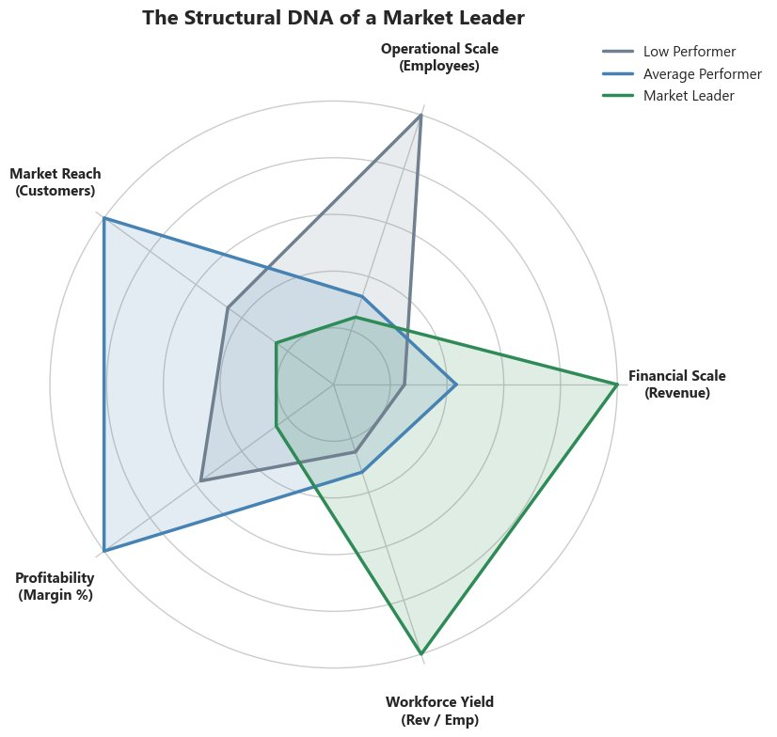
Market Leader DNA : Operational Profile
Leaders: efficiency first
Radar shows Market Leaders (green) extend far on Financial Scale and Workforce Yield — NOT on headcount or customer volume.
Average Performers
Average Performers: wide market reach — high customer volume, but modest revenue return per customer
Low performers: bloated
Low Performers (grey) spike on Operational Scale (Employees) — large workforce, low efficiency return on each team member.
Notes:
WHAT’S THE MARKET LEADER DNA? CHARTS SHOWN: 5-Axis Radar Chart — Structural DNA of a Market Leader (bottom). CHARTS ALSO ANALYZED (not shown in PPT, present in notebook): - 6-axis radar chart for individual industry profiles (Finance, Technology, Retail):
Each sector's Market Leader archetype has a distinct shape — Technology peaks on Workforce Yield, Healthcare peaks on Profitability RADAR CHART — 5 AXES: 1. Operational Scale (Employees) 2. Market Reach (Customers) 3. Financial Scale (Revenue) 4. Profitability (Margin %) 5. Workforce Yield (Rev/Emp) MARKET LEADERS (green): Strong on Revenue and Workforce Yield, moderate on everything else. AVERAGE PERFORMERS (blue): Largest customers — high volume, modest return. LOW PERFORMERS (grey): Largest employees — bloated workforce, low efficiency. CORE ANSWER: Market Leaders are NOT the biggest — they are the most efficient.

Slide 11
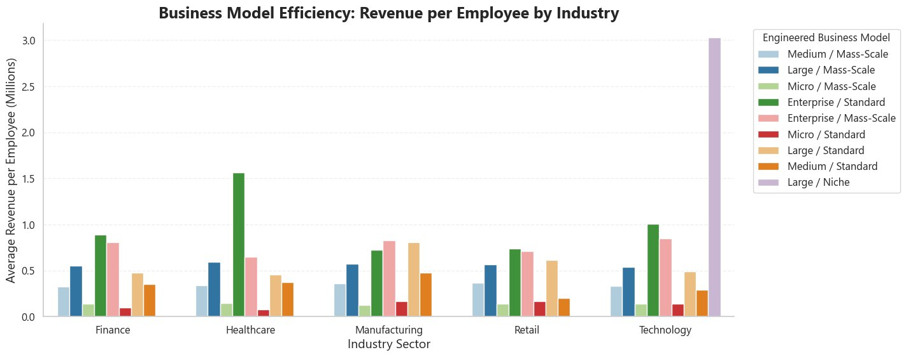
Multivariate Analysis : Cross-Sector Efficiency by Business Model
Tech/Large Niche: $3.04M/emp
The highest efficiency in the entire dataset. Technology's Large/Niche model generates $3.04M per employee — far above all others.
Healthcare Enterprise: $1.56M
Second highest. Enterprise/Standard in Healthcare reflects a high-value professional service model with disciplined cost control.
Mass-Scale always lowest
Across all 5 industries, Mass-Scale models cluster at ~$0.15–0.35M per employee. Large workforces consistently dilute efficiency.
Universal structural pattern
The Niche/Standard efficiency advantage over Mass-Scale holds in every sector — confirming a structural market dynamic, not a Tech-only anomaly.
Notes:
HOW DO MULTIPLE FACTORS INTERACT? CHARTS SHOWN: Business Model Efficiency — Revenue per Employee by Industry (Grouped Bar Chart). CHARTS ALSO ANALYZED IN MULTIVARIATE (not shown in PPT, present in notebook):
- Historical trajectories of revenue across founding years by industry (multi-line chart, split into top 2 and bottom 3 industries):
No industry shows consistent upward or downward trend over 30 years.
Revenue stays within a $480M–$620M band regardless of founding era.
Age does not predict revenue. KEY FINDINGS:
- Technology Large/Niche: $3.04M per employee ← single most important data point in the analysis - Healthcare Enterprise/Standard: ~$1.56M per employee ← second most important - All Mass-Scale variants across all 5 industries: $0.15–$0.35M per employee The fact that Niche > Standard > Mass-Scale efficiency pattern holds across all 5 industries confirms this is a structural market dynamic.
Adding more employees or customers consistently dilutes per-unit efficiency in every sector.

Slide 12
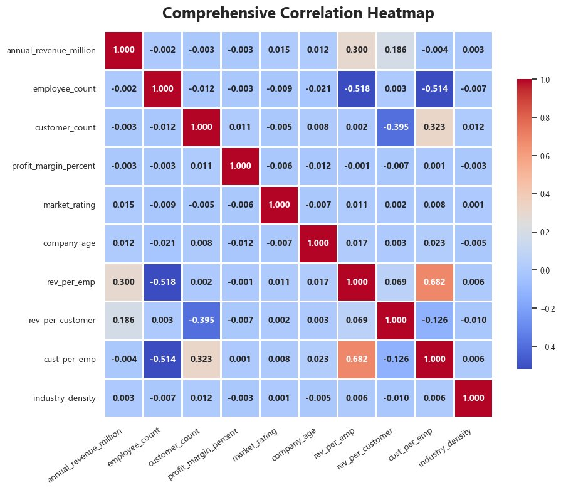
Multivariate Analysis : Comprehensive Correlation Analysis
Revenue vs size: ≈ 0
Revenue correlates with employee count at −0.002 and customer count at −0.003. Raw size is mathematically irrelevant to revenue.
Rev/Emp vs employees: −0.518
More employees = lower per-employee efficiency. Every hire dilutes the ratio — the scale penalty proven mathematically.
Rev/Emp & Cust/Emp: +0.682
Efficient companies are efficient across all dimensions — the strongest positive relationship in the entire matrix.
No multicollinearity
No two variables are correlated enough to be redundant. All 10 columns contribute a unique analytical dimension.
Notes:
WHICH METRICS MOVE TOGETHER? CHARTS SHOWN: Comprehensive Correlation Heatmap — all 10 numerical variables (5 base + 5 engineered). KEY CORRELATION VALUES: - annual_revenue vs employee_count: −0.002 - annual_revenue vs customer_count: −0.003 - annual_revenue vs rev_per_emp: +0.300 (moderate — efficient companies do earn more) - rev_per_emp vs cust_per_emp: +0.682 (strongest positive) - rev_per_emp vs employee_count: −0.518 (negative — more employees = lower efficiency) - rev_per_customer vs customer_count: −0.395 (negative — more customers = lower per-customer revenue) THE −0.518 IS CRUCIAL:
It mathematically proves that adding more employees decreases per-employee efficiency.
This is the Scale Paradox in correlation form — previewing the next slide. NO MULTICOLLINEARITY:
No base variable pair exceeds the 0.7 threshold that would make one redundant.
All 10 features contribute genuinely different information — validating the feature engineering decisions.

Slide 13
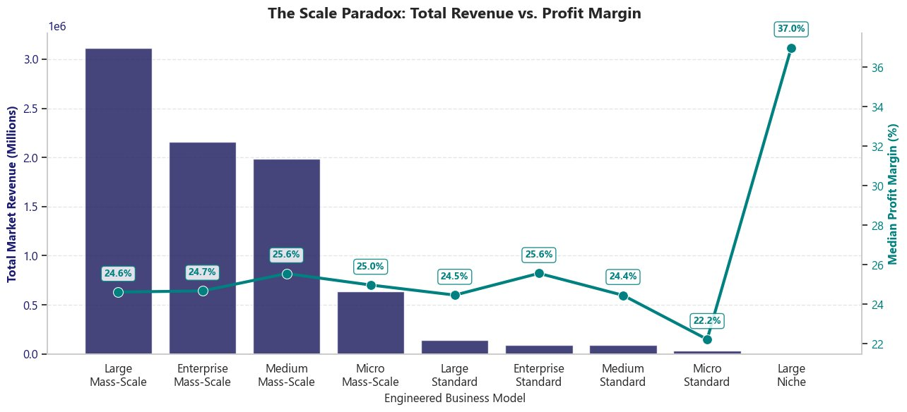
Multivariate Analysis : The Scale Paradox
The Scale Paradox: total revenue and profit margin move in opposite directions
Bigger ≠ more profitable
Large/Mass-Scale generates the highest total revenue but the lowest median profit margin at 24.6%.
Large/Niche margin: 37.0%
The lowest total revenue business model achieves the highest profit margin — 12.4 percentage points above Mass-Scale.
Consistent inverse relationship
As scale increases from Niche → Standard → Mass-Scale, profit margins consistently compress across all revenue tiers.
Strategic implication
Growing by adding more customers and employees consistently trades profitability for volume. Scale and margin are in direct tension.
Notes:
WHAT SURPRISING PATTERN EXISTS? CHARTS SHOWN: The Scale Paradox — Total Revenue (bars) vs. Median Profit Margin (line) across Business Models. READING THE CHART: - Navy/purple bars (left Y-axis): Total market revenue for each business model - Teal line (right Y-axis): Median profit margin for each model - The two series consistently move in OPPOSITE directions — as bars go up, the line goes down KEY DATA POINTS: - Large/Mass-Scale: Highest total revenue | 24.6% margin - Enterprise/Mass-Scale: 2nd highest revenue | 24.7% margin - Medium/Mass-Scale: 3rd highest | 25.6% margin - Micro/Standard: Low revenue | 22.2% margin ← the dip - Large/Niche: Lowest revenue | 37.0% margin ← the striking peak THE PARADOX:
Mass-Scale operations require more staff, more infrastructure, more coordination overhead.
The cost of scale grows faster than the revenue it generates.
Niche operators avoid this overhead — they generate less total revenue but keep significantly more of each dollar earned. This directly challenges the business assumption that 'growing bigger = growing more profitably.’

Slide 14
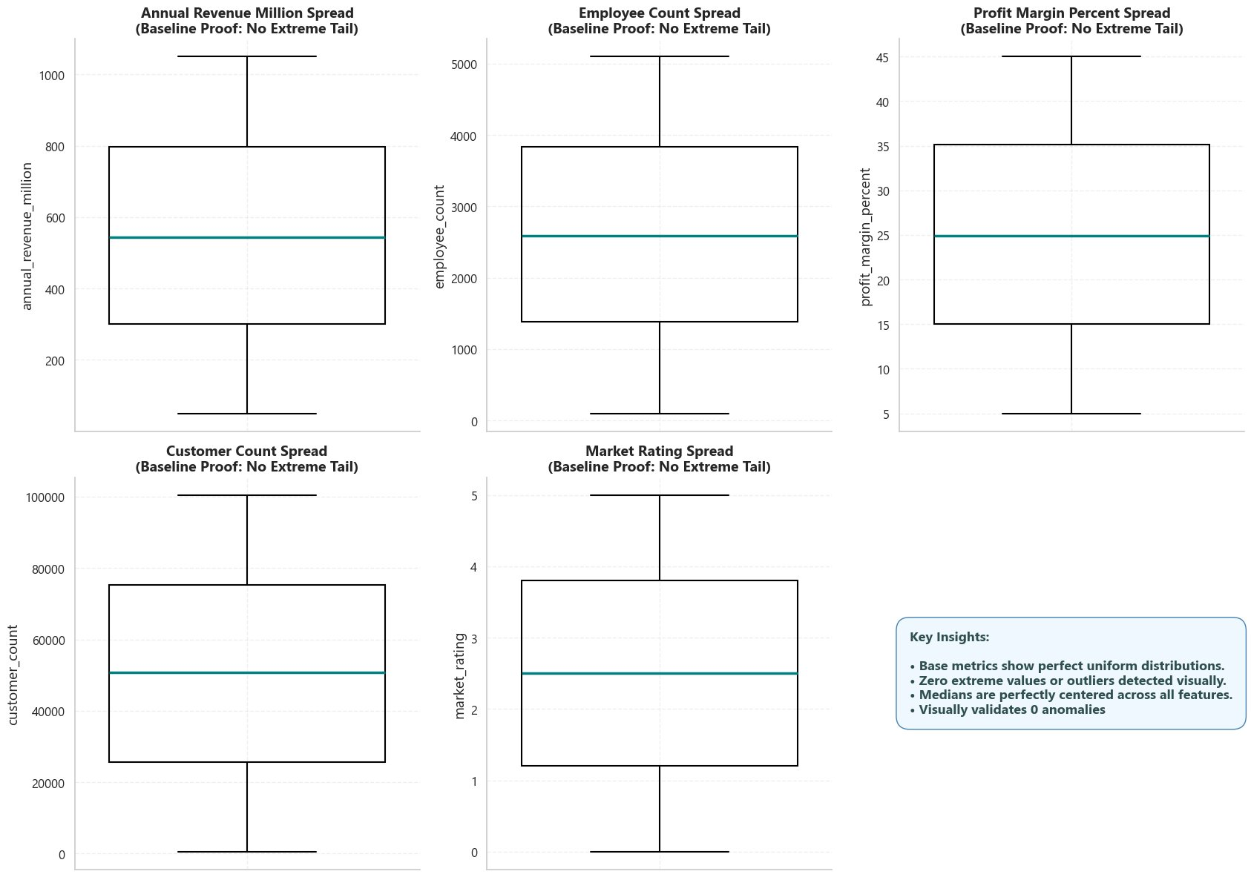
Outlier Detection : Base Metric Validation
Zero outliers in base metrics
All 5 columns — Revenue, Employees, Profit Margin, Customers, Market Rating — show no points beyond IQR boundaries.
Medians perfectly centred
The teal median line sits near the centre of each box — visually confirming near-zero skewness from univariate analysis.
No extreme tails visible
Whiskers extend cleanly to data boundaries. No scattered dots above or below — base data is genuinely clean.
Baseline validated
If outliers exist anywhere, they will only appear in the efficiency ratios — which is exactly what the next slide reveals.
Notes:
ARE THERE OUTLIERS? METHOD: Interquartile Range (IQR) — Outlier boundary: Q1 − 1.5×IQR (lower) and Q3 + 1.5×IQR (upper). CHARTS SHOWN: Boxplot dashboard for 5 base numerical metrics. CHARTS ALSO ANALYZED (not shown in PPT, present in notebook): - Outlier analysis table for base metrics: exact Q1, Q3, IQR boundary values with outlier counts - Q-Q Plot dashboard for base metrics: all 5 track the diagonal line — normality confirmed BASE METRIC RESULTS: - Annual Revenue Million: 0 outliers ✅ - Employee Count: 0 outliers ✅ - Customer Count: 0 outliers ✅ - Profit Margin Percent: 0 outliers ✅ - Market Rating: 0 outliers ✅ WHY SHOW CLEAN BOXPLOTS FIRST: The two-slide outlier structure is deliberate.
Showing zero outliers in base metrics first makes the contrast with efficiency ratios dramatically more impactful on the next slide.
The audience understands: the anomalies are not random — they are specifically and exclusively in the efficiency ratios.
This is a coherent, identifiable group behaving at a fundamentally different level.

Slide 15
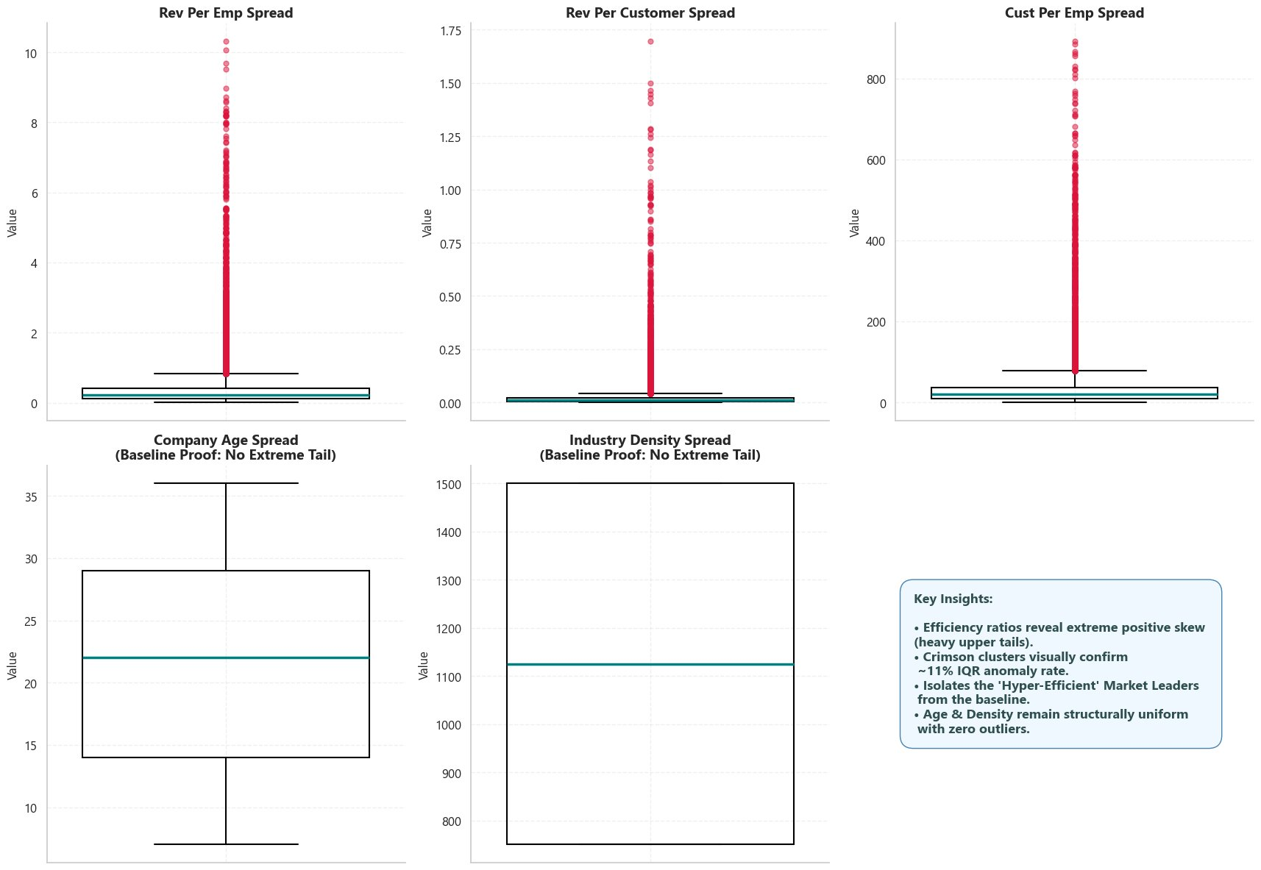
Outlier Detection : Efficiency Ratio Anomalies & Retention Strategy
⚖️ RETENTION DECISION
Column
Outliers
Rate
Rev / Employee
1,646
11.0%
Rev / Customer
1,638
10.9%
Cust / Employee
1,818
12.1%
✅ ALL OUTLIERS RETAINED
These are genuine high-efficiency operators — not data entry errors
①
Removing them erases the Market Leader segment from the analysis
②
Future ML: apply scaling/capping But EDA must retain them in full
③
Notes:
WHAT DID WE DO WITH THESE OUTLIERS? CHARTS SHOWN: Boxplot dashboard for 5 engineered numerical metrics + Retention Decision callout. CHARTS ALSO ANALYZED (not shown in PPT, present in notebook): - Outlier analysis table for engineered metrics: exact Q1, Q3, IQR boundaries and outlier counts - Q-Q Plot dashboard for engineered metrics: all three-efficiency ratio Q-Q plots show sharp detachment from the diagonal above the 95th percentile VISUAL:
Each of the three efficiency ratio boxplots shows a compact IQR box at the bottom with a long trail of crimson dots extending dramatically upward.
Company Age and Industry Density remain clean. EXACT OUTLIER COUNTS: - Rev/Emp: 1,646 (11.0%) - Rev/Customer: 1,638 (10.9%) - Cust/Emp: 1,818 (12.1%) RETENTION — 5 REASONS: 1. 11% rate is far above random noise (<1-2%) 2. Same companies appear across all three ratio columns — coherent, identifiable group 3. Genuinely different operational characteristics — not measurement errors 4. Removing them eliminates the Market Leader segment from analysis entirely 5. Future ML should use capped/scaled versions — EDA requires full retention

Slide 16
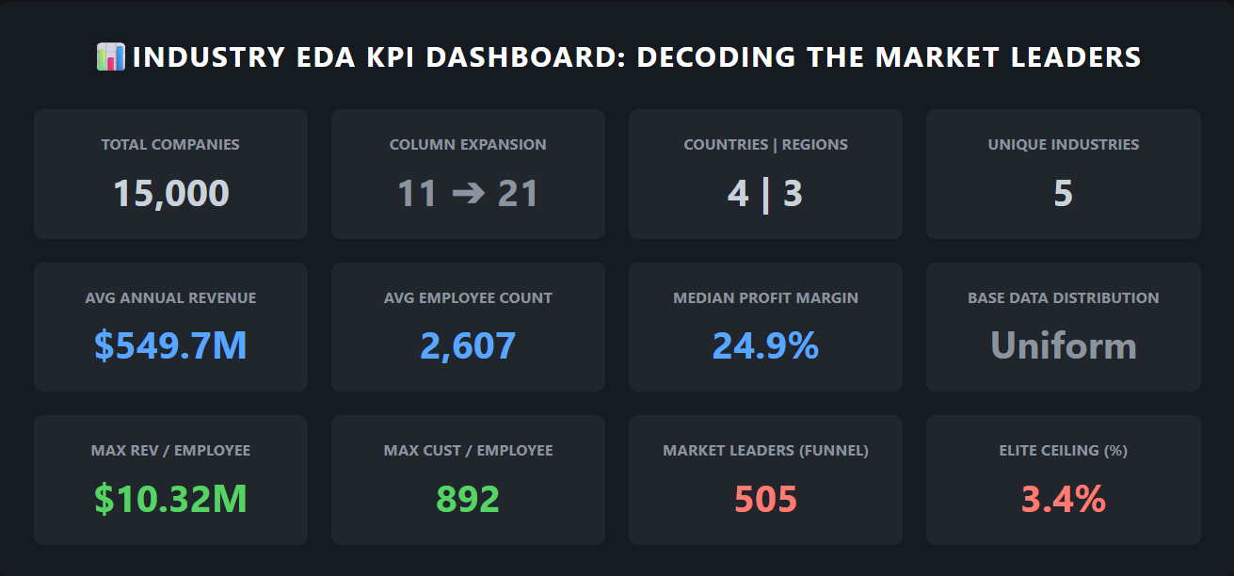
Executive KPI Dashboard : Decoding the Market Leaders
All findings from the full analytical pipeline — consolidated into one executive view
Notes:
HOW CAN EXECUTIVES CONSUME THIS? This dashboard is placed here — because showing a dashboard first gives no context to interpret it. The story must come before the summary. DASHBOARD METRICS: Row 1: Total Companies 15,000 | Column Expansion 11→21 | Countries|Regions 4|3 | Unique Industries 5 Row 2: Avg Annual Revenue $549.7M | Avg Employee Count 2,607 | Median Profit Margin 24.9% | Base Data Distribution: Uniform Row 3: Max Rev/Employee $10.32M | Max Cust/Employee 892 | Market Leaders (Funnel) 505 | Elite Ceiling 3.4% The 3.4% elite ceiling is the anchor number connecting every slide. Only 505 of 15,000 companies qualify simultaneously for all five Market Leader conditions.
This is the precise, quantitative answer to the project's central question i.e. decoding MARKET LEADERS!

Slide 17
Challenges & Learnings
01
📦 Library Scope Expanded Mid-Project
02
🔍 Extracting Signal from Uniform Distributions
Brief required only NumPy, Pandas, Matplotlib, Seaborn.
scipy → skewness, kurtosis, Q-Q plots
squarify → treemap visualization
sklearn MinMaxScaler → radar chart normalization
Each addition solved a specific deliverable — not added by preference.
.
All 12 original metrics exhibited near-zero skewness and negative kurtosis — producing virtually no variance between companies on raw metrics alone.
Conventional EDA techniques applied to perfectly uniform data yield no actionable differentiation.
The analytical pivot — engineering efficiency ratios — was driven entirely by this observation, not by the project brief
03
⚙️ Feature Engineering Beyond the Brief
04
⚖️ The Outlier Retention Dilemma
Original ask: analyse 12 base columns only.
Uniform distributions made meaningful comparison impossible without efficiency ratios and tier classifications.
Going beyond the brief was not optional — it was the only path to extractable insight.
Standard ML practice: remove or cap outliers.
11% of data flagged consistently across 3 columns is not noise — it is a coherent identifiable group.
Overriding textbook convention with context-aware statistical reasoning was the most important judgment call.
Key Learnings:
📌 Raw data uniformity demands analytical creativity — uniform distributions are not the end; they are the beginning.
📌 Context-aware reasoning outperforms textbook convention — retaining the 11% outlier group was the correct decision despite standard ML practice.
📌 Feature engineering is the bridge between data and insight — without it, 15,000 companies looked statistically identical.
Notes:
CHALLENGES 01. LIBRARY SCOPE: Brief specified 4 libraries. Analysis required 7. scipy.stats for skewness(), kurtosis(), probplot() for Q-Q charts. squarify for treemap layout. sklearn MinMaxScaler to normalize the 5-axis radar chart to 0-1 scale. Each was essential for a specific deliverable. 02. SYNTHETIC DATA: Perfectly flat base distributions meant standard EDA was useless. Recognizing this early — rather than forcing interpretation onto meaningless uniformity — was the first critical analytical decision. 03. BEYOND THE BRIEF: The decision to engineer 10 features when only 12 base columns were requested could have been seen as scope creep. The justification: uniform base metrics cannot produce differentiated insights. Feature engineering was the minimum necessary for meaningful output. 04. OUTLIER RETENTION: Standard ML textbook says remove outliers. Context said retain them. The statistical reasoning: 11% consistently across 3 columns, same companies appearing across all three flags, genuine operational behavior. Choosing the defensible path over the conventional one.
LEARNINGS:
01. Raw data uniformity demands analytical creativity — uniform distributions are not the end; they are the beginning.
02. Context-aware reasoning outperforms textbook convention — retaining the 11% outlier group was the correct decision despite standard ML practice.
03. Feature engineering is the bridge between data and insight — without it, 15,000 companies looked statistically identical.

Slide 18
Conclusion
Future Scope
The market baseline is structurally level — no industry, country, or geographic region holds an inherent revenue or performance advantage over another.
🔵 K-Means Clustering
Formally partition 15,000 companies into efficiency archetypes — moving beyond the funnel to ML-defined segments.
Competitive advantage is embedded in operational efficiency, not organizational size. Revenue per Employee — not headcount or customer volume — is the defining separator between Market Leaders and the rest
📊 Streamlit Dashboard
Deploy insights into a real-time interactive executive dashboard with live filters by industry, region, and business model.
The Scale Paradox is real and structural. Mass-Scale growth compresses profit margins to 24.6%, while focused Niche operators achieve 37.0% margins despite generating lower total revenue.
🤖 Predictive Modelling
Only 505 companies — 3.4% of 15,000 — simultaneously satisfy all five Market Leader conditions. This quantifies exactly how rare genuine elite performance is in this market.
Train a classification model (Random Forest) to predict Market Leader probability for new company entries.
There is no single blueprint for Market Leader status. Each sector reaches the top through a distinct operational archetype — but all paths converge on one principle: operational discipline over operational scale.
📈 Longitudinal Analysis
Track companies across multiple years — is Market Leader status stable over time or not? In another words — Forecasting.
Thank You | Yousuf S. R. Sakkaf | github.com/S-Yousuf-S/NHIS_Project3 | Industry Performance EDA v2.0
Notes:
WHAT DID WE LEARN? FIVE CONCLUSIONS: 1. The Uniform Market Baseline:
All five original numerical metrics — Revenue, Employee Count, Customer Count, Profit Margin, and Market Rating —
demonstrated near-perfect distributional uniformity with skewness values between −0.027 and +0.027 and
negative kurtosis of approximately −1.19 across all columns.
No single industry, country, or geographic region holds a structural baseline advantage.
The market playing field is mathematically level.
2. The Scale Paradox:
Engineered efficiency ratios exhibited extreme right-skew (Rev/Employee: 5.58, Rev/Customer: 9.34, Cust/Employee: 5.28)
and massive positive kurtosis (up to 118.9), in direct contrast to the uniform base metrics.
Cross-sector analysis confirmed that Mass-Scale business models generate the highest total revenue but
consistently produce the lowest profit margins (~24.6%),
while focused Niche operators achieve margins as high as 37.0% with a fraction of the workforce.
Competitive advantage is not found in organizational size — it is found in operational density.
3. The Technology Niche Anomaly:
The single most significant finding of the multivariate analysis is that Technology companies operating under a Large/Niche business model generate approximately $3.04M
revenue per employee — the highest efficiency ratio of any industry-model combination in the dataset.
This pattern, while most extreme in Technology, is structurally consistent across all five sectors:
Niche and Standard operators outperform Mass-Scale operators on a per-unit efficiency basis in every industry.
4. The 3.4% Elite Ceiling:
The business pipeline funnel, applying five sequential operational filters — Established Age, Mass-Scale Customers, Large or Enterprise Revenue, High Profit Margin, and Market Leader Rating
— reduced 15,000 companies to just 505 qualifying entities (3.4%). This quantifies precisely how rare simultaneous multi-dimensional excellence is in this market.
The revenue tier filter proved to be the sharpest single eliminator, dropping the qualifying pool from 83.4% to 37.3%.
5. Temporal and Regional Neutrality:
Correlation analysis confirmed near-zero relationships between founding year, country, region, and all performance outcomes.
A company's geographic location and operational age do not artificially inflate or restrict its revenue potential.
Performance is determined entirely by operational behaviour, not structural position.
FOUR FUTURE SCOPES: 1. K-Means Clustering: Formally define efficiency archetypes beyond the funnel filter 2. Streamlit Dashboard: Real-time executive access with drill-down filters 3. Predictive Modelling: Classify Market Leader probability for new company profiles 4. Longitudinal Analysis: Determine if elite performance is stable or transient over multiple years Thank you for your precious time.

