Slide 1
Smartphone Price Prediction
From Data Exploration to Business Recommendations
Data Preprocessing
Exploratory Analysis
Feature Extraction
Model Building
Recommendations
Yousuf S. R. Sakkaf
Notes:
Project Brief
This project focuses on predicting smartphone prices using hardware specifications through an end-to-end machine learning workflow. The analysis is based on a dataset containing 541 smartphone models and aims to identify the key factors influencing smartphone pricing while developing an accurate predictive model.
Presentation Flow
• Business Understanding & Dataset Overview
• Data Cleaning & Preprocessing
• Feature Engineering
• Exploratory Data Analysis
• Feature Extraction & Selection
• Model Building & Hyperparameter Tuning
• Model Performance Comparison
• Feature Importance Analysis
• Final Model Retraining & Validation
• Business Recommendations
• Challenges & Key Learnings
• Conclusion & Future Scope

Slide 2
Business Understanding & Dataset Overview
" Which hardware specifications drive mobile phone prices — and can we build a model that accurately predicts price from specs alone? "
541
12
0
₹920 – ₹80,999
Row Count
Column Count
Missing Values
Raw Price Range
Raw Dataset Columns
Column
Description
Project Objectives
Preprocess and clean raw smartphone specs dataset.
Engineer meaningful features from raw specs strings.
Identify and screen features using three complementary methods.
Resolve method conflicts through empirical experiments.
Build and compare 4 ML models under identical conditions.
Optimize the Winning Model through hyperparameter tuning.
Validate model through Residual & Prediction Error Analysis.
Provide business insights.
[Unnamed Column]
No analytical value (Will be dropped)
Model
187 unique phone names
Colour
275 unique colour variants
Memory
Internal storage (GB)
RAM
RAM size (GB)
Battery_
Battery capacity (mAh)
Rear Camera
String format — MP extraction needed
Front Camera
String format — MP extraction needed
AI Lens
Binary: 0 = No, 1 = Yes
Mobile Height
Physical height (cm) + few anomalies
Processor_
Full processor string — brand extraction needed
Prize ⭐
Selling price ₹ — TARGET
Notes:
Business problem:
A mobile phone retailer needs a data-driven pricing engine. Manual pricing is inconsistent. Dataset:
Processed_Flipdata.csv — 541 rows, 12 columns.
• 0 missing values and 10 duplicate rows detected during the initial data quality audit. • Prize (target) stored as string with commas → needs cleaning • Rear/Front Camera stored as strings like '13MP+2MP' → numeric extraction needed • Processor_ is a full string like 'Qualcomm Snapdragon 680' → brand needs extraction • Model (187 unique) and Colour (275 unique) are very high cardinality categoricals All 7 objectives were fully met and exceeded in the final 11-section notebook. Below are the detailed objectives:
Perform thorough data preprocessing and handle all structural inconsistencies in the raw dataset
Engineer meaningful features from raw specification strings (camera MP, processor brand, colour family, etc.)
Identify the most influential hardware features using three complementary screening methods
Resolve method conflicts through empirical experiments
Build and evaluate four machine learning models under identical, controlled conditions
Optimize the winning model through systematic hyperparameter tuning via GridSearchCV
Validate model reliability through residual analysis and a Feature Contribution Test
Provide actionable, evidence-backed business recommendations for pricing strategy

Slide 3
Data Preprocessing
✅ Missing Values: 0 · ✅ 10 Duplicate Rows identified and removed · ✅ Dataset ready for EDA
01
Column Cleaning & Type Casting
03
Categorical Feature Engineering
Extracted and grouped high-cardinality string columns into distinct categories:
Processor_Brand
Model_Category
Colour_Category
Removed formatting artifacts from the target price string and cast to integer.
Dropped non-analytical index column (Unnamed: 0).
02
Regex Numeric Extraction
04
Preprocessing Summary
Parsed integer megapixel (MP) values from unstructured Rear Camera and Front Camera strings.
Dataset transitioned from raw 541 x 12 to a cleaned 531 x 13 structure ready for EDA.
Notes:
The initial preprocessing phase focuses on verifying data integrity and applying structural transformations to the raw 541-record smartphone dataset.
The data quality audit identified zero missing values and ten duplicate rows.
After removing the duplicates, preprocessing focused primarily on structural transformation rather than data correction.
Machine learning models require numerical representations of input features before training. Unstructured text, such as camera specifications or formatting artifacts in the target price data, must be parsed to extract the underlying numerical values. Furthermore, raw model names and colour variants contain hundreds of unique values that would lead to a feature space explosion if encoded directly and therefore must be transformed into machine-readable representations while preserving their analytical value.
The target variable and camera strings are stripped of non-numeric characters using regular expressions and safely cast into integer datatypes.
Finally, non-analytical artifacts are removed, resulting in a refined 13-column dataset ready for exploratory data analysis (EDA).
In short, key cleaning steps:
1. `Unnamed:0` dropped — leftover from CSV export 2. `Battery_` renamed to `Battery_mAh` 3. Camera extraction:
str.extract(r'(\d+)') extracts the first numeric value from strings such as '13MP+2MP', then safely converts the result to integer. Zero nulls confirmed.
4. Prize cleaning:
.str.replace(',','').astype(int) removes comma separators, converts the values to integer, and the column is renamed to Price.
Data integrity audit results:
- isnull().sum(): 0 missing across all 12 columns - duplicated().sum(): 10 duplicate rows

Slide 4
Feature Engineering
Three helper features engineered from categorical attributes to support exploratory analysis and subsequent preprocessing
Processor_Brand
💡 Mediatek dominates (52.73%). 17 'Unknown' entries (Android, Octa Core strings) are a small fraction.
From: Processor_ (e.g. 'Qualcomm Snapdragon 680', 'Unisoc Spreadtrum SC9863A1')
Method: Keyword matching on processor strings → 6 brand categories
Mediatek 280 · Qualcomm 129 · Unisoc 69 · Exynos 28 · Google 8 · Unknown 17
Model_Category
💡 Xiaomi + Realme + Infinix = 55.4% of dataset
From: Model (187 unique names)
Method: Brand family keyword extraction → 13 brand families
Xiaomi 132 · Realme 97 · Infinix 65 · Vivo 60 · Samsung 53 · Motorola 45 · Others…
Colour_Category
💡 Black + Blue = 55.74% of devices. Colour family used for EDA only — dropped before modelling.
From: Colour (275 unique shade names — 'Midnight Black', 'Starry Blue' etc.)
Method: Base colour family grouping → 12 colour families
Black 157 · Blue 139 · Green 59 · Silver/Grey 39 · White 35 · Others…
Notes:
Three analytical helper features were engineered to support exploratory analysis and simplify the handling of high-cardinality categorical variables during subsequent preprocessing.
1. Processor_Brand — keyword matching from full processor strings:
'qualcomm'/'snapdragon' → Qualcomm
'mediatek'/'dimensity'/'helio' → Mediatek
'unisoc' → Unisoc
'exynos' → Exynos
'google tensor' → Google
Any unrecognized processor string was assigned to the 'Unknown' category.
Final distribution:
• Mediatek: 280
• Qualcomm: 129
• Unisoc: 69
• Exynos: 30
• Google: 8
• Unknown: 17
Only 17 records (3.2%) remained unmapped, indicating that the keyword-based extraction achieved high coverage across the dataset.
2. Model_Category — grouped 187 individual model names into 13 brand families using keyword extraction.
Xiaomi (132), Realme (97), and Infinix (65) together account for approximately 55% of the dataset, simplifying brand-level exploratory analysis while preserving the original Model column for modelling.
3. Colour_Category — grouped 275 individual colour variants into 12 base colour families.
Black (157) and Blue (139) together account for approximately 56% of all devices, making colour distribution visualizations more interpretable during exploratory analysis.
IMPORTANT:
Model_Category and Colour_Category were created exclusively as EDA helper features and were intentionally removed before model training. The original Model and Colour columns were retained and later Label Encoded to preserve fine-grained pricing information.
During the encoding stage, Processor_Brand was transformed into six One-Hot Encoded binary features, after which the original Processor_Brand column was removed.

Slide 5
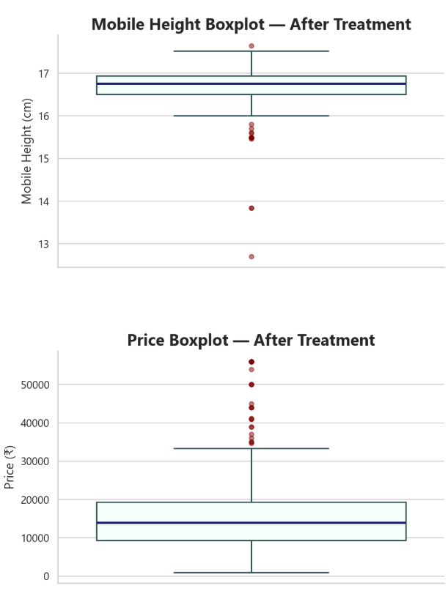
EDA — Outlier Assessment & Treatment
Feature | IQR Flags | Z-Score Flags | Remaining Flags | Decision | Justification
Memory | 55 | 0 | — | ☑️ Retained | Valid Storage Configurations
RAM | 0 | 0 | — | ☑️ Retained | Valid Hardware Specifications
Battery | 148 | 15 | — | ☑️ Retained | Valid Battery Capacities
Rear Camera | 39 | 8 | — | ☑️ Retained | Premium Camera Specifications
Front Camera | 13 | 13 | — | ☑️ Retained | Premium Camera Specifications
Mobile Height | — | — | 17 | ✅ Treated | Median Imputation
Price (₹) | 25 | 11 | 7 | ✅ Treated | 99th Percentile Capping
IQR and Z-score methods jointly assessed potential outliers.
Only justified treatments were applied; valid hardware values were retained.
The cleaned dataset was used for all subsequent analysis.
Notes:
Outlier Detection & Treatment
The dataset was examined for potential outliers using multiple complementary techniques rather than relying on a single statistical rule. The objective was to distinguish genuine premium smartphone specifications from erroneous observations before deciding whether treatment was necessary.
Two statistical detection methods were applied:
Interquartile Range (IQR)
Applied to all numerical features.
Flagged observations lying outside the conventional 1.5×IQR fences.
Detected:
Memory: 55
Battery: 148
Rear Camera: 39
Front Camera: 13
Price: 25.
Z-Score Method
Applied using the Empirical Rule (|Z| > 3).
Produced fewer extreme observations:
Battery: 15
Rear Camera: 8
Front Camera: 13
Price: 11
These records were also verified as genuine premium devices and therefore were not removed.
Unlike the remaining variables, Mobile Height contained implausible measurements identified during exploratory validation.
These values were corrected through median imputation.
For the target variable (Price), outright removal would unnecessarily discard valuable premium smartphones.
Instead, a 99th percentile cap (₹55,999) was applied, affecting only 7 observations while preserving every record within the dataset.
This selective treatment reduced distributional extremity without sacrificing legitimate market behaviour, allowing subsequent modelling to retain realistic premium-price information.

Slide 6
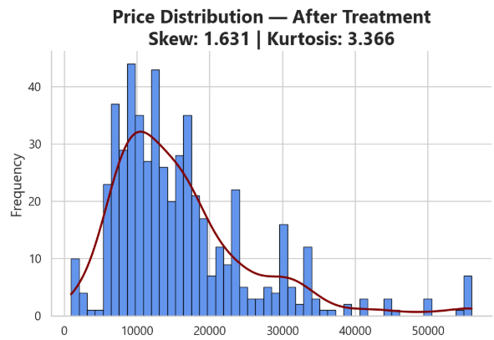
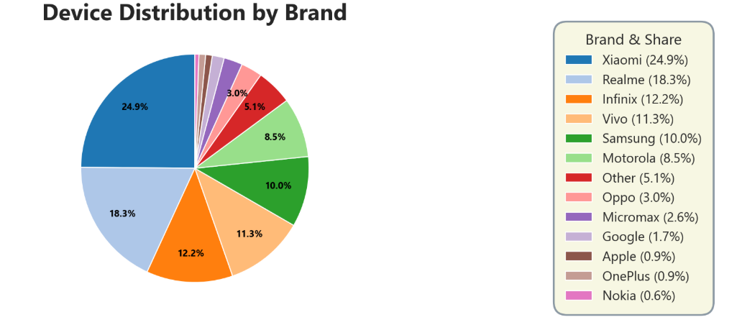
EDA — Univariate Analysis
Price remains moderately right-skewed after treatment, indicating that premium smartphones still form a relatively small segment of the dataset.
Budget and mid-range smartphones account for over three-quarters of all devices, making this the dominant market segment represented in the dataset.
The dataset is sufficiently diverse across brands and price levels to support robust downstream modelling.
Notes:
Following outlier treatment, univariate analysis was performed to understand the distribution of the target variable and the overall composition of the smartphone market represented within the dataset.
The capped price distribution remained positively skewed.
Price segment analysis showed:
Budget (< ₹10,000): 176 devices
Mid-range (₹10,000–20,000): 236 devices
Upper Mid (₹20,000–35,000): 97 devices
Premium (> ₹35,000): 22 devices
Together, the Budget and Mid-range segments account for approximately 77% of the dataset, confirming that the collection primarily represents affordable consumer smartphones.
Although capping reduced the influence of extreme prices, the histogram still exhibits a long right tail. This indicates that premium devices remain comparatively rare but continue to influence the overall distribution.
A Quantile-Quantile (Q-Q) Plot was also examined within the notebook. Systematic deviation from the reference line—particularly within the upper tail—confirmed that the target variable does not follow a normal distribution even after treatment. This finding later helps explain why tree-based ensemble models substantially outperform Linear Regression.
Brand composition further highlights the dataset structure.
Xiaomi, Realme and Infinix together account for slightly over half of all smartphones, whereas Apple and Google devices represent only a very small proportion of the observations.
Colour analysis showed that Black and Blue variants dominate the dataset, accounting for over half of all devices.
Since colour was not expected to influence pricing behaviour, the engineered Colour_Category feature was used only during exploratory analysis and removed before feature selection.

Slide 7
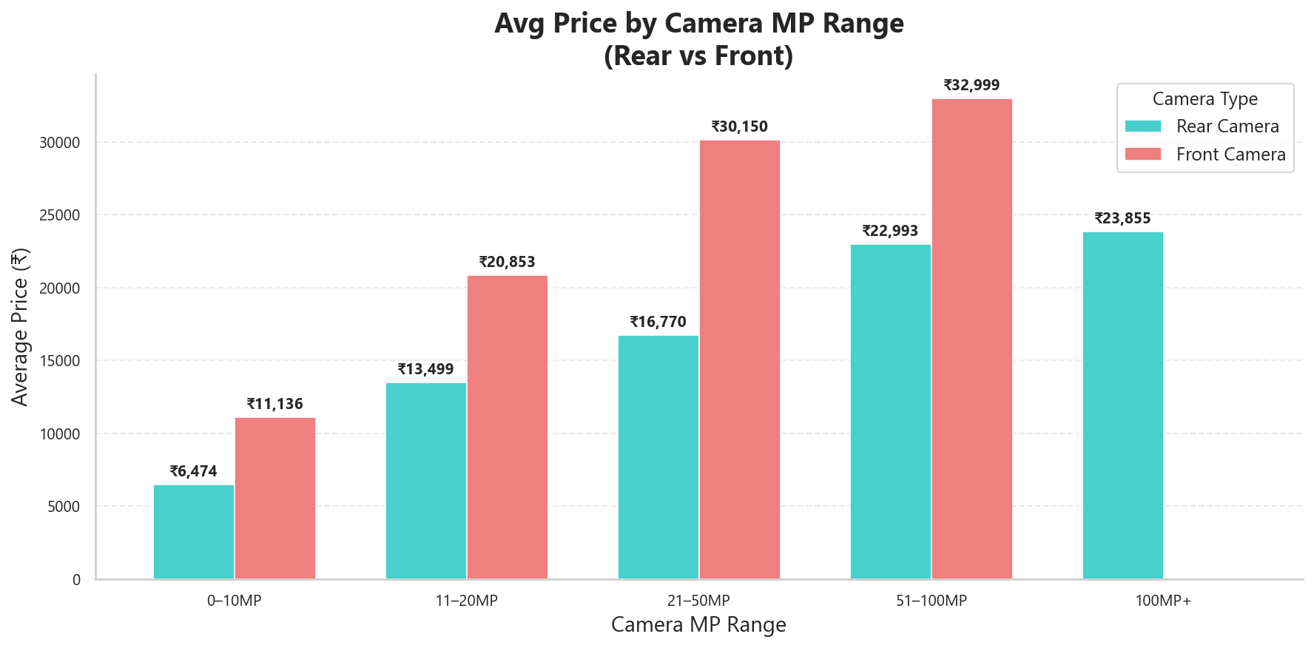
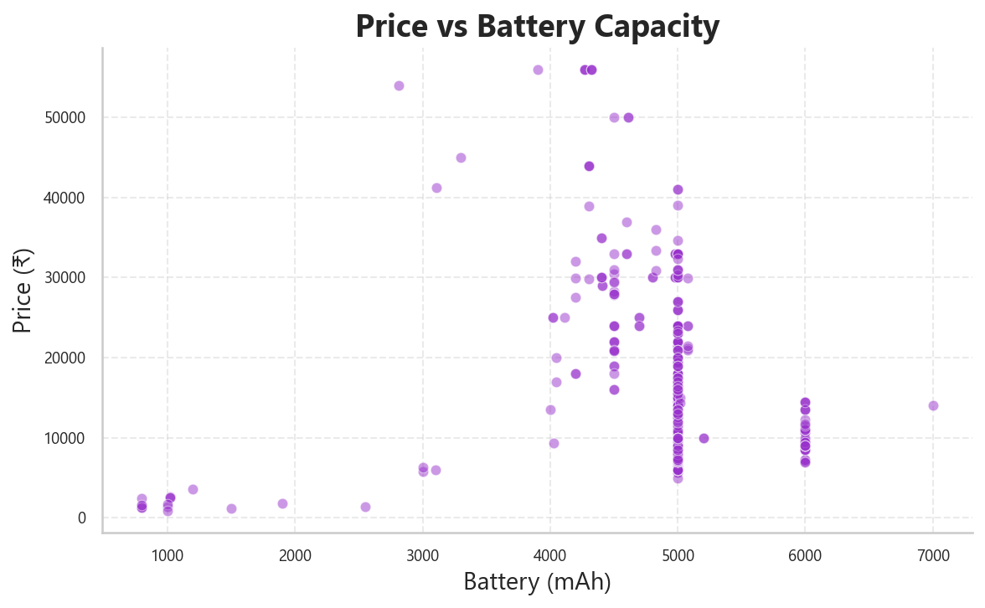
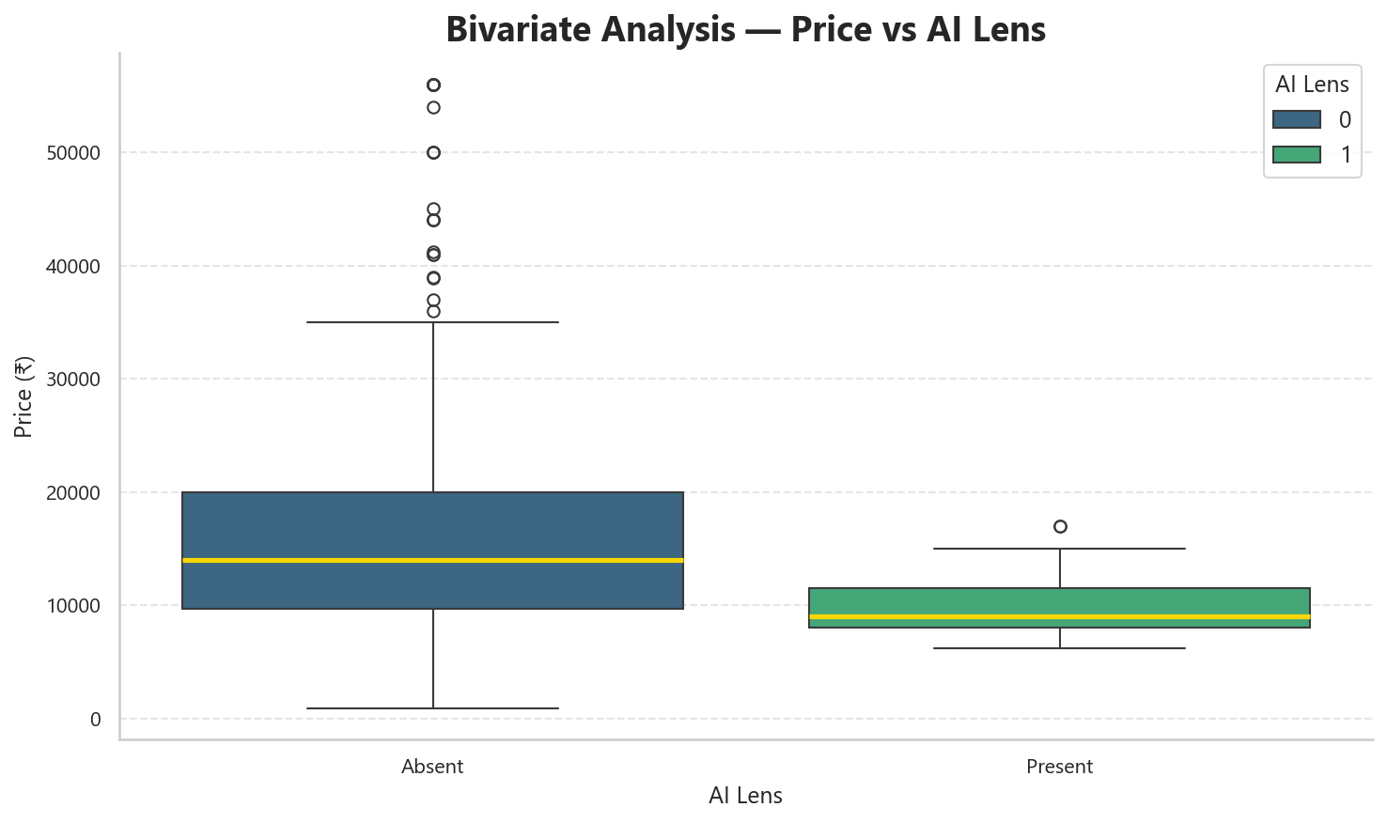
EDA — Feature Relationships with Price
Camera MP: Front camera consistently outprices rear camera at every tier
AI Lens: Counterintuitive — devices without it price higher
Battery: No visible trend — the real signal is non-linear
Beyond these three:
RAM and Memory both show strong, expected upward trends with price.
Processor Brand shows a clear hierarchy — Google commands roughly 6× Unisoc's average price.
Notes:
RAM vs Price (covered in notes only — no visual)
What: Average price rises from ₹7,865 (2GB) to ₹9,268 (3GB), ₹11,751 (4GB), ₹17,249 (6GB), and ₹24,063 (8GB).
How: Computed as mean Price grouped by RAM tier across all 531 devices.
Why it matters: The increase accelerates at higher tiers rather than rising linearly — but it isn't deterministic.
Some 8GB devices sell as low as ₹920 (the dataset's overall minimum price) — feature-phone-spec devices from budget brands with unusually high RAM but rock-bottom pricing.
RAM alone cannot determine price; brand and positioning override raw specs at the low end.
Memory vs Price (notes only)
What: Average price rises from ₹3,393 (16GB) to ₹6,749 (32GB), ₹10,631 (64GB), ₹19,375 (128GB), and ₹27,566 (256GB).
How: Same method as RAM, grouped by Memory tier.
Why it matters: Same accelerating pattern — the 128GB→256GB jump alone (+₹8,191) is larger than the entire 16GB→64GB range combined.
AI Lens vs Price (shown on slide — boxplot)
What: Devices without AI Lens show a higher median price (~₹14,000) than devices with it (~₹9,000).
How: Boxplot comparing Price distributions for AI Lens absent (0) vs. present (1).
Why it matters: Counterintuitive — a "smart" feature correlating with lower price.
This reflects AI Lens being marketed as a budget-tier spec in the Indian market, not a premium differentiator.
Battery vs Price (shown on slide — scatter)
What: Wide price dispersion at every battery level — most devices cluster at 4,000–6,000 mAh, but prices at that exact range span from ₹5,000 to ₹56,000. How: Scatter plot, all 531 devices, Battery_mAh vs. Price. Why it matters: No visible linear trend, and correlation confirms it (−0.035, near-zero).
Processor Brand vs Price (shown on slide — bar chart) What: Google ₹44,749 > Qualcomm ₹20,591 > Mediatek ₹14,738 > Unisoc ₹7,439 — roughly a 6× spread among the four major identifiable brands.
(Full ranking including smaller categories: Google > Unknown ₹23,559 > Qualcomm > Exynos ₹18,022 > Mediatek > Unisoc.) How: Mean Price grouped by extracted Processor_Brand category. Why it matters: Separately, at the brand (not processor) level, the spread is even more dramatic — Micromax averages ₹2,399 against Apple's ₹52,639, roughly a 22× gap — reinforcing that brand identity, not just processor choice, drives much of this hierarchy.
Camera MP vs Price (shown on slide — grouped bar) What: Front camera outprices rear camera at every comparable tier: ₹11,136 vs ₹6,474 (0–10MP), widening to ₹32,999 vs ₹22,993 (51–100MP). No devices exceed 100MP on front camera. How: Devices bucketed into MP range tiers, mean Price computed per bucket, per camera type. Why it matters: This says that it is one of the most important feature of the camera and might be still after the model is build perhaps.

Slide 8
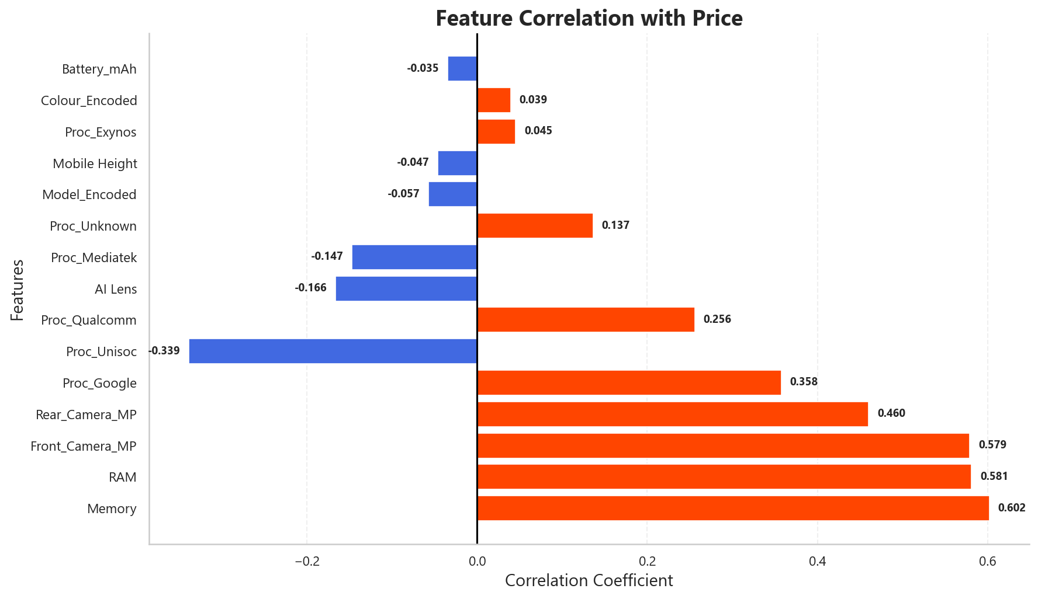
EDA — Feature Correlation & Encoding
EDA helper columns removed after exploratory analysis.
Label Encoding applied to Model & Colour
One-Hot Encoding applied to Processor_Brand
Dataset converted into numerical format for machine learning
Key Observations
Memory (0.602) & RAM (0.581) — strongest positive linear correlation with Price
Rear (0.460) and Front (0.579) Cameras also exhibit high positive relationships
Battery (-0.035) and Mobile Height (-0.047) have relatively weak linear correlation.
Encoding completed the transition from EDA to feature screening.
Notes:
Following completion of exploratory analysis, temporary helper columns created solely for EDA (including Model_Category and Colour_Category) were removed to prevent redundant information from entering the modelling pipeline. The dataset was then transformed into a fully numerical representation suitable for machine learning.
Encoding Strategy:
Model (187 unique categories) was Label Encoded into Model_Encoded, while Colour (275 unique categories) was transformed into Colour_Encoded. Label Encoding was selected because both variables exhibit very high cardinality, making One-Hot Encoding impractical. The assigned integers serve only as machine-readable identifiers and do not imply any ordinal relationship between categories.
Processor_Brand contains only six categories and was therefore One-Hot Encoded into six binary variables:
Proc_Exynos
Proc_Google
Proc_Mediatek
Proc_Qualcomm
Proc_Unisoc
Proc_Unknown
This preserves categorical information without introducing artificial ordering.
After preprocessing, the modelling dataset consisted of 531 observations and 15 predictor columns + 1 Target, ready for feature screening.
Pearson Correlation Analysis:
Pearson correlation was then used as the first feature-screening technique to measure linear relationships between each predictor and smartphone price.
Strongest positive correlations:
Memory: 0.602
RAM: 0.581
Front Camera MP: 0.579
Rear Camera MP: 0.460
These findings suggest that storage capacity, memory, and camera specifications exhibit the strongest linear association with smartphone price.
Several engineered processor features display weaker relationships.
Google-powered devices show a moderate positive correlation (0.358), whereas Unisoc devices exhibit the strongest negative correlation (−0.339), reflecting their concentration within lower-priced market segments.
Battery capacity (−0.035) and Mobile Height (−0.047) display negligible linear correlation with price, indicating that these specifications alone provide little explanatory power under a linear relationship.
Why this matters
Pearson correlation evaluates only linear relationships.
Features exhibiting weak correlation are not necessarily unimportant; they may influence price through non-linear interactions that linear correlation cannot detect.
This limitation motivates the use of additional feature-screening techniques in the next section, where multiple methods are compared before selecting the final modelling features.

Slide 9
Feature Selection & Empirical Validation
FEATURE SELECTION — Three-Method Comparison
■ Consensus Features ■ Conflicting Rankings
■ Directional Conflicts ■ Consistent Low Importance
🟩 Consensus Features
Memory, RAM and Camera features ranked consistently across all three screening methods.
Feature | Correlation Rank | SelectKBest Rank | RandomForest Rank | Average Rank
Memory | 1 | 1 | 4 | 2
Front_Camera_MP | 3 | 3 | 1 | 2.33
RAM | 2 | 2 | 6 | 3.33
Rear_Camera_MP | 4 | 4 | 5 | 4.33
Proc_Google | 5 | 5 | 7 | 5.67
Proc_Qualcomm | 7 | 7 | 10 | 8
Model_Encoded | 11 | 11 | 2 | 8
Proc_Unisoc | 6 | 6 | 15 | 9
Proc_Mediatek | 9 | 9 | 11 | 9.67
AI Lens | 8 | 8 | 14 | 10
Mobile Height | 12 | 12 | 8 | 10.67
Battery_mAh | 15 | 15 | 3 | 11
Proc_Unknown | 10 | 10 | 13 | 11
Colour_Encoded | 14 | 14 | 9 | 12.33
Proc_Exynos | 13 | 13 | 12 | 12.67
🟨 Conflicting Features
Battery, AI Lens and Model required empirical validation due to conflicting rankings.
🟥 Final Decisions
Retained: Battery and Model after empirical testing.
Dropped: AI Lens, Colour_Encoded, Proc_Exynos and Proc_Unknown.
Notes:
Feature Selection & Empirical Validation
Following the initial Pearson correlation screening presented in the previous section, two additional feature selection techniques were applied to capture statistical significance and non-linear feature importance. The combined results were then compared to identify both consensus features and conflicting rankings requiring further investigation.
SelectKBest (F-test):
SelectKBest evaluates whether each feature exhibits a statistically significant relationship with smartphone price.
Results:
10 of 15 features were statistically significant (p < 0.05).
The remaining five features (Battery_mAh, Mobile Height, Model_Encoded, Colour_Encoded and Proc_Exynos) were not statistically significant under the linear F-test.
Random Forest (RF Gain):
Unlike Pearson correlation and SelectKBest, Random Forest measures the contribution of each feature to prediction accuracy and is capable of capturing non-linear relationships.
The strongest gain scores were:
Front Camera MP (0.420)
Model_Encoded (0.217)
Battery_mAh (0.091)
Memory (0.082)
These rankings differed substantially from the earlier statistical methods, particularly for Model_Encoded and Battery_mAh, indicating that further validation was required before making feature selection decisions.
Why empirical validation was necessary
While Memory, RAM and Camera features ranked consistently across all screening methods, three features produced conflicting evidence:
Model_Encoded , Battery_mAh , AI Lens
Rather than relying solely on statistical rankings, controlled empirical experiments were conducted by retraining identical Random Forest models with and without each disputed feature while keeping all remaining predictors unchanged.
Empirical Validation Results
Model_Encoded
Removing Model_Encoded increased MAE from ₹2,712 to ₹2,908 and reduced R² from 0.6850 to 0.6646.
This confirms that the model information contributes meaningful predictive value despite receiving weak rankings from linear methods.
Decision: Retained.
Battery_mAh
Removing Battery_mAh increased MAE from ₹2,712 to ₹3,031 while reducing R² from 0.6850 to 0.6268.
Although Battery exhibited almost no linear relationship with price, empirical testing demonstrated that it provides useful non-linear information to the Random Forest model.
Decision: Retained.
AI Lens
Removing AI Lens produced only a negligible change in performance (MAE increased by ₹17, while R² changed from 0.6850 to 0.6847).
The feature therefore contributed virtually no practical predictive value despite being statistically significant under SelectKBest.
Decision: Dropped.
Final Feature Set
Following empirical validation, four features were excluded before model development:
AI Lens
Colour_Encoded
Proc_Exynos
Proc_Unknown
The remaining 11 validated features were carried forward into baseline model development.

Slide 10
Model Building — The Race
80% Train (424) · 20% Test (107) · Random State 42 · StandardScaler for Linear Regression only
01
Linear Regression
Test MAE
Test RMSE
Test R²
CV R²
Baseline
₹4,110
₹6,665
0.4570
0.6256
Explains only 45.7% of variance. CV R² of 0.6256 higher than single test-split R². Confirms non-linear models are essential.
02
Decision Tree Regressor
Test MAE
Test RMSE
Test R²
CV R²
Rule-Based Non-Linear
₹1,313
₹4,418
0.7615
0.7766
CV R² (0.7766) sits close to Test R² (0.7615) — a gap of just 0.0141 — indicating fairly consistent performance across data splits.
03
Random Forest Regressor
Test MAE
Test RMSE
Test R²
CV R²
Bagging Ensemble
₹1,987
₹4,641
0.7367
0.8593
The gap between CV R² (0.8593) and Test R² (0.7367) — the largest among the four baseline models — suggests this particular test split was harder than average for RF. CV R² remains the more reliable estimate of its true generalization.
04
XGBoost Regressor
Test MAE
Test RMSE
Test R²
CV R²
Boosting Ensemble
₹1,194
₹3,793
0.8241
0.8809
Best across all 4 metrics. CV R² of 0.8809 — excellent. Clear winner. Advances to GridSearchCV tuning.
Notes:
Model Building – The Race
Four regression algorithms were evaluated under identical training and testing conditions to compare predictive accuracy and generalization performance.
Why these four models?
Linear Regression establishes the baseline by assuming purely linear relationships between hardware specifications and smartphone price.
Decision Tree introduces non-linear decision boundaries but is susceptible to overfitting.
Random Forest reduces variance by averaging predictions across multiple decision trees trained on random subsets.
XGBoost builds trees sequentially, correcting previous prediction errors and typically achieving superior performance on structured tabular datasets.
Model Comparison Results
Linear Regression
Test MAE: ₹4,110
Test RMSE: ₹6,665
Test R²: 0.4570
CV R²: 0.6256
The comparatively weak performance confirms the earlier EDA finding that smartphone pricing cannot be adequately explained using purely linear relationships.
Decision Tree
Test MAE: ₹1,313
Test RMSE: ₹4,418
Test R²: 0.7615
CV R²: 0.7766
Introducing non-linearity substantially improved prediction accuracy over Linear Regression.
Random Forest
Test MAE: ₹1,987
Test RMSE: ₹4,641
Test R²: 0.7367
CV R²: 0.8593
Random Forest demonstrated strong cross-validation performance, reflecting the stabilizing effect of bagging, although its single test split performance was comparatively lower.
Baseline XGBoost
Test MAE: ₹1,194
Test RMSE: ₹3,793
Test R²: 0.8241
CV R²: 0.8809
Baseline XGBoost achieved the strongest overall performance across the baseline models and was therefore selected for hyperparameter tuning.
StandardScaler was applied only to Linear Regression because tree-based algorithms are inherently scale-independent.

Slide 11
Hyperparameter Tuning — GridSearchCV
learning_rate
max_depth
n_estimators
subsample
0.2
3
200
0.8
Paced gradient step
Controlled tree depth
Boosting rounds
Row sampling per tree
Search Configuration
Tuning Impact: Baseline → Tuned
Method:
Baseline
Tuned
Change
GridSearchCV — exhaustive grid
Grid:
n_estimators [100,200,300]
CV R²
0.8809
0.9100
+0.0291
max_depth [2, 3, 4, 5, 7]
learning_rate [0.01, 0.1, 0.2, 0.3]
Test R²
0.8241
0.7868
-0.0373
subsample [0.7, 0.8, 1.0]
Total Fits:
180 combos × 5 folds = 900
RMSE
₹3,793
₹4,176
−₹383
Scoring:
R² (coefficient of determination)
MAE
₹1,194
₹1,558
−₹364
Parallel:
n_jobs=−1 (all CPU cores)
Decisive metric for final model selection —
The tuned model achieved the highest Cross-Validated R² (0.9100) among all evaluated models.
Notes:
Hyperparameter Tuning — GridSearchCV
Hyperparameter tuning was performed exclusively on the baseline XGBoost model because it emerged as the strongest candidate during the initial model comparison.
Optimizing every model would substantially increase computational cost while providing limited practical benefit.
Grid Search Configuration
The following parameter grid was evaluated:
n_estimators: 100, 200, 300
max_depth: 2, 3, 4, 5, 7
learning_rate: 0.01, 0.1, 0.2, 0.3
subsample: 0.7, 0.8, 1.0
This produced 180 hyperparameter combinations, evaluated using 5-fold cross-validation, resulting in 900 model fits.
Best Hyperparameters
learning_rate = 0.2
max_depth = 3
n_estimators = 200
subsample = 0.8
These settings balance model complexity, learning speed and generalization while avoiding unnecessary tree depth.
Why the tuned model was selected
The tuned model achieved the highest Cross-Validated R² (0.9100) among all evaluated models.
Although its performance on the single held-out test split was slightly lower than the baseline XGBoost, notebook analysis demonstrated that a dataset of approximately 531 observations produces a relatively small (~107-row) test partition. Additional robustness analysis confirmed that this individual split is subject to meaningful sampling variance.
Cross-validation therefore provides the more reliable estimate of expected real-world performance, making the tuned XGBoost model the appropriate candidate for final retraining and deployment.

Slide 12
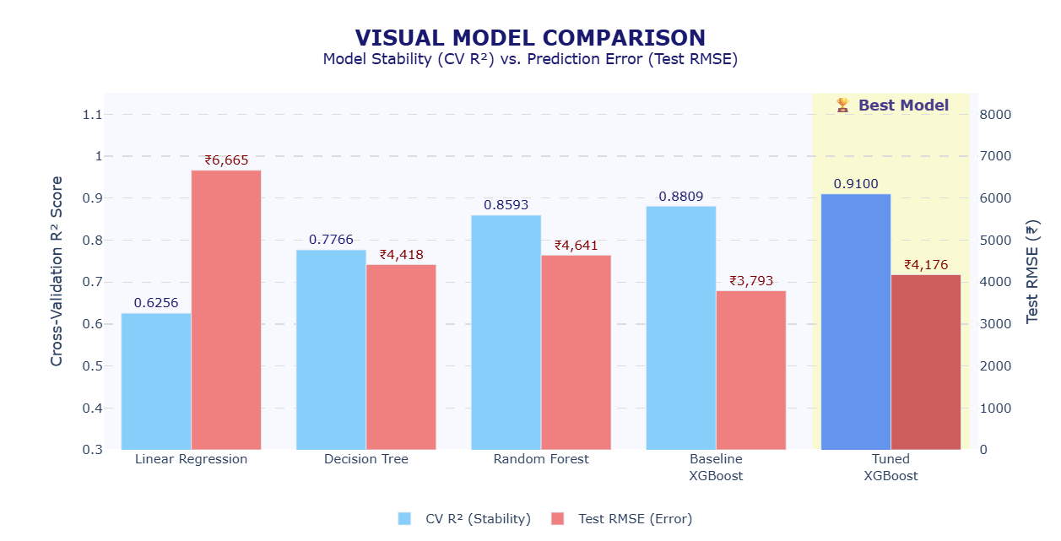
Model Comparison — The Verdict
Notes:
Model Comparison Dashboard
This dashboard consolidates the performance of all evaluated models using the two primary evaluation metrics: Cross-Validated R² (generalization performance) and Test RMSE (prediction error on the held-out test set).
Cross-validation is emphasized because it provides a more reliable estimate of expected model performance than a single train-test split, particularly for a dataset of 531 observations.
Overall Performance Progression
Model performance improves progressively throughout the project:
Linear Regression → CV R² = 0.6256
Decision Tree → 0.7766
Random Forest → 0.8593
Baseline XGBoost → 0.8809
Tuned XGBoost → 0.9100
The largest improvement occurs between Linear Regression and Decision Tree, confirming that smartphone pricing exhibits strong non-linear relationships that cannot be captured adequately by a linear model.
Hyperparameter tuning further increases the Cross-Validated R² from 0.8809 to 0.9100, demonstrating improved generalization performance.
Although the Baseline XGBoost achieved a slightly stronger score on one held-out test split, the Tuned XGBoost consistently performed better during repeated cross-validation.
Combined with the alternate-split robustness analysis presented later in the notebook, this supports selecting the tuned model for final deployment.
Dashboard Interpretation:
The dashboard combines CV R² and Test RMSE into a single visualization.
The ideal model simultaneously: maximizes Cross-Validated R², minimizes Test RMSE, and demonstrates stable generalization across unseen data.
Among all evaluated models, Tuned XGBoost provides the strongest cross-validated generalization — the metric prioritized for final model selection at this dataset size, as established in the Hyperparameter Tuning discussion — making it the model selected for retraining and business recommendations.

Slide 13
Feature Importance Analysis
FEATURE IMPORTANCE SYNTHESIS Final Feature Ranking (Permutation-Based)
🟦 Front Camera remained the most influential feature across both importance methods.
Built-in rank is shown for reference only. Final ranking is based on Permutation R² Drop.
Tier | Feature | Built-in Rank | Permutation Importance
Critical | Front_Camera_MP | #1 ➖ 42.02% | #1 ➖ 0.3629
High | Model_Encoded | #4 ➖ 8.60% | #2 ➖ 0.2367
Moderate | RAM | #6 ➖ 6.32% | #3 ➖ 0.0814
Moderate | Battery_mAh | #3 ➖ 10.50% | #4 ➖ 0.0748
Moderate | Memory | #2 ➖ 15.88% | #5 ➖ 0.0628
Moderate | Mobile Height | #8 ➖ 1.92% | #6 ➖ 0.0375
Low | Rear_Camera_MP | #5 ➖ 6.65% | #7 ➖ 0.0182
Negligible | Proc_Mediatek | #7 ➖ 4.44% | #8 ➖ 0.0062
Negligible | Proc_Qualcomm | #9 ➖ 1.46% | #9 ➖ 0.0034
Negligible | Proc_Unisoc | #11 ➖ 0.81% | #10 ➖ 0.0000
Negligible | Proc_Google | #10 ➖ 1.41% | #11 ➖ -0.0052
🟦 Smartphone Model identity ranked second after permutation testing, highlighting strong brand effects beyond hardware alone.
🟦 Memory's rank drops in Permutation Importance due to its strong correlation with RAM (r≈0.60) — RAM partially substitutes for Memory's signal when shuffled, understating its true contribution.
🟦 Processor features contributed little additional information after accounting for core hardware specifications.
Notes:
Feature Importance Analysis
Two complementary feature-importance techniques were applied.
Built-in XGBoost importance explains how the model makes decisions internally, while Permutation Importance measures each feature's actual contribution to predictive performance on unseen data.
1. Built-in Feature Importance:
The built-in XGBoost importance measures how frequently and effectively each feature contributes to decision-tree splits during training.
The ranking was:
Front_Camera_MP — 42.02%
Memory — 15.88%
Battery_mAh — 10.50%
Model_Encoded — 8.60%
Rear_Camera_MP — 6.65%
RAM — 6.32%
All processor-related variables individually contributed less than 5%, indicating relatively minor influence once stronger hardware specifications were already available.
2. Permutation Importance
Permutation Importance measures the actual decrease in predictive performance after randomly shuffling each feature.
Unlike built-in importance, this evaluates feature contribution on unseen data and is therefore less susceptible to training bias.
The final ranking became:
Front_Camera_MP — 0.3629
Model_Encoded — 0.2367
RAM — 0.0814
Battery_mAh — 0.0748
Memory — 0.0628
The remaining features produced substantially smaller performance drops, while several processor indicators produced values close to zero or slightly negative, indicating negligible independent predictive contribution.
Key observations:
1. Both importance methods consistently identified Front_Camera_MP as the single most influential predictor of smartphone price.
2. Permutation Importance elevated Model_Encoded to the second most influential feature, confirming that brand identity contributes substantially beyond raw hardware specifications.
3. Battery capacity again demonstrated meaningful predictive value despite appearing almost uncorrelated during Pearson analysis, reinforcing the earlier conclusion that it contributes through non-linear relationships rather than simple linear trends.
4. Memory and RAM swap rank order between the two methods — Memory ranks 2nd by built-in importance but only 5th by permutation, while RAM shows the reverse. This reflects their correlation (r≈0.60): shuffling Memory alone understates its contribution because RAM can partially substitute for the lost signal, while RAM's own score reflects less redundant, more unique predictive information.
5. Processor features consistently ranked near the bottom once other hardware specifications were considered, suggesting that processor brand alone adds relatively little unique pricing information after accounting for memory, cameras, battery capacity and model identity.
Final interpretation is based on Permutation Importance because it better reflects real-world model dependence.

Slide 14
Final Model — Retraining & FCTs
Retrained on all 531 samples using the tuned hyperparameters
(learning_rate=0.2, max_depth=3, n_estimators=200, subsample=0.8) — maximizing information available before deployment.
Feature Contribution Test – Model_Encoded
Configuration | MAE | R² | CV R²
With Model_Encoded ✅ | ₹ 1,558 | 0.7868 | 0.9100
Without Model_Encoded ❌ | ₹ 1,744 | 0.8440 | 0.6794
Feature Contribution Test – Mobile Height
Configuration | MAE | R² | CV R²
With Mobile Height ✅ | ₹ 1,558 | 0.7868 | 0.9100
Without Mobile Height ❌ | ₹ 1,574 | 0.7826 | 0.7582
Both features validated —
Model_Encoded's CV R² collapse (0.9100→0.6794) confirms it as the smartphone model's primary stabilising feature.
Mobile Height shows a fully consistent decline across all three metrics.
Notes:
Retraining Rationale: Once hyperparameters are confirmed via GridSearchCV, the test set has served its purpose.
The final model is retrained on the complete dataset (all 531 samples) using the confirmed tuned hyperparameters — learning_rate=0.2, max_depth=3, n_estimators=200, subsample=0.8 — to maximize the information available before deployment.
This is standard practice: once a model's configuration is locked in through cross-validated evaluation, holding back data no longer serves a purpose.
Feature Contribution Test — Model_Encoded: Removing Model_Encoded and retraining on the same 80/20 split:
MAE worsens (₹1,558→₹1,744), and CV R² collapses sharply (0.9100→0.6794) — over 23 percentage points.
Notably, single-split holdout R² actually improves slightly (0.7868→0.8440) when the feature is removed — a counterintuitive result, but consistent with the same CV-vs-single-split divergence already observed earlier.
Given that established pattern, CV R² is treated as the trustworthy signal: its consistency across five folds outweighs one ~107-row holdout result.
The CV collapse confirms Model_Encoded is not just improving accuracy — it's the model's primary stabilising anchor across different data subsets.
Without it, the model loses the brand/model context needed to differentiate pricing across market segments — the same specs from different brands price very differently, and Model_Encoded is what captures that.
Feature Contribution Test — Mobile Height: Removing Mobile Height:
All three metrics move consistently in the same direction — MAE worsens (₹1,558→₹1,574), R² worsens (0.7868→0.7826), and CV R² drops substantially (0.9100→0.7582).
Unlike Model_Encoded, there's no metric disagreement here — a clean, straightforward confirmation that Mobile Height contributes genuine stabilising interaction effects across folds, despite showing only a directional (non-definitive) conflict during initial feature screening.
Why this matters: both FCTs retrospectively validate decisions made earlier in the project under uncertainty — Model_Encoded via empirical experiment, Mobile Height via directional conflict deferred to this exact test. Both are now confirmed with the strongest evidence available.

Slide 15
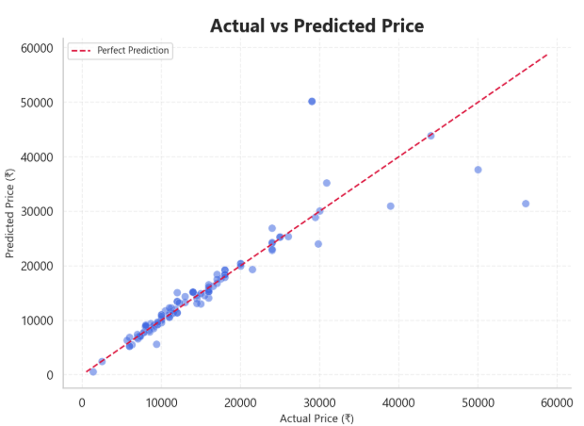
Final Model — Predictions & Validation
Sample Price Predictions
Profile | RAM | Storage | Front Camera | Rear Camera | Battery | Predicted Price (₹)
Entry Level | 4 GB | 64 GB | 5 MP | 13 MP | 4000 mAh | ₹ 5,166
Budget | 6 GB | 128 GB | 13 MP | 50 MP | 5000 mAh | ₹ 15,160
Mid-Range | 8 GB | 128 GB | 20 MP | 64 MP | 4500 mAh | ₹ 27,700
Upper Mid | 12 GB | 256 GB | 32 MP | 108 MP | 4800 mAh | ₹ 31,774
Flagship (Value Brand) | 16 GB | 512 GB | 50 MP | 200 MP | 5000 mAh | ₹ 33,785
Flagship (Premium Brand) | 16 GB | 512 GB | 50 MP | 200 MP | 5000 mAh | ₹ 36,364
Prediction Accuracy Summary
Tolerance | % of Predictions | Business Meaning
Within ±10% | 71.03% | Pricing-ready accuracy
Within ±20% | 92.52% | Acceptable for strategic decisions
Within ±30% | 95.33% | Directionally reliable
Mean Absolute % Error | 8.44% | Average prediction deviation
Median Absolute % Error | 4.48% | Typical prediction deviation
Notes:
Sample Predictions: The retrained final model generates predictions for six representative profiles spanning the market:
Entry Level ₹5,166 → Budget ₹15,160 → Mid-Range ₹27,700 → Upper-Mid ₹31,774 → Flagship (Value Brand) ₹33,785 → Flagship (Premium Brand) ₹36,364.
Each step up in specifications produces a meaningful, proportional price increase — confirming the model has learned realistic market pricing logic, not just abstract mathematical patterns.
The Flagship "A/B Test":
The final two profiles share identical hardware — 16GB RAM, 512GB storage, 50MP front camera, 200MP rear camera, 5000mAh battery — yet the model predicts a ₹2,579 gap between them, driven entirely by brand/model identity (Model_Encoded).
This is consistent with the dataset's own brand-level pricing pattern (e.g., Samsung averaging ~₹784 higher than Vivo overall) and directly validates the Feature Contribution Test finding: brand carries genuine pricing power beyond hardware specs alone.
Residual & Error Analysis —
These statistics use the tuned model's original held-out test-set predictions (computed before the full-dataset retraining above) — ensuring genuine out-of-sample validation rather than evaluating the model on data it has since been trained on.
Actual vs. Predicted:
Tight clustering along the perfect-prediction line across most of the price range, with wider deviations concentrated in the sparsely-represented premium tier (a few points above ₹35K show 30–40%+ error).
Residuals:
Mean residual of −₹86 — very close to zero, confirming the model shows no meaningful systematic bias toward over- or under-prediction.
Percentage Error:
71.03% of predictions fall within ±10%, 92.52% within ±20%, 95.33% within ±30%.
Mean Absolute Percentage Error is 8.44%, but the median is only 4.48% — the gap between mean and median indicates a small number of larger errors (concentrated in the premium segment) are pulling the average up, rather than errors being spread evenly across all predictions.
Limitation:
Premium devices (₹35K+) represent a small minority of the training data, which explains the wider error margins concentrated there.

Slide 16
Business Recommendations
1
Prioritise Front Camera Quality
2
Treat Battery as Non-Linear
Permutation R² drop of 0.36, the model's strongest price driver
Near-zero correlation, yet removing it worsens MAE by ₹319
3
Maintain Product Positioning
4
Use RAM & Storage for Tiers
Brand/model identity adds pricing power beyond specs
Consistent scaling from ₹5K (Entry) to ₹36K (Flagship)
5
Deprioritise Processor Brand
6
Deploy for Pricing Support
All processor features rank in the bottom half
71% of predictions land within ±10%
Notes:
This section translates the analytical findings into practical business recommendations supported by the complete modelling pipeline.
1. Prioritise Front Camera Quality
What: Front_Camera_MP emerged as the strongest pricing driver throughout the final model.
How: It ranked #1 in Permutation Importance (R² Drop = 0.3629) and remained the most influential feature in the tuned XGBoost model.
Why: Improvements in front-camera capability consistently contribute more to predicted price than equivalent upgrades in many other hardware specifications.
2. Treat Battery as a Non-linear Pricing Feature
What: Battery capacity showed almost no linear correlation with price but proved highly valuable during machine learning.
How: Empirical feature validation showed that removing Battery increased MAE by ₹319 and reduced model performance.
Why: Battery influences pricing through threshold effects rather than proportional increases, making it a specification that should meet market expectations rather than simply maximise capacity.
3. Maintain Consistent Product Positioning
What: Model_Encoded captured important pricing information beyond hardware specifications.
How: Removing Model_Encoded collapses CV R² from 0.9100 to 0.6794 in the Feature Contribution Test, despite showing no statistical significance in SelectKBest (p=0.189).
Why: Product lineage and market positioning contribute measurable pricing power beyond raw specifications alone.
4. Use RAM and Storage to Define Hardware Tiers
What: Memory and RAM consistently ranked among the strongest features during EDA and feature screening.
How: Both demonstrated strong positive relationships with price and formed the basis of distinct pricing tiers across the dataset.
Why: They establish the baseline hardware category, while camera quality and product positioning determine movement within those tiers.
5. Deprioritise Processor Brand
What: Processor-brand variables contributed very little once the remaining specifications were considered.
How: Permutation Importance ranked all processor features near the bottom.
Why: Processor branding alone should not be treated as the primary justification for premium pricing.
6. Deploy the Model for Pricing Support
What: The tuned XGBoost model achieved Test R² = 0.7868, CV R² = 0.9100, with 71.03% of predictions falling within ±10%.
Why: The model is suitable for competitive pricing analysis, launch-price estimation and pricing audits, while predictions for devices above approximately ₹35,000 should be interpreted more cautiously because of limited training data.

Slide 17
Project Challenges & Key Learnings
📌 Challenge 1 — Clean Data Before Modelling
📌 Challenge 2 — Choose Encoding Carefully
Challenge: Cleaning duplicates hidden by an index column, and inconsistent processor/camera text formatting.
Learning: Reliable models begin with reliable data
Challenge: Transforming high-cardinality categorical variables without losing useful information.
Learning: The choice of encoding influences both interpretability and model performance.
📌 Challenge 3 — Validate Feature Decisions Empirically
📌 Challenge 4 — Prioritize Generalisation
Challenge: Different screening techniques produced conflicting rankings.
Learning: Empirical validation is more trustworthy than relying on a single statistical method.
Challenge: Hyperparameter tuning improved CV performance but slightly reduced Test performance.
Learning: Generalisation should be prioritised over a single train-test split.
📌 Challenge 5 — Build Reproducible Workflows
📌 Challenge 6 — Translate Analytics into Business Value
Challenge: GridSearchCV required 900 model fits.
Learning: The USE_CACHE workflow improved development efficiency while preserving reproducibility.
Challenge: Translating technical findings into practical pricing recommendations.
Learning: Machine learning creates the greatest value when technical results are converted into actionable business insights.
Notes:
Project Challenges and Key Learnings in detail:
1. Data Quality & Preprocessing
What: Before any exploratory analysis or modelling could begin, the dataset required careful validation. During preprocessing, 10 duplicate records were identified and removed, missing values were handled appropriately, processor names were standardised through keyword extraction, and invalid Mobile Height measurements were corrected using median imputation.
How: Duplicates were removed to prevent repeated observations from biasing the analysis. Missing and inconsistent values were addressed using feature-specific preprocessing techniques, while Processor_Brand was engineered from raw processor descriptions to improve consistency across manufacturers.
Why it matters: This stage reinforced that model quality depends first on data quality. Accurate preprocessing ensured that subsequent exploratory analysis, feature selection, and model training were based on reliable and internally consistent data rather than noisy or duplicated observations.
2. Feature Engineering & Encoding
What: The dataset contained several high-cardinality categorical variables that could not be used directly by machine learning algorithms.
How: Processor_Brand was extracted from processor descriptions and One-Hot Encoded because it contained only six categories. Model and Colour were Label Encoded due to their high cardinality of 187 and 275 unique values respectively. Temporary helper features such as Model_Category and Colour_Category were created solely for exploratory analysis and removed before model training.
Why it matters: This demonstrated that encoding is not a one-size-fits-all process. Selecting an appropriate encoding strategy preserved useful information while avoiding unnecessary dimensionality and maintaining computational efficiency.
3. Feature Selection & Empirical Validation
What: Three complementary feature-screening methods—Pearson Correlation, SelectKBest, and Random Forest Feature Importance—produced conflicting rankings for several variables, particularly Battery Capacity, Model_Encoded, and AI Lens.
How: Rather than relying on any single statistical technique, empirical feature-removal experiments were conducted using Random Forest to measure the actual effect of each disputed feature on model performance. These experiments confirmed that Battery Capacity and Model_Encoded should be retained, while AI Lens could be removed with negligible impact.
Why it matters: This was one of the most important methodological lessons from the project. Statistical significance and linear correlation do not always translate into predictive usefulness. Empirical validation provided the most objective basis for feature-selection decisions.
4. Model Generalisation & Evaluation
What: During model optimisation, hyperparameter tuning improved the Cross-Validation R² from 0.8809 to 0.9100, while the Test R² decreased slightly from 0.8241 to 0.7868.
How: Instead of selecting the final model based solely on the test-set score, both Cross-Validation and Test performance were considered together. An alternate train-test split was also evaluated to verify that the observed behaviour reflected sampling variation rather than model instability.
Why it matters: This highlighted an important principle of machine learning: a single test split may not fully represent a model's ability to generalise. Cross-validation provides a more reliable estimate of expected real-world performance, making it the primary criterion for final model selection.
5. Reproducibility & Computational Efficiency
What: Hyperparameter tuning required evaluating 180 parameter combinations, resulting in 900 model fits, making repeated notebook execution computationally expensive.
How: A configurable USE_CACHE flag was implemented to optionally load previously saved GridSearchCV results during local development while retaining the complete training workflow for reproducibility and GitHub evaluation.
Why it matters: This approach eliminated the need for maintaining separate notebooks while ensuring that the full tuning process remained transparent and reproducible. It also significantly reduced development time during iterative experimentation.
6. Translating Analytics into Business Value
What: The project extended beyond predictive modelling by converting analytical findings into actionable business recommendations.
How: Results from exploratory analysis, feature importance, empirical validation, and model evaluation were synthesised into recommendations covering pricing strategy, product positioning, hardware prioritisation, and competitive benchmarking.
Why it matters: This demonstrated that machine learning delivers its greatest value when technical insights are translated into practical business decisions. The final outcome was not only an accurate prediction model but also an evidence-based framework to support smartphone pricing decisions.
Overall Learnings:
This project demonstrated that building an effective machine learning solution involves much more than selecting a high-performing algorithm. Careful data preparation, thoughtful feature engineering, evidence-based feature selection, robust model evaluation, reproducible experimentation, and meaningful business interpretation all contributed to developing a reliable smartphone price prediction model.

Slide 18
Conclusion & Future Scope
Conclusion
Future Scope
Front Camera emerged as the strongest smartphone pricing driver.
Expand the dataset with additional premium smartphones.
Incorporate time-based pricing and depreciation features.
Battery and Model captured important non-linear pricing signals
RAM and Memory established the primary hardware pricing tiers.
Explore advanced ensemble learning techniques.
Deploy the model as an operational pricing application.
Tuned XGBoost delivered the strongest overall generalisation performance.
Empirical validation resolved feature-selection disagreements objectively.
Develop an interactive pricing dashboard.
Incorporate additional market and hardware features.
An evidence-based machine learning pipeline successfully predicted smartphone prices while identifying the key drivers of market value.
Thank You
Thank You | Yousuf S. R. Sakkaf | github.com/S-Yousuf-S/NHIS_Project4 | SmartPhone_Price_Prediction
Notes:
Conclusion
This project set out to answer two business questions.
First, which smartphone specifications genuinely influence market price?
Second, can machine learning accurately estimate smartphone prices using those specifications?
The analysis demonstrates that both questions can be answered using a structured, evidence-based machine learning pipeline.
What the project revealed
The analysis showed that smartphone pricing is driven by a combination of hardware capability and product positioning rather than any single specification.
Front Camera MP consistently emerged as the strongest pricing signal, ranking first in the final permutation importance analysis.
Battery capacity demonstrated an important methodological finding. Although it exhibited almost no linear correlation with price, empirical validation showed that removing it noticeably reduced Random Forest performance, confirming that battery influences pricing through non-linear threshold effects rather than proportional increases.
Model_Encoded presented a similar pattern. It appeared weak during statistical screening but became one of the strongest contributors once evaluated using tree-based learning, highlighting that product positioning contributes information beyond hardware specifications alone.
RAM and Memory consistently defined the major hardware pricing tiers across the market, while processor-related variables contributed comparatively little independent pricing information once stronger predictors were considered.
Model Performance
Four regression algorithms were evaluated under identical experimental conditions to ensure a fair comparison.
Linear Regression established the baseline but struggled to capture the non-linear relationships identified during exploratory analysis.
Decision Tree substantially improved predictive accuracy but showed lower stability across cross-validation.
Random Forest further improved robustness through ensemble learning.
Baseline XGBoost achieved the strongest cross-validation performance and was therefore selected for GridSearchCV hyperparameter optimisation.
Following a search across 180 parameter combinations (900 model fits), the tuned XGBoost model achieved:
Test R² = 0.7868
CV R² = 0.9100
MAE = ₹1,558
RMSE = ₹4,176
Although the baseline XGBoost achieved a slightly stronger score on the single held-out test split, the tuned model produced the highest cross-validation performance. Given the relatively small test partition, the final recommendation prioritised the tuned model because cross-validation provides a more reliable estimate of generalisation to unseen data.
The final model also demonstrated practical predictive capability, with approximately 71% of predictions falling within ±10% of the actual market price and over 92% within ±20%.
Why these findings are trustworthy
Several methodological decisions strengthened the reliability of the study.
Duplicate records were identified and removed before modelling to ensure data quality.
Data validation and targeted preprocessing corrected measurement issues while preserving valid hardware specifications.
Rather than relying on a single feature-selection technique, disagreements between Correlation Analysis, SelectKBest and Random Forest were resolved through empirical feature contribution experiments.
Every regression model was trained using identical train-test splits, evaluation metrics and random seeds to ensure a fair comparison.
Cross-validation was incorporated throughout model development to reduce dependence on a single train-test split.
Residual analysis and prediction error evaluation further confirmed that the final model remained well calibrated across the primary market segment without systematic prediction bias.
Overall, the project demonstrates that a carefully engineered machine learning workflow can accurately predict smartphone prices while identifying the hardware characteristics that genuinely influence market value.
Future Scope
Although the developed model performs strongly, several opportunities exist for extending this work.
Expanding the dataset beyond 531 smartphones would improve coverage of premium flagship devices and strengthen generalisation.
Incorporating temporal variables such as launch year, product age and depreciation trends would allow the model to capture changing market prices over time.
Future work could also investigate more advanced ensemble approaches, including stacking and blending, to further improve predictive performance.
The trained model could be deployed as a lightweight pricing application to support competitive pricing analysis, catalogue optimisation and new product launches.
An interactive dashboard would improve accessibility by allowing users to enter specifications, generate predicted prices and visualise feature importance without requiring technical expertise.
Finally, incorporating additional market and hardware variables—such as display refresh rate, charging speed, processor generation, software support duration, launch year, customer ratings and market demand indicators—would further improve both predictive accuracy and practical business value.

