Slide 1
TELLCO USER ANALYTICS
A Due-Diligence Analysis for Acquisition Decision-Making
Yousuf S. R. Sakkaf
Notes:
Project Brief
This project focuses on evaluating TellCo, a mobile service provider in the Republic of Pefkakia, as a potential acquisition through an end-to-end data-driven due-diligence workflow. The analysis is based on one month of aggregated xDR network data covering 106,471 unique customers and aims to identify the key factors driving customer engagement, network experience, and satisfaction while delivering a clear, evidence-backed purchase recommendation.
Presentation Flow
- Business Understanding & Dataset Overview
- Analytical Framework
- User Overview — Customer & Handset Composition
- User Overview — Application Usage & Relationships
- User Overview — Dimensionality & Duration Segments
- User Engagement — Segmenting Power Users
- User Engagement — Application Traffic Dominance
- User Experience — Network Quality Segments
- User Experience — Handset Diagnostics
- User Satisfaction — Scoring & the Headline Finding
- User Satisfaction — Predictive Model Validation
- SQL Export — Data Delivery
- TellCo — By the Numbers
- Business Recommendation
- Limitations
- Project Challenges & Key Learnings
- Conclusion & Future Scope
- References & Data Sources
- Thank You

Slide 2
Business Understanding & Dataset Overview
“Who is TellCo's customer, and is the network good enough to keep them?”
106,471
150,001
55
1 Month
Unique Customers
Raw xDR Session Records
Raw Data Columns
Aggregated Network Data
Identifiers & Timing
Network Quality
Per-App Traffic
Device & Location
IMSI, MSISDN, Bearer Id, Start/End timestamps, Duration
TCP Retransmission, RTT (DL/UL), Throughput (DL/UL)
Social Media, Google, Email, YouTube, Netflix, Gaming, Other (DL/UL Bytes)
Handset Manufacturer, Handset Type, Last Location Name
Field Descriptions reference (55 fields) → see References, slide 19
Notes:
WHAT: A wealthy investor specializing in undervalued-asset acquisitions is evaluating TellCo, an existing mobile service provider in the Republic of Pefkakia.
TellCo's owners have shared financial information but have never had their system-generated data analyzed.
The raw dataset contains 150,001 session-level records across 55 columns spanning session identifiers, network-quality metrics (TCP retransmission, RTT, throughput), and per-application traffic volumes for seven applications: Social Media, Google, Email, YouTube, Netflix, Gaming, and Other.
After per-user aggregation, the working dataset condenses to 106,471 unique customers (identified by MSISDN/Number), each carrying session counts, durations, and total data volumes across the seven applications.
The four variable categories shown on this slide -- Identifiers & Timing, Network Quality, Per-App Traffic, and Device & Location -- describe all relevant variables and their data types in condensed category form rather than all 55 individual fields, which are fully documented in the linked Field Descriptions reference. WHY: This project analyzes one month of xDR data to surface the underlying fundamentals of the business: who its users are, how engaged they are, what quality of experience the network delivers, and how satisfied users ultimately are, in order to support a clear, evidence-based buy/sell recommendation.
Because this is one month of aggregated data with no prior system-level analysis, everything that follows is a first-ever look at TellCo's actual network usage. HOW: One row was identified as a genuine orphan record (no session identifiers, duration, throughput, or byte totals populated at all) and was removed during cleaning, along with 10 further duplicate rows found later once type-casting was complete -- these are documented in Data Cleaning.
Missingness in the raw data spanned three tiers:
[A] Heavy (54-87%) in conditional traffic-bucket and TCP/HTTP volume columns (more consistent with an event that never occurred than a true measurement gap)
[B] Moderate (~18.5%) in average RTT columns, and
[C] Trace (<1%) in identifiers and handset fields
-- each tier was treated differently in Data Cleaning rather than with one blanket method. ALSO, IN THE NOTEBOOK (not shown on this slide): The full missing-value audit across all 55 raw columns (a column-by-column bar chart / table of missingness percentages), and the complete descriptive-statistics table (mean, median, std, min/max) for every quantitative variable, not just the four category summaries shown here.

Slide 3
Analytical Framework
Overview
Engagement
Experience
Satisfaction
SQL Export
Recommendation
Each pillar's output becomes the next pillar's input — Engagement and Experience scores converge into Satisfaction, which is exported to SQL and synthesized into the final recommendation.
Notes:
WHAT: The four pillars are sequential rather than independent:
User Overview establishes who the customers are (handsets, manufacturers, usage complexity) before any engagement or experience judgment is made.
User Engagement then quantifies how much each customer uses the network via three metrics -- session frequency, duration, and total traffic -- clustering customers into three engagement tiers.
User Experience asks a genuinely different question -- not how much a customer uses the network, but how well the network serves them -- via TCP retransmission, RTT, and throughput, again clustered into three tiers.
User Satisfaction then combines the two into a single score, which is exported to a local SQL Server Express database, and every finding across all four pillars is synthesized into one specific, evidence-backed purchase Recommendation at the end of the deck. WHY: This scoring design is precise and deliberate: it lets us later ask whether satisfaction is driven more by engagement or more by experience. Sequencing the pillars this way means each stage's output becomes the next stage's input rather than four disconnected analyses bolted together at the end. HOW: Each customer receives an Engagement Score (Euclidean distance to the least-engaged cluster centroid) and an Experience Score (Euclidean distance to the worst-experience cluster centroid), and Satisfaction Score is simply their average.
The final customer-level table (ID plus all three scores) is exported and then imported into SQL Server via a companion notebook, as detailed on the SQL Export slide.

Slide 4
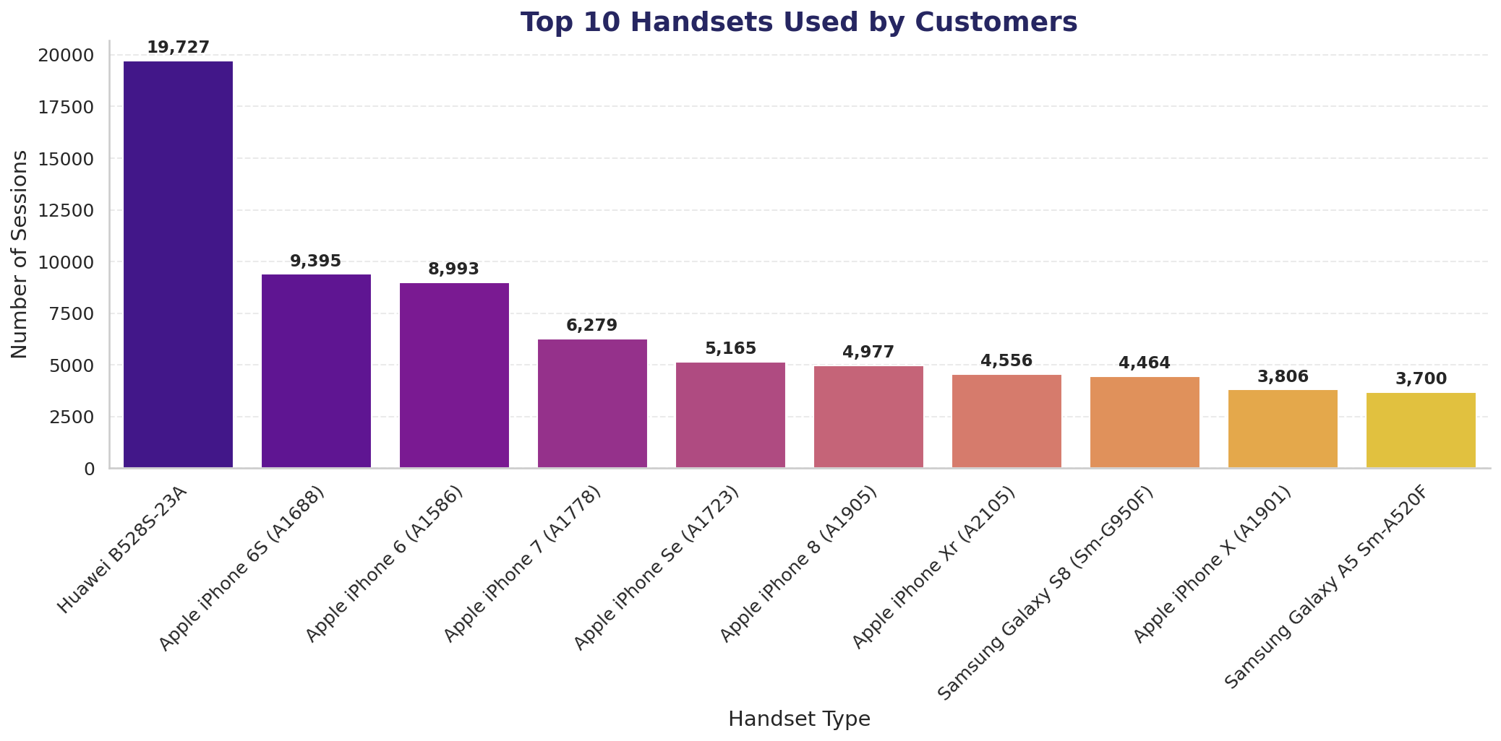
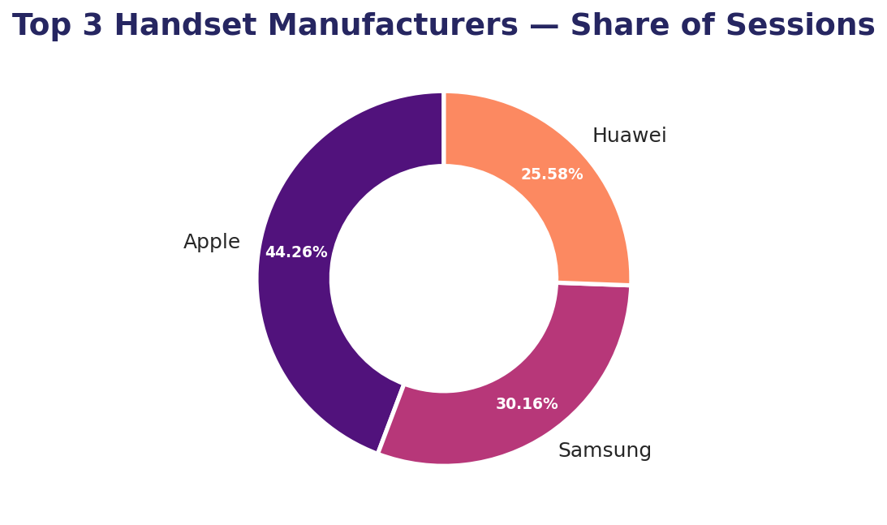
User Overview — Customer & Handset Composition
Top 5 Handsets per Top 3 Manufacturer
Huawei: B528S-23A dominates (19,727) — ~20x its own #2 Apple: even spread, 4,977–9,395 (~2x top-to-bottom) Samsung: most balanced, 3,171–4,464
Usage is concentrated in a single 7 AM hour, not a gradual ramp — see notebook for the full hourly pattern.
Notes:
WHAT:
Top 10 handsets:
Huawei B528S-23A is the single most-used device at 19,727 sessions -- more than double the next closest device -- even after removing the 8,987 sessions with no genuinely recorded device information (treated honestly as 'Unknown' and excluded from ranking rather than guessed).
Apple dominates the remaining rankings: 7 of the top 10 are iPhone models spanning generations 6S through X.
Only two Samsung models appear, and no other manufacturer breaks into the top 10 at all.
Manufacturer share:
Apple holds a clear plurality at 44.26% of sessions, roughly 14 points ahead of Samsung (30.16%) and nearly 19 points ahead of Huawei (25.58%).
Top 5 per manufacturer:
Huawei's device base is almost entirely one model (B528S-23A's 19,727 sessions outnumber its own remaining top 4 combined -- E5180, P20 Lite, P20, Y6 2018, each under 2,100), a ~20x internal gap.
Apple's top 5 range 4,977-9,395 (~2x gap)
Samsung's top 5 cluster tightly at 3,171-4,464 -- the most balanced of the three. WHY:
7 of the top 10 handsets being iPhone models spanning generations 6S through X suggests strong brand loyalty or simply widespread Apple device circulation regardless of release year -- a highly concentrated device landscape at the top despite dozens of manufacturers appearing elsewhere in the dataset.
Despite Huawei's B528S-23A being the single most-used individual handset, Huawei still finishes third at the manufacturer level, meaning Samsung's usage is spread across more distinct models rather than concentrated in one device, while Huawei's presence rests almost entirely on that one router/device model.
Business implication for marketing teams: Apple and Samsung represent the broad, diversified customer base worth retention-focused campaigns; Huawei's concentration in one device model is the working hypothesis that this may be shared/router infrastructure rather than personal handsets -- flagged here and revisited later. HOW:
Handset counts were aggregated by session count per handset type and per manufacturer, with unrecorded ('Unknown') device rows excluded from both rankings rather than imputed.
The top-5-per-manufacturer breakdown was computed by filtering to each of the top 3 manufacturers individually, then ranking their handsets by session count. ALSO, IN THE NOTEBOOK (not shown on this slide): The hourly-usage-by-session-start chart showing the sharp single-hour 7 AM spike and a geographic/location-based usage distribution chart -- both part of the section's temporal/geographic EDA but not included on this slide to keep it focused on handset composition specifically.

Slide 5
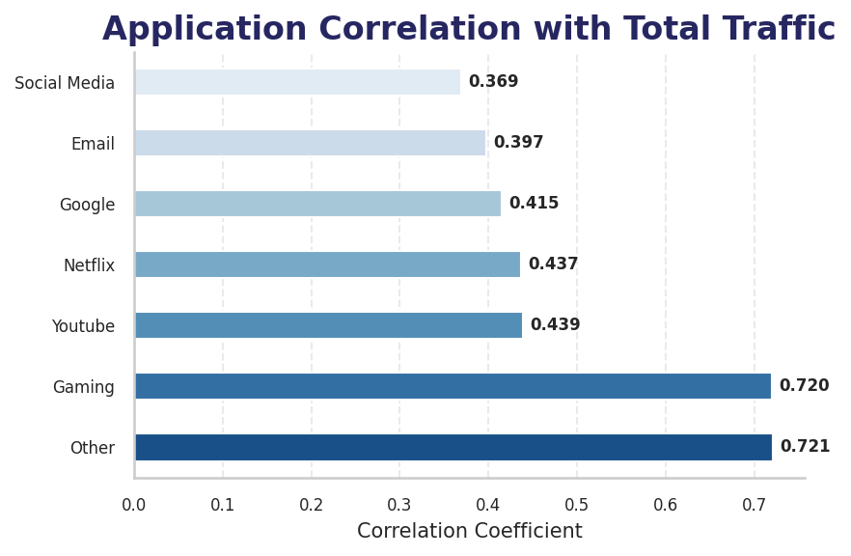
User Overview — Application Usage & Relationships
Two-Tier Split
Gaming (0.720) and Other (0.721) drive Total Traffic nearly 2x as strongly as the remaining five apps (0.37–0.44).
No single app pair among the 7 required apps correlates strongly with another (moderate 0.31–0.42 band) — usage is spread, not concentrated.
What the Full Correlation Matrix Adds
YouTube–Netflix (0.42): highest among the 7 — streaming usage clusters together. Gaming–Other (0.31): both drive traffic strongly, but not the same customers. Total Duration–Avg Duration (0.76): a genuine signal — some customers reach high totals via many sessions, others via long ones.
Notes:
WHAT:
Bivariate analysis:
Exploring the relationship between each of the 7 core applications and Total DL+UL traffic.
Gaming (0.720) and Other (0.721) correlate with Total Traffic nearly twice as strongly as the remaining five applications (0.369-0.439), forming a clear two-tier split.
Correlation analysis (multivariate):
Among the 7 application variables, correlations sit in a moderate, fairly uniform band (0.31-0.42) -- no pair of applications is strongly tied to another.
Two pairs stand out from that uniform band: YouTube-Netflix (0.42, the highest among the 7) and Gaming-Other (0.31, among the lowest).
Expanding beyond the core 7 in the full correlation matrix, Total Session Duration-Avg Session Duration correlates at 0.76, and DL/UL Ratio correlates moderately with Gaming/Other (0.34 each) but notably -0.38 with Total UL. WHY:
The Gaming/Other two-tier split is confirmed later in Engagement Analysis, where Gaming alone accounts for ~20x the traffic of Netflix or YouTube.
The moderate, uniform correlation band among the 7 apps means heavy usage of one app doesn't reliably predict heavy usage of a specific other app -- usage is spread across categories, not concentrated in a correlated cluster.
YouTube-Netflix's relatively higher correlation suggests streaming-app usage may cluster somewhat together.
Gaming-Other's relatively lower correlation suggests that despite both driving Total Traffic strongly, they aren't driven by the same underlying customers.
Some relationships in the full matrix are mathematical identities rather than genuine findings (Total DL-Total Traffic = 1.00, since Total Traffic is literally defined as DL+UL) and are noted but not treated as discoveries.
Total Session Duration-Avg Session Duration's 0.76 is a real, non-trivial relationship, since a customer having a high total duration doesn't automatically mean each individual session runs long -- this confirms some customers achieve high total duration through many sessions rather than long ones, while others do the opposite.
DL/UL Ratio's pattern is consistent with it capturing a genuinely distinct behavioral dimension (download-heavy vs. upload-heavy usage) HOW:
Bivariate correlation was computed between each of the 7 application traffic totals and the derived Total Traffic column using Pearson correlation.
The full multivariate correlation matrix extends this to every numeric feature in the per-customer aggregation, including duration and ratio-derived columns, to surface relationships beyond the 7 required applications. ALSO. IN THE NOTEBOOK (not shown on this slide): The full multivariate correlation heatmap across all numeric features (not just the 7-application subset shown here), and the raw scatter plot version of the Gaming-vs-Total-Traffic bivariate relationship -- this slide uses the ranked bar-chart summary derived from that scatter instead, for readability at presentation scale.

Slide 6
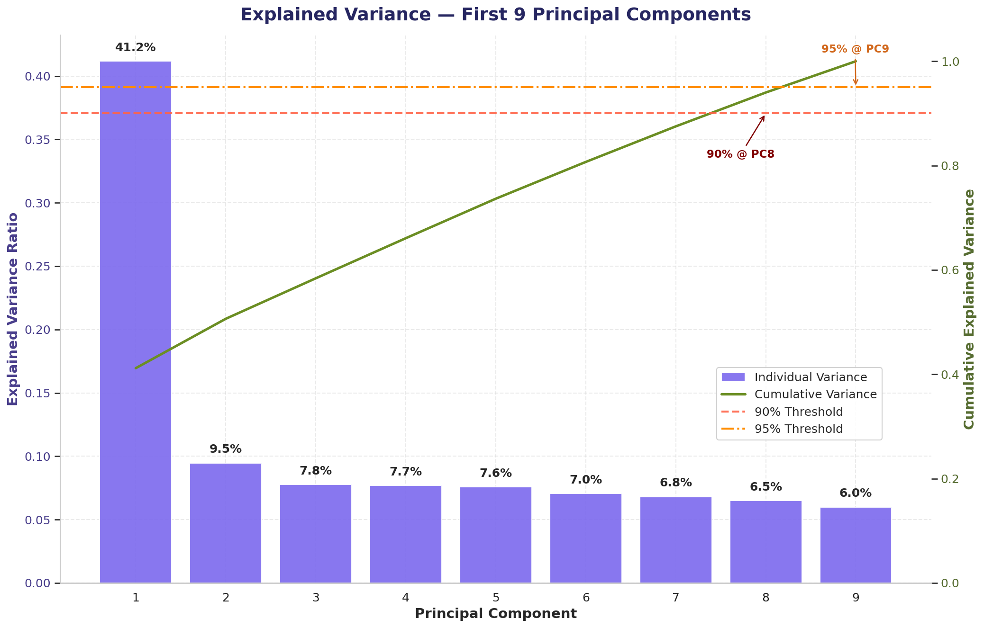
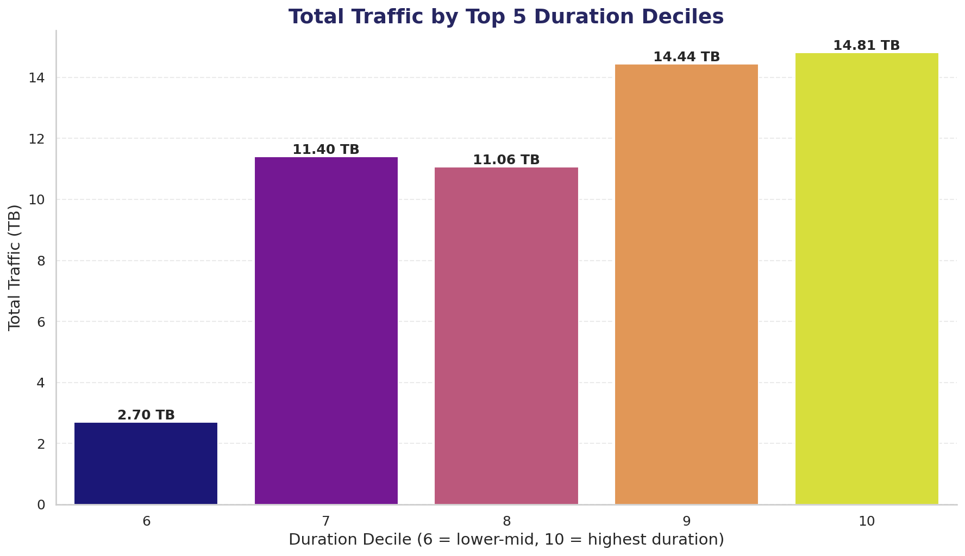
User Overview — Dimensionality & Duration Segments
Why This Matters
PCA: 8 of 9 components needed for 90% variance — usage behavior can't be compressed into 2–3 “super-metrics.” Deciles: traffic rises with duration, but not smoothly — deciles 7–8 are nearly flat before jumping again at 9–10.
Notes:
WHAT:
Dimensionality Reduction:
Reducing 9 independent numerical features (7 application traffic totals, xDR Sessions, Total Session Duration) via PCA to examine how many components are actually needed to preserve most of the data's variance.
The first component alone captures 41.2% of total variance -- substantial but not dominant -- while it takes 8 components to reach 90% and 9 (essentially all features) to reach 95%.
Variable Transformation:
Segmenting users into the top five decile classes by total session duration and computing total data (DL+UL) per decile.
Total traffic rises with duration decile, but not smoothly -- deciles 7 and 8 (11.40 TB, 11.06 TB) are nearly tied, essentially flat between them, rather than each decile climbing steadily, before deciles 9 and 10 (14.44 TB, 14.81 TB) resume the upward trend. WHY:
Four-bullet interpretation of the PCA result:
Needing 8-9 of 9 components for 90-95% variance indicates these 9 metrics carry largely independent information rather than redundant overlap.
This is meaningfully different from a typical dataset where 2-3 components often suffice: TellCo's usage behavior genuinely can't be compressed into a low-dimensional summary without losing most of its structure.
Practically, no small subset of 'super-metrics' can stand in for the full usage profile in later clustering work (Engagement, Experience) -- the full feature set carries real, distinct signal, which is why the Engagement and Experience clustering sections both use all their respective metrics rather than a PCA-reduced subset.
This reinforces the earlier correlation-matrix finding: the 7 applications were only moderately correlated with each other (0.31-0.42), which is exactly what prevents dimensionality reduction from working well -- genuinely low correlation between features means little redundancy to compress away.
On the decile result: This tells the investor that duration and traffic volume are correlated but not perfectly proportional -- there's a genuine plateau in the upper-middle of the customer base, not a smooth linear relationship.
HOW:
PCA was fit on the 9 standardized usage features (7 application totals, session count, total duration), with explained variance ratio computed per component and cumulative variance tracked to identify the 90% and 95% thresholds.
Decile segmentation used pandas qcut on Total Session Duration to create 10 equal-population bins, then summed Total Traffic (DL+UL) within the top 5 (deciles 6-10). ALSO, IN THE NOTEBOOK (not shown on this slide): The full 10-decile table (this slide shows only the top 5, deciles 6-10, per the segmentation's own scope).
PCA component-loading table showing which original features contribute most to each principal component.
Non-graphical univariate dispersion statistics (skewness, kurtosis, standard deviation, IQR) computed per quantitative variable.

Slide 7
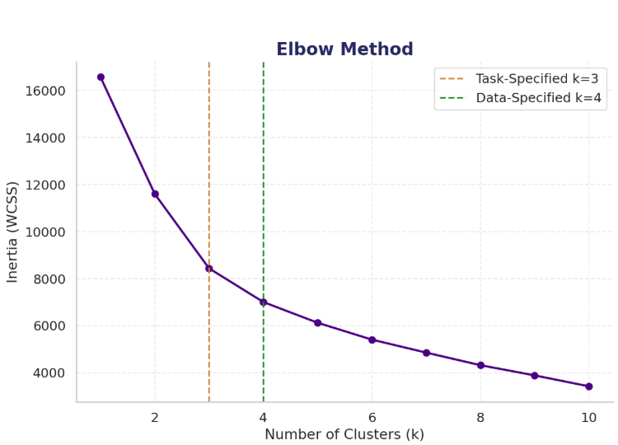
User Engagement — Segmenting Power Users
36,631
K-Means (k=3, task specified) found three comparably-sized tiers — no single cluster dominates.
Cluster 2 stands apart on session duration and traffic despite a similar session-frequency profile: engagement here is a duration/volume story more than a frequency one.
An independent elbow as well as silhouette check suggests k=4 as the data's natural optimum — reported transparently as a finding, without overriding the brief's specified k=3.
Cluster 0 — 34.4%
40,236
Cluster 1 — 37.8%
29,604
Cluster 2 — 27.8% (Power Users)
Notes:
WHAT:
Engagement metrics are aggregated per customer (MSISDN) across 3 core dimensions -- session frequency, session duration, total traffic -- plus 2 additional behavioral features, then K-Means (k=3) applied.
Clustering split customers into three comparably-sized groups -- 36,631 (34.4%), 40,236 (37.8%), and 29,604 (27.8%) -- no single cluster dominates.
Cluster 2 stands out with far higher session duration and total traffic despite a broadly similar session-frequency profile to the other two.
Top 10 customers per engagement metric were also identified across all 5 metrics -- only one customer appeared in both the Session Duration and Avg Session Duration top 10s.
The elbow chart shown on this slide (testing k=1 through 10) shows inertia decline stabilizing at k=4, confirmed independently by silhouette score.
WHY:
No single cluster dominating means TellCo's customer base genuinely splits into three distinct engagement tiers rather than one dominant behavior pattern with a small tail.
Engagement at TellCo is more a story of how long and how much per session than how often customers connect, since Cluster 2's duration/traffic gap isn't matched by a comparable frequency gap.
The Session Duration vs. Avg Session Duration top-10 lists barely overlapping confirms these are genuinely different rankings rather than near-duplicates -- some customers reach high totals via many short sessions, others via fewer long ones.
On the elbow/silhouette check: while k=10 produces the mathematically highest silhouette score, this is a common over-segmentation artifact; k=4 shows a genuine local peak (0.314) immediately following the elbow's bend, a far more reliable signal of real structure than chasing the global maximum.
Both methods independently pointing to k=4 as the data's natural optimum, a more granular segmentation than the k=3 actually used, is reported here as an honest, transparent finding rather than silently substituted into the clustering used elsewhere in the analysis.
HOW:
Each engagement metric spans a vastly different original scale (Session Frequency ranges 1-18, Session Duration ranges into hundreds of millions of ms), so MinMaxScaler normalization (not StandardScaler) was applied before clustering; without it, K-Means distance would be dominated by whichever feature happens to have the largest raw numbers.
K-Means with k=3 was then fit on the 5 normalized engagement features.
The elbow/silhouette check re-ran K-Means across k=1 through 10 on the same normalized features, tracking inertia decline (elbow, shown on this slide) and silhouette score at each k.
ALSO, IN THE NOTEBOOK (not shown on this slide):
Separate Minimum, Maximum, and Total metric-by-cluster charts (this slide shows only the Average three variant out of the five).
The silhouette-score plot itself as a visual (the elbow curve is now shown on-slide, but the paired silhouette chart isn’t).
The top-10-customer tables for each of the 5-engagement metrics individually.

Slide 8
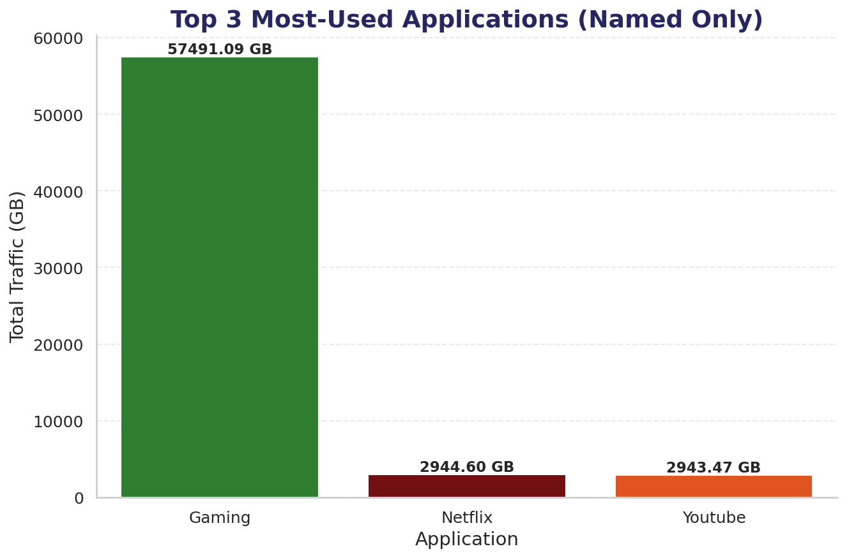
User Engagement — Application Traffic Dominance
~20x
Gaming vs. Netflix / YouTube
Excluding the catch-all “Other” category, Gaming alone accounts for 57,491 GB — roughly 19–20x either streaming app. Netflix and YouTube are essentially tied (within 1.13 GB of each other), forming a clear secondary tier of demand distinct from Gaming's outsized dominance.
Saturation at the Top
Across every application, the top 10 values cluster extremely tightly —
Social Media's top 10 are all identical at 6.45 MB, and Google, Email, YouTube, Netflix, Gaming, and Other each show similarly tight clustering.
This looks more like a data-generation cap than a smooth long tail of genuinely heavy users.
Notes:
WHAT:
Total traffic is plotted for the top 3 most-used applications, aggregated across all 106,471 customers, with 'Other' category excluded from this specific chart since it doesn't represent a genuine identifiable application.
With Other set aside, Gaming alone accounts for 57,491.09 GB of total traffic -- roughly 19-20x more than either Netflix (2,944.60 GB) or YouTube (2,943.47 GB), which are themselves essentially tied (a difference of just 1.13 GB out of ~2,944 GB each).
Top 10 most-engaged users per application were also computed separately:
Across every application, the top 10 values cluster extremely tightly -- Social Media's top 10 are all identical at 6.45 MB, and Google/Email/YouTube/Netflix/Gaming/Other each show similarly tight clustering, shown on this slide as the “Saturation on the Top” finding.
WHY:
Netflix and YouTube being essentially tied suggests these two streaming applications drive comparable, secondary-tier demand on TellCo's network, distinct from Gaming's outsized dominance. This confirms Gaming isn't just 'one of the heavier apps' -- it's the single overwhelming driver of application-specific traffic.
Business implication: Any network capacity planning or QoS prioritization conversation with TellCo's technical teams should treat Gaming traffic as the dominant capacity driver, not spread investment evenly across all seven application categories.
HOW:
Per-application total traffic (DL+UL) was summed across all customers for each of the 7 applications, 'Other' was excluded from this specific ranking, and the remaining 3 highest-traffic applications were plotted.
Top-10-per-application was computed independently by sorting each application's per-customer total traffic column in descending order, for all 7 applications, to check for this ceiling pattern.
ALSO, IN THE NOTEBOOK (not shown on this slide):
The complete top-10-most-engaged-user tables for all 7 applications individually with their exact values (this slide states the pattern; the notebook has the full per-application tables behind it).
The full per-application traffic ranking including the excluded 'Other' category.

Slide 9
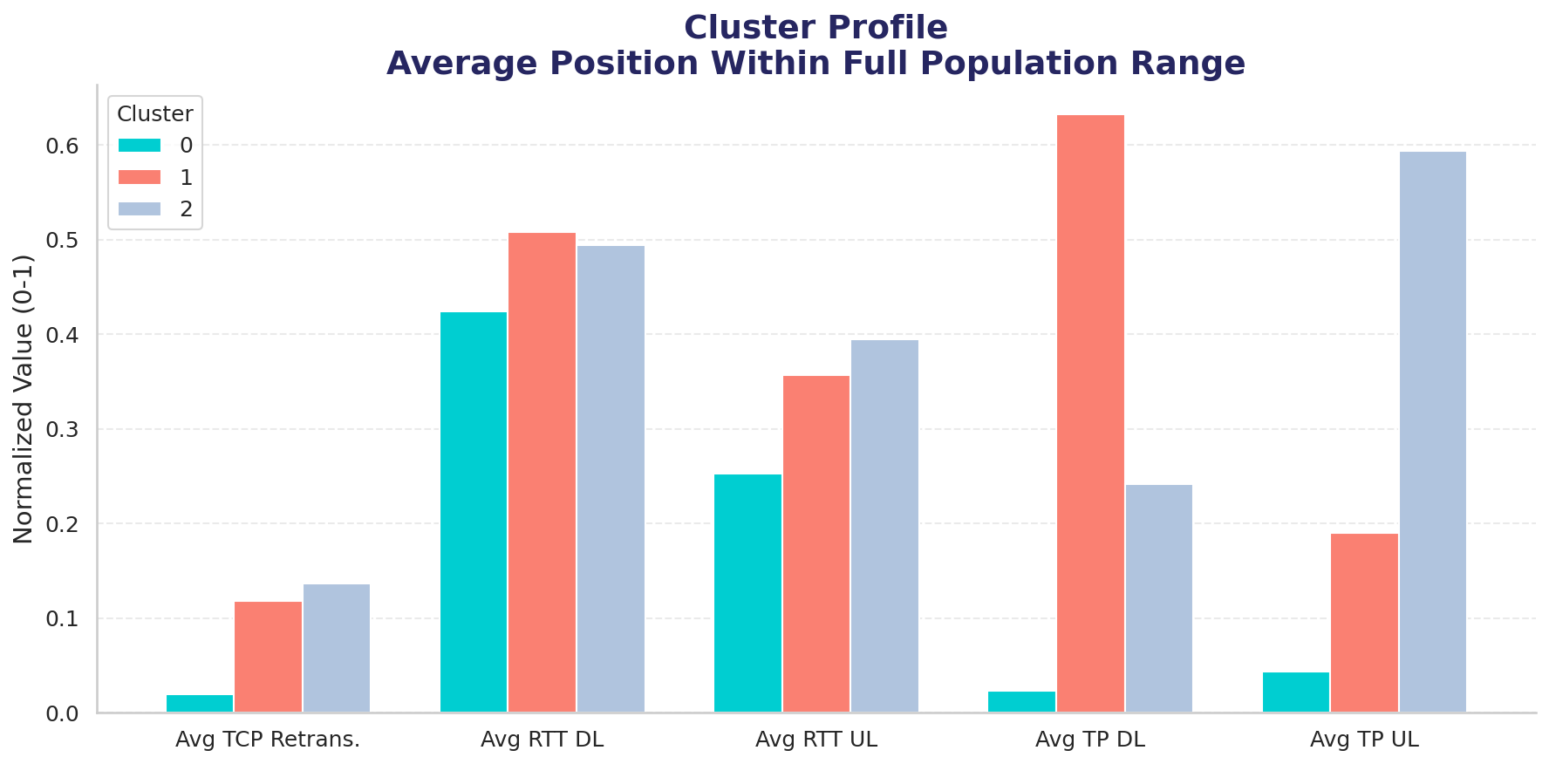
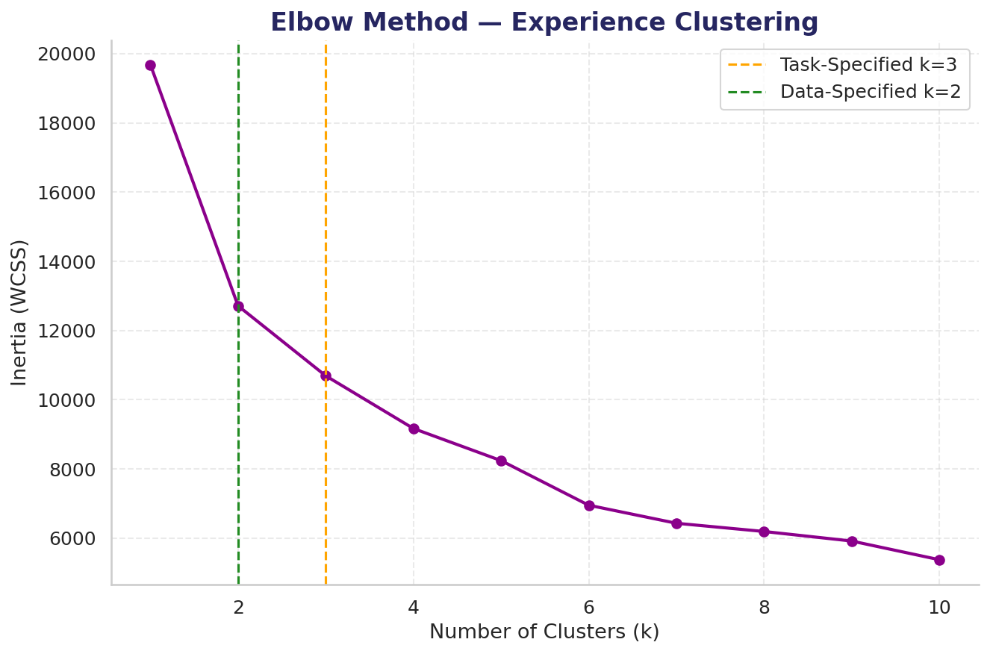
User Experience — Network Quality Segments
73.6%
Cluster 0 — Lowest on every metric — light/low-intensity users
15.6%
The single clearest lever: Cluster 2's heaviest uplink users show the highest retransmission AND worst uplink latency simultaneously — a real reliability concern, concentrated, not network-wide.
Cluster 1 — Highest DL throughput (0.63) + highest DL RTT (0.51) — heavy download-oriented usage
10.8%
Cluster 2 — Highest TCP retransmission (0.14) + highest UL RTT (0.39) + highest UL throughput (0.59) — this is the genuine-uplink-strain group
Notes:
WHAT:
Outlier Detection ahead of this clustering step was evidence-first rather than assumption-first:
Skewness, Kurtosis, and IQR/Z-score outlier rates were computed and compared before any treatment decision was made.
TCP Retransmission and RTT showed outlier rates of 12.6%-20.4% by the IQR method -- meaningfully higher than the comparable metrics examined back in User Overview (3.05%-7.64%). Clustering split customers into three highly unequal groups:
Cluster 0 (78,380 customers, 73.6%) scores lowest on every metric including throughput.
Cluster 1 (16,583 customers, 15.6%) shows the highest downlink throughput (0.63) alongside the highest downlink RTT (0.51).
Cluster 2 (11,508 customers, 10.8% -- the smallest) shows the highest TCP retransmission (0.14), highest uplink RTT (0.39), and highest uplink throughput (0.59) simultaneously.
WHY:
The elevated outlier rate in TCP/RTT relative to User Overview's metrics is itself informative: it suggests network-quality measurements are inherently noisier or more volatile than usage-volume measurements, which is part of why median-based capping (rather than mean-based) was the more defensible choice here specifically.
Cluster 0's low profile across every metric should be read with real caution: it's best understood as customers with minimal measured network activity rather than confirmed superior treatment, especially since most customers in this dataset have only one recorded session.
Cluster 1's pairing of high throughput with high RTT is a plausible, expected combination -- larger downloads plausibly extend measured RTT.
Cluster 2 is the standout: customers pushing the most data upward while simultaneously experiencing the network's worst reliability on that same uplink path -- high retransmission and high RTT together, not just one in isolation, is what makes this a genuine reliability concern rather than simply heavy usage.
This finding becomes the single most important thread in the whole analysis.
HOW:
All five experience metrics (Average TCP Retransmission, Average RTT DL/UL, Average Throughput DL/UL) were treated for outliers using IQR-based median capping -- 75,870 individual outlier values were replaced, with no customer records deleted -- then MinMaxScaler-normalized before K-Means (k=3) was fit across all five simultaneously.
The clustering's heavily unequal cluster sizes reflect how customer network experience is genuinely distributed, not a modeling artifact.
The elbow-method check shown on this slide (testing k=1 through 10) found the sharpest bend at k=2 rather than k=3 -- a real discrepancy reported honestly rather than smoothed over; k=3 was still used for the clustering actually shown, and the resulting 3-cluster split remains informative regardless of the discrepancy.
ALSO, IN THE NOTEBOOK (not shown on this slide):
The skew/kurtosis/IQR-vs-Z-score comparison table that justified the median-capping decision itself, showing the exact per-metric outlier rates behind the 12.6%-20.4% figure cited above.
The full pre/post-treatment distribution histograms for TCP Retransmission and RTT that visually show the effect of the IQR-based median capping.

Slide 10
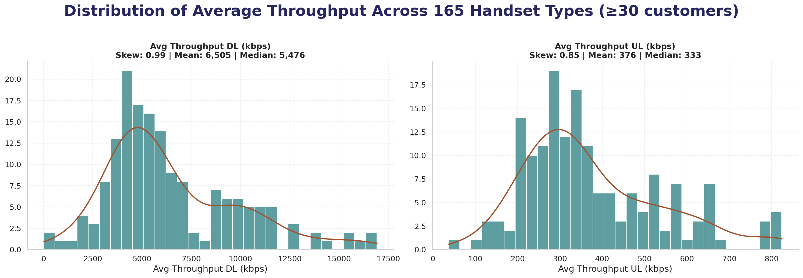
User Experience — Handset Diagnostics
Avg TCP Retransmission by Top-10 Handset Type
Rank | Handset Type | Avg TCP Retransmission (Bytes)
1 | Huawei B528S-23A | 34,188.81
2 | Samsung Galaxy S8 (Sm-G950F) | 32,684.97
3 | Apple iPhone 6 (A1586) | 25,192.85
4 | Apple iPhone 7 (A1778) | 24,087.74
5 | Apple iPhone Xr (A2105) | 23,387.12
6 | Unknown | 22,124.82
7 | Apple iPhone 8 (A1905) | 21,218.23
8 | Apple iPhone 6S (A1688) | 17,542.00
9 | Apple iPhone Se (A1723) | 17,352.84
10 | Samsung Galaxy J5 (Sm-J530) | 14,015.08
165 of 1,391 handset types retained (≥30 customers) — 95.55% of the customer base.
Huawei B528S-23A Flag
Ranks #1 on TCP retransmission — consistent with a shared 4G-router device rather than a personal handset.
A direct traffic-per-session check found no meaningful difference from other devices (1.00x), so this neither confirms nor rules out shared infrastructure.
Flagged as an open item, not a factor driving the recommendation.
Handset popularity shows no meaningful relationship with TCP retransmission (r ≈ 0) , and only weak positive links to throughput (DL ≈ 0.19, UL lower) — popularity is not a proxy for experience quality.
Notes:
WHAT:
The slide shows the distribution of average throughput per handset type (left) and the average TCP retransmission ranked across the top 10 handset types by customer count (right table). Restricting the throughput distribution to the 165 handset types with at least 30 customers still retains 95.55% of the customer base.
Both DL and UL show a secondary bump well past the main peak (DL: a plateau near 9,000-11,000 kbps beyond the main 4,000-6,000 cluster).
The TCP retransmission ranking: Huawei B528S-23A tops the list at 34,188.81 bytes average retransmission, followed by Samsung Galaxy S8 (32,684.97), several Apple iPhone models (iPhone 6: 25,192.85; iPhone 7: 24,087.74; iPhone XR: 23,387.12), Unknown (22,124.82), then iPhone 8 (21,218.23), iPhone 6S (17,542.00), iPhone SE (17,352.84), and Samsung Galaxy J5 (14,015.08) rounding out the top 10.
A separate diagnostic check found handset popularity has essentially no relationship with TCP retransmission (correlation approximately 0) and only weak positive relationships with throughput (DL approximately 0.19, UL weaker).
WHY:
Sample-size discipline matters here: of 1,391 distinct handset types, 591 have exactly one customer, so their 'average' is just that one customer's single reading, not a genuine average -- restricting to types with at least 30 customers.
The secondary bump in the throughput distribution suggests the handset population splits into distinct performance tiers rather than varying continuously -- worth flagging for anyone building handset-tier-based network planning.
Huawei B528S-23A standing out sharply from every other entry across both this ranking and the throughput analysis.
HOW:
Handset types with fewer than 30 customers were excluded before plotting the throughput distribution shown on this slide, leaving 165 types.
Average TCP retransmission was computed per handset type and ranked for the full top 10 types by customer count, shown in the table on this slide.
The popularity-vs-experience check used Handset Type_Freq (a frequency-encoded column built during Encoding) correlated directly against TCP retransmission and throughput.
The traffic-per-session check compared Huawei B528S-23A's average traffic-per-session against all other devices' average, expressed as a ratio.
ALSO, IN THE NOTEBOOK (not shown on this slide):
The top-10, bottom-10, and most-frequent-10 value tables for TCP Retransmission, RTT, and Throughput individually.
A distinct deliverable from the per-handset-type views shown here.
The Throughput Speed-Band Time-Share heatmap across the top 15 handset types, which enriches this slide's single-averaged-throughput view with the full share of time each handset spends in each speed band.

Slide 11
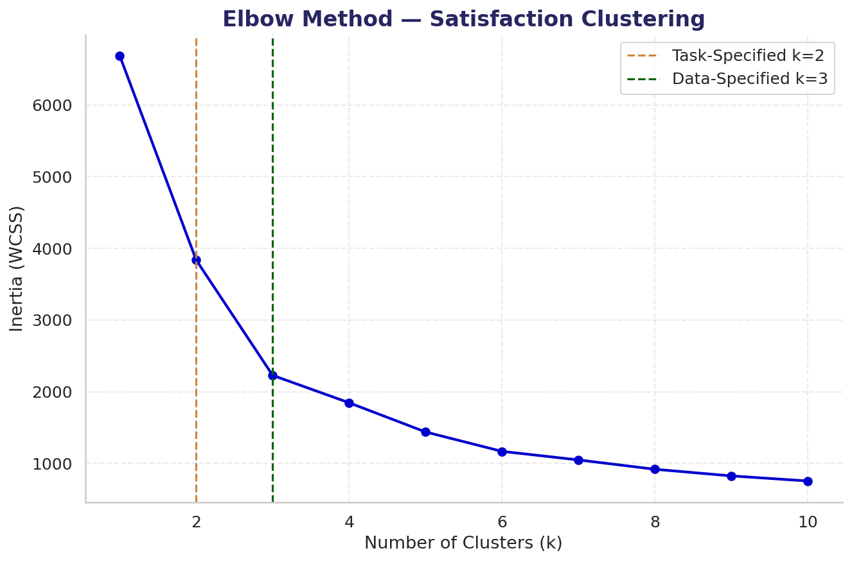
User Satisfaction — Scoring & the Headline Finding
27.3%
Cluster 0 — Higher Satisfaction (Engagement 0.383 / Experience 0.771)
Satisfaction here is overwhelmingly an experience story, not an engagement one — directly reinforcing the Experience Analysis finding that a real minority faces genuine network strain, broad enough to define the majority cluster's outcome.
72.7%
Cluster 1 — Lower Satisfaction Despite Equal-or-Higher Engagement (Engagement 0.430 / Experience 0.183)
Notes:
WHAT:
Each customer's Engagement Score is their Euclidean distance from their normalized data point to the least-engaged cluster centroid (from the Engagement clustering).
Experience Score is their Euclidean distance to the worst-experience cluster centroid (from the Experience clustering).
Satisfaction Score is the average of the two.
K-Means (k=2) on the engagement and experience scores together produced two clusters:
Cluster 0 (29,027 customers, 27.3%) has the higher satisfaction profile (0.577), driven almost entirely by a much stronger Experience Score (0.771 vs. 0.183).
Cluster 1 (77,444 customers, 72.7%, the majority) has the lower satisfaction profile (0.307) -- but notably, its Engagement Score (0.430) is actually higher than Cluster 0's (0.383).
The elbow chart shown on this slide (testing a range of k values) found the data's own bend sits at k=3 rather than k=2.
WHY:
Both scores are Euclidean distances in normalized [0,1] space, so their range is bounded by the metric space itself rather than a fixed 0-1 or 1-10 scale -- higher values mean farther from the 'bad' reference cluster, i.e. better standing.
The satisfaction score distribution is right-skewed (mean 0.380 above median 0.354), with most customers clustering 0.2-0.4 and a thin tail to 1.0-1.2 -- very few customers are simultaneously excellent on both dimensions. The two clusters aren't separated by engagement at all; they're separated almost entirely by Experience.
Nearly three-quarters of customers are engaging with the network at a comparable or even slightly better rate than the more-satisfied group, but poor network experience alone is what's dragging their overall satisfaction down. This directly reinforces the Experience Analysis finding that a real minority of customers face genuine network strain - affecting 10.8% of customers in isolation..
The elbow check landing on k=3 rather than the k=2 actually used is reported transparently, consistent with how the Engagement and Experience sections each disclosed their own data-vs-brief clustering discrepancies, rather than quietly picked whichever k looked more convenient.
HOW:
The least-engaged and worst-experience reference clusters were identified from each clustering's actual metric values, then every customer's normalized feature vector had its Euclidean distance computed to each respective centroid. K-Means with k=2 was fit on the resulting Engagement Score / Experience Score pairs. The elbow check shown on this slide re-ran K-Means across a range of k values on the same two scores, tracking inertia decline to identify where the data's own curve bends.
ALSO, IN THE NOTEBOOK (not shown on this slide):
The full customer-level Engagement-vs-Experience scatter plot (this slide uses a bar-chart summary of cluster averages instead, since a 106,471-point scatter doesn't render legibly at presentation scale).
The top-10-most-satisfied-customer table.

Slide 12
User Satisfaction — Predictive Model Validation
XGBoost: CV R² = 0.9936
Honest Qualification
Closes nearly all the remaining gap left by Linear Regression's genuine straight-line baseline (CV R² = 0.7909). Typical error (MAE) drops from 0.065 to 0.009 — under 1% of the score's usable range. Predictors used: the underlying normalized engagement & experience metrics — not the scores themselves.
Satisfaction Score is a deterministic formula (avg of the two component scores). This high accuracy reflects how well a flexible model reconstructs a known formula, not a fully independent behavioral prediction.
Notes:
WHAT:
Two regression models were compared to predict Satisfaction Score:
Linear Regression (R² = 0.7902, CV R² = 0.7909) as a genuine straight-line baseline.
XGBoost (R² = 0.9937, CV R² = 0.9936) as the stronger, final model, closing nearly all of the remaining gap.
Linear Regression's typical error (MAE 0.065, RMSE 0.0809) drops to XGBoost's 0.009 MAE and 0.0140 RMSE -- under 1% of the score's usable range.
Predictors used were the underlying normalized engagement and experience metrics directly -- not the Engagement Score and Experience Score themselves.
WHY:
The gap between the two models' R² is itself informative -- it shows satisfaction score has meaningful non-linear structure relative to the underlying normalized metrics, consistent with how the engagement and experience clustering themselves were non-linear (K-Means on multi-dimensional normalized space) rather than simple linear relationships.
The important qualification that must accompany this result: Satisfaction Score is a deterministic formula built directly from Engagement and Experience Score, which are themselves built from the same underlying metrics used as regression features.
The high model accuracy (XGBoost CV R² = 0.9936) reflects how well a flexible model can reconstruct a known formula, not a fully independent prediction of unseen customer.
This modeling step validates normalized engagement and experience metrics which contains enough signal to reconstruct the satisfaction formula almost perfectly.
The two models' near-identical test R² and CV R² (0.7902 vs. 0.7909; 0.9937 vs. 0.9936) also rules out overfitting in both cases -- neither model is memorizing the training set.
The MAE/RMSE figures reinforce the same story on a more intuitive scale for a non-technical reader: an average error of under 1% is a concrete, graspable number in a way R² alone isn't.
HOW:
An earlier iteration of this modeling step used Engagement Score and Experience Score directly as predictors; since Satisfaction Score is literally defined as their average, this produced a perfect but meaningless fit (documented in Challenges & Key Learnings) -- diagnosed by testing the circular version and finding its R² suspiciously close to 1.0, then corrected by using the underlying normalized metrics as features instead. Both models were then trained on that corrected feature set with cross-validation to produce the CV R² figures shown alongside the single-split test R² and error metrics.
ALSO, IN THE NOTEBOOK (not shown on this slide):
The Satisfaction Score distribution histogram (right-skewed, mean 0.380 above median 0.354) showing how scores are actually spread across the customer base.

Slide 13
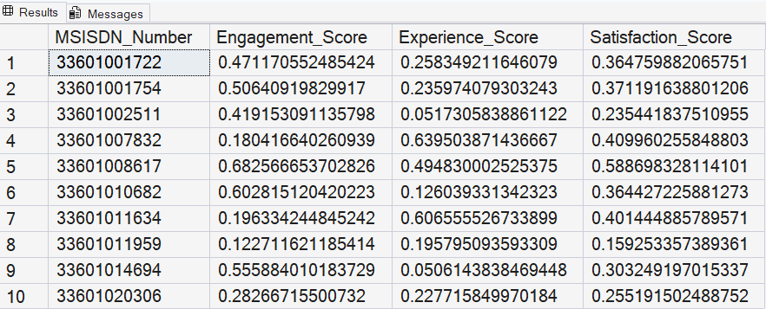
SQL Export — Data Delivery
Same Export, Two Views: Notebook (3-decimal display) vs. SSMS (full precision)
MSISDN_Number | Engagement_Score | Experience_Score | Satisfaction_Score
33601001722 | 0.471 | 0.258 | 0.365
33601001754 | 0.506 | 0.236 | 0.371
33601002511 | 0.419 | 0.052 | 0.235
33601007832 | 0.18 | 0.64 | 0.41
33601008617 | 0.683 | 0.495 | 0.589
33601010682 | 0.603 | 0.126 | 0.364
33601011634 | 0.196 | 0.607 | 0.401
33601011959 | 0.123 | 0.196 | 0.159
33601014694 | 0.556 | 0.051 | 0.303
33601020306 | 0.283 | 0.228 | 0.255
Notebook — centered_table() (3 decimals)
SSMS — SELECT TOP 10 * FROM dbo.user_satisfaction_scores
Table: user_satisfaction_scores
Database:
TelecomDB (SQL Server Express, Windows Auth)
Rows Exported:
106,471 (all customers)
Values match exactly — the only difference is displaying precision (SSMS shows raw floats; the notebook's display helper rounds to 3 decimals for readability).
This confirms the export completed without truncation or transformation.
Notes:
WHAT:
The final table (customer ID plus Engagement, Experience, and Satisfaction scores, all 106,471 customer rows) is delivered to a local SQL database, with a live SELECT query against the resulting table as proof of a complete, accurate import.
This deliverable spans two notebooks rather than one:
The main analysis notebook exports the final scoring table to a CSV file (Assets/user_satisfaction_scores.csv) in its own dedicated section, fully Colab-compatible;
Standalone notebook (telecom_SQL_Import.ipynb) then reads that CSV and imports it into a local SQL Server Express database named TelecomDB, run separately on a local machine.
The two views shown here are the same 10 rows presented two ways: a reproduction of the main notebook's own centered_table() display helper, which formats floats to 3 decimal places for on-page readability, alongside a screenshot of SQL Server Management Studio's native query result grid, which shows the full unrounded floating-point precision. The values are identical to 3 decimals in both.
WHY:
Splitting the work into two notebooks exists for a specific technical reason, not organizational preference:
SQL Server access requires Windows Authentication, which only works when code executes on the same physical machine as the SQL Server instance -- incompatible with Google Colab's cloud runtime, where the rest of this project is designed to run.
Keeping the CSV export in the main notebook (rather than the SQL write itself) means the primary analysis notebook stays fully portable and Colab-compatible, while isolating the one genuinely environment-dependent step into its own small, standalone file.
The two-view comparison is the concrete, verifiable proof that the import is accurate and complete, not a display artifact or a partial/corrupted transfer -- this matters for an investor-facing deliverable because it shows the handoff from analysis to database was verified, not just assumed to have worked.
HOW:
The main notebook's export step writes MSISDN/Number, Engagement Score, Experience Score, and Satisfaction Score to Assets/user_satisfaction_scores.csv, with the working 'user_satisfaction' DataFrame used throughout the rest of the main notebook's analysis keeping its original column names unchanged.
The separate SQL Import notebook then reads that CSV, cleans column names for SQL compatibility (spaces and the '/' in MSISDN/Number replaced with underscores) on the imported copy only, and uses sqlalchemy and pyodbc via Windows Authentication against a local SQL Server Express instance to create the TelecomDB database (if it doesn't already exist) and import all 106,471 rows into a table named user_satisfaction_scores.
A live SELECT TOP 10 query was then run against that table in SQL Server Management Studio to capture the verification screenshot shown on the right; the left table reproduces the same 10 rows as they appear in the main notebook's own output.

Slide 14
TELLCO USER ANALYTICS
The Case for Purchase, in Twelve Numbers (One Month of Data)
106,471
150,001
44.3%
57,491 GB
Customers Analyzed
Network Session Records Analyzed
Customers Use Apple Devices
Gaming Dominates App Traffic (~20x Netflix/YouTube)
4
73.6%
10.8%
2
Data Suggests 4 Engagement Tiers (Task-Specified: 3)
Customers With a Smooth Network Connection
Customers With Real Network Problems
Data Suggests 2 Experience Tiers (Task-Specified: 3)
72.7%
3
0.9936
PURCHASE
Held Back Only by Poor Network Quality, Not Lower Usage
Data Suggests 3 Satisfaction Tiers (Task-Specified: 2)
XGBoost CV R² Fits
Satisfaction Formula
Final Recommendation
Same usage, different network quality — the uplink-reliability gap is the addressable investment lever.
Notes:
WHAT:
This is analysis view before the recommendation slide:
Dataset scale (customers, session records, Apple share, Gaming traffic dominance);
Each pillar's task-specified vs. data-suggested cluster count (Engagement, Experience, Satisfaction);
The two Experience Analysis cluster shares (73.6% smooth / 10.8% real problems);
The Satisfaction Analysis's engagement-vs-experience finding (72.7% held back by network quality, not usage);
The model validation score (0.9936);
The final recommendation (Purchase).
WHY:
73.6% and 10.8% (Experience Analysis) likely reflect, respectively, light/single-session measurement and a genuine, concentrated uplink-reliability concern rather than a broad network-wide failure -- flagged rather than overstated.
The 0.9936 cross-validated R² is included as a credibility marker for the underlying scoring methodology, labeled here as fitting the satisfaction formula specifically.
The three task-specified vs. data-suggested cluster-count cards make a specific, deliberate point: at every clustering step in this analysis, the number of segments actually used matched what the brief specified, even where an elbow-method check suggested a different number would fit the data more naturally -- shown here together, transparently, rather than smoothed over individually. The tagline at the bottom -- 'same usage, different network quality' -- directly references the Satisfaction Analysis's headline finding (Engagement Scores nearly identical across clusters, Experience Scores sharply divided) that makes the final recommendation possible: because dissatisfaction is driven by network experience specifically, and concentrated in an identifiable minority, the investor has a precise, non-diffuse investment target rather than a diffuse structural problem.
HOW:
Each figure is pulled directly from its source pillar's own clustering, correlation, or modeling output rather than recomputed independently.
So, this slide is a synthesis view, not a new calculation.
The three cluster-count cards each pair the k value specified for that section's clustering step with the k value an independent elbow-method check found to fit the data's own inertia curve most naturally.

Slide 15
Business Recommendation
Growth Potential: POSITIVE — Contingent on Uplink Investment
Broad, Well-Served Base
One Identifiable Lever
Targeted, Not Structural
One Open Question
73.6% of customers show minimal network friction; engagement is comparable across both satisfaction segments — this is not a business in decline or facing diffuse churn.
The 10.8% heaviest-uplink customers show the highest retransmission and worst uplink latency — and anchor the lower-satisfaction cluster despite engaging just as much as happier customers.
Improving uplink capacity/reliability specifically — not a costly network-wide overhaul — directly targets the segment most responsible for dissatisfaction.
Huawei B528S-23A (most-used device) is consistent with router infrastructure, not a personal handset. Flagged for further investigation — not a factor driving this recommendation.
Notes:
WHAT:
Growth potential assessment, grounded directly in the findings across all four pillars -- not a generic buy/sell framing, but a specific answer to where TellCo's actual lever for improvement sits.
Overall assessment:
Positive, contingent on uplink investment.
The customer base is broad and largely well-served -- 73.6% of customers show minimal network friction, and engagement levels are comparable across both the more- and less-satisfied customer segments.
The specific lever:
Uplink network reliability for heavy uploaders.
The 10.8% of customers with the heaviest uplink traffic show simultaneously the highest TCP retransmission and worst uplink latency -- and this same group anchors the lower-satisfaction cluster in the Satisfaction Analysis, despite engaging with the network just as much as happier customers.
A noted open question:
Huawei B528S-23A, the single most-used device in the dataset, carries a model name consistent with Huawei's 4G router line rather than a personal handset. WHY:
The growth opportunity here is unusually well-defined rather than diffuse:
TellCo isn't facing a broad-based churn or engagement problem, it's facing one identifiable, addressable weak point. Improving uplink capacity/reliability specifically -- rather than a broad, costly network-wide overhaul.
This is a favorable acquisition profile:
The improvement lever is specific rather than structural, the affected customer segment is identifiable rather than diffuse, and the majority of the customer base already reflects a functioning, engaged relationship with the network.
The investor's stated goal -- finding where a focused change can drive profitability -- has a clear answer here: Uplink capacity and reliability investment, not a network-wide overhaul.
The Huawei question is flagged as an open item for further investigation, not a factor driving the recommendation above, since a direct traffic-per-session check found no meaningful difference from other devices, neither confirming nor ruling out shared-infrastructure use. HOW:
This recommendation synthesizes:
The Experience Analysis's cluster findings (73.6% minimal friction / 10.8% uplink-strained)
The Satisfaction Analysis's cluster comparison (engagement near-identical, experience sharply divided)
The Handset Diagnostics finding on Huawei B528S-23A, rather than being derived from any single pillar in isolation.
Further investigation of the Huawei question would require checking IMEI ranges or device registration data outside this dataset.

Slide 16
Limitations — What This Analysis Cannot Tell You
Single-Session Bias
Huawei B528S-23A — Unresolved
Satisfaction Model Circularity
72.74% of customers have exactly one recorded session — every “average” for them is really one raw reading, not genuine behavior over time.
Consistent with router infrastructure, not a personal handset. Traffic-per-session check found no difference (1.00x) — inconclusive, not resolved.
Satisfaction Score is a deterministic formula built from Engagement + Experience. High model R² reflects formula reconstruction, not independent prediction.
Fixed Cluster Counts
Noisy Handset-Level Averages
One Month, No Trend Visibility
All three K-Means runs (k=3, k=3, k=2) used brief-specified values. Elbow checks pointed elsewhere in every case — reported transparently, not overridden.
591 of 1,391 handset types have exactly one customer. Thresholds (≥30) manage this, but any handset-level view carries this constraint.
A single aggregated month cannot speak to seasonality, trend direction, or whether patterns are stable, improving, or worsening.
Notes:
WHAT:
Six limitations are flagged:
72.74% of customers have exactly one recorded session.
Huawei B528S-23A's model name is consistent with Huawei's 4G router product line rather than a personal handset, and it is the single most-used device in the dataset by a wide margin, yet a direct traffic-per-session check found no meaningful difference from other devices (a 1.00x ratio).
Satisfaction Score is a deterministic formula built directly from Engagement and Experience Score, which are themselves built from the same underlying metrics used as regression features.
All three clustering exercises (Engagement k=3, Experience k=3, Satisfaction k=2) used fixed k values, while elbow checks run alongside each showed the data's own inertia curve pointing elsewhere in every case.
Of 1,391 distinct handset types, 591 have exactly one customer.
The analysis reflects one month of aggregated data only
WHY:
For customers with exactly one session, every 'average' metric is really just one raw reading -- not a genuine average of behavior over time.
This affects interpretation throughout: Cluster 0's 'best network experience' in the Experience Analysis, and the majority satisfaction cluster's 'minimal friction', likely reflect light, limited measurement rather than confirmed superior treatment.
The Huawei traffic-per-session check neither confirms nor rules out shared-infrastructure use, and the dataset offers no further way to resolve it -- an open, unresolved question rather than a settled one.
Satisfaction Score prediction is not fully independent: the high model accuracy (XGBoost R² = 0.9934) reflects how well a flexible model can reconstruct a known formula, not a fully independent prediction of unseen customer behavior.
The cluster-count discrepancies are reported transparently at each step, but the cluster counts used throughout reflect the specified requirement, not necessarily the structure the data would suggest on its own.
Handset-level averages are noisy for rare devices, so any handset-level analysis carries this sample-size constraint even with thresholds in place.
One month of data means nothing here can speak to seasonality, trend direction, or whether observed patterns are stable or already improving/worsening -- a material caveat for an acquisition decision. HOW:
Single-session share was computed by counting customers with exactly one row in the per-session data before aggregation.
The Huawei traffic-per-session check compared its average traffic-per-session ratio directly against all other devices.
Cluster-count discrepancies were surfaced by running an elbow-method inertia check alongside each K-Means clustering step, independent of the k value actually used.
Handset-type sample sizes were audited by counting customers per distinct handset type.
Two additional notes for methodology reviewers:
Two of three frequency-encoded columns remain unused beyond diagnostic checks -- Handset Type_Freq was applied as a diagnostic check against network experience (finding no meaningful relationship); Handset Manufacturer_Freq and Last Location Name_Freq were built but not used in this iteration.
And two documented deviations from literal brief wording -- median instead of mean, and IQR instead of Z-score for outlier detection -- were each justified and documented at the point they were made (data skew, established project convention), acknowledged departures from literal brief wording, not from the brief's own methodology intent.

Slide 17
Project Challenges & Key Learnings
Challenge 1 — Integer Overflow
Challenge 2 — Detection Before Treatment
Challenge 3 — Circular Regression
Challenge: Bearer Id (~1.31e19) silently overflowed int64 (max ~9.22e18) when cast alongside genuine identifiers.
Challenge: An early attempt skipped straight to outlier capping without first quantifying skew, kurtosis, or IQR/Z-score rates.
Challenge: Using Engagement + Experience Score directly as Satisfaction predictors produced a perfect but meaningless fit (they define the formula).
Learning: Root-caused to the type-casting step; excluded Bearer Id from the cast since it's a pure identifier, only ever used for counting.
Learning: Separated aggregation-design decisions from outlier treatment; computed real evidence before any capping, mirroring User Overview's own rigor.
Learning: Diagnosed via a suspiciously-near-1.0 R²; corrected by using the underlying normalized metrics as features instead.
Challenge 4 — Random Forest Runtime
Challenge 5 — Variable Name Collisions
Challenge 6 — Scope Discipline
Challenge: An untuned Random Forest (n_jobs=1 default) took 25+ minutes on 106,471 rows.
Challenge: Engagement and Experience clustering both reused the generic name 'kmeans', so each cell overwrote the last.
Challenge: Deciding what's 'beyond the ask' vs. task-required (full EDA depth, top-N vs. full-population stats) required care throughout.
Learning: Parallelized (n_jobs=-1), capped tree depth, and ultimately replaced with XGBoost for both speed and accuracy.
Learning: Renamed to kmeans_engagement / kmeans_experience / kmeans_satisfaction, preserving direct access to each model's centroids.
Learning: Checked each task's actual wording rather than defaulting to the heaviest precedent elsewhere — a recurring discipline, not a one-time fix.
Notes:
WHAT:
Six challenges are documented:
Bearer Id silently overflowed int64 when cast alongside genuine identifier columns.
(2) An early outlier-treatment attempt skipped straight to capping without first quantifying skew, kurtosis, or IQR/Z-score outlier rates.
(3) An initial regression setup used Engagement Score and Experience Score directly as predictors of Satisfaction Score.
(4) An untuned Random Forest with default settings took over 25 minutes to train and cross-validate on 106,471 rows.
(5) Both the Engagement and Experience clustering cells originally reused the generic name 'kmeans' for their fitted models.
(6) Distinguishing genuinely task-required scope from 'beyond the ask' additions required care throughout (full univariate/bivariate/multivariate treatment vs. a leaner approach, top-N vs. full-population distributions, min/max/total statistics vs. averages only). WHY:
Bearer Id's values (~1.31e19) exceed int64's maximum (~9.22e18), producing a fixed sentinel value for every row if left uncaught -- a silent, easy-to-miss data corruption rather than an obvious error.
The early outlier-treatment attempt conflated a separate design decision (how to aggregate multiple sessions per customer) with outlier treatment itself, which would have produced misleading capping thresholds.
The circular regression setup produced a perfect but meaningless fit, since Satisfaction Score is literally defined as the average of the two scores used as predictors -- a model can't be said to meaningfully 'predict' a value it was given the exact ingredients to reconstruct.
The Random Forest runtime issue mattered practically at this dataset size, not just as an inconvenience.
Reusing 'kmeans' as a variable name across sections meant only the most recently run model remained accessible by the time the Satisfaction Analysis needed both engagement and experience cluster centroids.
Distinguishing task-required scope from extras matters because defaulting to the heaviest precedent everywhere would inflate scope without adding real analytical value, while under-scoping would miss genuine requirements -- both were checked against the brief's actual wording at each step, a recurring discipline throughout rather than a one-time fix.
Overall learning: Building an effective machine learning solution involves much more than selecting a high-performing algorithm -- careful data preparation, thoughtful feature engineering, evidence-based feature selection, robust model evaluation, reproducible experimentation, and meaningful business interpretation all contributed to a reliable, trustworthy final analysis. HOW: (1) Root-caused to the data type correction step and resolved by excluding Bearer Id from the int64 cast, since it's a pure identifier only ever used for counting.
(2) Corrected by properly separating the aggregation-design decision from outlier treatment, then computing real skew/kurtosis/IQR evidence before any capping decision, mirroring the User Overview section's own established rigor.
(3) Diagnosed by explicitly testing the circular version and confirming its R² was suspiciously close to 1.0, then corrected by using the underlying normalized metrics as features instead.
(4) Resolved by explicitly parallelizing (n_jobs=-1) and capping tree depth, then ultimately replaced with XGBoost for both stronger accuracy and substantially faster training.
(5) Resolved by renaming to kmeans_engagement / kmeans_experience / kmeans_satisfaction, allowing direct access to each model's own stored cluster centroids rather than recomputing them. (6) Resolved by checking each task's actual wording directly rather than defaulting to the heaviest precedent available elsewhere in the notebook.

Slide 18
Conclusion & Future Scope
Conclusion
Future Scope
Recommendation: TellCo is worth purchasing. The customer base is broad, engaged, and largely well-served — not a business in decline, nor one with a diffuse, expensive-to-fix problem. One clearly identified, addressable weak point:
Uplink network reliability for a specific, quantifiable minority (10.8%) of heavy uploaders, whose poor experience — not engagement — separates them from the majority's satisfaction. All 5 original expected outcomes met:
Customer composition characterized, dominant handsets/apps identified, engagement/experience clusters built, satisfaction quantified & validated, and a clear acquisition recommendation delivered. Recommended next step:
Request additional months of data to confirm patterns are stable, and pursue the Huawei device question via records unavailable in this dataset.
Descoped from the original brief (by supervisor agreement):
pip-installable package with unit tests & CI/CD, Docker containerization, Streamlit/Flask dashboard, and model deployment/tracking — deliberate decisions, not oversights.
Natural extensions: • Multi-user SQL connection handling (credential-input flow vs. hardcoded local connection) • Multi-month trend analysis — is uplink strain worsening or improving? • Resolve the Huawei B528S-23A question via device registration / IMEI-range data • A/B validate the uplink investment recommendation on new data post-fix
Notes:
Conclusion:
This project set out to answer two business questions –
Which factors genuinely influence the business's fundamentals?
Can data-driven analysis support a clear buy/sell recommendation?
Final recommendation:
TellCo is worth purchasing, with one clearly identified, addressable weak point -- uplink network reliability for a specific, quantifiable minority of heavy uploaders (10.8% of customers), whose poor experience, not their engagement level, is what separates them from the majority's satisfaction.
All five of the project's original expected outcomes are confirmed met: customer composition and behavior characterized, dominant handsets/applications identified, engagement/experience clusters built, satisfaction quantified and validated, and a clear acquisition recommendation delivered.
Future Scope:
Several items were explicitly descoped for this deliverable -- a reusable pip-installable package with unit tests and CI/CD, Docker containerization, a Streamlit/Flask dashboard, and model deployment/tracking.
Natural extensions include multi-user SQL connection handling, multi-month trend analysis, resolving the Huawei B528S-23A open question, and A/B validation of the uplink investment recommendation on new data.

Slide 19
References & Data Sources
📄 Field Descriptions
🔗 Project Repository
Full data dictionary — 55 xDR fields (identifiers, network-quality metrics, per-application traffic). Embedded below as a linked object; double-click to open.
Full notebook (telecom_user_analytics_final.ipynb), data cleaning code, and SQL export scripts — NHIS Project 5.
github.com/S-Yousuf-S/NHIS_Project5
📎 Field_Descriptions.csv (attached)
Dataset & Brief
• TellCo xDR dataset — one month of aggregated data session detail records, Republic of Pefkakia (provided by TellCo's ownership for due diligence). • Nexthikes IT Solutions — “User Analytics in the Telecommunication Industry” project brief (Tasks 1–4, Final Submission requirements). • Analysis conducted in Google Colab / Jupyter; SQL export executed locally against SQL Server Express (Windows Authentication).
Notes:
This slide provides references within the 20-slide deck.
The Field Descriptions reference (55 fields) is the complete data dictionary referenced back on slide 2's Business Understanding & Dataset Overview.
The Project Repository link points to the GitHub repository holding the complete main analysis notebook (telecom_user_analytics_final.ipynb), the standalone SQL Import notebook (telecom_SQL_Import.ipynb), all data cleaning and feature engineering code, and the README.
The dataset and brief section documents provenance: the xDR dataset itself (one month of aggregated data session detail records from TellCo, Republic of Pefkakia, shared by the current ownership specifically for this due-diligence exercise), and the original project brief from Nexthikes IT Solutions that defined the four analytical tasks and final submission requirements this deck responds to. The analysis was conducted end-to-end in Google Colab / Jupyter notebook format, with the one exception of the SQL import step, which required local execution against a SQL Server Express instance via Windows Authentication, since Colab's cloud runtime has no network path to a local machine's SQL Server -- noted explicitly in the README and in-notebook as an environment-specific constraint.

Slide 20
Thank You
TellCo User Analytics — Yousuf S. R. Sakkaf
github.com/S-Yousuf-S/NHIS_Project5

